Slide 1

Visvesvaraya National Institute of Technology, Nagpur
Electronics and Communication Engineering Department
Executive M.Tech. in Applied AI and Communications
Cohort 3B sem. 3, Summer 2026
Eval. 3 (24/05/2026)
Edge AI based Predictive Maintenance of Industrial Motors
Presented by
Kartik Burele (MT24AAC011)
Embedded Software Engineer @ L & T Technology Services
Under the supervision of
Dr. Mansi A. Radke Asst. Professor
VNIT Nagpur

Slide 2
Table of Contents:
Introduction
Objective of the Project
Proposed Model
Methodology
Timeline of the Project
Literature Survey
Work Done
Results and Discussion
Conclusion
References

Slide 3
Introduction
Overview
Industrial motors are critical components in manufacturing systems. Unexpected failures can lead to:
Production downtime
Maintenance cost
Safety hazards
Traditional maintenance strategies include:
Reactive maintenance (repair after failure)
Preventive maintenance (scheduled replacement)
These methods are inefficient and often lead to unnecessary downtime.
Motivation
Predictive maintenance uses sensor data and machine learning to detect faults before failure occurs.
Key benefits:
Reduced downtime
Lower maintenance cost
Increased equipment lifespan
Edge AI enables real-time monitoring directly on embedded devices, eliminating the need for cloud processing.
Research Gap
Many existing systems rely on:
Cloud processing
High-cost industrial monitoring systems
There is a need for:
Low-cost embedded AI solutions
Real-time fault detection at the edge

Slide 4
Objective of the Project
The primary objective of this project is to develop an Edge AI based predictive maintenance system for industrial motors(BLDC).
Specific Objectives:
Collect vibration and temperature data from industrial motors using sensors
Develop a machine learning model to classify motor operating conditions
Deploy the trained model on an embedded device for real-time monitoring
Detect faults such as imbalance, misalignment, and bearing faults, electrical, mechanical and combined damage
Reduce equipment downtime through early fault detection

Slide 5
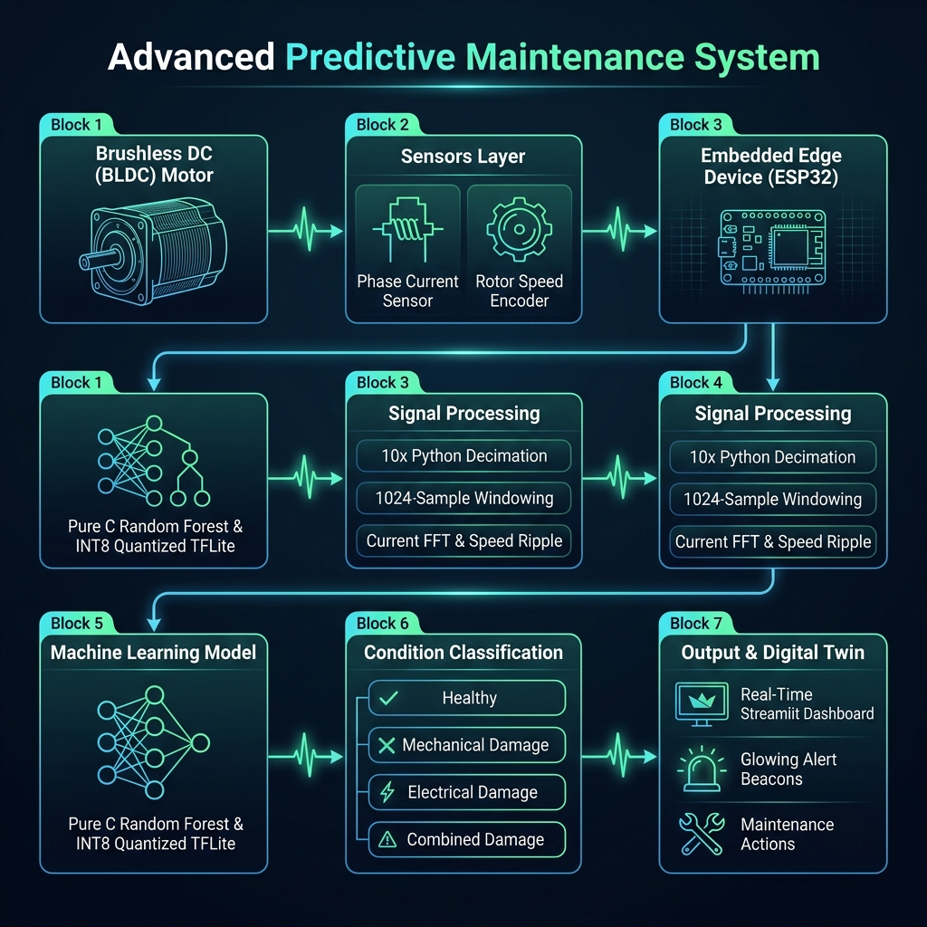
Proposed Model

Slide 6
Methodology
The project methodology consists of five major stages.
Data Acquisition
Sensor data will be collected from industrial motors using:
Vibration sensors
Temperature sensors
Current sensors
Encoder/Speed sensors
The signals represent motor operating conditions.
Data Preprocessing
Raw signals will undergo:
Noise filtering
Fast Fourier Transform (FFT)
Feature extraction
Features include:
RMS vibration/ RMS current
Kurtosis/ Kurtosis current
Spectral entropy/ Spectral entropy current
Standard speed ripples
Model Training
Machine learning models will be trained using Python libraries such as:
Scikit-learn
TensorFlow
Models evaluated:
Random Forest
Support Vector Machine
CNN
Model Deployment
The trained model will be converted to:
TensorFlow Lite
and deployed on an embedded device for real-time inference.
Fault Detection
The system will classify motor conditions into:
Normal operation
Imbalance
Misalignment
Bearing fault /
Healthy
Mechanical Damage
Electrical Damage
Combined Damage

Slide 7
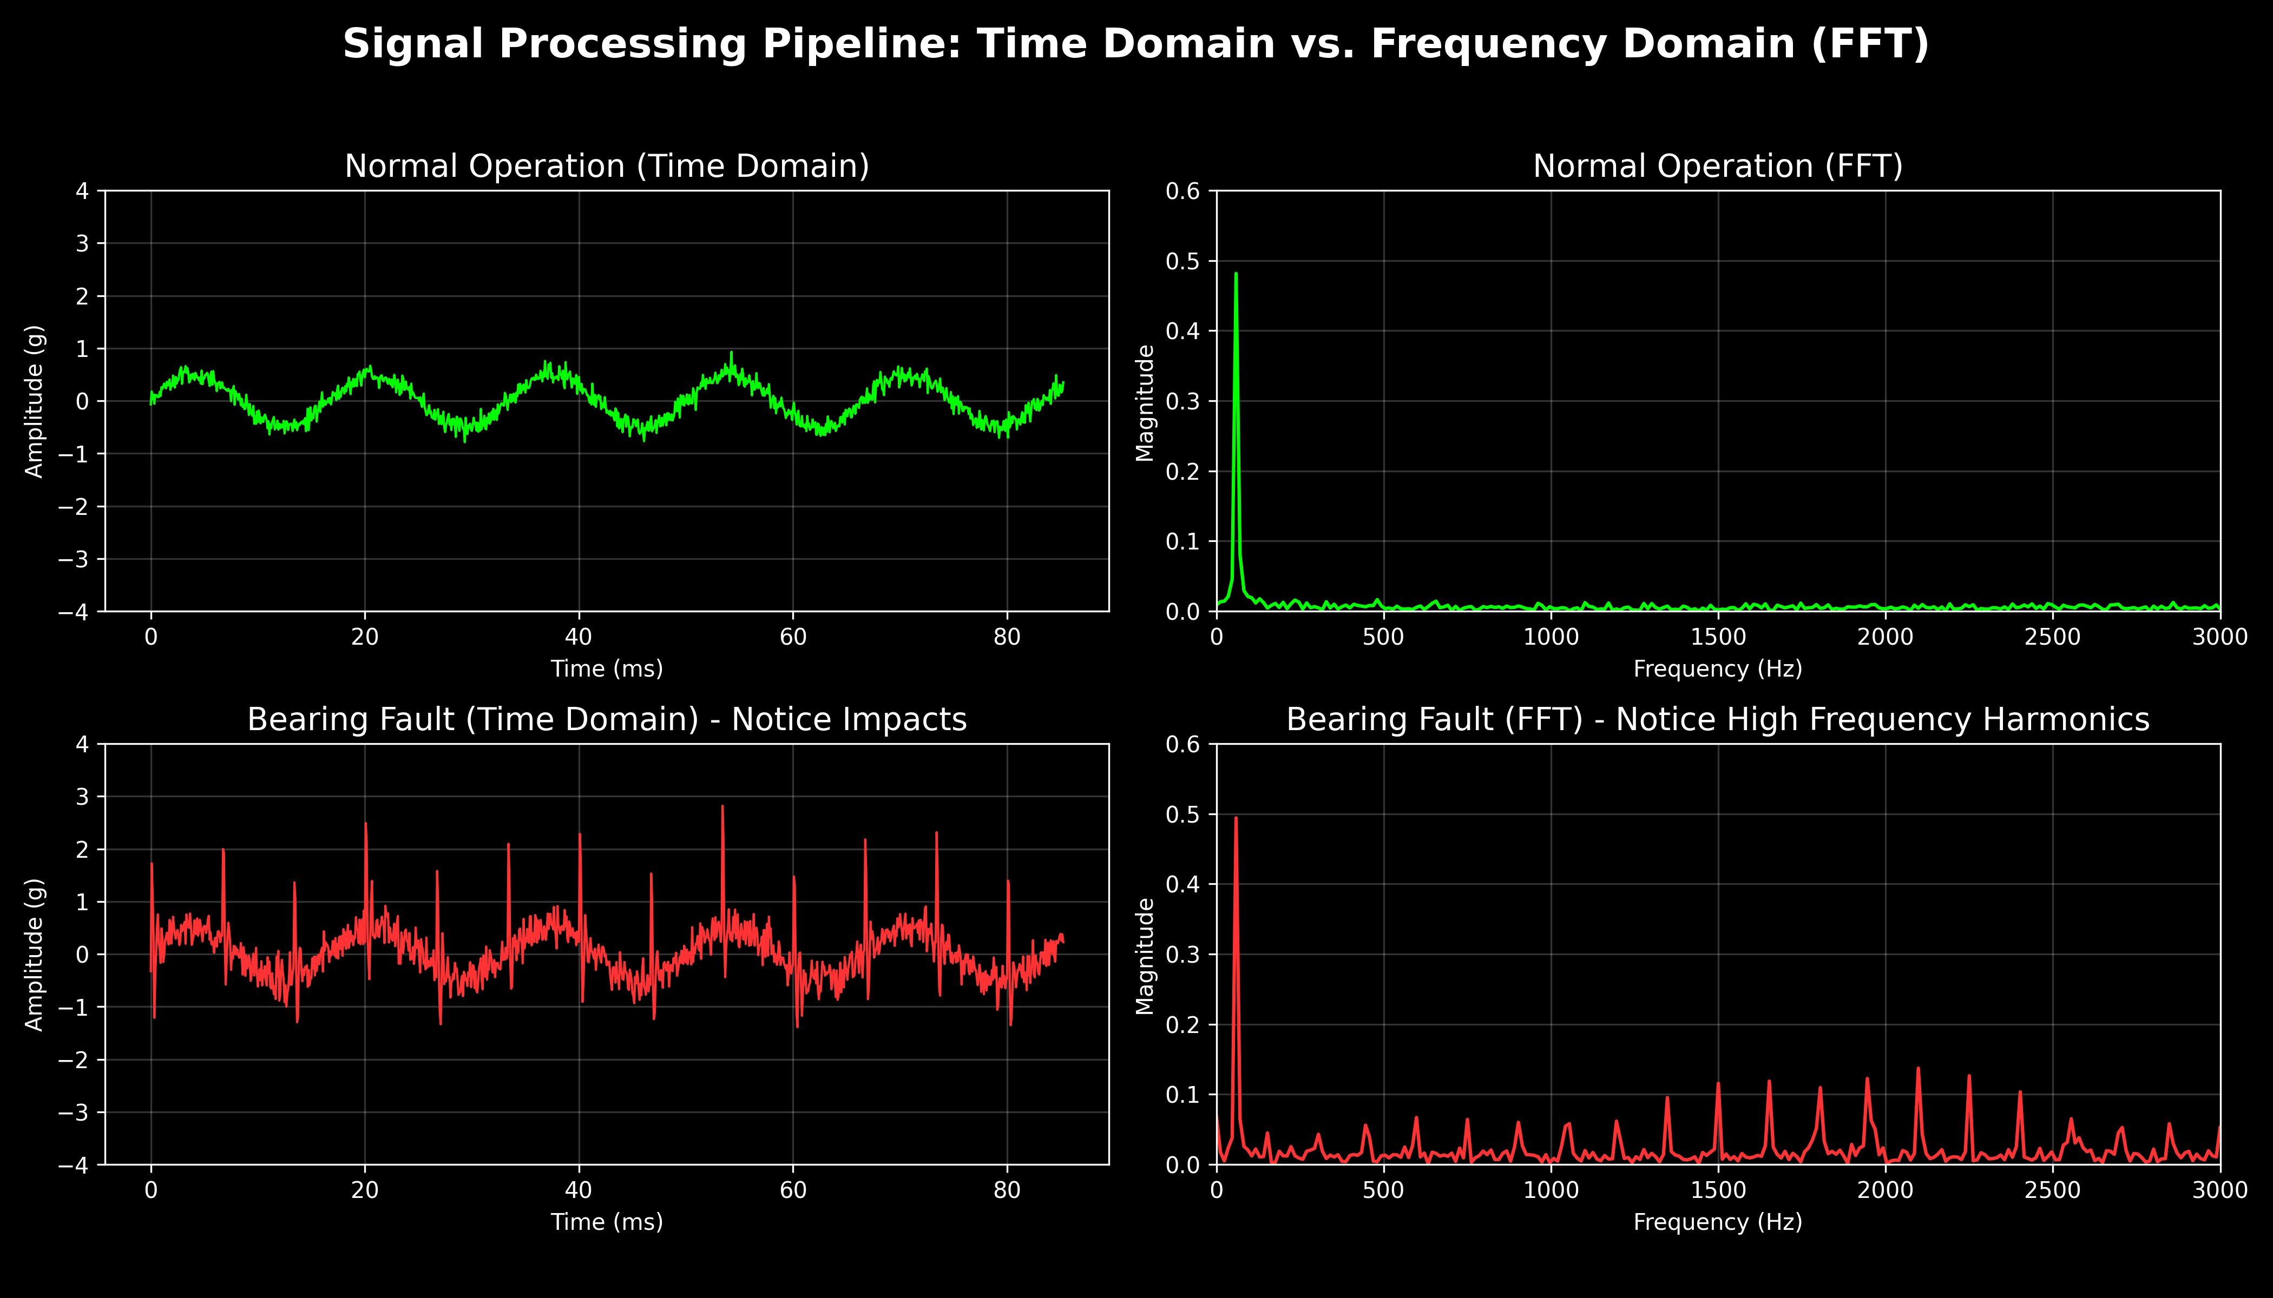
Methodology Continued…

Slide 8
Timeline of the project

Slide 9
Literature Survey
Predictive Maintenance (PdM) has become an important strategy in Industry 4.0 to reduce equipment downtime and improve production efficiency using sensor data and machine learning models.
AI techniques such as machine learning, deep learning, and time-series forecasting enable early detection of faults by analysing historical operational data from industrial machines.
Studies show that predictive maintenance systems can reduce maintenance costs by 15–70% while improving system reliability and safety in manufacturing environments.
Traditional predictive maintenance architectures rely heavily on cloud-based processing, which may introduce latency and large data transmission overhead in industrial environments.
Edge AI enables local processing of sensor data near industrial equipment, significantly reducing latency and bandwidth consumption compared to centralized cloud solutions.
Research on Edge AI for motor condition monitoring demonstrates that edge-based systems can reduce diagnostic latency by more than 70% while achieving fault detection accuracy above 94%.
Embedded AI models deployed on microcontrollers and IIoT edge devices allow real-time monitoring of vibration, temperature, and electrical signals of industrial motors.
Several machine learning models including SVM, Random Forest, Neural Networks, and k-NN have been tested for predictive maintenance tasks in industrial manufacturing systems.

Slide 10
Work Done Continued…
Data Acquisition:
Transitioned to the international-standard DUDU-BLDC Motor Dataset to analyze electromagnetic (magnet/winding) degradation and physical load anomalies.
Acquired co-dependent high-frequency stator current (A) and rotational speed (RPM) telemetry across 4 states: Healthy, Mechanical Damage, Electrical Damage, and Combined Mech-Elec Damage.
Data Preprocessing:
Implemented 10x Python decimation (downsampling 50 kHz to 5 kHz) and strict 1024-sample windowing to capture ~204.8 ms of shaft dynamics.
Extracted 6 core features: Current RMS, Current Kurtosis, Mean Speed, Speed Ripple (Std Dev), Current Spectral Entropy, and Current Peak Frequency.
Key Edge Constraint: Reduced raw signals to a lightweight 213-byte feature payload (<1KB Edge Invariant), guaranteeing low-latency transmission.
Model Training & Quantization:
We trained two distinct models optimized for microcontrollers:
A Random Forest model transpiled entirely into pure C code (.c header) for bare-metal execution.
A TensorFlow Lite Neural Network aggressively quantized to INT8 to drastically reduce memory footprint.

Slide 11
Results and discussions
1. ESP32 Hardware Deployment (Wokwi Simulation):
Successfully deployed the compiled C-based ML model onto a simulated ESP32 microcontroller.
Achieved real-time inference (in microseconds) directly on the edge hardware without relying on any cloud API.
2. Streamlit “Digital Twin” Dashboard:
Developed a fully functional web dashboard that loads the quantized edge_model.tflite model.
Evaluates simulated real-time telemetry, plotting continuous Telemetry Trends (Vibration & Entropy) and visualizing Model Confidence Distributions.
3. Implementation of Smart Alerting Rules:
Built dynamic thresholding: If the model's prediction confidence drops below 75%, the system safely flags the state as "Uncertain" rather than triggering a false-positive factory alarm.

Slide 12
Results and Discussions Continued…
Model Comparison and Trade-off
Rigorous 80/20 Train/Test Split on 620/156 telemetry windows.
MODEL 1: INT8 Quantized TensorFlow Lite Neural Network
Overall validation Accuracy: 64.10%
Average Latency: ~0.010 ms per sample
Memory Footprint: 3.08 KB
MODEL 2: Embedded Random Forest (Pure C-Transpiled)
Overall Accuracy: 76.92%
Average Latency: ~0.005 ms per sample
Memory Footprint: ~901 KB (Raw C Array footprint)
Verdict: Extremely compact and lightweight in flash memory. While highly efficient for storage-constrained edge environments, the dense neural network has lower accuracy on tabular current/speed statistical boundaries compared to the ensemble method.
Verdict: The primary model candidate. It achieves a 12.8% higher diagnostic accuracy and boasts unbeatable execution speed because it compiles into direct, raw hardware instructions. The footprint size is larger (~901KB source file) because it represents 50 decision trees of depth 10, which easily fits within the ESP32’s 4MB flash

Slide 13
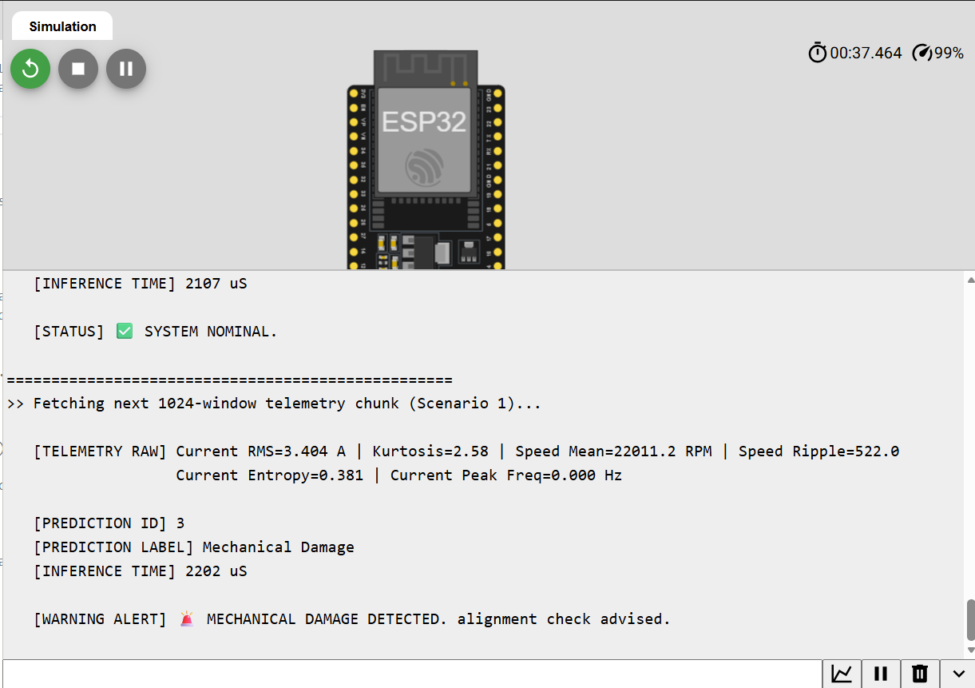
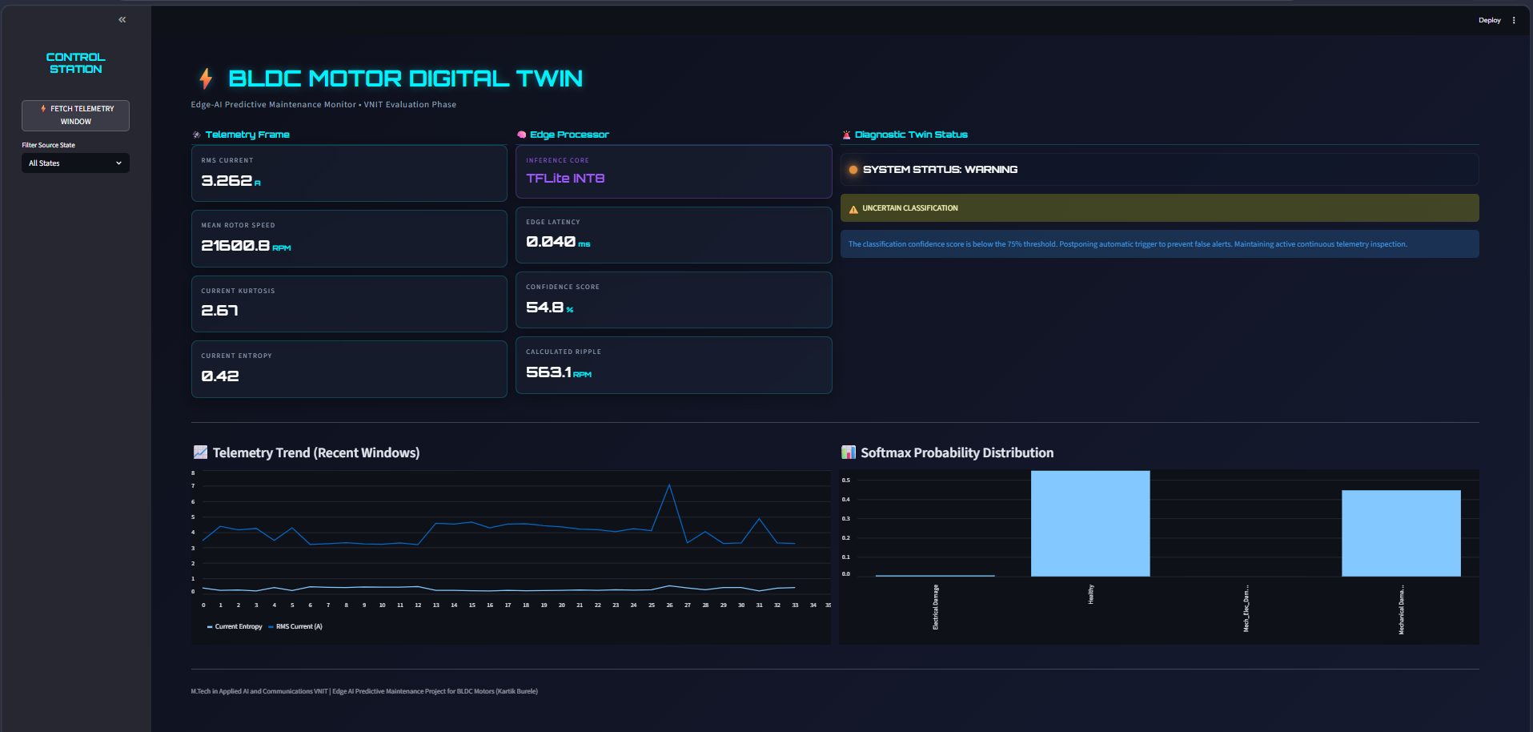
Results and Discussions Continued…
Simulation: Random Forrest model deployed over ESP32
Simulation: INT8 Quantized Tflite neural Network

Slide 14
Conclusion
Conclusion:
Successfully validated that co-dependent current and rotational speed telemetry can be processed and diagnosed entirely on resource-constrained Edge IoT devices.
Proven that our edge-invariant preprocessing pipeline distills high-frequency waveforms into a lightweight 213-byte feature payload, enabling real-time edge anomaly diagnostics.
Demonstrated that transpiled pure C models and INT8 quantized TFLite binaries can operate within microseconds on microcontrollers, eliminating cloud dependencies, bandwidth costs, and transmission latencies.
Future Work:
Physical Hardware-in-the-Loop (HIL) Integration: Interfacing physical Hall-effect current sensors (e.g., ACS712) and optical speed encoders directly to the ESP32 ADC pins on a live, physical BLDC motor rig.
Multi-Sensor Fusion Development: Fusing current/speed electrical telemetry with physical vibration (MEMS accelerometer) and temperature inputs to build a comprehensive, multi-modal diagnostic engine.
Wireless Telemetry Edge-Streaming: Implementing low-energy wireless protocols (BLE or Wi-Fi MQTT) to pipe live edge classifications and latency metrics from the physical microcontroller directly to our Streamlit Digital Twin dashboard.

Slide 15
References
Achouch, M., Dimitrova, M., Ziane, K., Sattarpanah Karganroudi, S., Dhouib, R., Ibrahim, H., & Adda, M. (2022). On Predictive Maintenance in Industry 4.0: Overview, Models, and Challenges. In Applied Sciences (Switzerland) (Vol. 12, Issue 16). MDPI. https://doi.org/10.3390/app12168081
Aires, F. L., Galeno, G. D., Belchior, F. N., Oliveira, A. M., & Hunt, J. D. (2025). Enhancing three-phase induction motor reliability with health index and artificial intelligence-driven predictive maintenance. Royal Society Open Science, 12(5). https://doi.org/10.1098/rsos.241946
Artiushenko, V., Lang, S., Lerez, C., Reggelin, T., & Hackert-Oschätzchen, M. (2024). Resource-efficient Edge AI solution for predictive maintenance. Procedia Computer Science, 232, 348–357. https://doi.org/10.1016/j.procs.2024.01.034
Bharathi, Y. H. (n.d.). International Journal of INTELLIGENT SYSTEMS AND APPLICATIONS IN ENGINEERING Edge AI for Real-Time Motor Condition Monitoring in Smart Grids. In Original Research Paper International Journal of Intelligent Systems and Applications in Engineering IJISAE (Vol. 2024, Issue 23s). Retrieved www.ijisae.org
Dey, S., & Nagavalli, S. P. (2022). AI-Based Predictive Maintenance in Edge IoT Devices: A Proactive Approach to Latency Reduction. International Journal of Emerging Trends in Computer Science and Information Technology, 3(1), 55–64. https://doi.org/10.63282/3050-9246.ijetcsit-v3i1p107
Drakaki, M., Karnavas, Y. L., Tzionas, P., & Chasiotis, I. D. (2021). Recent Developments towards Industry 4.0 Oriented Predictive Maintenance in Induction Motors. Procedia Computer Science, 180, 943–949. https://doi.org/10.1016/j.procs.2021.01.345
Hafeez, T., Xu, L., & McArdle, G. (2021). Edge intelligence for data handling and predictive maintenance in IIoT. IEEE Access, 9, 49355–49371. https://doi.org/10.1109/ACCESS.2021.3069137
Lamdjad, B., & Chaiter, A. (2026). AI-Powered Predictive Maintenance and Prognostic Health Management Using Edge-Based Predictive Algorithms for Industrial Operations. https://doi.org/10.20944/preprints202603.0010.v1
Lazzaro, A., D’Addona, D. M., & Merenda, M. (2024). A Detailed Study on Algorithms for Predictive Maintenance in Smart Manufacturing: Chip Form Classification Using Edge Machine Learning. IEEE Open Journal of the Industrial Electronics Society, 5, 1190–1205. https://doi.org/10.1109/OJIES.2024.3484006
Nunes, P., Santos, J., & Rocha, E. (2023). Challenges in predictive maintenance – A review. In CIRP Journal of Manufacturing Science and Technology (Vol. 40, pp. 53–67). Elsevier Ltd. https://doi.org/10.1016/j.cirpj.2022.11.004
Soni, K., & Agrawal, M. (2025). AI Driven Predictive Maintenance at the Edge.
Vermesan, O., & Coppola, M. (2023). Embedded Edge Intelligent Processing for End-To-End Predictive Maintenance in Industrial Applications. In Industrial Artificial Intelligence Technologies and Applications (pp. 157–175). River Publishers. https://doi.org/10.1201/9781003377382-12
Zhou, Z., Qiao, Y., Lin, X., Li, P., Wu, N., & Yu, D. (2025). A Deployment Method for Motor Fault Diagnosis Application Based on Edge Intelligence. Sensors, 25(1). https://doi.org/10.3390/s25010009
Dataset: CWRU Download a Data File | Case School of Engineering
DUDU-BLDC: Data set for diagnostic of Brushless DC motors with degrading magnets DUDU-BLDC: Data set for diagnostic of Brushless DC motors with degrading magnets
DUDU-BLDC: Dataset for Diagnostics of Brushless DC motors with Degrading Magnets | IEEE Conference Publication | IEEE Xplore https://ieeexplore.ieee.org/document/11363866

Slide 16
Thank you

