Slide 1

Visvesvaraya National Institute of Technology, Nagpur
Electronics and Communication Engineering Department
Executive M.Tech. in Applied AI & Communications
Cohort 3B sem. 3, Summer 2026
Eval. 2 (10/05/2026)
SemiSage: Encoder-Based Retrieval Assistant for Semiconductor Documents
Presented by Group 21
Kartik Burele (MT24AAC011)
Yekollu Saakshara (MT24AAC014)
Under the supervision of
Dr. Saugata Sinha
VNIT Nagpur

Slide 2


Problem Statement & Dataset
PDF data in image format
Problem Statement: Time-consuming manual search in large SEMI standard documents
Semiconductor standard PDFs are:
Unstructured (OCR noise, tables, specs)
Difficult to query automatically
No ready-made QnA datasets available for this use-case
Need a local, secure system (no RAG allowed)
Solution: Transformer-based assistant trained on manually/auto-generated QnA dataset
Dataset Creation (Our Approach)
Input: OCR-based SEMI standard PDFs
Built automated dataset(json) pipeline
Extracted:
Definitions
Specifications (numeric facts)
Contextual statements
Output: Structured QnA dataset (~70–80 QnA per PDF)(49k Samples)
Public Dataset: SQuAD2.0(100k Samples)
Text Extraction using OCR
OCR PDF
Chunk size 250. Rule based QnA creation
Definition Fact Context
Conversion into JSON Squad-like format
{
"question": "What is xyz?",
"context": “xyz",
"answer": “xyz",
"answer_start":123,
"type": "definition",
"source": “xyz.pdf"
},

Slide 3
Project overview & Dataset Details
PDF data in image format
Problem Statement: Time-consuming manual search in large SEMI standard documents
Semiconductor standard PDFs are:
Unstructured (OCR noise, tables, specs)
Difficult to query automatically
Objective: An offline, end-to-end Question Answering system to extract precise
answers from 213 unstructured semiconductor standard PDFs.
Dataset Generation :
Replaced previous noisy rule-based method with a Local LLM (Gemma 4B via Ollama) to generate high-quality extractive QA pairs. No cloud APIs used.
Data Quality Pipeline:
PyMuPDF extraction -> OCR Cleaning.
Semantic deduplication using MiniLM (Cosine similarity > 0.90).
Answer validation (ensuring exact substring matches in context).
Dataset Statistics:
Total Cleaned QA Pairs: 49,603 (Filtered down from 57,191).
Split: Train: 39,682 (80%) | Val: 4,960 (10%) | Test: 4,961 (10%).
Text Extraction using OCR
OCR PDF
Chunk size 250. Rule based QnA creation
Definition Fact Context
Conversion into JSON Squad-like format
{
"question": "What is xyz?",
"context": “xyz",
"answer": “xyz",
"answer_start":123,
"type": "definition",
"source": “xyz.pdf"
},

Slide 4
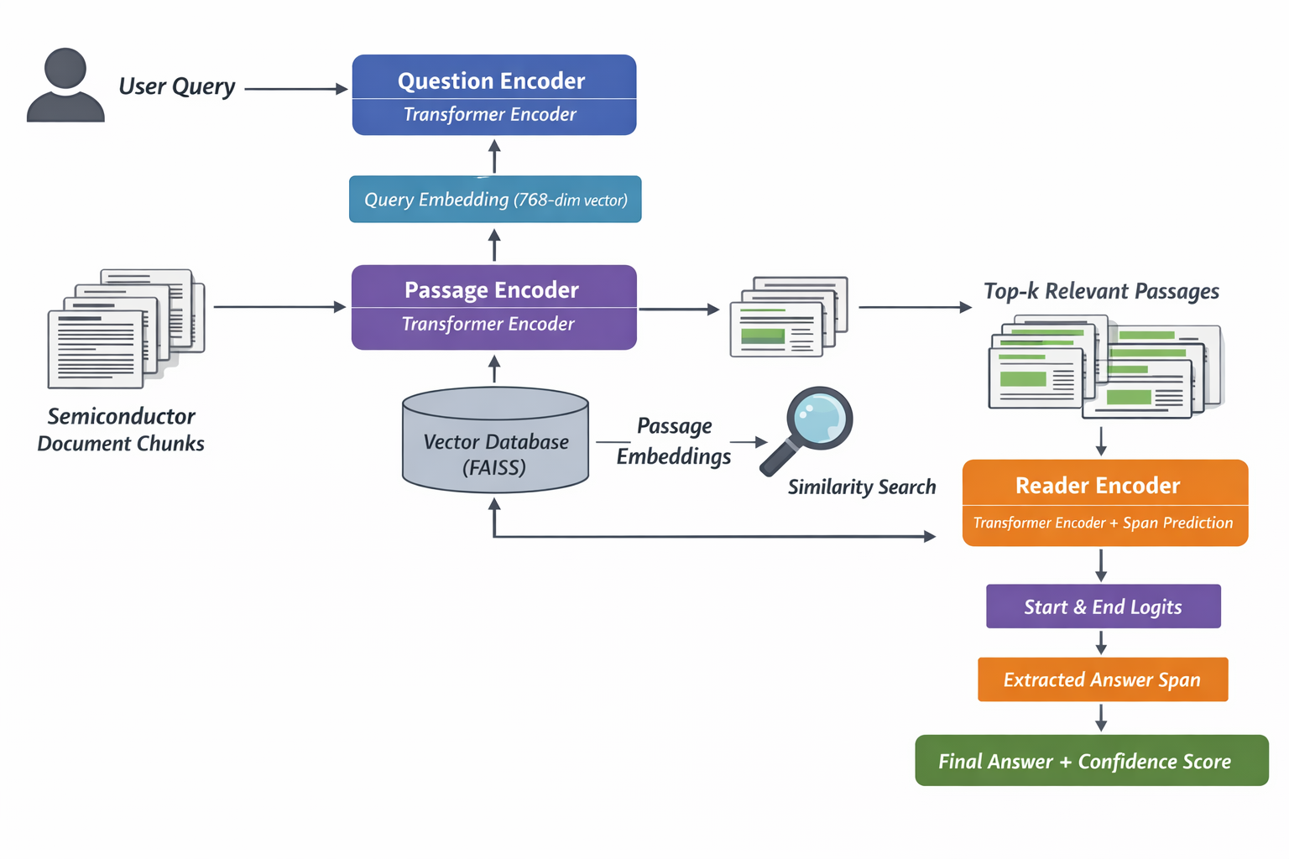

Method & Algorithms
Model Used: BAAI/bge-base-en-v1.5 · Hugging Face
SQuAD2.0

Slide 5
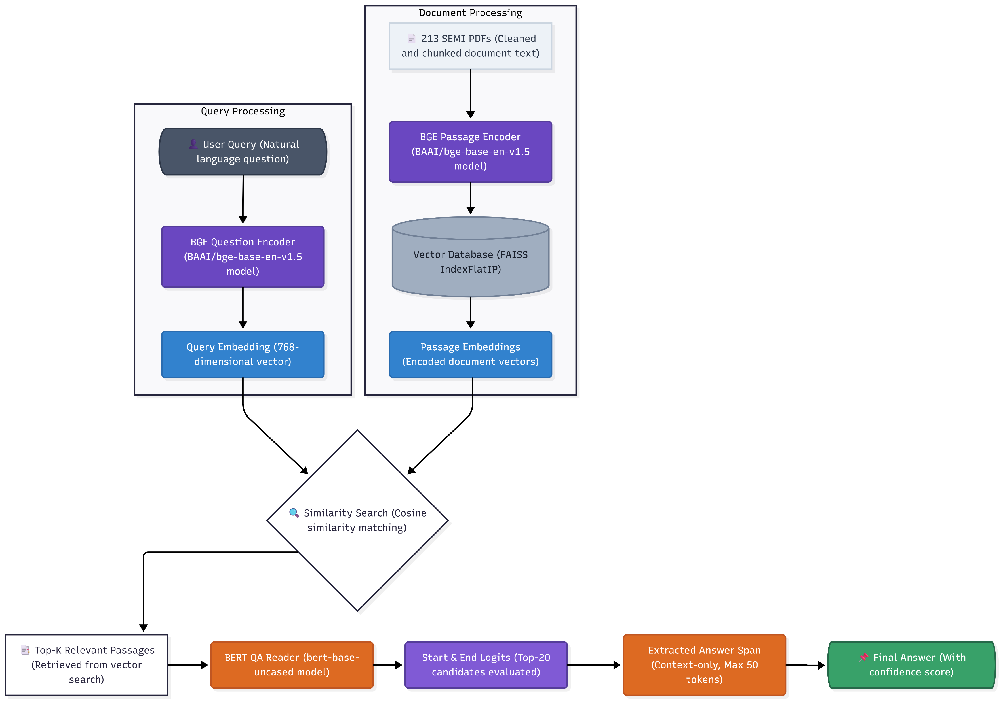
System Architecture (Retriever – Reader)
Models Used:
BAAI/bge-base-en-v1.5 · Hugging Face
google-bert/bert-base-uncased · Hugging Face

Slide 6
Work Done Till Now
Stage 1: Retriever (BAAI/bge-base-en-v1.5 + FAISS)
Fine-tuned using MultipleNegativesRankingLoss (MNRL) for a much stronger training signal.
Windowed positives (±100 characters around the answer) to improve contextual relevance.
Corpus: 48,969 unique passages indexed with cosine similarity.
Stage 2: QA Reader (bert-base-uncased)
Fine-tuned specifically for Extractive QA to pinpoint the exact answer span within the retrieved passage.
Evaluates top-20 start/end token candidates to compute final confidence scores.
Pipeline Flow:

Slide 7
Work Done Till Now
Stage | Issue | Fix
Initial | Noisy QnA | Added Filters
Mid | Over-filtering | Balanced Filtering
Final | Root cause found | Fixed extraction
Major Improvements
Replaced naive sentence split → spaCy
Fixed term extraction (removed garbage like “N”)
Added numeric QnA (engineering specs - Tables)
Controlled paraphrasing (only definitions)
Optimized pipeline for speed
System Features
Fully local (no data leakage)
Works on confidential PDFs
Scalable to multiple documents
Validation Strategy
Used → SQuAD v2.0
Human-annotated QA dataset (~100K samples)
Applied SAME pipeline:
Same model (BGE)
Same training method
Same FAISS retrieval
Performance
Reduced noise significantly
Stable pipeline (minor variation due to randomness)
Efficient generation of QnA pairs using rule traditional based methods

Slide 8
Model Evaluation and Results
Key Insight
Quality Data fundamentally fixed the learning process.
Retrieval model now effectively understands semantic relationships.
Future Scope:
Add reranker for better ranking
Build user interface

Slide 9
Results Obtained Till Now
Metric | OCR Dataset | SQuAD2.0 Dataset
Recall@1 | 0.001 | 0.59
Recall@5 | Very low | 0.84
Accuracy | 0.001 | 0.59
Avg. F1 Score | Low(~0.05) | 0.64
MRR | Very low | 0.69
Key Insight
Data quality > Model complexity
Retrieval models learn semantic relationships
Noisy OCR data breaks learning
Clean data → strong retrieval performance
Future Scope:
Improve OCR cleaning pipeline
Sentence-based chunking
Hard negative mining
Add QA layer (answer extraction)
Add reranker for better ranking
Build user interface

Slide 10
Thank you

