Slide 1

Visvesvaraya National Institute of Technology, Nagpur
Electronics and Communication Engineering Department
Executive M.Tech. in Applied AI & Communications
Cohort 3B sem. 3, Summer 2026
Eval. 2 (10/05/2026)
SemiSage: Encoder-Based Retrieval Assistant for Semiconductor Documents
Presented by Group 21
Kartik Burele (MT24AAC011)
Yekollu Saakshara (MT24AAC014)
Under the supervision of
Dr. Saugata Sinha
VNIT Nagpur

Slide 2


Project overview & Dataset Details
PDF data in image format
Problem Statement: Time-consuming manual search in large SEMI standard documents
Semiconductor standard PDFs are:
Unstructured (OCR noise, tables, specs)
Difficult to query automatically
Objective: An offline, end-to-end Question Answering system to extract precise
answers from 213 unstructured semiconductor standard PDFs.
Dataset Generation :
Replaced previous noisy rule-based method with a Local LLM (Gemma 4B via Ollama) to generate high-quality extractive QA pairs. No cloud APIs used.
Data Quality Pipeline:
PyMuPDF extraction -> OCR Cleaning.
Semantic deduplication using MiniLM (Cosine similarity > 0.90).
Answer validation (ensuring exact substring matches in context).
Dataset Statistics:
Total Cleaned QA Pairs: 49,603 (Filtered down from 57,191).
Split: Train: 39,682 (80%) | Val: 4,960 (10%) | Test: 4,961 (10%).
Text Extraction using OCR
OCR PDF
Chunk size 250. Rule based QnA creation
Definition Fact Context
Conversion into JSON Squad-like format
{
"question": "What is xyz?",
"context": “xyz",
"answer": “xyz",
"answer_start":123,
"type": "definition",
"source": “xyz.pdf"
},

Slide 3
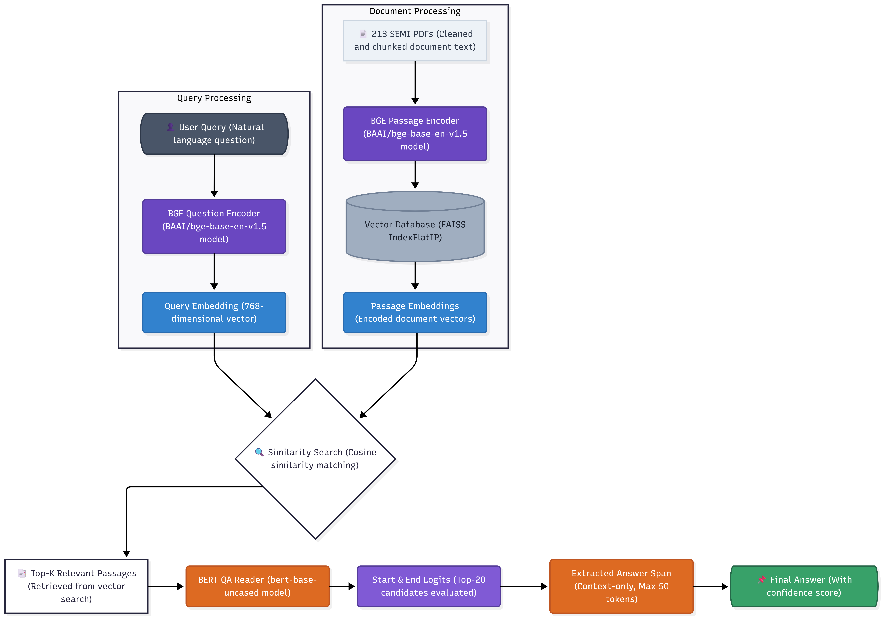

System Architecture (Retriever – Reader)
Models Used:
BAAI/bge-base-en-v1.5 · Hugging Face
google-bert/bert-base-uncased · Hugging Face

Slide 4
Work Done Till Now
Stage 1: Retriever (BAAI/bge-base-en-v1.5 + FAISS)
Fine-tuned using MultipleNegativesRankingLoss (MNRL) for a much stronger training signal.
Windowed positives (±100 characters around the answer) to improve contextual relevance.
Corpus: 48,969 unique passages indexed with cosine similarity.
Stage 2: QA Reader (bert-base-uncased)
Fine-tuned specifically for Extractive QA to pinpoint the exact answer span within the retrieved passage.
Evaluates top-20 start/end token candidates to compute final confidence scores.
Pipeline Flow:

Slide 5
Model Evaluation and Results
Key Insight
Quality Data fundamentally fixed the learning process.
Retrieval model now effectively understands semantic relationships.
Future Scope:
Add reranker for better ranking
Build user interface

Slide 6
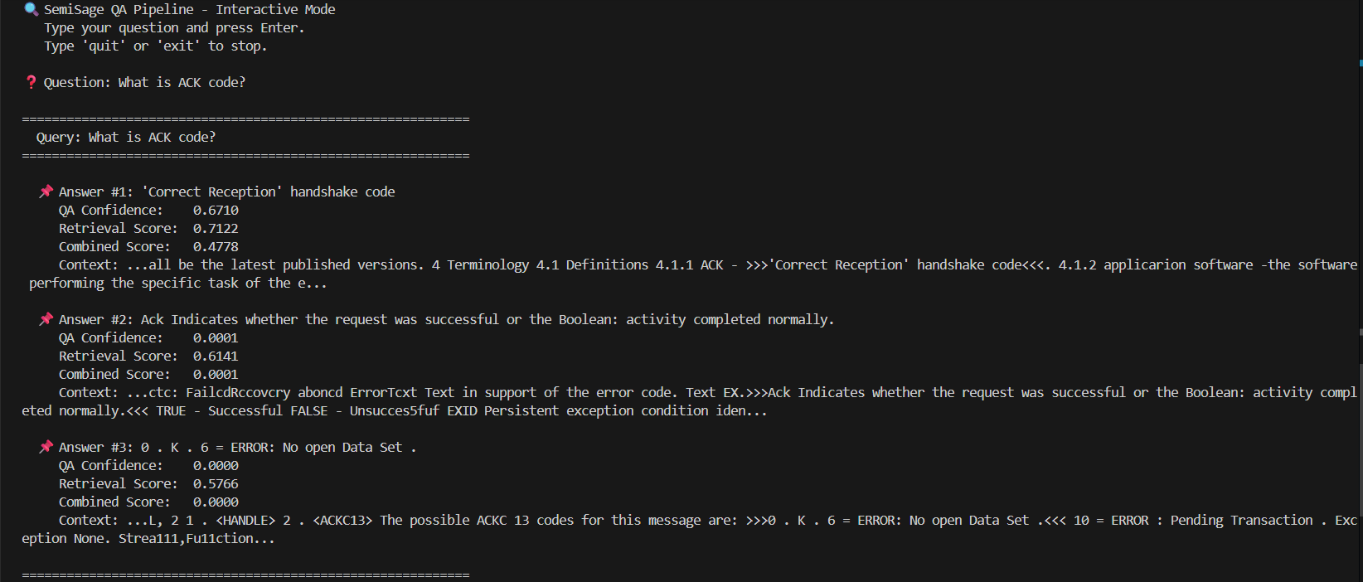
Demo
Please run the python project script from git using command uv run .\12_pipeline.py

Slide 7
Git Repository Link
https://github.com/Kartik-Burele/nlp_mini_project.git

Slide 8
Thank you

