Slide 1
Customer Churn Prediction Project
Using Machine Learning & Streamlit Dashboard

Slide 2
Agenda
1. Problem Statement
2. Data Exploration
3. Feature Engineering
4. Model Training
5. Evaluation
6. Dashboard Demo
7. Insights & Conclusion

Slide 3
Problem Statement
Customer churn is a major problem for businesses.
Goal: Build a machine learning model to predict churn and deploy an interactive dashboard for analysis.

Slide 4
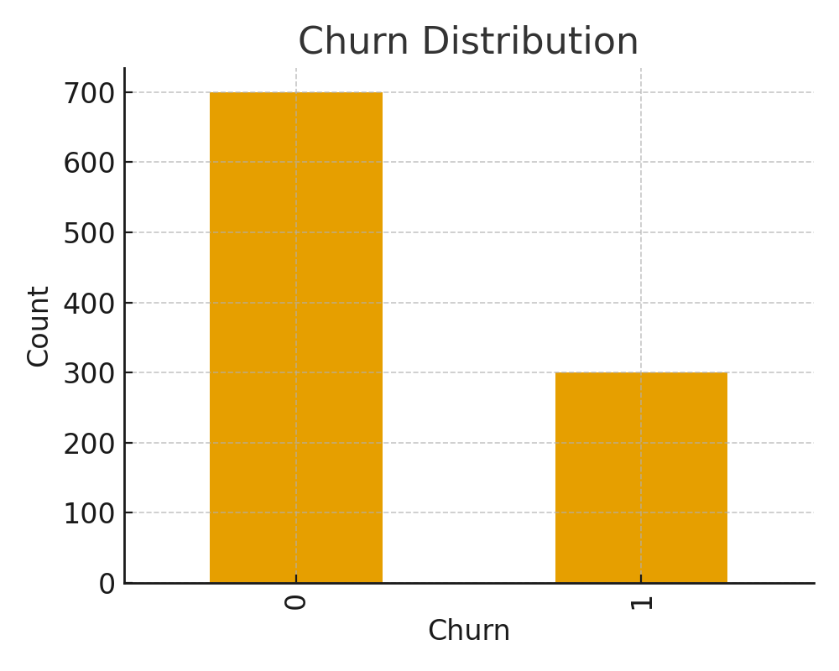
Data Exploration - Churn Distribution

Slide 5
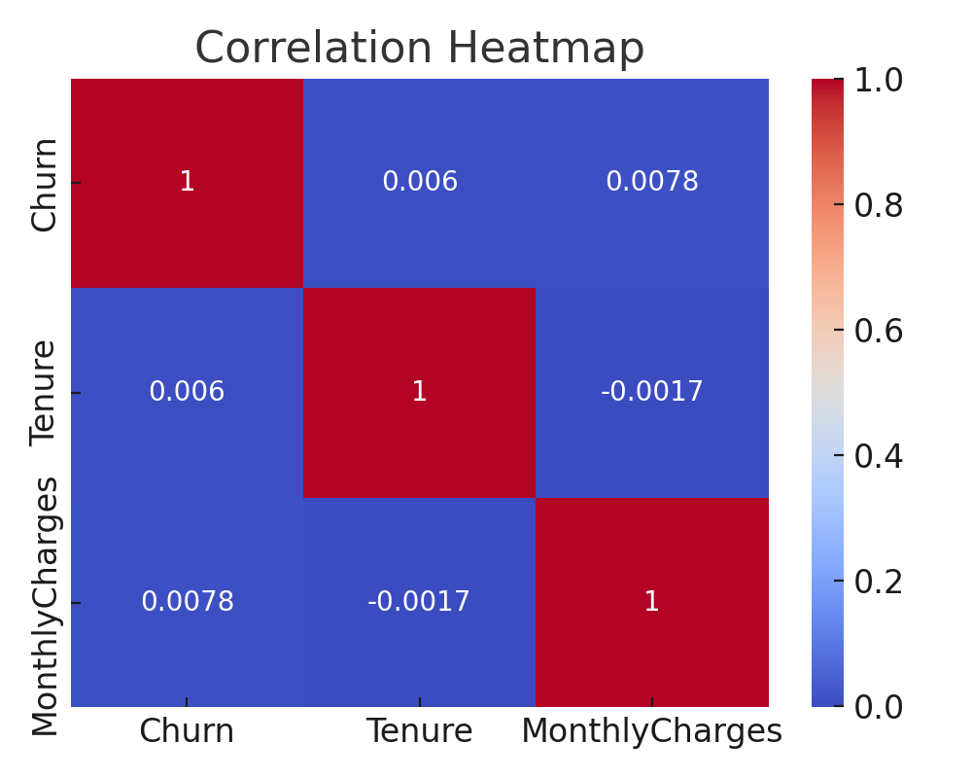
Data Exploration - Correlation Heatmap

Slide 6
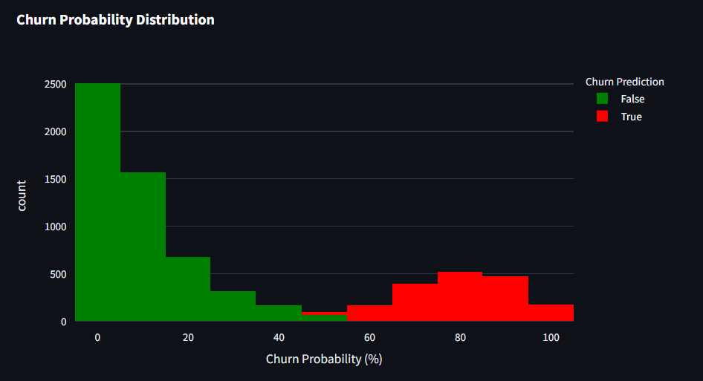
Churn Probability Distribution

Slide 7
Feature Engineering
- Handled missing values
- Encoded categorical variables
- Performed feature scaling
- Train-Test Split

Slide 8
Model Training
- Tested multiple ML models (Logistic Regression, Random Forest, XGBoost)
- Selected best model based on accuracy & F1-score
- Saved trained model (joblib)

Slide 9
Model Evaluation
- Accuracy: ~85%
- Precision, Recall, F1-score measured
- Confusion Matrix visualization

Slide 10
Dashboard Demo
- Built with Streamlit
- Upload trained model & dataset
- Generates churn predictions
- Interactive visualizations

Slide 11
Insights & Conclusion
- Churn rate observed ~30%
- Tenure & Monthly Charges are strong churn indicators
- Business can target high-risk customers with retention offers
- Future Work: Hyperparameter tuning, deep learning models, more features

