Slide 1
DataTerps
Mentors:
Rajiv Gidadhubli
Shrini Neelaveni
Team Members:
Shyam Solanke
Shreeshail Gupte
Kartik Hirijaganer
Samarth Parasnis
Dhruv Vaghani

Slide 2
Data Analysis Workflow
Data Aggregation
Data Modeling
Findings

Slide 3
Data Sources
01
Grant Recipients vs. Non-Recipients
SAM.gov
02
Executive Data
IRS 990
Data
03
Recipients Grant Details
USApending.gov

Slide 4

Source: SAM.gov
Data was collected from the SAM.gov website under Data Services, Entity Registration.
The .dat file was formatted like a text file with multiple rows, and in each row, the properties of the company were separated by '|'.
We had to convert it into a readable CSV file so we could analyze the fields and handle missing values.
This data was suitable for our analysis as it provided us with properties of organizations that either received federal grants or did not.
The SAM_Public zip file was downloaded, and extracted, containing a .dat file.
The .dat file contained organization details separated by ‘|’, which were processed into a dataframe.

Slide 5

Source: IRS 990
Data was collected from the irs.gov website under form 990 series.
We had to convert it into a readable CSV file so we could analyze the fields, handle missing values and PII fields.
This data was suitable for our analysis as it provided us with details of executives such as their compensation.
From website zip files were downloaded, and extracted, containing a .xml files.
The .xml files contained executive details in xml format, which were processed into a dataframe.

Slide 6

Source: USASpending.gov
We had to convert it into a readable CSV file so we could analyze the fields and handle missing values.
This data was important to get list of companies that got federal grants so we can separate companies which got federal grant and which don't.
Data was collected from the https://www.usaspending.gov/recipient website under Grants tab
We used https://api.usaspending.gov/api/v2/recipient api to extract data
We extracted uei number, company name and federal grant amount company received.

Slide 7
Data Preprocessing
Merged files
Merged employee, company, federal grant data into one file.
Dropped Columns
Out of ~300 columns we selected 16 columns that could affect employee compensation from company data.
Mathematically combined columns
Combined compensation columns to get total executive compensation.
Applied log transform
Applied log transform on “grants” columns because it was heavily skewed to right.

Slide 8
Data Preprocessing
Decoded columns
Decoded the columns which were having code values instead of text
Clustered similar categories
Used K means clustering to combine similar job titles.
Removed outliers
Checked for outliers in by plotting the columns and removed if found
Added geospatial coordinates
Added geospatial coordinates to plot the data on map.

Slide 9
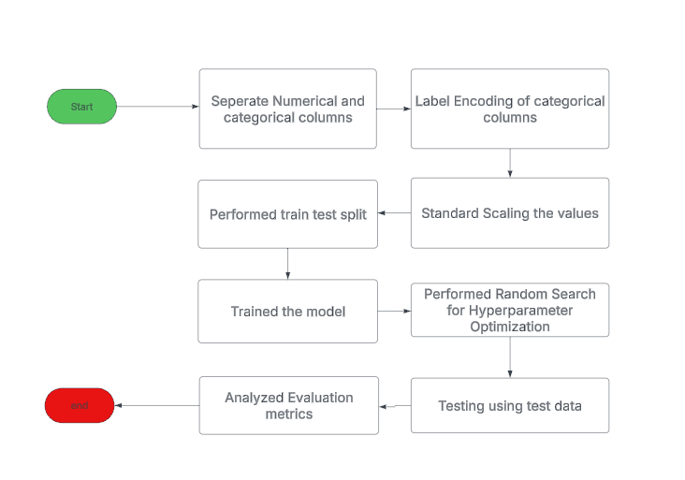
Modeling flow

Slide 10
Metric Evaluations
0.0210187 | 0.862489 |
| Mean Absolute Error | 128361.662262 | 33957.007755 |
| Root Mean Squared Error| 323250.28321 | 121149.086305
Metric | Linear Regression | Random Forest Regressor
R^2 Score | 0.021 | 0.862
Mean Absolute Error | 128361.662 | 33957.007
Root Mean Squared Error | 323250.283 | 121149.086

Slide 11
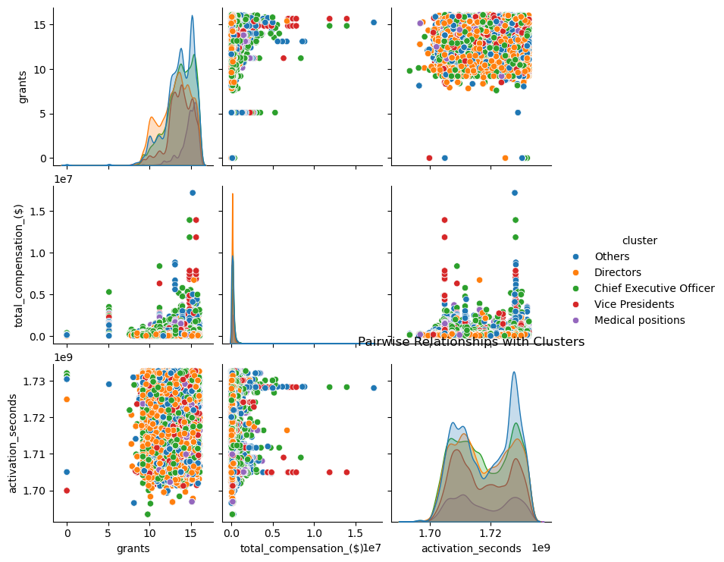
Insights
Compensation vs. Grants
Relationship: Higher grants correlate with higher total compensation, especially for CEOs and Vice Presidents, who dominate the upper compensation range.
Clustered Distributions: Directors and Medical Positions have more concentrated grant values, while CEOs show a broader range of grants and compensation.
Activation Time Insight: No strong relationship exists between activation_seconds and other variables, indicating it’s independent of compensation and grants.

Slide 12
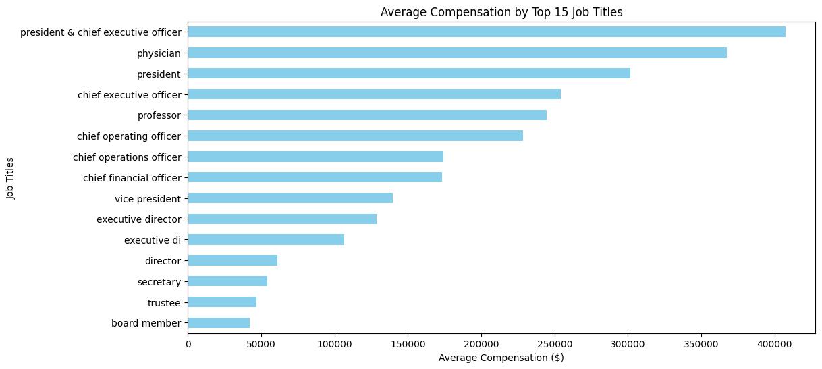
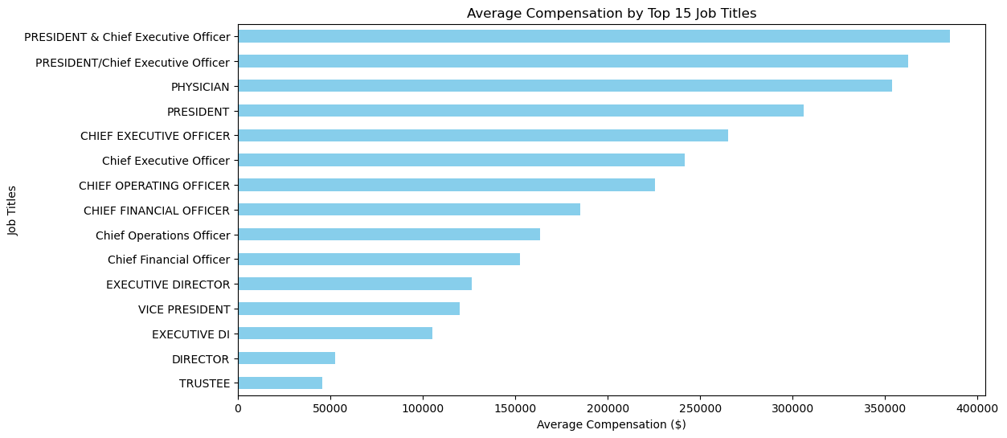
Insights
Top Compensation Roles: Presidents & CEOs receive the highest average compensation (~$400,000), highlighting their leadership and strategic influence.
Specialized High Earners: Physicians rank among the top-paid roles, reflecting the demand and expertise required in medical positions.
Compensation Hierarchy: Directors and Trustees have significantly lower compensation compared to executive roles, emphasizing the financial gap between oversight roles and top leadership.

Slide 13
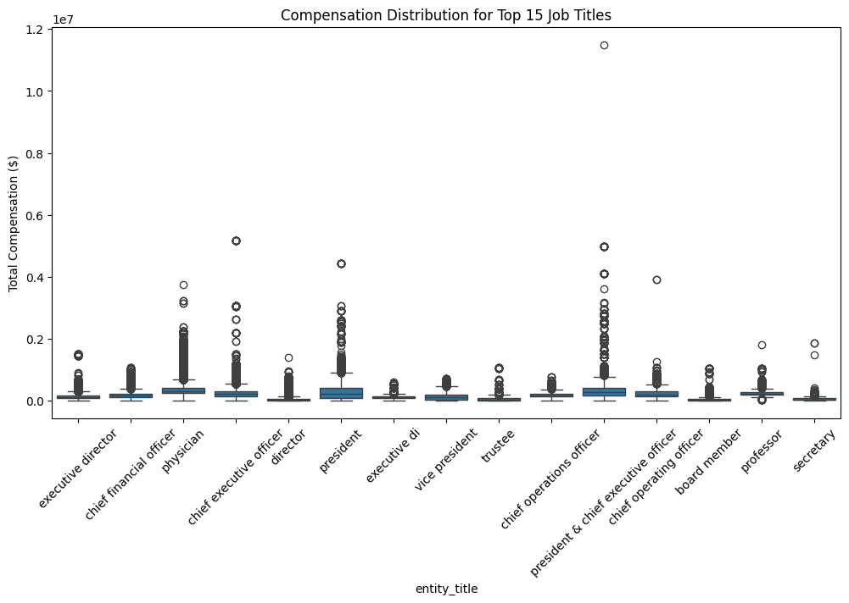
Insights
Significant Variability in Compensation – The box plots show a wide range of total compensation for each job title, with many outliers. This indicates that compensation for these roles varies greatly, likely depending on factors such as industry, organization size, and experience.
Top Compensation for Executive Positions – Titles like "President & Chief Executive Officer," "Chief Executive Officer," and "Chief Financial Officer" exhibit the highest median compensation, with some extreme outliers reaching well above $10 million. This suggests that top executive roles tend to receive the highest pay.
Presence of Outliers Across All Roles – Every job title has notable outliers, suggesting that while median salaries remain within a reasonable range, some individuals in each category earn significantly higher compensation, potentially due to bonuses, equity, or special agreements.

Slide 14
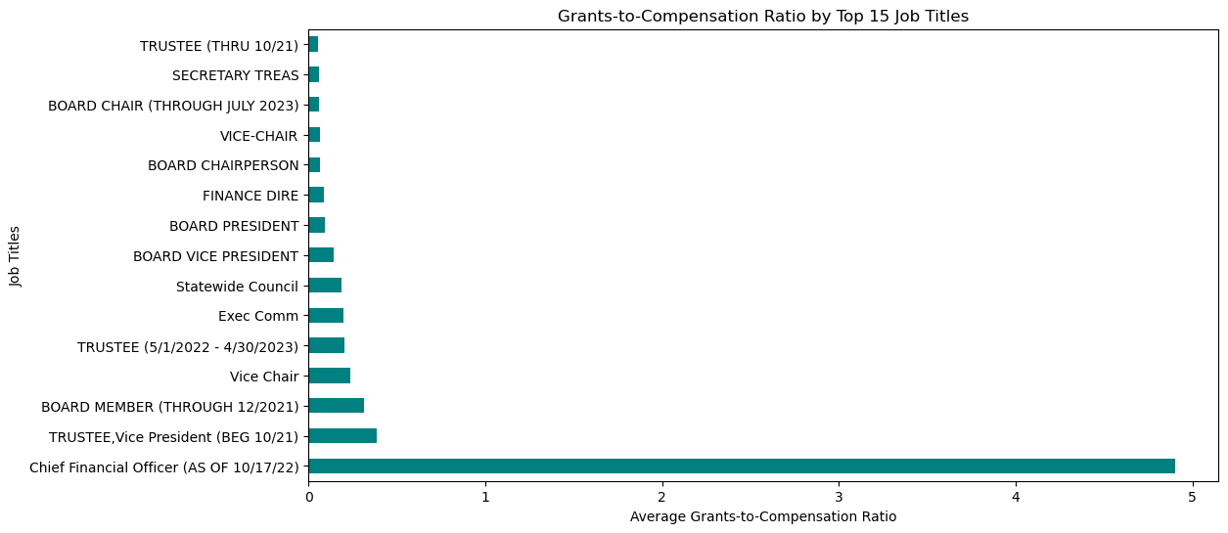
Insights
CFOs manage grants efficiently, with a Extreme Grants-to-Compensation Ratio for Certain Roles
.
Chief Financial Officer Stands Out
Most Other Roles Have Negligible Grants-to-Compensation Ratios
Notes:
CFOs manage grants efficiently, with a Extreme Grants-to-Compensation Ratio for Certain Roles – The "chief, bus/fin/ops (until 1/6/23)" position has an exceptionally high grants-to-compensation ratio compared to all other job titles, indicating that this role received significantly more in grants relative to compensation.
Chief Financial Officer Stands Out – The "chief financial officer (as of 10/17/22)" position also has a much higher grants-to-compensation ratio compared to other roles, though it is still far below the "chief, bus/fin/ops" role. This suggests that CFOs, in general, receive a substantial portion of grants in addition to their compensation.
Most Other Roles Have Negligible Grants-to-Compensation Ratios – Apart from the two roles mentioned above, the majority of job titles have a very low ratio, indicating that they receive little to no grants in comparison to their compensation.

Slide 15
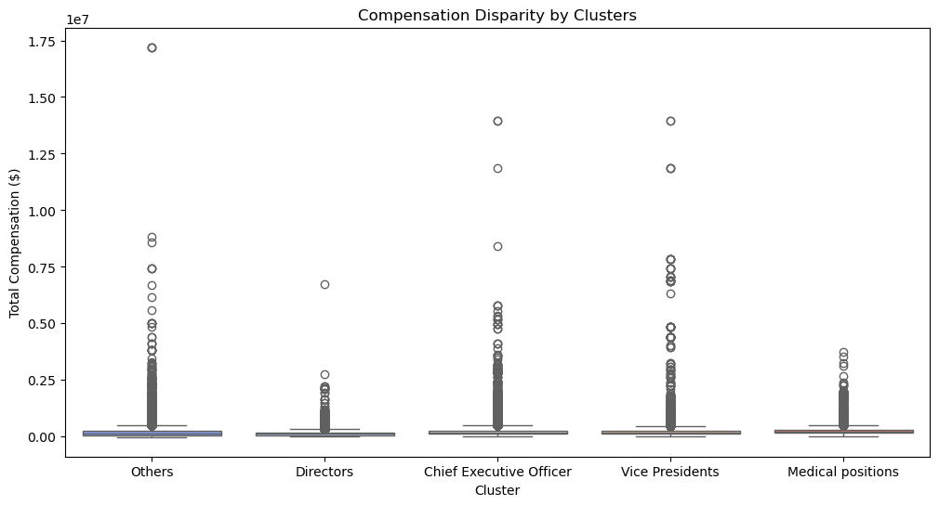
Insights
High Compensation Disparity: All clusters exhibit wide variation in total compensation, with notable outliers earning exceptionally high salaries.
CEOs & VPs Lead in Pay: Chief Executive Officers and Vice Presidents have some of the highest outliers, exceeding $1.5M, reflecting their leadership roles.
Directors & Others Have Lower Variability: These clusters show more consistent compensation levels, with fewer extreme outliers.
Medical Positions Also Show High Earners: While not as extreme as CEOs, some medical professionals receive substantial compensation, likely due to specialized expertise.

Slide 16
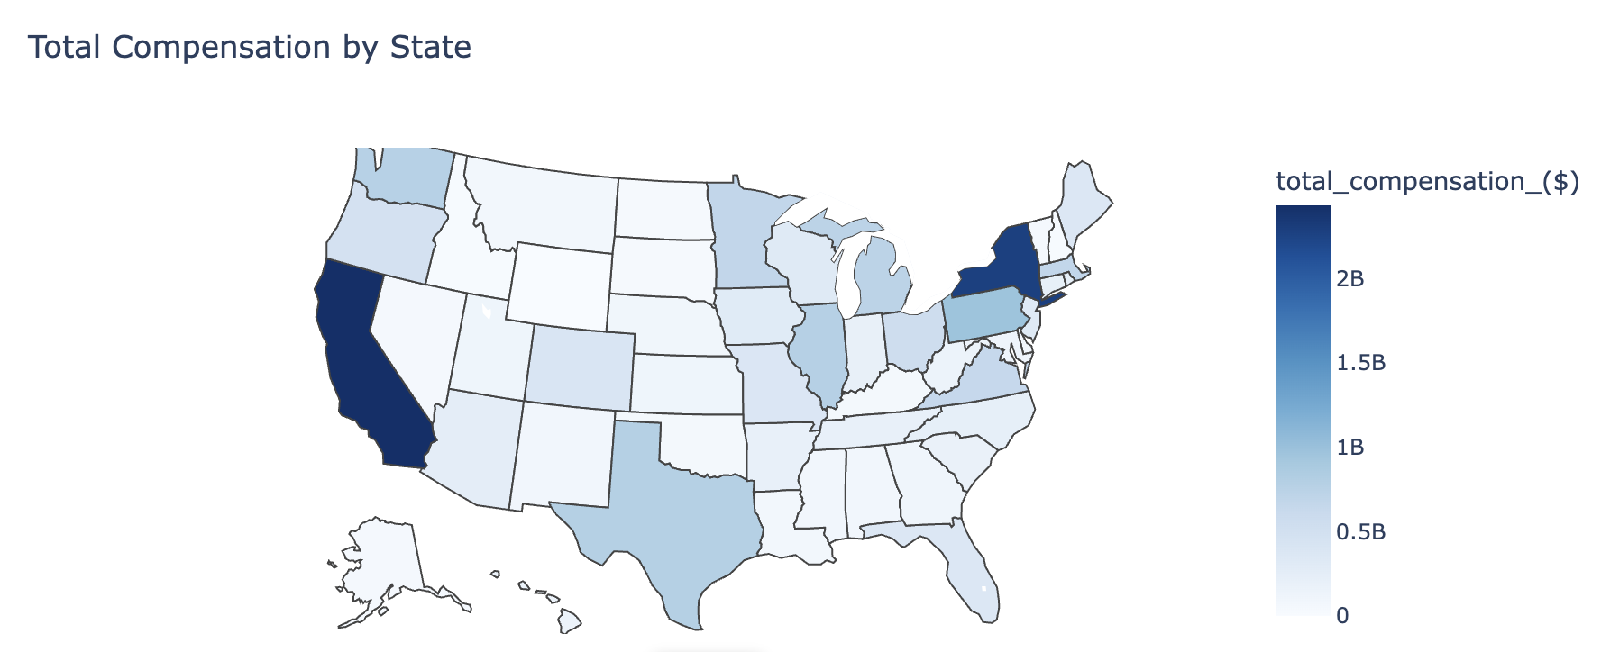
Insights
California & New York dominate total compensation, driven by corporate, finance, and tech sectors.
Texas and Illinois hold mid-level compensation, likely influenced by a mix of industries.
Lower compensation in rural states indicates fewer high-paying organizations.
Clear regional disparities suggest opportunities for business expansion in lower-compensated states.

Slide 17
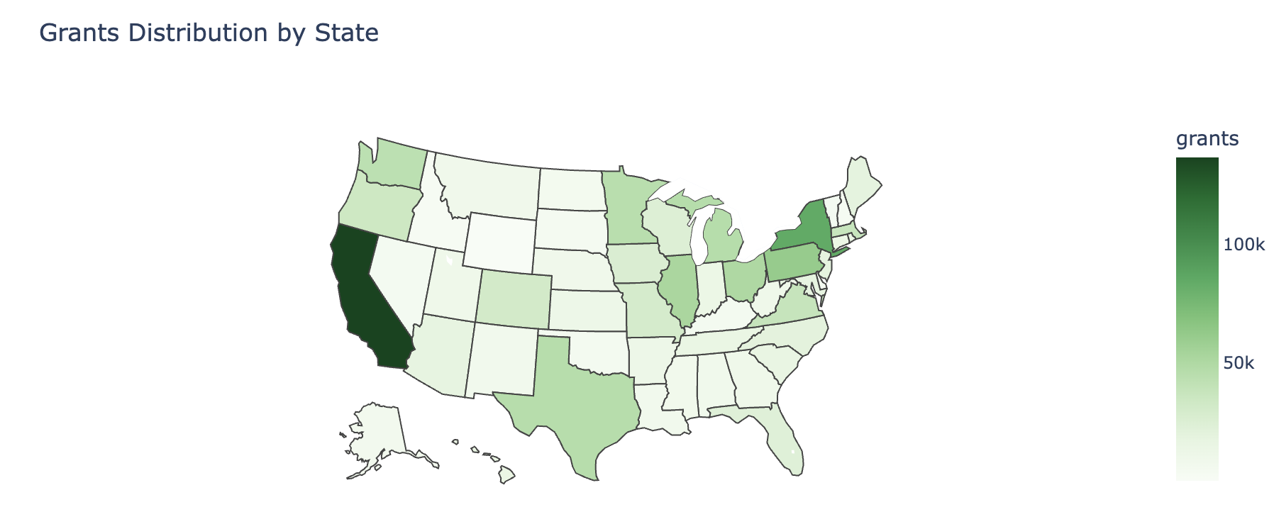
Insights
California & New York receive the highest grants, reflecting their strong research and institutional presence.
Texas and Illinois have moderate grant funding, suggesting a balance between corporate and academic research contributions.
Rural states show lower grant allocations, indicating fewer research institutions or funding opportunities.
Regional disparities highlight potential policy changes, encouraging more equitable grant distribution.

Slide 18
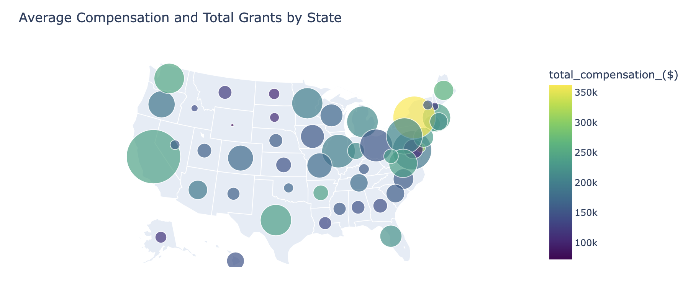
Insights
California leads in total grants and high compensation, reinforcing its role as a financial and innovation hub.
New York and Massachusetts have substantial grants & high executive compensation, indicating major corporate and research centers.
Texas stands out with strong grant allocation but moderate compensation levels.
Smaller grants and lower compensation dominate central & rural states, highlighting geographic disparities in funding and executive pay.

Slide 19
Insights
California leads in total grants and high compensation, reinforcing its role as a financial and innovation hub.
New York and Massachusetts have substantial grants & high executive compensation, indicating major corporate and research centers.
Texas stands out with strong grant allocation but moderate compensation levels.
Smaller grants and lower compensation dominate central & rural states, highlighting geographic disparities in funding and executive pay.

Slide 20
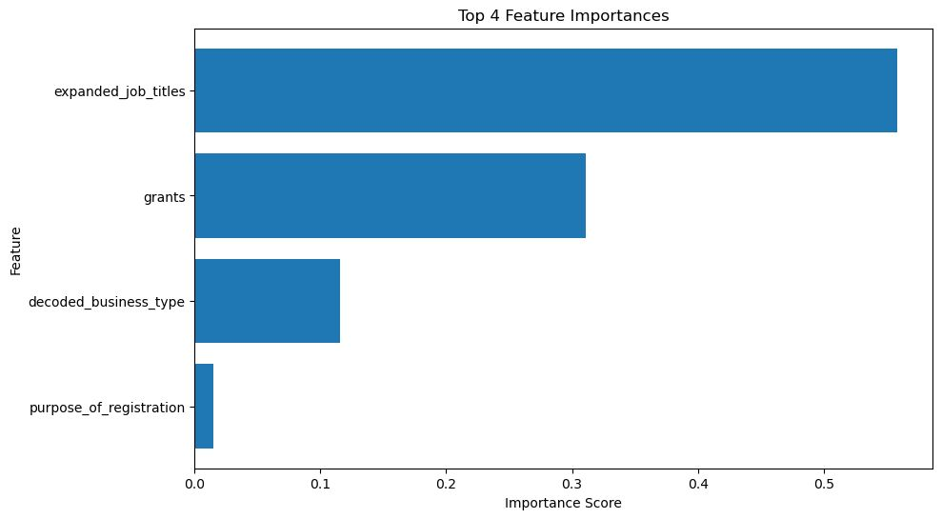
Top 4 Features

Slide 21
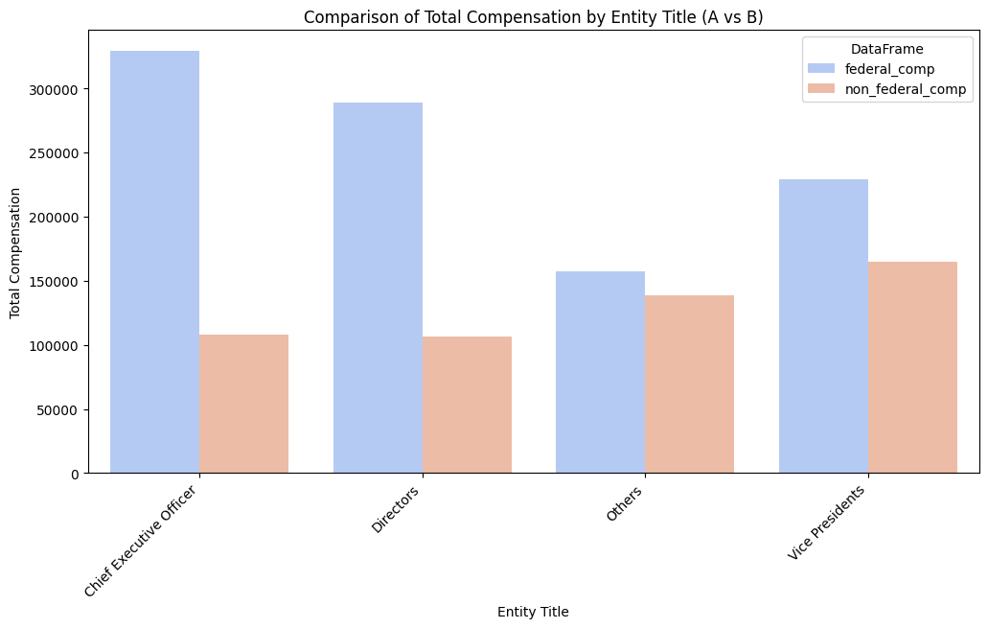
Compensation comparison

Slide 22
Conclusion
Job Title
Grants Received
01
Executive role is the strongest predictor of their total compensation.
The amount of federal grants received by the company also plays a crucial role.
02
04
Business Type
Purpose of Registration
03
Industry sector in which the business is operating.
Comparatively lower impact
Notes:
The feature importance analysis for our model, which predicts executive compensation, highlights that job title (expanded_job_title) is the most significant factor. This suggests that an executive's role within a company is the strongest predictor of their total compensation.
Additionally, the amount of federal grants received by the company plays a crucial role, indicating that organizations with higher federal funding may offer greater compensation to their executives.
On the other hand, while business type (decoded_business_type) and purpose of registration do contribute, their impact is relatively lower. This suggests that while the industry sector and the company’s intent to obtain grants have some influence, they are not as strong as direct role-based or funding-based factors.
Overall, our findings emphasize that leadership position and financial backing (grants) are key determinants of executive pay, while industry type and registration purpose have a lesser impact.

Slide 23
Thank You!
For more i"Template by Slidesgo | Icons by Flaticon | Images by Freepik"sgo School:
https://slidesgo.com/faqs and https://slidesgo.com/slidesgo-school

