Slide 1
Indian Institute of Technology Kharagpur
Applied Data Intelligence (ADI) • Problem Set 3
PROBLEM SET 3
AI-Native Field Address Geocoder
Exploratory Data Analysis, Model Architecture,
Evaluation and Delivery Report
Name: Kartik Roll No.: 2025112
October 2026
PS3_Geocoder_EDA.ipynb • PS3_PROBLEM_SOLUTION_REPORT.md • evaluation artifact (SHA-256 pinned)
Notes:
Title slide. PS3: address-intelligence geocoder with uncertainty and evidence trails.

Slide 2
SECTION 1
Executive Summary
• Problem: collection addresses are descriptions, not pins — the commercial geocoder returns a locality centre while the operational answer is “behind the ration shop, two lanes after the temple”.
• Solution: an evidence-fusion geocoder — address text + landmarks + visit history + GPS quality + dwell + integrity signals → location + uncertainty radius + evidence trail + operational action (visit_directly / verify_first / skip).
• Model: 150-tree LightGBM ranker over a 21-feature evidence contract, fronted by a deterministic reliability-weighted aggregator; confirmed and predicted locations kept strictly separate.
204.4 m
−46.3%
53.0%
72.7%
3.3 ms
median error (weighted geocoder, n = 66)
median error vs commercial baseline (380.8 m)
within 250 m (baseline: 28.8%)
radius coverage of true location
per prediction • ECE 0.155
• Conservative by design: projected metres (not WGS84), no check-in treated as ground truth, no causal claims without treatment assignment + independent recovery outcome.
• Reproducible: every run writes a JSON artifact with run ID, SHA-256 source hashes, baselines, ablations, split metadata and explicit limitations.
PS3 — AI-Native Field Address Geocoder
2
Notes:
Headline results on the train split: 2,175 addresses, 3,896 visits, 66 surveyed truth addresses.

Slide 3
SECTION 2
The Business Problem: Cost and Motivation
Channel | Fully-loaded cost
SMS / WhatsApp | fraction of a rupee
AI voice | ~INR 1–3 per call
Human tele-caller | ~INR 15–30 per connect
Productive field visit | ~INR 150–400
Why ordinary geocoding fails
• Mixed Devanagari / Roman / Kannada / Hindi / English text and transliteration variants
• Relational descriptions: “behind”, “near”, “opposite” — informal landmarks absent from global geocoders
• Locality names shared by several towns; addresses that name a shop or workplace, not a residence
Why visit GPS is valuable but imperfect
• Check-ins are evidence, not truth: met at work, poor GPS, tea-stall check-ins, failed searches near (not at) the address
• Fix: combine evidence with reliability weights and uncertainty — never copy the latest latitude and longitude
Objective: recovery net of contact cost, goodwill and compliance risk.
PS3 — AI-Native Field Address Geocoder
3
Notes:
A geocoder is useful only if it raises the probability a field visit is productive.

Slide 4
SECTION 3
Dataset and Data Quality (train split)
Table | Rows | Size
accounts | 1,680 | 220.8 KB
addresses | 2,175 | 278.3 KB
field_visits | 3,896 | 658.3 KB
agents | 30 | 1.0 KB
baseline_geocodes | 2,010 | 64.6 KB
surveyed_addresses | 66 | 1.6 KB
visit_gps_points | 112,080 | 5.1 MB
landmarks_poi | 240 | 11.3 KB
localities / towns | 36 / 3 | 1.9 KB
Coordinates are projected local metres — not WGS84
error_m = sqrt((Δx)² + (Δy)²); ranges ±4,400 m confirm a local CRS
• 0 orphan rows across all 5 core joins (addresses→accounts, visits→addresses, surveyed→addresses, baseline→addresses)
• 0 duplicate primary keys in any table; nulls only in optional attributes
• 3 towns · 3 address styles (karnataka, hindi, metro) · 2,175 addresses · 240 landmarks
• Address mix: 78% residence, 15% office, 7% permanent-native; 99% from KYC origination, 19 skip_trace (the hard cases)
• Every artifact records SHA-256 of source files — results reproducible against identical inputs
PS3 — AI-Native Field Address Geocoder
4
Notes:
Table 3 of the report lists the full 10-file inventory.

Slide 5
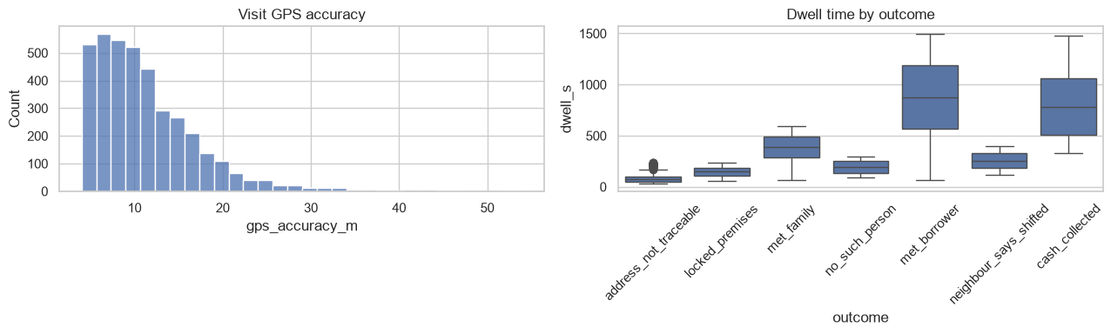
SECTION 4
EDA — Evidence Quality: GPS Accuracy vs Dwell
Metric | Mean | Median | P90 | Max
GPS accuracy (m) | 11.28 | 9.9 | 18.7 | 54.0
Dwell time (s) | 339.8 | 203.0 | 908.0 | 1,495.0
• Dwell is the discriminator: median 876 s on met_borrower vs 78 s on address_not_traceable — an 11× gap
• GPS accuracy barely moves across outcomes (9.1–10.9 m median) — it is a filter, not a discriminator
• Weighting encodes the separation: (1/accuracy) × dwell/300
• Agent concentration is mild (top agent 470 vs fleet average 130) → agent-independence feature guards clusters
Figure 2. GPS-accuracy distribution (left) and dwell by outcome (right).
PS3 — AI-Native Field Address Geocoder
5
Notes:
Notebook Section 4; Tables 10–12 of the report.

Slide 6
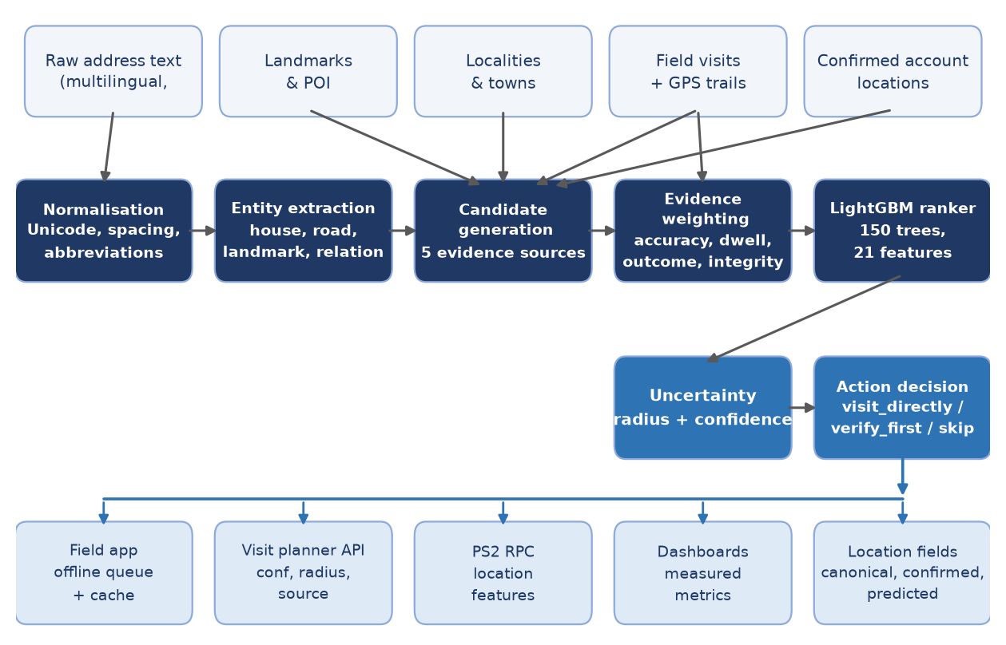
SECTION 6
Model Architecture: End-to-End View
Figure 4. Inputs → normalisation → entities → five-source candidate generation → evidence weighting → LightGBM ranker → uncertainty → action → consumers.
PS3 — AI-Native Field Address Geocoder
6
Notes:
The deterministic aggregator (stage 4) works even where the learned ranker has no support.

Slide 7
SECTION 6
Evidence Weighting and Candidate Sources
SUCCESSFUL = {met_borrower, met_family, cash_collected}
weight = (1 / gps_accuracy) * clip(dwell, 1, 600) / 300
predicted = weighted average of successful check-ins
radius = max(50 m, weighted RMS spread)
confidence = clip(1 - radius / 1000, 0, 1)
Five candidate sources
• Commercial / open geocoder — prior and fallback
• Historical successful visits — weighted centroid (strongest source)
• Nearby confirmed accounts / shared-place clusters — guarded corroboration
• Landmarks & locality centroids — anchor for “behind the temple”
• Agent-remarks corrections — conservative, high-precision only
No usable successful visit → fall back to the commercial geocode with a 500 m radius. Shared-place clusters propagate only under source and reliability thresholds — never unconditional copying.
PS3 — AI-Native Field Address Geocoder
7
Notes:
Table 16 + the Section 6.4 formulas of the report.

Slide 8
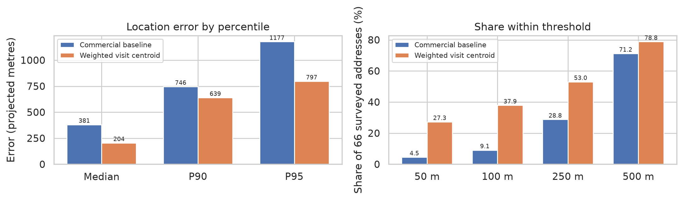
SECTION 7
Model Evaluation: Head-to-Head (n = 66)
Metric | Commercial baseline | Weighted visit centroid | Change
Median error (m) | 380.8 | 204.4 | −46.3%
P90 / P95 error (m) | 745.6 / 1,176.9 | 639.2 / 797.1 | −14.3% / −32.3%
Within 50 / 100 m | 4.5% / 9.1% | 27.3% / 37.9% | +22.7 / +28.8 pts
Within 250 m | 28.8% | 53.0% | +24.2 pts
Within 500 m | 71.2% | 78.8% | +7.6 pts
Radius coverage (error ≤ radius) | — | 72.7% | —
Latency (ms / prediction) | — | 3.31 | —
Figure 6. Error percentiles (left) and share within each threshold (right).
PS3 — AI-Native Field Address Geocoder
8
Notes:
Table 20 + Figure 6. 48/66 addresses use visit evidence; 18 fall back to the geocode.

Slide 9
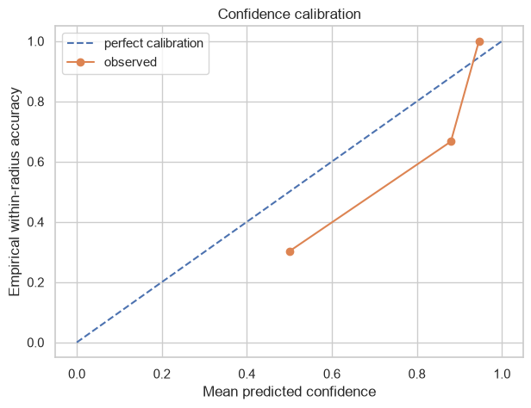
SECTION 7
Uncertainty Coverage and Calibration
Bin | Mean predicted | Empirical ≤ 250 m | n
0.5 – 0.6 | 0.500 | 0.302 | 43
0.8 – 0.9 | 0.880 | 0.667 | 3
0.9 – 1.0 | 0.946 | 1.000 | 20
• ECE = 0.155 on 66 predictions; radius coverage 72.7%
• High-confidence bin (radius ≤ 100 m): 20/20 correct within 250 m
• Middle bin over-confident (0.50 predicted vs 0.30 observed) → default verify_first; recalibrate on held-out data before pilot thresholds
• Coverage is reported with accuracy: the 27% without visit history get the geocode fallback, not silence
Figure 7. Predicted confidence vs empirical within-250 m accuracy.
PS3 — AI-Native Field Address Geocoder
9
Notes:
Table 21 + Figure 7 of the report.

Slide 10
SECTION 10
Security, RBAC and Compliance
Role-based access control
• Borrower locations, visit trails, agent GPS, remarks and territory metrics are sensitive operational data
• Agents: own territory only · managers: broader views · auditors: evidence + audit · admins: configuration
• Retraining endpoint protected by backend RBAC — hiding the UI nav item is not the security boundary
• Production: tenant + territory scoping at the data-query boundary, not only the UI
RBI and DPDP boundaries
• Per-deployment configuration and audit: contact hours and frequency
• Consent and purpose limitation; retention and deletion windows
• Access logging and export controls; separation of collections data from unrelated uses
• Agent-monitoring governance; incident response and correction workflows
• The geocoder must not infer locations beyond what collections requires
PS3 — AI-Native Field Address Geocoder
10
Notes:
Section 10 of the report.

Slide 11
SECTION 11
Deployment Plan
Phase 1 — Shadow mode
Phase 2 — Controlled pilot
• ingest evidence without changing planner decisions
• measure error, coverage, calibration
• review integrity alerts with field managers
• comparable territories; frozen model version
• record action assignment + recovery outcomes
• productive visits/agent-day; cost per recovery
Phase 3 — Guarded rollout
Phase 4 — Continuous governance
• direct visits only above calibrated thresholds
• low confidence → verification route
• rollback path to incumbent planner
• version data / model / config / artifacts
• rerun temporal + geography holdouts
• recalibrate; retention-driven deletion; audits
PS3 — AI-Native Field Address Geocoder
11
Notes:
Four-phase rollout from shadow mode to continuous governance.

Slide 12
SECTION 14
Conclusion
• An evidence-learning geocoder, not a generic lookup: normalisation → entities → five-source candidates → reliability weighting → 150-tree LightGBM ranker → uncertainty-driven action
• Measured: median error 204.4 m vs 380.8 m (−46.3%), within-250 m 53.0% vs 28.8%, 72.7% radius coverage, ECE 0.155, 3.3 ms per prediction — all reproducible from the SHA-256-pinned artifact
• Where it is strong: high-confidence predictions (20/20) and evidence-rich accounts. Where it stays honest: the uncertain middle band, the 27% without visit history, and causal claims the data cannot support
• Ready for Phase 1 shadow mode behind a real collections operation — that discipline, not a single number, is the delivery claim
Thank you — questions on the model, the evaluation boundary, or the rollout plan are welcome.
PS3 — AI-Native Field Address Geocoder
12
Notes:
Closing slide.

