Slide 1
Indian Institute of Technology Kharagpur
Applied Data Intelligence (ADI) • Problem Set 3
PROBLEM SET 3
AI-Native Field Address Geocoder
Exploratory Data Analysis, Model Architecture,
Evaluation and Delivery Report
Name: Kartik Roll No.: 2025112
October 2026
PS3_Geocoder_EDA.ipynb • PS3_PROBLEM_SOLUTION_REPORT.md • evaluation artifact (SHA-256 pinned)
Notes:
Title slide. PS3: address-intelligence geocoder with uncertainty and evidence trails.

Slide 2
CONTENTS
Report Outline
1. Executive Summary
2. The Business Problem
3. Dataset and Data Quality
4. Exploratory Analysis of Field-Visit Evidence
5. Commercial Baseline Geocoder Evaluation
6. Model Architecture and Detailed Design
7. Model Evaluation
8. Key Insights and Interpretation
9. Evaluation Framework and Reproducibility
10. Security, RBAC and Compliance
11. Deployment Plan
12. Known Limitations and Next Engineering Work
13. Deliverables and Submission
14. Conclusion
Notes:
Fourteen sections; the deck follows the report order.

Slide 3
SECTION 1
Executive Summary
• Problem: collection addresses are descriptions, not pins — the commercial geocoder returns a locality centre while the operational answer is “behind the ration shop, two lanes after the temple”.
• Solution: an evidence-fusion geocoder — address text + landmarks + visit history + GPS quality + dwell + integrity signals → location + uncertainty radius + evidence trail + operational action (visit_directly / verify_first / skip).
• Model: 150-tree LightGBM ranker over a 21-feature evidence contract, fronted by a deterministic reliability-weighted aggregator; confirmed and predicted locations kept strictly separate.
204.4 m
−46.3%
53.0%
72.7%
3.3 ms
median error (weighted geocoder, n = 66)
median error vs commercial baseline (380.8 m)
within 250 m (baseline: 28.8%)
radius coverage of true location
per prediction • ECE 0.155
• Conservative by design: projected metres (not WGS84), no check-in treated as ground truth, no causal claims without treatment assignment + independent recovery outcome.
• Reproducible: every run writes a JSON artifact with run ID, SHA-256 source hashes, baselines, ablations, split metadata and explicit limitations.
PS3 — AI-Native Field Address Geocoder
2
Notes:
Headline results on the train split: 2,175 addresses, 3,896 visits, 66 surveyed truth addresses.

Slide 4
SECTION 2
The Business Problem: Cost and Motivation
Channel | Fully-loaded cost
SMS / WhatsApp | fraction of a rupee
AI voice | ~INR 1–3 per call
Human tele-caller | ~INR 15–30 per connect
Productive field visit | ~INR 150–400
Why ordinary geocoding fails
• Mixed Devanagari / Roman / Kannada / Hindi / English text and transliteration variants
• Relational descriptions: “behind”, “near”, “opposite” — informal landmarks absent from global geocoders
• Locality names shared by several towns; addresses that name a shop or workplace, not a residence
Why visit GPS is valuable but imperfect
• Check-ins are evidence, not truth: met at work, poor GPS, tea-stall check-ins, failed searches near (not at) the address
• Fix: combine evidence with reliability weights and uncertainty — never copy the latest latitude and longitude
Objective: recovery net of contact cost, goodwill and compliance risk.
PS3 — AI-Native Field Address Geocoder
3
Notes:
A geocoder is useful only if it raises the probability a field visit is productive.

Slide 5
SECTION 3
Dataset and Data Quality (train split)
Table | Rows | Size
accounts | 1,680 | 220.8 KB
addresses | 2,175 | 278.3 KB
field_visits | 3,896 | 658.3 KB
agents | 30 | 1.0 KB
baseline_geocodes | 2,010 | 64.6 KB
surveyed_addresses | 66 | 1.6 KB
visit_gps_points | 112,080 | 5.1 MB
landmarks_poi | 240 | 11.3 KB
localities / towns | 36 / 3 | 1.9 KB
Coordinates are projected local metres — not WGS84
error_m = sqrt((Δx)² + (Δy)²); ranges ±4,400 m confirm a local CRS
• 0 orphan rows across all 5 core joins (addresses→accounts, visits→addresses, surveyed→addresses, baseline→addresses)
• 0 duplicate primary keys in any table; nulls only in optional attributes
• 3 towns · 3 address styles (karnataka, hindi, metro) · 2,175 addresses · 240 landmarks
• Address mix: 78% residence, 15% office, 7% permanent-native; 99% from KYC origination, 19 skip_trace (the hard cases)
• Every artifact records SHA-256 of source files — results reproducible against identical inputs
PS3 — AI-Native Field Address Geocoder
4
Notes:
Table 3 of the report lists the full 10-file inventory.

Slide 6
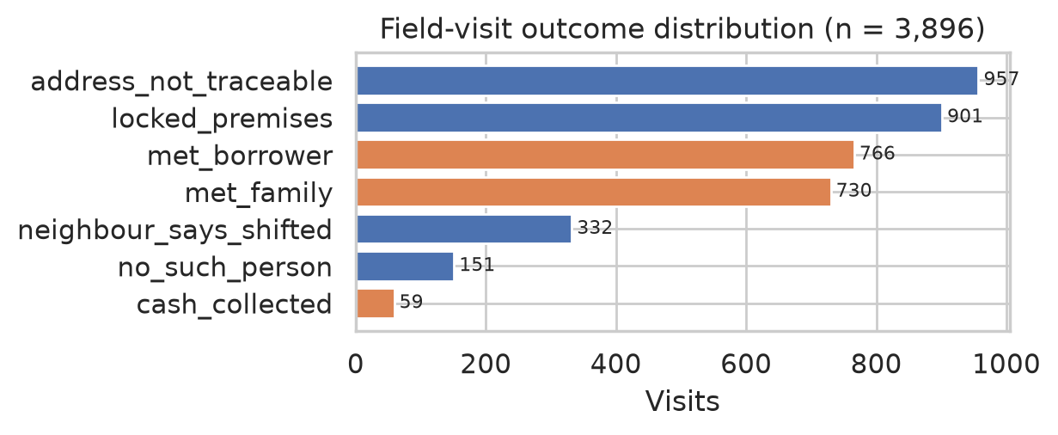
SECTION 4
EDA — Field-Visit Outcomes (n = 3,896)
Outcome | Visits | Share
address_not_traceable | 957 | 24.6%
locked_premises | 901 | 23.1%
met_borrower | 766 | 19.7%
met_family | 730 | 18.7%
neighbour_says_shifted | 332 | 8.5%
no_such_person | 151 | 3.9%
cash_collected | 59 | 1.5%
Figure 1. Outcome distribution; orange = successful-contact evidence.
• 1,555 of 3,896 visits (39.9%) are successful contacts (orange in the chart)
• Failed visits are still information: they mark where agents searched and found nobody — the raw signal behind “address-not-traceable”
PS3 — AI-Native Field Address Geocoder
5
Notes:
Notebook Section 4; Table 9 of the report.

Slide 7
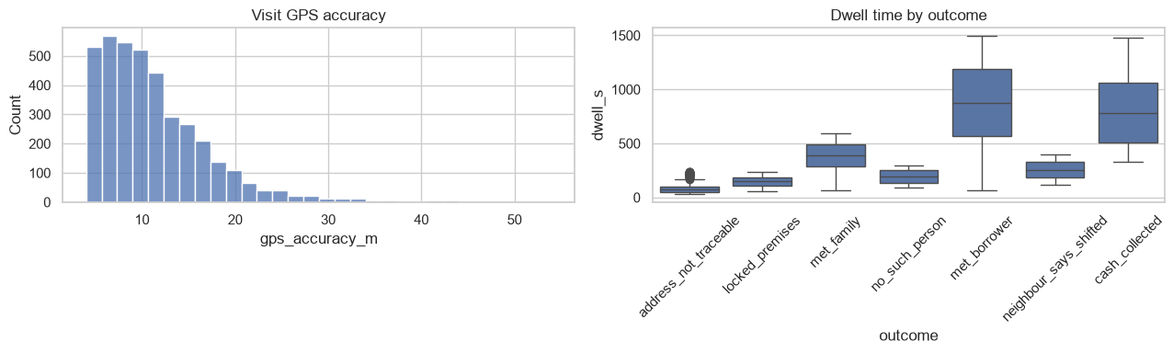
SECTION 4
EDA — Evidence Quality: GPS Accuracy vs Dwell
Metric | Mean | Median | P90 | Max
GPS accuracy (m) | 11.28 | 9.9 | 18.7 | 54.0
Dwell time (s) | 339.8 | 203.0 | 908.0 | 1,495.0
• Dwell is the discriminator: median 876 s on met_borrower vs 78 s on address_not_traceable — an 11× gap
• GPS accuracy barely moves across outcomes (9.1–10.9 m median) — it is a filter, not a discriminator
• Weighting encodes the separation: (1/accuracy) × dwell/300
• Agent concentration is mild (top agent 470 vs fleet average 130) → agent-independence feature guards clusters
Figure 2. GPS-accuracy distribution (left) and dwell by outcome (right).
PS3 — AI-Native Field Address Geocoder
6
Notes:
Notebook Section 4; Tables 10–12 of the report.

Slide 8
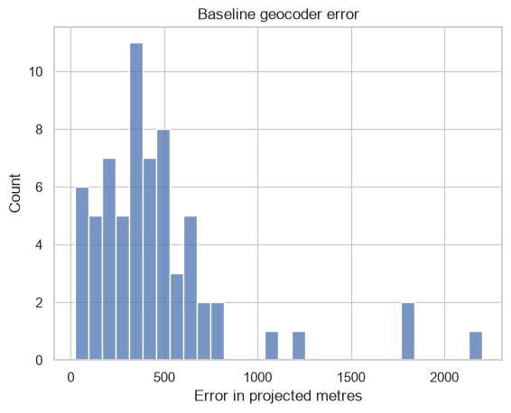
SECTION 5
Commercial Baseline Geocoder (n = 66 surveyed)
Metric | Value
Median error (m) | 380.8
P90 / P95 error (m) | 745.6 / 1,176.9
Within 50 m | 4.5%
Within 100 m | 9.1%
Within 250 m | 28.8%
Within 500 m | 71.2%
Town | Median (m) | Within 250 m
T2 Devgarh Nagar (hindi) | 359.3 | 33.3%
T3 Navanagara East (metro) | 369.3 | 28.6%
T1 Kaveripura (karnataka) | 420.2 | 25.0%
The failure tracks address style: the weakest town is the Kannataka-style T1 — transliteration and script diversity degrade global geocoders.
Figure 3. Baseline error distribution: tight core near 400–600 m, heavy tail to ~2.2 km.
PS3 — AI-Native Field Address Geocoder
7
Notes:
Table 13–14 of the report. Only 28.8% within 250 m — the headroom the evidence geocoder must fill.

Slide 9
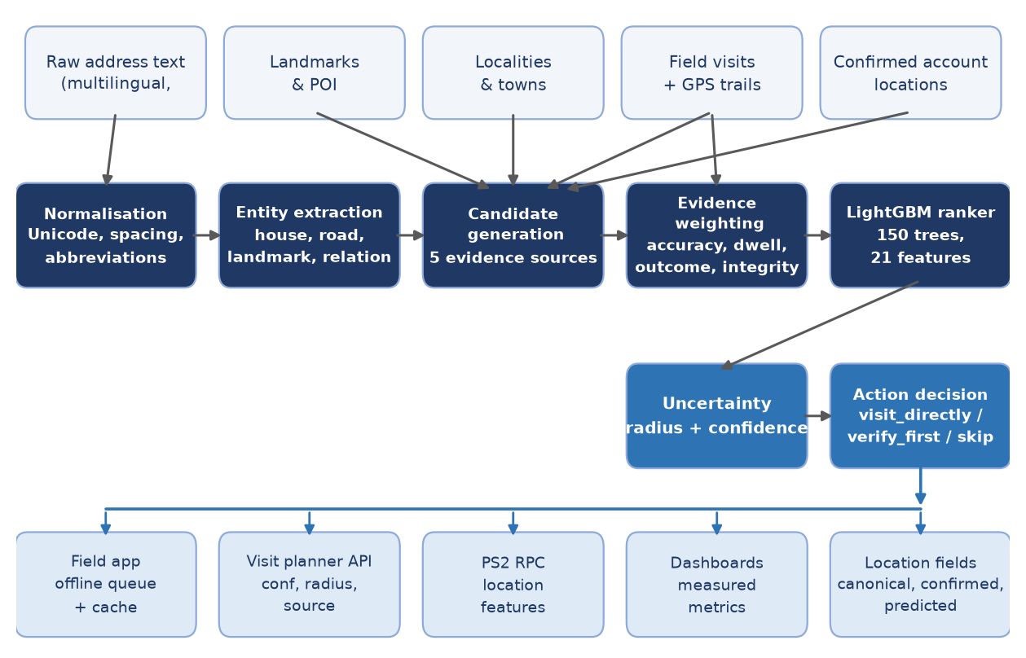
SECTION 6
Model Architecture: End-to-End View
Figure 4. Inputs → normalisation → entities → five-source candidate generation → evidence weighting → LightGBM ranker → uncertainty → action → consumers.
PS3 — AI-Native Field Address Geocoder
8
Notes:
The deterministic aggregator (stage 4) works even where the learned ranker has no support.

Slide 10
SECTION 6
Pipeline: Stage-by-Stage Contract
Stage | Input | Processing | Output
1. Ingestion & CRS validation | 10 CSV files | Existence checks, SHA-256, projected-CRS declaration | Clean tables + artifact metadata
2. Address normalisation | Raw multilingual text | Unicode, whitespace, abbreviations, transliteration-aware tokens | Normalised string (original kept for audit)
3. Entity & relation extraction | Normalised address | House/plot, roads, village/town, landmarks, relations, pincodes | Searchable entity set
4. Candidate generation | Entities + 5 sources | Resolve vs landmarks, localities, visits, confirmed accounts, remarks | Alternative coordinates
5. Evidence weighting | Check-ins + quality signals | w = (1/acc) × dwell/300; integrity, recency, agent controls | Weighted evidence
6. Candidate ranking | 21-feature vector | LightGBM, 150 trees | Accept probabilities
7. Uncertainty & action | Winner + spread | radius = max(50, wRMS); conf = 1 − r/1000; thresholds | Pin + radius + action
8. Persistence & serving | Prediction + confirmed | Confirmed/predicted separation; RBAC routes | App, planner, PS2 RPC, dashboards
PS3 — AI-Native Field Address Geocoder
9
Notes:
Table 15 of the report.

Slide 11
SECTION 6
Evidence Weighting and Candidate Sources
SUCCESSFUL = {met_borrower, met_family, cash_collected}
weight = (1 / gps_accuracy) * clip(dwell, 1, 600) / 300
predicted = weighted average of successful check-ins
radius = max(50 m, weighted RMS spread)
confidence = clip(1 - radius / 1000, 0, 1)
Five candidate sources
• Commercial / open geocoder — prior and fallback
• Historical successful visits — weighted centroid (strongest source)
• Nearby confirmed accounts / shared-place clusters — guarded corroboration
• Landmarks & locality centroids — anchor for “behind the temple”
• Agent-remarks corrections — conservative, high-precision only
No usable successful visit → fall back to the commercial geocode with a 500 m radius. Shared-place clusters propagate only under source and reliability thresholds — never unconditional copying.
PS3 — AI-Native Field Address Geocoder
10
Notes:
Table 16 + the Section 6.4 formulas of the report.

Slide 12
SECTION 6
Ranker: 21-Feature Contract and Training
Group | Feature | Training range
Text similarity | address_similarity | 0.10–0.60
Text similarity | landmark_similarity | 0.00–0.40
Text similarity | locality_similarity | 0.30–0.80
Visit evidence | distance_to_successful_visits | const 999999
Visit evidence | distance_to_failed_visits | const 999999
Visit evidence | number_of_supporting_visits | 0–7
Visit evidence | weighted_successful_visit_count | 0–7
Evidence quality | visit_integrity | 0.80–1.00
Evidence quality | gps_accuracy | 4.1–1000 m
Evidence quality | dwell_time | 0–1475 s
Evidence quality | trajectory_quality | 0.20–0.70
Corroboration | nearby_account_support | default
Corroboration | place_cluster_support | default
Commercial ref. | commercial_geocoder_distance | default
Adversarial | agent_independence | 0–1
Source one-hot (6) | source_historical / nearby / geocoder / landmark / locality / pincode | 0–1
Parameter | Value
Framework | LightGBM binary (sigmoid), text v4
Trees | 150 retained (cap 200)
Learning rate | 0.05
Leaves per tree | 31 (trees 452–885 nodes)
Bagging | 0.8, every 5 iters (seed 400)
Min data in leaf | 3
Split | Deterministic account-level 80/20, disjoint-ID assertion
Check | P(accept | zero vector) = 0.6927
Portability | Embedded base64 in notebook
PS3 — AI-Native Field Address Geocoder
11
Notes:
Tables 17–18 of the report; ranges from the model artifact feature_infos.

Slide 13
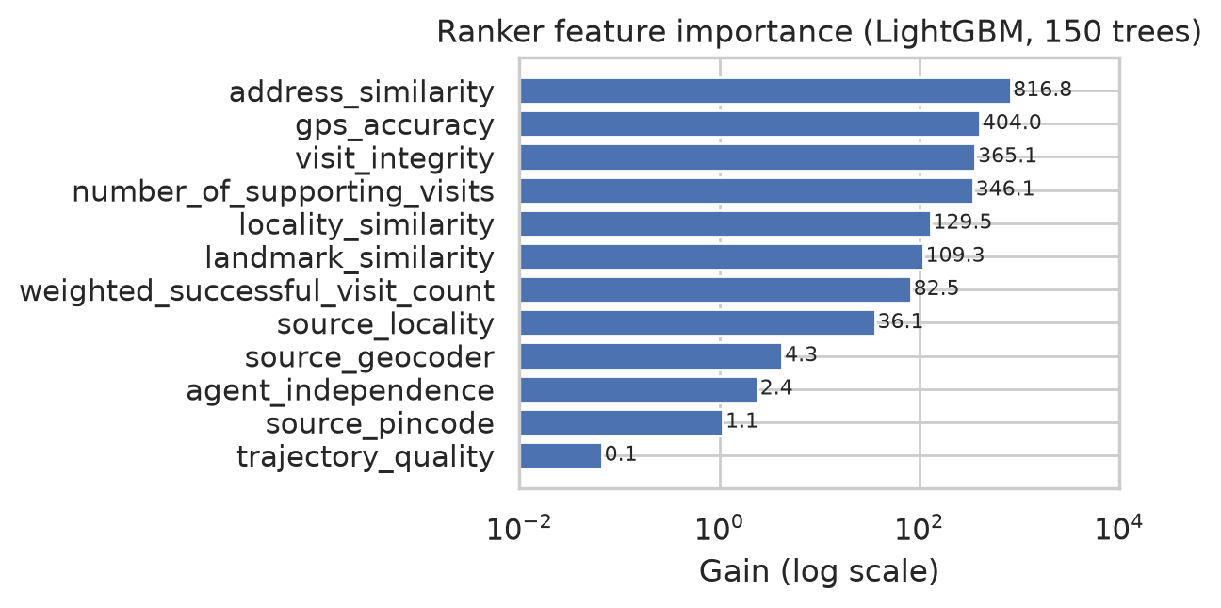
SECTION 6
What the Ranker Learned: Feature Importance
Feature | Gain | Splits
address_similarity | 816.8 | 181
gps_accuracy | 404.0 | 74
visit_integrity | 365.1 | 38
number_of_supporting_visits | 346.1 | 39
locality_similarity | 129.5 | 105
landmark_similarity | 109.3 | 26
weighted_successful_visit_count | 82.5 | 14
source_locality | 36.1 | 12
source_geocoder | 4.3 | 13
agent_independence | 2.4 | 4
source_pincode | 1.1 | 4
trajectory_quality | 0.067 | 2
Figure 5. Feature gain (log scale).
Text similarity and evidence quality dominate; the three raw distance features and five corroboration/source features contribute no gain (constant at training).
PS3 — AI-Native Field Address Geocoder
12
Notes:
Table 19 + Figure 5 of the report.

Slide 14
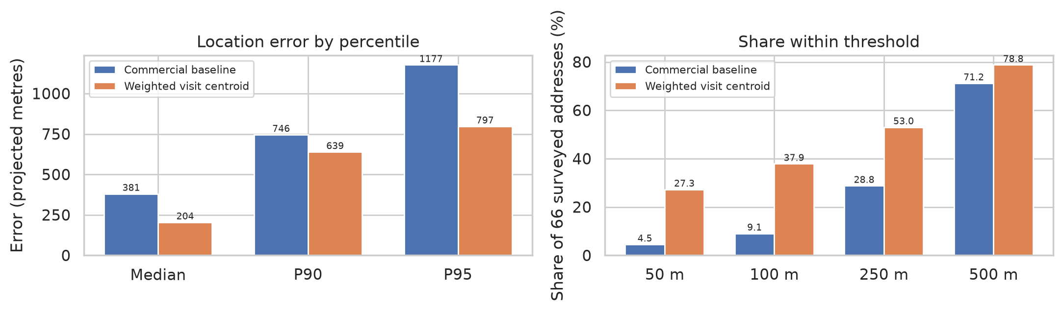
SECTION 7
Model Evaluation: Head-to-Head (n = 66)
Metric | Commercial baseline | Weighted visit centroid | Change
Median error (m) | 380.8 | 204.4 | −46.3%
P90 / P95 error (m) | 745.6 / 1,176.9 | 639.2 / 797.1 | −14.3% / −32.3%
Within 50 / 100 m | 4.5% / 9.1% | 27.3% / 37.9% | +22.7 / +28.8 pts
Within 250 m | 28.8% | 53.0% | +24.2 pts
Within 500 m | 71.2% | 78.8% | +7.6 pts
Radius coverage (error ≤ radius) | — | 72.7% | —
Latency (ms / prediction) | — | 3.31 | —
Figure 6. Error percentiles (left) and share within each threshold (right).
PS3 — AI-Native Field Address Geocoder
13
Notes:
Table 20 + Figure 6. 48/66 addresses use visit evidence; 18 fall back to the geocode.

Slide 15
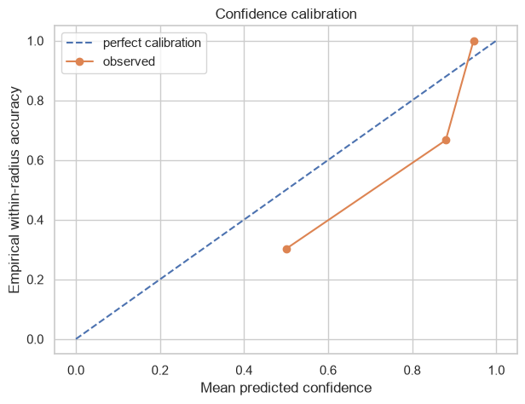
SECTION 7
Uncertainty Coverage and Calibration
Bin | Mean predicted | Empirical ≤ 250 m | n
0.5 – 0.6 | 0.500 | 0.302 | 43
0.8 – 0.9 | 0.880 | 0.667 | 3
0.9 – 1.0 | 0.946 | 1.000 | 20
• ECE = 0.155 on 66 predictions; radius coverage 72.7%
• High-confidence bin (radius ≤ 100 m): 20/20 correct within 250 m
• Middle bin over-confident (0.50 predicted vs 0.30 observed) → default verify_first; recalibrate on held-out data before pilot thresholds
• Coverage is reported with accuracy: the 27% without visit history get the geocode fallback, not silence
Figure 7. Predicted confidence vs empirical within-250 m accuracy.
PS3 — AI-Native Field Address Geocoder
14
Notes:
Table 21 + Figure 7 of the report.

Slide 16
SECTION 8
Key Insights (1–4)
1. The baseline fails for linguistic, not geographic, reasons.
Within-250 m share tracks address style: T1 karnataka 25.0% vs T2 hindi 33.3% — the pipeline invests in normalisation and entity resolution, not locale tuning.
2. Dwell is the evidence discriminator; GPS accuracy is the filter.
Median dwell 876 s (met_borrower) vs 78 s (not_traceable) — 11×; accuracy moves only 9.1–10.9 m. The weight (1/acc) × dwell/300 encodes exactly this.
3. Visit history already contains the location the geocoder is missing.
A single deterministic weighted centroid cuts median error 46.3% — the learned ranker refines the signal, it does not replace it.
4. The hard 27% define the fallback contract.
18/66 addresses have no usable successful visit → geocode + 500 m radius. Coverage and accuracy are reported together, always.
PS3 — AI-Native Field Address Geocoder
15
Notes:
Insights 1–4 of Section 8.

Slide 17
SECTION 8
Key Insights (5–8)
5. Confidence is bimodal: near-perfect at the top, over-confident in the middle.
20/20 correct in the 0.9–1.0 bin; 0.50 predicted vs 0.30 observed in the middle → govern thresholds: auto-route only above the calibrated bar.
6. The ranker is evidence-driven, not proximity-driven.
Top gains: address_similarity 816.8, gps_accuracy 404.0, visit_integrity 365.1, supporting visits 346.1; all raw distance features zero gain.
7. The data is structurally clean enough to evaluate losslessly.
0 orphans, 0 duplicate keys → every baseline is evaluated on the identical 66 addresses.
8. Causal claims are withheld by design, and that is measurable.
No treatment arm, no independent recovery outcome → the artifact returns not_estimable as a first-class, hash-pinned status.
PS3 — AI-Native Field Address Geocoder
16
Notes:
Insights 5–8 of Section 8.

Slide 18
SECTION 9
Evaluation Framework and Reproducibility
• Versioned JSON artifact per run: run ID, artifact version, split, SHA-256 input hashes, baselines, ablations, split metadata, radar, causal status
• Ablations: address-only / +visits / +integrity / +nearby (not_estimable without an independent nearby table — never silently substituted)
• Radar: 6 axes, explicitly labelled baseline_coverage until a frozen model scores held-out data
• Temporal split: pre-cutoff visits only; geography holdout: held-out town, train-town retrain before scoring; account-level split: disjoint-ID assertion
• Runner: python -m evaluation.ps3_experiments Dataset --split train
{
"status": "not_estimable",
"estimand": "policy value /
treatment effect",
"required_columns": [
"treatment/action/policy_arm",
"recovery outcome",
"pre-treatment covariates"
]
}
Counterfactual policy evaluation (IPW / doubly robust) is deliberately not computable from the supplied files. This is a feature — a pilot must record policy arm, covariates, recovery and cost before any causal claim.
PS3 — AI-Native Field Address Geocoder
17
Notes:
Section 9 of the report.

Slide 19
SECTION 10
Security, RBAC and Compliance
Role-based access control
• Borrower locations, visit trails, agent GPS, remarks and territory metrics are sensitive operational data
• Agents: own territory only · managers: broader views · auditors: evidence + audit · admins: configuration
• Retraining endpoint protected by backend RBAC — hiding the UI nav item is not the security boundary
• Production: tenant + territory scoping at the data-query boundary, not only the UI
RBI and DPDP boundaries
• Per-deployment configuration and audit: contact hours and frequency
• Consent and purpose limitation; retention and deletion windows
• Access logging and export controls; separation of collections data from unrelated uses
• Agent-monitoring governance; incident response and correction workflows
• The geocoder must not infer locations beyond what collections requires
PS3 — AI-Native Field Address Geocoder
18
Notes:
Section 10 of the report.

Slide 20
SECTION 11
Deployment Plan
Phase 1 — Shadow mode
Phase 2 — Controlled pilot
• ingest evidence without changing planner decisions
• measure error, coverage, calibration
• review integrity alerts with field managers
• comparable territories; frozen model version
• record action assignment + recovery outcomes
• productive visits/agent-day; cost per recovery
Phase 3 — Guarded rollout
Phase 4 — Continuous governance
• direct visits only above calibrated thresholds
• low confidence → verification route
• rollback path to incumbent planner
• version data / model / config / artifacts
• rerun temporal + geography holdouts
• recalibrate; retention-driven deletion; audits
PS3 — AI-Native Field Address Geocoder
19
Notes:
Four-phase rollout from shadow mode to continuous governance.

Slide 21
SECTION 12
Known Limitations and Next Engineering Work
1. Planner: distance-aware prioritiser, not yet a travel-time/cost route optimiser
2. PS3 dataset cannot support a causal policy-value estimate
3. Nearby-account ablation needs an independent evidence table
4. Geography holdout requires train-town-only retraining before scoring
5. Held-out account partition should be scored separately by the full harness
6. Remark-to-offset extraction stays conservative by design
7. Cluster propagation needs lender-specific scale thresholds
8. Offline: dead-letter exists; conflict resolution + idempotency need hardening
9. Tenant/territory filtering must be enforced in repository queries
10. Full notebook execution needs backend notebook dependencies
PS3 — AI-Native Field Address Geocoder
20
Notes:
Ten limitations, verbatim in substance from Section 12 of the report.

Slide 22
SECTION 13
PS3 Deliverables and Evidence
# | Deliverable | Location | Evidence
1 | EDA + evaluation notebook | PS3_Geocoder_EDA.ipynb | 22 cells; syntax-validated; embedded ranker; artifact writer
2 | Trained ranker model | Embedded base64 in notebook | 150 trees, 21 features, account-level 80/20 split (Sec. 6)
3 | Versioned evaluation artifact | ps3_notebook_train.json / ps3_eval_<run_id>.json | SHA-256 hashes, run ID, ablations, splits, causal status (Sec. 9)
4 | Backend geocoder service | Project backend | Planner, PS2 RPC, account search, admin retraining, RBAC (Sec. 6.8)
5 | Frontend field app + dashboards | Project frontend | Pin + radius + evidence, offline queue, WGS84-only maps rule (Sec. 6.8)
6 | Solution documentation | PS3_PROBLEM_SOLUTION_REPORT.md | Problem–solution mapping, deployment plan, checklist
7 | This report + deck | PS3_Report.pdf / PS3_Report.pptx | Findings, architecture, evidence, delivery status
PS3 — AI-Native Field Address Geocoder
21
Notes:
Table 22 of the report. Acceptance checklist (Table 23): 1 of 16 items satisfied pre-pilot — ranker disjoint-ID assertion.

Slide 23
SECTION 14
Conclusion
• An evidence-learning geocoder, not a generic lookup: normalisation → entities → five-source candidates → reliability weighting → 150-tree LightGBM ranker → uncertainty-driven action
• Measured: median error 204.4 m vs 380.8 m (−46.3%), within-250 m 53.0% vs 28.8%, 72.7% radius coverage, ECE 0.155, 3.3 ms per prediction — all reproducible from the SHA-256-pinned artifact
• Where it is strong: high-confidence predictions (20/20) and evidence-rich accounts. Where it stays honest: the uncertain middle band, the 27% without visit history, and causal claims the data cannot support
• Ready for Phase 1 shadow mode behind a real collections operation — that discipline, not a single number, is the delivery claim
Thank you — questions on the model, the evaluation boundary, or the rollout plan are welcome.
PS3 — AI-Native Field Address Geocoder
22
Notes:
Closing slide.

