Slide 1

SMART INDIA HACKATHON 2026
JOCKY — a forensic scripting language for computer & network analysis
Problem Statement ID: ⟨ fill from portal ⟩
Problem Statement Title: Creation of scripts/functions with a new programming language to commence computer & network forensic analysis without triggering security solutions
Theme: Blockchain & Cybersecurity
PS Category: Software
Team ID: 148458 ⟨ verify ⟩
Team Name (Registered on portal): Data_Drishti

Slide 2
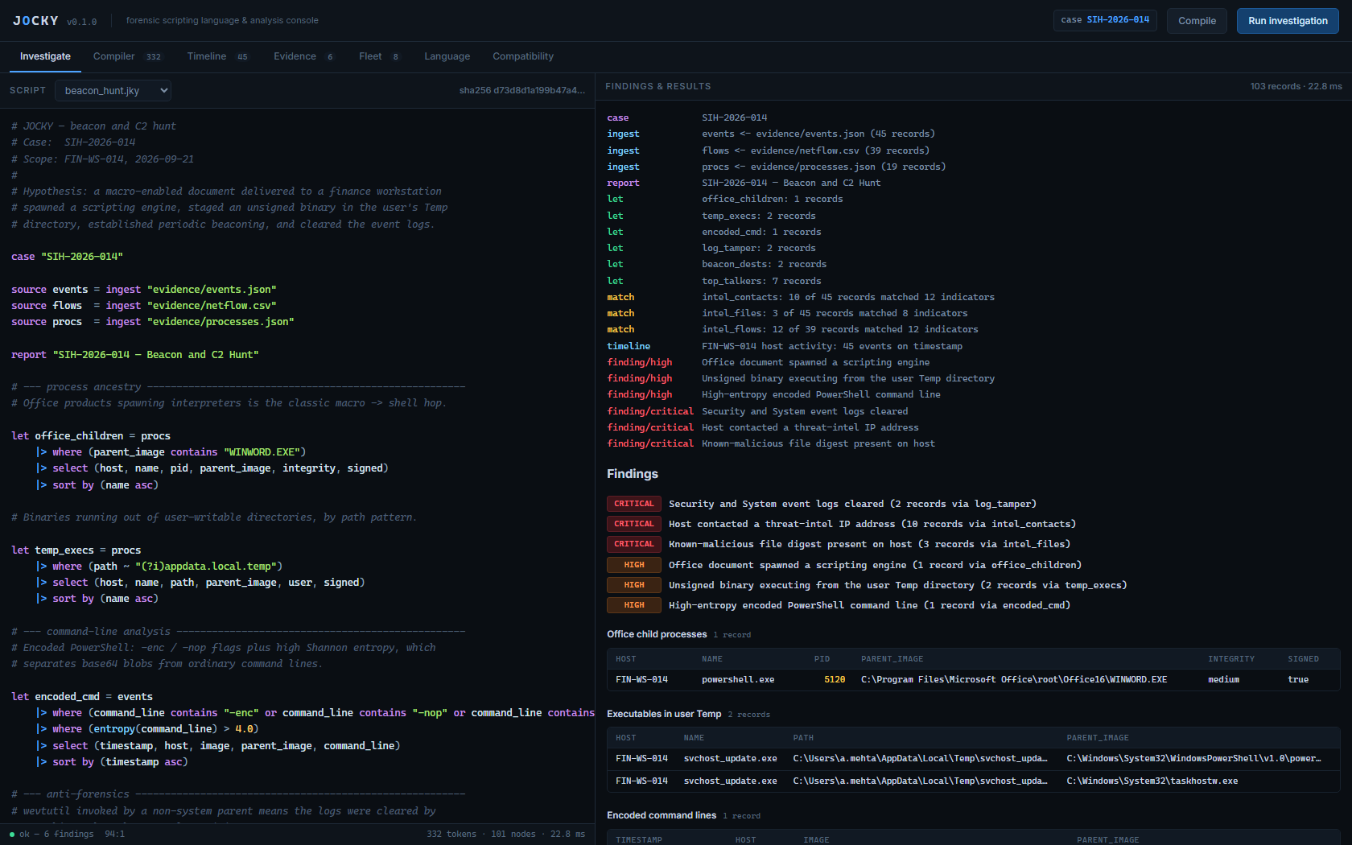
JOCKY
one language for host and network forensics — analyse in place, cite every finding, prove the chain of custody
Data_Drishti
Detailed explanation of the proposed solution · How it addresses the problem · Innovation and uniqueness of the solution
THE PROBLEM IT TACKLES
GRAPHICAL ABSTRACT
▪ Examiners stitch tools together. Volatility, plaso, KAPE, Chainsaw and throwaway scripts — every hop loses provenance.
▪ Findings arrive without a citable query. Ad-hoc pipelines produce results no one can reproduce or defend on the stand.
▪ Security tooling fights the endpoint. Collection and analysis trigger AV/EDR, and the industry habit is to weaken the defence instead of documenting the telemetry.
▪ The tooling becomes the risk. Anything that hides from endpoint security is indistinguishable from the intrusion it is meant to investigate — examiners are asked to trade visibility for capability.
EVIDENCE
EVTX · JSON · CSV · netflow · CTI feeds — opened read-only, SHA-256 digest taken
LEXER
332 tokens · 11 ms — Windows paths, regex and base64 survive verbatim
PARSER → AST
101 nodes · plain nested dicts — inspectable and JSON-safe
INTERPRETER
pipeline stages · 14 builtins · entropy, hashing, IP classification
Operator console — findings cite the query that produced them
INNOVATION & UNIQUENESS (UVP)
CORRELATION
threat-intel match · timeline reconstruction · severity assignment
▪ Findings cannot be uncited. A finding must name the result set that raised it — provenance is enforced by the grammar, not by examiner discipline.
▪ Offline and dependency-free. Pure Python standard library. Runs on an air-gapped examiner workstation with nothing installed.
▪ Compatible by design, not by stealth. Signed reproducible builds with published hashes for vendor allowlisting — no kernel drivers, no injection, no log tampering.
▪ Judge-independent. Deterministic execution: the same script over the same digests yields the same findings, byte for byte.
PROPOSED SOLUTION
REPORT
findings, each citing the result set that raised it
▪ One language, one evidence model. A pipeline DSL — source → |> where |> group by |> sort by — over host events, processes, netflow and CTI feeds alike.
▪ Every finding is a citation. A finding names the result set and record count behind it; the run logs source and script digests, so the report is reproducible.
▪ Runs with the endpoint, not against it. Read-only evidence access, loopback-only console, documented telemetry sources, signed builds — no evasion of any kind.
▪ Small enough to audit. Roughly 2,000 lines of Python across six modules with a 50-test suite — an examiner can read the whole interpreter before deciding to trust it.
no kernel drivers · no injection · no obfuscation · no log tampering
11 ms
first finding
on 45 records
0
third-party
dependencies
6 / 6
findings cite
their query
127.0.0.1
console binds
loopback only
WHY IT IS DIFFERENT
▪ Sigma detects, VQL queries — neither makes a finding citable. JOCKY's grammar refuses a finding that does not name its source.
▪ A DSL is a contract. Scripts become reviewable, versionable artefacts that transfer between examiners and agencies.

Slide 3
TECHNICAL APPROACH
Data_Drishti
Technologies to be used (languages, frameworks, hardware) · Methodology and process for implementation
LAYERED ARCHITECTURE
METHODOLOGY — DATA FLOW
Presentation
Operator console — one HTML file, 7 tabs, deep-linkable, Ctrl+Enter to run
STEP 1
STEP 2
STEP 3
STEP 4
Open & digest
SHA-256 per file, read-only
Tokenise
strings survive verbatim
Parse
recursive descent → AST
Bind
sources resolved, lint-checked
Service
serve.py — loopback API (/api/state, /run, /compile), client-address check, path-traversal guard
Language core
lexer → parser → interpreter · AST as plain nested dicts · 11 ms for a 332-token script
STEP 8
STEP 7
STEP 6
STEP 5
Primitives
14 builtins — entropy, sha256, md5, is_public_ip, age_minutes, regex
Report
findings cite result sets
Narrate
timeline on timestamp
Correlate
CTI match, group, sort
Execute
pipeline stages, lazy rows
Evidence adapters
JSON · CSV · line-based CTI — read-only, digested at open
Evidence is never written to; every artefact is digested before it is parsed. A script that cites an undeclared binding fails `lint` before it ever touches evidence.
STATE MACHINE — ONE SCRIPT RUN
TECHNOLOGY STACK & LANGUAGE
SOURCE
evidence declared
LEXED
tokens
PARSED
AST built
Python 3.11+
standard library only
0 dependencies
ThreadingHTTPServer
SHA-256 / MD5
unittest — 50 tests
single-file console
loopback binding
REPORTED
findings emitted
EXECUTING
stages run
BOUND
bindings resolved
case "SIH-2026-014"
source flows = ingest "evidence/netflow.csv"
let beacon = flows
|> where (direction == "outbound")
|> where (is_public_ip(dst_ip))
|> where (bytes < 2000)
|> group by (dst_ip, dst_port)
|> sort by (count desc)
finding "Beaconing to an external endpoint"
severity critical from beacon
REJECTED STATES — a run fails loudly, never silently
SYNTAX ERROR
line:col with a caret under the offending token
UNKNOWN BINDING
caught by `lint` before evidence is read
RUNTIME ERROR
missing evidence names the path it looked for
Real script from scripts/beacon_hunt.jky — 332 tokens, 101 AST nodes, 6 findings, 11 ms.

Slide 4
FEASIBILITY AND VIABILITY
Data_Drishti
Analysis of the feasibility of the idea · Potential challenges and risks · Strategies for overcoming these challenges
EXECUTION TIME SCALES LINEARLY WITH EVIDENCE VOLUME
MEASURED RESULTS
Measured result | Value
Lex + parse | 2.2 – 3.1 ms — independent of evidence size
Interpreter throughput | 5,079 – 7,363 records / second
Peak interpreter memory | 1.9 MB @1k → 188 MB @100k, linear
Overhead vs hand-written Python | 20 – 26 ×
Result stability across scales | identical findings at every size
Third-party dependencies | 0 — standard library only
Automated test suite | 50 tests, all passing
One representative investigation — filter, entropy, CTI join, group-by, sort, timeline, 3 findings. Lex + parse stayed at 2.2–3.1 ms at every size, so script cost is independent of data volume.
THROUGHPUT IS FLAT — THE OVERHEAD IS MEASURED, NOT HIDDEN
RISKS AND MITIGATION STRATEGY
Risk | Mitigation strategy
Interpreter too slow for full-disk images | Measured and stated, not hidden. Scope scripts to triage sets (10⁴–10⁵ records) where first-response calls are made; bytecode VM is the next milestone.
Examiner over-trusts an automated finding | Severity is authored by the examiner, never inferred. Every finding cites its result set and record count; the report is reproducible.
AV/EDR blocks the collector | Not answered with obfuscation: signed reproducible builds with published hashes for vendor allowlisting, documented telemetry sources only, read-only access.
Evidence altered during analysis | Sources opened read-only and SHA-256 digested at open; nothing is ever written back to a source system.
Console reachable from the network | Loopback binding plus per-request client-address validation; fleet mode is opt-in, over TLS with pinned certificates.
Script path traversal | Resolved path must remain inside scripts/; rejected, and covered by the test suite.
Throughput holds at 5.1k–7.4k records/sec, so cost is linear and predictable. The tree-walking interpreter costs 20–26× the equivalent hand-written Python — accepted for an auditable reference implementation, and the reason a bytecode VM is the first roadmap item.
All figures measured on the target machine by deck/bench.py and deck/bench_baseline.py — see deck/bench_results.json. Ratios and throughputs, not absolute speeds, are the portable result.

Slide 5
IMPACT AND BENEFITS
Data_Drishti
Potential impact on the target audience · Benefits of the solution (social, economic, industry)
ADDRESSABLE IMPACT
SWOT ANALYSIS
IMPACT
TAM
S · STRENGTHS
W · WEAKNESSES
SOCIAL
A small cyber cell can defend its conclusion in court, and a citizen whose device was seized can see the reasoning behind the finding. Forensic conclusions stop being an expert's private judgement.
▪ Zero dependencies — runs offline, air-gapped
▪ Findings are citable by grammar, not by habit
▪ 50 unit tests; deterministic, reproducible runs
▪ Loopback-only console, read-only evidence access
▪ Tree-walking interpreter: ~6k records/sec (measured)
▪ 14 builtins — no EVTX / USN / MFT adapter yet
▪ Single-host console; no central case management
▪ Correlation is signature-based, not behavioural
SAM
SOM
ECONOMIC
Removes a paid-tool dependency for labs that cannot license commercial DFIR suites, and removes re-work: one reviewable, cited script replaces a chain of throwaway scripts re-validated per case.
O · OPPORTUNITIES
T · THREATS
TAM
~US$10–16 B by 2030
Global DFIR — Every organisation that must investigate a breach or hold evidence. Software + services.
▪ DPDP Act 2023 and CERT-In norms create evidence-handling duties
▪ Sigma / ATT&CK mapping is a natural next layer
▪ University curricula need a teachable forensic language
▪ Edge and IoT forensics need small, offline tooling
▪ Commercial suites bundled into lab contracts
▪ Free incumbents (plaso, Hayabusa, Velociraptor) already trusted
▪ Language adoption is slow without a script-sharing community
▪ Evidence formats change with every OS release
SAM
~US$0.3–0.5 B
Indian obligation-holders — Cyber cells, CERT-In empanelled auditors, MSSPs and university labs with a legal duty to handle evidence.
INDUSTRY
Gives DFIR a shared, versionable language. Investigation scripts become portable artefacts that can be peer-reviewed and exchanged between agencies — what Sigma did for detection rules.
SOM
~US$20–40 M
Budget-constrained labs — District cyber cells and university forensic labs on air-gapped workstations, where a free offline tool wins on day one.
WHO THIS REACHES FIRST
AT A GLANCE
▪ District cyber cells and state CID units. Small teams, mixed caseloads, no budget for per-seat commercial licences — and a legal duty to document what they did.
▪ CERT-In empanelled auditors and MSSPs. Repeatable scripts turn a per-engagement method into a reviewable, transferable asset.
▪ University and police forensic labs. An air-gapped workstation is the normal environment, not the exception — and a readable language is teachable.
▪ The examiner herself. The console shows the query behind every finding, so a conclusion can be checked rather than taken on trust.
▪ 0 — licence cost per seat; nothing to renew.
▪ Air-gapped — no network calls; the console binds loopback.
▪ Cited — every finding names the query that raised it.
▪ Read-only — evidence is digested at open, never modified.
Sizing is a top-down estimate from published DFIR market analyses, not a vendor forecast; the method and assumptions are recorded in the repository README.

Slide 6
RESEARCH AND REFERENCES
Data_Drishti
Details / links of the reference and research work
STANDARDS AND WORKS IMPLEMENTED OR CITED
ARTEFACTS
1.
NIST SP 800-86
Guide to Integrating Forensic Techniques into Incident Response — the collection / analysis / reporting workflow the case model follows.
jocky/
lexer.py · parser.py · runtime.py · builtins.py · cli.py · serve.py
2.
RFC 3227
Guidelines for Evidence Collection and Archiving — order of volatility governs what JOCKY ingests first.
console/index.html
operator console — seven tabs, no external assets, no build step
scripts/*.jky
beacon_hunt · triage · insider_usb · telemetry_audit
3.
ISO/IEC 27037:2012
Identification, collection, acquisition and preservation of digital evidence.
evidence/
one coherent synthetic incident on FIN-WS-014, 2026-09-21
Repository and demo links: ⟨ paste before upload ⟩ — the whole prototype runs from one checkout with no install step.
4.
NIST SP 800-61r2
Computer Security Incident Handling Guide — the triage-first workflow triage.jky implements.
RESEARCH CONTRIBUTION & CORE FINDINGS
5.
MITRE ATT&CK
Technique vocabulary the findings map to (T1059, T1071, T1070.001).
▪ Provenance can be a grammar rule, not a discipline. Requiring a finding to name the result set that raised it makes an uncited conclusion a parse error rather than a bad habit — the contribution this work claims is that formulation.
▪ The interpreter envelope is measured. 5.1k–7.4k records/sec, linear memory, 20–26× over hand-written Python — which bounds the right workload to triage sets and names the next milestone.
▪ Compilation cost is volume-independent. Lex + parse held at 2.2–3.1 ms from 10³ to 10⁵ records, separating script complexity from data volume as cost centres.
▪ “Without triggering security solutions”, read defensibly. A tool that hides from EDR is indistinguishable from malware to the endpoint's own evidence. Compatibility engineering — signed builds, published hashes, vendor allowlisting, documented telemetry — is the reading that survives an audit.
▪ Forensic text breaks conventional lexing. Windows paths, regex and base64 force a minimal escape set; the textbook escape table silently turned \Temp into a tab. Found by test, fixed by design.
6.
Sigma
Prior art for a portable, shareable detection language; JOCKY is the forensic analogue.
7.
Velociraptor VQL
Closest existing art — a query language for endpoint DFIR; JOCKY adds cited findings and reproducible reports.
8.
plaso · Chainsaw · Hayabusa
Timeline and EVTX tooling the timeline stage is measured against.
9.
E. Zimmerman's tools
De-facto reference implementations for EVTX, USN journal and MFT parsing — the adapter roadmap.
10.
Shannon (1948)
A Mathematical Theory of Communication — basis of the entropy() builtin that separates base64 from prose.
11.
FIPS 180-4
Secure Hash Standard — SHA-256 for every evidence digest and script hash.
RESEARCH METHODOLOGY & EVOLUTION PIPELINE
12.
Python Software Foundation
Standard library only; deliberately no third-party runtime dependency.
Problem Identification
Standards Review
Prior-Art Gap Analysis
Language Design
tool sprawl, no provenance, AV friction
NIST 800-86 · RFC 3227 · ISO 27037
Sigma detects, VQL queries — neither cites
pipeline stages, minimal escapes, plain-dict AST
Evolution Pipeline
Adversarial Review
Empirical Validation
Reference Implementation
bytecode VM · EVTX/USN/MFT · ATT&CK · fleet
lexer escape bug, case-override semantics fixed
50 tests · benchmarked 10³–10⁵ records
lexer → parser → interpreter, 0 deps
Works JOCKY implements against, or deliberately departs from — no result in this deck depends on an uncited external claim.
Prototype, benchmark harness, evidence set and test suite are all in the submitted repository.

