Slide 1
ABSENTEEISM PREDICTION
Name: Kartik Kumar
Roll No : 181210026
Data Mining Presentation

Slide 2
Problem Statement
For a company to reach new heights in its field , it is very essential for the company to concentrate in the employee’s commitment towards the work assessed for him/her .
This study will help the company to adopt measures to reduce absenteeism and to increase the employee’s commitment towards his/her job by knowing the factors which remains as a hindrance for the employee to be punctual towards his/her job

Slide 3
What really Absenteeism is ?
. The dictionary definition of absenteeism is ‘the practice of regularly staying away from work or school without good reason’

Slide 4
Types of Absenteeism 1. Innocent Absenteeism 2. Culpable Absenteeism

Slide 5
Objectives of the study
* To study the general causes for employee absenteeism
* To analyze the workplace factors which leads to employee absenteeism in the organization
* To come out the most prominent general and work life factors that avoids to absenteeism in the organization

Slide 6
Parts of the Project
Data Preprocessing
Model Building and Prediction
Drawing insights from the result

Slide 7
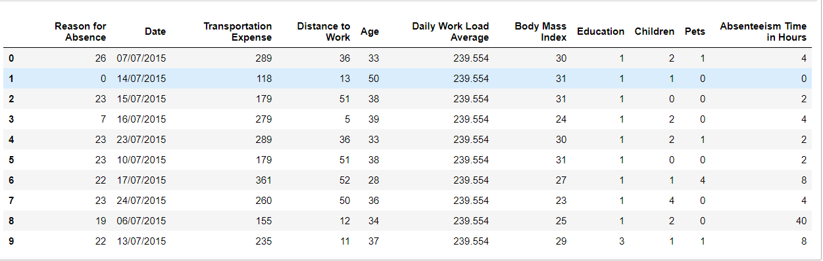
Dataset Sample

Slide 8
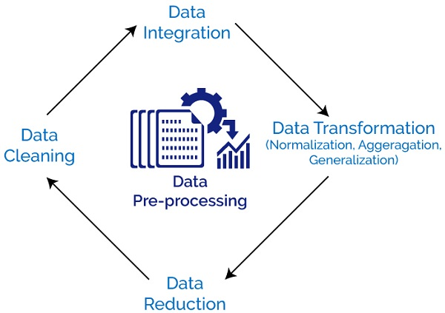
Data Pre-processing
Dealing with categorical data
Dealing with data types
Converting numerical data to categorical for classification
Normalization and etc

Slide 9
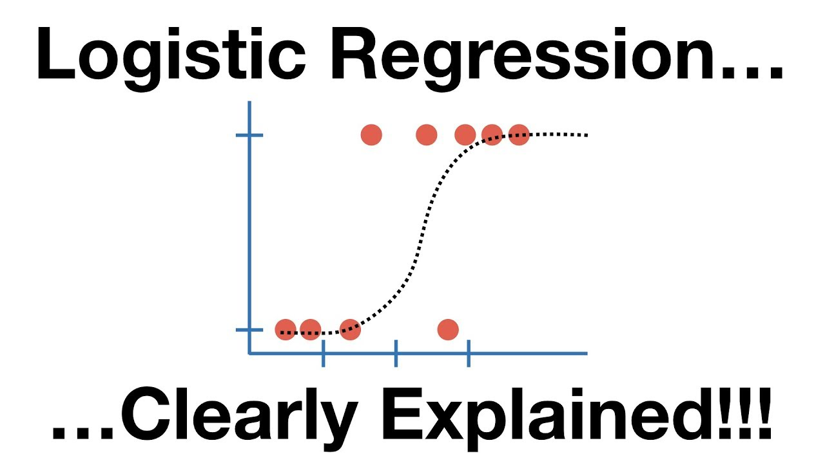
Model Building
Logistic Regression
Logistic regression is a statistical model that in its basic form uses a logistic function to model a binary dependent variable, although many more complex extensions exist. In regression analysis, logistic regression (or logit regression) is estimating the parameters of a logistic model (a form of binary regression).

Slide 10
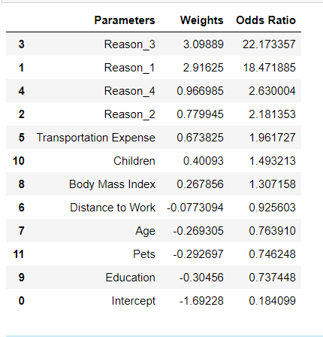
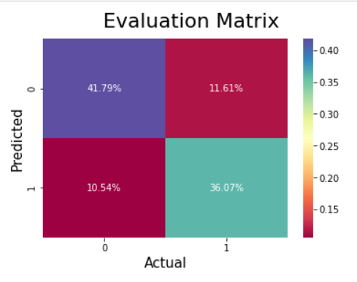
Observations
Confusion Matrix
Summary table

Slide 11
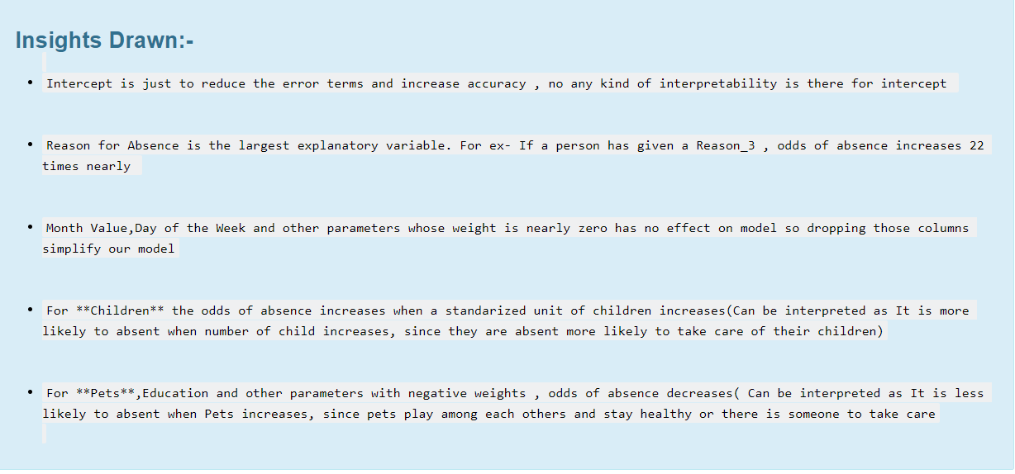

Slide 12
Conclusions and solutions
>> Since every company is different, it will require various levels of analyses to identify the factors that impact absenteeism for a specific employer. If absenteeism is identified as a significant problem, the company will need to take a hard look at the cause of the problem and begin to consider strategies to recapture lost revenues
DISCIPLINARY PROCEEDINGS/ABSENCE MANAGEMENT PROGRAM
CREATION OF POSITIVE COMPANY CULTURE
CHILDCARE AND FLEXIBLE SCHEDULING
INCENTIVES
HIRING EMPLOYEES FOR FUTURE SCOPE, WHO ARE INTERESTED AND SATISFIED WITH THE JOB

Slide 13
References
https://www.researchgate.net/publication/301796227_Absenteeism_Problems_And_Costs_Causes_Effects_And_Cures
https://www.Kaggle.com
https://www.isbr.in/journals/33-41-f-1.pdf

Slide 14
Thank you

