Slide 1
Default Rate prediction Case Study
Done by: Kartik Mathpal Submitted to: UpGrad Campus

Slide 2
Background This company is the largest online loan marketplace facilitating personal loans, business loans, and the financing of medical procedures. Borrowers can easily access lower interest rate loans through a fast online interface. Business Objective To identify variables which are strong indicators of default and potentially use the insights in approval / rejection decision making.

Slide 3
Data Understanding Types of variables 1. Customer (applicant) demographic - Employment length - Employment Title - Annual income - Zip code - Description 2. Loan related information & characteristics - Loan amount - Funded amount - Interest rate - loan status - loan grade

Slide 4
3. Customer behaviour (if the loan is granted) - Delinquency Year – 2 - Earliest credit line - Revolving balance - Recoveries - Application Type - Loan Purpose

Slide 5
Data Understanding - Overall Default Rate is 14%

Slide 6
Time Frame of the Data –2007-2011
•78% increment in applicants in 2011 compared to 2010
•145% increment in applicants in 2010 compared to 2009

Slide 7
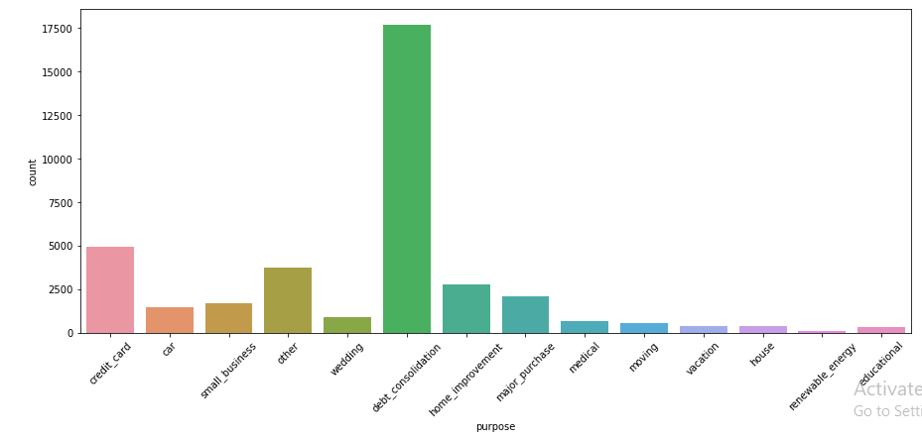
Loan Purpose Distribution : Debt Consolidation Loan is the most popular type of loan.
• 46.8% debt consolidation
loans.
• 13% credit card loans.
• 7.5% home improvement
loans.
• 5.6% major purchase loans

Slide 8
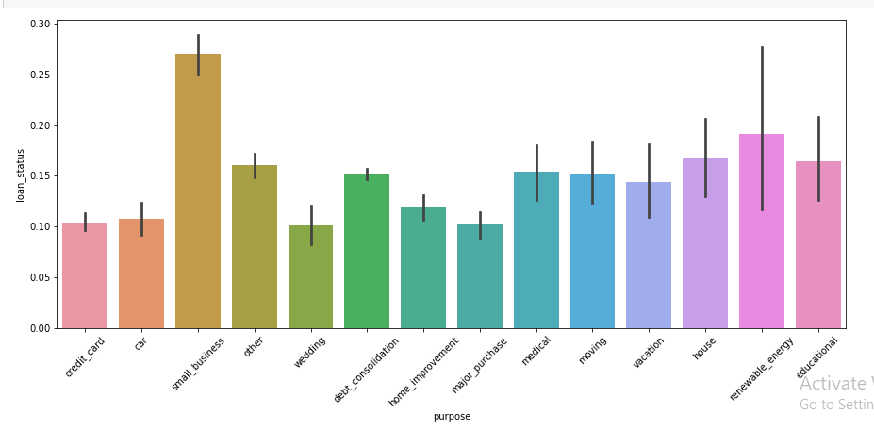
Default Rates By Loan Purpose
•Small business: 27% • Educational: 16% •Credit card: 10%
•Debt consolidation: 15% • House:17% •Major purchase: 10%

Slide 9
Top-4 Products over time: Credit Card, Debt Consolidation, Home Improvement & Major purchase
•In 2007 & 2008, Lending Club focused
on major purchase loans
•In 2009, they started lending money for
home improvement purpose also
•In 2010, they started lending loan for
debt consolidation
•In 2011, credit card loans were
introduced

Slide 10
Term Distribution in Top-4 products
•Lending club has given out 36
month term period loan for
major purpose and home
improvement.

Slide 11
Grade Distribution in top-4 products

Slide 12
Average Interest Rate in top-4 products

Slide 13
Important Variables: Credit Card
•Grade
•Term
•Bin interest rate
•Year
•Home Ownership

Slide 14
Important Variables–Debt Consolidation
•Grade
•Bin interest rate
•Home Ownership
•Term
•Bin loan amount

Slide 15
Important Variables -Home Improvement
•Grade
•Bin interest rate
•Home Ownership
•Term
•Bin Annual Income

Slide 16
Important Variables–Major Purchase
•Grade
•Bin interest rate
•Term
•Home Ownership
•Year

