Slide 1
X Education - Lead Scoring Case Study
Identifying Hot leads to increase conversion ratio for X
Education by focusing more on them.
Prepared by: Kartik Mathpal
Course : DS&A (5022)
Upgrad campus

Slide 2
Background - X Education Company
X Education is an education company that sells online courses to people looking to advance in there career.
The company markets there products on platforms like google, facebook, etc. People interested in these courses land on there website and browse through the courses, they might fill up some form or signup on their website.
Once these people fill up the form and enter their emails and mobile numbers they are classified as leads.
After the leads are acquired, members from the sales team start making calls and writing emails, etc. To persuade leads into purchasing the course.
The leads that buys the course is said to be converted. The average lead conversion rate is 30%.

Slide 3
Problem Statement
Although the company is getting a lot of leads, their lead conversion rate is very poor.
The company wants to improve its lead conversion rate.
For this they want to identify Hot leads ( Potential leads with high chance of being converted), if they are able to correctly identify them then the sales team will focus more on the hot leads and conversion rate will go up.
We have to help the company to correctly identify these leads.
For this we have to build a model to accurately identify hot leads.
The CEO has given us target lead conversion rate of 30%.

Slide 4
Lead conversion process
Lead Generation:
1. Ads on websites like Google
2. Referrals
Visit to X Education website by these potential customers (professionals)
Visitors either provide Email id & Contact Details
Or
View videos etc
Tele calling and Emailing activity to all the leads
~30% leads get converted
Lead to Conversion process
Proposed Solution:
A model to filter leads so that leads to conversion ratio is 80%+

Slide 5
Proposed Solution
Selection of Hot Leads
Communicating with Hot Leads
Conversion of Hot Leads
Leads Clustering
We cluster the leads into certain categories based on their tendency or probability to convert, thus, getting a smaller section of hot leads to focus more on.
Focus Communication
Since we would have a smaller set of leads to have communication with, we might make more impact with effective communication.
Increase conversion
Since we focused on hot leads, which were more probable to convert, we would have a better conversion rate, and hence we can achieve the 80% target.

Slide 6
Solution
For our problem statement we need to accurately identify hot leads.
For this we need to build a model with high accuracy in predicting hot leads.

Slide 7
Implementation
Loading & Observing the past data provided by the Company
Univariate, Bivariate, and Heatmap for numerical and categorical columns
Performing pre-requisites for RFE and Logistic Regression
Data Gathering
Data Cleaning
Performing EDA
Data Preparation
Model Building
Duplicate removal, null value treatment, unnecessary column elimination, etc.
Outlier Treatment, Feature-Standardization

Slide 8
Selection of top 15 features using RFE
Reduction of columns and Model re-building
Evaluating model with ROC curve and other metrices.
Model Evaluation
Feature Selection
Model Building
Model Improvement
Final Model
Model building using RFE for selected columns
Final Model Analysis and performance on Test Data

Slide 9
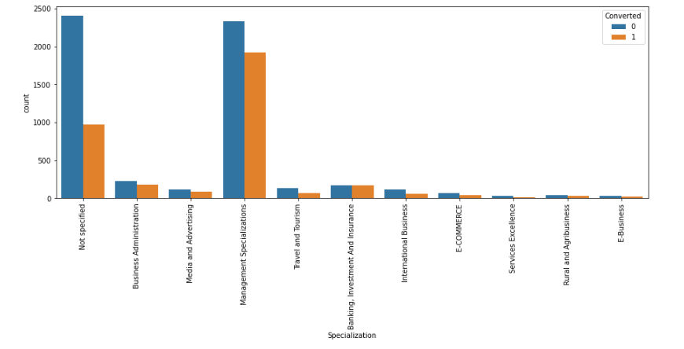
Visualization
This plot shows the distribution of converted and non-converted leads across
different specializations.

Slide 10
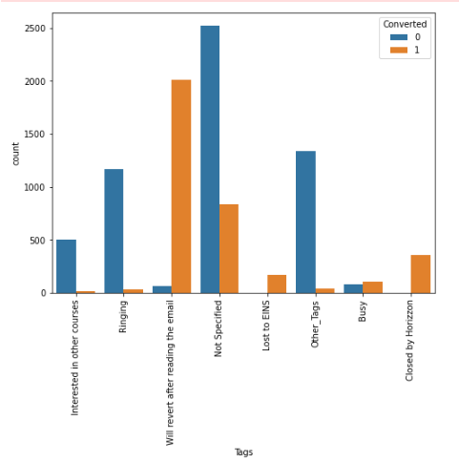
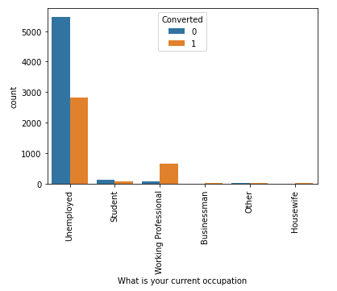
These plots shows variations in conversions and non conversions across different
categorical variables (‘What is your current occupation’ , ’Tags’)

Slide 11
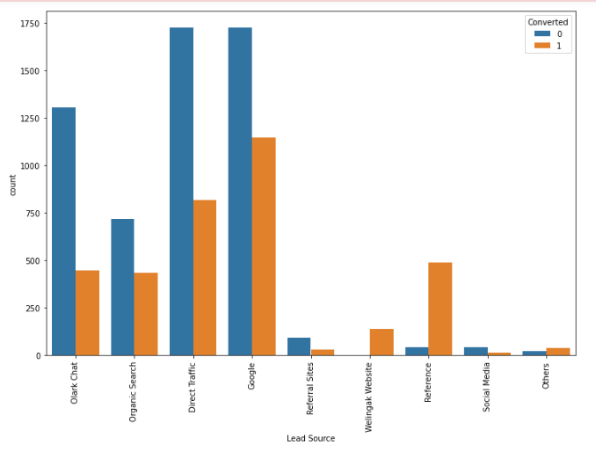
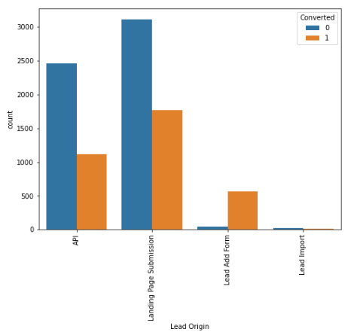
These plots shows variations in conversions and non conversions across different categorical variables (‘Lead Source’ , Lead Origin’)

Slide 12
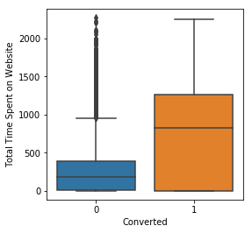
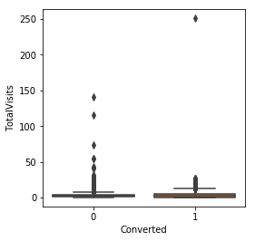
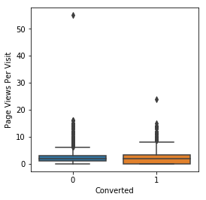
These plots shows variation in numerical columns for those who Converted and those who didn't.

Slide 13
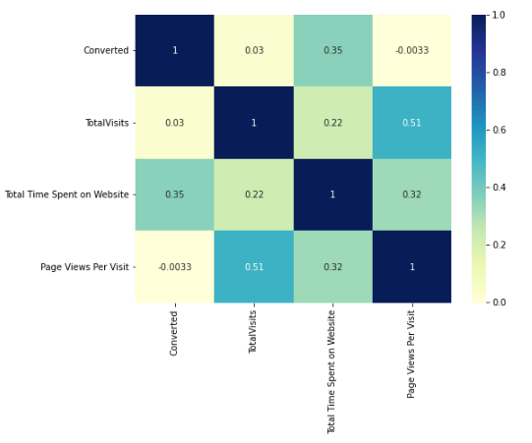
Checking correlation between various numerical variables.

Slide 14
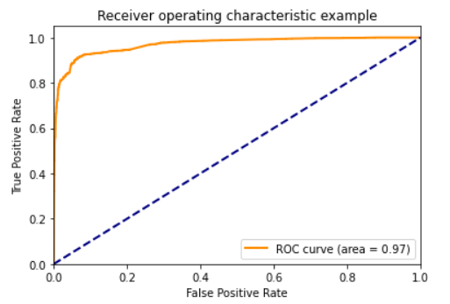
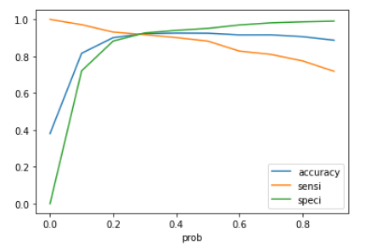
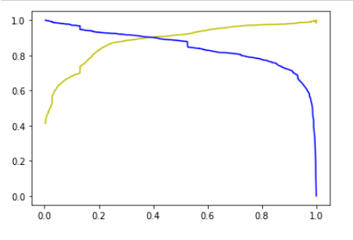
Evaluating our Final model with ROC Curve (Area under ROC = 0.97)
0.3 is the optimum cut-off point
Precision-Recall curve for Evaluation

Slide 15
Model Evaluation
Evaluation:
Overall accuracy on Test set = 92.5 %
Sensitivity = 88%
Specificity = 95%

Slide 16
Inferences
Top 3 variables that contribute towards lead conversion are:
Total Time Spent on Website
Last Activity_SMS Sent
Lead Origin_Lead Add Form
Top 3 variables on which the company should focus:
Last Activity_SMS Sent (positively impacting)
Tags_Will revert after reading the email (Positively impacting)
Last Activity_Olark Chat Conversation (negatively impacting)

Slide 17
Conclusion
Our Logistic Regression Model is decent and accurate enough, with 92.78 % Accuracy, 92 % Sensitivity and 93.26 % Specificity on the test set.
We can vary these parameters by varying the cut-off value and thus predict Hot leads based on scenarios like availability of extra resources and vice-versa.

Slide 18
Recommendations
X Education Company needs to focus on following key aspects to improve the overall conversion rate:
Increase user engagement on their website since this helps in higher conversion
Lead add form has high conversion to non conversion ratio,
The company can focus on this variable.
Increase on sending SMS notifications since this helps in higher conversion
Improve the Olark Chat service since this is affecting the conversion negatively

