Slide 1
Analysis of Airbnb Listing

Slide 2

AGENDA
INTRODUCTION
PROBLEM STATEMENT
OBJECTIVE
KEY INSIGHTS
APPENDIX
a) Data understanding
b) Data methodology
c) Assumption

Slide 3

INTRODUCTION
Airbnb, Inc is an American San Francisco-based company operating an online marketplace for short- and long-term rentals and homestay.
Airbnb also provide platform for all host to list down there property on website .
In New York Airbnb has listing in five area Manhattan , Brooklyn , Queens , Bronx , Staten Island.

Slide 4

PROBLEM STATEMENT
Airbnb has recently seen a major decline in revenue in past few months
Globally the restriction has been imposed on travelling due to pandemic after which business in travelling and tourism industry sector has been impacted hard.

Slide 5
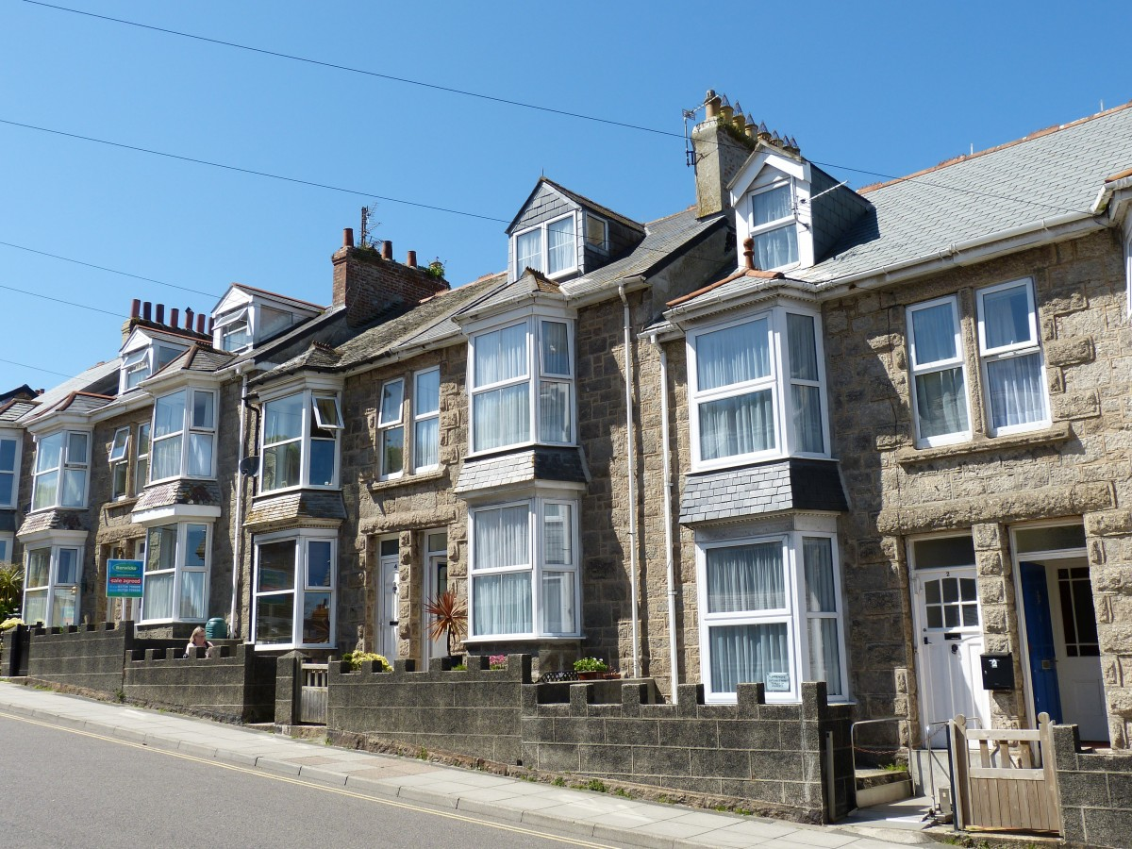
OBJECTIVE
Now that the restrictions have started lifting and people have started to travel more, Airbnb wants to make sure that it is fully prepared for this change.
Analysis the Airbnb listing in New York City on various parameter.
Get better understanding on customer segment and there preferences.

Slide 6
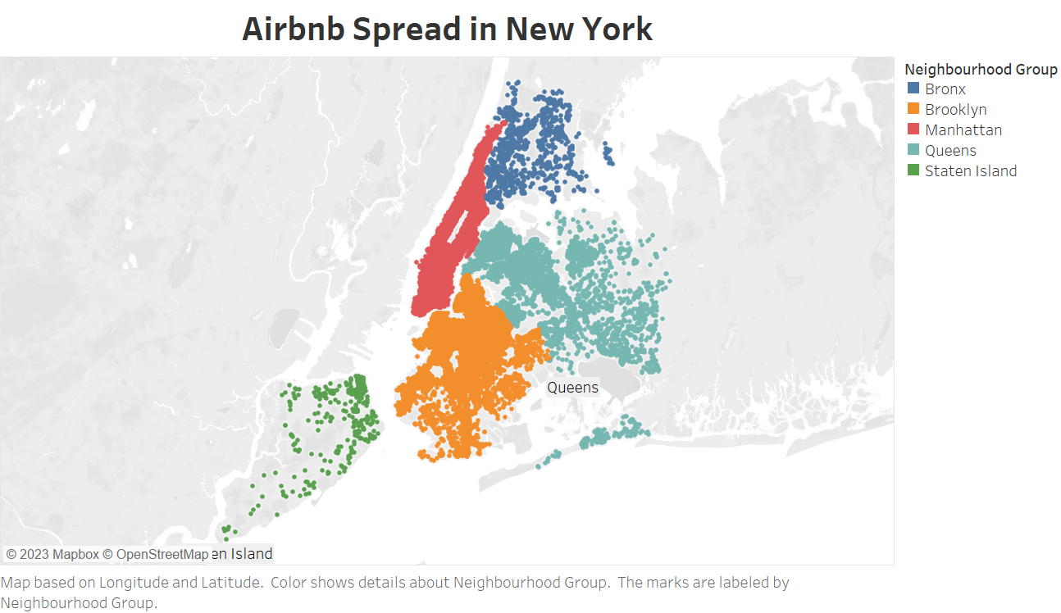
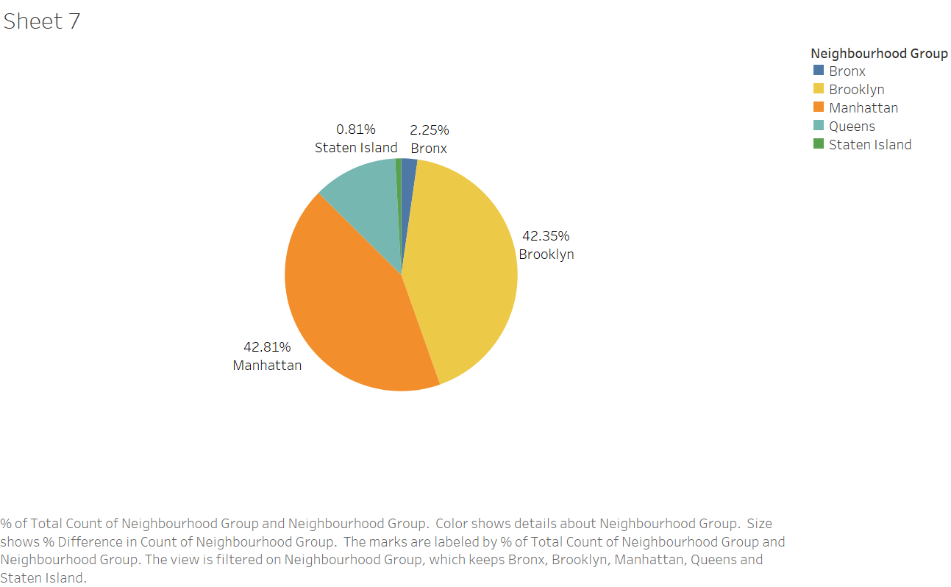
Airbnb Listing in New-York
Airbnb has a wide spread of listing in New York
Manhattan has 42.81% and Brooklyn has 42.35% of listing due to its many tourist destination and scenic view.
Staten Island has less than 1% of total listing available due to few tourist destination.

Slide 7
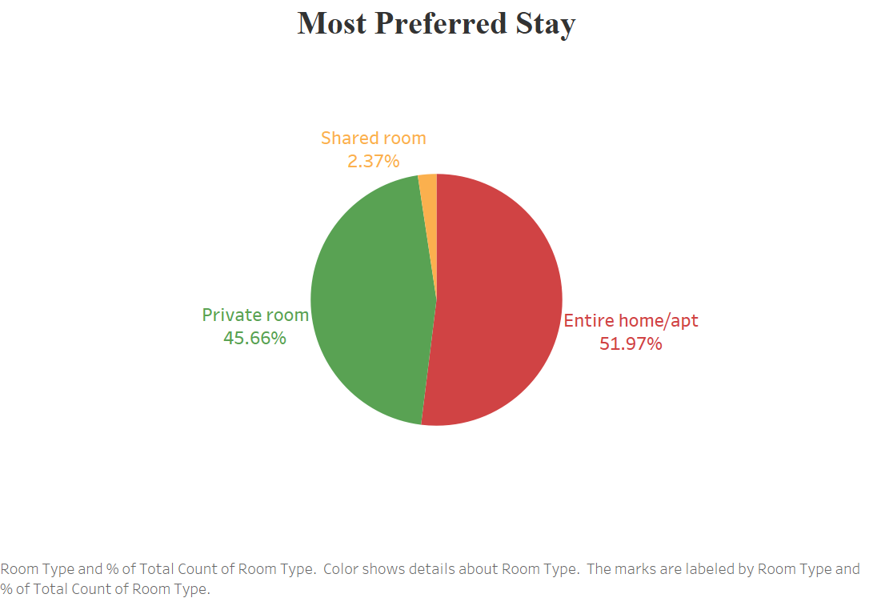
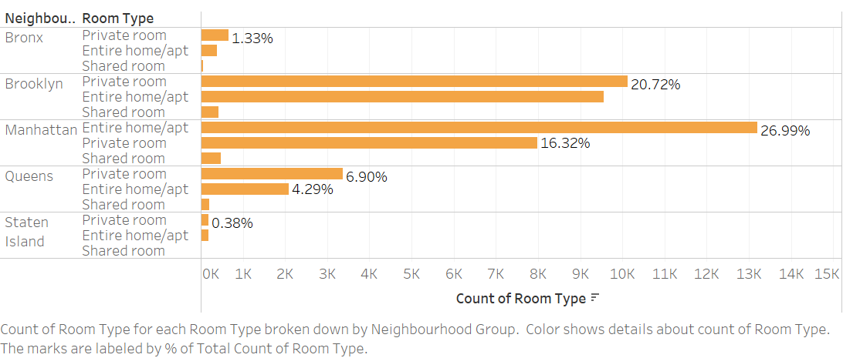
Most Preferred Room Type
Airbnb has three types of room available in listing in New York.
Most preferred is Entire home/apt (51.97%) followed by Private room (45.66%)
The Shared room contribution is very less (2.37%)
The Staten Island and Bronx has very less share of Private and Entire home/apt which is customer first choice ,so Airbnb should increase the listing in these area
Airbnb should provide discount on Shared room to increase its booking percentage

Slide 8
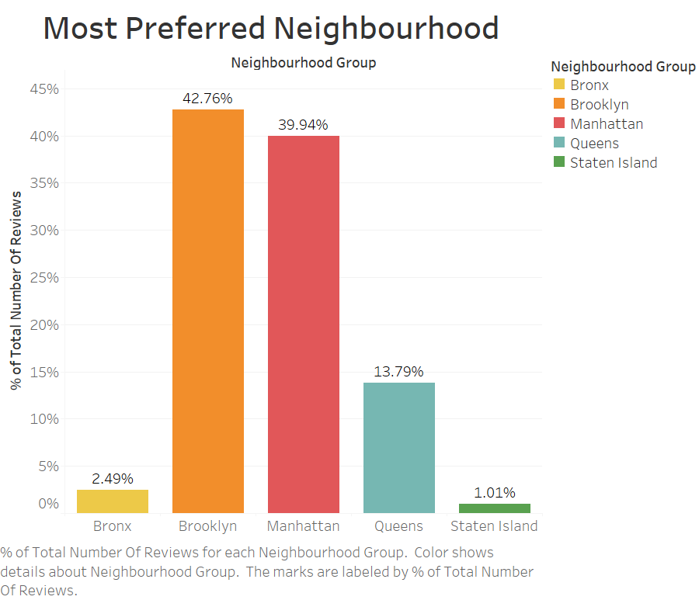
Most Preferred Neighbourhood w.r.t Customer Review
About 80% of Customer prefer to stay in Brooklyn and Manhattan .
13.7% in Queens and 3.5% Customer in Bronx and Staten Island this is due to less no of listing available in these area and very few tourist destination.

Slide 9
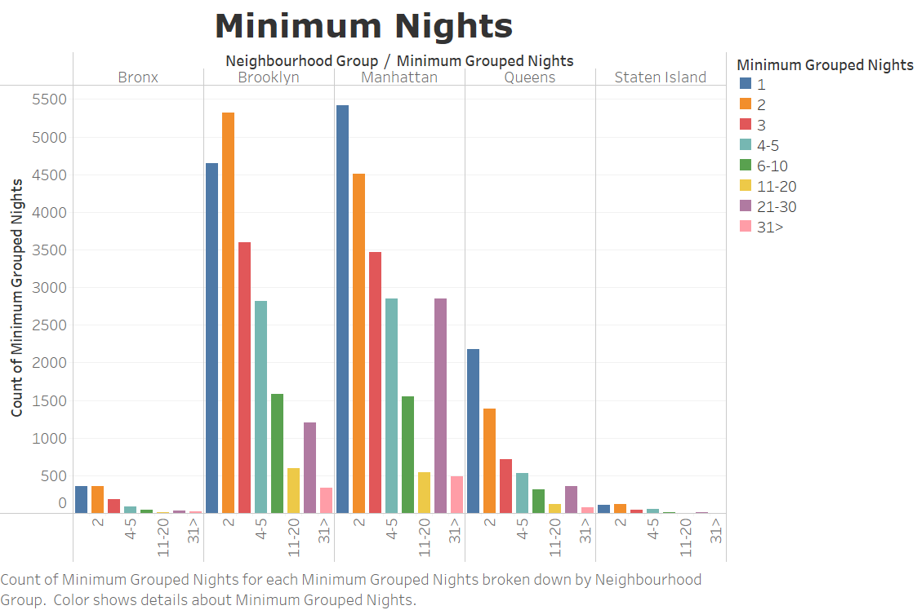
Minimum Nights w.r.t Neighbourhood Groups
Most Customer likely to stay for 1-5 Minimum nights .
We can see a spike in minimum nights in 21-30 bucket mostly in Manhattan these might due to some customer travel for there professional work as Manhattan is also a global centre for financial sector industry

Slide 10
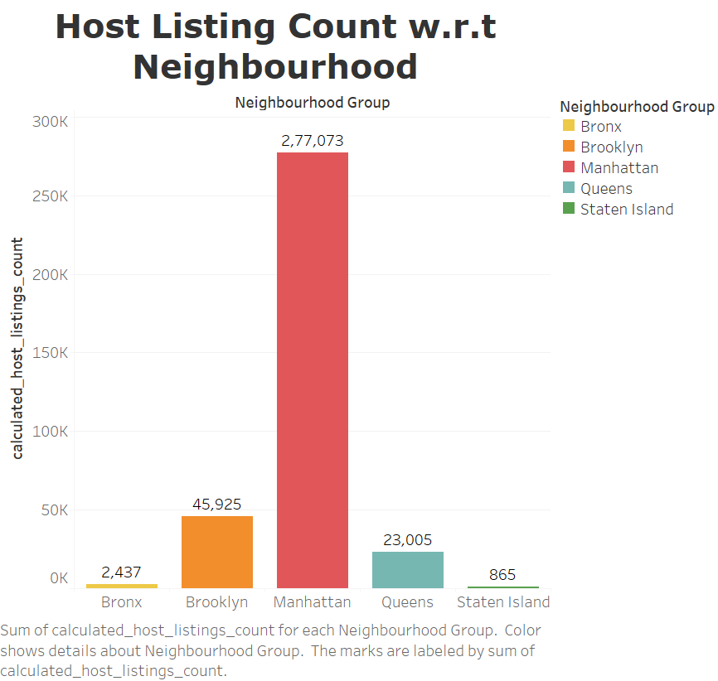
Host Listing count w.r.t Neighbourhood
We can observe that many host have listing mainly in Manhattan . This is due to the Manhattan has highest tourist influx and professional people visiting the city all year round.
This make more profitable for host to acquire the property in these area.

Slide 11
APPENDIX- Data understanding.
The dataset contain Airbnb listing, price, Host detail and other attribute in New York.
It Contain following details:
Id- listing id
Name – Name of listing
Host Id – Host Id
Host name- Name of Host
Neighbourhood Groups- Location
Neighbourhood – Area
Latitude – Latitude coordinates
Longitude – Longitude coordinate
Price – Price of Listing
Minimum nights- Amount of minimum nights
No of review – no of review
Last review – last review
Review per month – number of review per month
Calculated host listing count- amount of listing per host
Availablity_365- number of days when listing is available for booking

Slide 12

Appendix- Methodology
The dataset is cleaned and outlier analysis done.
Exploratory data analysis is done to generate insights from dataset
The Insight are derived using Visualisation tool Tableau Tool.
The main parameter consider for analysis purpose:
1. Geographical Data
2. Room-type data
3. Number of review
4. Minimum nights
5. Area based on area.

Slide 13

Appendix- Assumption
No of reviews assume to be best measure of impact for customer preferences
Dropping Null values assuming no impact on data.

Slide 14
THANKYOU

