Slide 1

Twitter Semantic Analysis
Group: 6
Sumedh Likhar
Kartik Sonawane
Vaishnavi Pawar
Pritam Anekar
Pooja Patil
Sakshi Thote
Mentor: Neha Gupta
Date: 05/06/2023

Slide 2
Business Problem:
The business problem in this case is to analyze the sentiment and type of tweets in order to gauge their impact. By classifying the tweets into different categories such as regular, sarcasm, figurative, and irony, the goal is to gain insights into the emotions and sentiments expressed by Twitter users. This analysis can be valuable for various purposes, such as understanding public opinion, monitoring brand sentiment, or identifying trends in social media conversations. The deployment through R Shiny or Flask/Streamlit can provide a user-friendly interface to interact with the analysis results and visualize them through various charts and plots.
Objective:
The objective is to perform sentiment analysis and emotion mining on a dataset of tweets with the following goals:
Sentiment Analysis: Determine the sentiment (positive, negative, or neutral) expressed in each tweet.
Type Classification: Classify tweets into four categories: regular, sarcasm, figurative, and irony.
Impact Assessment: Analyze the sentiment and type to assess the impact of tweets and gain insights into public opinion and brand sentiment.
Data Visualization: Create charts and plots (e.g., histograms, density plots, bar plots, pie plots) to visually represent the sentiment and type distribution in the dataset.
Deployment: Implement the sentiment analysis and emotion mining model using R Shiny, Flask, or Streamlit to provide a user-friendly interface for interacting with the analysis results and visualizations.

Slide 3
Project Architecture :
Business Understanding
Data Collection
Data Preparation
Exploratory Data Analysis
Data Visualization
Preprocessing
Model Building
Model Evaluation
Deployment

Slide 4
Project Flow :
Understanding the business problem.
Data collection
EDA
Data preprocessing.
Data Visualization
Data transformation
Model building
Model training and evaluation
Deployment

Slide 5
Exploratory Data Analysis (EDA) and
Feature Engineering

Slide 6
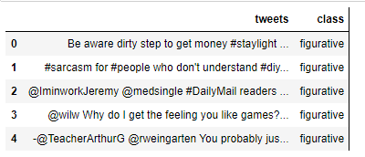
Data set details :
The dataset has 81408 records, 2 columns. With ‘tweets’ and ‘class’.

Slide 7
print('length of data is', len(df))
length of data is 81408.
df.shape
(81408, 2)
Checking null spaces
tweets 0 class0
Check unique target values
df['class'].unique()
array(['figurative', 'irony', 'regular', 'sarcasm'], dtype=object)

Slide 8
Data Visualization :Variable
Plotting the distribution for dataset.ax = df.groupby('class').count().plot(kind='bar', title='Distribution of data‘ ,legend=False ax.set_xticklabels(['figurative', 'irony', 'regular', 'sarcasm'], rotation=0)
# Storing data in lists.tweets, sentiment = list(df['tweets']), list(df['class'])

Slide 9
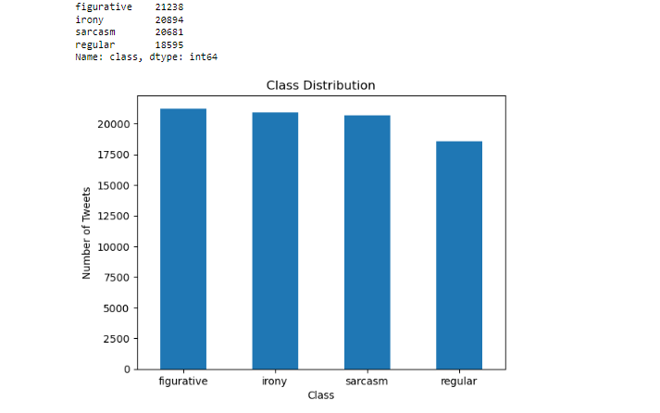

Slide 10
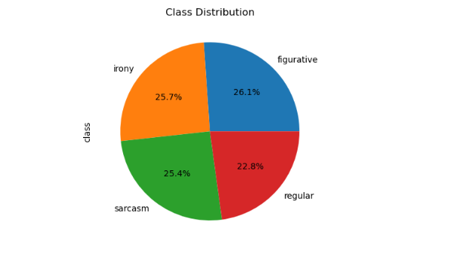
plt.pie(class_counts, labels=class_counts.index,autopct='%1.1f%%')
plt.title('Class Distribution')
plt.show()
The diagram shows the class distribution of each class in percentage.

Slide 11

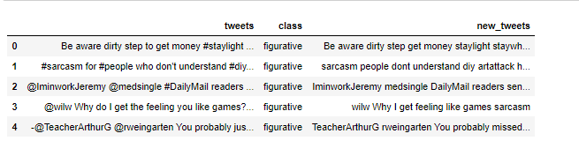
Here it defines a function called removal_stopwords that takes a text as input. It splits the text into individual words and returns a new string by joining only those words that are not present in the set of English stopwords.
We then also remove Frequent words, rare words, URL’S, Special characters from the table

Slide 12
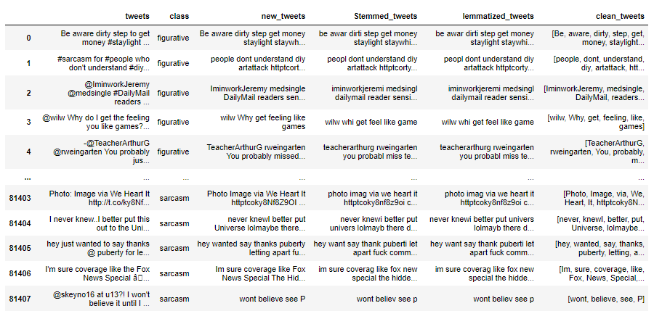
Stemming, lemmatization, and tokenization involve reducing words to their base form, canonicalizing words to their dictionary form, and splitting text into individual units respectively
Now as we apply tokenization on tweets and after that steamming and lemmitazation with tweets we get the tweets result as.

Slide 13
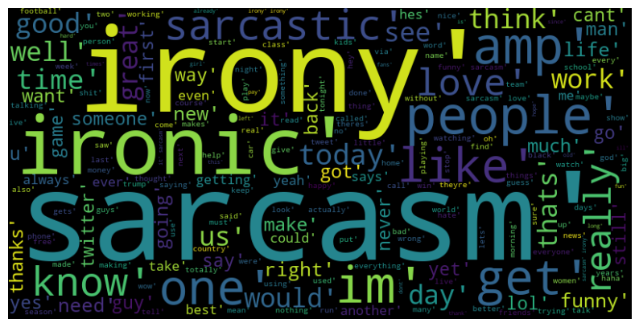
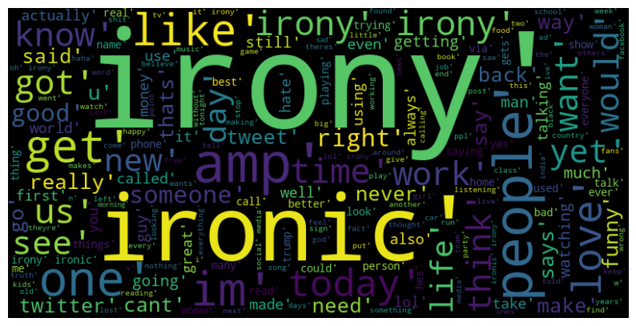
1.Seperating Figurative classified data
2.Seperating Irony classified data

Slide 14
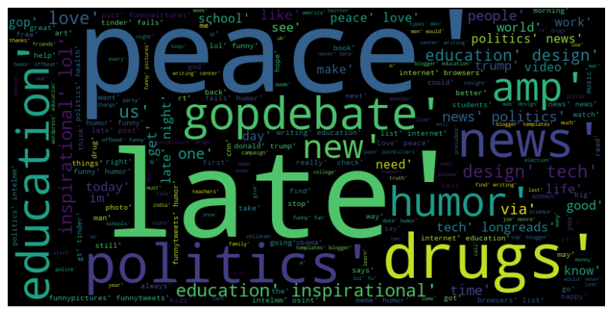
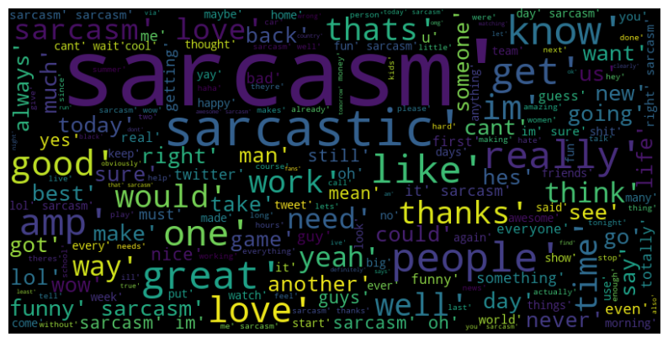
3.Seperating Regular classified data
4.Seperating Sarcasm classified data

Slide 15
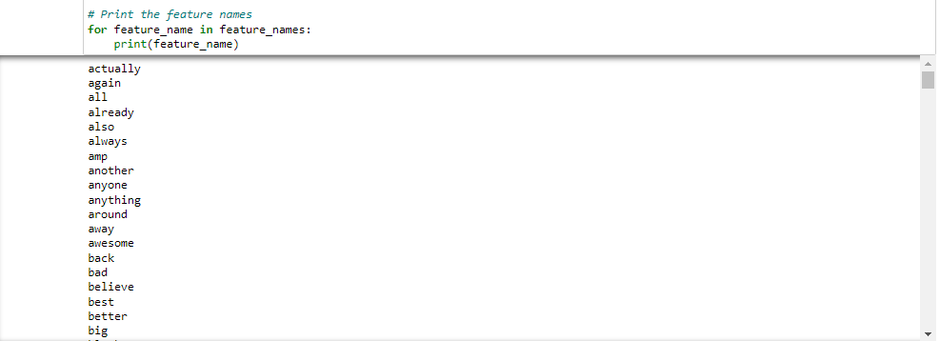
Splitting our data into Train and Test sets.
Separating the 80% data for training data and 20% for testing data
X_train, X_test, y_train, y_test = train_test_split(X,Y,test_size = 0.20, random_state =26)
Create an instance of the TF-IDF vectorizer
vectorizer = TfidfVectorizer(ngram_range=(1, 3), max_features=300)
Where we have max feature range of 300 and on procceding we get the feature names.

Slide 16
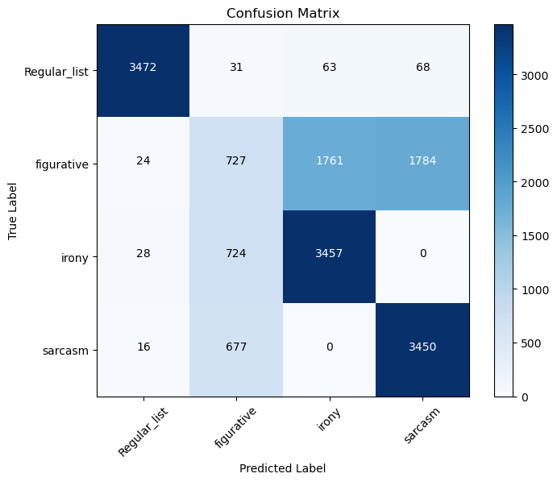
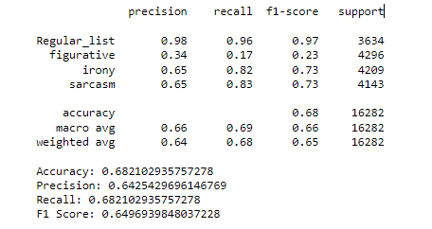
Transform the data using TF-IDF Vectorizer on X-train and X-test.
By initializing MNB model to get the accuracy, precision, f1, recall.
MNB stands for Multinomial Naive Bayes. It is a classification algorithm commonly used in machine learning and natural language processing tasks.

Slide 17
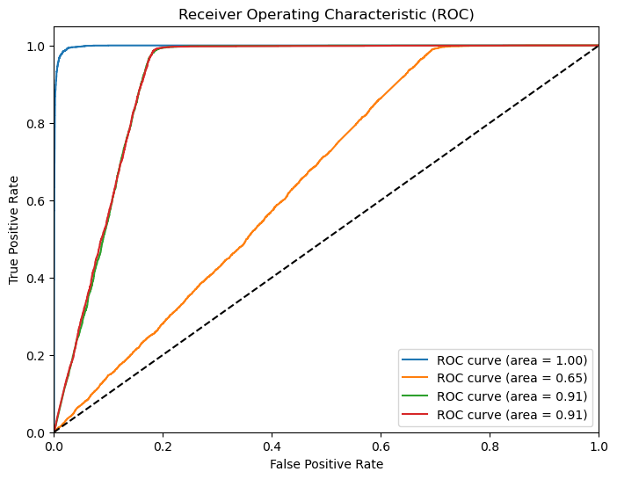
Here after calculating the probabilities for each class by binarizing the labels to ROC curve.
The ROC (Receiver Operating Characteristic) curve shows the performance of a binary classification model by plotting the true positive rate (TPR) against the false positive rate (FPR) at various classification thresholds.

Slide 18
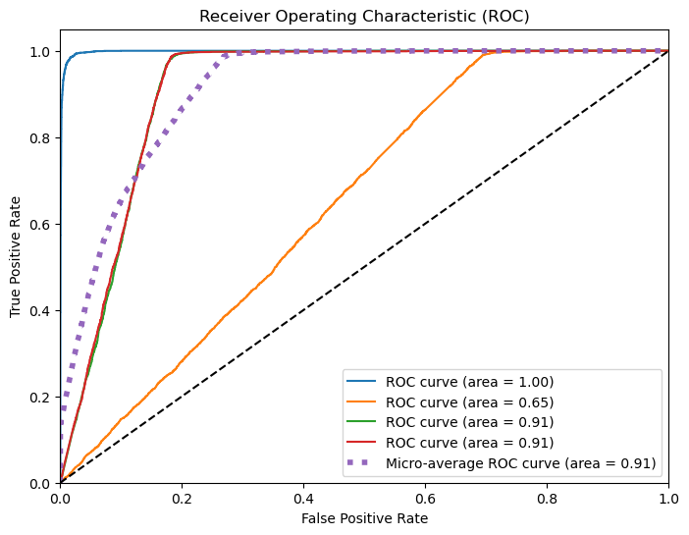
Now Compute ROC curve and AUC for each class we get the graphical plotting as

Slide 19
DEPLOYMENT :
Now getting result after the process by performing the operations like EDA, Data visualization, Data processing, TF-IDF
and model building and evaluating. We have got the output as per the require result.
So after the completion of all processes the last step is to deploy the project in Streamlit to check the result of classes as
we run them in Sentiment Analysis app.
Where we will find easily wheather the tweets come under which classes like figurative, Irony, Regular or Sarcasm.

Slide 20
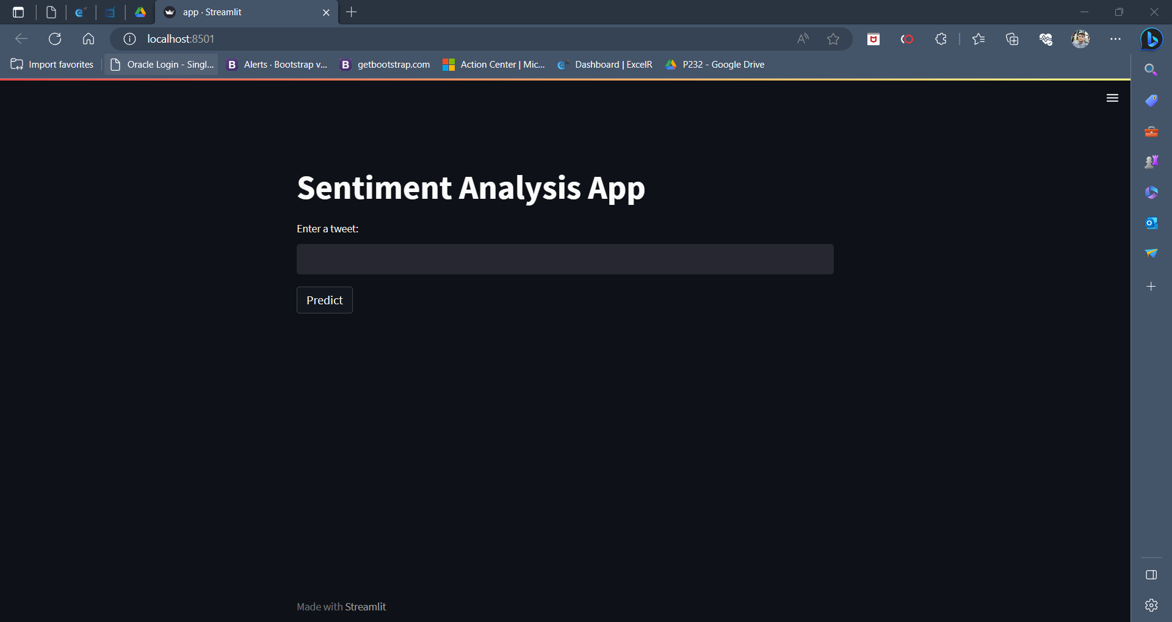
Sentiment analysis App interface :

Slide 21
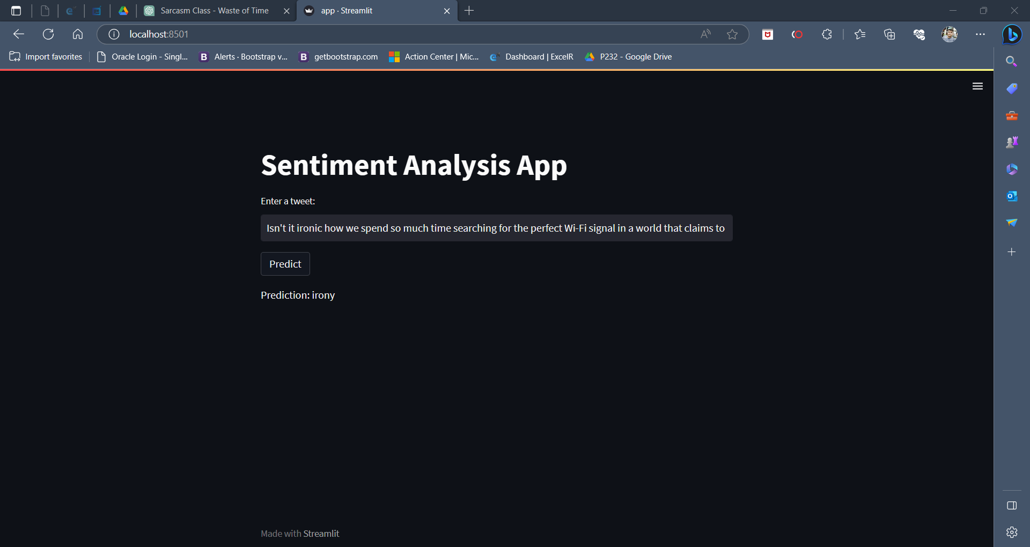
Sentiment app showing the output of tweets related to their classes.

Slide 22
Thank you

