Slide 1
Telecom Customer Churn
Group – 6
Mentors – Karthik & Dhanya
07/07/2023
Atharva Gajanan Namde
Kartik Sonawane
Krishna Vitthal Aher
MOHAMMED SAAD QURESHI
Mohan Samadhan Patil
Pritam Vilas Anekar
Sumedh R. Likhar
Vinay N

Slide 2
Business Problem:
Customer churn is a big problem for telecommunications companies. Indeed, their annual churn rates are usually higher than 10%. For that reason, they develop strategies to keep as many clients as possible.
This is a classification project since the variable to be predicted is binary (churn or loyal customer).
Objective:
The goal here is to model churn probability, conditioned on the customer features. Telecommunications
The Customers to be classified into one of the 2 classes:
Loyal Customer
Customer who Churns

Slide 3
Project Architecture / Project Flow
Balancing the pre-processed data(SMOTE/Under sampling/Oversampling).
Data Balancing
Clean the collected data by Nulls , Duplicates etc.
Data Pre-processing
Use the Churn.csv perform EDA.
Data Collection and EDA
Model Building
Normalize the data to Numerical form(Label Encoding/Hot Encoding).
Generate plots or graphs to show trends of Dataset
Build a custom model using machine learning.
Visualize the sentiment analysis results to gain insights.
Deployment
Develop a user-friendly interface to interact with the Customer Churning Prediction system.

Slide 4
Technologies
Data Collection and EDA
Python (Pandas, Matplot and seaborn library)
Data Pre-processing
Python (Scikit library)
Model Building
Python (scikit-learn)
Deployment
Python (Streamlit/Streamlit Cloud(hosting app))

Slide 5
Exploratory Data Analysis (EDA)

Slide 6
Data set details
Filename : Churn.csv
Shape of Dataset
Rows : 5000
Columns : 20
Duplicates : 0
Unique Classes : [‘Churn-Yes', ‘Churn-No’]
 | state | area.code | account.length | voice.plan | voice.messages | intl.plan | intl.mins | intl.calls | intl.charge | day.mins | day.calls | day.charge | eve.mins | eve.calls | eve.charge | night.mins | night.calls | night.charge | customer.calls | churn
1 | KS | area_code_415 | 128 | yes | 25 | no | 10 | 3 | 2.7 | 265.1 | 110 | 45.07 | 197.4 | 99 | 16.78 | 244.7 | 91 | 11.01 | 1 | no
2 | OH | area_code_415 | 107 | yes | 26 | no | 13.7 | 3 | 3.7 | 161.6 | 123 | 27.47 | 195.5 | 103 | 16.62 | 254.4 | 103 | 11.45 | 1 | no
3 | NJ | area_code_415 | 137 | no | 0 | no | 12.2 | 5 | 3.29 | 243.4 | 114 | 41.38 | 121.2 | 110 | 10.3 | 162.6 | 104 | 7.32 | 0 | no
4 | OH | area_code_408 | 84 | no | 0 | yes | 6.6 | 7 | 1.78 | 299.4 | 71 | 50.9 | 61.9 | 88 | 5.26 | 196.9 | 89 | 8.86 | 2 | no
5 | OK | area_code_415 | 75 | no | 0 | yes | 10.1 | 3 | 2.73 | 166.7 | 113 | 28.34 | 148.3 | 122 | 12.61 | 186.9 | 121 | 8.41 | 3 | no
6 | AL | area_code_510 | 118 | no | 0 | yes | 6.3 | 6 | 1.7 | 223.4 | 98 | 37.98 | 220.6 | 101 | 18.75 | 203.9 | 118 | 9.18 | 0 | no
7 | MA | area_code_510 | 121 | yes | 24 | no | 7.5 | 7 | 2.03 | 218.2 | 88 | 37.09 | 348.5 | 108 | 29.62 | 212.6 | 118 | 9.57 | 3 | no

Slide 7
Data set details – Features
The data set includes the following variables:
state: Categorical, for the 51 states and the District of Columbia.
Area.code
account.length: how long the account has been active.
voice.plan: yes or no, voicemail plan.
voice.messages: number of voicemail messages.
intl.plan: yes or no, international plan.
intl.mins: minutes customer used service to make international calls.
intl.calls: total number of international calls.
intl.charge: total international charge.
day.mins: minutes customer used service during the day.
day.calls: total number of calls during the day.
day.charge: total charge during the day.
eve.mins: minutes customer used service during the evening.
eve.calls: total number of calls during the evening.
eve.charge: total charge during the evening.
night.mins: minutes customer used service during the night.
night.calls: total number of calls during the night.
night.charge: total charge during the night.
customer.calls: number of calls to customer service.
churn: Categorical, yes or no. Indicator of whether the customer has left the company (yes or no).

Slide 8
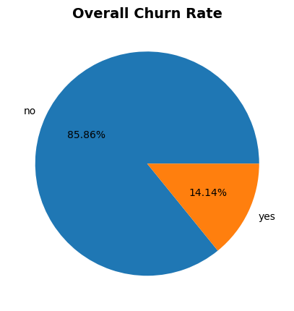
Data Visualization – Class Distribution
Class Distribution
No – Customer have not Churn - 4293
Yes - Customer have Churned - 707
Analysing the distribution of labels in the dataset. We see the dataset has in-equal proportions of instances for each class, it can be considered balanced.
Overall Churn rate is 14.14%

Slide 9
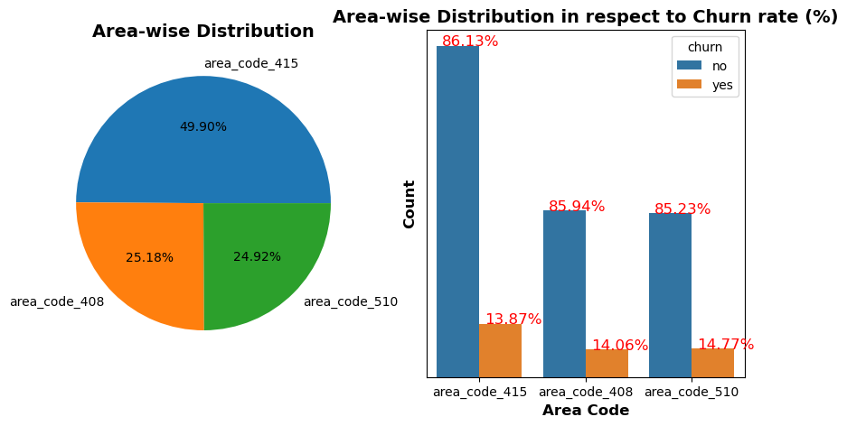
Data Visualization – Categorical Plots
Most number of entries are from area_code_415 = 49.90%
Percentage for churn rate for area code 415 is 13.87 %
Percentage for churn rate for area code 408 is 14.06 %
Percentage for churn rate for area code 510 is 14.77 %
The churn rate is similar for all the three areas.

Slide 10
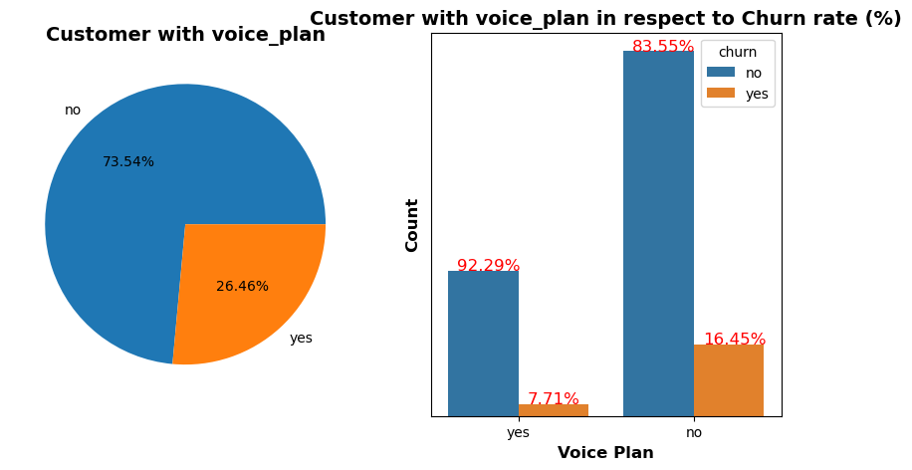
Data Visualization – Categorical Plots
Most number of entries are from customers who don’t have voice plan = 74.54%
Percentage for churn rate for customer where they have purchased voice plan is 7.71 %
Percentage for churn rate for customer where they have no purchased voice plan is 16.45 %
The churn rate is higher for the customer who have not purchased the voice plan

Slide 11
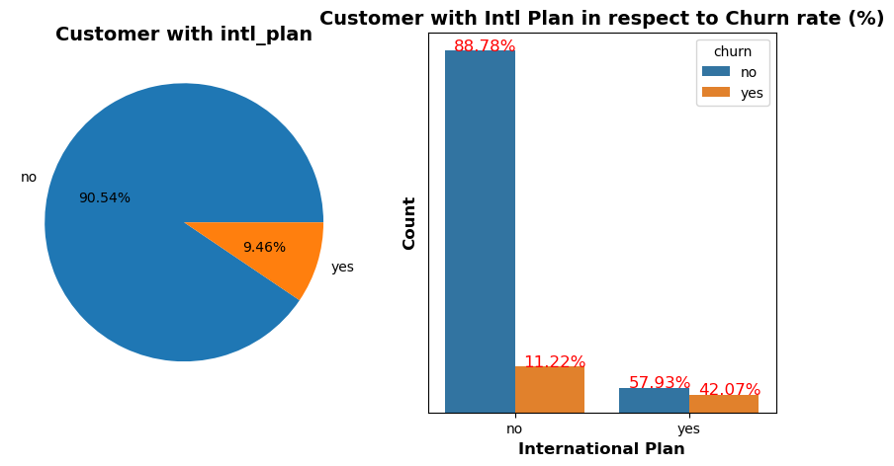
Data Visualization – Categorical Plots
Most number of entries are from customers who don’t have international plan = 90.54%
High ratio of customers with an international plan leaves the company.
Customers with International tends to leave the company , this could be due the intl charges imposed

Slide 12
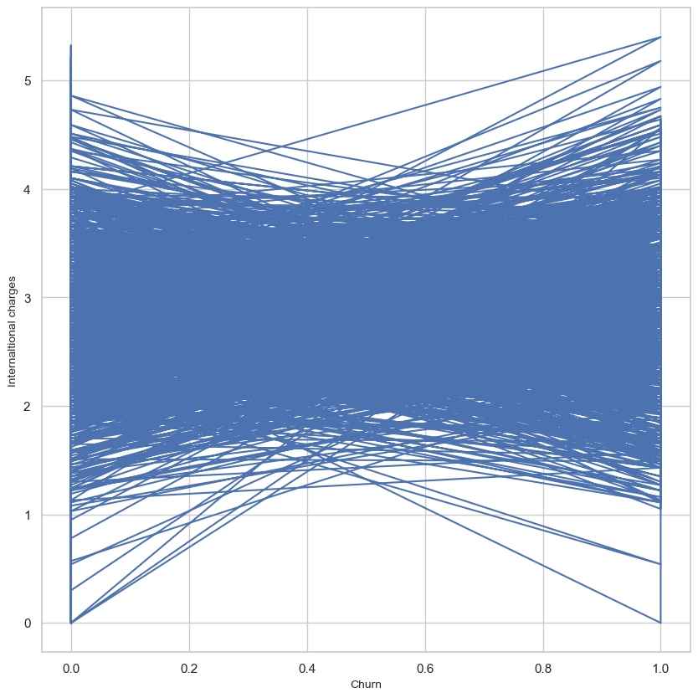
Data Visualization – International Charges
From the graph we can we see the churn rates varies highly between the international charges between the range 1.5 to 4

Slide 13
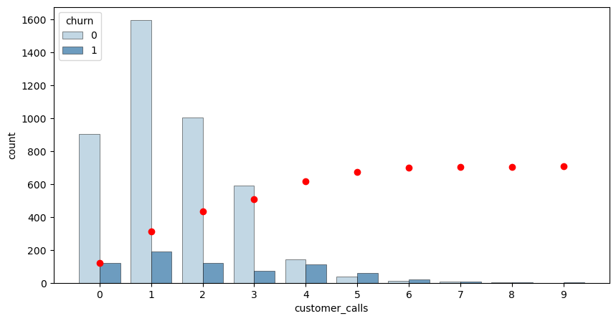
Customer Calls v/s Churn
0 Customer calls have 11.83% Churn rate
1 Customer calls have 10.64% Churn rate
2 Customer calls have 10.83% Churn rate
3 Customer calls have 10.98% Churn rate
4 Customer calls have 44.05% Churn rate
5 Customer calls have 60.42% Churn rate
6 Customer calls have 64.71% Churn rate
7 Customer calls have 53.85% Churn rate
8 Customer calls have 50.00% Churn rate
9 Customer calls have 100.00% Churn rate
Whenever there are 4 or more customer calls , the churn rates are higher
There are more then 300-350 unsatisfied customers who have called more than once.
From the above graph, we can observe that churn is directly proportional to customer calls. That is, churn is increasing with increase in customer service calls

Slide 14
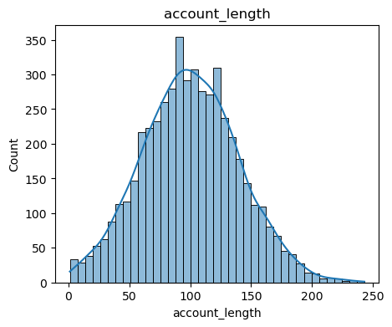
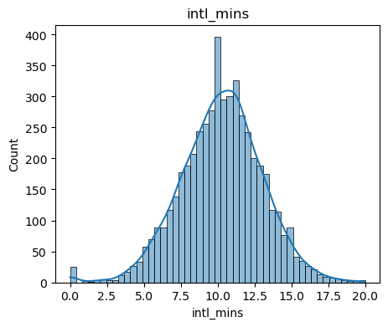
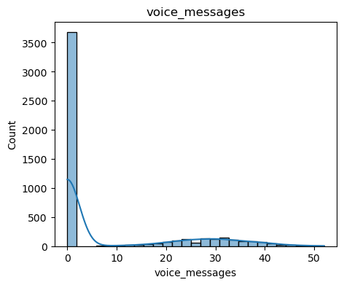
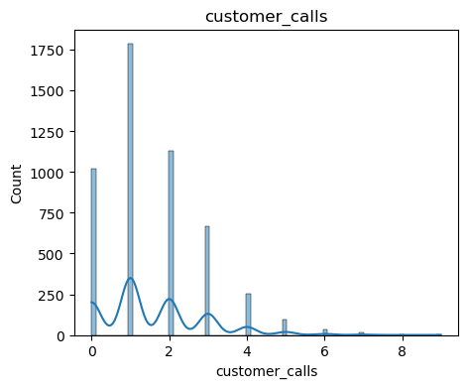
Data Visualization – Histogram
We see data to most of the features are Normally Distributed with very less Skewness
We also see presence of Outliers in some features

Slide 15
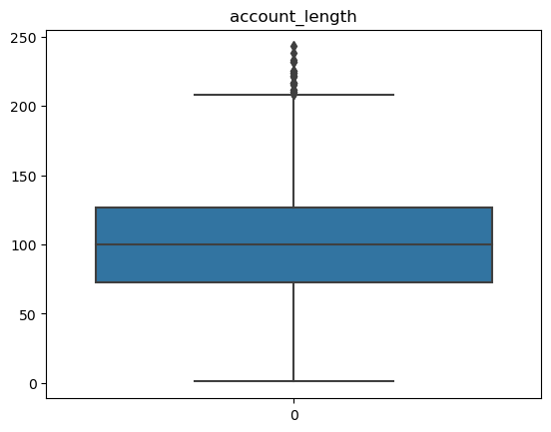
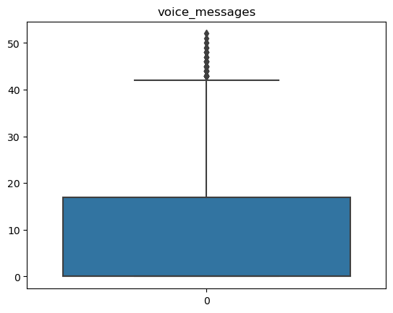
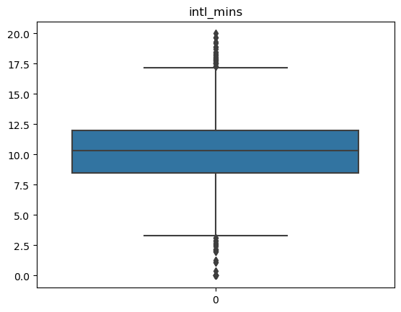
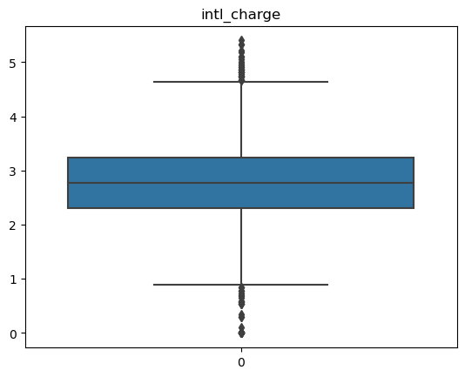
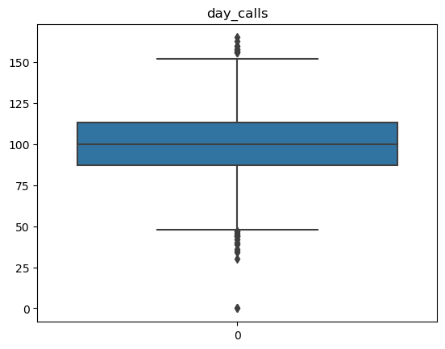
Outlier Detection using Box Plot
We see presence of Outliers in the Features

Slide 16
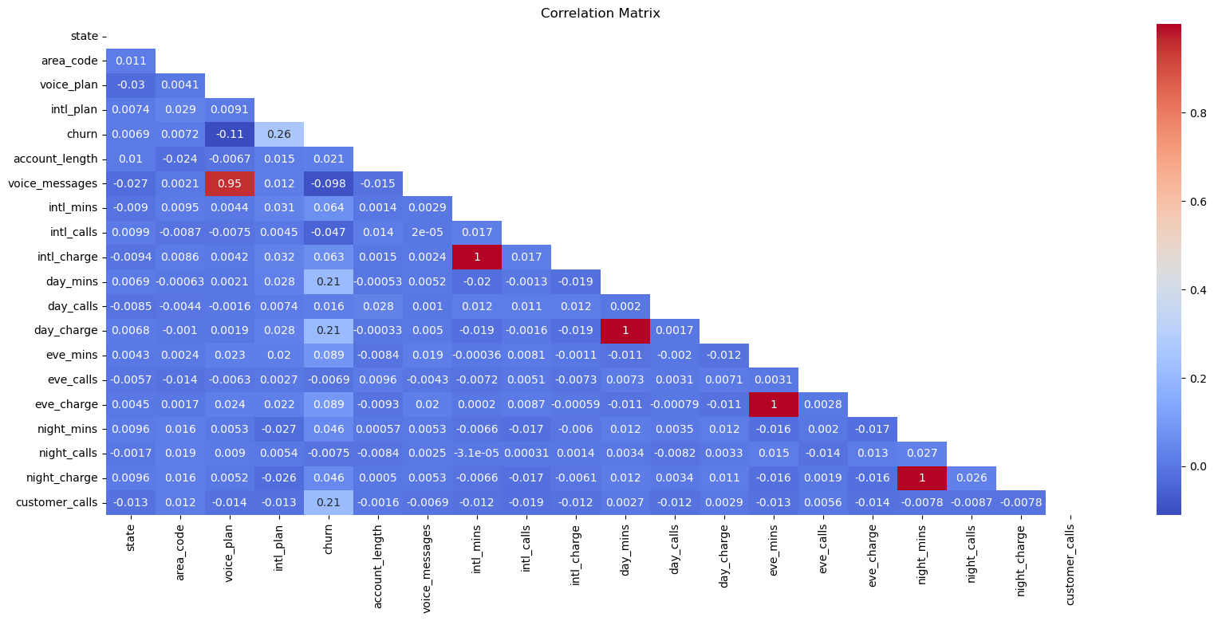
Correlation Matrix
A correlation matrix is a tabular representation of the pairwise correlations between variables in a dataset
There are some features wit high correlation with each other instead with the target variable as shown below
X | Y | Coefficient
night_charge | night_mins | 0.999952
day_charge | day_mins | 0.999759
intl_charge | intl_mins | 0.999254
eve_charge | eve_mins | 0.997632
voice_messages | voice_plan | 0.954465

Slide 17
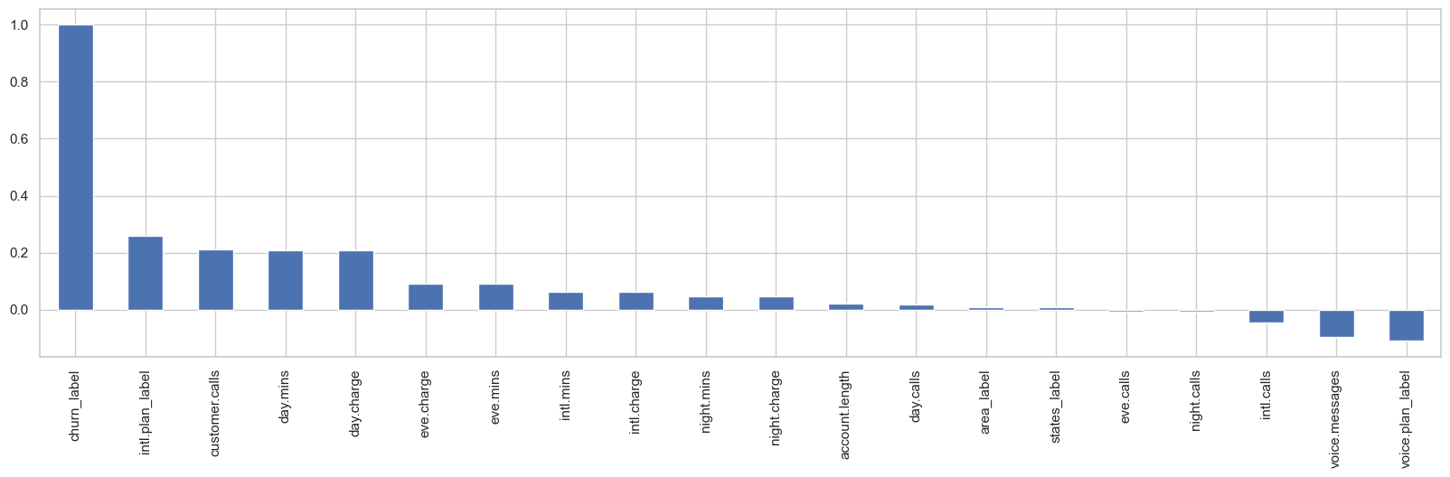
Correlation Strength- Input Features V/s Target Variable
Pearson Coefficient - It provides a way to examine the linear relationship between variables and can help identify patterns and dependencies among the variables.
Churn has weak correlationship with International plan,customer calls,day minutes and day charge.

Slide 18
Feature Engineering

Slide 19
Feature Extraction
Label Encoding: Converting categorical variables into numerical values. Steps are as follows
Identify the categorical variable
Assign numerical labels
Replace categorical values with numerical labels
area_code | Labels
area_code_415 | 0
area_code_408 | 1
area_code_510 | 2
One-Hot Encoding: Converting categorical variables into binary vectors. Steps are as follows
Identify the categorical variable
Create a binary feature for each category
Assign binary values
area_code_area_code_408 | area_code_area_code_415 | area_code_area_code_510
0 | 1 | 0
1 | 0 | 0
0 | 0 | 1

Slide 20
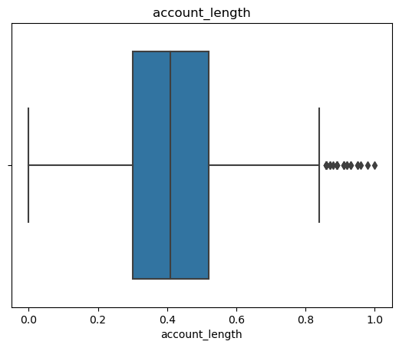
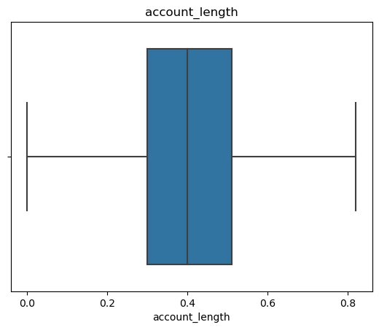
Data Selection – Removing Outliers
Removing outliers from a dataset is a common data preprocessing step to improve the quality and reliability of the data
IQR (Interquartile Range)
Calculate Q1 and Q3 then Calculate the IQR for the data(Q3-Q1)
Identify data points that fall below the lower quartile minus a multiple of the IQR or above the upper quartile plus a multiple of the IQR (e.g., 1.5 times the IQR).
Out of 5000 records we managed to retained 2886 rows ~ 58% of Original Data Set
Hence We have decided not to filter out Outliers as it might result in Building a biased model with extreme values
Filtering Outliers

Slide 21
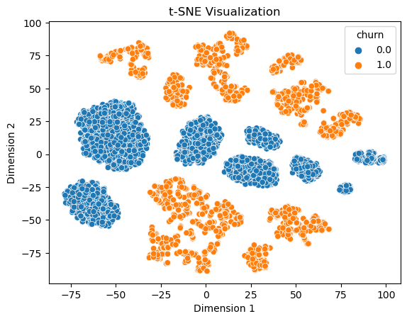
Dimension Reduction using t-SNE
t-SNE (t-Distributed Stochastic Neighbor Embedding) is a popular dimensionality reduction technique commonly used in data visualization
It can be utilized as a tool to explore and visualize high-dimensional data
The data points are clearly separated in the t-SNE plot, it indicates that the features have discriminative power in distinguishing the classes.

Slide 22
Feature Scaling
Rescale the features to ensure they have similar ranges.
Common techniques include normalization (e.g., min-max scaling) or standardization (e.g., z-score scaling).
MinMaxScaler is a data normalization technique commonly used in machine learning to scale numerical features within a specific range.
It transforms the original values of a feature into a new range, typically between 0 and 1, by applying a linear transformation.
The formula for MinMaxScaler is as follows: X_scaled = (X - X_min) / (X_max - X_min)
Normalization
account_length | voice_messages | intl_mins | intl_calls | intl_charge | day_mins
128 | 25 | 10 | 3 | 2.7 | 265.1
107 | 26 | 13.7 | 3 | 3.7 | 161.6
137 | 0 | 12.2 | 5 | 3.29 | 243.4
84 | 0 | 6.6 | 7 | 1.78 | 299.4
75 | 0 | 10.1 | 3 | 2.73 | 166.7
account_length | voice_messages | intl_mins | intl_calls | intl_charge | day_mins
0.52 | 0.48 | 0.5 | 0.15 | 0.5 | 0.75
0.44 | 0.5 | 0.68 | 0.15 | 0.69 | 0.46
0.56 | 0 | 0.61 | 0.25 | 0.61 | 0.69
0.34 | 0 | 0.33 | 0.35 | 0.33 | 0.85
0.31 | 0 | 0.5 | 0.15 | 0.51 | 0.47

Slide 23
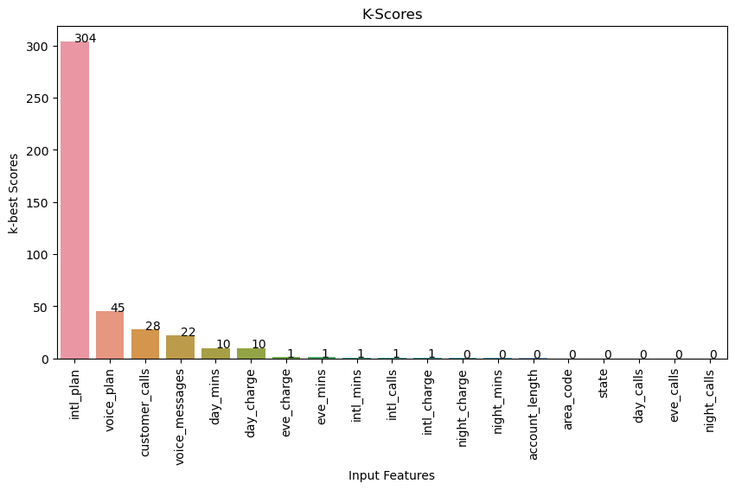
Feature Selection - Chi-squared Test
Feature Selection
Chi-2 Test - measuring the dependency between each feature and the target variable using the chi-squared statistical test. Features with high dependency are selected.
We can see from the bar plot that the following features have almost zero score:
Night_mins
Account_length
Area_code
State
Day_calls
Eve_calls
Night_calls

Slide 24
Feature Selection - Recursive Feature Elimination
Feature | Support | Ranking
day_mins | TRUE | 1
night_mins | TRUE | 1
eve_charge | TRUE | 1
account_length | TRUE | 1
intl_mins | TRUE | 1
day_charge | TRUE | 1
intl_charge | TRUE | 1
night_charge | TRUE | 1
day_calls | TRUE | 1
eve_mins | FALSE | 2
voice_messages | FALSE | 3
customer_calls | FALSE | 4
intl_plan | FALSE | 5
night_calls | FALSE | 6
voice_plan | FALSE | 7
area_code | FALSE | 8
eve_calls | FALSE | 9
intl_calls | FALSE | 10
state | FALSE | 11
Feature Selection
Recursive Feature Elimination- is a feature selection technique used in machine learning to select the most important features from a given dataset.
It is an iterative process that recursively eliminates less important features until a specified number of features remains.
From the table ranking of the features based on Support
Important Features – True – 9/19 = 47%
Unimportant Feature – False – 10/19 = 53%

Slide 25
Feature Selection - Feature Importance
Feature | Importance
day_charge | 0.16
customer_calls | 0.11
intl_plan | 0.10
intl_charge | 0.08
day_mins | 0.08
eve_mins | 0.08
intl_calls | 0.06
eve_charge | 0.05
voice_plan | 0.04
night_charge | 0.03
state | 0.03
night_mins | 0.03
night_calls | 0.03
day_calls | 0.02
account_length | 0.02
intl_mins | 0.02
eve_calls | 0.02
voice_messages | 0.01
area_code | 0.01
Feature Selection
Feature Importance - measures the relevance or importance of each feature in a dataset for predicting the target variable
It helps identify the most influential features and provides insights into the underlying patterns and relationships in the data
Estimator Used : Decision Tree
From the table in order of the features based on importance score

Slide 26
Feature Selection – Overall Ranking
The Feature are given an rank Based on K-Best Scores , RFE Support and Importance Score of the feature , which help us filter Features that are useful for Model Building
Feature | Importance | Score | Support | Ranking | Importance_Rank | Score_Rank | Overall Ranking2
customer_calls | 0.1135 | 27.661 | FALSE | 4 | 2 | 3 | 1
day_charge | 0.1560 | 9.86 | TRUE | 1 | 1 | 6 | 1
intl_plan | 0.0959 | 303.963 | FALSE | 5 | 3 | 1 | 1
day_mins | 0.0789 | 9.889 | TRUE | 1 | 5 | 5 | 4
intl_charge | 0.0841 | 0.728 | TRUE | 1 | 4 | 11 | 5
eve_mins | 0.0756 | 1.373 | FALSE | 2 | 6 | 8 | 5
eve_charge | 0.0504 | 1.395 | TRUE | 1 | 8 | 7 | 5
voice_plan | 0.0398 | 45.058 | FALSE | 7 | 9 | 2 | 8
voice_messages | 0.0138 | 21.642 | FALSE | 3 | 18 | 4 | 9
night_charge | 0.0338 | 0.341 | TRUE | 1 | 10 | 12 | 9
intl_mins | 0.0218 | 0.753 | TRUE | 1 | 16 | 9 | 11
intl_calls | 0.0649 | 0.748 | FALSE | 10 | 7 | 10 | 11
night_mins | 0.0309 | 0.337 | TRUE | 1 | 12 | 13 | 11
account_length | 0.0227 | 0.146 | TRUE | 1 | 15 | 14 | 14
day_calls | 0.0241 | 0.03 | TRUE | 1 | 14 | 17 | 15
night_calls | 0.0296 | 0.006 | FALSE | 6 | 13 | 18.5 | 16
state | 0.0334 | 0.041 | FALSE | 11 | 11 | 16 | 17
area_code | 0.0116 | 0.065 | FALSE | 8 | 19 | 15 | 18
eve_calls | 0.0191 | 0.006 | FALSE | 9 | 17 | 18.5 | 19
Dataset Shape Before
Rows : 5000
Columns : 20
Dataset Shape After
Rows : 5000
Columns : 14 + 1 Target Variable

Slide 27
Feature Selection
When dealing with feature selection or dimensionality reduction in a dataset, it is common to drop highly correlated features to avoid multicollinearity or redundant information.
From Correlation Matrix(Pearson correlation coefficient) we observed that following variables are highly correlated,
night_charge & night_mins 0.999952
day_charge & day_mins 0.999759
intl_charge & intl_mins 0.999254
eve_charge & eve_mins 0.997632
We have dropped one variable from each pair , to avoid multicollinearity and redundant information
Dropping Variables
Dataset Shape Before
Rows : 5000
Columns : 15
Dataset Shape After
Rows : 5000
Columns : 11

Slide 28
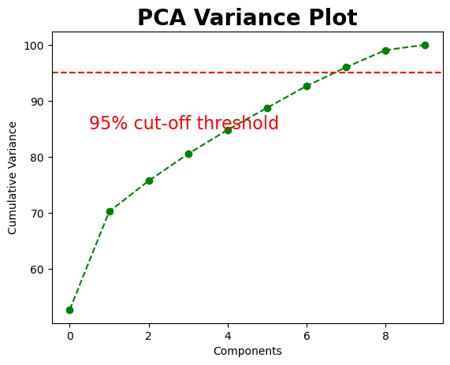
Feature Reduction - PCA
Principal Component Analysis (PCA) is a widely used technique to reduce the dimensionality of a dataset while preserving the most important information.
PCA transforms a set of correlated variables (features) into a new set of uncorrelated variables called principal components.
Dataset Shape Before
Rows : 5000
Columns : 11
Information : 100%
P
C
A
Dataset Shape After
Rows : 5000
Columns : 9(8PCA+target)
Information : 96.01%
12 principal component explains the 96.23% variance

Slide 29
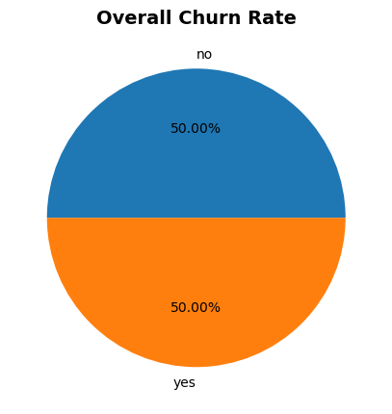
Data Balancing - SMOTE
Balancing is done to avoid creating a biased model that favors the majority class.
SMOTE (Synthetic Minority Over-sampling Technique) is another popular oversampling technique used to address class imbalance in classification problems
It generates synthetic samples for the minority class by interpolating between existing minority class samples.
SMOTE
Class distribution before oversampling
No : 4293
Yes : 707
Class distribution after oversampling
No : 4293
Yes : 4293

Slide 30
Model Building

Slide 31
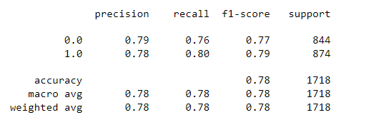
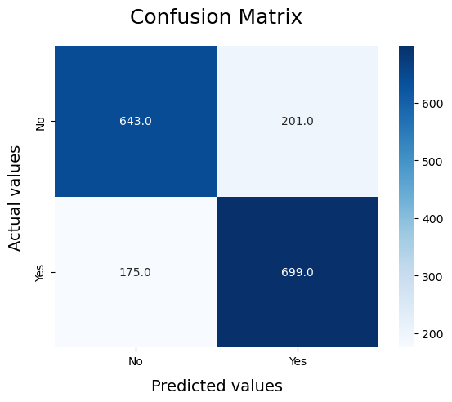
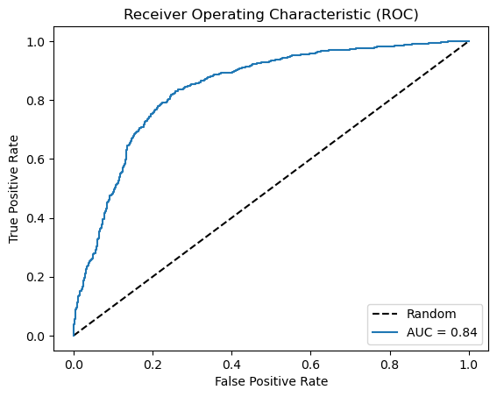
Logistic Regression Model
Classification Report
Logistic Regression models the relationship between the input features and the probability of belonging to a certain class
It is computationally efficient and can handle large datasets with a relatively low computational cost.

Slide 32
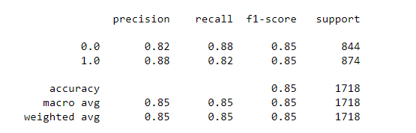
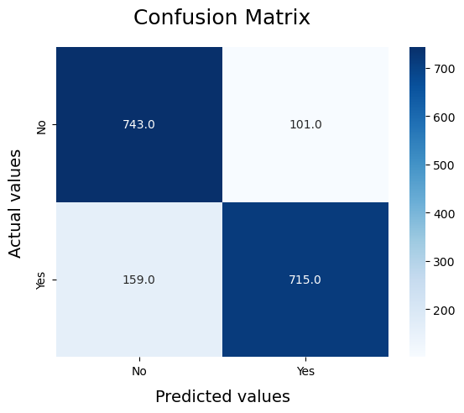
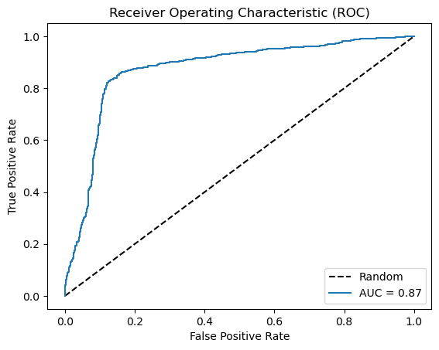
Gaussian Naïve Bayes
Classification Report
Gaussian Naïve Bayes is a variant of the Naïve Bayes algorithm that assumes a Gaussian (normal) distribution for the continuous features in the dataset.
It is commonly used for classification tasks and is particularly effective when dealing with continuous or numeric data.

Slide 33
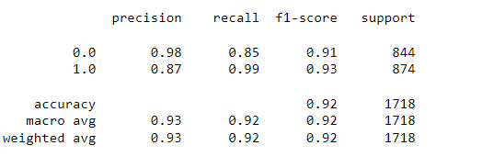
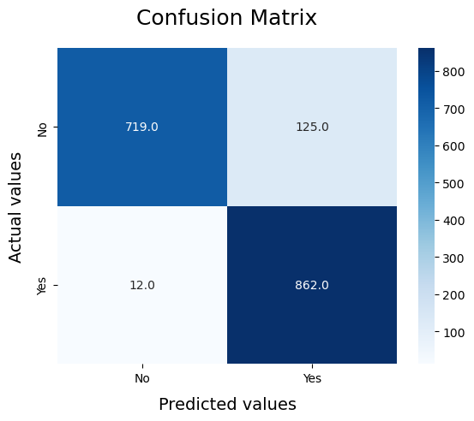
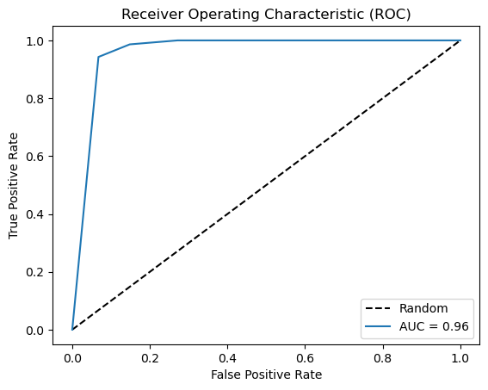
K-nearest neighbors (KNN)
Classification Report
The K-nearest neighbors (KNN) algorithm is a simple and effective machine learning algorithm used for both classification and regression tasks.
The main idea behind the KNN algorithm is to predict the class or value of a new data point based on the majority vote or average of its k nearest neighbors in the feature space.

Slide 34
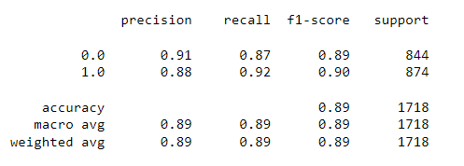

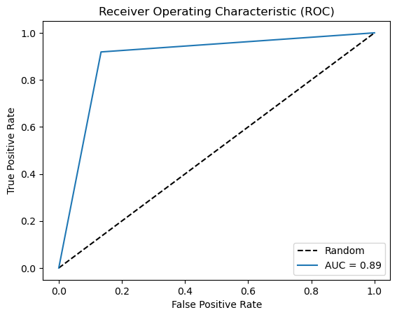
Decision Tree Classifier
Classification Report
A Decision Tree Classifier is a popular machine learning algorithm used for both classification and regression tasks.
It builds a hierarchical tree structure that makes decisions based on feature values to classify or predict the target variable.

Slide 35
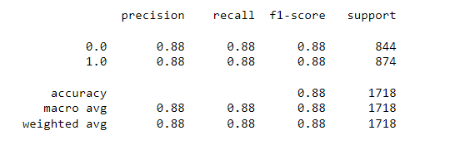
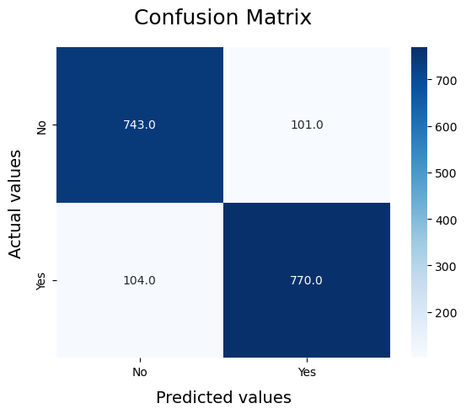
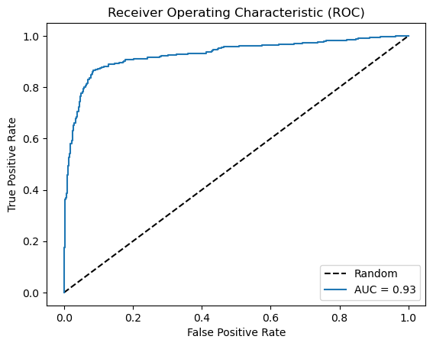
Support Vector Machines (SVM)
Classification Report
Support Vector Machines (SVM) is a powerful supervised machine learning algorithm used for classification and regression tasks.
SVMs are particularly effective in cases where the data is not linearly separable and requires a decision boundary that is more complex than a simple linear function.

Slide 36
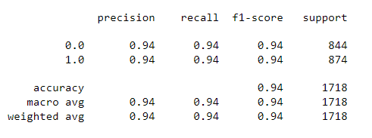
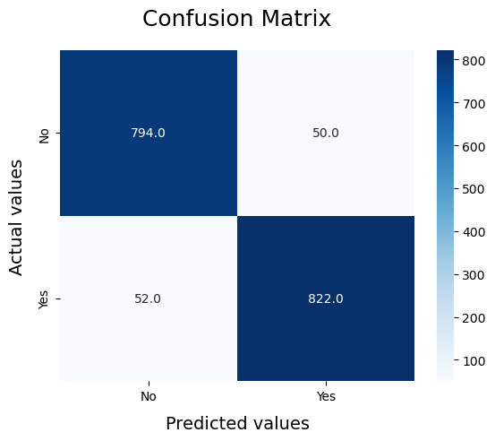
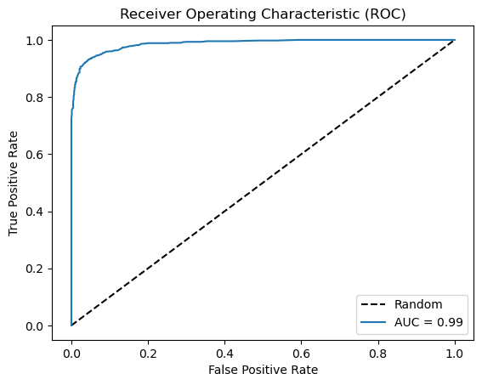
Random Forest Classifier
Classification Report
Random Forest is a popular ensemble machine learning algorithm that combines multiple decision trees to make predictions
Random Forest improves upon the decision tree algorithm by reducing overfitting and increasing prediction accuracy.

Slide 37
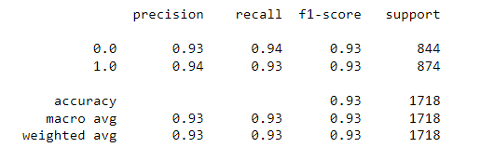

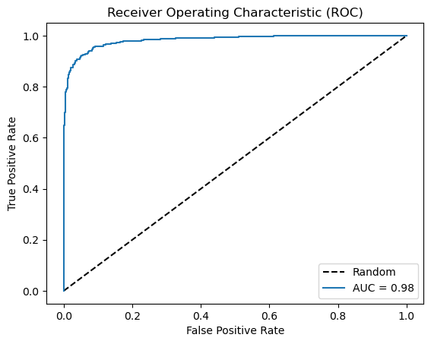
Gradient Boosting Machines (GBM)
Classification Report
Gradient Boosting Machines (GBM) is a powerful machine learning algorithm that belongs to the family of boosting algorithms
It combines these weak models by focusing on the mistakes made by the previous models and adjusting subsequent models to correct those mistakes.

Slide 38
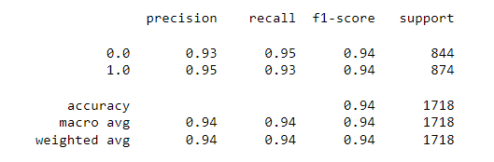


XGBoost (eXtreme Gradient Boosting)
Classification Report
XGBoost (eXtreme Gradient Boosting) is a powerful gradient boosting algorithm that has gained popularity for its high predictive accuracy and efficiency.
It is designed to optimize performance and computational speed, making it suitable for a wide range of machine learning tasks, including classification, regression, and ranking problems.

Slide 39
Model Evaluation

Slide 40
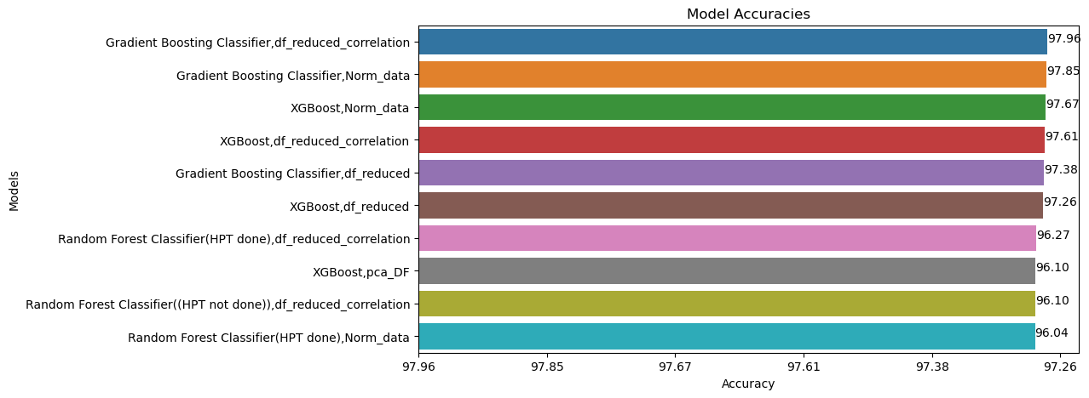
Top Model
We can see from the bar plot that GBoost Models has highest Accuracy with 98%

Slide 41
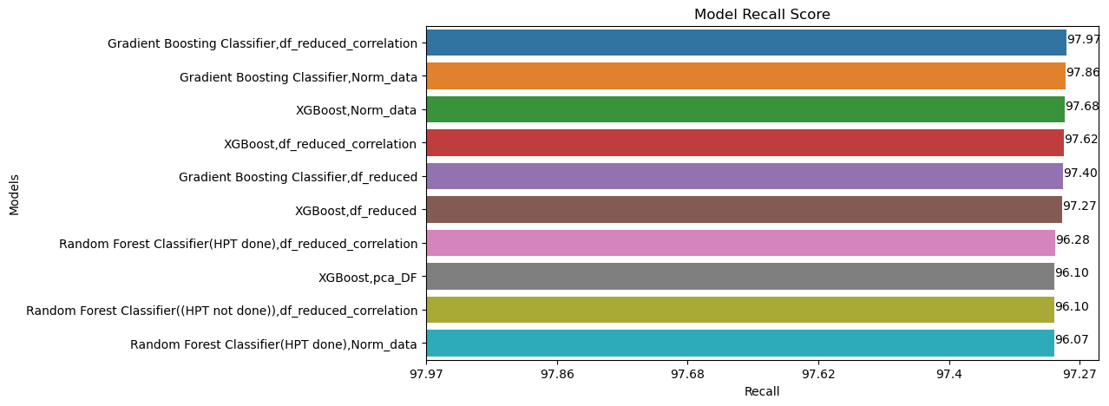
Top Model
We can see from the bar plot that Random Forest Classifier and GBoost Models have highest Recall Score with 98%

Slide 42
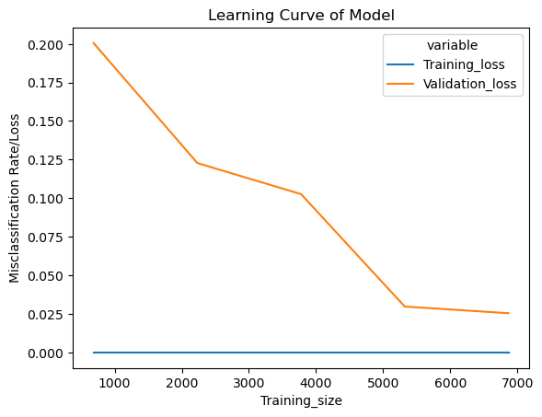
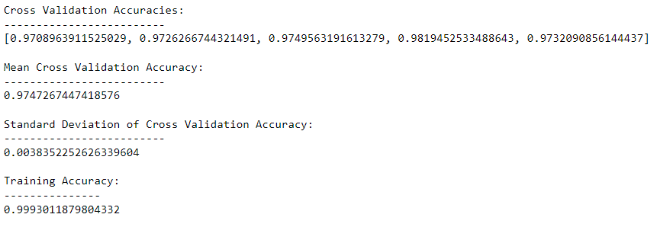
Learning Curve – Cross Validation Score
The mean cross-validation accuracy is 0.9747, which indicates that the model has achieved a high level of accuracy across multiple folds of the data.
Additionally, the standard deviation of the cross-validation accuracy is relatively low (0.0038), suggesting that the model's performance is consistent.

Slide 43
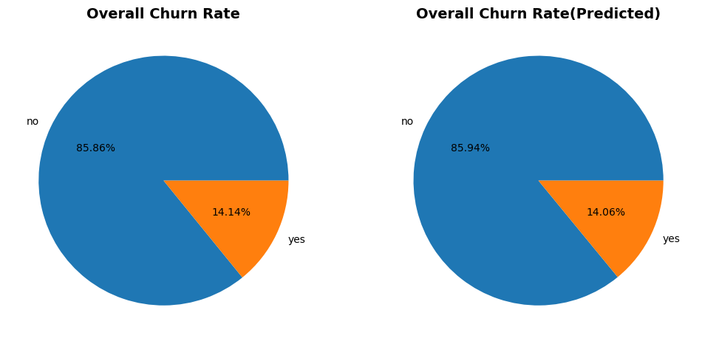
Model Prediction
The Difference between actual and predicted churn rate is 0.08% for the given dataset.

Slide 44
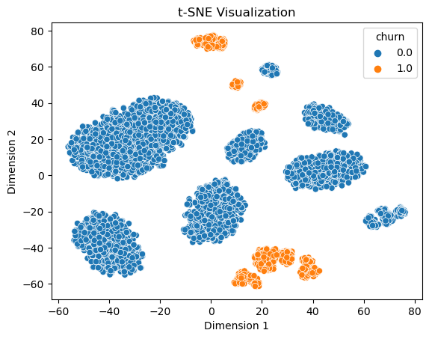
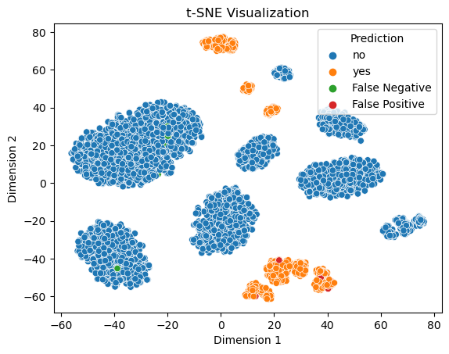
Model Prediction - Visualization
Out of the 5000 Data records , the model was not able to predict for 36 which is 0.72% Erroneously Predicted data points.

Slide 45
Model Deployment

Slide 46

Model Deployment using Streamlit
Streamlit is an open-source Python library that allows you to create interactive web applications for machine learning and data science projects with ease.
Link for Deployed App
https://telecomchurnprediction-m049p2aws8.streamlit.app/
Prediction Type
Input Parameters
Prediction Results

Slide 47

Model Deployment using Streamlit
Prediction Type-Batch
Input CSV File
Prediction Results

Slide 48
Challenges faced?
Imbalanced dataset
The dataset given suffers from class imbalance, where the number of churned customers is significantly lower than non-churned customers.
This can lead to biased models and inaccurate predictions. Hence we use data balancing Techniques to overcome this.
Feature selection and engineering
Identifying the most relevant features for churn prediction was challenging. As it had very low Correlation Strength
Feature engineering techniques like variable transformation, creation of new features, and dimensionality reduction was used to improve model performance.
Model selection and evaluation
Choosing the appropriate ML algorithm for churn prediction is crucial.
We had to experiment with different models such as logistic regression, decision trees, random forests, or gradient boosting to find the best fit for dataset.
Evaluating model performance using appropriate metrics like accuracy, precision, recall, or F1 score is important but also complex.

Slide 49
Challenges faced?
We had to Focus on Recall with Model Accuracies ,
Since we want to avoid classifying people who actually churn wrongly classifying as not churn, as it Crucial for the Problem Statement as the company is trying to retain customers by offering some complimentary plans.
Specificity, also known as the "True Negative Rate" measures the ability of a binary classification model to correctly identify negative instances from the total number of actual negative instances.
It is a complementary metric to sensitivity (recall), It measures the ability of a model to correctly identify positive instances (i.e., true positives) from the total number of actual positive instances.
Deployment and scalability
Successfully deploying the churn prediction model into a production environment and ensuring its scalability was challenging
We used Normaliser and Label Encoder on the test data to make sure its following same values as for test

Slide 50
Thank You

