Slide 1

Data visualization and Model training
Dated: 25-06-2023

Slide 2
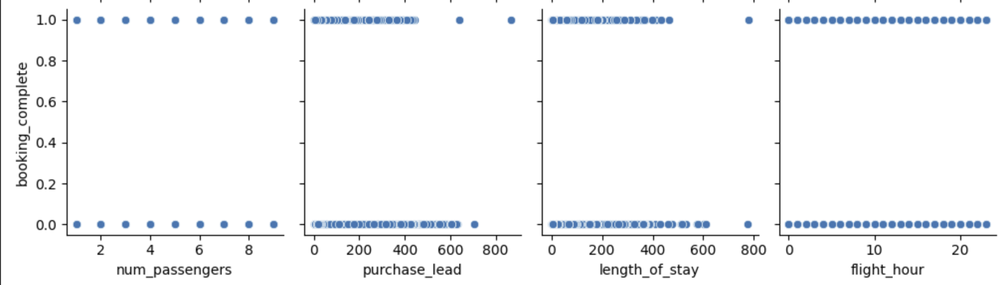
Relationship of Features with Successful Booking

Slide 3
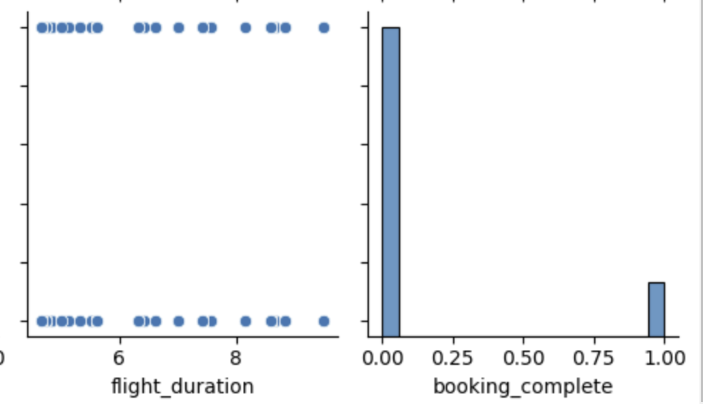
Relationship of Features with Successful Booking

Slide 4
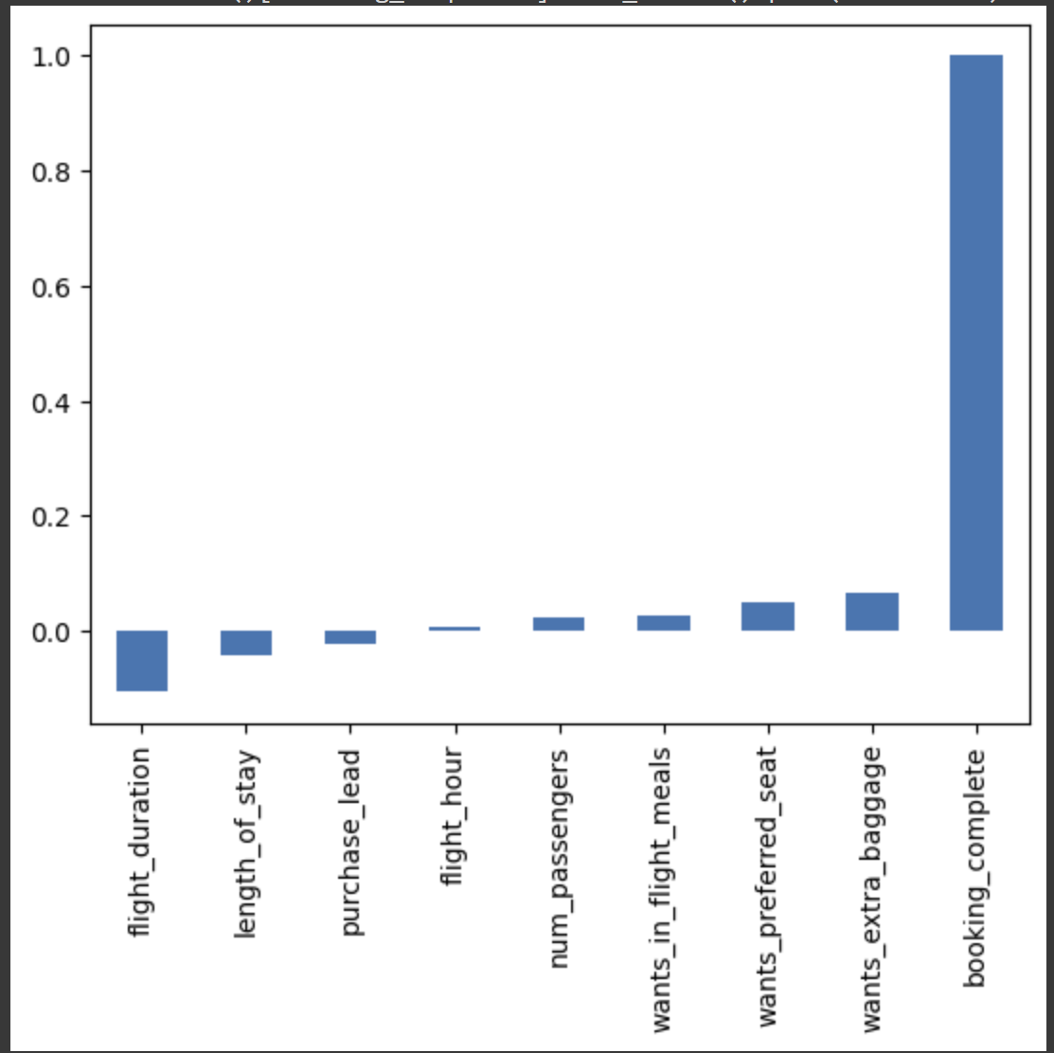
Correlation Between different features and Successful Booking
It clearly shows, the successful booking is not highly dependent on just one feature, out of all flight_duration has highest correlation with successful booking

Slide 5
Conclusions Of Relation
There are outliers in purchase lead and length of stay, so these must be removed from training data as it would cause overfitting.
The data is highly imbalanced, around 85% of data belong to only one class.

Slide 6
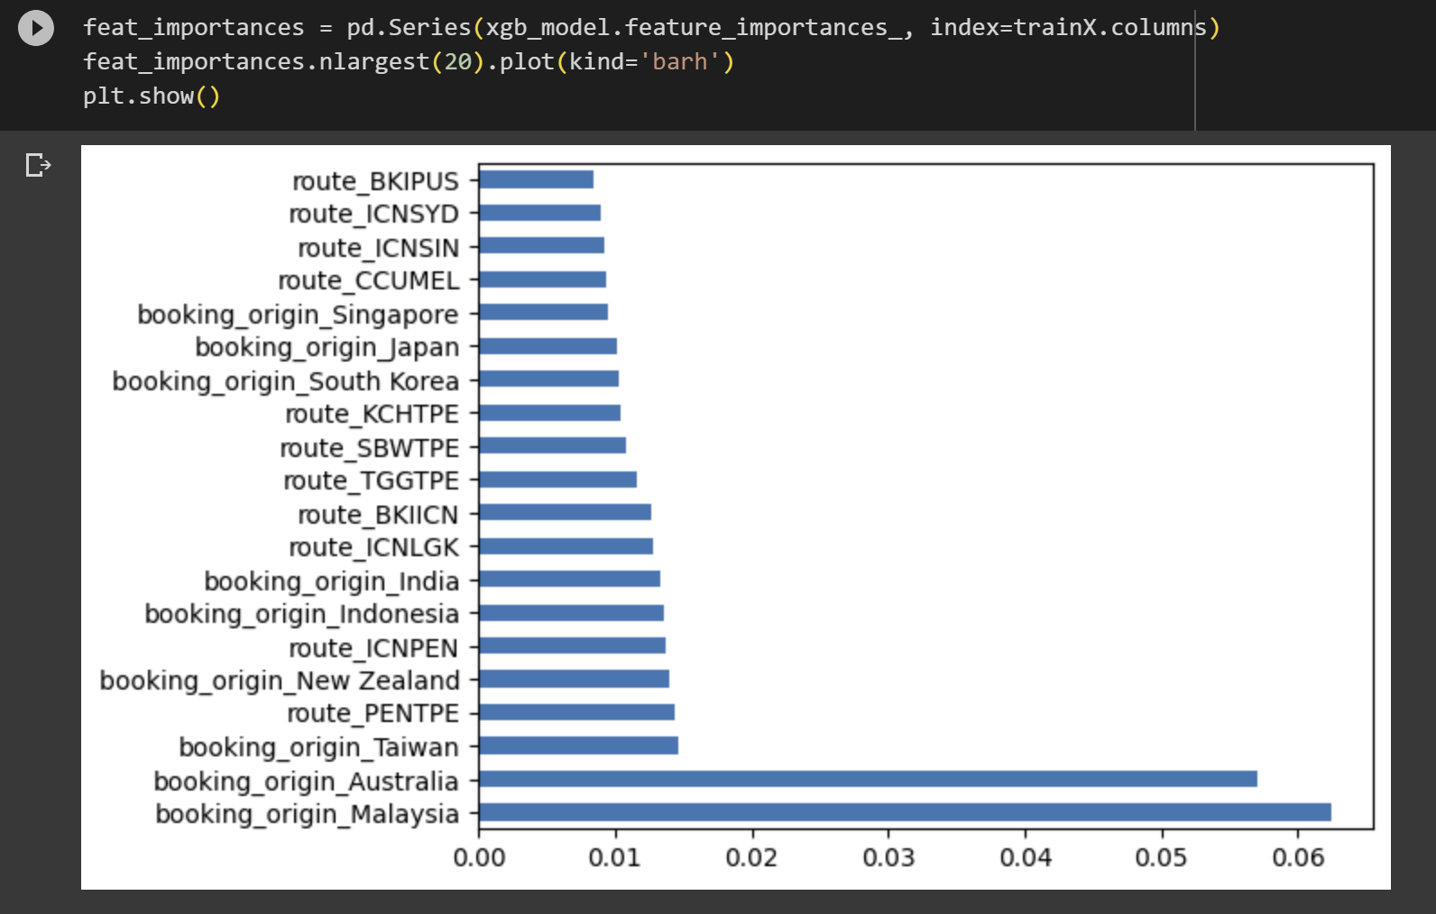
Most Important Features
These are top 20 features that contributed to the model while training.
It can be concluded that flight route plays important role, and after this booking origin plays important role.

Slide 7
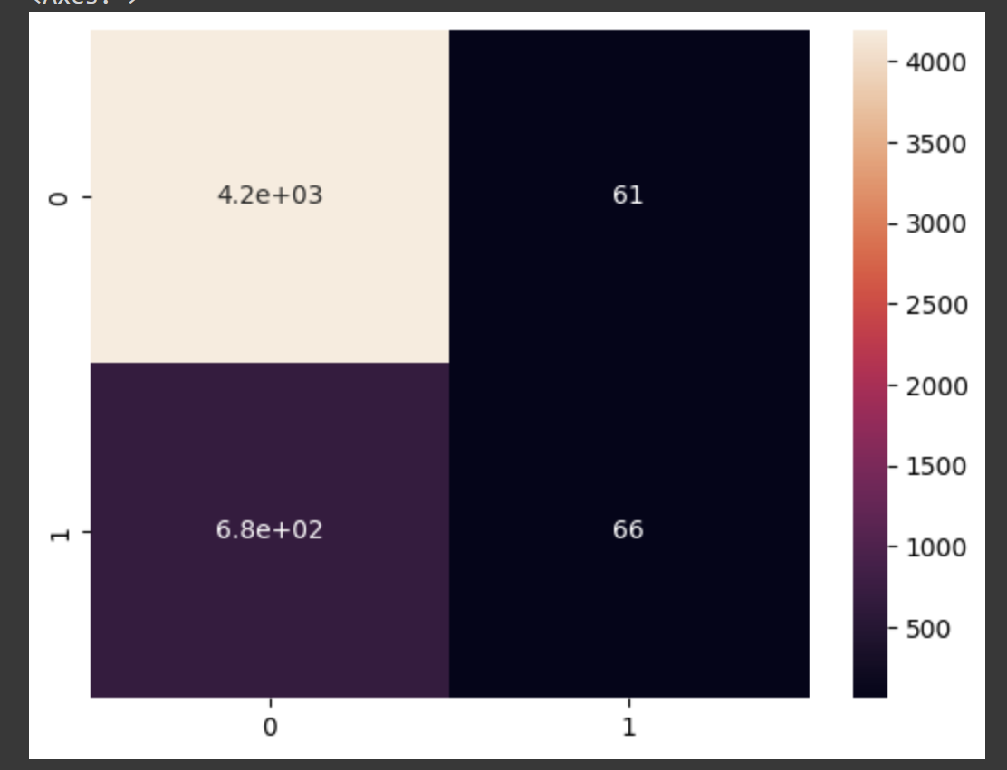
Evaluation of Model
Confusion matrix

Slide 8
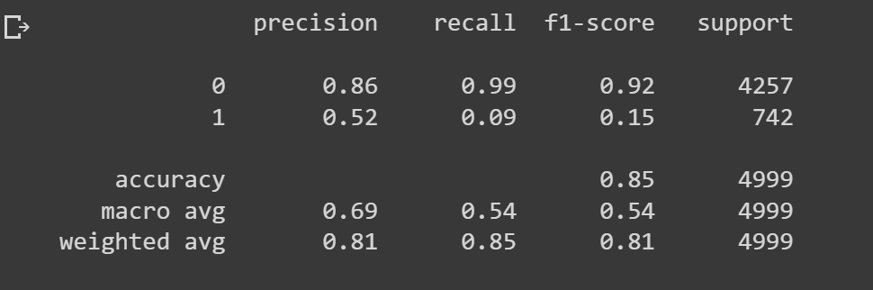
Evaluation of Model
Classification Report of Model

Slide 9
Conclusion
The data is very imbalanced and has outliers, so they must be removed, and data provided should be more balanced.
The features Routes and Booking_Origin are most important while training the data.
The XGB model accuracy is 85.25%, which is higher than predicting randomly

