Slide 1

Swiggy Data Analysis Case Study
- By Kartik Pant (Cohort-4)

Slide 2
Acknowledgement
I would like to express my gratitude to WsCube Tech for their invaluable guidance and support throughout the Swiggy SQL project. This project provided an excellent opportunity to apply and enhance my SQL skills through advanced query writing, complex joins, and real-world data analysis.
Special thanks to the mentors at WsCube Tech for their clear explanations, prompt feedback, and encouragement to dive deep into data-driven decision-making. The experience has significantly contributed to my understanding of SQL in the context of real-world business intelligence.
Thank you for making this learning journey insightful and rewarding.

Slide 3
Table of Content:
Display all customers who live in 'Delhi'.
Find the average rating of all restaurants in 'Mumbai'.
List all customers who have placed at least one order.
Display the total number of orders placed by each customer.
Find the total revenue generated by each restaurant.
Find the top 5 restaurants with the highest average rating.
Display all customers who have never placed an order.
Find the number of orders placed by each customer in 'Mumbai'.
Display all orders placed in the last 30 days.
List all delivery partners who have completed more than 1 delivery
Find the customers who have placed orders on exactly three different days.
Find the delivery partner who has worked with the most different customers.
Identify customers who have the same city and have placed orders at the same restaurants, but on different dates.

Slide 4

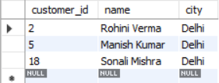
All the customers who live in 'Delhi'

Slide 5
Key Findings:
Query: The SQL query select customer_id, name, city from swiggydb.customers Where city = "Delhi"; was executed.
Objective: The objective of this query was to display all customers who reside in 'Delhi’.
Result: The query successfully returned three customers living in Delhi:
Rohini Verma (customer_id: 2)
Manish Kumar (customer_id: 5)
Sonali Mishra (customer_id: 18)

Slide 6
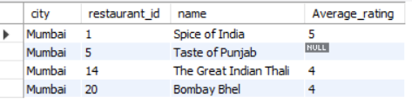
Average rating of all restaurants in “Mumbai”:

Slide 7
Key Findings:
Query Objective: To find the average rating for all restaurants located in 'Mumbai’.
SQL Query: The query select swiggydb.restaurants.city, swiggydb.restaurants.restaurant_id, swiggydb.restaurants.name, round(avg(swiggydb.restaurants.rating),0) Average_rating from swiggydb.restaurants where swiggydb.restaurants.city = "Mumbai" group by swiggydb.restaurants.city, swiggydb.restaurants.restaurant_id, swiggydb.restaurants.name; was executed. This query selects the city, restaurant ID, name, and the rounded average rating for restaurants, filtering by 'Mumbai' and grouping the results by the selected attributes.
Results: The query successfully returned the following average ratings for restaurants in Mumbai:
Spice of India (ID: 1): Average rating of 5.
Taste of Punjab (ID: 5): Average rating is NULL, indicating no ratings available or recorded for this restaurant.
The Great Indian Thali (ID: 14): Average rating of 4.
Bombay Bhel (ID: 20): Average rating of 4.

Slide 8
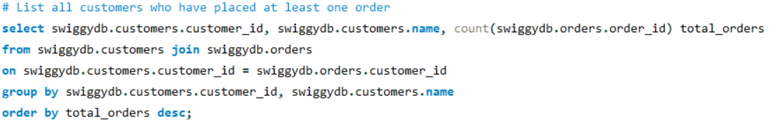
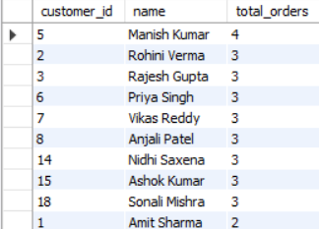
All customers who have placed at least one order:

Slide 9
Key Findings:
Objective: To list all customers from the swiggydb.customers table who have placed at least one order, along with the total number of orders they've placed.
SQL Query: The query select swiggydb.customers.customer_id, swiggydb.customers.name, count(swiggydb.orders.order_id) total_orders from swiggydb.customers join swiggydb.orders on swiggydb.customers.customer_id = swiggydb.orders.customer_id group by swiggydb.customers.customer_id, swiggydb.customers.name order by total_orders desc; was executed.
This query joins the customers and orders tables, counts the orders for each customer, groups the results by customer ID and name, and then orders them in descending order of total orders.
Results: The results provide a ranked list of customers based on their order frequency.
Manish Kumar (Customer ID: 5) is the most active customer, having placed 4 orders.
A significant number of customers, including Rohini Verma (ID: 2), Rajesh Gupta (ID: 3), Priya Singh (ID: 6), Vikas Reddy (ID: 7), Anjali Patel (ID: 8), Nidhi Saxena (ID: 14), Ashok Kumar (ID: 15), and Sonali Mishra (ID: 18), have each placed 3 orders.

Slide 10
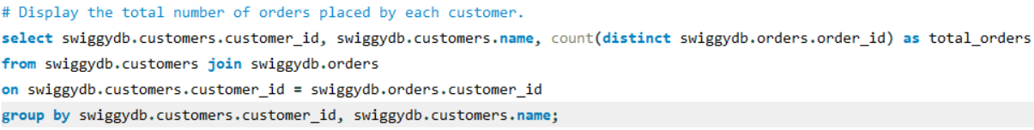
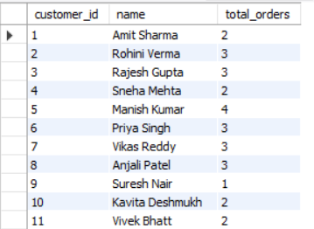
Total Orders placed by each customers:

Slide 11
Key Findings:
Objective: To display the total number of orders placed by each individual customer.
SQL Query: The query select swiggydb.customers.customer_id, swiggydb.customers.name, count(distinct swiggydb.orders.order_id) as total_orders from swiggydb.customers join swiggydb.orders on swiggydb.customers.customer_id = swiggydb.orders.customer_id group by swiggydb.customers.customer_id, swiggydb.customers.name; was executed. This query effectively joins the customers and orders tables, counts only distinct order IDs for each customer, and groups the results by customer ID and name to provide an accurate total order count per customer.
Results: The result set provides a clear overview of customer order activity:
Manish Kumar (ID: 5) is the top customer with 4 orders.
Several customers, including Rohini Verma (ID: 2), Rajesh Gupta (ID: 3), Priya Singh (ID: 6), Vikas Reddy (ID: 7), and Anjali Patel (ID: 8), have each placed 3 orders.
Customers like Amit Sharma (ID: 1), Sneha Mehta (ID: 4), Kavita Deshmukh (ID: 10), and Vivek Bhatt (ID: 11) have placed 2 orders.
Suresh Nair (ID: 9) has placed 1 order.

Slide 12
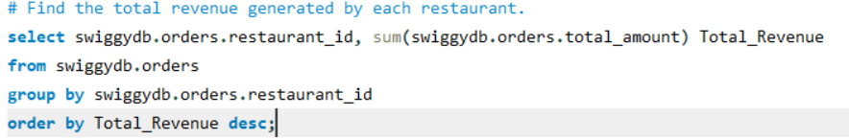
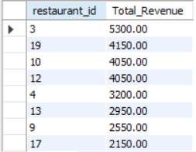
Total Revenue generated by each restaurants:

Slide 13
Key Findings:
Objective: To calculate and display the total revenue generated by each restaurant.
SQL Query: The query select swiggydb.orders.restaurant_id, sum(swiggydb.orders.total_amount) Total_Revenue from swiggydb.orders group by swiggydb.orders.restaurant_id order by Total_Revenue desc; was executed. This query sums the total_amount from the orders table for each restaurant_id, effectively calculating the total revenue per restaurant, and then orders the results in descending order of Total_Revenue.
Results: The results provide a ranking of restaurants by the revenue they have generated:
Restaurant ID 3 is the top revenue generator with a total of 5300.00.
Restaurant ID 19 follows with 4150.00.
Restaurant ID 10 and 12 both generated 4050.00 in revenue.
Other notable revenue generators include Restaurant ID 4 (3200.00), Restaurant ID 13 (2950.00), Restaurant ID 9 (2550.00), and Restaurant ID 17 (2150.00).

Slide 14
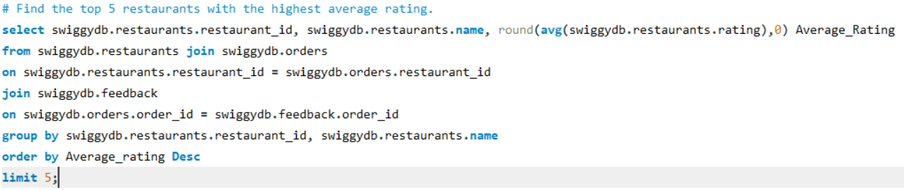
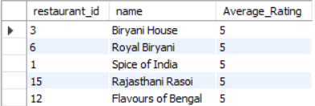
Top 5 restaurants by highest average rating:

Slide 15
Key Findings:
Objective: To find the top 5 restaurants with the highest average customer ratings.
SQL Query: The query select swiggydb.restaurants.restaurant_id, swiggydb.restaurants.name, round(avg(swiggydb.restaurants.rating),0) Average_Rating from swiggydb.restaurants join swiggydb.orders on swiggydb.restaurants.restaurant_id = swiggydb.orders.restaurant_id join swiggydb.feedback on swiggydb.orders.order_id = swiggydb.feedback.order_id group by swiggydb.restaurants.restaurant_id, swiggydb.restaurants.name order by Average_rating Desc limit 5; was executed. This query joins the restaurants, orders, and feedback tables to accurately calculate average ratings based on customer feedback. It then groups the results by restaurant, orders them by average rating in descending order, and limits the output to the top 5.
Results: The top 5 restaurants with the highest average ratings are all rated a perfect 5:
Biryani House (Restaurant ID: 3)
Royal Biryani (Restaurant ID: 6)
Spice of India (Restaurant ID: 1)
Rajasthani Rasoi (Restaurant ID: 15)
Flavours of Bengal (Restaurant ID: 12)

Slide 16
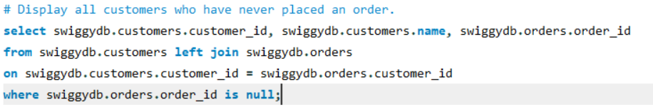
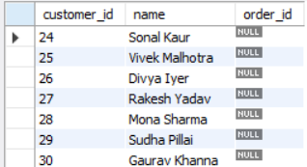
All Customers who have never placed an order:

Slide 17
Key Findings:
Objective: To identify and list all customers who have not yet placed any orders.
SQL Query: The query select swiggydb.customers.customer_id, swiggydb.customers.name, swiggydb.orders.order_id from swiggydb.customers left join swiggydb.orders on swiggydb.customers.customer_id = swiggydb.orders.customer_id where swiggydb.orders.order_id is null; was executed. This query performs a LEFT JOIN between the customers and orders tables. A LEFT JOIN returns all records from the left table (customers), and the matching records from the right table (orders). If there is no match, NULL is returned for the columns from the right table. The WHERE swiggydb.orders.order_id is null clause then filters these results to only include customers for whom no matching order ID was found, effectively identifying those who have never placed an order.
Results: The query successfully identified the following customers who have not placed any orders, as indicated by the NULL value in the order_id column:
Sonal Kaur (customer_id: 24)
Vivek Malhotra (customer_id: 25)
Divya Iyer (customer_id: 26)
Rakesh Yadav (customer_id: 27)
Mona Sharma (customer_id: 28)
Sudha Pillai (customer_id: 29)
Gaurav Khanna (customer_id: 30)

Slide 18
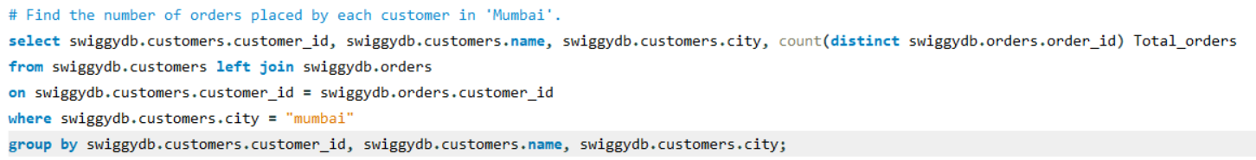
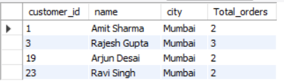
Number of orders placed by each customers in “Mumbai”:

Slide 19
Key Findings:
Objective: To determine the total number of distinct orders placed by each customer specifically located in 'Mumbai’.
SQL Query: The query select swiggydb.customers.customer_id, swiggydb.customers.name, swiggydb.customers.city, count(distinct swiggydb.orders.order_id) Total_orders from swiggydb.customers left join swiggydb.orders on swiggydb.customers.customer_id = swiggydb.orders.customer_id where swiggydb.customers.city = "Mumbai" group by swiggydb.customers.customer_id, swiggydb.customers.name, swiggydb.customers.city; was executed. This query performs a LEFT JOIN between the customers and orders tables, ensuring all Mumbai customers are included. It then filters for customers in 'Mumbai' and counts the distinct order_id for each customer, grouping by customer ID, name, and city.
Results: The analysis reveals the order activity of customers in Mumbai:
Rajesh Gupta (customer_id: 3) is the most active customer in Mumbai, having placed 3 orders.
Amit Sharma (customer_id: 1), Arjun Desai (customer_id: 19), and Ravi Singh (customer_id: 23) have each placed 2 orders.

Slide 20
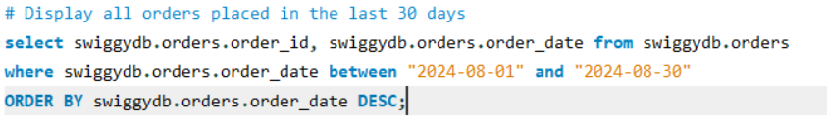
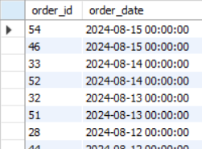
All Orders placed in last 30 days:

Slide 21
Key Findings:
Objective: To display all orders that were placed within a defined 30-day window, specifically between August 1st, 2024, and August 30th, 2024.
SQL Query: The query executed was select swiggydb.orders.order_id, swiggydb.orders.order_date from swiggydb.orders where swiggydb.orders.order_date between "2024-08-01" and "2024-08-30" ORDER BY swiggydb.orders.order_date DESC;. This query selects the order ID and order date from the swiggydb.orders table, filters the results to include only orders with dates within the specified range, and then orders them by date in descending order.
Results: The results demonstrate that orders from the specified period were successfully retrieved and sorted:
Orders on August 15, 2024, include order_id 54 and 46.
Orders on August 14, 2024, include order_id 33 and 52.
Orders on August 13, 2024, include order_id 32 and 51.
Orders on August 12, 2024, include order_id 28 and 44.

Slide 22
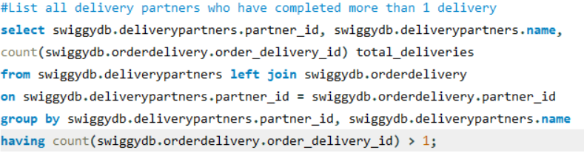
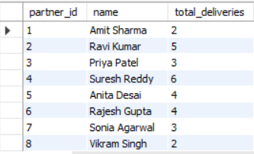
All delivery partners who have completed more than 1 delivery

Slide 23
Key Findings:
Objective: To list all delivery partners who have completed more than one delivery, along with the total number of deliveries they have made.
SQL Query: The query executed was select swiggydb.deliverypartners.partner_id, swiggydb.deliverypartners.name, count(swiggydb.orderdelivery.order_delivery_id) total_deliveries from swiggydb.deliverypartners left join swiggydb.orderdelivery on swiggydb.deliverypartners.partner_id = swiggydb.orderdelivery.partner_id group by swiggydb.deliverypartners.partner_id, swiggydb.deliverypartners.name having count(swiggydb.orderdelivery.order_delivery_id) > 1;. This query performs a LEFT JOIN between the deliverypartners and orderdelivery tables to link partners with their deliveries. It then counts the total deliveries for each partner, groups the results by partner ID and name, and finally filters these groups using the HAVING clause to include only those partners with more than 1 delivery.
Results: The results highlight the active delivery partners and their delivery volumes:
Suresh Reddy (Partner ID: 4) is the most active, having completed 6 deliveries.
Ravi Kumar (Partner ID: 2) has completed 5 deliveries.
Anita Desai (Partner ID: 5) and Rajesh Gupta (Partner ID: 6) have each completed 4 deliveries.
Priya Patel (Partner ID: 3) and Sonia Agarwal (Partner ID: 7) have each completed 3 deliveries.
Amit Sharma (Partner ID: 1) and Vikram Singh (Partner ID: 8) have each completed 2 deliveries.

Slide 24
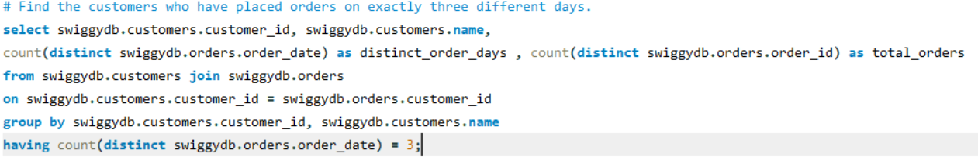
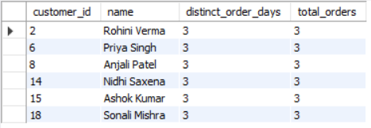
Customers who have placed orders on exactly 3 different days:

Slide 25
Key Findings:
Objective: To identify customers who have placed orders on precisely three distinct calendar days and to display their customer ID, name, the number of distinct order days, and their total distinct orders.
SQL Query: The query executed was select swiggydb.customers.customer_id, swiggydb.customers.name, count(distinct swiggydb.orders.order_date) as distinct_order_days , count(distinct swiggydb.orders.order_id) as total_orders from swiggydb.customers join swiggydb.orders on swiggydb.customers.customer_id = swiggydb.orders.customer_id group by swiggydb.customers.customer_id, swiggydb.customers.name having count(distinct swiggydb.orders.order_date) = 3;. This query joins the customers and orders tables. It then calculates the count of distinct order dates and distinct order IDs for each customer, groups the results by customer ID and name, and finally filters these groups to include only customers whose distinct order days count is exactly 3.
Results: The results show a list of customers who meet the criteria of having ordered on exactly three different days. Notably, all customers in the displayed result set have also placed a total of 3 orders, which suggests that each order was placed on a separate day for these specific customers. The customers identified are:
Rohini Verma (customer_id: 2): 3 distinct order days, 3 total orders.
Priya Singh (customer_id: 6): 3 distinct order days, 3 total orders.
Anjali Patel (customer_id: 8): 3 distinct order days, 3 total orders.
Nidhi Saxena (customer_id: 14): 3 distinct order days, 3 total orders.
Ashok Kumar (customer_id: 15): 3 distinct order days, 3 total orders.
Sonali Mishra (customer_id: 18): 3 distinct order days, 3 total orders.

Slide 26
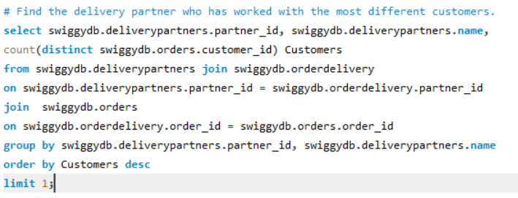

Delivery partner who has worked with the most different customers:

Slide 27
Key Findings:
Objective: To find the single delivery partner who has completed deliveries for the highest number of different customers.
SQL Query: The query executed was select swiggydb.deliverypartners.partner_id, swiggydb.deliverypartners.name, count(distinct swiggydb.orders.customer_id) Customers from swiggydb.deliverypartners join swiggydb.orderdelivery on swiggydb.deliverypartners.partner_id = swiggydb.orderdelivery.partner_id join swiggydb.orders on swiggydb.orderdelivery.order_id = swiggydb.orders.order_id group by swiggydb.deliverypartners.partner_id, swiggydb.deliverypartners.name order by Customers desc limit 1;. This complex query joins three tables: deliverypartners, orderdelivery, and orders. It counts the distinct customer_id associated with each partner_id, groups the results by partner, orders them in descending order based on the count of distinct customers, and finally limits the output to only the top result.
Results: The query successfully identified Suresh Reddy (Partner ID: 4) as the delivery partner who has worked with the most different customers. Suresh Reddy has served 6 distinct customers.

Slide 28
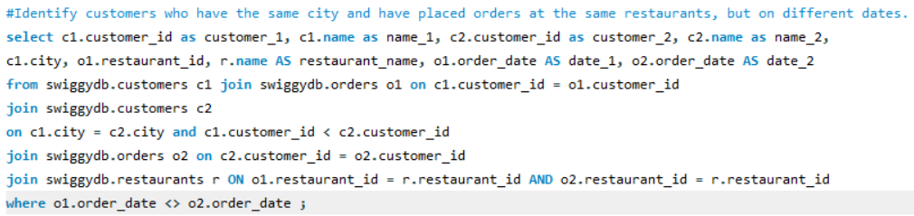
Customers who have the same city and have placed orders at the same restaurants, but on different dates:

Slide 29
Key Findings:
Objective: To identify and list pairs of customers who reside in the same city, have placed orders from the same restaurant, but where the order dates for these customers are distinct. The query ensures that each pair is listed only once by comparing customer_id values.
SQL Query: The executed query is:
select c1.customer_id as customer_1, c1.name as name_1, c2.customer_id as customer_2, c2.name as name_2, c1.city, o1.restaurant_id, r.name AS restaurant_name, o1.order_date as date_1, o2.order_date as date_2 from swiggydb.customers c1 join swiggydb.orders o1 on c1.customer_id = o1.customer_id join swiggydb.customers c2 on c1.city = c2.city and c1.customer_id < c2.customer_id join swiggydb.orders o2 on c2.customer_id = o2.customer_id join swiggydb.restaurants r ON o1.restaurant_id = r.restaurant_id AND o2.restaurant_id = r.restaurant_id where o1.order_date <> o2.order_date;
This query involves multiple joins:
swiggydb.customers (aliased as c1) and swiggydb.orders (aliased as o1) for the first customer's order.
A self-join on swiggydb.customers (aliased as c2) to find other customers in the same city, ensuring c1.customer_id < c2.customer_id to avoid duplicate pairs and self-comparisons.
Another join with swiggydb.orders (aliased as o2) for the second customer's order.
A join with swiggydb.restaurants (aliased as r) to get the restaurant name, ensuring both customers ordered from the same restaurant.
The final WHERE clause filters for cases where the order dates (o1.order_date and o2.order_date) are different.
Results: The results show pairs of customers meeting the specified criteria:
Manish Kumar (Customer ID: 5) and Sonali Mishra (Customer ID: 18), both from Delhi, ordered from Biryani House (Restaurant ID: 3).
Manish ordered on 2024-08-04, while Sonali ordered on 2024-08-05.
Another instance shows Manish ordering on 2024-08-07 and Sonali still on 2024-08-05, from the same Biryani House in Delhi.
Arjun Desai (Customer ID: 19) and Ravi Singh (Customer ID: 23), both from Mumbai, ordered from Veggie Delight (Restaurant ID: 8).
Arjun ordered on 2024-08-03, while Ravi ordered on 2024-08-09.

Slide 30
Swiggy Data Analysis Case Study
- Thank you

