Slide 1
VittaManthan
AI-Powered Financial Intelligence Platform
Consent-based aggregation + RAG AI for real-time insights

Slide 2
Problem & Motivation
Indian users manage multiple banks and payment instruments—data is fragmented.
Manual tracking and CSV imports are slow, error-prone, and lack real-time insight.
Existing tools miss Account Aggregator (AA) integration and compliance.
Need secure, consent-based access with AI-driven financial understanding.

Slide 3
Solution Overview
Integrates Setu Account Aggregator to fetch financial data with user consent.
Unifies multi-account transactions into a single dashboard.
RAG-powered assistant answers natural language queries (EN/HI/Hinglish).
Real-time streaming responses and export to PDF/Excel/CSV.

Slide 4
Why It Works
AA consent lifecycle ensures secure, compliant data access—no credential sharing.
RAG combines FAISS vector search with LLM reasoning over grounded transaction data.
Microservices + API gateway enable independent scaling and resilience.
Per-user vector stores isolate data; SSE streaming delivers fast feedback.

Slide 5
Key Capabilities
Consent management with visual lifecycle tracking.
Multi-account aggregation and unified analytics dashboard.
AI chat assistant with multilingual support and vector search.
Transaction intelligence: categorization, anomaly patterns, stats.
Multi-format exports (PDF/Excel/CSV) and real-time updates.

Slide 6
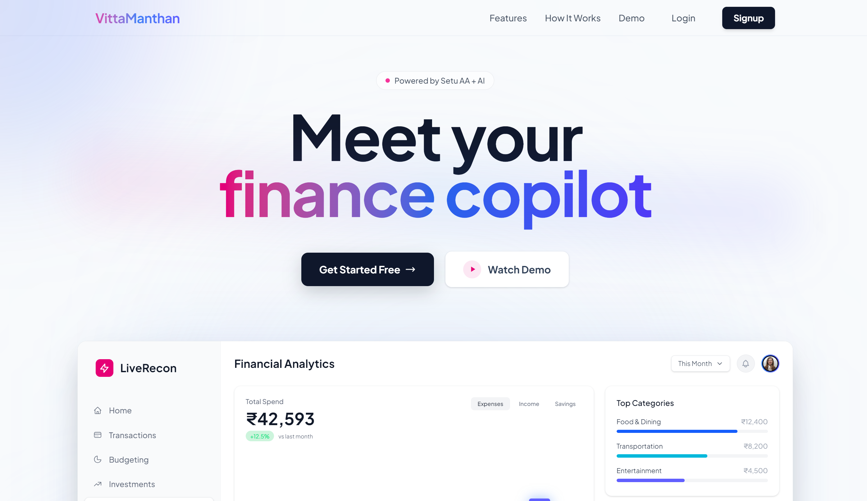
UI Overview
Overall product interface

Slide 7
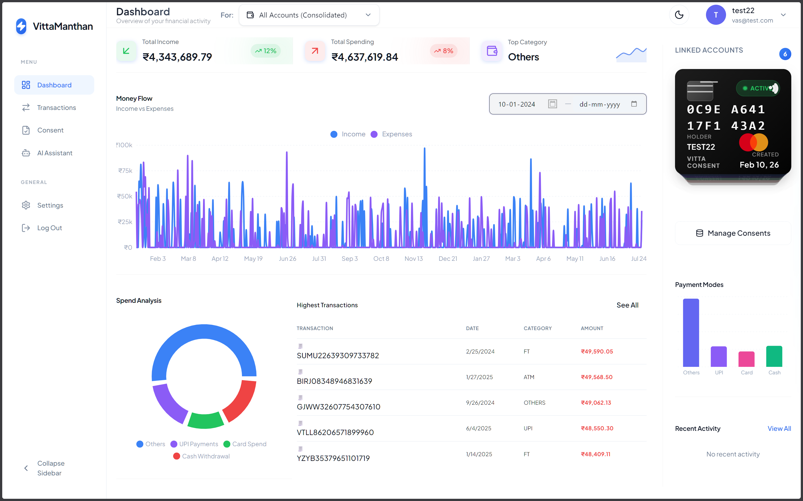
Dashboard
Consolidated financial overview with money flow and spend analysis

Slide 8
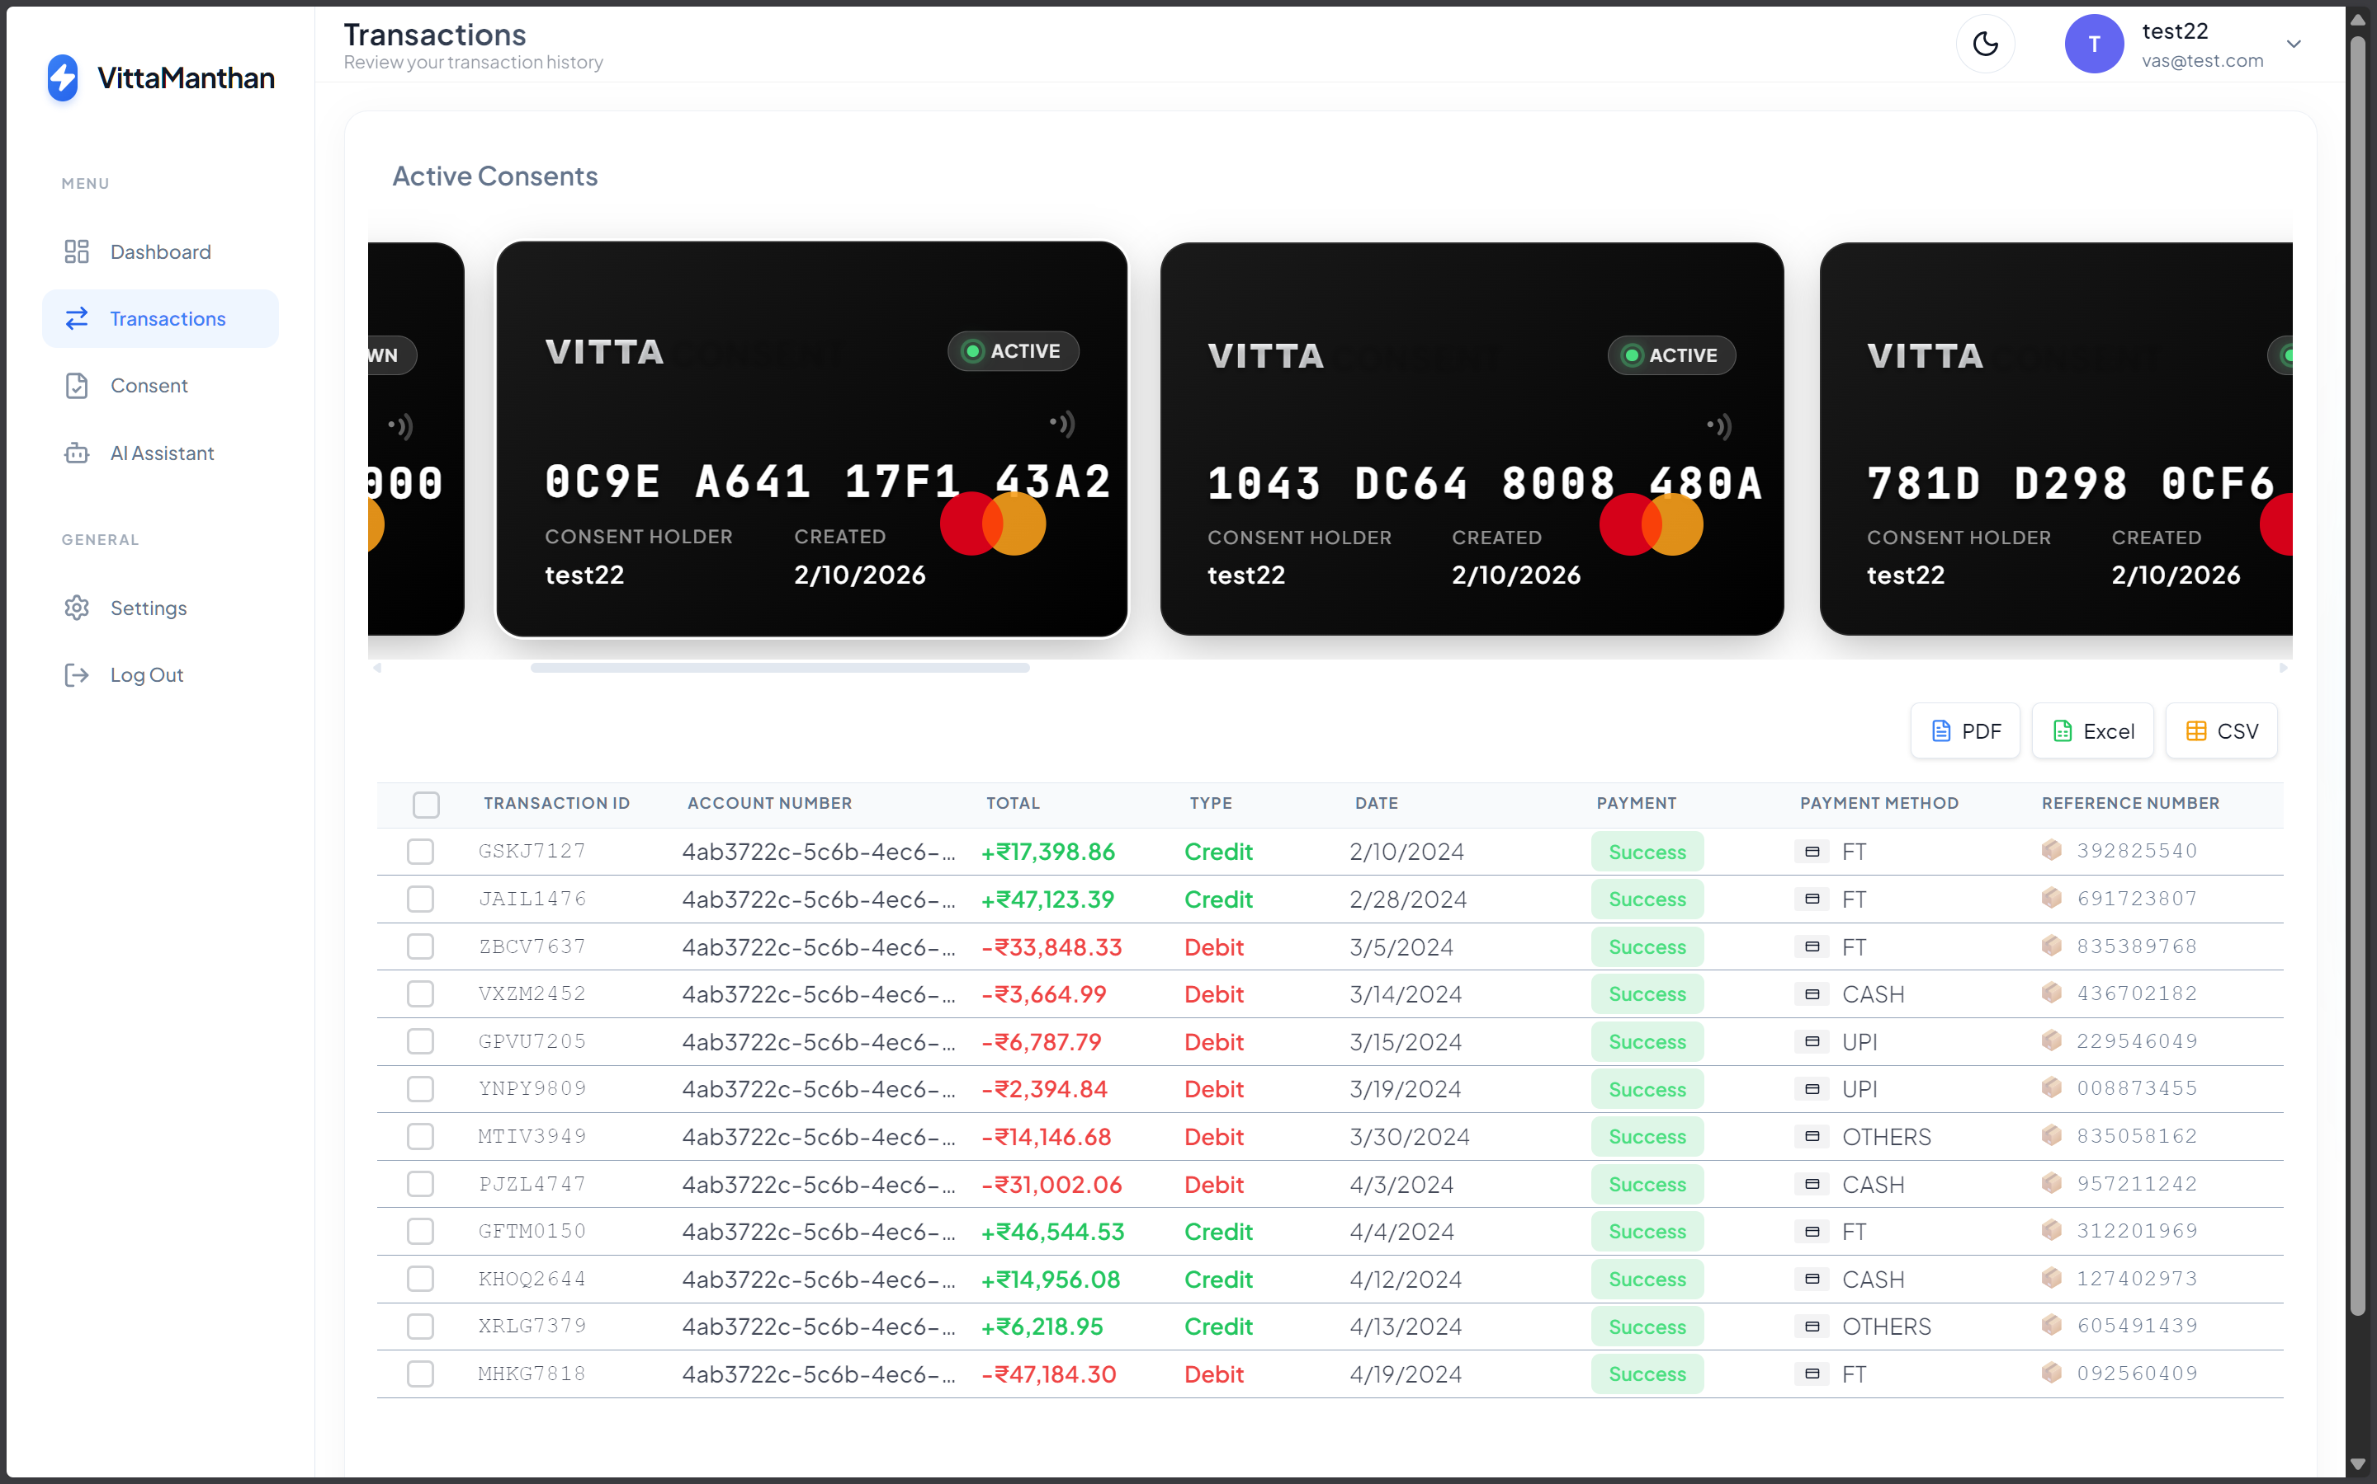
Transactions
Detailed transaction table with exports and filters

Slide 9
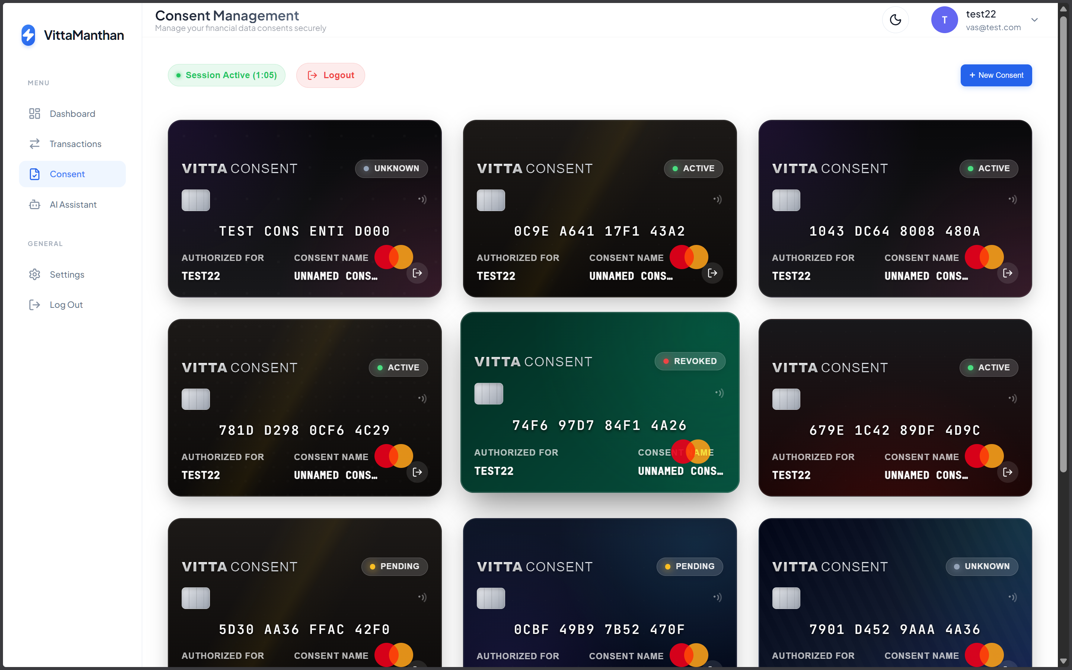
Consent Management
AA consent lifecycle with status tracking

Slide 10
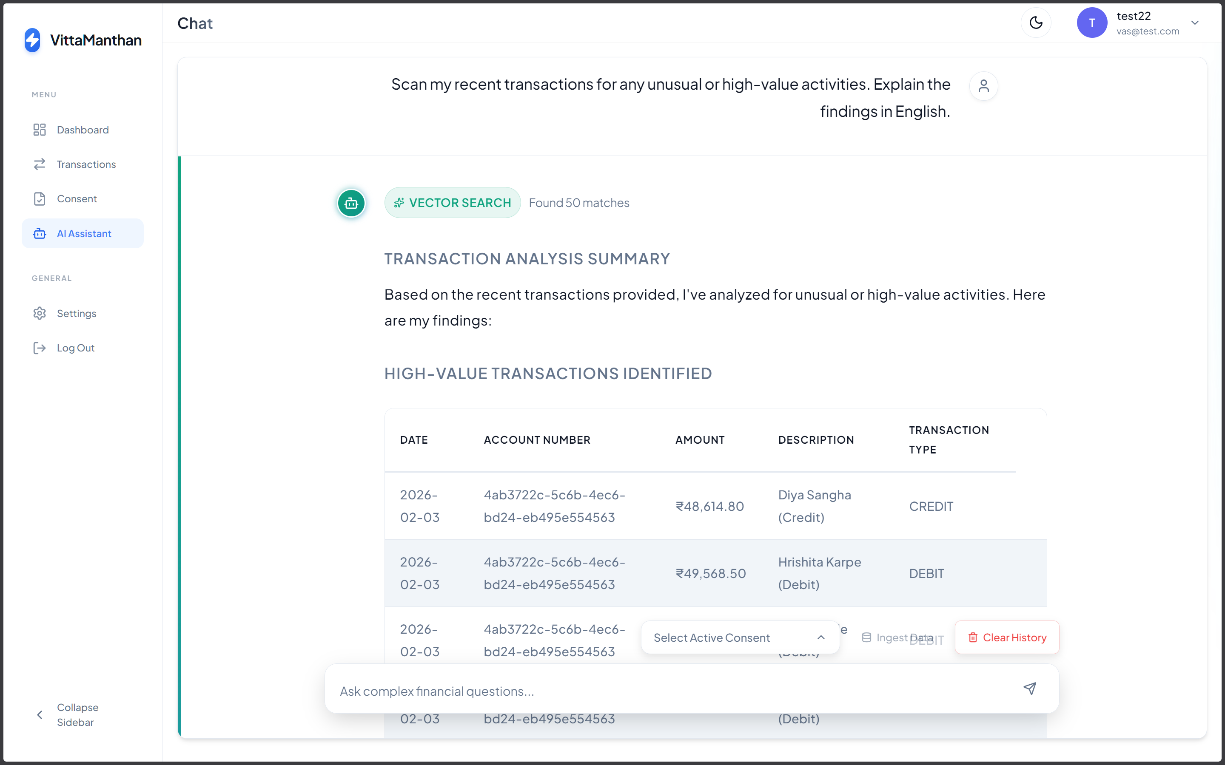
AI Assistant
RAG-powered conversational insights

Slide 11
System Architecture
Frontend: React + Vite on Netlify (dashboard, transactions, consents, AI chat).
Gateway: Spring Cloud Gateway (JWT validation, routing, rate limiting).
Services: Auth, Account, Transaction (Spring Boot) + RAG (FastAPI).
Data layer: DynamoDB for core data; PostgreSQL + FAISS for RAG.
External: Setu AA APIs, OpenRouter LLMs, HuggingFace embeddings.

Slide 12
Technology Stack
Frontend: React 18, Vite, Recharts.
Backend: Spring Boot microservices + Spring Security.
AI: FastAPI, LangChain, OpenRouter LLMs, FAISS, sentence-transformers.
Data: DynamoDB, PostgreSQL, in-memory vector stores.
DevOps: Docker, Kubernetes, Netlify, AWS EC2/S3/DynamoDB.

Slide 13
RAG Pipeline (How it Works)
Ingest: format transactions and create MiniLM-L6-v2 embeddings.
Store embeddings in per-user FAISS vector store (k-NN search).
Detect query mode: vector search, analytical, statistical, or smart-full.
Build prompt with retrieved context and call LLM via OpenRouter.
Stream responses via SSE with tables, stats, and summaries.

Slide 14
Data Flow
Consent flow: User → Frontend → Gateway → Account Service → Setu AA.
AA webhooks notify consent approval and FI data availability.
Account/Transaction services decrypt and store data in DynamoDB.
AI flow: Frontend → RAG Service → ingest → search/analysis → LLM response.

Slide 15
Performance, DevOps & Security
Performance: <50ms vector search; 0.5–1.5s index build for 1k txns; ~0.5–1s first token.
Scalability: Kubernetes HPA, DynamoDB on-demand, per-user vector stores.
DevOps: Docker Compose for local, K8s manifests for prod, Netlify + AWS EC2.
Security: JWT + RBAC, gateway validation, AA encryption, CORS allowlist, env secrets.
Live demo: https://vittamanthan.netlify.app

