Slide 1
Credit Card Fraud Detection
Machine Learning
Name : Kartik Dharmaraj Patil
Batch Code : ML 20

Slide 2
Contents
- Abstract
- Introduction
- Fraud Detection
- Project Workflow
- Technologies and Tools Used
- ML Model

Slide 3
Abstract ->
Due to cashless Transaction every people use ATM card and credit card for transaction, so fraud can also be increase . Billions of dollars of loss are caused every year by fraudulent credit card transactions. The design of efficient fraud detection algorithms is key for reducing these losses, and more and more algorithms rely on advanced machine learning techniques to assist fraud investigators.

Slide 4
Introduction ->
The online shopping growing day to day. Credit cards are used for purchasing goods and services with the help of virtual card and physical card where as virtual card for online transaction and physical card for offline transaction . In a physical-card based purchase, the cardholder presents his card physically to a merchant for making a payment. If the cardholder does not realize the loss of card, it can lead to a substantial financial loss to the credit card company. In online payment mode, attackers need only little information for doing fraudulent transaction (secure code, card number, expiration date etc.)

Slide 5
Fraud Detection ? ->
Fraud detection is a topic which is applicable to many industries including banking and financial sectors, insurances, government agencies, and low enforcement and more. Through the use of sophisticated use of data mining tools millions of transaction can be searched to spot patterns and detect fraudulent transaction. Fraud detection is process of identifying fraud rent transaction . Credit card fraud detection technic used to recognize fraudulent credit card transactions so that customers are not charged for items that they did not purchases.

Slide 6
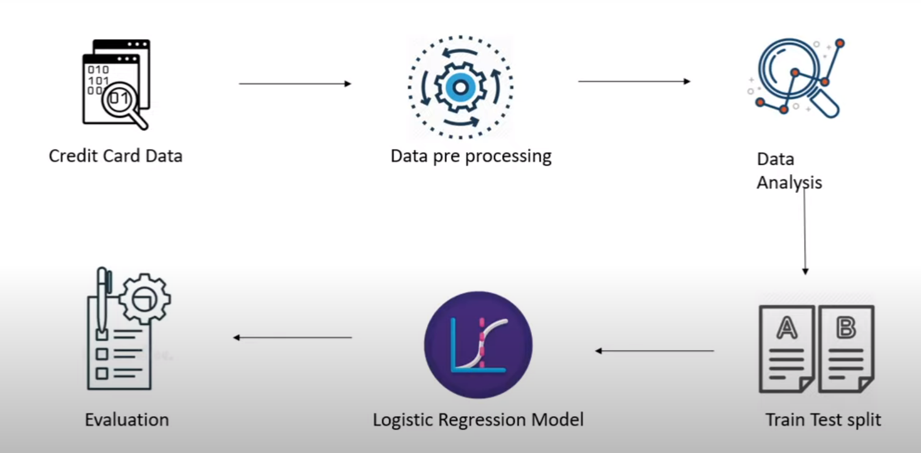
Project Work Flow ->
Ignore Missing Values rows/ Delete Rows
Filling Missing Values Manually
Global Constant
Measure Of Central Tendency (Mean, Median, Mode)
Most Probable Value (ML Algorithm)

Slide 7
Technologies and Tools Used ->
Dataset : kaggle datasets download -d mlg-ulb/creditcardfraud
Tools :
Numpy
Pandas
Matplotlib
Seaborn
Sciket-Learn
ML Model :
Supervised Learning
Logistic regression Algorithm

Slide 8
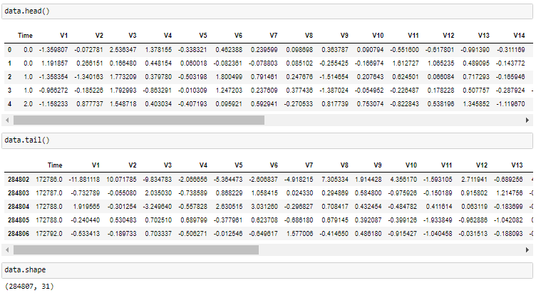
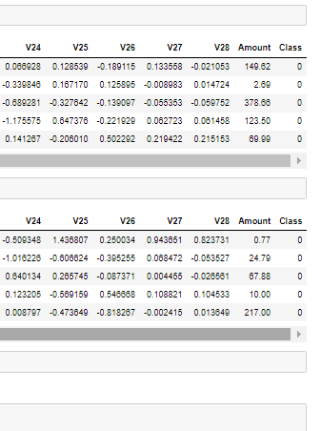
DATASET ->

Slide 9
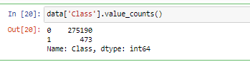
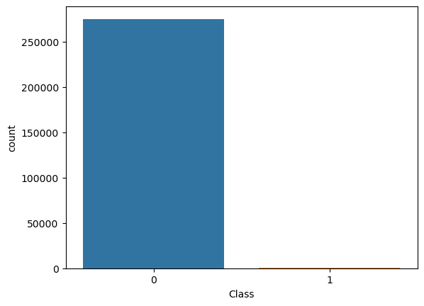
Data Visualization ->
Showing the Unbalancing in the Data:

Slide 10
Logistic Regression Algorithm ->
Logistic regression: It is a statistical model that in its basic form uses a logistic function to model a binary dependent variable, although many more complex extensions exist. In regression analysis, logistic regression is estimating the parameters of a logistic model (a form of binary regression).

Slide 11
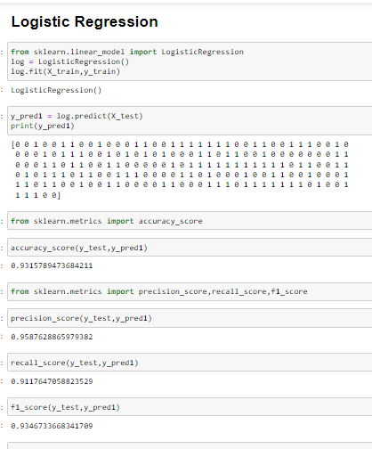

Slide 12
Advantages ->
The results obtained by the Logistic Regression Algorithm is best Compared to any other Algorithms.
The Accuracy Obtained was almost equal to cent percent which proves using of Logistic Algorithm gives best Results.

Slide 13
References ->
https://www.kaggle.com/
https://www.github.com/
https://www.geeksforgeeks.org/

Slide 14
Thanks
For your valuable time.

