Slide 1

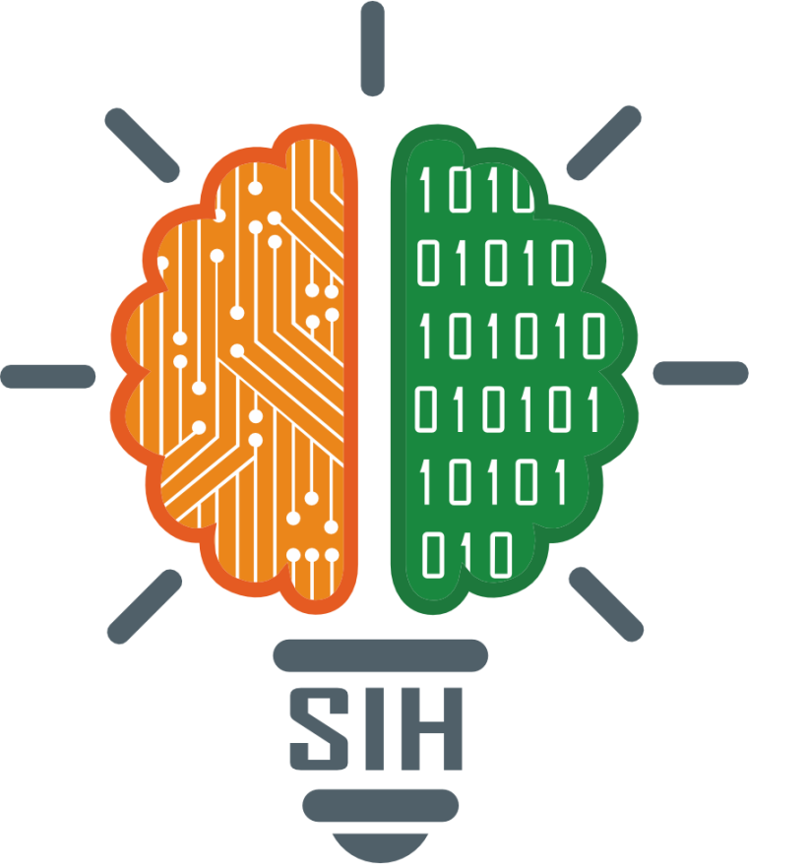
SMART INDIA HACKATHON 2025
Problem Statement ID – 25022
Problem Statement Title-
Maximizing Section Throughput Using Al-Powered Precise Train Traffic Control
Theme- Transportation & Logistics
PS Category- Software
Team ID-
Team Name- Orion Pax
Notes:
Good afternoon esteemed judges and fellow teachers, today we at Orion pax bring to you traya, where we move beyond traditional ,static scheduling methods to an intelligent dynamic scheduling system to optimize train movements in real time. While the development of traya, we had one primary goal in mind — to avoid any accidents—yes I'm talking about the 2023 Odisha train accident, which resulted in the loss of lives of 300 people and injured another 1200. Frankly, all of it could've it been avoided, had one train been on time and the electronic breaking system were working. To ensure that such a tragedy never occurs and the your life just doesn't turn into another statistic, we at traya strive for excellence so that we can not only save your time, but also your life. Now satyabrat will be taking over to talk about the core technologies that we have implemented to further our vision

Slide 2
AI-Driven Dynamic Train Scheduling for Real-Time Traffic Optimization
Orion Pax
IDEA/SOLUTION:
AI-Driven Dynamic Train Scheduling for Real-Time Traffic Optimization.
AI engine for dynamic scheduling
GPS & sensors for live train data
Predictive rescheduling to cut delays
Ticket-ID based hashed tracking
Dashboard with live map & ETA
Smart alerts on delays and arrivals
One platform for ops and passengers
PROBLEM RESOLUTION:
Dynamic scheduling with ticket linked passenger services
Ticket-ID based personalized live train updates
AI-driven predictive rescheduling for congestion control
Unified dashboard for operators and passengers
Modular design scalable to full ITMS
Aligned with RDSO and EN standards
INNOVATION & UNIQUENESS:
Integrates traffic optimization with passenger services
Ticket ID based personalized tracking for tourists
Quantum AI predictive scheduling reduces conflicts
Unified platform for railways and travellers
Modular architecture for scalable deployment
Ready for RDSO compliance adaptation
Notes:
Use PyTorch as the primary DL framework, because:
Easier prototyping & debugging (ideal for hackathon speed).
Strong support for YOLO-based CV models (fastener/sleeper/defect detection).
PyTorch Lightning makes training/experimentation faster.
Hugging Face + PyTorch integration is smoother for pre-trained models.
Use TensorFlow Lite for deployment (especially on edge/IoT devices):
TF Lite runs efficiently on Jetson Nano, Raspberry Pi, smartphones.
Good for real-time inference with low compute.
Lightweight → ensures passengers’ ticket-ID tracking + anomaly detection work live.
these api handle ticket-ID queries, train status requests, and integrate external data sources like NTES/IRCTC.
Django powers our operator + passenger dashboards.
Handles authentication, analytics, and report generation.
Provides ORM mapping → direct link to PostgreSQL for structured data
Redis for Real-Time Caching
Train data changes every second → Redis ensures fast, real-time caching.
Multi-source input: GPS (train location), Axle Encoder (chainage mapping), IoT sensors (IMU, accelerometer), APIs (NTES/IRCTC).
Time Synchronization: Every data point is timestamped (PTP/GPS sync) → ensures accuracy for scheduling.
Pre-processing: Noise filtering, cleaning, data normalization before feeding into ML models.
Streaming Pipeline: Kafka/RabbitMQ (optional in future) → for continuous real-time ingestion.
Edge Processing: Some data filtered/stored on IoT devices (Jetson, Pi) before sending to cloud/server → reduces bandwidth.
Fail-Safe Design: NVMe buffer storage if network drops → no data loss.
API Integration: Standardized formats (CSV, JSON, XML) for smooth transfer between layers.
IoT devices collect → Data Ingestion Layer cleans & syncs → API layer exposes → Redis caches → PostgreSQL stores → Django dashboard shows → ML engine optimizes → Passengers/operators see live results.

Slide 3


TECHNICAL APPROACH
Orion Pax
Signaling Systems
Operator Dashboard
Interlock and signal status feeds
Visualize alerts and KPIs
Edge Sensors
Feedback Loop
Real-time train & track telemetry
AI Processing
Labelled data for continuous learning
Python ML engine for inference
Core Technologies
Hardware Infrastructure
Programming Languages: Python for AI/ML algorithms and data processing
Machine Learning Frameworks: TensorFlow and PyTorch for deep learning model development and training
Web Framework: Flask for lightweight API development, Django for comprehensive dashboard functionality
Database Systems: Redis for real-time caching, PostgreSQL for historical data storage and analytics
Processing Units: Industrial-grade PCs with NVIDIA GPU acceleration for AI computations
Connectivity: Bluetooth beacons 20-30meteres
Environmental Rating: IP69k-rated enclosures suitable for harsh railway environments
Power Systems: Uninterrupted power supplies with 4-hour and solar battery backup for continuity
Data Ingestion Layer
AI Optimisation Engine
Operator Interface
Real-time data streams from track circuits, axle counters, weather stations, and rolling stock telemetry feed into our high-performance data ingestion pipeline. The system processes up to 10,000* data points per second with sub-100ms latency.
Quantum Machine learning algorithm analyse current network state and predict optimal routing decisions. The engine evaluates thousands of potential scenarios simultaneously, selecting strategies that maximise throughput whilst maintaining safety margins.
Intuitive web-based dashboard provides real-time network visualisation, conflict predictions, and recommended actions. Mobile responsive design ensures accessibility across devices, enabling remote monitoring and decision-making.
Notes:
Thank you Satyabrat.[show your landing page]This is TRAYA, our indigenous railway innovation platform. It combines AI precision, indigenous design and unmatched reliability to transform Indian Railways.
Behind this sleek interface are real-time dashboards that pull in over 10 000 data points per second from track circuits, axle counters, weather stations and telemetry.
Our AI engine analyses them instantly to predict conflicts and identify delays learning over patterns.
[scroll to Innovation or Benefits section]Here you can see how TRAYA is built for 25 cm accuracy with 100 % repeatability, delivering economic, passenger and environmental benefits.
[scroll to AI Features Panel]We’ve integrated multiple smart modules: analytics for track monitoring and predictive-maintenance AI.
[mention quantum ML briefly]Quantum machine learning can explore and optimise huge, constraint-heavy scheduling spaces in parallel, which grow exponentially for classical ML.This parallelism helps reach higher-quality routing and prediction solutions faster than traditional models.
Today our core modules run on classical ML frameworks. But in simulation we’ve compared them to a quantum-enhanced model on realistic scheduling problems. Where the classical model plateaued below 65 % accuracy, the quantum model reached 91 %, demonstrating clear potential for the next scale-up phase.
We promote the use of Quantum Machine Learning for the functioning of TRAYA, furthermore, Processed via an AI optimization engine for conflict prediction and routing.

Slide 4
FEASIBILITY AND VIABILITY
Orion Pax
Technical Feasibility
Operational Challenges
TRAYA leverages mature technologies including established machine learning frameworks and industrial computing systems. Our development approach builds upon existing successful implementations in logistics and manufacturing sectors, adapted specifically for railway operations.
Integration capabilities with current SCADA and signaling systems will be validated through extensive simulation testing. The system's modular architecture allows incremental deployment, reducing implementation complexity and associated risks.
Primary challenges include data latency in legacy systems and the critical need for regulatory approval from railway safety authorities. Additionally, operator training and change management represent significant considerations for successful adoption.
Weather-related sensor degradation and the complexity of integrating with diverse signaling systems across different railway sections present ongoing operational challenges requiring continuous monitoring and adaptation.
Risk Mitigation Strategies
Data latency concerns are addressed through implementation of low-latency communication protocols and edge computing capabilities. On premise processing with local decision capability ensures critical decisions remain independent of external network connectivity, maintaining operational reliability during communication disruptions.
Regulatory approval processes are facilitated through comprehensive safety case development, including extensive simulation testing and gradual deployment strategies. Our approach includes collaboration with railway safety authorities from project inception, ensuring compliance requirements are integrated into system design rather than addressed retrospectively.
Small-scale pilot projects provide validation opportunities whilst demonstrating tangible benefits to stakeholders. These controlled implementations allow comprehensive performance measurement and system refinement before broader deployment across the network.
Critical Success Factors
Robust failover mechanisms ensuring seamless transition
Comprehensive operator training programmes
Continuous monitoring and performance validation
Regular system updates and algorithm refinement
Months 1-6
Months 13-18
Pilot implementation and safety validation
Phased deployment across priority sections
1
2
3
4
Months 7-12
Months 19-24
Regulatory approval and system certification
Full network integration and optimisation
Notes:
Ladies and Gentlemen,Every advancement in our technology drives societal growth and welfare. Let us dive into the business model of our TRAYA.In India, while third-party apps dominate ticket booking and status checks with user-friendly interfaces and real-time sync, they're pulling users from government software. TRAYA bridges this gap, rebuilding trust and long-term dependency on indigenous solutions, embodying Atmanirbhar Bharat.At the heart of our 68,000 km network, with 13,000 trains daily, TRAYA optimizes punctuality, safety, and efficiency. It taps into the ₹15-20 lakh crore modernization market, backed by the government's ₹2.52 lakh crore FY25-26 budget.Our B2G model partners with Indian Railways, DFCCIL, and metros, delivering hardware kits, software licensing, and AMC contracts for 60-80% recurring revenue. At 40-60% cheaper than imported TRC or ITMS, we slash downtime by 30-40% and ensure 99.9% uptime.Built on proven machine learning and industrial computing, TRAYA integrates with SCADA and signaling via modular edge architecture, enabling low-risk deployment while tackling data latency and sensor issues.

Slide 5




IMPACT AND BENEFITS
Orion Pax
Enhanced Passenger Experience
Safety Enhancement
Environmental Sustainability
Improved punctuality and service reliability directly enhance passenger satisfaction and confidence in railway services. Reduced delays mean commuters can plan their journeys with greater certainty, improving work-life balance and reducing stress associated with unpredictable travel times.
AI powered conflict prediction significantly reduces the risk of human error in critical scheduling decisions. Automated systems provide consistent, objective analysis free from fatigue-related mistakes that can compromise safety during extended operational periods.
Optimised train movements reduce overall energy consumption by minimising unnecessary acceleration and braking cycles. Intelligent routing reduces idle time at signals, decreasing fuel consumption and associated carbon emissions by an estimated 15-20% per journey.
92%
67%
ROI Projection: Conservative estimates indicate full cost recovery within 18-24 months of implementation, with ongoing annual benefits of approx. ₹5.3M per major route section.
Punctuality Improvement
Passenger Satisfaction
Target achievement of 92% on-time performance through predictive scheduling and conflict prevention
Projected improvement in passenger satisfaction scores through enhanced reliability and journey experience
₹2.8M
₹1.6M
₹890K
Annual Revenue Increase
Operational Cost Savings
Delay Compensation Reduction
Through 25-30% improvement in section throughput capacity enabling additional train services during peak periods
Reduced fuel consumption through optimised acceleration and braking patterns, plus decreased maintenance costs
Significant reduction in passenger compensation claims through improved punctuality and service reliability
Notes:
The impact? 92% punctuality, 67% passenger satisfaction surge, 20% reduced emissions, ₹2.8 million revenue boost per section, ₹1.6 million cost savings, and ₹890,000 less in delay compensations.We manage risks with low-latency protocols, failover mechanisms, and regulatory partnerships. Success hinges on robust systems, operator training, continual monitoring, and algorithm refinement.With phased pilots yielding ₹50-200 crore in Years 1-2, scaling to 300-800% ROI by Year 5 via PPPs, TRAYA promises full cost recovery in 18-24 months and over ₹5.3 million annual benefits per route.This isn't just tech—it's India's commitment to commuters and global leadership.

Slide 6
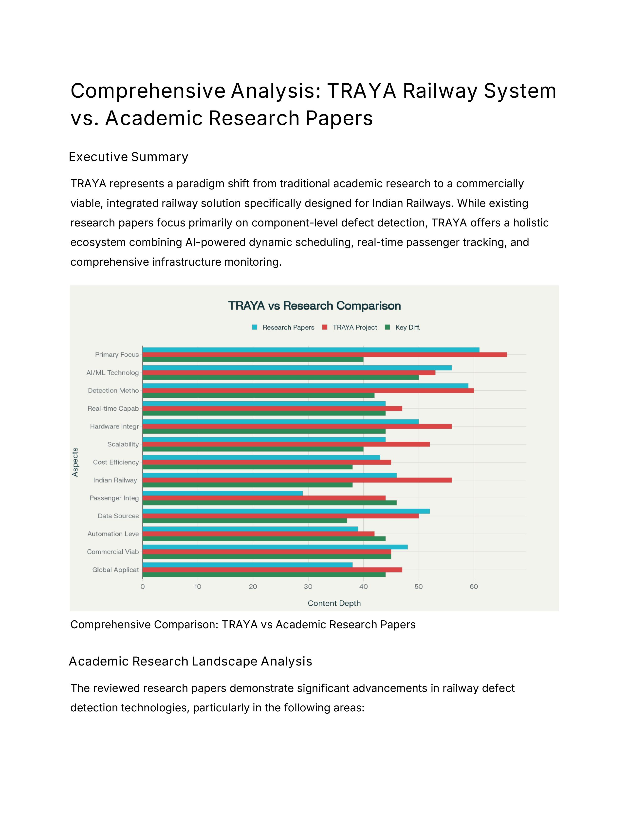
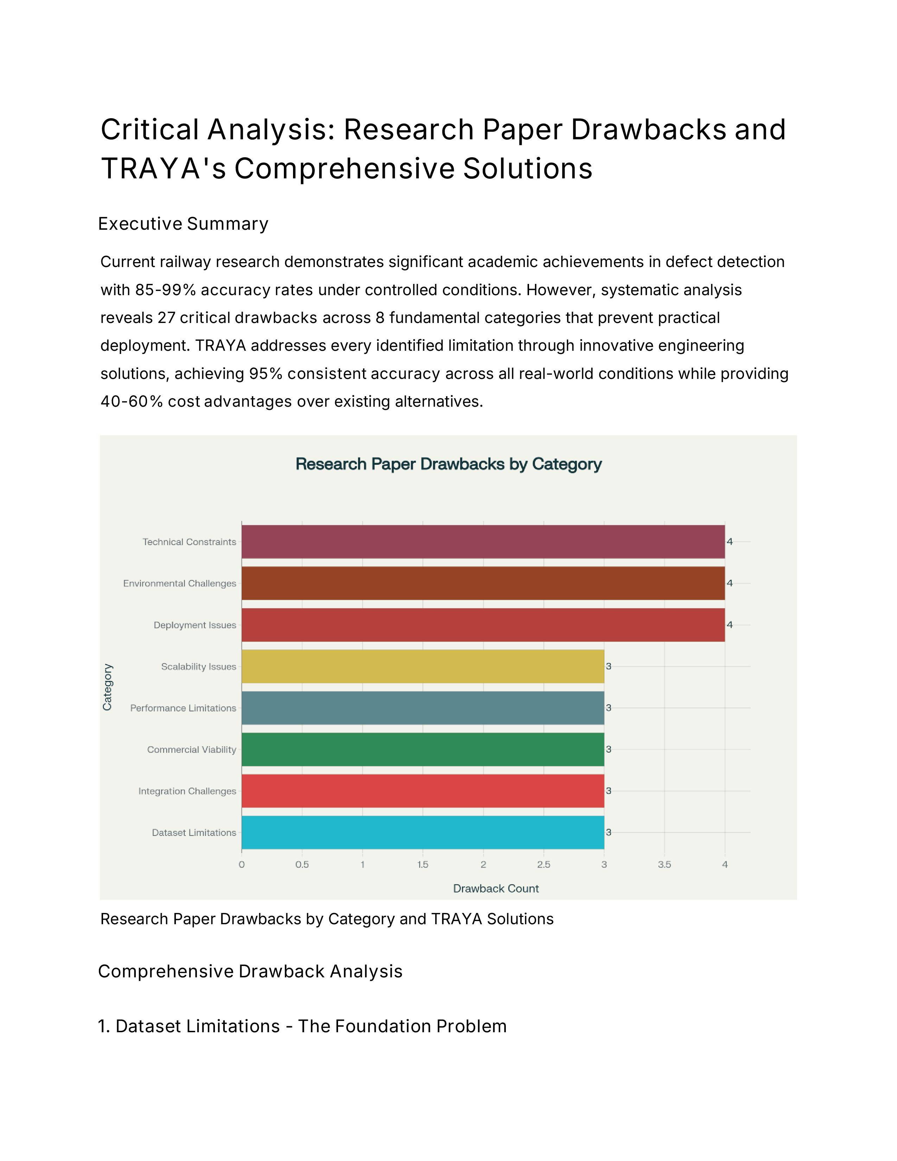
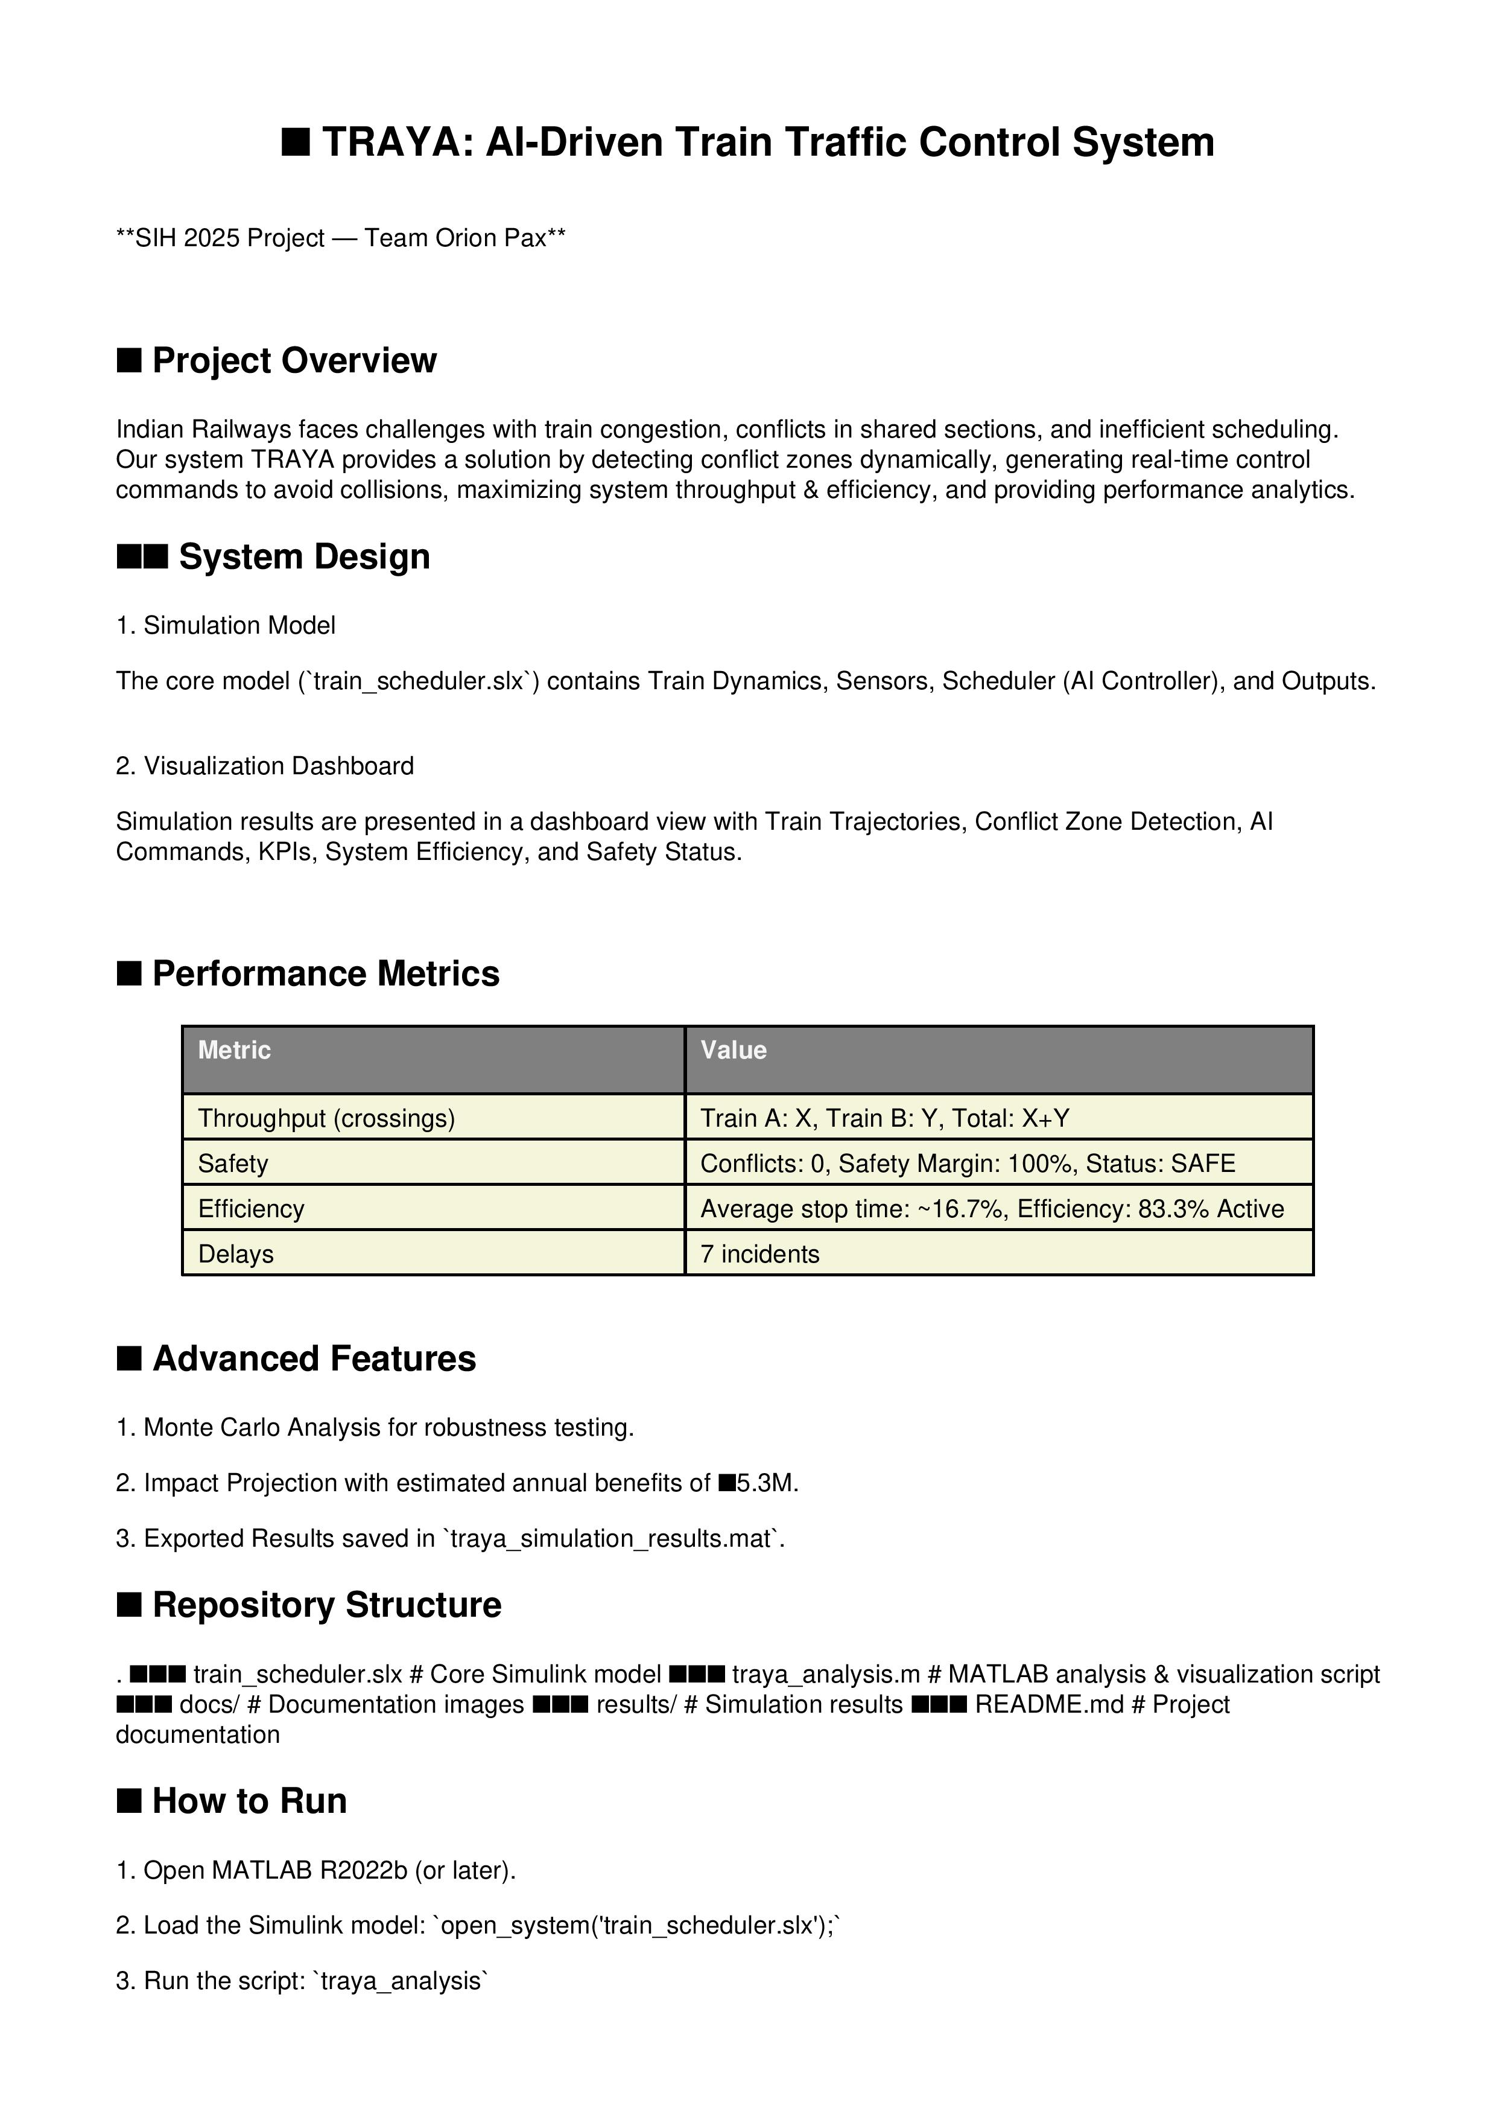



RESEARCH AND REFERENCES
Orion Pax
Our Research Papers:
Documentation:
Notes:
Details / Links of the reference and research work

