Slide 1


SQL DATA ANALYSIS PROJECT
Mission SafeCity
Analyzing Women's Safety Incidents Across the City to Uncover Risk
Patterns, Response Gaps, and Infrastructure Priorities
20,000
100
4 Yrs
25
INCIDENTS ANALYZED
LOCATIONS COVERED
2022 – 2025
SQL QUERIES BUILT
Kartik Yadav

Slide 2







PROJECT OVERVIEW
Objectives & Analytical Approach
Mission SafeCity examines women's safety incident records — collected via mobile apps, smartwatches, and public panic buttons — to help city safety planners understand where incidents cluster, how fast responders arrive, and which locations most urgently need infrastructure investment.
Identify Patterns
Flag High-Risk Zones
Evaluate Response
Uncover the most common incident types and when/where they occur
Rank locations and city zones by incident volume and risk level
Measure response speed across shifts, devices and panic-button use
Audit Infrastructure
Score Priorities
Apply Advanced SQL
Compare CCTV, streetlight and patrol coverage against incident load
Build a composite score to rank locations for intervention
CTEs, window functions, ranking & lag analysis across 25 queries
2

Slide 3
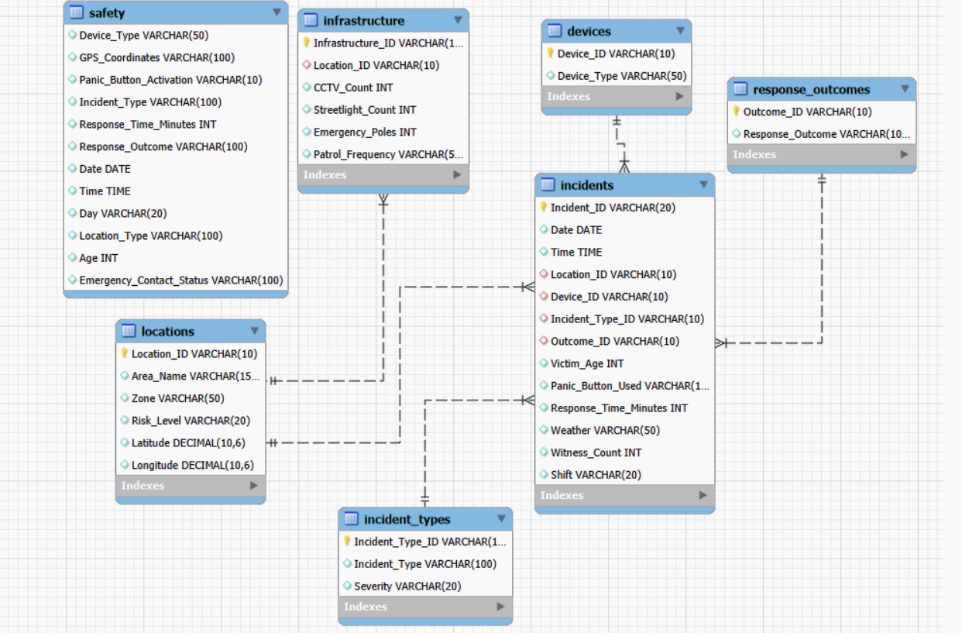
DATA FOUNDATION
Dataset & Relational Schema
A star style schema built in MySQL Workbench: one central incidents fact table joined to five dimension tables, plus a flat pre-normalization staging table (safety).
TABLE ROW COUNTS
incidents
20,000
safety (staging)
1,000
infrastructure
100
locations
100
incident_types
8
devices
3
response_outcomes
3
3

Slide 4


QUERY 02–04 · DATA PREPARATION
Data Quality & Validation
Before analysis, every table was checked for duplicates, nulls, and out-of-range values across all 20,000 incident records.
0
0
18–60
2–25 min
Duplicate Incident IDs
Missing / Null Values
Victim Age Range
Response Time Range
found across 20,000 rows
across all 10 key columns
average 38.92 years
average 12.37 minutes
Data
Zero duplicate incident IDs and zero missing values across incident_id, date, time, location, outcome, age, response time, etc.
The dataset is ready for analysis without cleansing.
4

Slide 5




QUERY 05 · HEADLINE METRICS
KPI Dashboard
20,000
100
3
8
TOTAL INCIDENTS
LOCATIONS AFFECTED
DEVICE TYPES IN USE
DISTINCT INCIDENT TYPES
56.65%
38.92
12.37 min
11,329
PANIC BUTTON ACTIVATIONS
AVERAGE VICTIM AGE (YRS)
AVERAGE RESPONSE TIME
PANIC BUTTON USES (COUNT)
5

Slide 6
QUERY 06 · INCIDENT PATTERNS
Incident Type Analysis
All eight incident types occur at strikingly similar volumes: no single category dominates, meaning safety interventions must be broad based rather than targeted at one issue.
6

Slide 7
QUERY 07 · INCIDENT PATTERNS
Severity Distribution
Half of All Incidents Are High-Severity
Exactly 50.06% of incidents (10,013) are classified High severity — and Critical-severity ‘SOS Alert’ cases carry the same 12.4 minute average response time as every other category, suggesting response prioritization by severity is not yet happening operationally.
Severity Count % Total Avg Response
Severity
Count
% Total
Avg Resp.
High
10,013
50.06%
12.33 min
Medium
4,981
24.91%
12.40 min
Low
2,511
12.55%
12.47 min
Critical
2,495
12.47%
12.37 min
7

Slide 8

QUERY 08 · LOCATION RISK
Top 10 Highest-Incident Locations
Ranked by total incident volume across all 100 tracked locations.
# | ID | Area Name | Zone | Risk | Incidents
1 | L031 | Savvy Subcity | East | High | 235
2 | L066 | Technovia Heights | South | Medium | 224
3 | L044 | Arama Residency | West | Medium | 223
4 | L069 | Southlake Vista | South | Medium | 222
5 | L085 | Silver Hub Gardens | North | Low | 222
6 | L062 | Creme Delights Enclave | South | Medium | 221
7 | L042 | Arama Extension | West | Medium | 220
8 | L013 | Real Chartered Extension | Central | High | 217
9 | L099 | Silver Hub Phase 1 | North | Low | 216
10 | L014 | K. Springs Phase 2 | Central | High | 216
8

Slide 9
QUERY 09 · LOCATION RISK
Zone & Risk Level Patterns
City zones carry very different response burdens — East and Central (High risk) take nearly 3x longer to respond to than North (Low risk).
9

Slide 10
QUERY 10–11 · RESPONSE PERFORMANCE
Response Time Analysis
2 min
12.37 min
25 min
FASTEST RESPONSE
AVERAGE RESPONSE
SLOWEST RESPONSE
Response Category Volume by Shift
10

Slide 11
QUERY 12–13 · TECHNOLOGY & ALERTS
Panic Button & Device Usage
Panic Button Activation
Incidents by Device Type
11

Slide 12
QUERY 14–16 · CONTEXTUAL PATTERNS
Shift, Weather & Witness Patterns
Night shift sees the most incidents (7,431) with the slowest average pace of activity; weather has little effect on volume (spread <5%); most incidents (50%+) occur with 3–5 witnesses present.
By Shift
By Weather
By Witness Count
12

Slide 13
QUERY 17 and 22,23 · TREND ANALYSIS
Incident Trends Over Time
Across 48 months of data (Jan 2022 – Dec 2025), yearly incident volume is remarkably stable — there is no runaway growth, but also no meaningful decline.
Annual Incident Volume
Cumulative Incident Growth
13

Slide 14
QUERY 18–19 · INFRASTRUCTURE AUDIT
Safety Infrastructure Gaps
Cross-referencing incident load against CCTV, streetlighting, emergency poles and patrol frequency for the 5 highest-volume locations.
Area | Risk | CCTV | Lights | Poles | Incidents | Avg Resp.
Savvy Subcity | High | 48 | 167 | 11 | 235 | 17.0 min
Technovia Heights | Medium | 22 | 145 | 5 | 224 | 11.73 min
Arama Residency | Medium | 28 | 144 | 5 | 223 | 11.43 min
Southlake Vista | Medium | 38 | 140 | 5 | 222 | 11.40 min
Silver Hub Gardens | Low | 5 | 54 | 3 | 222 | 5.92 min
Savvy Subcity has the most CCTV (48) and streetlights (167) of the top 5, yet the highest incident count and slowest response time (17 min), hardware alone isn't solving the problem. Meanwhile Silver Hub Gardens, despite minimal infrastructure (5 CCTV), sees comparable incident volume but a far faster response (5.92 min), pointing to patrol responsiveness as the deciding factor.
14

Slide 15
QUERY 20 to 25 · ADVANCED SQL
Business Priority Ranking Model
A composite score built with CTEs and DENSE_RANK() combines incident volume, response speed, and risk classification into one prioritization metric for city planners.
priority_score = incident_count + avg_response_time + (High risk: +20 · Medium: +10 · Low: +0)
Other advanced techniques applied across the 25-query suite: ROW_NUMBER() to find each location's top incident type, LAG() for month-over-month % change, and SUM() OVER() for running cumulative totals.
Window Functions: DENSE_RANK(), ROW_NUMBER()
Common Table Expressions (CTEs): Modular WITH clauses for isolating severe incidents and building priority score models.
Time-Series Analysis: Month over Month revenue growth velocity and ride frequency intervals via LAG() and DATEDIFF().
15

Slide 16
SYNTHESIS
Key Insights
No dominant incident type
Half of incidents are High severity
All 8 categories fall within a 200 incident band (2377 to 2571): the response strategy must cover the full spectrum, not one issue.
50.06% of all 20,000 incidents are High severity, yet response time doesn't vary meaningfully by severity level (12.3 to 12.5 min across the board).
Response time isn't the bottleneck city wide
Infrastructure volume ≠ safety outcome
12.37 min average, ranging only 2 to 25 min: but East and Central zones (High risk) average 16–17 min while North's 6.02 min, a 3x gap.
Savvy Subcity has the most cameras & lights of any top location, yet the highest incident count and slowest response: patrol responsiveness matters more than hardware.
Panic button usage is moderate
Incident volume is flat, not falling
56.65% of incidents involve panic-button activation; Mobile, Smartwatch and Panic Button devices are used almost equally (6500–6800 each).
4938 → 5137 incidents per year (2022–2025), a slight uptick — no evidence current measures are reducing incident frequency.
16

Slide 17
PROJECT SUMMARY AND INSIGHTS
Summary of Analytics Outcomes
Mission SafeCity examines women's safety incident records — collected via mobile apps, smartwatches, and public panic buttons — to help city safety planners understand where incidents cluster, how fast responders arrive, and which locations most urgently need infrastructure investment.
Validated Risk Patterns
Flagged High-Risk Zones
Evaluated Response
Successfully mapped the correlation between time, location, and incident frequency across the City.
Ranked locations and city zones by incident volume and risk level
Measured response speed across shifts, devices and panic button use
Infrastructure Impact
Scored Priorities
Applied Advanced SQL
Proved the statistical value of functional CCTV and street lighting is deterring crimes.
Built a composite score to rank locations for intervention
CTEs, window functions, ranking & lag analysis across 25+ queries
Thank You!
Kartik Yadav
Github
17

