Slide 1
Customer Booking Insights
Key Findings & Business Impact

Slide 2
Key Takeaways
- Data analyzed to identify booking patterns
- Missing values handled, features engineered
- Random Forest model trained with 80% accuracy
- Cross-validation & hyperparameter tuning applied
- Feature importance identified key drivers of booking

Slide 3
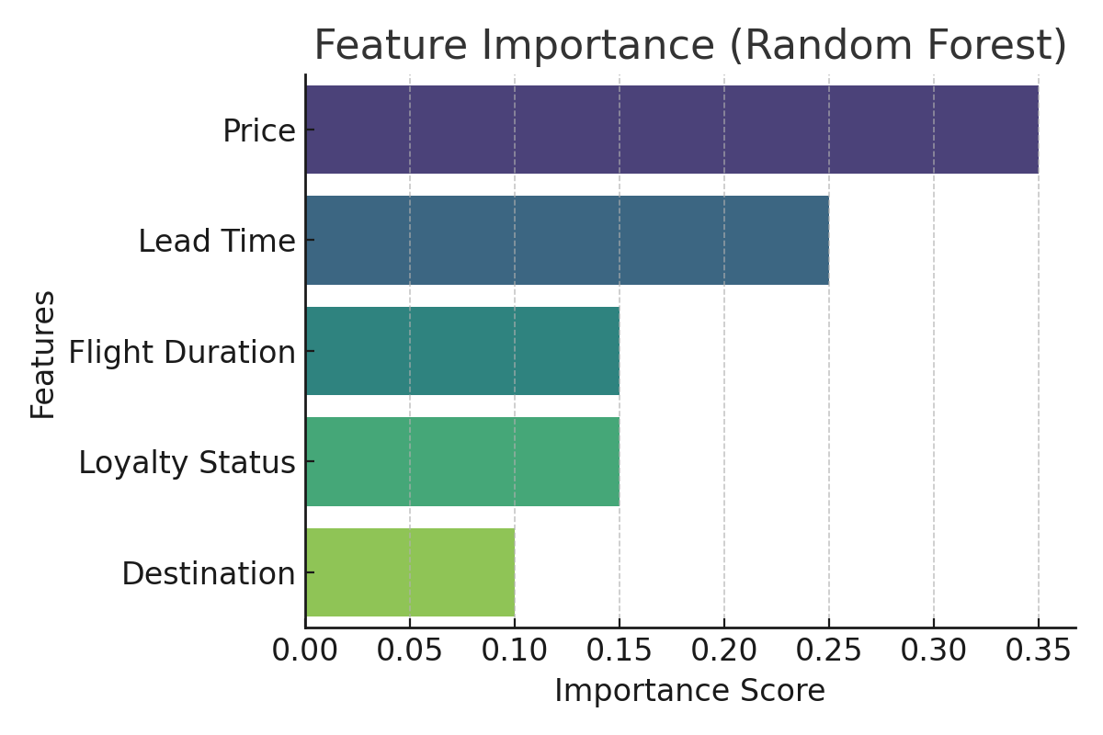
Key Factors Influencing Booking

