Slide 1
Customer Booking Insights
Analysis of booking behavior and key influencing factors

Slide 2
Summary of Findings
- Majority of customers do not complete bookings
- Key influencing factors: price, flight availability, and customer preferences
- Certain demographics are more likely to book flights
- Strong correlation between price sensitivity and booking decisions

Slide 3
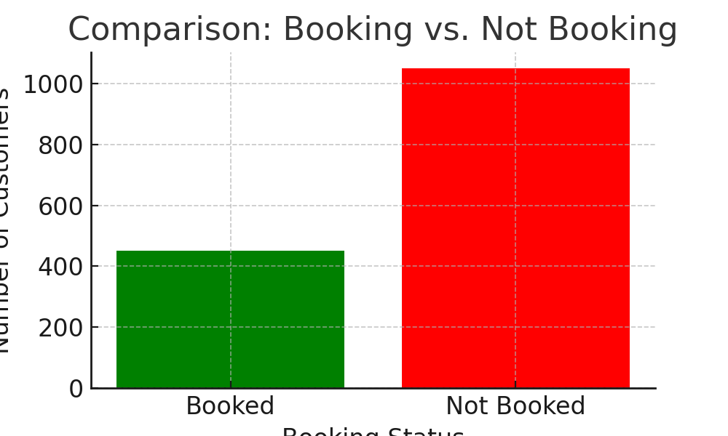
Booking vs. Not Booking

Slide 4
Top Reasons for Not Booking
Top Reasons for Not Booking
1. High ticket prices
2. Better deals found elsewhere
3. Unavailability of preferred flight timings
4. Complex booking process
5. Lack of trust in airline

