Slide 1
NLP Final Project
Kartik Barmaiya BT19CSE034 Shivam Kumar BT19CSE071
Guided by: Dr. Pooja Jain

Slide 2
Project Name:
Speech Signal Analysis

Slide 3
Libraries Used
Librosa:
It is a python library for music and audio analysis. It provides the building blocks necessary to create music information retrieval systems.
It helps us work with sound signals or the dataset of sound itself. We we’ll be able to find a particular signals, sample rate or how many channel our sound have and many more!

Slide 4
Pandas:
Pandas is a software library written for the Python programming language for data manipulation and analysis. In particular, it offers data structures and operations for manipulating numerical tables and time series.
Pandas are used here to handle the metadata of the Database. We have csv table that contains details of all audio files w.r.t their class id and classname e.g. dog_barking, children_playing etc. and data like in which folder they are, and audio length as well.

Slide 5
What details the csv file contains:
File name
In which folder file is in
Which class the file belongs to
These data will help in result as well.

Slide 6
Extracting data:
Librosa.load(filename) : Gives data and sample rate of ‘filename’ (We can also use scipy library to get the data)

Slide 7
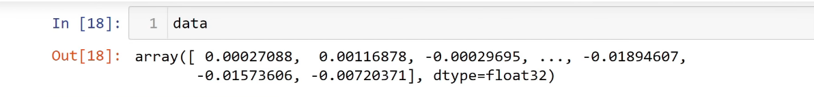
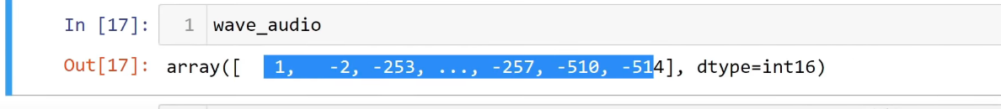
Why we did not used scipy:
Each and every signals can be represented as an integer/floating value. And Librosa normalizes these values (it scales it down) whereas scipy won’t do that.
Librosa nomalises every signal into mono signal (1 dimensional signals) And if we do it in scipy e.g if we have 2 channel audio it will give 2 dimensional array of integer digits for signals ALSO two overlapped graphs.

Slide 8
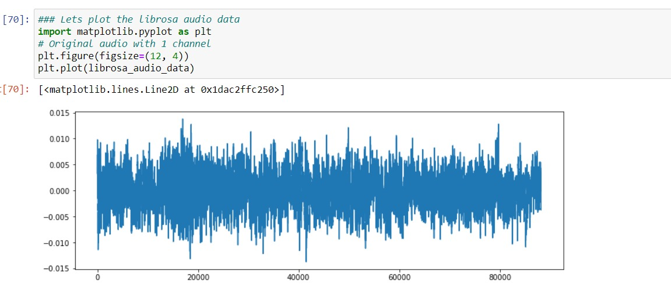
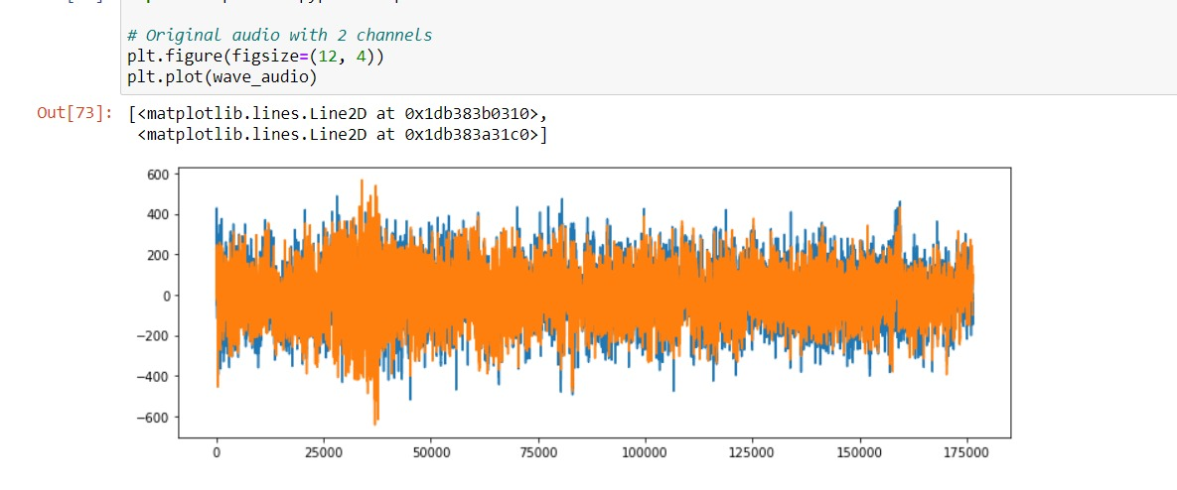
Using Librosa Using scipy

Slide 9
tqdm:
^{IPythondisplay :}
tqdm is a Python library that allows you to output a smart progress bar by wrapping around any iterable.
Display Graphs of Sound Waves

Slide 10
TensorFlow:
TensorFlow is a free and open-source software library for machine learning and artificial intelligence. It can be used across a range of tasks but has a particular focus on training and inference of deep neural networks. We used it here for label encoding.

Slide 11
MFCC (Mel-Frequency Cepstral Coefficients)
In sound processing, the mel-frequency cepstrum (MFC) is a representation of the short-term power spectrum of a sound, based on a linear cosine transform of a log power spectrum on a nonlinear mel scale of frequency.
Mel-frequency cepstral coefficients (MFCCs) are coefficients that collectively make up an MFC. They are derived from a type of cepstral representation of the audio clip (a nonlinear "spectrum-of-a-spectrum"). The difference between the cepstrum and the mel-frequency cepstrum is that in the MFC, the frequency bands are equally spaced on the mel scale, which approximates the human auditory system response more closely than the linearly-spaced frequency bands used in the normal spectrum. This frequency warping can allow for better representation of sound, for example, in audio compression.

Slide 12
Applications
MFCCs are commonly used as features in speech recognition systems, such as the systems which can automatically recognize numbers spoken into a telephone.
MFCCs are also increasingly finding uses in music information retrieval applications such as genre classification, audio similarity measures, etc.

Slide 13
ANN Model
An Artificial Neural Network (ANN) is an information processing paradigm that is inspired from the brain. ANNs, like people, learn by examples. An ANN is configured for a specific application, such as pattern recognition or data classification, through a learning process. Learning largely involves adjustments to the synaptic connections that exist between the neurons.

Slide 14
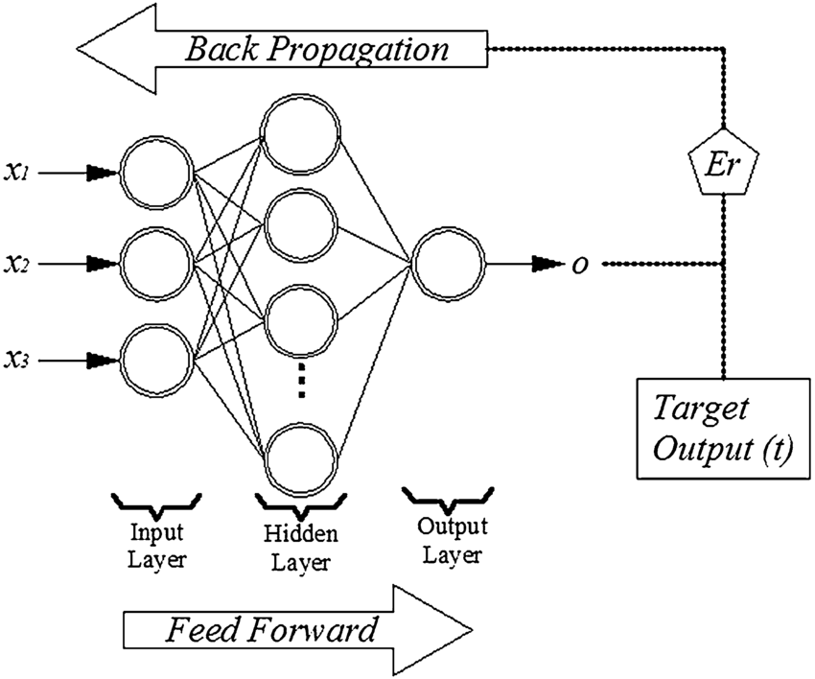

Slide 15
Project explanation

Slide 16
References
https://urbansounddataset.weebly.com/download-urbansound8k.html

Slide 17
Thank you!

