Slide 1

SMART INDIA HACKATHON 2026
SMART INDIA HACKATHON 2026
TITLE PAGE
•
Problem Statement ID — 26171
•
Problem Statement Title — On-device Visual Perception for Light-weight Browser Agents
•
Organisation — Indian Space Research Organisation (ISRO)
•
Theme — Smart Automation
•
PS Category — Software
•
Team ID — —
•
Team Name : Tesseract BTW
Privacy-Preserving Browser Agent
A local privacy proxy between the webpage and the reasoning model — on-device perception, redaction before the network, constrained actions after.
Chrome extension · On-device redaction · Constrained browser agent
Notes:
Tesseract BTW — Title Page. All text boxes, cards and table cells are editable.

Slide 2

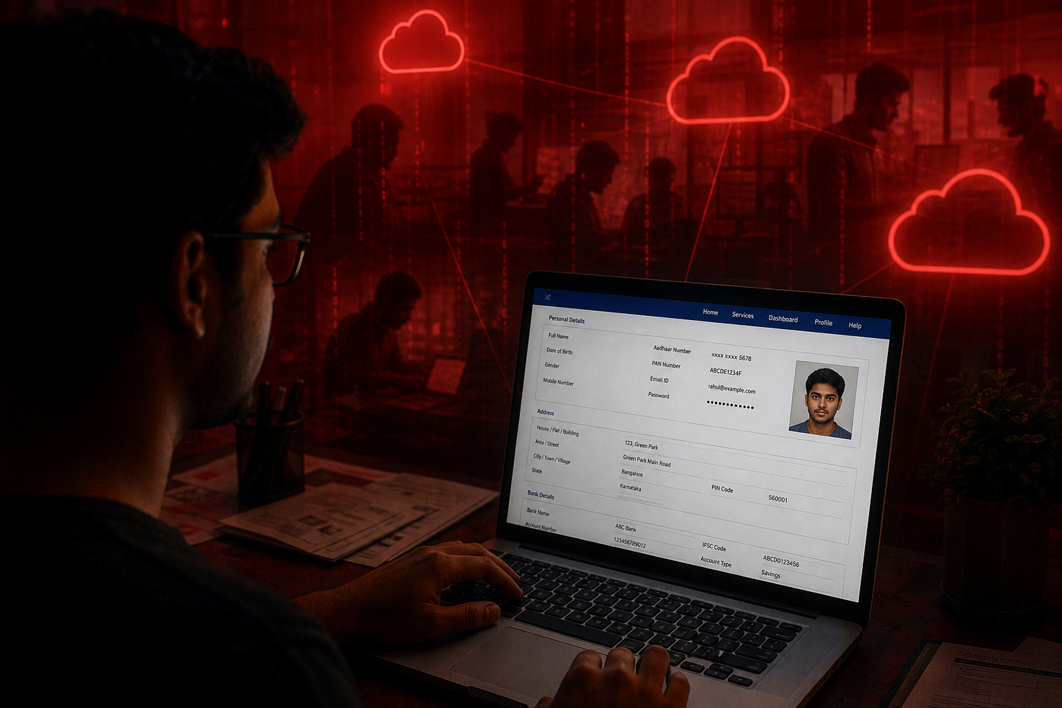
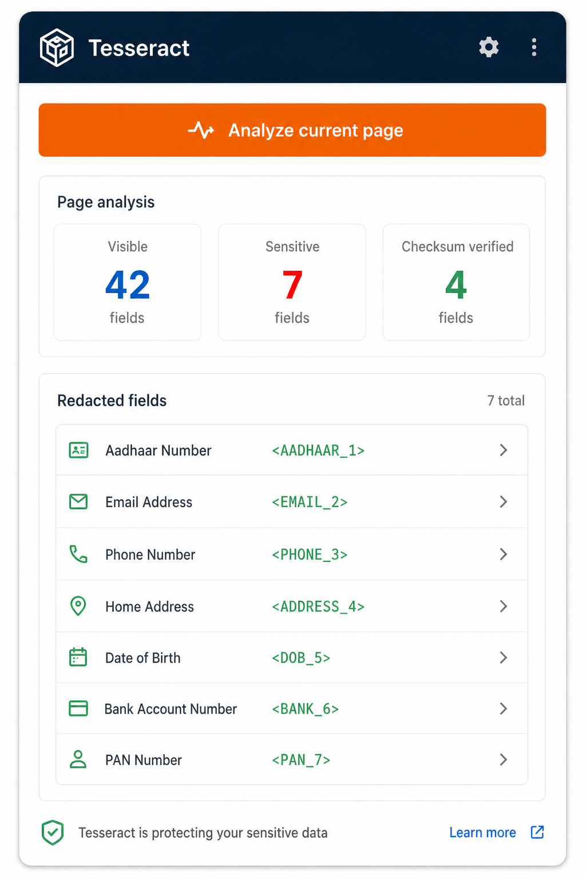
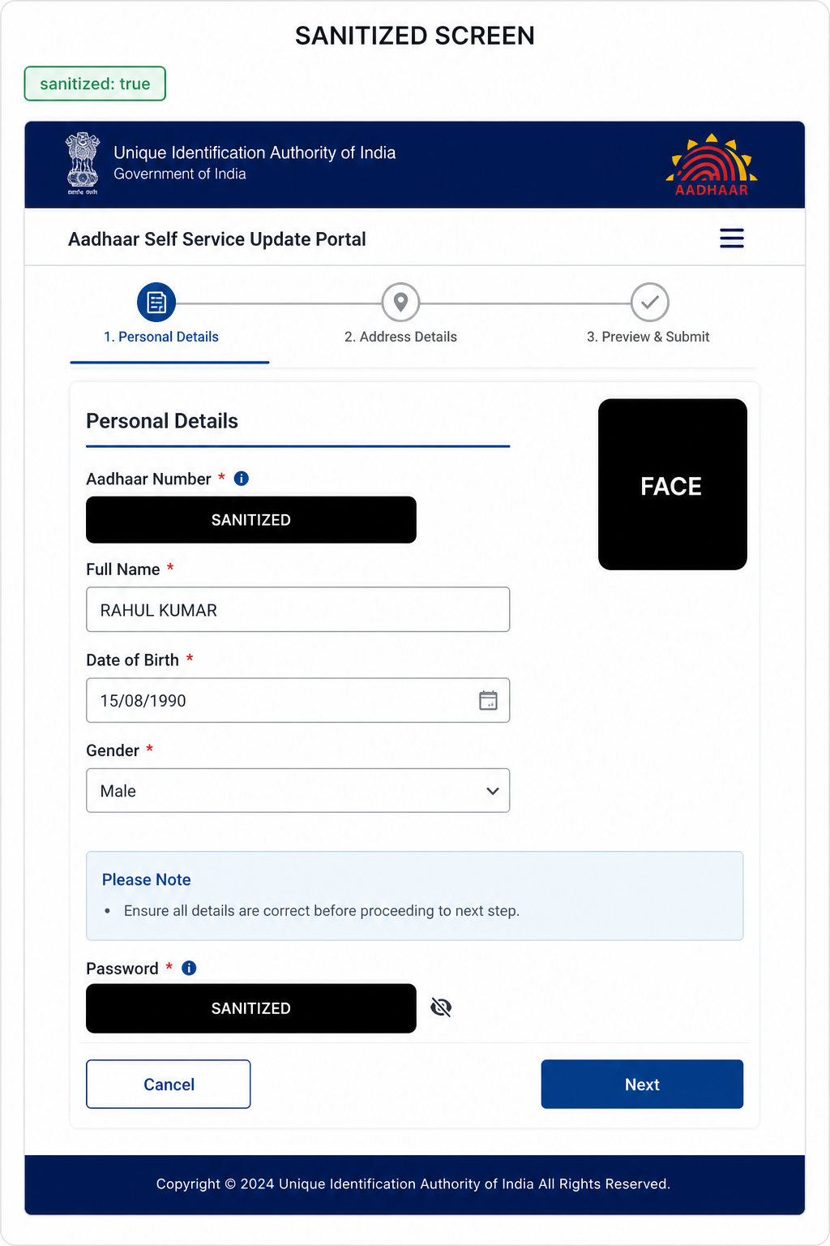
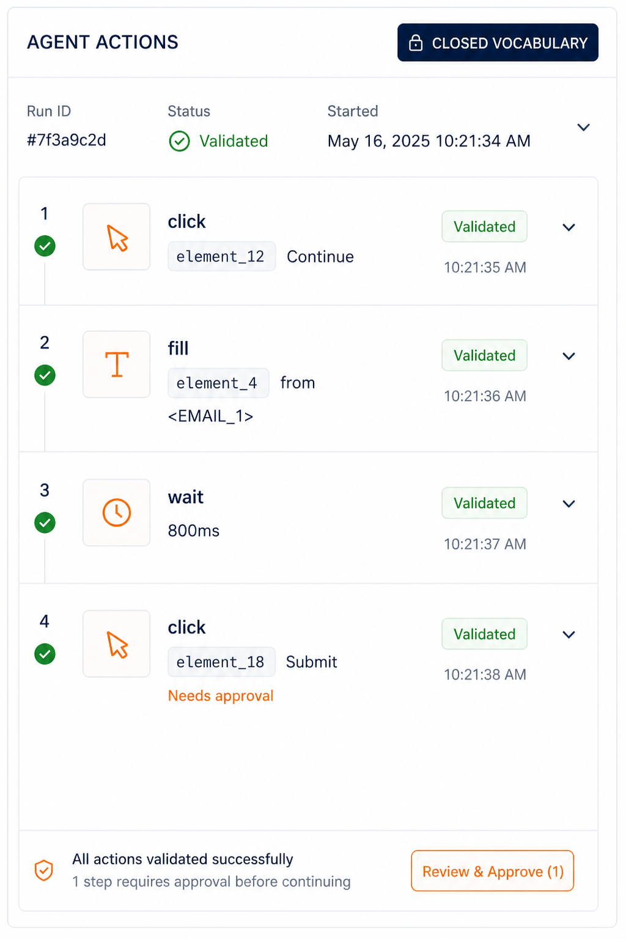
TESSERACT
PROPOSED SOLUTION
SMART INDIA HACKATHON 2026
LOCAL PRIVACY. REMOTE REASONING.
1. Local Visual Perception
On-device YuNet face detection plus DOM-first screen reading. The raw screenshot never leaves the machine.
THE REALITY TODAY
Cloud agents see Aadhaar, PAN, faces, passwords and bank fields on the live screen.
CURRENT CHALLENGES
01 Raw screenshots
Cloud GUI agents upload the live screen, secrets included.
2. Layered PII Detection
Field purpose, checksum validators for Aadhaar / PAN / GSTIN / cards, then English NER only where regex fails.
02 Indian identifiers
Aadhaar, PAN, GSTIN and UPI sit in ordinary page text.
RAW SCREEN · RAW PII · RAW TRUST GAP
3. Privacy-Preserving Filter
Typed placeholders, padded black-box masks, one-way password / OTP / CVV tokens. Vault stays in the tab.
03 Faces & documents
Portraits and ID photos leak through pixel pipelines.
BENEFITS ✓ PII stays local ✓ Checksum IDs ✓ Face masks ✓ Closed actions ✓ DPDP-aligned
04 Unconstrained actions
A model that can run JS can exfiltrate or destroy data.
4. Constrained Browser Agent
Closed action vocabulary, current element ids, user approval for submit / purchase. No model-written JavaScript.
05 Browser budget
A full VLM will not fit; latency and RAM are real limits.
5. Sanitized Server Planning
Only anonymized context reaches the LLM. The server returns click, type and scroll — never secrets.
06 Trust gap
Users will not adopt agents that treat PII as context.
ANALYZE PAGE
SANITIZED SCREEN
VALIDATED ACTIONS
Notes:
Tesseract BTW — Proposed Solution. All text boxes, cards and table cells are editable.

Slide 3
TESSERACT
Technical Approach
SMART INDIA HACKATHON 2026
LOCAL PRIVACY. REMOTE REASONING.
SYSTEM WORKFLOW
SMART WORKFLOW OF THE AGENT
1
1. User starts Analyze or Run agent from the popup.
USER CHANNEL
Chrome popup · consent · policy toggles · sanitized preview
ORCHESTRATOR
MV3 service worker · inject · capture · agent loop
PAGE CONTEXT
Isolated content script · DOM · vault · apply
2
2. Service worker injects the content script on demand — never on every page load.
OFFSCREEN MODELS
YuNet faces · DistilBERT names · Tesseract OCR · WASM / ONNX
TRUST BOUNDARY
Vault never leaves the tab. Passwords / OTP / CVV are one-way tokens. Raw PNG never accepted on the wire.
3
3. Visible DOM is extracted with stable element_N ids.
4
4. Rules + checksums redact PII. The vault is minted inside the tab.
PRIVACY GATEWAY :4317
Structural validation · leak scan · branded JPEG · mock or OpenAI-compatible planner
PLANNER
Closed JSON actions only: click, type, fill_from_vault, scroll, wait, done
5
5. Offscreen WASM runs YuNet, DistilBERT NER and selective OCR.
6
6. Screenshot sanitizer paints padded black masks for secrets and faces.
LOCAL EXECUTION
Validate ids twice · refuse credential fills · confirm submit/purchase · expand placeholders only inside the isolated world · re-extract each turn (max 6 / 90s)
7
7. Privacy gateway rejects unsanitized or leaking payloads.
8
8. LLM returns a closed action list. The extension validates, confirms and applies locally.
WHY THIS SHAPE EXISTS
Popup cannot read a tab. Service worker cannot host long WASM. Only the content script can keep a vault next to the live DOM.
Models are used only where checksums and DOM facts are not enough: names, faces, painted text.
The remote model proposes intent. Deterministic code owns authority, ids, and secret expansion.
TECH STACK
Chrome MV3 · Vanilla JS · ONNX Runtime Web · OpenCV YuNet 232 KB
DistilBERT NER q8 · Tesseract.js · Express gateway · OpenAI-compatible LLM
Mock provider · Playwright E2E
Notes:
Tesseract BTW — Technical Approach. All text boxes, cards and table cells are editable.

Slide 4
TESSERACT
Feasibility & Viability
SMART INDIA HACKATHON 2026
LOCAL PRIVACY. REMOTE REASONING.
1. Analysing the feasibility of the idea
• Easy to implement: Chrome MV3, WASM and ONNX Runtime Web — no native app, no new hardware. • Lightweight: YuNet is ~232 KB and packaged locally; DistilBERT q8 loads once and is cached. • Measured: 16-page rule corpus, 100% precision, 90.2% F1. Safety, server and E2E suites are separate. • Demo-ready: mock planner runs fully offline; cloud LLM is a config switch, not an architecture change.
Potential Challenges & Risks
• Indic names in prose: English DistilBERT recall does not cover Devanagari person names. • No labelled pixel corpus yet: YuNet/OCR run in E2E tests, but face IoU / over-redaction are not scored. • Hybrid-mode gap: local vision can run without those detections reaching the planner. • Detection defines coverage: novel IDs and some bank-account shapes can still slip through.
2. Strategies for overcoming these challenges
• Strongest-first evidence: Verhoeff / Luhn / GSTIN checksums before any model confidence score. • Lazy, offscreen inference so the service worker stays event-driven and the UI does not freeze. • Dual gates: extension and server both reject raw fields, vault values and unknown actions. • Separate eval families: rule F1, safety suite, server tests, and real-browser E2E — never mixed.
Evaluation of Long-Term Sustainability
• Scalable: a Chrome/Edge extension can move from one machine → campus → department → nationwide. • Policy fit: local minimisation matches DPDP 2023 and the ISRO brief to send only non-sensitive structure. • Improving data: more pages and a labelled pixel set raise recall without enlarging the trust boundary. • Adaptable: swap the planner (mock, Ollama, OpenRouter) without touching redaction or the vault.
Notes:
Tesseract BTW — Feasibility & Viability. All text boxes, cards and table cells are editable.

Slide 5
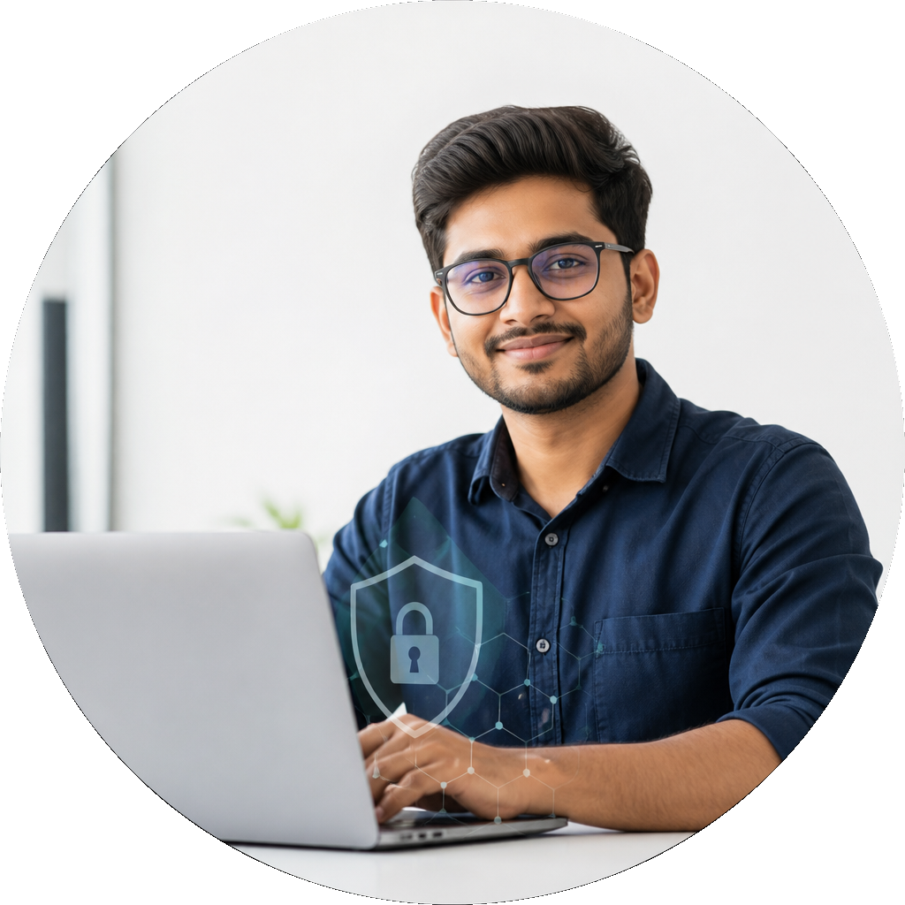
TESSERACT
Impacts and Benefits
SMART INDIA HACKATHON 2026
LOCAL PRIVACY. REMOTE REASONING.
Impact Created on Society
No raw PII to the cloud
Redacted DOM + masked JPEG only.
Saves user trust
Secrets stay in the tab-local vault.
Indian ID intelligence
Verhoeff, Luhn, GSTIN, PAN, IFSC.
Our Social Impact
Digital Transformation
Citizens can use agents on DigiLocker, banks and government portals without handing over Aadhaar, PAN or passwords.
Turns the agentic web from “upload the screen” into a privacy proxy: local evidence, remote reasoning, local action.
Environmental Impact
Government Impact
On-device WASM inference and a 232 KB face model avoid shipping every screenshot to a GPU cluster.
Fits ISRO’s brief: only non-sensitive structure leaves the client. Path from one workstation → organisation → national scale.
Faces blacked out
YuNet boxes become padded masks.
Safe agency
Closed vocabulary, confirmations, 6-turn cap.
Scalable extension
Chrome/Edge today; same privacy contract later.
Notes:
Tesseract BTW — Impacts and Benefits. All text boxes, cards and table cells are editable.

Slide 6
TESSERACT
Research & References
SMART INDIA HACKATHON 2026
LOCAL PRIVACY. REMOTE REASONING.
COMPARISON WITH EXISTING APPROACHES
CHOOSING PROBLEM STATEMENT
FEATURES | Cloud GUI agents | Browser copilots | Password managers | TESSERACT
On-device visual perception | ✗ | ✗ | ✗ | ✓
Redact before any network call | ✗ | ✗ | ✗ | ✓
Indian ID checksums (Aadhaar/PAN/GSTIN) | ✗ | ✗ | ✗ | ✓
Face & screenshot masking | ✗ | ✗ | ✗ | ✓
Typed placeholders for the planner | ✗ | ✗ | ✗ | ✓
Closed action vocabulary | ✗ | ✗ | ✗ | ✓
Tab-local secret vault | ✗ | ✗ | ✓ | ✓
Offline mock + optional cloud LLM | ✗ | ✗ | ✗ | ✓
Working Chrome MV3 prototype | ✗ | ✓ | ✓ | ✓
EVAL, SAFETY GATES, DEMO
Research Workflow
ANALYSIS OF EXISTING AGENTS
DESIGN LAYERED PRIVACY STACK
SIH26171 | ISRO | DPDP 2023 | MV3
1. SIH 2026 PS SIH26171 — On-device Visual Perception for Light-weight Browser Agents (ISRO / Department of Space).
2. ONNX Runtime Web + OpenCV YuNet 2023mar — compact on-device face detection.
3. Hugging Face Transformers.js / DistilBERT NER (q8) — English names after rule redaction.
4. Tesseract.js — selective OCR for image, canvas and video text.
5. Digital Personal Data Protection Act, 2023 — purpose limitation and minimisation.
6. Chrome Manifest V3 + Offscreen Documents — event-driven privacy architecture.
7. UIDAI Verhoeff checksum, Luhn (cards), GSTIN mod-36 — exact Indian identifier tests.
8. Minim / MaskClaw (2026) — edge-side sanitization for GUI agents before cloud reasoning.
Tesseract is the only column that combines on-device perception, Indian identifier intelligence, and a constrained agent.
Notes:
Tesseract BTW — Research & References. All text boxes, cards and table cells are editable.

