Slide 1
Aarogya Patrika
An interactive mobile phone-based job aid for accredited social health activists (ASHAs)

Slide 2
INTRODUCTION
ASHA Accredited Social Health Activists workers are helping to build a strong foundation for promoting healthy practices in our society.
The “Aarogya Patrika” is designed with the aim of blurring all these possibilities of lack of access to healthcare information, refresher training and meaningful supervision so that their ability to contribute to improved maternal and new-born health outcomes will play a major role.

Slide 3
Community level Problems
Ashas

Slide 4
Novelty and inventive step of the proposal
Available in multiple regional languages.
Simplifies public administration, eliminating the need for data-entry operators.
Convert the data into digital format right from the point of entry, to be used, analyzed, accessed and processed across the health system by all relevant staff members

Slide 5
Social Relevance
The impact of ASHAs on their communities is largely dependent on the quality of their training and other health system factors.
Currently there is inadequate health system support for ASHAs including a lack of strong supervision, limited opportunities for continuing education and training and poor workload management.
Empowering Asha’s with Aarogya Patrika will help them to overcome the barrier

Slide 6
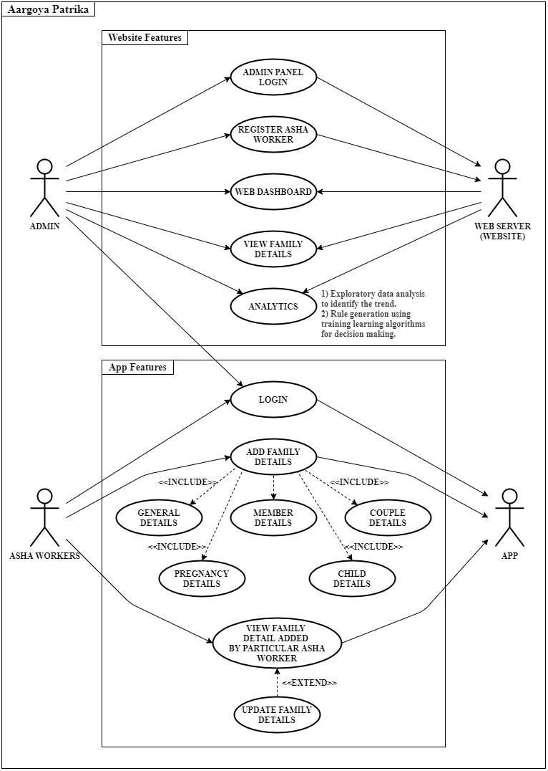
SYSTEM DESIGN
Software Architecture: The software architecture is comprised of the database, server and the client application.
Database: The database consists of a number of tables; some are fixed while some are created dynamically. These tables storing the data are implemented in MongoDB.
Client Application: The application provides an efficient user interface for all the ASHA workers.
Server The server is deployed on Heroku as it is robust, free and easy to deploy
Hardware Architecture: The basic hardware requirement for the system is any device having access to the internet connection which can run the “Aarogya Patrika” app and a server to store the database and host the Smart ASHA website.

Slide 7
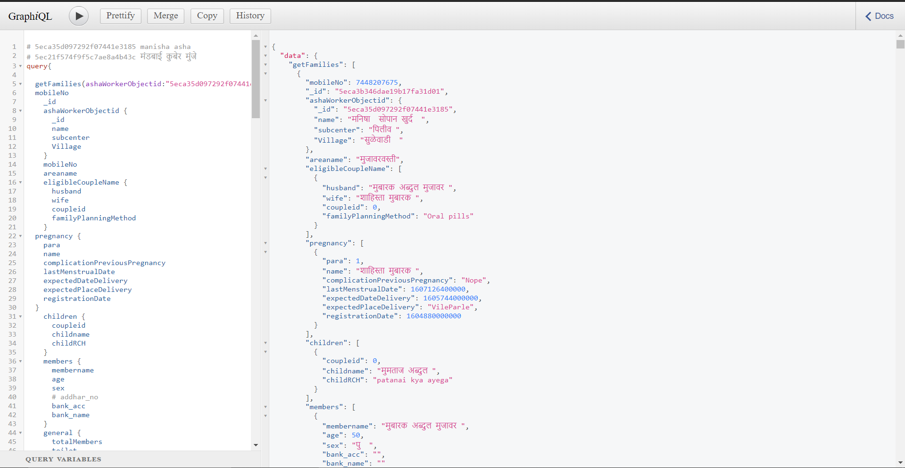
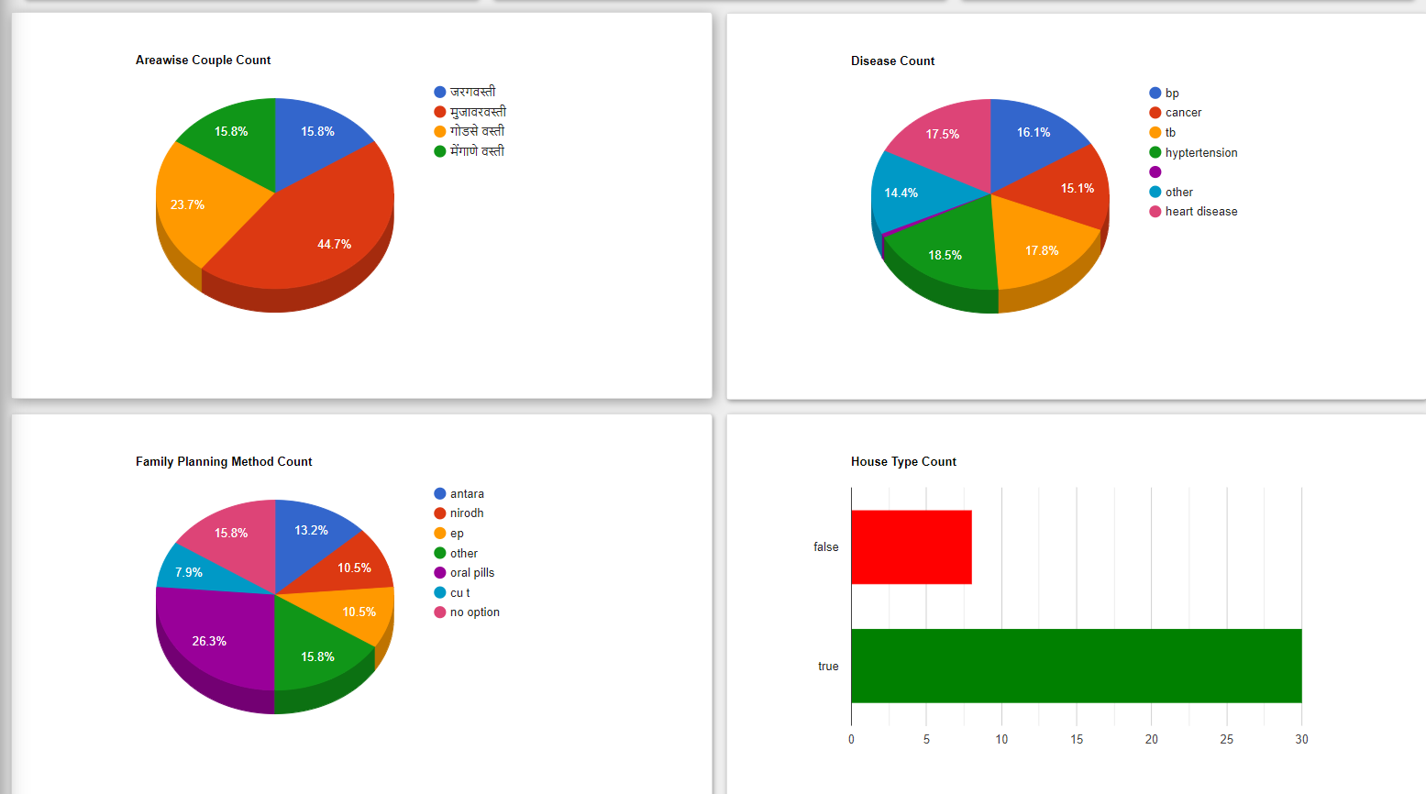
A GraphQL API for interaction of the Mobile App and website with the MongoDB Database
Dashboards that help medical professionals quickly analyze large sets of data can save time, and can even save lives.

Slide 8
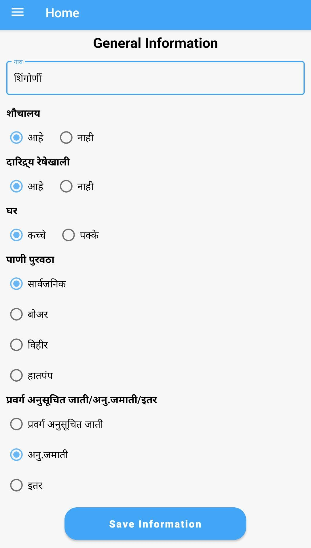
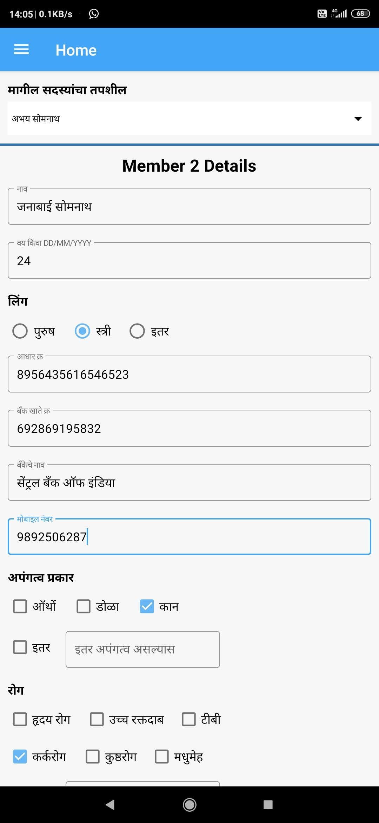
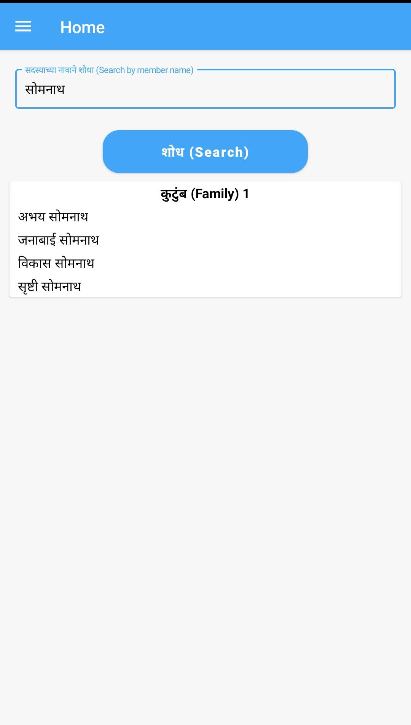
Aarogya Patrika App

Slide 9
THANK YOU
Do you have any questions?

