Slide 1
Name | Designation | Email | Class
Nayan Bhatia | Leader | nayan.bhatia@somaiya.edu | TE comps-07
Kartik Chawda | Member | chawdakartik@gmail.com | TE comps-10
Dharmin Chothani | Member | dharmin.chothani@somaiya.edu | TE Comps-14
Harshal Patil | Member | harshal.sp@somaiya.edu | Be comps-56
Notes:
mr

Slide 2
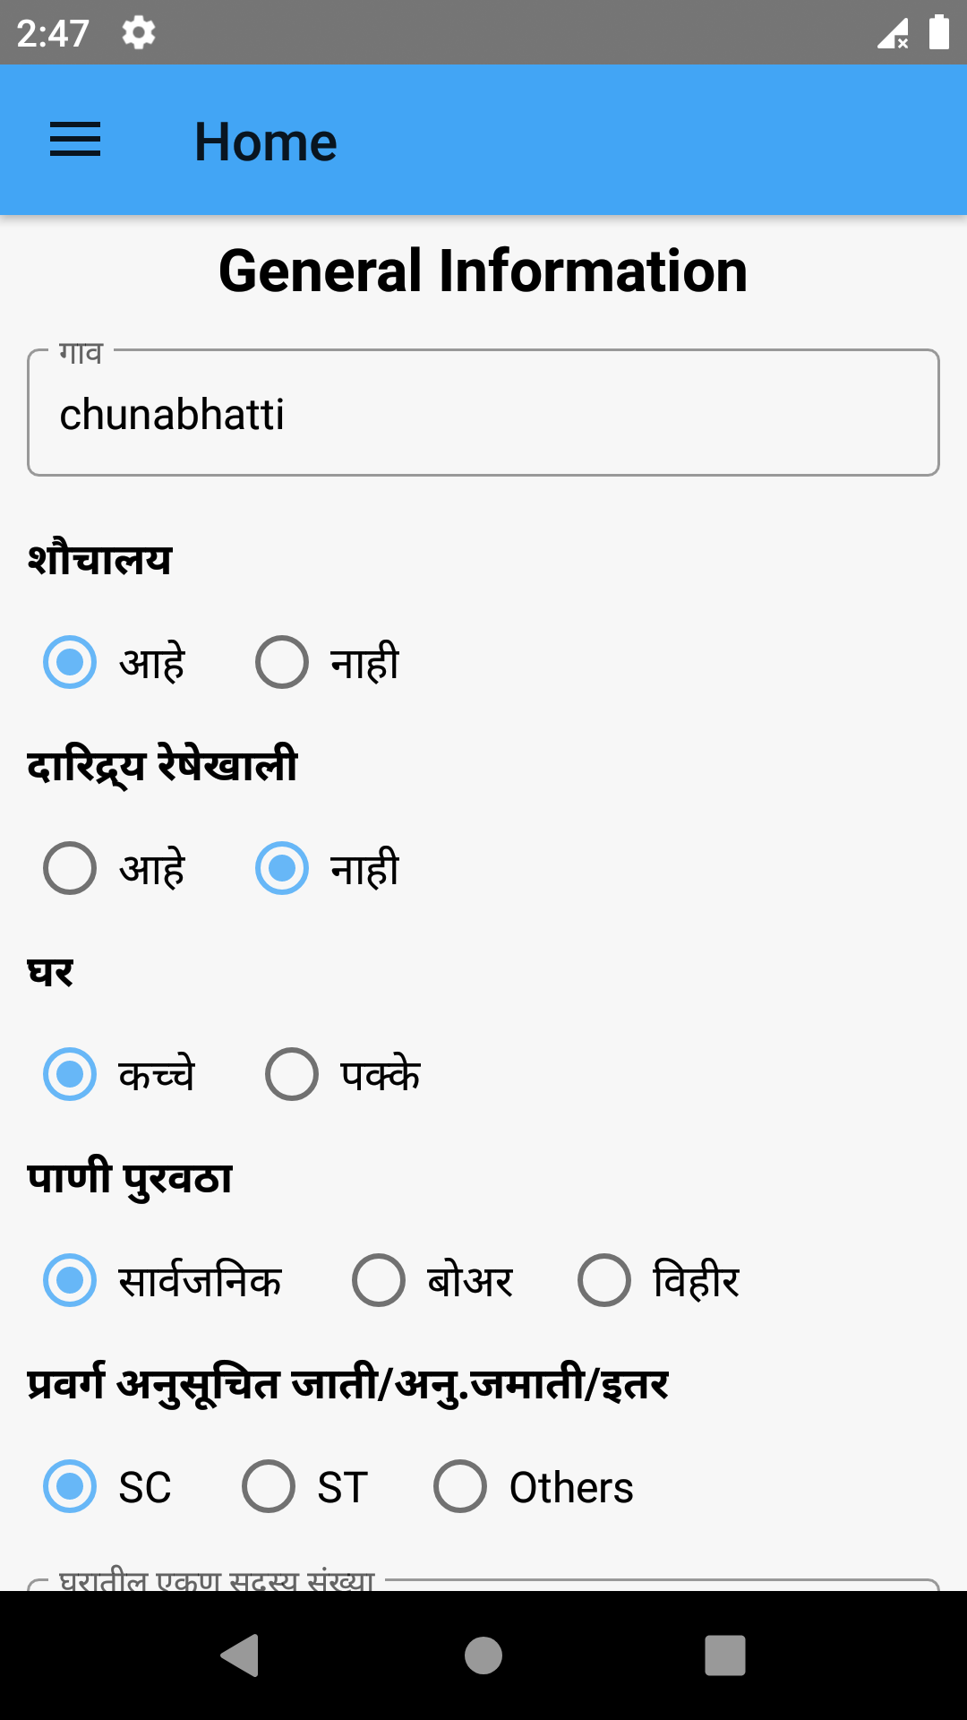
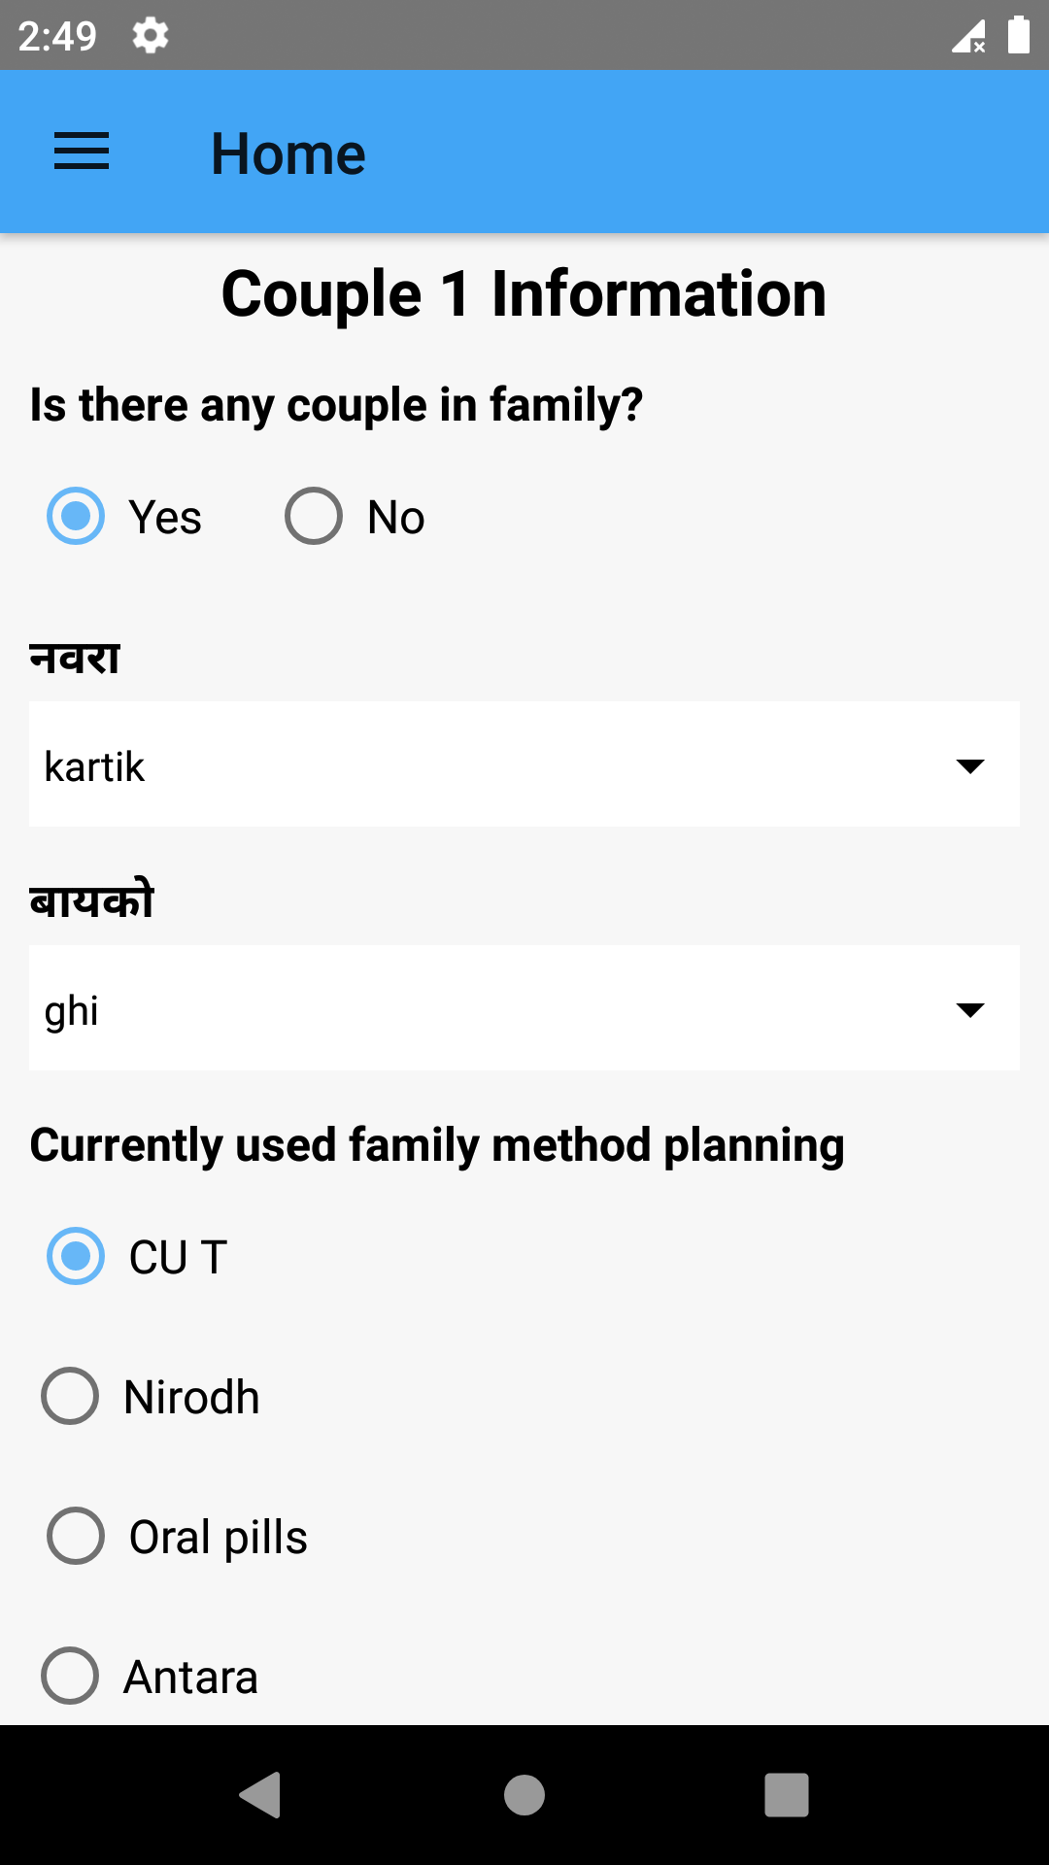
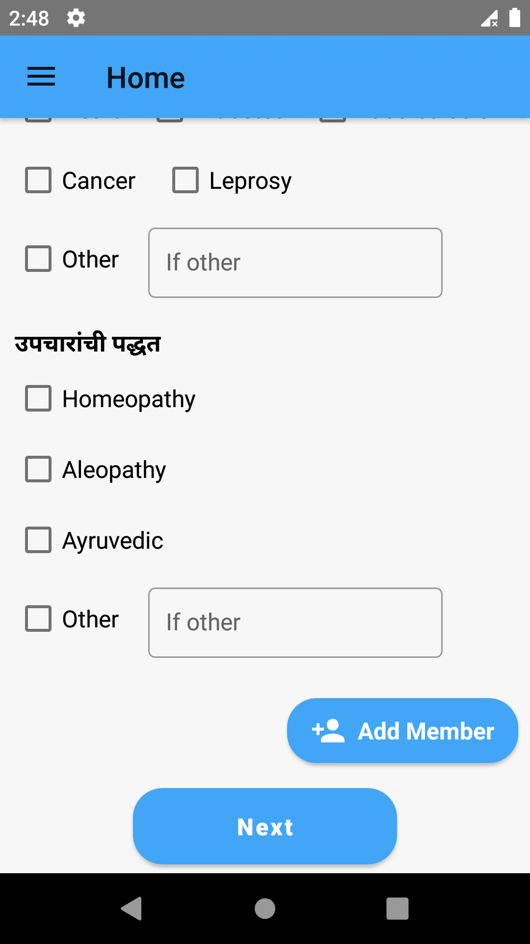
Mobile Application for the Asha workers to enter the survey data directly into the centralized database

Slide 3
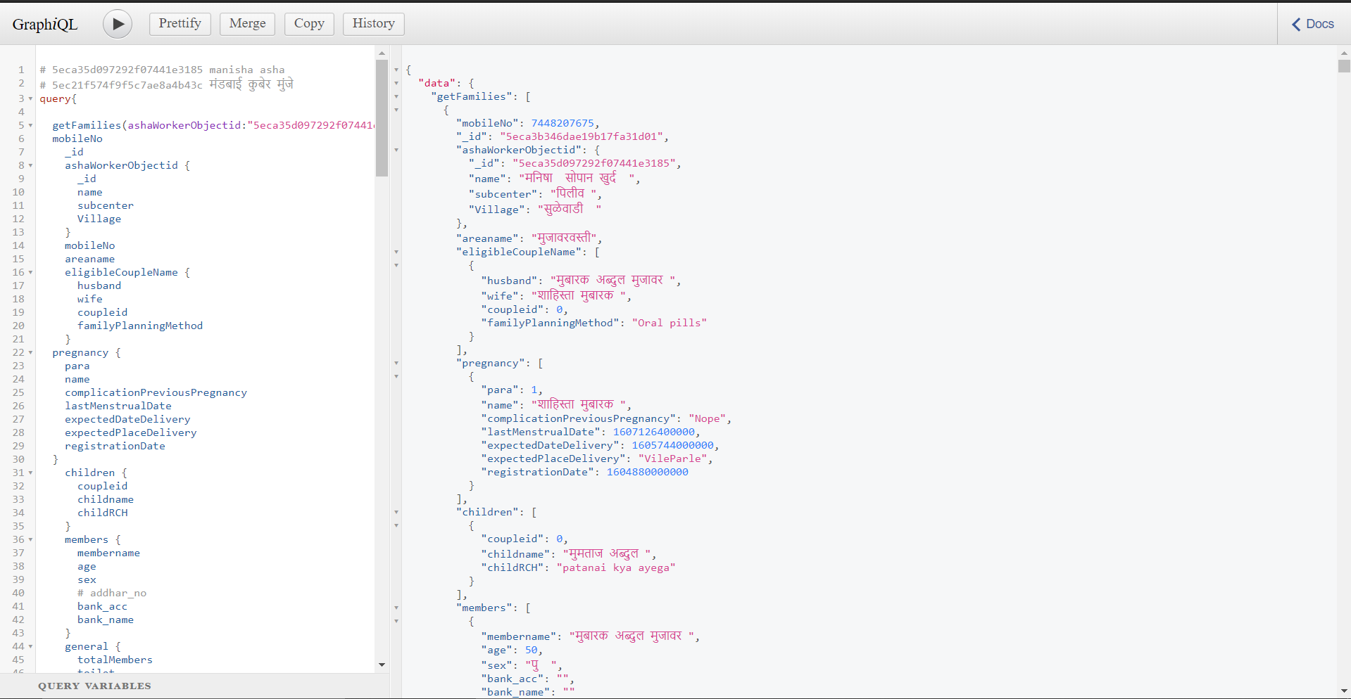
A GraphQL API for interaction of the Mobile App and website with the MongoDB Database

Slide 4
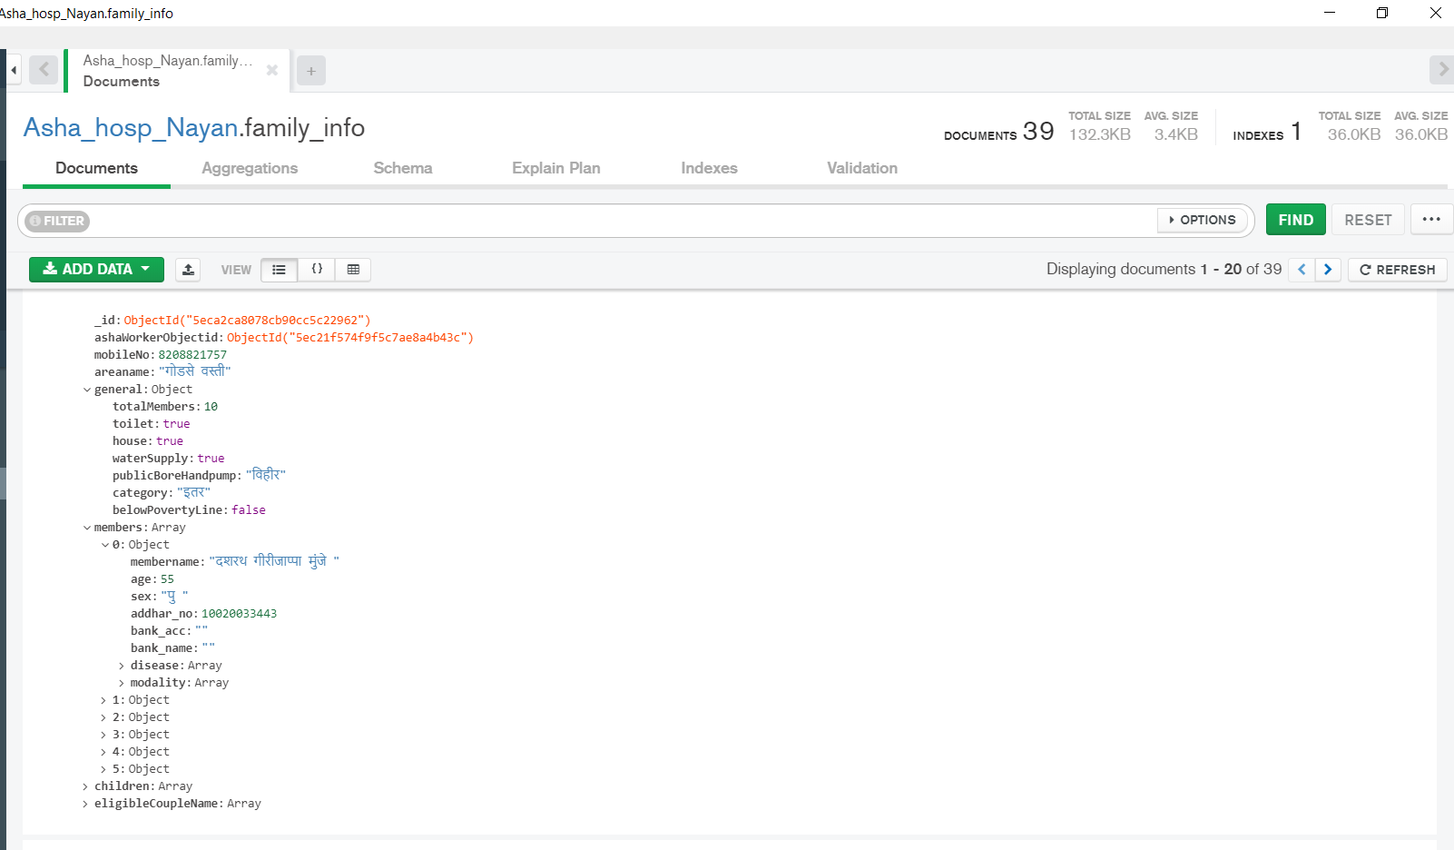
A NoSQL Database with necessary aggregation pipelines highly optimized for high speed data retrieval operations

Slide 5
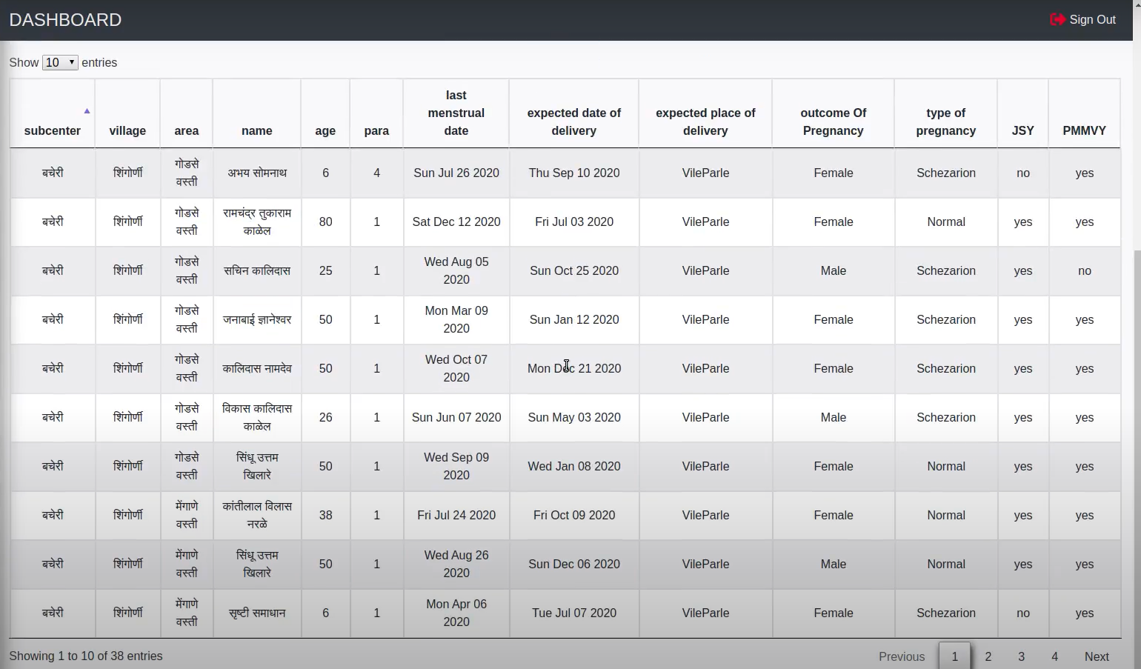
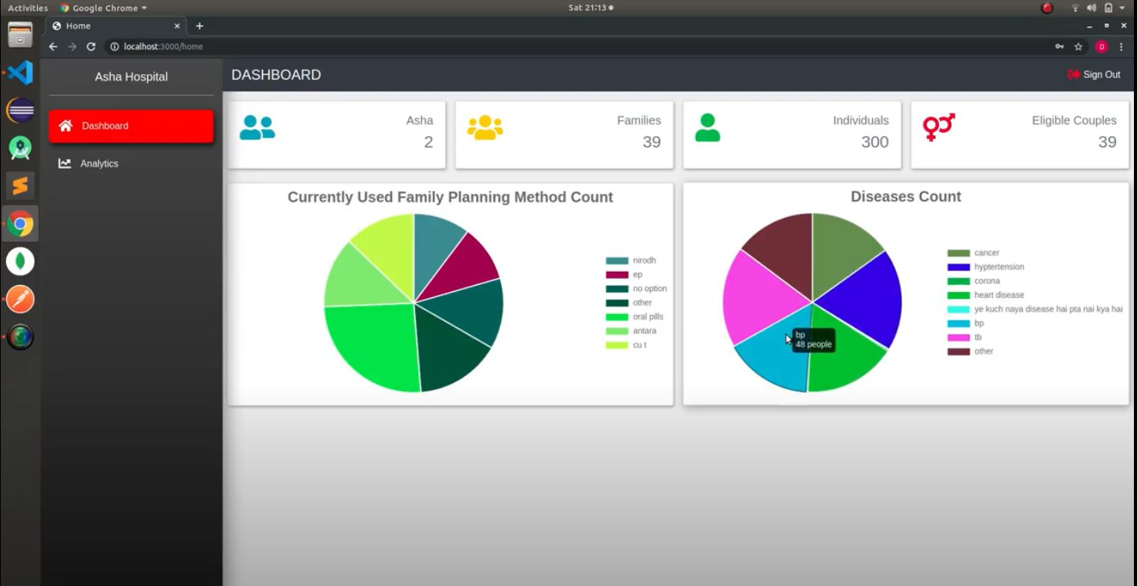
An Admin Panel for viewing the data collected by Asha workers and different analysis based on the data collected

