Slide 1



K. J. Somaiya Institute of Engineering & Information Technology, Mumbai
Department of Computer Engineering
Final Year Project Presentation (Sem VII)
Academic Year 2020-21
Survey App for ASHA Workers (Aarogya Patrika)
Kartik Chawda – 7
Yash Gandhi - 17
Juhi Gori – 19
Supervisor
Nisha Vanjari

Slide 2

Outline of Project
Introduction
Literature Survey
Proposed system / idea
Software and Hardware requirement
System design
System implementation
Yet to Implement!
Conclusion
References

Slide 3
Introduction
ASHA Accredited Social Health Activists workers are helping to build a strong foundation for promoting healthy practices in our society. They play critical role for various health programs of the Government of India. Now, it is time to empower them by imparting training and upgrading skills as a majority of ASHAs are village women with low literacy skills and they face operational challenges in conducting routine maternal, new-born, child health activities and infection prevention.
ASHAs are the first point of contact for the needy rural masses and can become frontline healthcare workers by imparting training in regional languages.
The “Aarogya Patrika” is designed with the aim of blurring all these possibilities of lack of access to healthcare information, refresher training and meaningful supervision so that their ability to contribute to improved maternal and new-born health outcomes will play a major role.

Slide 4
Literature Review
N. D. Valakunde in Smart ASHA pregnancy monitoring system: The Smart ASHA Pregnancy Monitoring System (SAPMS) aims to reduce the MMR by digitalizing the work of the health workers in the Uttar Pradesh state, by enabling them to monitor the pregnancies of the women in their area with the help of smart phones, effectively and efficiently. They focused on maternal mortality rate (MMR) and new borns and ensured that Women visits atleast 4 times to a health care centre to ensure a safe and healthy pregnancy. [2]
Bhatia, Kavita in Performance-based incentives of the ASHA scheme stakeholders perspectives: mHealth also aims to reduce the MMR by digitalizing the work of health workers in Gujarat state. But they implemented notification service facility where ASHA’s were notified about the emergency situation and also took feedback on the mHealth app performance and efficiency. [1]

Slide 5
Proposed System
The app simplifies public administration, eliminating the need for data-entry operators.
The app manages to convert the data into digital format right from the point of entry, to be used, analyzed, accessed and processed across the health system by all relevant staff members
CHW (Community Health Workers) manages admin panel where they analyze the health data of families.

Slide 6
Hardware and Software Requirement
Hardware Requirement:
Android Device (Minimum API 17 i.e. Jelly Bean)
Intel Pentium 4, 2 GB RAM, 20 GB HDD, Min. Windows XP, Chrome Browser.
Software Requirement:
Android Studio
HTML, CSS, JS, BootStrap (Admin Panel)
JavaScript, Node JS Framework (Backend)
GraphQL API
MongoDB Database

Slide 7
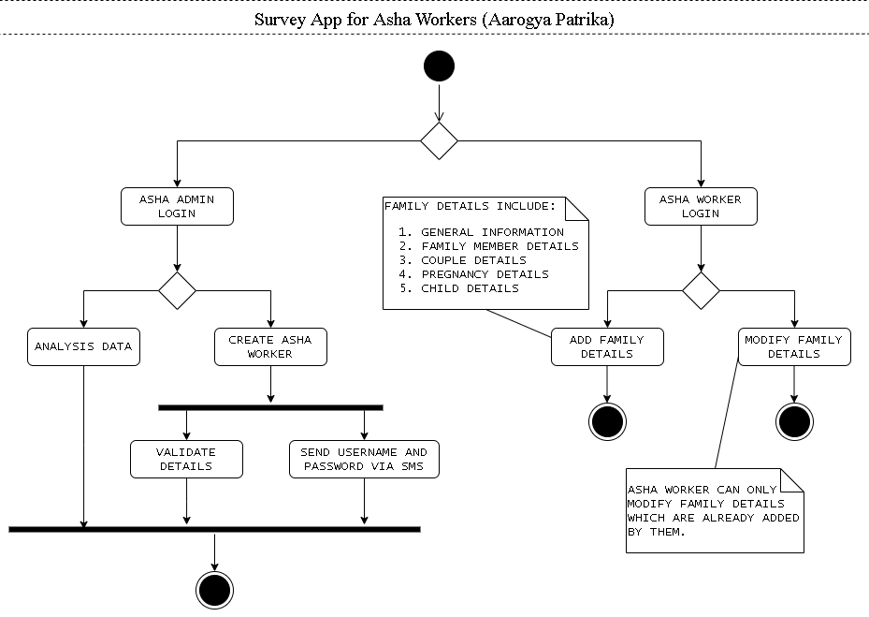
System Design

Slide 8
System Design
Software Architecture: The software architecture is comprised of the database, server and the client application.
Database: The database consists of a number of tables; some are fixed while some are created dynamically. These tables storing the data are implemented in MongoDB.
Client Application: The application provides an efficient user interface for all the ASHA workers. Server The server is deployed on Heroku as it is robust, free and easy to deploy.
Hardware Architecture: The basic hardware requirement for the system is any device having access to the internet connection which can run the “Aarogya Patrika” app and a server to store the database and host the Smart ASHA website.

Slide 9
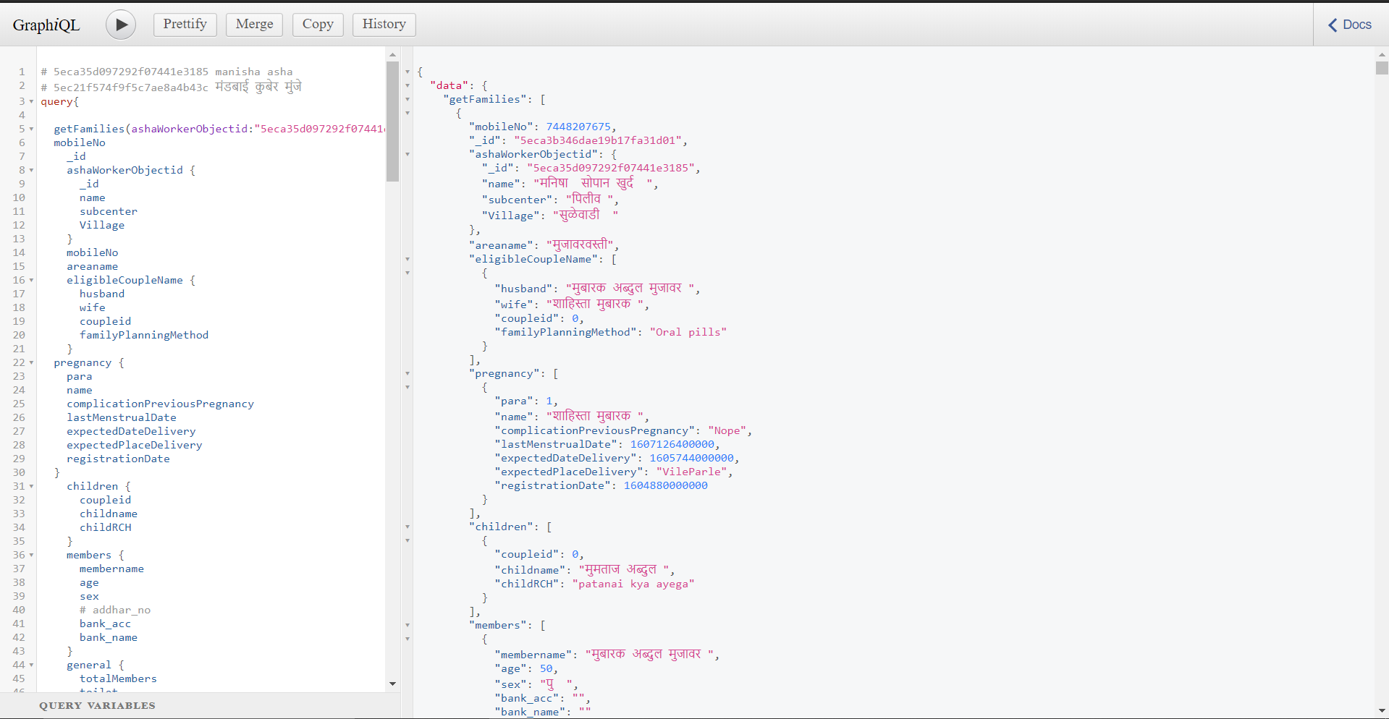
System Implementation
A GraphQL API for interaction of the Mobile App and website with the MongoDB Database

Slide 10
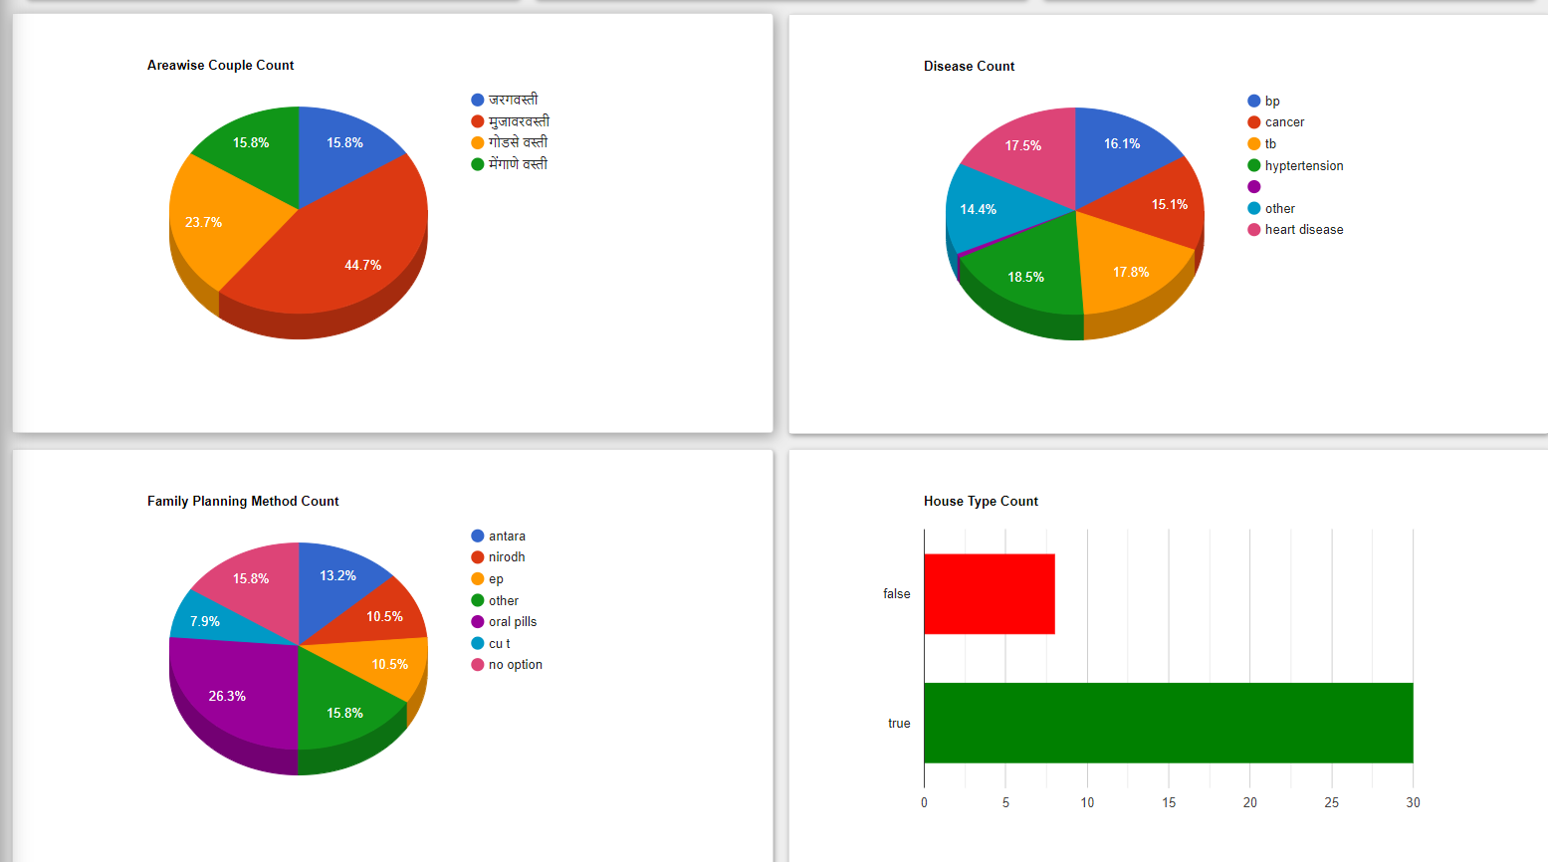
System Implementation
Dashboards that help medical professionals quickly analyze large sets of data can save time, and can even save lives.

Slide 11
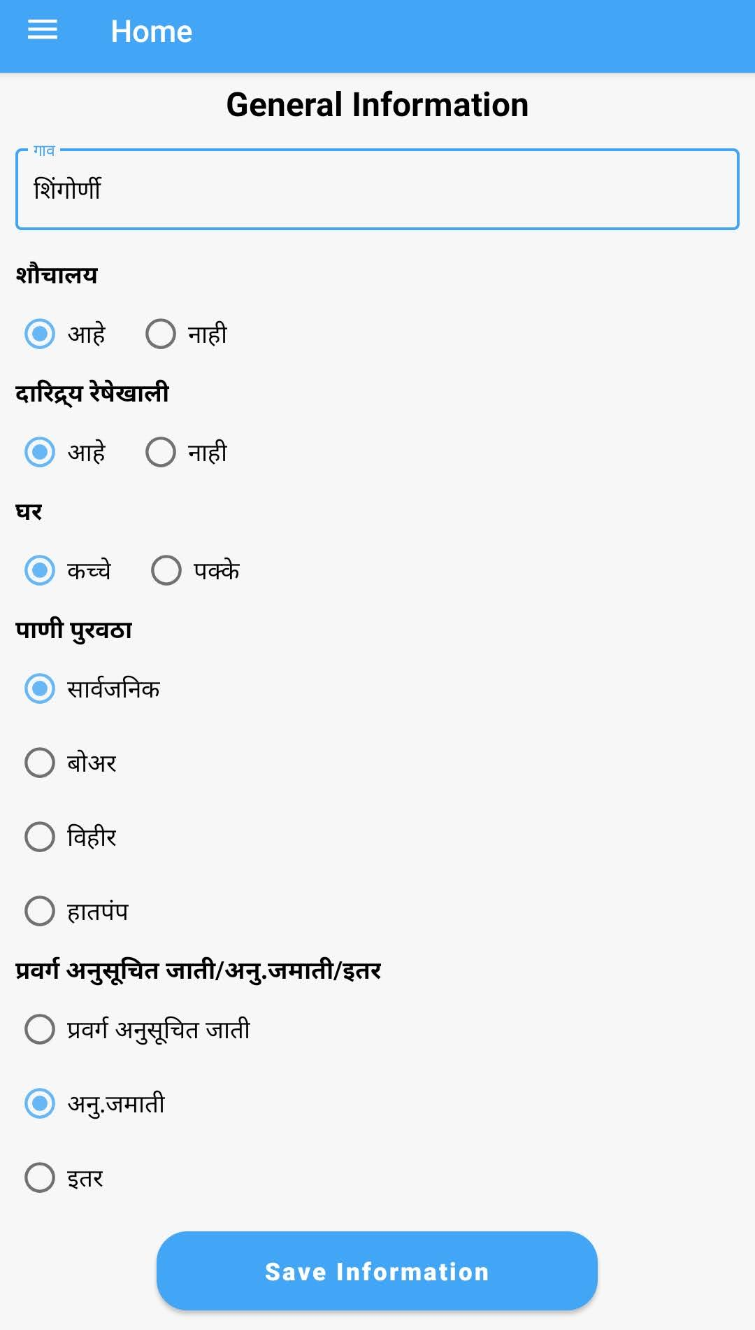
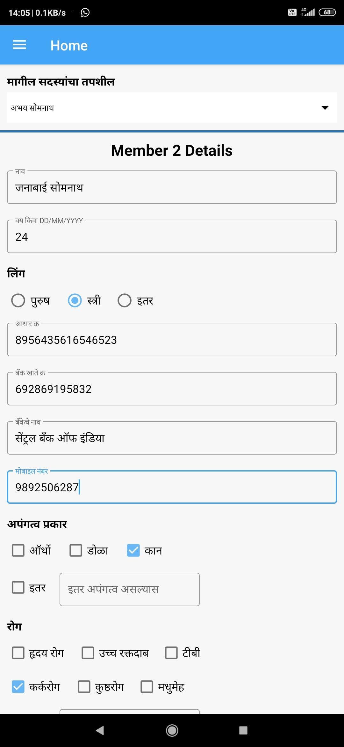
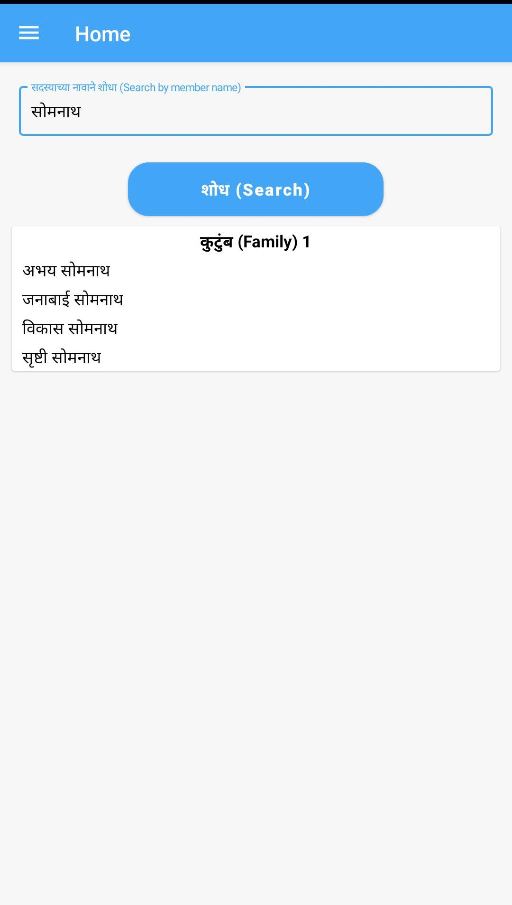
System Implementation
Aarogya Patrika

Slide 12
Yet to Implement!
Provide app in multiple regional languages.
Adding more analytical data in admin panel where CHW workers can analyze and take necessary actions to the situation.
Try to implement push notifications in app where ASHA’s will be notified whether there is any emergency in upcoming days.
Login and Authentication both on Admin Panel and App

Slide 13
Conclusion
Thus the project has benefit of improving the social status of women health workers, since they will be some of the first ones to get smartphones in their villages and blocks. It actually enhances humanized interaction by guiding the service providers to have structured inter-personal conversations with the mother and her family members to counsel and care for them better.

Slide 14
References
[1] Bhatia, Kavita. 2014 . Performance-based incentives of the ASHA scheme stakeholders perspectives. Economic and political weekly. 145-151.
[2] N. D. Valakunde et al., Smart ASHA pregnancy monitoring system, 2017 International Conference on Big Data, IoT and Data Science BID , Pune, 2017, pp. 185-192, doi: 10.1109/BID.2017.8336596.

Slide 15
Thank You

