Slide 1
CS4102 – Algorithms
Tom Horton
horton@cs.virginia.edu
Mark Floryan
mfloryan@cs.virginia.edu
Course Mechanics
Course content
Topics from earlier classes
Course learning objectives
What’s the course all about? A quick tour

Slide 2
Course introduction

Slide 3
General Info
See syllabus on course website for general information
Pre-requisites:
CS2150 (with C- or better)
Math topics: proof by induction, proof by contradiction, exponents, logarithms, limits, simple differentiations (covered in APMA 1090 or MATH 1210 or MATH 1310)
Teaching Assistants
Graduates (?):
TBD: Will likely have one graduate student
Undergraduates (~20)
We should have plenty of undergraduate support!
Both will hold office hours, which will start next week
Locations and hours TBA
Also, we’ll use Piazza for questions
Post all questions about HW, topics, etc to Piazza NOT email to instructors!

Slide 4
Discord
Most of our course communication will happen on Discord.
Class announcements
Office Hours
General Q&A with Tas, etc. (We will use piazza too)
Please join ASAP!
https://discord.gg/ycPkfQK9

Slide 5
Expectations
Of you:
When asked, prepare for things in advance
Participate in class activities when asked
Act mature, professional.
Plan ahead.
Don’t take advantage. Follow the Honor Code. (See the BOCM.)
Of me:
Be fair, open, and considerate.
Seek and listen to your feedback.
Not to waste your time.
Be effective in letting you know how you’re doing

Slide 6
General Info
Textbook:
Introduction to Algorithms, 3rd edition, by Cormen, et. al.
Other references:
Your CS2150 material (will be VERY useful here)
Discrete Math textbook / references
Other readings may be assigned
We’ll see…

Slide 7
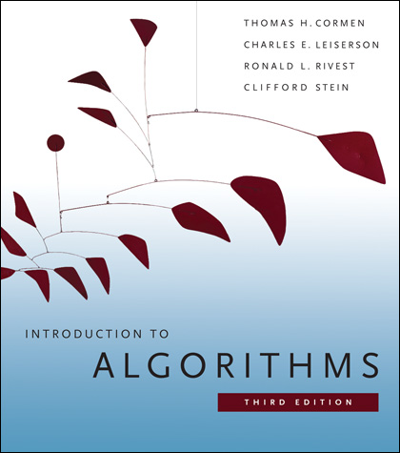
Textbook
You really need to read and study material other than the slides.
There are options, but a textbook is the easiest option.
We’ll post readings from CLRS, urge you to read them or get that info from another source.
We may also post additional resources.
Introduction to Algorithms by Cormen, et. al. (CLRS)
3rd edition!
UVA Library has a digital version of CLRS available online for free at https://search.lib.virginia.edu/catalog/u6757775

Slide 8
Lectures
Going to try a half asynchronous, half synchronous model
And see how it goes. Could change, but likely not.
First half of each lecture is recorded ahead of time. You can either:
Watch it ahead of time at your leisure
Watch it during the first 35-45 mins of lecture
Then, we meet up on zoom to:
Go over extra examples
Answer questions, do proofs, etc.

Slide 9
Lectures, example
So…say class is from 11-12:15
You DO NOT need to show up from 11-11:30
Either watch recording from 11-11:30
Or watch it ahead of time
Get on Zoom at 11:35
40 mins of live lecture
For follow-up, examples, etc.

Slide 10
Modules
The course is divided into 4 modules
Divide and Conquer / Sorting
Graphs, MST, Find-Union
Greedy Algorithms and Dynamic Programming
Network Flow and Reductions
Each is approximately 3 weeks of content. Each contains:
2 basic homeworks
2 advanced homeworks
1 quiz
More on all this in a moment

Slide 11
Quizzes
Short assessments for each of the four modules
Will be take-home over an ~24 hour period
Meant to challenge your problem-solving skills, make sure you attended class, force you to analyze across topics, etc.
Three possible grade outcomes:
Incomplete: Knowledge not shown
Satisfactory: Good, but noticeable issues remain
Mastered: Looks great, can have minor errors / flaws
You will have three attempts at most of these (sometimes only two due to time constraints). More details later.
(Also, a 5th quiz at the end of the course.)

Slide 12
Homeworks
Most Homeworks are programming assignments or written descriptions of algorithms / proofs
Programming HW:
Can be written in Java, C++, or Python (your choice)
Homework will specify the problem, input, and output specs. That is it. Sometimes a target runtime will be given
Must also submit a written summary of your approach, and description of runtime complexity
Written HW
Solving small problems, analyzing runtimes, etc.
Sometimes proofs of correctness, etc.
Written in Latex (tutorial on course webpage)

Slide 13
Homework Grades
Homeworks also have three grade levels:
Incomplete: HW is not complete or does not show a minimum level of competence.
Satisfactory: HW is good, but contains noticeable issues that need to be addressed.
Mastered: HW looks very good, might contain minor errors.
Homeworks can be submitted multiple times to allow you to reach higher grade levels.
Some restrictions apply. More on this when we look at the schedule.

Slide 14
Quiz and Homework Deadlines
Let’s look at schedule on course website →
Summary:
Quizzes are at end of every module. Most have a second attempt during the next module (if time allows)
A final “putting it all together” quiz
Homeworks have a soft deadline and a hard deadline
Will be graded and feedback given if submitted at either deadline.
Expectation is you will submit at soft deadline, and resubmit at hard deadline IF you don’t pass the HW. But…up to you.

Slide 15
Final Exam
Our final exam time will be used to: Provide another attempt at each module quiz, and Take the “putting it all together” quiz.
You will be given five quizzes, one per module and a final “putting it all together” quiz.
If you already passed some of these, you don’t need to do them again during the final.
If you want to reattempt any quiz (or multiple ones) you may do so.
This will be your ONLY ATTEMPT at the “putting it all together” quiz.

Slide 16
Homework: Programming Hints
Understand the problem!
Consider all boundary cases
Use pre-existing library code
Number formatting: NumberFormat in Java, printf() in C/C++
Input: Scanner in Java, scanf() in C, cin in C++
Know how to handle floating point numbers
Understand float/double precision issues
Rounding, floating-point mod
Make sure it works for the provided test cases
Then write some of your own
Make sure you read the language specific details for submission!!!

Slide 17
Homework: Programming FAQ
Do I need to write my own sorting methods.
Yes! You should be able to do this, and it is good practice. Also, sorting is one of our first topics this semester.
Can I get the test cases from submission server?
No, part of the point is to work on brainstorming cases your code is missing without being told. Submission server will give limited feedback on purpose!
Will you help me debug my code?
No, we won’t. You need to learn how to do this on your own. I’m happy to give you advice on how to approach your debugging problems, but I will not sit down and debug code with you.

Slide 18
Homework: Written
These assignments must be typeset in LaTeX
I will provide a couple tutorials, guides, and templates when the first assignment is given out
You may not embed images of text or formulas!

Slide 19
Working in groups
For the homeworks, you may work together in groups of 3 or less to discuss the algorithmic aspects ONLY
State who you worked with (in code comments)
No looking at another person’s code, or ANY code online!!
For the written homeworks, you may work together in groups of 3 or less, but you MUST:
State who you worked with
Type up your own assignment!

Slide 20
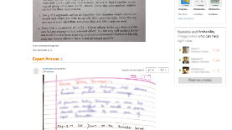
Academic Integrity
Collaboration allowed and encouraged!
But only within your groups of up to 3 per assignment (you + 2 more)
Write-ups/code written independently
DO NOT share written solutions / code
DO NOT share documents (ex: Overleaf)
DO NOT share debugging of code
DO NOT seek published solutions online
Be able to explain any solution you submit!
We will find those who don’t do the right thing.

Slide 21
Grading Overview
Let’s look at how grades work on course website →
Summary:
Count how many homeworks / quizzes you’ve mastered, satisfied, etc.
Look up the HIGHEST LETTER GRADE row on the table that for which you satisfy or exceed the requirements.
That is your final letter grade for the course.

Slide 23
What you know already from CS2150
Definition of an algorithm
Definition of algorithm “complexity”
Measuring worst-case complexity
Cost as a function of input size
Asymptotic rate of growth: Big-Oh, Big-Theta
Relative ordering of rates of growth
Analyzing an algorithm's cost:
sequences, loops, if/else, functions, recursion
Focus on counting one particular statement or operation; don’t count all statements

Slide 24
What you know already from CS2150
Problems and their solutions:
Linear data structures vs. tree data structures
Searching: linear/sequential search, binary search (?), hashing
Sorting: quicksort, mergesort in CS2110 (?)
Priority Queue ADT and Heap Implementation

Slide 25
What you know already from all your courses
Examples of Algorithm design methods:
Divide and Conquer (quicksort, mergesort)
Greedy (though you didn’t call it this)
Dynamic programming (fibonacci numbers, Floyd-Warshall)
NP-complete (traveling salesperson. Have you seen this?)

Slide 26
What you know already from Discrete Math and Theory of Computation…
From CS2102:
Proofs: induction, contradiction
If you are uncomfortable with these two, review them NOW!
Counting, probability, combinatorics, permutations
From some earlier math class:
Exponents, logarithms, limits, differentiation on polynomials and other simple functions
From CS3102 (if you have taken it)
Maturity in mathematics and computing theory
Ability to do proofs
Abstract models of computation, such as Turing machines

Slide 27
Questions? Concerns? Wrath to vent?

Slide 28
A first algorithm: making change

Slide 29
OK… But What’s It Really All About?
Let’s illustrate some ideas you’ll see throughout the course
Using one example
Concepts:
Describing an algorithm
Measuring algorithm efficiency
Families or types of problems
Algorithm design strategies
Alternative strategies
Lower bounds and optimal algorithms
Problems that seem very hard

Slide 30
Everyone Already Knows Many Algorithms!
Worked retail? You know how to make change!
Example:
My item costs $4.37. I give you a five dollar bill. What do you give me in change?
Answer: two quarters, a dime, three pennies
Why? How do we figure that out?

Slide 31
Making Change
The problem:
Give back the right amount of change, and…
Return the fewest number of coins!
Inputs: the dollar-amount to return
Also, the set of possible coins. (Do we have half-dollars? That affects the answer we give.)
Output: a set of coins
Note this problem statement is simply a transformation
Given input, generate output with certain properties
No statement about how to do it.
Can you describe the algorithm you use?

Slide 32
A Change Algorithm
Consider the largest coin
How many go into the amount left?
Add that many of that coin to the output
Subtract the amount for those coins from the amount left to return
If the amount left is zero, done!
If not, consider next largest coin, and go back to Step 2
Notes:
Will this always finish? Yes, because we have pennies!

Slide 33
Is this a “good” algorithm?
What makes an algorithm “good”?
Good time complexity. (Maybe space complexity.)
Better than any other algorithm
Easy to understand
How could we measure how much work an algorithm does?
Code it and time it. Issues?
Count how many “instructions” it does before implementing it
Computer scientists count basic operations, and use a rough measure of this: order class, e.g. O(n lg n)

Slide 34
Evaluating Our Greedy Algorithm
How much work does it do?
Say C is the amount of change, and N is the number of coins in our coin-set
Loop at most N times, and inside the loop we do:
A division
Add something to the output list
A subtraction, and a test
We say this is O(N), or linear in terms of the size of the coin-set
Could we do better?
Is this an optimal algorithm?
We need to do a proof somehow to show this

Slide 35
You’re Being Greedy!
This algorithm is an example of a family of algorithms called greedy algorithms
Suitable for optimization problems
There are many feasible answers that add up to the right amount, but one is optimal or best (fewest coins)
Immediately greedy: at each step, choose what looks best now. No “look-ahead” into the future!
What’s an optimization problem?
Some subset or combination of values satisfies problem constraints (feasible solutions)
But, a way of comparing these. One is best: the optimal solution

Slide 36
Does Greed Pay Off?
Greedy algorithms are often efficient.
Are they always right? Always find the optimal answer?
For some problems.
Not for checkers or chess!
Always for coin-changing problem? Depends on coin values
Say we had a 11-cent coin
What happens if we need to return 15 cents?
So how do we know?
In the real world:
Many optimization problems
Many good greedy solutions to some of these
Notes:
Use a funny name for the 11-cent coin. Name it after yourself, or call it a “Kardashian” or a Floryan or something.
If our set of coins contains a “Kardashian” plus the usual, then our algorithm will return first a Kardashian, then four pennies. Five coins. The best answer is a dime and a nickel, or two coins.

Slide 37
Formal algorithmic description
All algorithms in this course must have the following components:
Problem description (1 line max)
Inputs
Outputs
Assumptions
Strategy overview
1 or 2 sentences outlining the basic strategy, including the name of the method you are going to use for the algorithm
Algorithm description
If listed in English (as opposed to pseudo-code), then it should be listed in steps

Slide 38
Change solution (greedy)
Problem description: providing coin change of a given amount in the fewest number of coins
Inputs: the dollar-amount to return. Perhaps the possible set of coins, if it is non-obvious.
Output: a set of coins that obtains the desired amount of change in the fewest number of coins
Assumptions: If the coins are not stated, then they are the standard quarter, dime, nickel, and penny. All inputs are non-negative, and dollar amounts are ignored.
Strategy: a greedy algorithm that uses the largest coins first
Description: Issue the largest coin (quarters) until the amount left is less than the amount of a quarter ($0.25). Repeat with decreasing coin sizes (dimes, nickels, pennies).

Slide 39
Another Change Algorithm
Give me another way to do this?
Brute force:
Generate all possible combinations of coins that add up to the required amount
From these, choose the one with smallest number
What would you say about this approach?
There are other ways to solve this problem
Dynamic programming: build a table of solutions to small subproblems, work your way up

Slide 40
Change solution (brute-force)
Problem description: providing coin change of a given amount in the fewest number of coins
Inputs: the dollar-amount to return. Perhaps the possible set of coins, if it is non-obvious.
Output: a set of coins that obtains the desired amount of change in the fewest number of coins
Assumptions: If the coins are not stated, then they are the standard quarter, dime, nickel, and penny. All inputs are non-negative, and dollar amounts are ignored.
Strategy: a brute-force algorithm that considers every possibility and picks the one with the fewest number of coins
Description: Consider every possible combination of coins that add to the given amount (done via a depth-first search). Return the one with the fewest number of coins.

Slide 41
Motivating problems

Slide 42
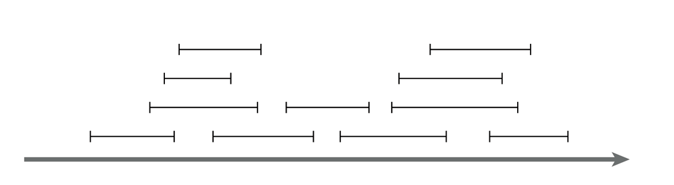
Motivating problem: Interval scheduling
Interval scheduling
Given a series of requests, each with a start time and end time, maximize the number of requests scheduled
This is solved by a greedy algorithm
Most of the CS 2150 algorithms you’ve seen are greedy algorithms: Dijkstra’s shortest path, both MST algorithms, etc.

Slide 43
Motivating problem: Weighted interval scheduling
Weighted interval scheduling
Same as the regular interval scheduling, but in addition each request has a cost associated with it
The goal is to maximize the cost from scheduling the items
This is solved by dynamic programming

Slide 44
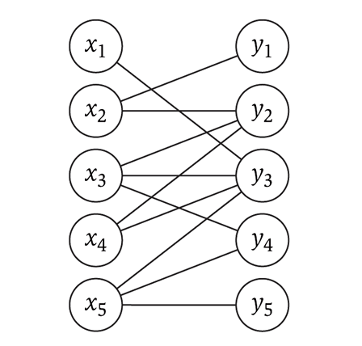
Motivating problem: Bipartite matching
Bipartite matching
Given a graph G, find the maximum sub-graph of G that partitions G into sets X and Y such that no node from X is connected to a node in Y, and vise-versa
Example: given a series of requests, and entities that can handle each request (such people, computers, etc.), find the optimal matching of requests to entities
This is a network flow problem

Slide 45
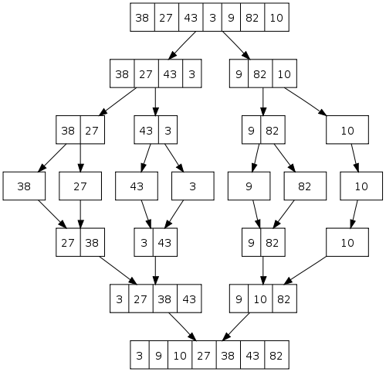
Motivating problem: Sorting
How do you implement a general-purpose sort that is as efficient as possible in both space and time, and is stable?
One solution is merge-sort
We’ll see later why quicksort, heapsort, and radix sort are not sufficient
This is an application of both sorting and divide and conquer

Slide 46
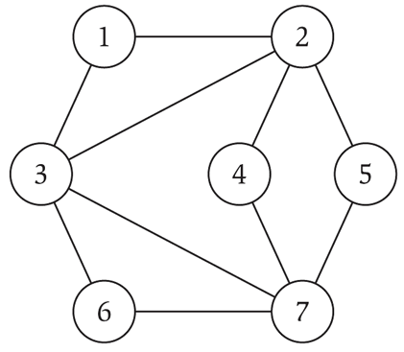
Motivating problem: Independent set
Independent set
Given a graph G, find the maximum size subset X of G such that no two nodes in X are connected to each other
This is a NP-complete problem
You’ve seen TSP (travelling salesperson problem) in CS 2150, which is a NP-complete problem

Slide 47
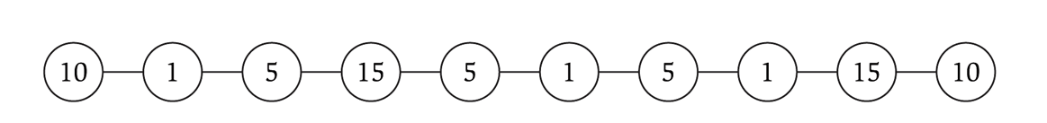
Motivating problem: Competitive facility location
Competitive facility location
Consider a graph G, where two ‘players’ choose nodes in alternating order. No two nodes can be chosen (by either side) if a connecting node is already chosen. Choose the winning strategy for your player.
This is a PSPACE problem, which are harder than NP-complete problems

