Slide 1
Quickselect and Median of Medians: Improving Quicksort
CS 4102: Algorithms
Spring 2021
Mark Floryan and Tom Horton

Slide 2
Readings
CLRS:
Chapter 9
Wikipedia articles on Quickselect and Median of Medians

Slide 3
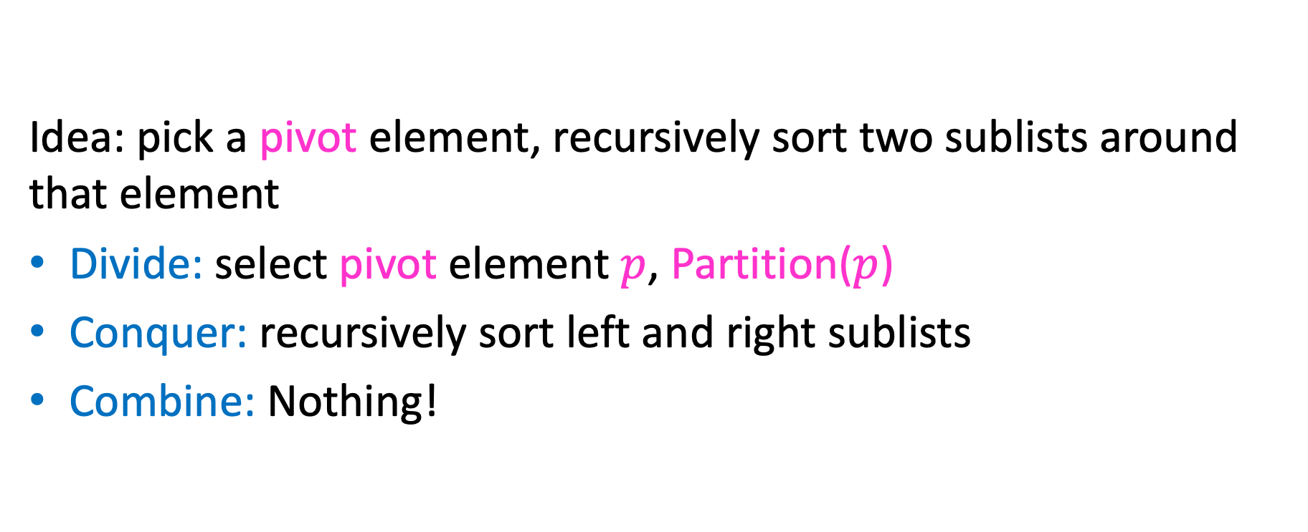
Review: Quicksort
Idea: pick a pivot element, recursively sort two sublists around that element
Divide: select pivot element $p$, Partition($p$)
Conquer: recursively sort left and right sublists
Combine: Nothing!

Slide 4


Partition (Divide step)
Given: a list, a pivot $p$
Start: unordered list
8
5
7
3
12
10
1
2
4
9
6
11
Goal: All elements $<p$ on left, all $>p$ on right
5
7
3
1
2
4
6
8
12
10
9
11

Slide 5

Quicksort Run Time (Best)
If the pivot is always the median:
2
5
1
3
6
4
7
8
10
9
11
12
2
1
3
5
6
4
7
8
9
10
11
12
Then we divide in half each time
$$T\left(n\right)=2T\left(\frac{n}{2}\right)+n$$
$$T\left(n\right)=O(n\log{n})$$

Slide 6
Quicksort Run Time (Worst)
If the pivot is always at the extreme:
1
5
2
3
6
4
7
8
10
9
11
12
1
2
3
5
6
4
7
8
10
9
11
12
Then we shorten by 1 each time
$$T\left(n\right)=T\left(n−1\right)+n$$
$$T\left(n\right)=O(n^{2})$$

Slide 7
Can we Pick a Good Pivot for Quicksort?
What makes a good Pivot for Quicksort?
Roughly even split between left and right
Ideally: the median
Can we find a list’s median in linear time?
Quickselect (https://en.wikipedia.org/wiki/Quickselect)
Finds the median
Works a lot like Quicksort: needs to do a Partition
We need a good pivot for Quickselect for it to have good time-complexity
Median of Medians (https://en.wikipedia.org/wiki/Median_of_medians)
Can be used to find “pretty good” pivot for QS, or with Quickselect

Slide 8
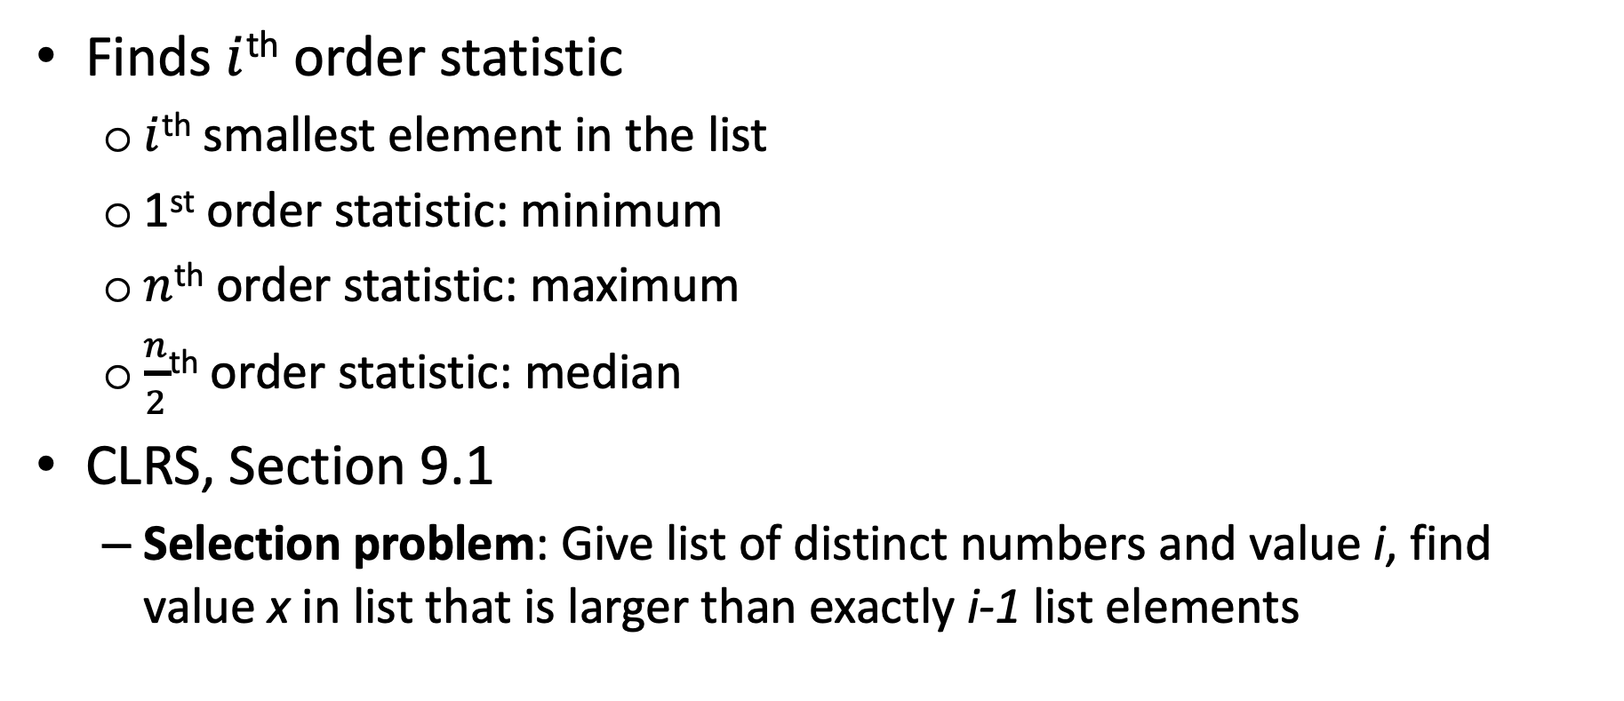
Quickselect
Finds $i$^{th} order statistic
$i$^{th} smallest element in the list
1st order statistic: minimum
$n$^{th} order statistic: maximum
$\frac{n}{2}$^{th} order statistic: median
CLRS, Section 9.1
Selection problem: Give list of distinct numbers and value i, find value x in list that is larger than exactly i-1 list elements

Slide 9
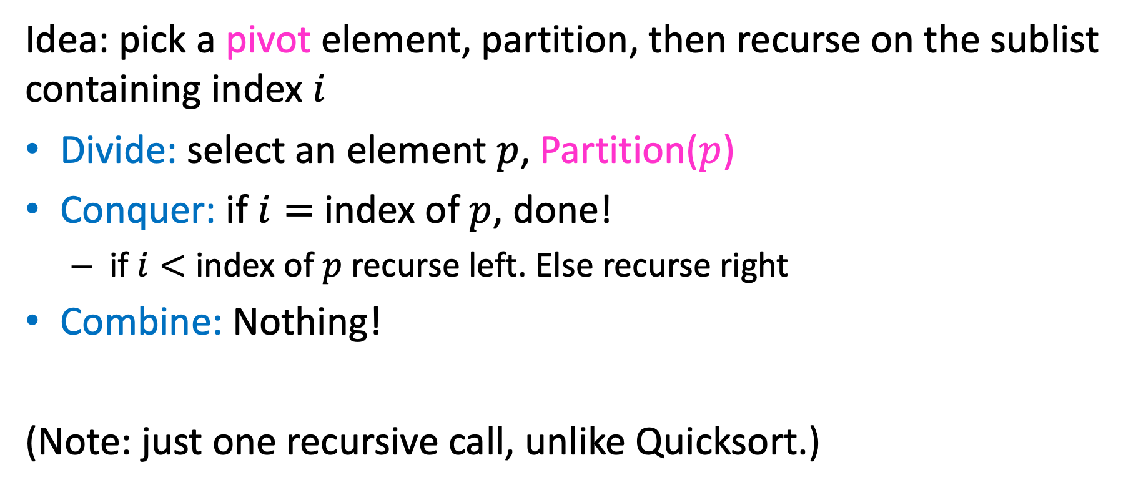
Quickselect
Idea: pick a pivot element, partition, then recurse on the sublist containing index $i$
Divide: select an element $p$, Partition($p$)
Conquer: if $i=$ index of $p$, done!
if $i<$ index of $p$recurse left. Else recurse right
Combine: Nothing!
(Note: just one recursive call, unlike Quicksort.)

Slide 10


Partition (Divide step)
Given: a list, a pivot value $x$
Note: now using “x” to refer to pivot value. We called it “p” in previous slides.
Start: unordered list
11
5
7
3
12
10
1
2
4
9
6
8
Goal: All elements $<x$ on left, all $>x$ on right
5
7
3
1
2
4
6
8
12
10
9
11

Slide 11
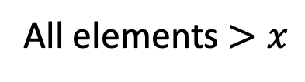
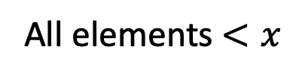
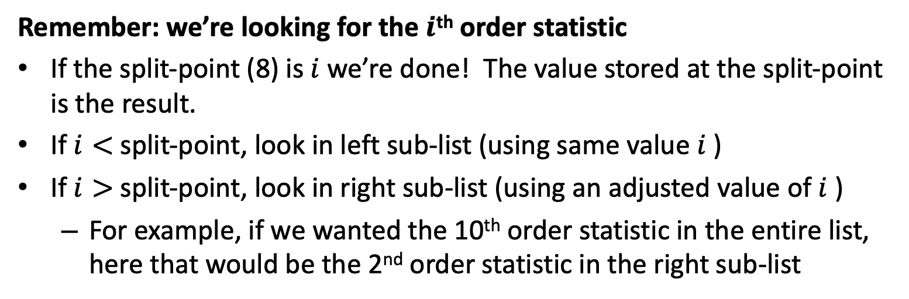
Conquer
Position
in list
1
2
3
4
5
6
7
8
9
10
11
12
2
5
7
3
6
4
1
8
10
9
11
12
All elements $<x$
All elements $>x$
$x=8 put e$xactly where it belongs at position 8 (the split-point)
Remember: we’re looking for the $i$^{th} order statistic
If the split-point (8) is $i$we’re done! The value stored at the split-point is the result.
If $i<$split-point, look in left sub-list (using same value $i$)
If $i>$split-point, look in right sub-list (using an adjusted value of $i$)
For example, if we wanted the 10th order statistic in the entire list, here that would be the 2nd order statistic in the right sub-list

Slide 12
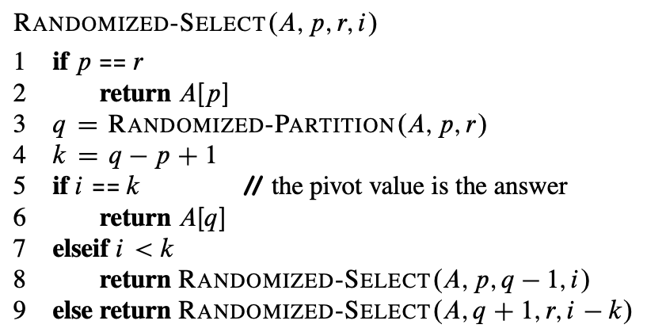
CLRS Pseudocode for Quickselect
A – the list
p – index of first item r – index of last item
i – find ith smallest item
q – pivot location
k – number on left + 1
// number of elements in left sub-list + 1
// note adjustment to i when recursing on right side
Note: In CLRS, they’re using a partition that randomly chooses the pivot element.
That’s why you see “Randomized” in the names here. Ignore that for the moment.

Slide 13
Work These Examples!
For each of the following calls, show
The value of q after each partition,
Which recursive calls made
Select( [3, 2, 9, 0, 7, 5, 6, 1], p=0, r=7, i=2)
Select( [3, 2, 9, 0, 7, 5, 6, 1], p=0, r=7, i=5)
Select( [3, 2, 9, 0, 7, 5, 6, 1], p=0, r=7, i=7)

Slide 14

Quickselect Run Time
If the pivot is always the median:
2
5
1
3
6
4
7
8
10
9
11
12
2
1
3
5
6
4
7
8
9
10
11
12
Then we divide in half each time
$$S\left(n\right)=S\left(\frac{n}{2}\right)+n$$
$$S\left(n\right)=O(n)$$

Slide 15
Quickselect Run Time
If the partition is always unbalanced:
1
5
2
3
6
4
7
8
10
9
11
12
1
2
3
5
6
4
7
8
10
9
11
12
Then we shorten by 1 each time
$$S\left(n\right)=S\left(n−1\right)+n$$
$$S\left(n\right)=O(n^{2})$$

Slide 16
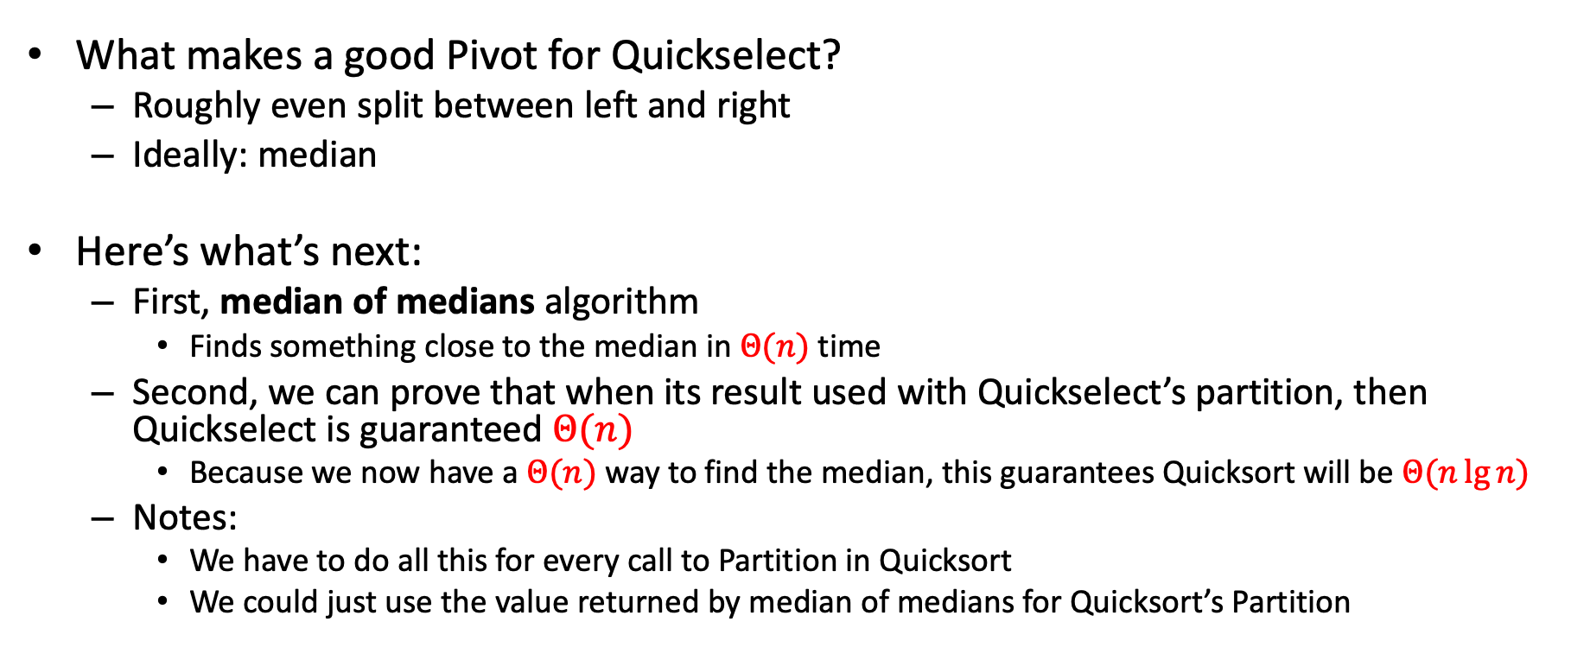
Good Pivot for Quickselect
What makes a good Pivot for Quickselect?
Roughly even split between left and right
Ideally: median
Here’s what’s next:
First, median of medians algorithm
Finds something close to the median in $Θ(n)$ time
Second, we can prove that when its result used with Quickselect’s partition, then Quickselect is guaranteed $Θ(n)$
Because we now have a $Θ(n)$ way to find the median, this guarantees Quicksort will be $Θ(n\lg{n})$
Notes:
We have to do all this for every call to Partition in Quicksort
We could just use the value returned by median of medians for Quicksort’s Partition
Déjà vu?

Slide 17
Pretty Good Pivot
What makes a “pretty good” Pivot?
Both sides of Pivot >30%
>30%
Select Pivot from this range
Or
>30%

Slide 18
Median of Medians
Fast way to select a “pretty good” pivot
Guarantees pivot is greater than 30% of elements and less than 30% of the elements
I.e. it’s in the middle 40% (±20% of the true median)
Idea: break list into chunks, find the median of each chunk, use the median of those medians
CLRS, pp. 220-221
https://en.wikipedia.org/wiki/Median_of_medians

Slide 19
Median of Medians
1. Break list into chunks of size 5
List could be long, many more than 5 chunks!
2. Find the median of each chunk (using insertion sort: n=5, 20 comparisons)
3. Return median of medians (using Quickselect, this algorithm, called recursively, on list of medians)
List could be long, many more than 5 medians!

Slide 20









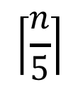















Why is this good?
Imagine each chunk sorted, chunks ordered by their medians
MedianofMedians is Greater than all of these
$$<$$
$$<$$
$$<$$
$$<$$
$$<$$
$$5$$
$$<$$
$$<$$
$$<$$
$$<$$
$$<$$
$$<$$
$$<$$
$$<$$
$$<$$
$$<$$
$$<$$
$$<$$
$$<$$
$$<$$
$$<$$
$$<$$
$$<$$
$$<$$
List could be long, so not a small number!
$$\left\lceil \frac{n}{5}\right\rceil$$

Slide 21
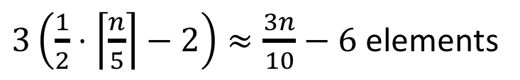


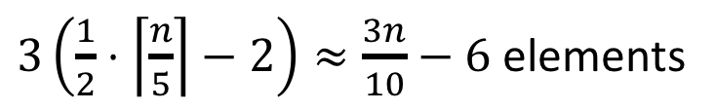

Why is this good?
MedianofMedians is larger than all of these
$$<$$
$$<$$
$$<$$
$$<$$
$$<$$
$$<$$
$$<$$
$$<$$
$$<$$
$$<$$
$$<$$
$$<$$
$$<$$
$$<$$
$$<$$
$$<$$
$$<$$
$$<$$
$$<$$
$$<$$
$$<$$
$$<$$
$$<$$
Worried about the details of this math? See CLRS p. 221
Larger than 3 things in each (but one) list to the left
$$\left\lceil \frac{n}{5}\right\rceil$$
$3\left(\frac{1}{2}⋅\left\lceil \frac{n}{5}\right\rceil −2\right)≈\frac{3n}{10}−6$ elements
$$<$$
Similarly:
$3\left(\frac{1}{2}⋅\left\lceil \frac{n}{5}\right\rceil −2\right)≈\frac{3n}{10}−6$ elements
$$>$$

Slide 22
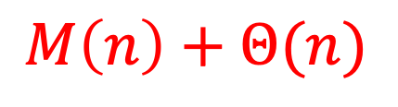
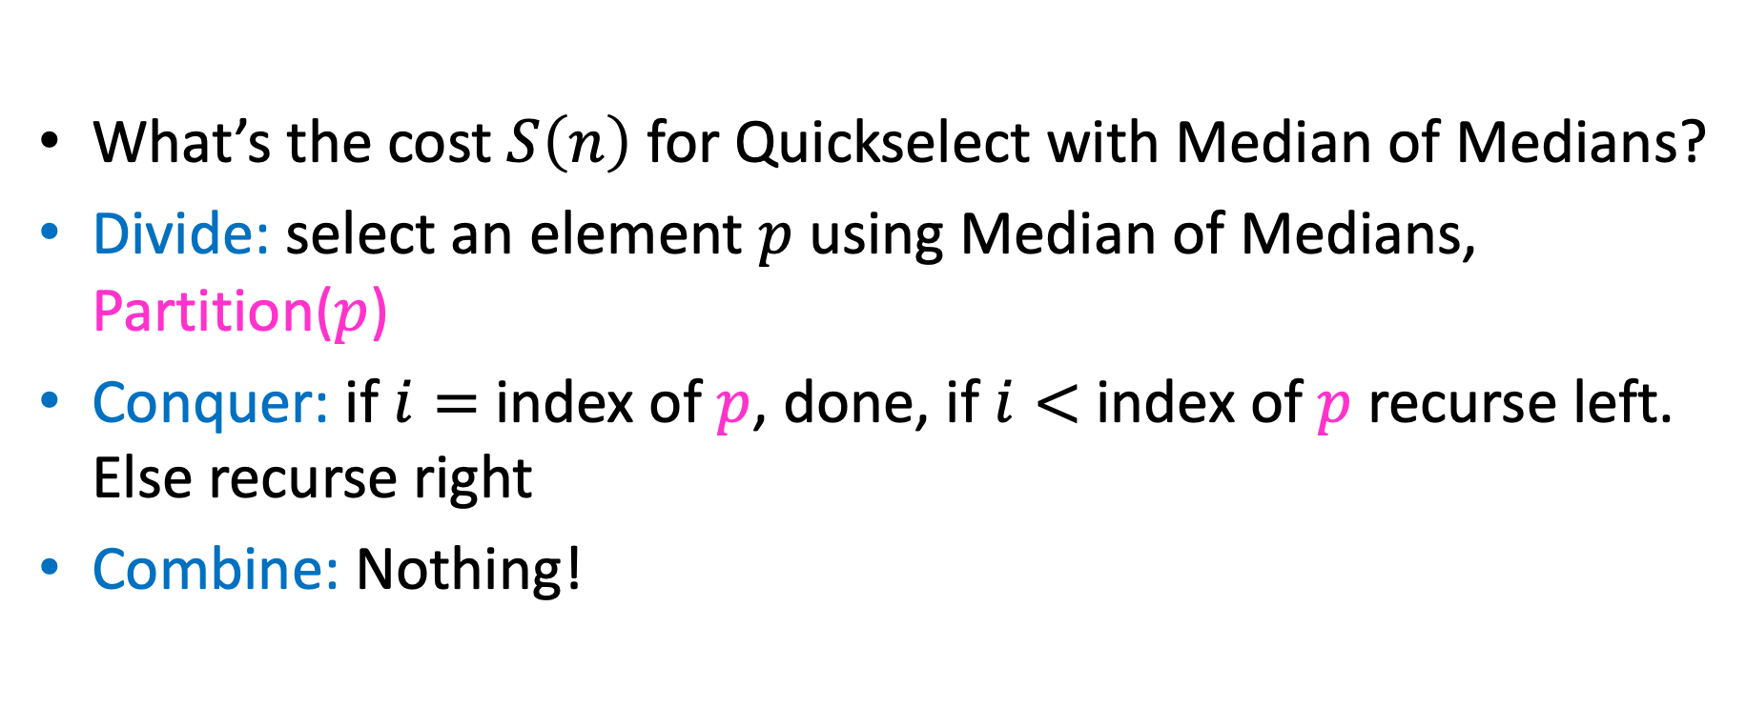
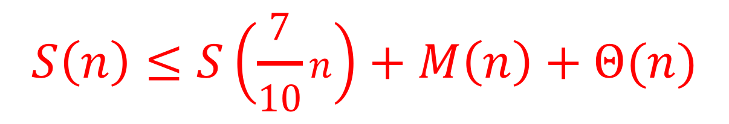
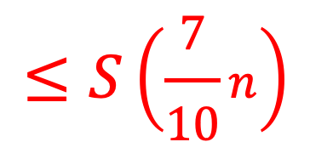
Run-time of Quickselect with Median of Medians
What’s the cost $S\left(n\right)$ for Quickselect with Median of Medians?
Divide: select an element $p$ using Median of Medians, Partition($p$)
Conquer: if $i=$ index of $p$, done, if $i<$ index of $p$recurse left. Else recurse right
Combine: Nothing!
$$M\left(n\right)+Θ(n)$$
$$≤S\left(\frac{7}{10}n\right)$$
$$S\left(n\right)≤S\left(\frac{7}{10}n\right)+M\left(n\right)+Θ(n)$$

Slide 23
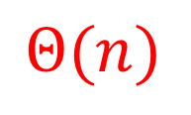
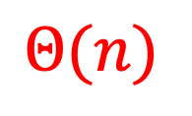
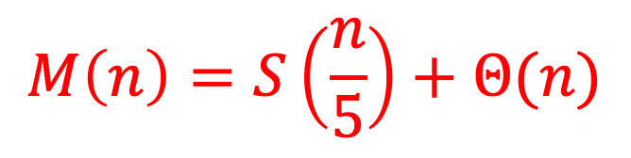
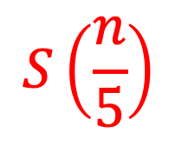
Run-time M(n) for Median of Medians
1. Break list into chunks of 5
$$Θ(n)$$
2. Find the median of each chunk
$$Θ(n)$$
3. Return median of medians (using Quickselect)
$$S\left(\frac{n}{5}\right)$$
$$M\left(n\right)=S\left(\frac{n}{5}\right)+Θ(n)$$

Slide 24
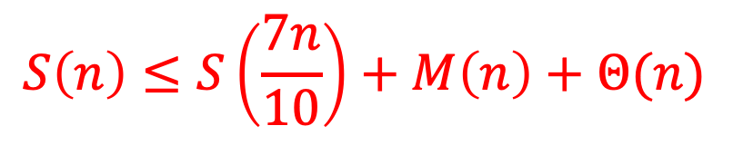
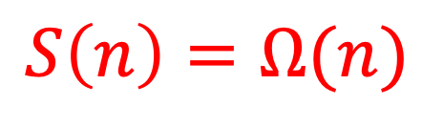
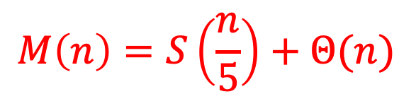
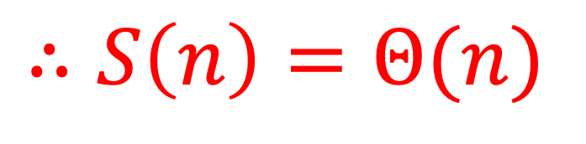
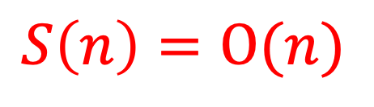
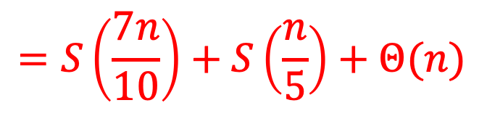
Quickselect
$$S\left(n\right)≤S\left(\frac{7n}{10}\right)+M\left(n\right)+Θ(n)$$
$$M\left(n\right)=S\left(\frac{n}{5}\right)+Θ(n)$$
$$=S\left(\frac{7n}{10}\right)+S\left(\frac{n}{5}\right)+Θ(n)$$
We can show by proof by induction that:
$$S\left(n\right)=O(n)$$
(next two slides)
$$S\left(n\right)=Ω(n)$$
$$∴S\left(n\right)=Θ(n)$$

Slide 25
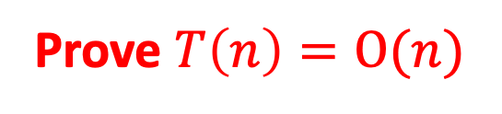
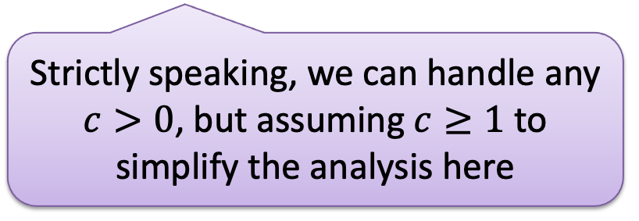
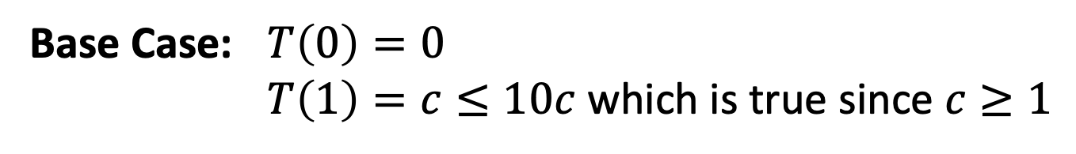
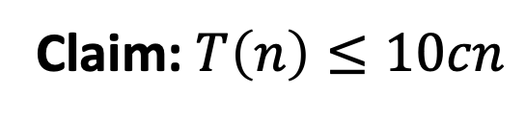
Proof by Induction
$$T\left(n\right)=T\left(n/5\right)+T\left({7n}/{10}\right)+c⋅n$$
Prove $T\left(n\right)=O(n)$
Claim: $T\left(n\right)≤10cn$
Base Case: $T\left(0\right)=0$
$T\left(1\right)=c≤10c$ which is true since $c≥1$
Strictly speaking, we can handle any $c>0$, but assuming $c≥1$ to simplify the analysis here

Slide 26
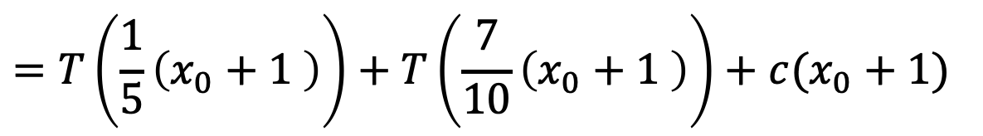
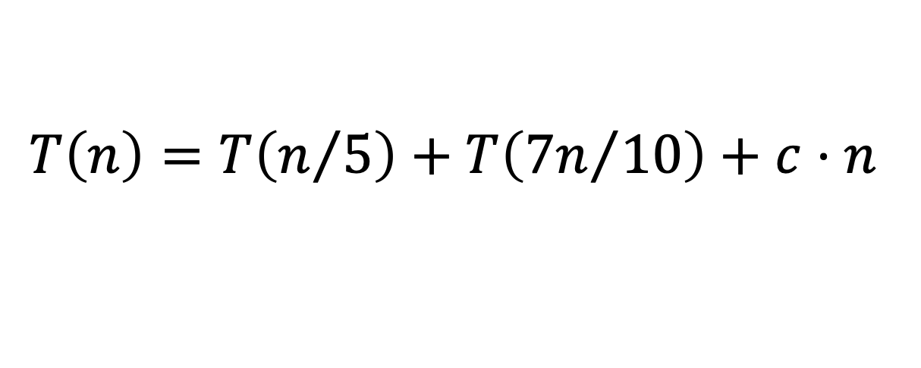
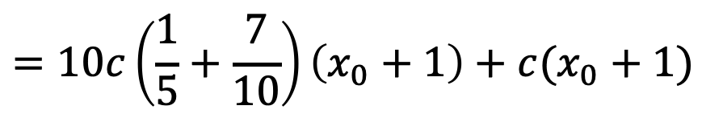

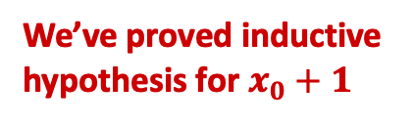
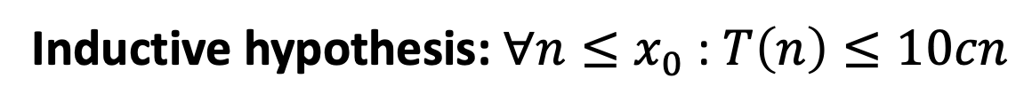
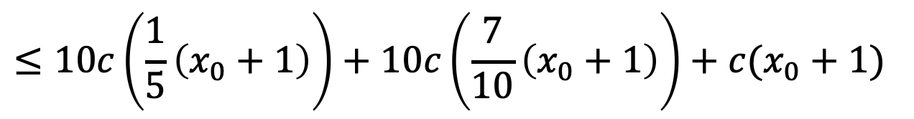
Proof by Induction
$$T\left(n\right)=T\left(n/5\right)+T\left({7n}/{10}\right)+c⋅n$$
Inductive hypothesis: $∀n≤x_{0}$ : $T\left(n\right)≤10cn$
Inductive step:
$$=T\left(\frac{1}{5}\left(x_{0}+1 \right)\right)+T\left(\frac{7}{10}\left(x_{0}+1 \right)\right)+c(x_{0}+1)$$
$$T\left(x_{0}+1\right)$$
$$≤10c\left(\frac{1}{5}\left(x_{0}+1\right)\right)+10c\left(\frac{7}{10}\left(x_{0}+1\right)\right)+c(x_{0}+1)$$
Use inductive hypothesis
$$=10c\left(\frac{1}{5}+\frac{7}{10}\right)\left(x_{0}+1\right)+c(x_{0}+1)$$
Simplify terms w/ algebra
$$=9c\left(x_{0}+1\right)+c\left(x_{0}+1\right)=10c(x_{0}+1)$$
We’ve proved inductive
hypothesis for $x_{0}+1$

Slide 27
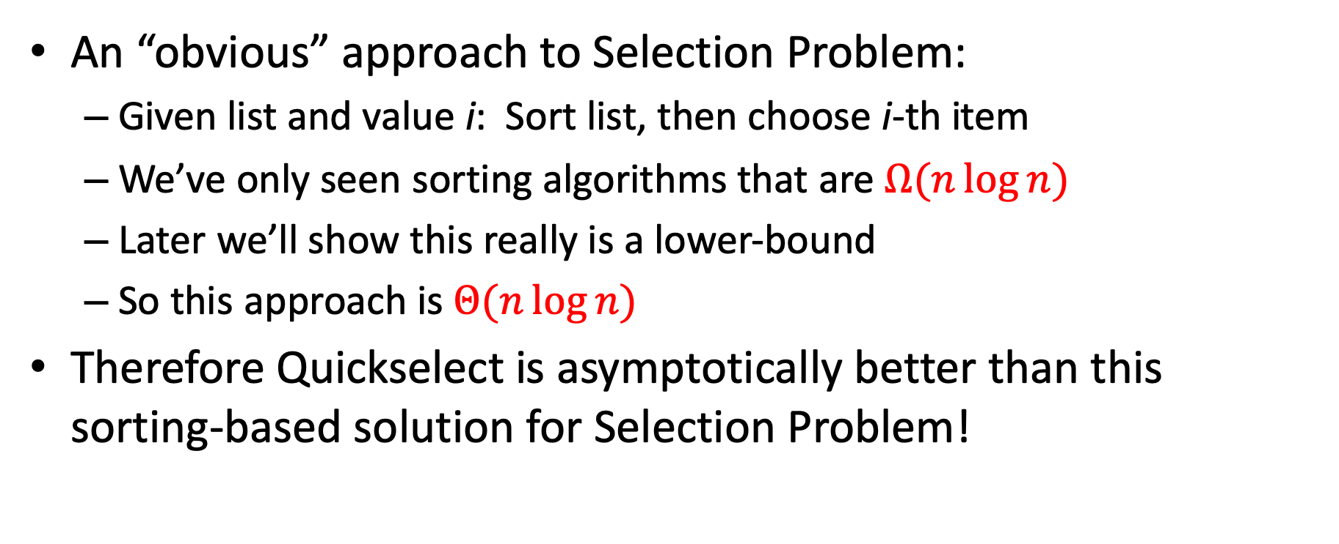
Compare to ‘Obvious’ Approach
An “obvious” approach to Selection Problem:
Given list and value i: Sort list, then choose i-th item
We’ve only seen sorting algorithms that are $Ω(n\log{n})$
Later we’ll show this really is a lower-bound
So this approach is $Θ(n\log{n})$
Therefore Quickselect is asymptotically better than this sorting-based solution for Selection Problem!

Slide 28

Phew! Back to Quicksort
Using Quickselect, with a median-of-medians partition, we’re guaranteed to use true median, so:
2
5
1
3
6
4
7
8
10
9
11
12
2
1
3
5
6
4
7
8
9
10
11
12
Then we divide in half each time
$$T\left(n\right)=2T\left(\frac{n}{2}\right)+Θ(n)$$
$$T\left(n\right)=Θ(n\log{n})$$

Slide 29
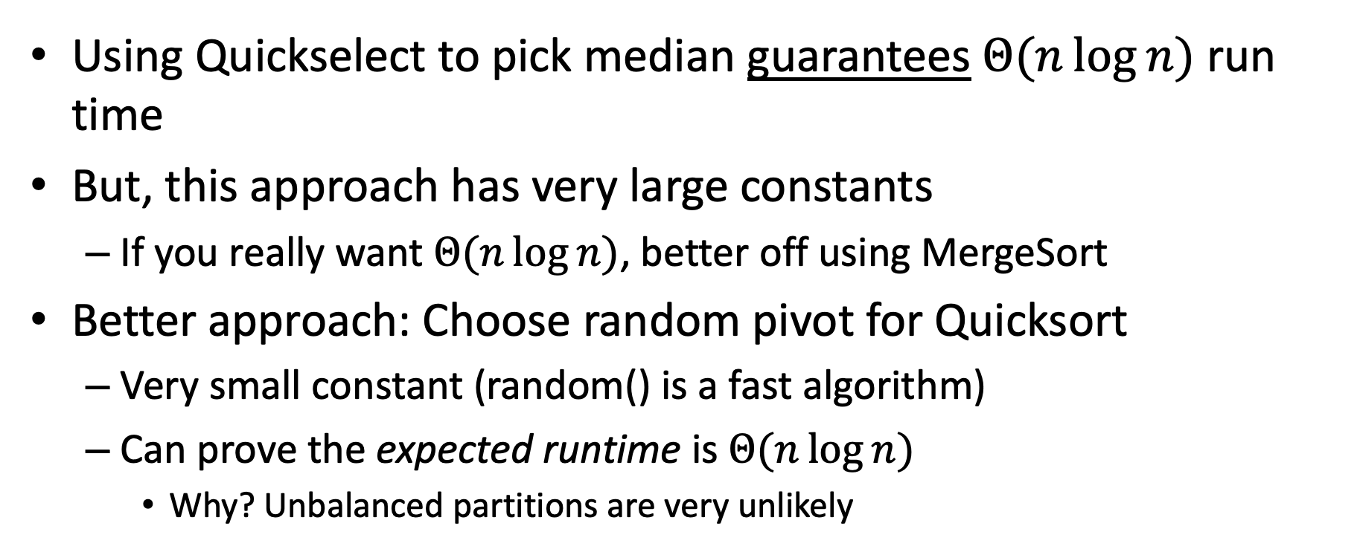
Is it worth it?
Using Quickselect to pick median guarantees $Θ(n\log{n})$ run time
But, this approach has very large constants
If you really want $Θ(n\log{n})$, better off using MergeSort
Better approach: Choose random pivot for Quicksort
Very small constant (random() is a fast algorithm)
Can prove the expected runtime is $Θ(n\log{n})$
Why? Unbalanced partitions are very unlikely

Slide 30





Sorting, so far
Sorting algorithms we have discussed:
Insertionsort
Mergesort
Quicksort
Other sorting algorithms (next):
Heapsort
$$O(n^{2})$$
$$O(n\log{n})$$
$$O(n\log{n})$$
$$O(n\log{n})$$
Can we do better than $O(n\log{n})$?

Slide 31
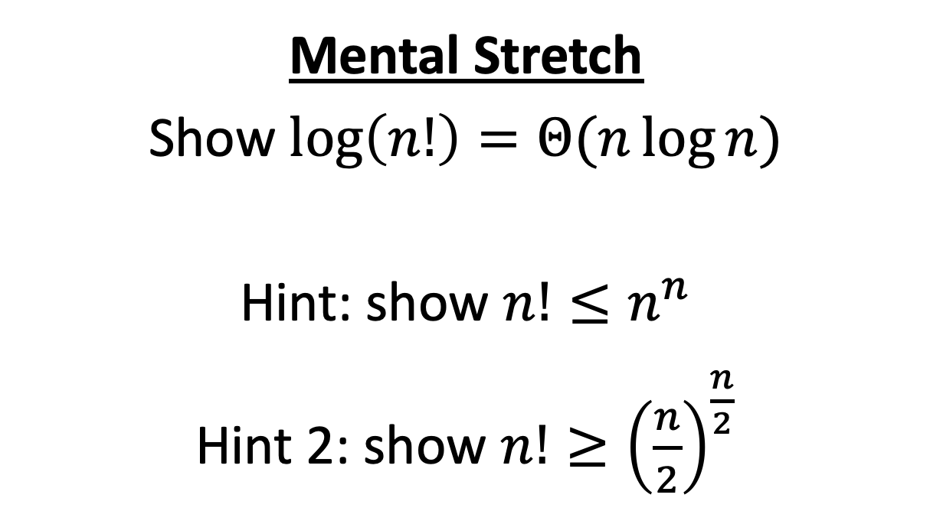
Mental Stretch
Show $\log\left(n!\right)=Θ(n\log{n})$
Hint: show $n!≤n^{n}$
Hint 2: show $n!≥{\left(\frac{n}{2}\right)}^{\frac{n}{2}}$

Slide 32

$$\log{n!}=O\left(n\log{n}\right)$$
$$n!=n⋅\left(n−1\right)⋅\left(n−2\right)⋅…⋅2⋅1$$
$$=$$
$$<$$
$$<$$
$$<$$
$$<$$
$$n^{n}=n⋅ n ⋅ n ⋅…⋅n⋅n$$
$$n!≤n^{n}$$
$$⇒\log\left(n!\right)≤\log\left(n^{n}\right)$$
$$⇒\log\left(n!\right)≤n\log{n}$$
$$⇒\log\left(n!\right)=O(n\log{n})$$

Slide 33

$$\log{n!}=Ω\left(n\log{n}\right)$$
$$n!=n⋅\left(n−1\right)⋅\left(n−2\right)⋅…⋅\frac{n}{2}⋅\left(\frac{n}{2}−1\right)⋅…⋅2⋅1$$
$$>$$
$$>$$
$$>$$
$$=$$
$$>$$
$$>$$
$$=$$
$${\left(\frac{n}{2}\right)}^{\frac{n}{2}}=\frac{n}{2}⋅ \frac{n}{2} ⋅ \frac{n}{2} ⋅…⋅\frac{n}{2}⋅ 1 ⋅…⋅1⋅1$$
$$n!≥{\left(\frac{n}{2}\right)}^{\frac{n}{2}}$$
$$⇒\log\left(n!\right)≥\log\left({\left(\frac{n}{2}\right)}^{\frac{n}{2}}\right)$$
$$⇒\log\left(n!\right)≥\frac{n}{2}\log{\frac{n}{2}}$$
$$⇒\log\left(n!\right)=Ω(n\log{n})$$

Slide 34
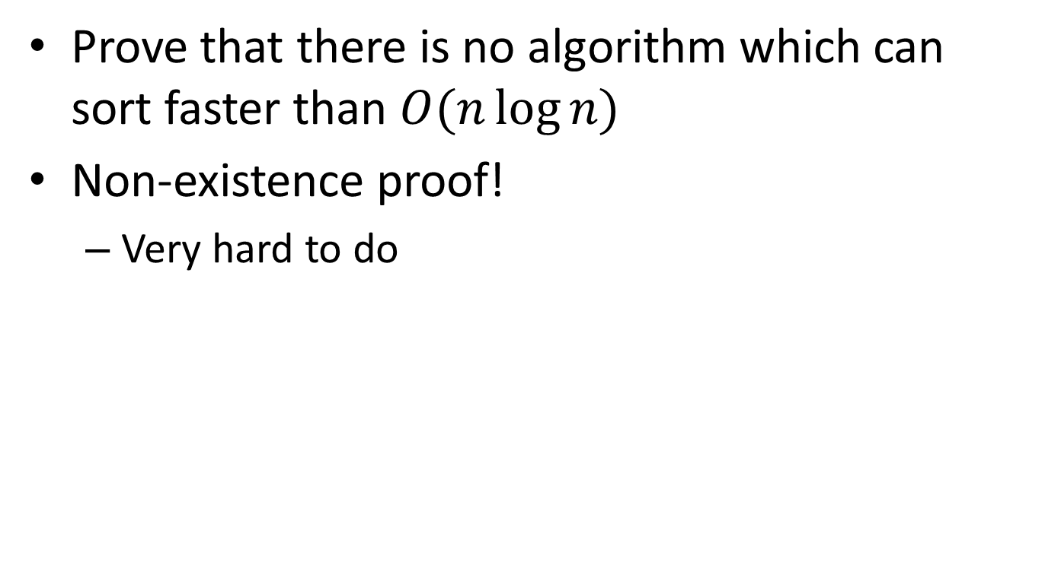
Worst Case Lower Bounds
Prove that there is no algorithm which can sort faster than $O(n\log{n})$
Non-existence proof!
Very hard to do

Slide 35
Strategy: Decision Tree
Sorting algorithms use comparisons to figure out the order of input elements
Draw tree to illustrate all possible execution paths
One comparison
Possible execution path
Result of comparison
<
>or<?
>
<
>or<?
>
<
>or<?
>
<
>or<?
>
<
>or<?
<
>or<?
>
<
>or<?
>
>
>or<?
>or<?
>or<?
>or<?
>or<?
>or<?
>or<?
>or<?
…
…
…
…
…
…
Permutation of sorted list
[1,2,3,4,5]
[2,1,3,4,5]
[5,2,4,1,3]
[5,4,3,2,1]

Slide 36



Strategy: Decision Tree
Worst case run time is the longest execution path
i.e., “height” of the decision tree
One comparison
Possible execution path
Result of comparison
<
>or<?
>
<
>or<?
>
<
>or<?
>
<
>or<?
>
<
>or<?
<
>or<?
>
<
>or<?
>
$$\log\left(n!\right)$$
>
>or<?
>or<?
>or<?
>or<?
>or<?
>or<?
>or<?
>or<?
$$Θ(n log{n})$$
…
…
…
…
…
…
Permutation of sorted list
[1,2,3,4,5]
[2,1,3,4,5]
[5,2,4,1,3]
[5,4,3,2,1]
$n!$Possible permutations

Slide 37
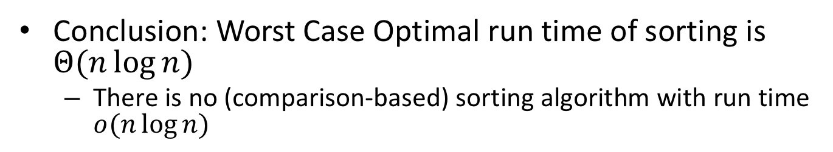
Strategy: Decision Tree
Conclusion: Worst Case Optimal run time of sorting is $Θ(n\log{n})$
There is no (comparison-based) sorting algorithm with run time $o(n\log{n})$
One comparison
Possible execution path
Result of comparison
<
>or<?
>
<
>or<?
>
<
>or<?
>
<
>or<?
>
<
>or<?
<
>or<?
>
<
>or<?
>
$$\log\left(n!\right)$$
>
>or<?
>or<?
>or<?
>or<?
>or<?
>or<?
>or<?
>or<?
$$Θ(n log{n})$$
…
…
…
…
…
…
Permutation of sorted list
[1,2,3,4,5]
[2,1,3,4,5]
[5,2,4,1,3]
[5,4,3,2,1]
$n!$Possible permutations

Slide 38





Sorting, so far
Sorting algorithms we have discussed:
Mergesort
Quicksort
Other sorting algorithms (will discuss):
Bubblesort
Insertionsort
Heapsort
$$O(n\log{n})$$
Optimal!
$$O(n\log{n})$$
Optimal!
$$O(n^{2})$$
$$O(n^{2})$$
$$O(n\log{n})$$
Optimal!

Slide 39
Speed Isn’t Everything
Important properties of sorting algorithms:
Run Time
Asymptotic Complexity
Constants
In Place (or In-Situ)
Done with only constant additional space
Adaptive
Faster if list is nearly sorted
Stable
Equal elements remain in original order
Parallelizable
Runs faster with many computers

Slide 40
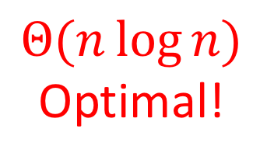
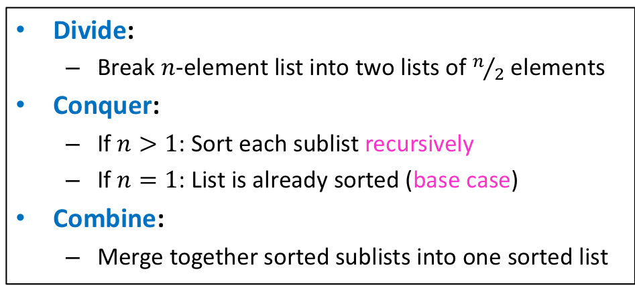
Mergesort
Divide:
Break $n$-element list into two lists of $n/2$ elements
Conquer:
If $n>1$: Sort each sublist recursively
If $n=1$: List is already sorted (base case)
Combine:
Merge together sorted sublists into one sorted list
Run Time?
$$Θ(n\log{n})$$
Optimal!
In Place?
Adaptive?
Stable?
No
No
Yes!
(usually)

Slide 41
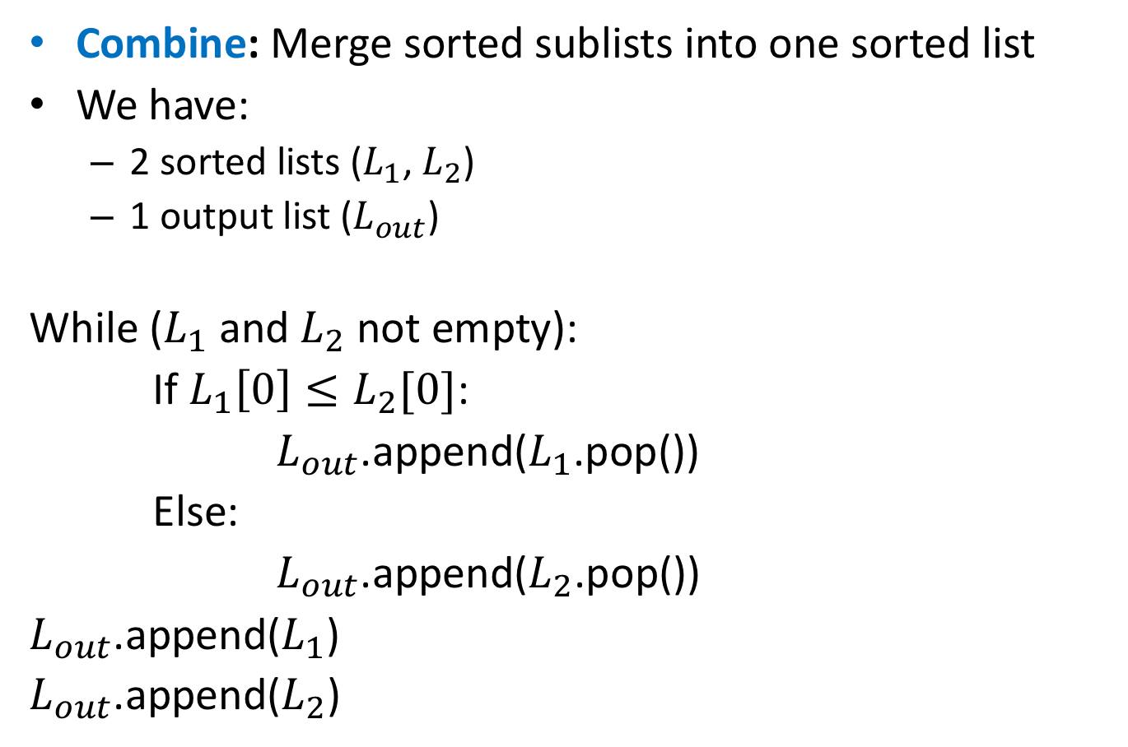
Merge
Combine: Merge sorted sublists into one sorted list
We have:
2 sorted lists ($L_{1}$, $L_{2}$)
1 output list ($L_{out}$)
While ($L_{1}$ and $L_{2}$ not empty):
If $L_{1}\left[0\right]≤L_{2}[0]$:
$L_{out}$.append($L_{1}$.pop())
Else:
$L_{out}$.append($L_{2}$.pop())
$L_{out}$.append($L_{1}$)
$L_{out}$.append($L_{2}$)
Adaptive:
If elements are equal, leftmost comes first

Slide 42
Mergesort
Divide:
Break $n$-element list into two lists of $n/2$ elements
Conquer:
If $n>1$: Sort each sublist recursively
If $n=1$: List is already sorted (base case)
Combine:
Merge together sorted sublists into one sorted list
Run Time?
$$Θ(n\log{n})$$
Optimal!
In Place?
Adaptive?
Stable?
Parallelizable?
No
No
Yes!
(usually)
Yes!

Slide 43

Mergesort
Parallelizable:
Allow different machines to work on each sublist
Divide:
Break $n$-element list into two lists of $n/2$ elements
Conquer:
If $n>1$:
Sort each sublist recursively
If $n=1$:
List is already sorted (base case)
Combine:
Merge together sorted sublists into one sorted list

Slide 44
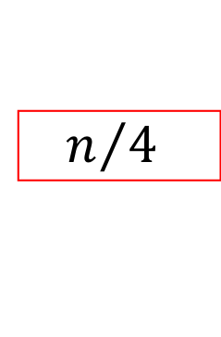


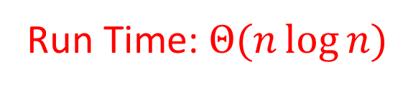
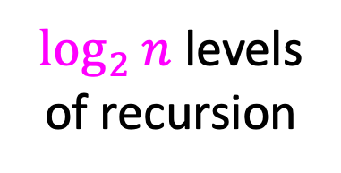

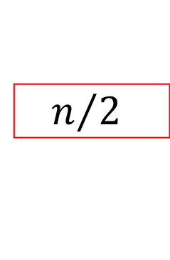









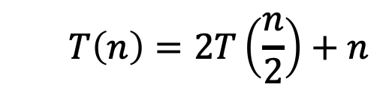








Mergesort (Sequential)
$$T\left(n\right)=2T\left(\frac{n}{2}\right)+n$$
$$n$$
$$n$$
$n$ total / level
$$\frac{n}{2}$$
$$\frac{n}{2}$$
$$n/2$$
$$n/2$$
$$\frac{n}{4}$$
$$\frac{n}{4}$$
$$\frac{n}{4}$$
$$\frac{n}{4}$$
$\log_{2}⁡n$ levels
of recursion
$$n/4$$
$$n/4$$
$$n/4$$
$$n/4$$
…
…
…
…
$$1$$
$$1$$
$$1$$
…
$$1$$
$$1$$
$$1$$
$$1$$
$$1$$
$$1$$
$$1$$
$$1$$
$$1$$
Run Time: $Θ(n\log{n})$

Slide 45

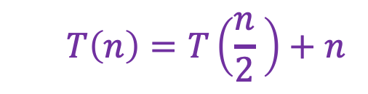


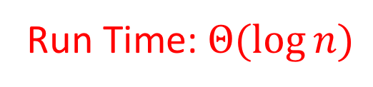
Mergesort (Parallel)
$$T\left(n\right)=T\left(\frac{n}{2} \right)+n$$
$$n$$
$$n$$
Done in Parallel
$$\frac{n}{2}$$
$$\frac{n}{2}$$
$$\frac{n}{2}$$
$$n/2$$
$$n/2$$
$$\frac{n}{4}$$
$$\frac{n}{4}$$
$$\frac{n}{4}$$
$$\frac{n}{4}$$
$$\frac{n}{4}$$
$$n/4$$
$$n/4$$
$$n/4$$
$$n/4$$
…
…
…
…
$$1$$
$$1$$
$$1$$
$$1$$
…
$$1$$
$$1$$
$$1$$
$$1$$
$$1$$
$$1$$
$$1$$
$$1$$
$$1$$
Run Time: $Θ(\log{n})$

Slide 46


Quicksort
Run Time?
Idea: pick a partition element, recursively sort two sublists around that element
Divide: select an element $p$, Partition($p$)
Conquer: recursively sort left and right sublists
Combine: Nothing!
$$Θ(n\log{n})$$
Optimal!
(almost always)
In Place?
Adaptive?
Stable?
Parallelizable?
No…
No!
No
Yes!

