Slide 1
Horton LIVE on Feb. 24 Heaps and Heapsort Strassen’s Algorithm for Matrix Multiplication
CS 4102: Algorithms
Spring 2021
Mark Floryan and Tom Horton

Slide 2
Readings
CLRS Chapter 6 on Heaps and Heapsort
CLRS Section 4.2 on Strassen’s algorithm
Today’s learning-check quiz: https://forms.gle/irjAusfWRC7rD8bS9

Slide 3
Heapsort

Slide 4
Reminders, Terminology
ADT Priority Queue
What’s an ADT?
What’s high priority?
Operations?
How is data stored?
Heap data structure
The heap structure: an almost-complete binary tree
The heap condition or heap order property:
At any given node j, value[j] has higher priority than either of its child nodes’ values
Heaps are weakly sorted
Higher priority: large or small?
Max-heap vs min-heap

Slide 5
ADT Priority Queue
An ADT that maintains a set of elements, each with an associated key
Can have max or min priority queues
Operations for max priority queue
Maximum
Extract-Max
Insert
Update-Priority
Similar operations for min priority queue
Data structures that implement this:
Usually: Binary heap in an array
Or, tree, Binomial Heap, Fibonacci Heap, …

Slide 6
Heapsort Basics
Running time is O(n lg n) like merge sort, unlike insertion sort
Sorts in-place (only a constant number of array elements stored outside the array at any time) like insertion sort, unlike merge sort
Uses a “heap” data structure

Slide 7
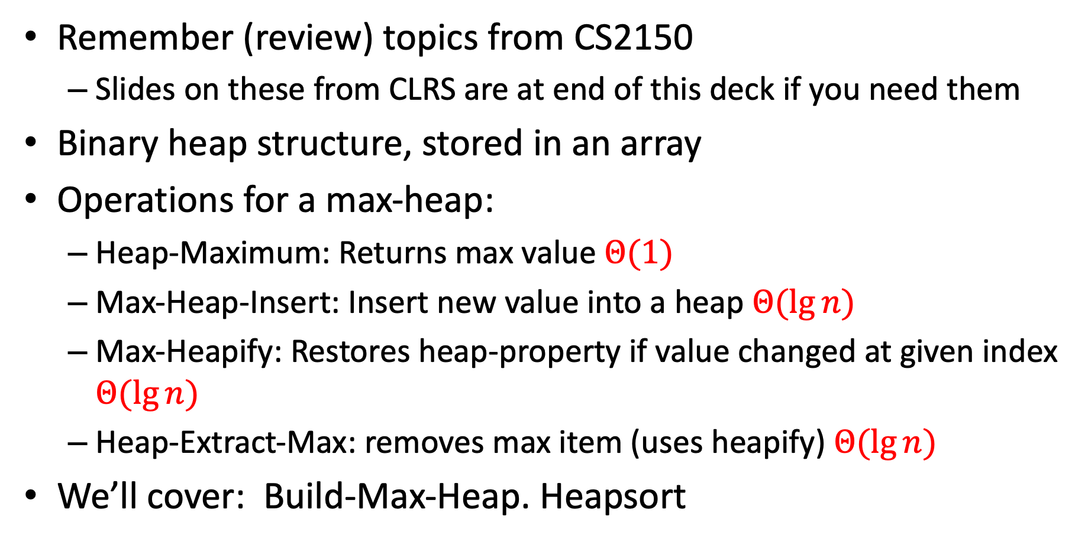
Remember Heaps from CS2150?
Remember (review) topics from CS2150
Slides on these from CLRS are at end of this deck if you need them
Binary heap structure, stored in an array
Operations for a max-heap:
Heap-Maximum: Returns max value $Θ(1)$
Max-Heap-Insert: Insert new value into a heap $Θ(\lg{n})$
Max-Heapify: Restores heap-property if value changed at given index $Θ(\lg{n})$
Heap-Extract-Max: removes max item (uses heapify) $Θ(\lg{n})$
We’ll cover: Build-Max-Heap. Heapsort

Slide 8
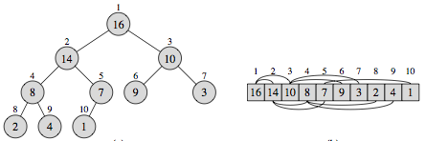
Example of Heap Stored in Array
Review!
p. 152 in text
Height of a node: Length of the longest path from the node to a leaf
Height of the heap: Height of the root (θ(lgn))

Slide 9
How to Build a Heap
Option 1:
Repeatedly insert a new item, start with a heap of 1 item
Cost: Θ(n lg n) (Can you do the sum?)
Option 2:
Take an unordered list, build the heap in place
Build-Max-Heap() algorithm, CLRS page 157
Strategy:
Work bottom up, starting with lowest sub-heaps
Call Max-Heapify() on each
Note: Some give this a different name, including (confusingly) “heapify”

Slide 10
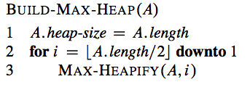
Building a Heap using Heapify
Starts at lowest level non-leaf node, goes up to root, calling Max-Heapify for each node
Do this example: [3, 1, 4, 2, 7, 11, 9, 8, 15, 12]
Also see Figure 6.3 (next slide)
Proof of correctness? Loop invariant is this: At the start of the for-loop, each node i+1, i+2,…, n is the root of a max-heap.

Slide 11
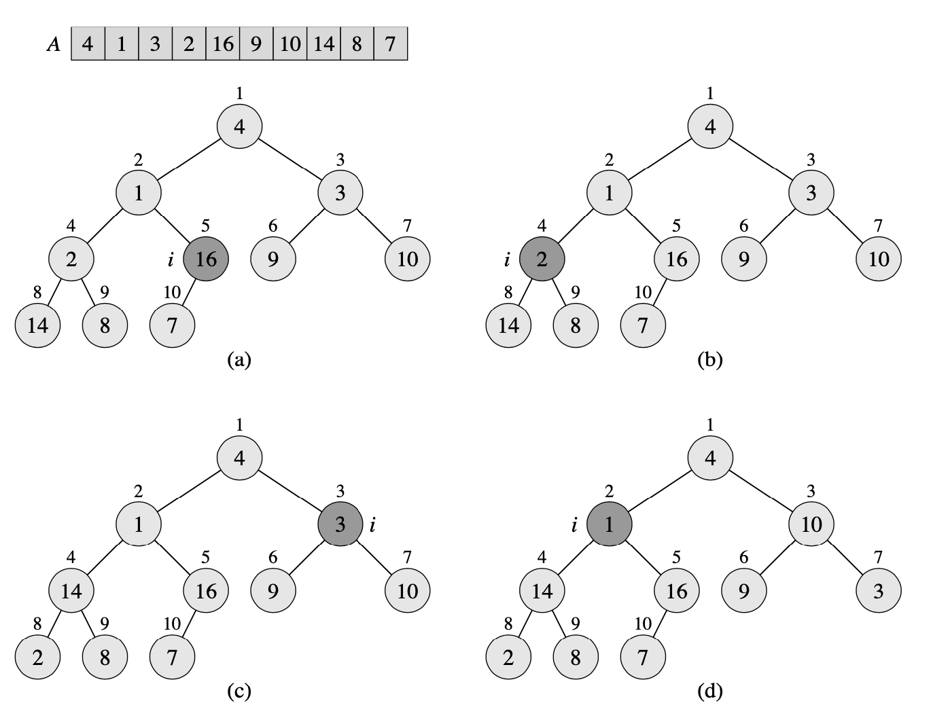

Slide 12
Runtime of Build-Max-Heap
Each call to Max-Heapify costs O(lgn) time
There are O(n) calls to Max-Heapify
Upper bound on running time: O(nlgn)
But the tight bound is: O(n)
Smaller sub-heaps at the bottom of tree are shorter, and there are more of them
See book for analysis

Slide 13
Applications of Heaps, Priority Queues
Many!
But (oh yeah) we were trying to sort
What’s our strategy?
I’ll tell you this: it’s kind of like selection-sort
Now, you tell me what you think it is
(If you already know, let someone else try to figure this out.)

Slide 14
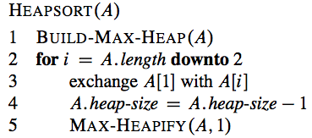
Heapsort
Maximum element is stored at the root (1st item in the list)
Exchange it with the last element
Call Max-Heapify on the root, but with a heap-size that decrements
Note that we need a way to say how much of A is part of the current heap. How can we do this?

Slide 15
Runtime of Heapsort
Build-Max-Heap takes O(n) time
Each of the n-1 calls to Max-Heapify takes O(lgn) time
Total time: O(nlgn)

Slide 16
Do You Understand?
Answer these:
Show how array is rearranged when heap-sorting the heap you got when you built one from this list: [3, 1, 4, 2, 7, 11, 9, 8, 15, 12]
Also, see Figure 6.4 (next slide)
Can you say anything about Heapsort’s behavior if the array is already sorted?
Can you say anything about Heapsort’s behavior if the array is in “reverse sorted” order?

Slide 17
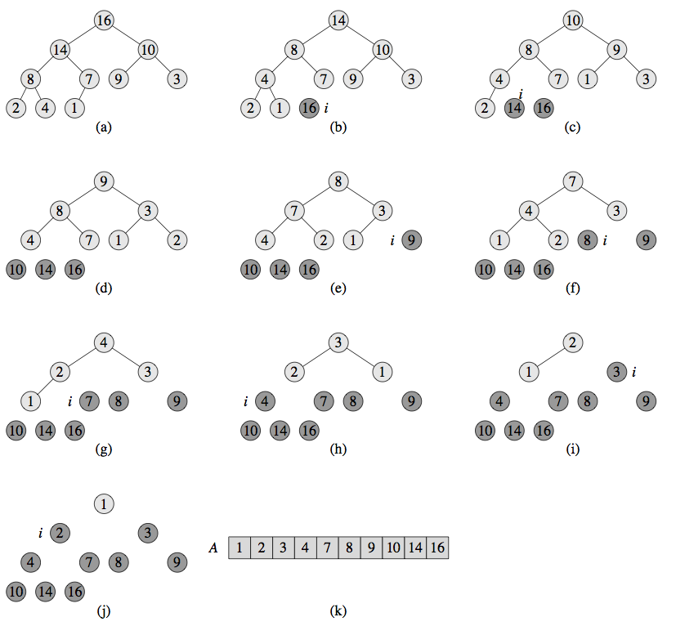

Slide 18
Summary
ADT Priority Queue
Generally useful concept. We’ll see it again.
Binary Heap Data Structure
An effective implementation of ADT Priority Queue
Most basic operations are O(lg n)
Heapify operation: used to changing a heap at its root, and then restoring it
One gotcha (which we’ll see later): how to update priority of item at position i
Heapsort
W(n) is O(n lg n)
In-place

Slide 19
Matrix Multiplication

Slide 20
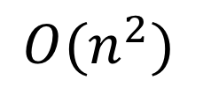
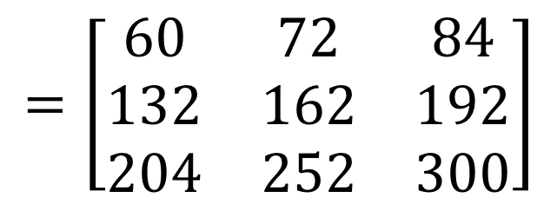

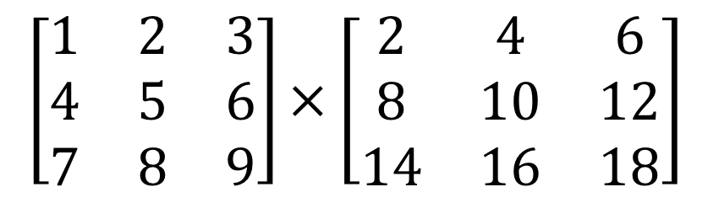

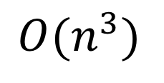
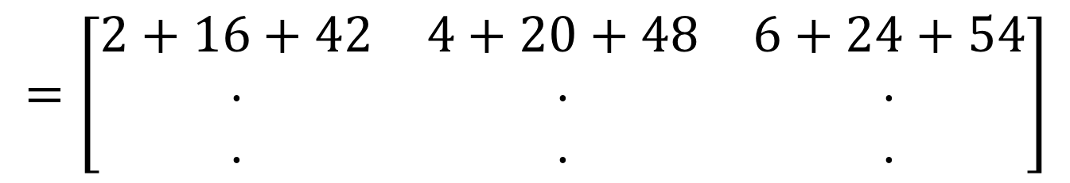
Matrix Multiplication
$$n$$
$$\left[\begin{matrix}1 & 2 & 3 \\ 4 & 5 & 6 \\ 7 & 8 & 9\end{matrix}\right]×\left[\begin{matrix}2 & 4 & 6 \\ 8 & 10 & 12 \\ 14 & 16 & 18\end{matrix}\right]$$
$$n$$
$$=\left[\begin{matrix}2+16+42 & 4+20+48 & 6+24+54 \\ ⋅ & ⋅ & ⋅ \\ ⋅ & ⋅ & ⋅\end{matrix}\right]$$
$$=\left[\begin{matrix}60 & 72 & 84 \\ 132 & 162 & 192 \\ 204 & 252 & 300\end{matrix}\right]$$
Run time?
$$O(n^{3})$$
Lower Bound?
$$O(n^{2})$$

Slide 21
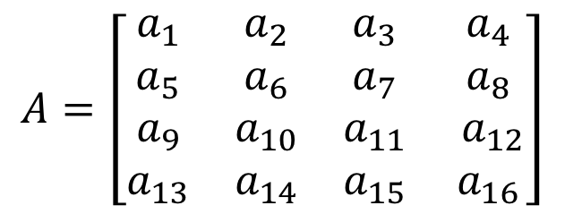
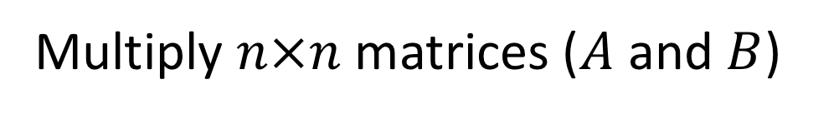
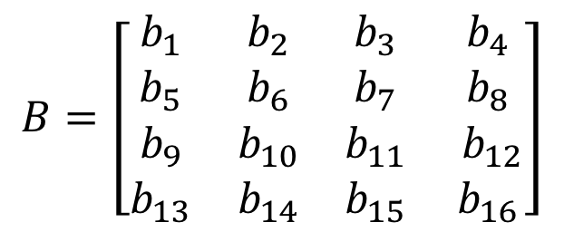
Matrix Multiplication D&C
Multiply $n×n$ matrices ($A$ and $B$)
Divide:
$$A=\left[\begin{matrix}a_{1} & a_{2} & a_{3} & a_{4} \\ a_{5} & a_{6} & a_{7} & a_{8} \\ a_{9} & a_{10} & a_{11} & a_{12} \\ a_{13} & a_{14} & a_{15} & a_{16}\end{matrix}\right]$$
$$B=\left[\begin{matrix}b_{1} & b_{2} & b_{3} & b_{4} \\ b_{5} & b_{6} & b_{7} & b_{8} \\ b_{9} & b_{10} & b_{11} & b_{12} \\ b_{13} & b_{14} & b_{15} & b_{16}\end{matrix}\right]$$

Slide 22
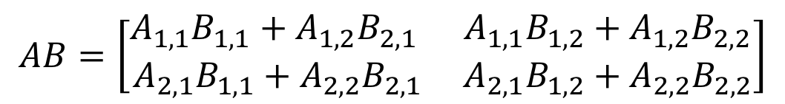







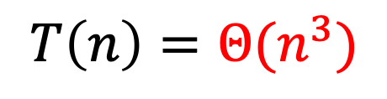


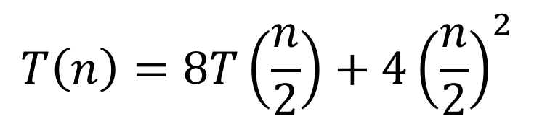
Matrix Multiplication D&C
Multiply $n×n$ matrices ($A$ and $B$)
$$A=\left[\begin{matrix}a_{1} & a_{2} & a_{3} & a_{4} \\ a_{5} & a_{6} & a_{7} & a_{8} \\ a_{9} & a_{10} & a_{11} & a_{12} \\ a_{13} & a_{14} & a_{15} & a_{16}\end{matrix}\right]$$
$$A_{1,1}$$
$$A_{1,2}$$
$$B=\left[\begin{matrix}b_{1} & b_{2} & b_{3} & b_{4} \\ b_{5} & b_{6} & b_{7} & b_{8} \\ b_{9} & b_{10} & b_{11} & b_{12} \\ b_{13} & b_{14} & b_{15} & b_{16}\end{matrix}\right]$$
$$B_{1,1}$$
$$B_{1,2}$$
$$A_{2,1}$$
$$A_{2,2}$$
$$B_{2,1}$$
$$B_{2,2}$$
Combine:
$$AB=\left[\begin{matrix}A_{1,1}B_{1,1}+A_{1,2}B_{2,1} & A_{1,1}B_{1,2}+A_{1,2}B_{2,2} \\ A_{2,1}B_{1,1}+A_{2,2}B_{2,1} & A_{2,1}B_{1,2}+A_{2,2}B_{2,2}\end{matrix}\right]$$
$$T\left(n\right)=8T\left(\frac{n}{2}\right)+4{\left(\frac{n}{2}\right)}^{2}$$
Case 1!
Run time?
$$T\left(n\right)=Θ(n^{3})$$

Slide 23
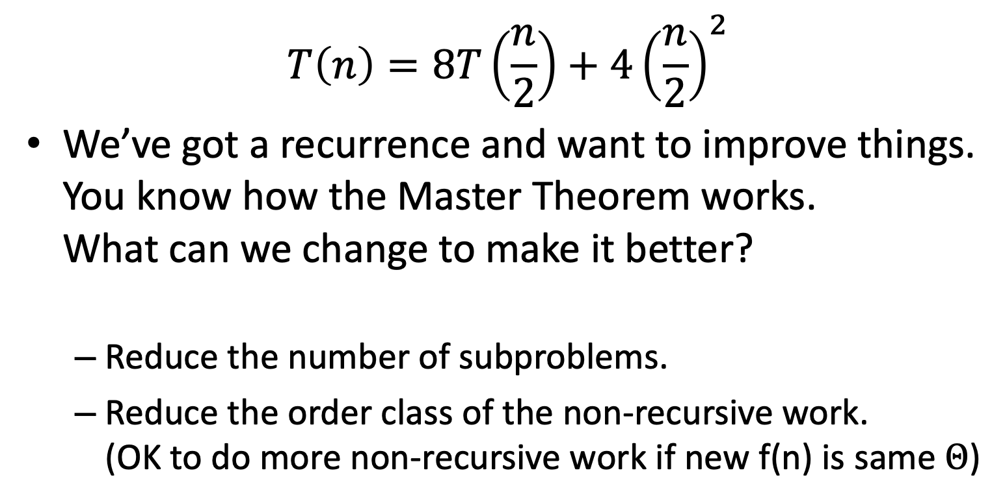
Find an Algorithm with Better Recurrence?
$$T\left(n\right)=8T\left(\frac{n}{2}\right)+4{\left(\frac{n}{2}\right)}^{2}$$
We’ve got a recurrence and want to improve things. You know how the Master Theorem works. What can we change to make it better?
Reduce the number of subproblems.
Reduce the order class of the non-recursive work. (OK to do more non-recursive work if new f(n) is same $Θ$)

Slide 24





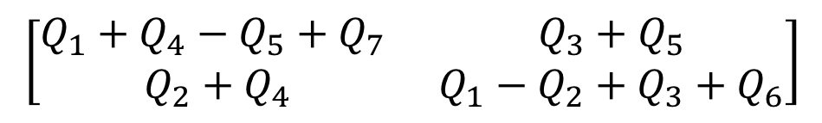


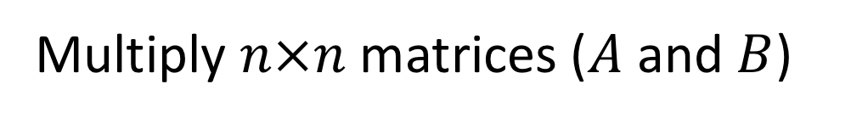

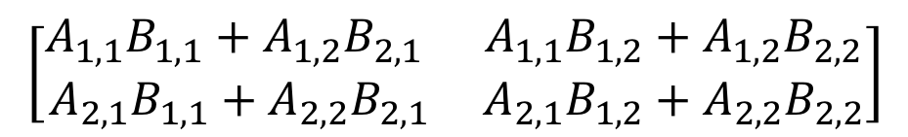




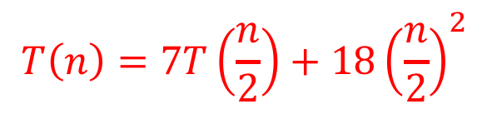






Strassen’s Algorithm
Multiply $n×n$ matrices ($A$ and $B$)
$$A=\left[\begin{matrix}a_{1} & a_{2} & a_{3} & a_{4} \\ a_{5} & a_{6} & a_{7} & a_{8} \\ a_{9} & a_{10} & a_{11} & a_{12} \\ a_{13} & a_{14} & a_{15} & a_{16}\end{matrix}\right]$$
$$A_{1,1}$$
$$A_{1,2}$$
$$B=\left[\begin{matrix}b_{1} & b_{2} & b_{3} & b_{4} \\ b_{5} & b_{6} & b_{7} & b_{8} \\ b_{9} & b_{10} & b_{11} & b_{12} \\ b_{13} & b_{14} & b_{15} & b_{16}\end{matrix}\right]$$
$$B_{1,1}$$
$$B_{1,2}$$
$$A_{2,1}$$
$$A_{2,2}$$
$$B_{2,1}$$
$$B_{2,2}$$
Calculate:
Find $AB$:
$$Q_{1}=\left(A_{1,1}+A_{2,2}\right)(B_{1,1}+B_{2,2})$$
$$\left[\begin{matrix}A_{1,1}B_{1,1}+A_{1,2}B_{2,1} & A_{1,1}B_{1,2}+A_{1,2}B_{2,2} \\ A_{2,1}B_{1,1}+A_{2,2}B_{2,1} & A_{2,1}B_{1,2}+A_{2,2}B_{2,2}\end{matrix}\right]$$
$$Q_{2}=\left(A_{2,1}+A_{2,2}\right)B_{1,1}$$
$$Q_{3}=A_{1,1}(B_{1,2} −B_{2,2})$$
$$=$$
$$Q_{4}=A_{2,2}(B_{2,1}−B_{1,1})$$
$$\left[\begin{matrix}Q_{1}+Q_{4}−Q_{5}+Q_{7} & Q_{3}+Q_{5} \\ Q_{2}+Q_{4} & Q_{1}−Q_{2}+Q_{3}+Q_{6}\end{matrix}\right]$$
$$Q_{5}=\left(A_{1,1}+A_{1,2}\right)B_{2,2}$$
$$Q_{6}=\left(A_{2,1}−A_{1,1}\right)(B_{1,1}+B_{1,2})$$
Number Mults.: 7
Number Adds: 18
$$Q_{7}=\left(A_{1,2}−A_{2,2}\right)(B_{2,1}+B_{2,2})$$
$$T\left(n\right)=7T\left(\frac{n}{2}\right)+18{\left(\frac{n}{2}\right)}^{2}$$

Slide 25
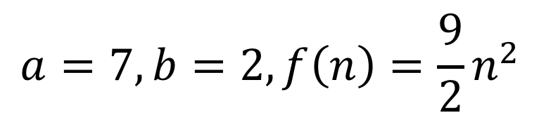
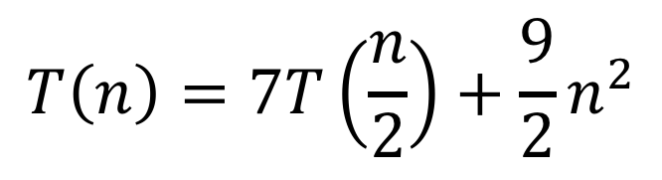
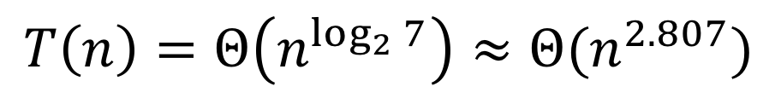
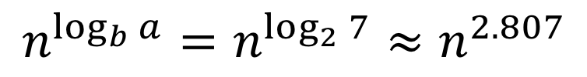
Strassen’s Algorithm
$$T\left(n\right)=7T\left(\frac{n}{2}\right)+\frac{9}{2}n^{2}$$
$$a=7, b=2, f\left(n\right)={\frac{9}{2}n}^{2}$$
$$n^{\log_{b}{a}}=n^{\log_{2}{7}}≈n^{2.807}$$
Case 1!
$$T\left(n\right)=Θ\left(n^{\log_{2}{7}}\right)≈Θ(n^{2.807})$$

Slide 26
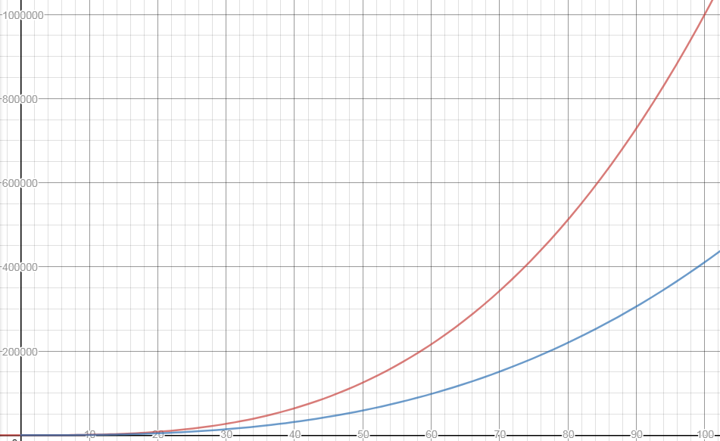


$$n^{3}$$
$$n^{\log_{2}{7}}$$

Slide 27
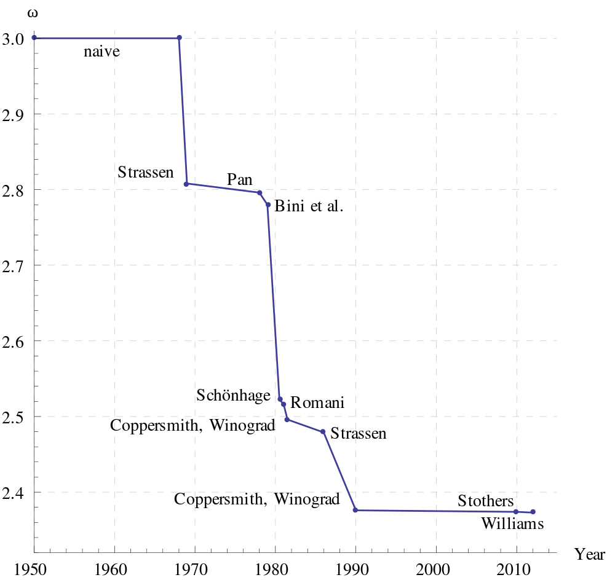
Is this the fastest?
Best possible is unknown
May not even exist!

Slide 28
Trominoes
A board puzzle with a nice divide and conquer solution. (For those of you tired of manipulating lists!)

Slide 29
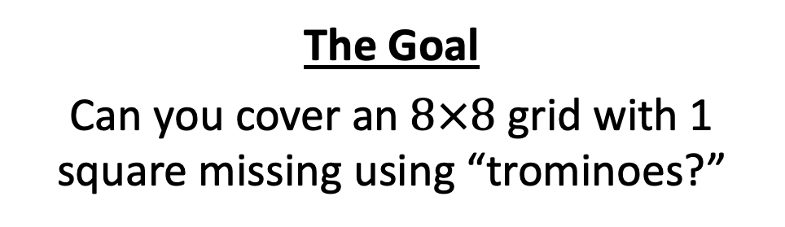
Trominoes Board Puzzle
The Goal
Can you cover an $8×8$ grid with 1 square missing using “trominoes?”
Can you cover this board?
With these?

Slide 30

Trominoes Puzzle Solution
$$2^{n}$$
$$2^{n}$$
What about larger boards?

Slide 31
Trominoes Puzzle Solution
Divide the board into quadrants

Slide 32
Trominoes Puzzle Solution
Place a tromino to occupy the three quadrants without the missing piece

Slide 33
Trominoes Puzzle Solution
Each quadrant is now a smaller subproblem

Slide 34
Trominoes Puzzle Solution
Solve Recursively

Slide 35
Trominoes Puzzle Solution

Slide 36
Divide and Conquer
Divide:
Break the problem into multiple subproblems, each smaller instances of the original
Conquer:
If the suproblems are “large”:
Solve each subproblem recursively
If the subproblems are “small”:
Solve them directly (base case)
Combine:
Merge together solutions to subproblems

Slide 37
Slides Reviewing Heaps from CS2150
Using code and terminology from CLRS Chapter on Heapsort

Slide 38
Binary Heap
Implemented as an array
Viewed as a nearly complete binary tree
Each tree node corresponds to an array element
All tree levels filled except possibly the lowest
Example in Figure 6.1

Slide 39
Indices of Key Nodes
Root: 1
Given index i of a node:
Parent(i) = floor(i/2)
Left-child(i) = 2i
Right-child(i) = 2i+1
Multiplying by 2 goes down a level
Dividing by 2 goes up a level
Question: How do these change if we index the list from 0 (like Python, Java, etc.)?

Slide 40
Example of Heap Stored in Array
p. 152 in text
Height of a node: Length of the longest path from the node to a leaf
Height of the heap: Height of the root (θ(lgn))

Slide 41
Basic Heap Algorithms
Let’s work with max-heaps for now
Define a set of simple heap operations
Traverse tree, thus logarithmic complexity
Highest priority item?
At the root. Just return it.
Insert an item?
Add after the nth item (end of list)
Out of place? Swap with parent. Repeat, pushing it up the tree until in proper place
Remove an item?
Hmm...

Slide 42
Book’s Heap Operations
Max-Heapify: Restores heap-property (O(lgn))
Build-Max-Heap: Creates max-heap from unordered array (O(n))
Heapsort: Sorts an array in place (O(nlgn))
Max-Heap-Insert, Heap-Extract-Max, Heap-Maximum: Implement a priority queue (O(lgn))

Slide 43
Max-Heap-Insert
Here’s Python. Not quite than the same as in CLRS text, p. 164
def max_heap_insert(A, key):
A.append(None) # grow list by one
i = len(A)
while (i>1 and A[i//2] < key):
A[i] = A[i//2]
i = i//2
A[i] = key

Slide 44
Maintaining the Heap Property
Max-Heapify(A, i)
Also known as “fixheap” or “siftdown” or “percolate”
Assumptions
left and right subtree of node i are max-heaps, but
A[i] might be smaller than its children
Value at A[i] is “pushed down” the heap to restore the heap property. How?
Find larger of two children of current node
If current node is out-of-place, then swap with largest of its children
Keep pushing it down until in the right place or it’s a leaf

Slide 45
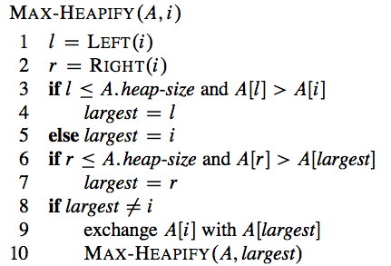
Max-Heapify Algorithm
Example: Figure 6.2

Slide 46
Max-Heapify in Python, with loop
Python code that’s closer to what you saw in CS2150, non-recursive
def max_heapify(A, i): temp = A[i] while 2*i <= len(A): # while left child exists max_child= 2*i # is there right child, and is it bigger? if max_child< len(A) and A[max_child+1] > A[max_child]: max_child= max_child+ 1 # move child up? if A[max_child] > temp: A[i] = A[max_child] else: break # done, exit loop i = max_child A[i] = temp # after loop, put original item in correct spot

Slide 47
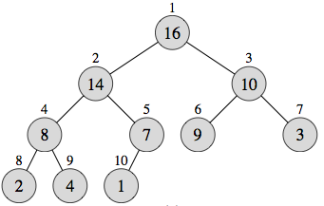
Practice with Max-Heapify
Store 15 in A[3] and do Max-Heapify(A,3)
Store 3 in A[2] and do Max-Heapify(A,2)
Store 9 in A[1] and do Max-Heapify(A,1)

Slide 48
Runtime of Max-Heapify
For a subtree of size n rooted at node i
Θ(1) for fixing node i and its children
Time to run Max-Heapify on a child’s subtree: has size at most 2n/3 (worst case when bottom level of tree is exactly half full)
Recurrence: T(n) ≤ T(2n/3) + θ(1)
Solution: T(n) = O(lgn) = O(h)
Another analysis (without recursion):
At each level, does at most 2 comparisons
Find larger child, and then see if it’s larger than current node
In worst case, “push down” h levels, where h is the height of the current node (distance to a leaf)
Overall from the root: T(n) = O(2h) = O(lg n)

Slide 49
Back to Heap Operations: Extract-Max
The max value is at A[1]
A’s size has to shrink by one, so A[n] has to move somewhere. So, A[1]=A[n]
Still a heap? Probably not at position 1! Max-Heapify can fix that!

Slide 50
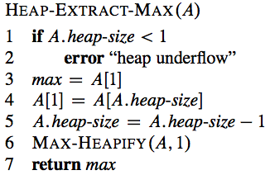
Heap-Extract-Max
Worst-case complexity: θ(lgn)

