Slide 1
Depth-First Search (DFS)
CS 4102: Algorithms
Spring 2021
Mark Floryan and Tom Horton

Slide 2
Readings
CLRS:
Section 22.3 on DFS
Later/eventually:
Section 22.4 on Topological Sort
Section 22.5 on Strongly Connected Components

Slide 3
DFS: the Strategy in Words
Depth-first search: Strategy
Go as deep as can visiting un-visited nodes
Choose any un-visited vertex when you have a choice
When stuck at a dead-end, backtrack as little as possible
Back up to where you could go to another unvisited vertex
Then continue to go on from that point
Eventually you’ll return to where you started
Reach all vertices? Maybe, maybe not

Slide 4
Observations about the DFS Strategy
Note: we must keep track of what nodes we’ve visited
DFS traverses a subset of E (the set of edges)
Creates a tree, rooted at the starting point: the Depth-first Search Tree (DFS tree)
Each node in the DFS tree has a distance from the start. (We often don’t care about this, but we could.)
At any point, all nodes are either:
Un-discovered
Finished (you backed up from it), or
Discovered (i.e. visited) but not finished
On the path from the current node back to the root
We might back up to it
(Later we’ll call these states: white, black and gray respectively)

Slide 5
DFS Strategy 1: Use a stack
Maintain a Stack (Let’s call it S)
Start at some node ‘s’ (push ‘s’ to S and mark as visited)
While S not empty
Pop a node ‘n’ from S
Process ‘n’ if necessary (depending on problem you are solving)
For each non-visited neighbor of ‘n’
Mark neighbor as visited
Push neighbor onto S
Repeat
Sound familiar? Same as BFS but uses stack instead of queue!
Or we can implement recursively (see next slide)

Slide 6
DFS Strategy #2
Use a recursive function to “visit” each node
Need a non-recursive function to initialize and make first call
Before we look at this code… Important!
Best to think of DFS is a strategy as well as a single, particular bit of pseudo-code
We often add things to DFS code to solve problems
”Swiss Army Knife” of graph algorithms?

Slide 7
DFS Strategy 2: Recursion
def dfs(graph, start): //Main loop, inits and calls
visited = {}
dfs_recurse(graph, start, visited)
def dfs_recurse(graph, curnode, visited): //sometimes called dfs_visit()
visited[curnode] = True alist = graph.get_adjlist(curnode) //get the neighbors of curnode
for v in alist:
if v not in visited:
print " dfs traversing edge:", curnode, v
dfs_recurse(graph, v, visited)
# end for-all adjacent vertices
return

Slide 8
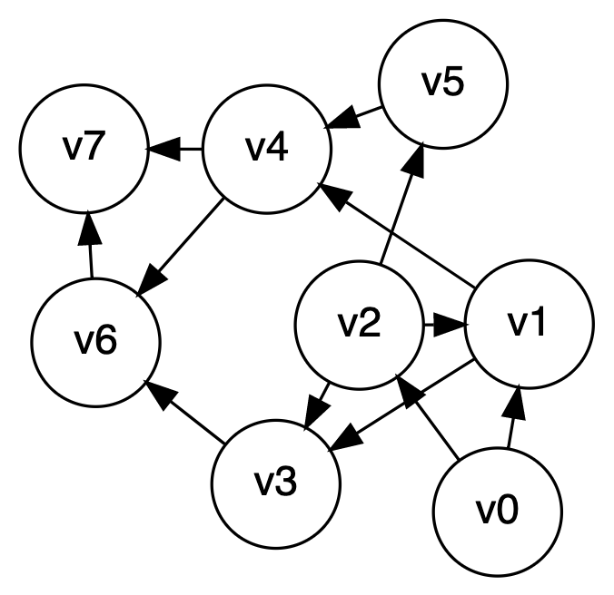
depth-first search, example
Let’s start at V0

Slide 9
DFS to Process all Vertices in a Graph
Purpose: do all required initializations, then call dfs_recurse() as many times as needed to visit all nodes.
May create a DFS forest.
Can be used to count connected components
Could remember which nodes are in each connected component
def dfs_sweep(graph, start):
visited = {}
# loop repeats DFS on every unvisited node
for v in graph:
if v not in visited:
dfs_recurse(graph, v, visited)

Slide 10
Using DFS to Find if a Graphic is Acyclic
Does a graph have a cycle?
DFS is great for this
But, slightly harder if graph is undirected
Use DFS tree: classify edges and nodes as you process them
Nodes:
White: unvisited
Black: done with it, backed up from it (never to return)
Gray: Have reached it; exploring its adjacent nodes; but not done with it

Slide 11
CLRS’s DFS Algorithm (non-recursive part)
DFS(G)
1 for each vertex u in G.V
2 u.color = WHITE
3 u.π = NIL
4 time = 0
5 for each vertex u in G.V
6 if u.color == WHITE // if unseen
7 DFS-VISIT(G, u) // explore paths out of u

Slide 12
CLRS’s DFS Algorithm (recursive part)
DFS-VISIT(G, u)
1 time = time + 1 // white vertex u has just been discovered
2 u.d = time // discovery time of u
3 u.color = GRAY // mark as seen
4 for each v in G.Adj[u] // explore edge (u, v)
5 if v.color == WHITE // if unseen
6 v.π = u
7 DFS-VISIT(G, v) // explore paths out of v (i.e., go “deeper”)
8 u.color = BLACK // u is finished
9 time = time + 1
10 u.f = time // finish time of u

Slide 13
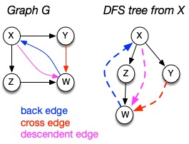
Depth-first search tree
As DFS traverses a digraph, edges classified as:
tree edge, back edge, descendant edge, or cross edge
If graph undirected, do we have all 4 types?

Slide 14
Using Non-Tree Edges to Identify Cycles
From the previous graph, note that:
Back edges (indicates a cycle)
dfs_recurse() sees a vertex that is gray
This back edge goes back up the DFS tree to a vertex that is on the path from the current node to the root
Cross Edges and Descendant Edges (not cycles)
dfs_recurse() sees a vertex that is black
Descendant edge: connects current node to a descendant in the DFS tree
Cross edge: connects current node to a node in another subtree – not a descendant of current node

Slide 15
Non-tree Edges in DFS
Question 1: Finding back edges for an undirected graph is not quite this simple:
The parent node of the current node is gray
Not a cycle, is it? It’s the same edge you just traversed
Question: how would you modify our code to recognize this?
Question 2:
In digraph, how could you modify the code to distinguish cross edges from descendant edges?
Need to record the “time” at which a node was discovered (set to “gray”) and finished (set to “black”)
Also, have a “time counter”, say, ctr
Set d[v] = ctr++ as discovery time
Set f[v] = ctr++ as finish time

Slide 16
Time Complexity of DFS
For a digraph having V vertices and E edges
Each edge is processed once in the while loop of dfs_recurse() for a cost of θ(E)
Think about adjacency list data structure.
Traverse each list exactly once. (Never back up)
There are a total of 2*E nodes in all the lists
The dfs_sweep() algorithm will do θ(V) work even if there are no edges in the graph
Thus over all time-complexity is θ(V+E)
Remember: this means the larger of the two values
Note: This is considered “linear” for graphs since there are two size parameters for graphs.
Extra space is used for color array.
Space complexity is θ(V)

Slide 17
depth-first search, example
Let’s start at V0

Slide 18
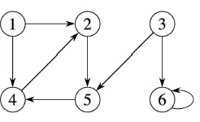
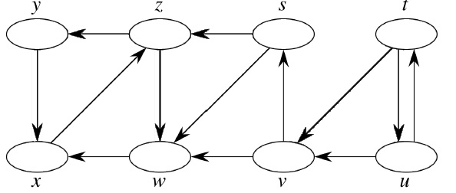
DFS Examples
Source vertex: 1
Source vertex: s

Slide 19
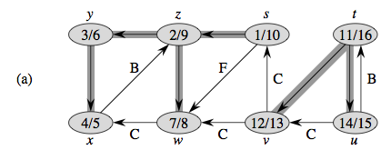
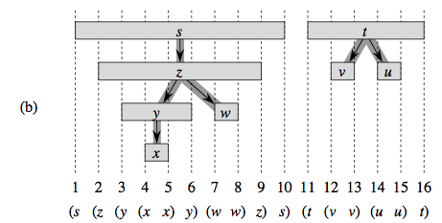
Properties of DFS Search, DFS Trees
“Parentheses Structure”. See pp. 606-609

Slide 20
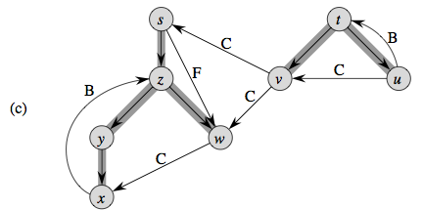
Properties of DFS Search, DFS Trees
Edge Classification. See pp. 606-609

Slide 21
Summary

Slide 22
What Did We Learn?
Traversals of graphs:
Breadth-first search
Depth-first search
Coming next – applying these graph algorithms:
Topological Sort

