Slide 1
Greedy Algorithms
CS 4102: Algorithms
Mark Floryan

Slide 2
Overview

Slide 3
Inventory of greedy algorithms
Coin change
Knapsack algorithm
Interval scheduling
Prim’s MST
Kruskal’s MST
Dijkstra’s shortest path
Huffman Codes

Slide 4
Greedy Method: Overview
Optimization problems: terminology
A solution must meet certain constraints: A solution is feasible
Example: All edges in solution are in graph, form a simple path
Solutions judged on some criteria: Objective function
Example: Sum of edge weights in path is smallest
One (or more) feasible solutions that scores best (by the objective function) is the optimal solution(s)

Slide 5
Greedy Method: Overview
Greedy strategy:
Build solution by stages, adding one item to partial solution found so far
At each stage, make locally optimal choice based on the greedy rule (sometimes called the selection function)
Locally optimal, i.e. best given what info we have now
Irrevocable, a choice can’t be un-done
Sequence of locally optimal choices leads to globally optimal solution (hopefully)
Must prove this for a given problem!
Approximation algorithms, heuristics

Slide 6
Proving them correct
Given a greedy algorithm, how do you show it is optimal?
As opposed to other types of algorithms (divide-and-conquer , etc.)
One common way is to compare the solution given with an optimal solution

Slide 7
Making Change

Slide 8
Everyone Already Knows Many Algorithms!
Worked retail? You know how to make change!
Example:
My item costs $4.37. I give you a five dollar bill. What do you give me in change?
Answer: two quarters, a dime, three pennies
Why? How do we figure that out?

Slide 9
Making Change
The problem:
Give back the right amount of change, and…
Return the fewest number of coins!
Inputs: the dollar-amount to return
Also, the set of possible coins. (Do we have half-dollars? That affects the answer we give.)
Output: a set of coins
Note this problem statement is simply a transformation
Given input, generate output with certain properties
No statement about how to do it.
Can you describe the algorithm you use?

Slide 10
A Change Algorithm
Consider the largest coin
How many go into the amount left?
Add that many of that coin to the output
Subtract the amount for those coins from the amount left to return
If the amount left is zero, done!
If not, consider next largest coin, and go back to Step 2
Notes:
Will this always finish? Yes, because we have pennies!

Slide 11
Is this a “good” algorithm?
What makes an algorithm “good”?
Good time complexity. (Maybe space complexity.)
Better than any other algorithm
Easy to understand
How could we measure how much work an algorithm does?
Code it and time it. Issues?
Count how many “instructions” it does before implementing it
Computer scientists count basic operations, and use a rough measure of this: order class, e.g. O(n lg n)

Slide 12
Evaluating Our Greedy Algorithm
How much work does it do?
Say C is the amount of change, and N is the number of coins in our coin-set
Loop at most N times, and inside the loop we do:
A division
Add something to the output list
A subtraction, and a test
We say this is O(N), or linear in terms of the size of the coin-set
Could we do better?
Is this an optimal algorithm?
We need to do a proof somehow to show this

Slide 13
Formal algorithmic description
All algorithms in this course must have the following components:
Problem description (1 line max)
Inputs
Outputs
Assumptions
Strategy overview
1 or 2 sentences outlining the basic strategy, including the name of the method you are going to use for the algorithm
Algorithm description
If listed in English (as opposed to pseudo-code), then it should be listed in steps

Slide 14
Change solution (greedy)
Problem description: providing coin change of a given amount in the fewest number of coins
Inputs: the dollar-amount to return. Perhaps the possible set of coins, if it is non-obvious.
Output: a set of coins that obtains the desired amount of change in the fewest number of coins
Assumptions: If the coins are not stated, then they are the standard quarter, dime, nickel, and penny. All inputs are non-negative, and dollar amounts are ignored.
Strategy: a greedy algorithm that uses the largest coins first
Description: Issue the largest coin (quarters) until the amount left is less than the amount of a quarter ($0.25). Repeat with decreasing coin sizes (dimes, nickels, pennies).

Slide 15
Another Change Algorithm
Give me another way to do this?
Brute force:
Generate all possible combinations of coins that add up to the required amount
From these, choose the one with smallest number
What would you say about this approach?
There are other ways to solve this problem
Dynamic programming: build a table of solutions to small subproblems, work your way up

Slide 16
Change solution (brute-force)
Problem description: providing coin change of a given amount in the fewest number of coins
Inputs: the dollar-amount to return. Perhaps the possible set of coins, if it is non-obvious.
Output: a set of coins that obtains the desired amount of change in the fewest number of coins
Assumptions: If the coins are not stated, then they are the standard quarter, dime, nickel, and penny. All inputs are non-negative, and dollar amounts are ignored.
Strategy: a brute-force algorithm that considers every possibility and picks the one with the fewest number of coins
Description: Consider every possible combination of coins that add to the given amount (done via a depth-first search). Return the one with the fewest number of coins.

Slide 17
Algorithm for making change
This algorithm makes change for an amount A using coins of denominations
denom[1] > denom[2] > ··· > denom[n] = 1.
Input Parameters: denom, A
Output Parameters: None
greedy_coin_change(denom, A) {
i = 1
while (A > 0) {
c = A / denom[i]
println(“use ” + c + “ coins of denomination ” + denom[i])
A = A - c * denom[i]
i = i + 1
}
}

Slide 18
Making change proof
Prove that the provided making change algorithm is optimal for denominations 1, 5, and 10
Via induction, and on board -->

Slide 19
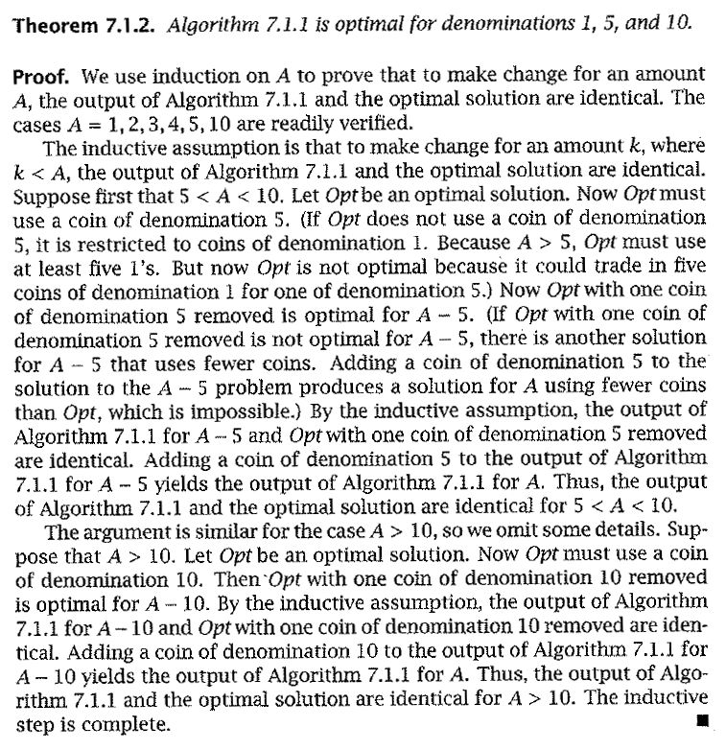
Formal proof
Formal proof of the change problem
Algorithm 7.1.1 is what is presented two slides previously

Slide 20
How would a failed proof work?
Prove that the provided making change algorithm is optimal for denominations 1, 6, and 10
Via induction, and on board -->

Slide 21
Knapsack Algorithm

Slide 22

Knapsack Problems
Motivated by a theoretical burglary scenario (realistically motivated by other similar problems)
A thief breaks into a house and must gather as many precious items as possible.
BUT…he cannot gather items, the total weight of which, exceeds the capacity of his knapsack.

Slide 23
Knapsack Problems
Inputs:
n items, each with a weight w_{i} and a value v_{i}
capacity of the knapsack, C
Output:
Fractions for each of the n items, x_{i}
Or…the actual weights of each item taken
Chosen to maximize total profit but not to exceed knapsack capacity

Slide 24
Two Types of Knapsack Problem
0/1 knapsack problem (or discrete knapsack)
Each item is discrete. Must choose all of it or none of it. So each x_{i} is 0 or 1
Greedy approach does not produce optimal solutions
But another approach, dynamic programming, does
Continuous knapsack problem
Can pick up fractions of each item
The correct selection function yields a greedy algorithm that produces optimal results

Slide 25
Greedy Rule for Knapsack?
Build up a partial solution by choosing x_{i} for one item until knapsack is full (or no more items). Which item to choose?
There are several choices. Pick one and try on this:
n = 3, C = 20
weights = (18, 15, 10)
values = (25, 24, 15)
What answer do you get?
The optimal answer is: (0, 1, 0.5), total=31.5
Can you verify this?

Slide 26
Possible Greedy Rules for Knapsack
Build up a partial solution by choosing x_{i} for one item until knapsack is full (or no more items). Which item to choose?
Maybe this: take as much as possible of the remaining item that has largest value, v_{i}
Or maybe this: take as much as possible of the remaining items that has smallest weight, w_{i}
Neither of these produce optimal values! The one that does “combines” these two approaches.
Use ratio of profit-to-weight

Slide 27
Example Knapsack Problem
For this example:
n = 3, C = 20
weights = (18, 15, 10)
values = (25, 24, 15)
Ratios = (25/18, 24/15, 15/10) = (1.39, 1.6, 1.5)
The optimal answer is: (0, 1, 0.5)

Slide 28
Continuous knapsack algorithm
a is an array containing the items to be put into the knapsack. Each element has the following fields:
p: the profit for that item
w: the weight for that item
id: the identifier for that item
C is the capacity of the knapsack
What is the running time?
continuous_knapsack(a, C)
n = a.last
for i = 1 to n
ratio[i] = a[i].p / a[i].w
sort (a,ratio)
weight = 0
i = 1
while ( i ≤ n && weight < C )
if ( weight + a[i].w ≤ C )
println (“select all of object “ + a[i].id)
weight = weight + a[i].w
else
r = (C – weight) / a[i].w
println (“select “ + r + “ of object “ + a[i].id)
weight = C
i++

Slide 29
How do we know it’s correct?
Proof time!!!
On board -->

Slide 30
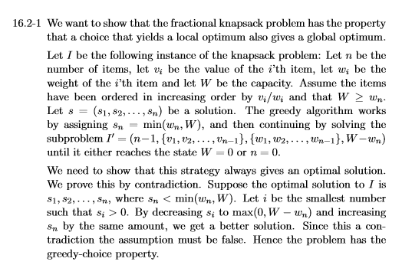
How do we know it’s correct?
Proof time!!!

Slide 31
Prim’s MST

Slide 32
Prim’s algorithm
Idea: Grow a tree by adding an edge from the “known” vertices to the “unknown” vertices. Pick the edge with the smallest weight.
G
v
known
Notes:
Pick one node as the root,
Incrementally add edges that connect a “new” vertex to the tree.
Pick the edge (u,v) where u is in the tree, v is not AND
where the edge weight is the smallest of all edges (where u is in the tree and v is not).

Slide 33
Prim’s Algorithm for MST
Pick one node as the root,
Incrementally add edges that connect a “new” vertex to the tree.
Pick the edge (u,v) where:
u is in the tree, v is not AND
where the edge weight is the smallest of all edges (where u is in the tree and v is not).

Slide 34
MST
v1
{v1, v4}
{v1, v2}
{v4, v3}
{v4, v7}
{v7, v6}
{v7, v5}
2
v₂
v₁
4
1
3
10
v₃
2
v₄
7
v₅
5
8
4
6
v₂
v₁
v₆
1
v₇
v₃
v₄
v₅
v₇
v₆

Slide 35
Minimum Spanning Tree
MSTs satisfy the optimal substructure property
If S is an optimal solution to a problem, then the components of S are optimal solutions to sub-problems
Here: an optimal tree is composed of optimal subtrees
Let T be an MST of G with an edge (u,v) in the middle
Removing (u,v) partitions T into two trees T₁ and T₂
Claim: T₁ is an MST of G₁ = (V₁,E₁), and T₂ is an MST of G₂ = (V₂,E₂)
Proof: w(T) = w(u,v) + w(T₁) + w(T₂)
There can’t be a better tree than T₁ or T₂, or T would be suboptimal

Slide 36
Minimum Spanning Tree
MSTs also satisfy the greedy choice property
If S is an optimal solution to a sub-problem, then the min weight edge ‘e’ leaving S is always in the optimal solution for all of G
Formal Claim:
Candidate edge e with minimum cost always member of T where T is MST of G
How to prove?
Assume ‘e’ is NOT in the MST of G
Finish on board→

Slide 37
Prim’s MST Algorithm
Greedy strategy:
Choose some start vertex as current-tree
Greedy rule: Add edge from graph to current-tree that
has the lowest weight of edges that…
have one vertex in the tree and one not in the tree.
Thus builds-up one tree by adding a new edge to it
Can this lead to an infeasible solution? (Tell me why not.)
Is it optimal? (Yes. Need a proof.)

Slide 38
Tracking Edges for Prim’s MST
Candidates edges: edge from a tree-node to a non-tree node
Since we’ll choose smallest, keep only one candidate edge for each non-tree node
But, may need to make sure we always have the smallest edge for each non-tree node
Fringe-nodes: non-trees nodes adjacent to the tree
Need data structure to hold fringe-nodes
Priority queue, ordered by min-edge weight
May need to update priorities!

Slide 39
Prim’s Algorithm
MST-Prim(G, wt)
init PQ to be empty;
PQ.Insert(s, wt=0);
parent[s] = NULL;
while (PQ not empty)
v = PQ.ExtractMin();
for each w adj to v
if (w is unseen) {
PQ.Insert(w, wt(v,w));
parent[w] = v;
}
else if (w is fringe && wt[v,w] < fringeWt(w)){
PQ.decreaseKey(w, wt[v,w]);
parent[w] = v;
}

Slide 40
Cost of Prim’s Algorithm
(Assume connected graph)
Clearly it looks at every node and edge, so Ω(V+E)
Is there more?
Yes, priority queue operations
ExtractMin called V times
How expensive? Depends on the size of the PQ
descreaseKey could be called for each edge
How expensive is each call?

Slide 41
Worst Case
If all nodes connected to start, then size of PQ is V-1 right away.
Decreases by 1 for each node selected
Total cost is O(cost of extractMin for size n-1)
Note use of Big-Oh (not Big-Theta)
Could descreaseKey be called a lot?
Yes! Imagine an input that adds all nodes to the PQ at the first step, and then after that calls descreaseKey every possible time. (For you to do.)

Slide 42
Priority Queue Costs and Prim’s
Simplest choice: unordered list
PQ.ExtractMin() is just a “findMin”
Cost for one call is Θ(V)
Total cost for all n calls is Θ(V²)
PQ.decreaseKey() on a node finds it, changes it.
Cost for one call is Θ(V)
But, if we can index an array by vertex number, the cost would be Θ(1). If so, worst-case total cost is Θ(E)
Conclusion: Easy to get Θ(V²)

Slide 43
Better PQ Implementations
Consider using a min-heap for the Priority Queue
PQ.ExtractMin() is O(log(V)) each time
Called V times, so like Heap’s Construct: efficient!
What about PQ.decreaseKey() ?
Our need: given a vertex-ID, change the value stored
But our basic heap implementation does not allow look-ups based on vertex-ID!
Solution: Indirect heaps
Heap structure stores indices to data in an array that doesn’t change
Can increase or decrease key in O(log(V)) after O(1) lookup

Slide 44
Better PQ Implementations (2)
Use Indirect Heaps for the PQ
PQ.decreaseKey() is O(log(V)) also
Called for each edge encountered in MST algorithm
So O(E * log(V))
Overall: Might be better: Θ(V²) than if E << V²
Fibonacci heaps: an even more efficient PQ implementation. We won’t cover these.
Θ(E + V * log(V))

Slide 45
Kruskal’s MST

Slide 46
Kruskal’s MST Algorithm
Prim’s approach:
Build one tree. Make the one tree bigger and as good as it can be.
Kruskal’s approach
Choose the best edge possible: smallest weight
Not one tree – maintain a forest!
Each edge added will connect two trees. Can’t form a cycle in a tree!
After adding n-1 edges, you have one tree, the MST

Slide 47
Kruskal’s MST Algorithm
Idea: Grow a forest out of edges that do not create a cycle. Pick an edge with the smallest weight.
G=(V,E)
v

Slide 48
MST
2
v₂
v₁
4
1
3
10
v₃
2
v₄
7
v₅
5
8
4
6
v₆
1
v₇
v₁
v₂
v₃
v₄
v₅
v₇
v₆

Slide 49
Kruskal code
void Graph::kruskal(){
int edgesAccepted = 0;
DisjSet s(NUM_VERTICES);
while (edgesAccepted < NUM_VERTICES – 1){
e = smallest weight edge not deleted yet;
// edge e = (u, v)
uset = s.find(u);
vset = s.find(v);
if (uset != vset){
edgesAccepted++;
s.unionSets(uset, vset);
}
}
}
|E| heap ops
2|E| finds
|V| unions

Slide 50
Strategy for Kruskal’s
EL = sorted set of edges ascending by weight
Foreach edge e in EL
T1 = tree for head(e)
T2 = tree for tail(e)
If (T1 != T2)
add e to the output (the MST)
Combine trees T1 and T2
Seems simple, no?
But, how do you keep track of what trees a node is in?
Trees are sets. Need to findset(v) and “union” two sets

Slide 51
kruskal(edgelist,n) {
sort(edgelist)
for i = 1 to n
makeset(i)
count = 0
i = 1
while (count < n - 1) {
if (findset(edgelist[i].v) !=
findset(edgelist[i].w)) {
println(edgelist[i].v + “ ” + edgelist[i].w)
count = count + 1
union(edgelist[i].v,edgelist[i].w)
}
i = i + 1
}
}

Slide 52
Union/Find and Disjoint Sets
Sets stored as a parent array
findset(v): trace upward in parent array
union(i,j): make one tree a child of a node it the other
Improvements!
Union by rank
Path compression

Slide 53
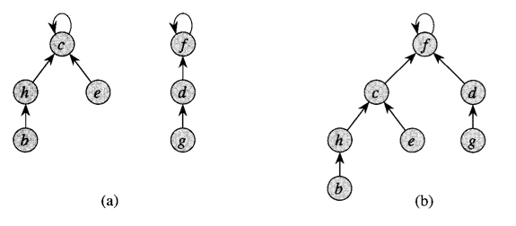
Union by rank

Slide 54
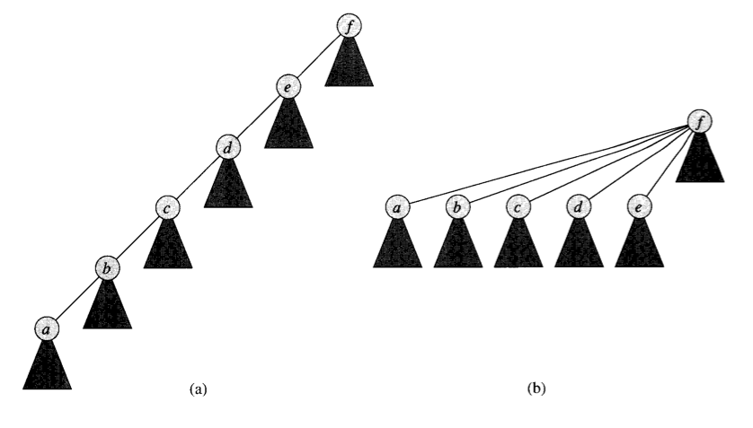
Path Compression

Slide 55
Complexity for Kruskal’s
A basic analysis leads us to Θ(E*V) = O(V³)
But with the optimizations presented here, it can be reduced to Θ(E * log(E))

Slide 56
Interval Selection

Slide 57
Activity-Selection Problem
Problem: You and your classmates go on Semester at Sea
Many exciting activities each morning
Each starting and ending at different times
Maximize your “education” by doing as many as possible. (They’re all equally good!)
Welcome to the activity selection problem
Also called interval scheduling

Slide 58
The Activities!
Id | Start | End | Activity
1 | 9:00 | 10:45 | Fractals, Recursion and Crayolas
2 | 9:15 | 10:15 | Tropical Drink Engineering with Prof. Bloomfield
3 | 9:30 | 12:30 | Managing Keyboard Fatigue with Swedish Massage
4 | 9:45 | 10:30 | Applied ChemE: Suntan Oil or Lotion?
5 | 9:45 | 11:15 | Optimization, Greedy Algorithms, and the Buffet Line
6 | 10:15 | 11:00 | Hydrodynamics and Surfing
7 | 10:15 | 11:30 | Computational Genetics and Infectious Diseases
8 | 10:30 | 11:45 | Turing Award Speech Karaoke
9 | 11:00 | 12:00 | Pool Tanning for Engineers
10 | 11:00 | 12:15 | Mechanics, Dynamics and Shuffleboard Physics
11 | 12:00 | 12:45 | Discrete Math Applications in Gambling

Slide 59
Generalizing Start, End
Id | Start | End | Len | Activity
1 | 0 | 6 | 7 | Fractals, Recursion and Crayolas
2 | 1 | 4 | 4 | Tropical Drink Engineering with Prof. Bloomfield
3 | 2 | 13 | 12 | Managing Keyboard Fatigue with Swedish Massage
4 | 3 | 5 | 3 | Applied ChemE: Suntan Oil or Lotion?
5 | 3 | 8 | 6 | Optimization, Greedy Algorithms, and the Buffet Line
6 | 5 | 7 | 3 | Hydrodynamics and Surfing
7 | 5 | 9 | 5 | Computational Genetics and Infectious Diseases
8 | 6 | 10 | 5 | Turing Award Speech Karaoke
9 | 8 | 11 | 4 | Pool Tanning for Engineers
10 | 8 | 12 | 5 | Mechanics, Dynamics and Shuffleboard Physics
11 | 12 | 14 | 3 | Discrete Math Applications in Gambling

Slide 60
Greedy Approach
Select a first item.
Eliminate items that are incompatible with that item. (i.e. they overlap.)
Apply the greedy rule (AKA selection function) to pick the next item.
Go to Step 2
What is a good greedy rule for selecting the next item?

Slide 61
Some Possibilities
Pick the next compatible one that starts earliest
Pick the shortest one
Pick the one that has the least conflicts (i.e. overlaps)
Do any of these work? Counter-examples?

Slide 62
Activity-Selection
Formally:
Given a set S of n activities
s_{i} = start time of activity i
f_{i} = finish time of activity i
Find max-size subset A of compatible activities
Assume (wlog) that f₁ ≤ f₂ ≤ … ≤ f_{n}
3
4
6
2
1
5

Slide 63
Activity Selection: A Greedy Algorithm
So actual algorithm is simple:
Sort the activities by finish time
Schedule the first activity
Then schedule the next activity in sorted list which starts after previous activity finishes
Repeat until no more activities
Intuition is even more simple:
Always pick next activity that finishes earliest

Slide 64
Activity Selection: Optimal Substructure
Let k be the minimum activity in A (i.e., the one with the earliest finish time). Then A - {k} is an optimal solution to S’ = {i ∈ S: s_{i} ≥ f_{k}}
In words: once activity #1 is selected, the problem reduces to finding an optimal solution for activity-selection over activities in S compatible with #1
Proof: if we could find optimal solution B’ to S’ with |B’| > |A - {k}|,
Then B’ U {k} is compatible
And |B’ U {k}| > |A|, which is a contradiction

Slide 65
Back to Semester at Sea…
Id | Start | End | Len | Activity
2 | 1 | 4 | 4 | Tropical Drink Engineering with Prof. Bloomfield
4 | 3 | 5 | 3 | Applied ChemE: Suntan Oil or Lotion?
1 | 0 | 6 | 7 | Fractals, Recursion and Crayolas
6 | 5 | 7 | 3 | Hydrodynamics and Surfing
5 | 3 | 8 | 6 | Optimization, Greedy Algorithms, and the Buffet Line
7 | 5 | 9 | 5 | Computational Genetics and Infectious Diseases
8 | 6 | 10 | 5 | Turing Award Speech Karaoke
9 | 8 | 11 | 4 | Pool Tanning for Engineers
10 | 8 | 12 | 5 | Mechanics, Dynamics and Shuffleboard Physics
3 | 2 | 13 | 12 | Managing Keyboard Fatigue with Swedish Massage
11 | 12 | 14 | 3 | Discrete Math Applications in Gambling
Solution: 2, 6, 9, 11

Slide 66
Visualizing these Activities
ID | Start | End |  | 0 | 1 | 2 | 3 | 4 | 5 | 6 | 7 | 8 | 9 | 10 | 11 | 12 | 13 | 14
1 | 0 | 6
2 | 1 | 4
3 | 2 | 13
4 | 3 | 5
5 | 3 | 8
6 | 5 | 7
7 | 5 | 9
8 | 6 | 10
9 | 8 | 11
10 | 8 | 12
11 | 12 | 14

Slide 67
Visualizing these Activities
ID | Start | End |  | 0 | 1 | 2 | 3 | 4 | 5 | 6 | 7 | 8 | 9 | 10 | 11 | 12 | 13 | 14
1 | 0 | 6
2 | 1 | 4
3 | 2 | 13
4 | 3 | 5
5 | 3 | 8
6 | 5 | 7
7 | 5 | 9
8 | 6 | 10
9 | 8 | 11
10 | 8 | 12
11 | 12 | 14

Slide 68
Sorted, Then Showing Selection and Incompatibilities
ID | Start | End |  | 0 | 1 | 2 | 3 | 4 | 5 | 6 | 7 | 8 | 9 | 10 | 11 | 12 | 13 | 14
2 | 1 | 4
4 | 3 | 5
1 | 0 | 6
6 | 5 | 7
5 | 3 | 8
7 | 5 | 9
8 | 6 | 10
9 | 8 | 11
10 | 8 | 12
3 | 2 | 13
11 | 12 | 14
Select solid-colored item,
Eliminates activities X’d
out of same color

Slide 69
Interval selection algorithm
greedy-interval (s, f)
n = s.length
A = {a₁}
k = 1
for m = 2 to n
if s[m] ≥ f[k]
A = A U {a_{m}}
k = m
return A
s is an array of the intervals’ start times
f is an array of the intervals’ finish times
A is the array of the intervals to schedule
How long does this take?

Slide 70
The proof…
On board -->
Show that the greedy algorithm stays ahead!

Slide 71
Huffman Codes

Slide 72
Compression Phase
Determine the frequencies of the characters stored in the source file.
Read the source file
Then store the character frequencies in a min-heap
Build a tree of prefix codes (a Huffman code) that determines the unique bit codes for each character.
Write the prefix codes or code tree to the output file.
Re-read the source file and for each character read, write its prefix code into the output file.
You must WRITE the prefix code/tree and the encoded file to the SAME output file

Slide 73
Huffman coding example
From Weiss, page 416
Uses 5 letters (a, e, i, s, t), plus the space and the newline
Total of 58 characters
Normal ASCII encoding is 8 bits per character
58*8 = 464 bits
Which is 58 bytes, obviously
Straight encoding is 3 bits per character
58*3 = 174 bits
Which is 21.75 bytes

Slide 74
Compression step 1 (a)
Determine frequencies of letters
Character | Frequency
a | 10
e | 15
i | 12
s | 3
t | 4
(space) | 13
(newline) | 1
Total | 58

Slide 75
Compression step 1 (b)
Build a min-heap
Sorted by frequency
Character | Frequency
a | 10
e | 15
i | 12
s | 3
t | 4
(space) | 13
(newline) | 1
Total | 58
1: nl
4: t
3: s
15: e
10: i
13: sp
12: i

Slide 76
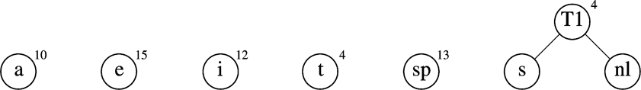
Compression step 2
Build the tree
Start with a “forest” of trees:
Repeat
Take the two trees that have the lowest frequency
The next two removals from the heap
Make them children of a new node
Keep track of the total frequency of that node
And stick that tree back into the heap

Slide 77
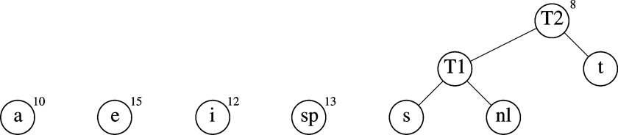
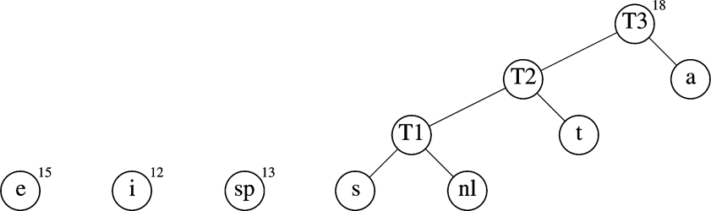

Slide 78
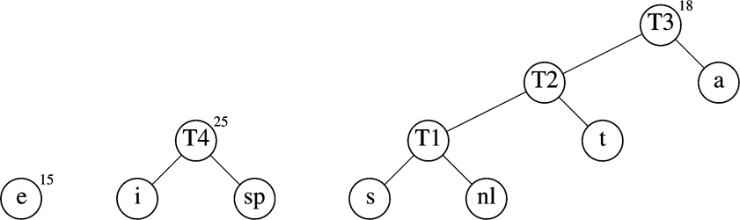
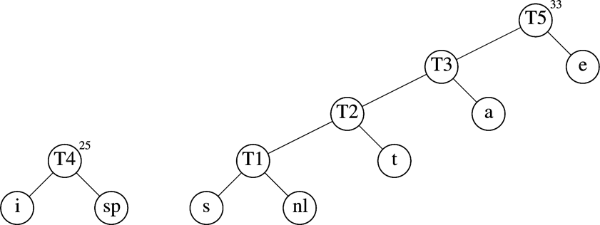

Slide 79
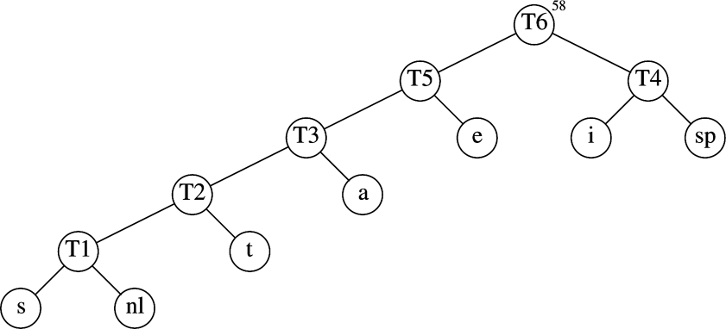
The final Huffman coding tree
Character | Code
a | 001
e | 01
i | 10
s | 00000
t | 0001
(space) | 11
(newline) | 00001

Slide 80
Resulting encoding table
Total encoding is 146 bits
ASCII was 464 bits: compression ratio of 3.2:1
Straight encoding was 174 bits: compression ratio of 1.2:1
Character | Code | Frequency | Total bits
a | 001 | 10 | 30
e | 01 | 15 | 30
i | 10 | 12 | 24
s | 00000 | 3 | 15
t | 0001 | 4 | 16
(space) | 11 | 13 | 26
(newline) | 00001 | 1 | 5
Total |  | 58 | 146

Slide 81
Another way to prove optimality
Show that it fulfills the greedy-choice property
Is the greedy choice at any arbitrary point a member of an optimal solution?
Show that it has optimal sub-structure
Show that a solution to a problem contains optimal solutions to sub-problems

Slide 82
Is Huffman encoding optimal?
First define what optimal means:
The Huffman code for a given alphabet achieves the minimum average number of bits per letter of any prefix code
To prove this, we must first prove two things:
Optimal sub-structure
Greedy choice property
We’ll show the second one first

Slide 83
Step 1
Lemma 16.2: Let C be an alphabet in which each character c ∈ C has frequency c.freq. Let x and y be two characters in C having the lowest frequencies. Then there exists an optimal prefix code for C in which the codewords for x and y have the same length and differ only in the last bit.
Rephrased: the greedy choice property (of picking the two lowest-frequency nodes) will yield an optimal tree
No time…but try it on your own!
Notes:
Pages 433-435 of Cormen

Slide 84
Step 2
Lemma 16.3: Let C be a given alphabet with frequency c.freq defined for each character c ∈ C. Let x and y be two characters in C with minimum frequency. Let C’ be the alphabet C with the characters x and y removed and a new character z added, so that C’ = C-{x,y}∪{z}. Define f for C’ as for C, except that z.freq = x.freq + y.freq. Let T’ be any tree representing an optimal prefix code for the alphabet C’. Then the tree T, obtained from T’ by replacing the leaf node for z with an internal node having x and y as children, represents an optimal prefix code for the alphabet C.
Rephrased: constructing prefix codes has the optimal sub-structure property
Try it yourself.
Notes:
Pages 433-435 of Cormen

Slide 85
Dijkstra’s Shortest Path

Slide 86
Weighted Shortest Path
no negative weight edges.
Dijkstra’s algorithm: uses similar ideas as the unweighted case.
Greedy algorithms:
do what seems to be best at every decision point.
v
s
S
“known”
V - S
“unknown”

Slide 87
Dijkstra’s algorithm
Initialize each vertex’s distance as infinity
Start at a given vertex s
Update s’s distance to be 0
Repeat
Pick the next unknown vertex with the shortest distance to be the next v
If no more vertices are unknown, terminate loop
Mark v as known
For each edge from v to adjacent unknown vertices w
If the total distance to w is less than the current distance to w
Update w’s distance and the path to w

Slide 88
v₀
2
v₁
2
1
5
1
1
1
v₂
v₃
v₄
6
5
3
V | Known | Dist | path
v0
v1
v2
v3
v4
v5
v6
2
10
v₅
v₆

Slide 89
void Graph::dijkstra(Vertex s){
Vertex v,w;
s.dist = 0;
while (there exist unknown vertices, find the unknown v with the smallest distance)
v.known = true;
for each w adjacent to v
if (!w.known)
if (v.dist + Cost_VW < w.dist){
w.dist = v.dist + Cost_VW;
w.path = v;
}
}
}

Slide 90
Analysis
How long does it take to find the smallest unknown distance?
simple scan using an array: O(v)
Total running time:
Using a simple scan: O(v²+e) = O(v²)
Optimizations?
Use adjacency graphs and heaps
Assuming that the graph is connected (i.e. e > v-1), then the running time decreases to O(e + v log v)
We can simplify this to O(e log v)

Slide 91
Negative Cost Edges?
Perhaps the graph weights are the amount of fuel expended
Positive means fuel was used
And passing by a fuel station is a refueling, which is a negative cost edge
Dijkstra’s algorithm does not work for negative cost edges
Others do, but are much less efficient
What about negative cost cycles?

Slide 92
Dijkstra’s Shortest Path Algorithm
Identical in structure to Prim’s MST algorithm
Of course it solves a different problem!
Same time complexity
Additional input parameter(s)
Start node v
Destination node w (if needed)
Different output: a path from v to w and a cost (or sets of paths and costs)
The tree is the sets of shortest paths to nodes
Different greedy strategy:
Store shortest paths to fringe-nodes in priority queue
Store path-distance to node, not just the one edge-weight

Slide 93
Reminder: Prim’s Algorithm
MST-Prim(G, wt)
init PQ to be empty;
PQ.Insert(s, wt=0);
parent[s] = NULL;
while (PQ not empty){
v = PQ.ExtractMin();
for each w adj to v
if (w is unseen) {
PQ.Insert(w, wt(v,w));
parent[w] = v;
}
else if (w is fringe && wt[v,w] < fringeWt(w)){
PQ.decreaseKey(w, wt[v,w]);
parent[w] = v;
}

Slide 94
Dijkstra' Algorithm
dijkstra(G, wt, s)
init PQ to be empty;
PQ.Insert(s, dist=0);
parent[s] = NULL; dist[s] = 0;
while (PQ not empty)
v = PQ.ExtractMin();
for each w adj to v
if (w is unseen) {
dist[w] = dist[v] + wt(v,w)
PQ.Insert(w, dist[w] );
parent[w] = v;
}
else if (w is fringe && dist[v] + wt(v,w) < dist[w] ) {
dist[w] = dist[v] + wt(v,w)
PQ.decreaseKey(w, dist[w]);
parent[w] = v;
}

Slide 95
Notes on Dijkstra’s Algorithm
Use dist[] to store distances from start to any fringe or tree node
Store and calculate using distances instead of edge-weights (like in Kruskal’s MST)
What’s the output?
Tree captured in the parent[] array
Shortest distance to each node in dist[] array
Trace shortest path in reverse by using parent[] to move from target back to start node, s

Slide 96
dijkstra(adj, start, parent) {
n = adj.last
for i = 1 to n { key[i] = ∞} // key is a local array
key[start] = 0; predecessor[start] = 0
// the following statement initializes the
// container h to the values in the array key
h.init(key,n)
for i = 1 to n {
v = h.min_weight_index()
min_cost = h.keyval(v)
v = h.del()
ref = adj[v]
while (ref != null) {
w = ref.ver
if (h.isin(w) && min_cost + ref.weight < h.keyval(w)) {
predecessor[w] = v
h.decrease(w, min_cost+ref.weight)
} // end if
ref = ref.next
} // end while
} // end for
}

Slide 97
Correctness of These Greedy Algorithms
Recall that the greedy approach may or may not guarantee an optimal result
Do these produce optimal solutions?
The min weight spanning tree? Kruskal’s, Prim’s
The shortest path from s? Dijkstra’s
Answer: Yes, they do.

Slide 98
Proof of Dijkstra’s algorithm
Via induction and contradiction
On board -->

Slide 99
Conclusion

Slide 100
Greedy algorithm summary
Algorithms we saw:
Coin change
Knapsack algorithm
Interval scheduling
Prim’s MST
Kruskal’s MST
Dijkstra’s shortest path
Huffman Codes

Slide 101
Greedy Method: Overview
Optimization problems: terminology
Solutions judged on some criteria: Objective function
Example: Sum of edge weights in path is smallest
A solution must meet certain constraints: A solution is feasible
Example: All edges in solution are in graph, form a simple path
One (or more) feasible solutions that scores highest (by the objective function) is the optimal solution(s)

Slide 102
Greedy Method: Overview
Greedy strategy:
Build solution by stages, adding one item to partial solution found so far
At each stage, make locally optimal choice based on the greedy rule (sometimes called the selection function)
Locally optimal, i.e. best given what info we have now
Irrevocable, a choice can’t be un-done
Sequence of locally optimal choices leads to globally optimal solution (hopefully)
Must prove this for a given problem!
Approximation algorithms, heuristics

Slide 103
Proving them correct
Given a greedy algorithm, how do you show it is optimal?
As opposed to other types of algorithms (divide-and-conquer , etc.)
One way is to compare the solution given with an optimal solution
Another way is through induction

Slide 104
Proving a greedy algorithm is correct
Show that it fulfills the greedy-choice property
Does making a greedy choice at any arbitrary point yield an optimal solution?
Consider an optimal solution to a sub-problem
Show that making the greedy choice will yield an optimal solution to the overall problem
Show that it has optimal sub-structure
Show that a solution to a problem contains optimal solutions to sub-problems
Or use a general proof that compares !

Slide 105
Warning!
Proving that an algorithm makes a greedy choice at each stage is NOT the same as showing that the algorithm has the greedy choice property
The first is a property of the algorithm designed
The second shows that making the greedy choice will yield an optimal solution to the overall problem

