Slide 1
Divide and Conquer Algorithms
CS 4102: Algorithms
Spring 2015
Mark Floryan

Slide 2
Recurrences and Divide & Conquer
First design strategy: Divide and Conquer
Examples…
Recursive algorithms
Counting basic operations in recursive algorithms
Solving recurrence relations
By iteration method
Recursion trees (quick view)
The “Main” and “Master” Theorems
Mergesort
Trominos
Closest Pair of Points
Fast Matrix Multiplication

Slide 3
Recursion

Slide 4
Recursion: Basic Concepts and Review
Recursive definitions in mathematics
Factorial: n! = n (n-1)! and 0! = 1! = 1
Fibonacci numbers: F(0) = F(1) = 1 F(n) = F(n-1) + F(n-2) for n > 1
Note base case
In programming, recursive functions can be implemented
First, check for simple solutions and solve directly
Then, solve simpler subproblem(s) by calling same function
Must make progress towards base cases

Slide 5
Designing Recursive Procedures
Think Inductively!
Converging to a base case (stopping the recursion)
identify some unit of measure (running variable)
identify base cases
How to solve p for all inputs from size 0 through 100
Assume method99 solves sub-problem all sizes 0 through 99
if p detect a case that is not base case it calls method99
method99 works and is called when:
1. The sub-problem size is less than p’s problem size
2. The sub-problem size is not below the base case
3. The sub-problem satisfies all other preconditions of method99 (which are the same as the preconditions of p)

Slide 6
Recursion: Good or Evil?
It depends…
Sometimes recursion is an efficient design strategy, sometimes not
Important! we can define recursively and implement non-recursively
Note that many recursive algorithms can be re-written non-recursively
Use an explicit stack
Remove tail-recursion (compilers often do this for you)
Consider: factorial, binary search, Fibonacci
Let’s consider Fibonacci carefully…

Slide 7
Implement Fibonacci numbers
It’s beautiful code, no? long fib(int n) { assert(n >= 0); if ( n == 0 ) return 1; if ( n == 1 ) return 1; return fib(n-1) + fib(n-2); }
Let’s run and time it.
Let’s trace it.

Slide 8
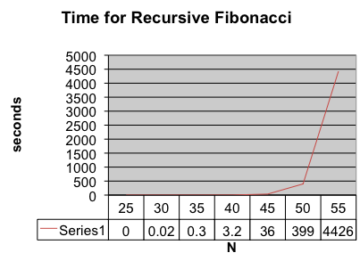

Slide 9

Towers of Hanoi
Ah, the legend:
64 golden disks
Those diligent priests
The world ends!

Slide 10

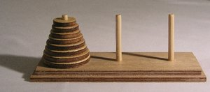
Towers of Hanoi
Back in the commercial Western world…
Game invented by the French mathematician, Edouard Lucas, in 1883.
Now, for only $19.95, call now!

Slide 11
Your turn to design!
Write a recursive function for the Towers of Hanoi.
Number each peg: 1, 2, 3
Function signature: hanoi ( n, source, dest, aux) where: n is number of disks (from the top), and other parameters are peg values In function body print: Move a disk from <peg> to <peg>
Do this in pairs. Then pairs group and compare. Find bugs, issues, etc. Explain to each other. Turn in one sheet with all four names.

Slide 12
Divide & Conquer

Slide 13
Divide and Conquer: A Strategy
Our first design strategy: Divide and Conquer
Often recursive, at least in definition
Strategy:
Break a problem into 1 or more smaller subproblems that are identical in nature to the original problem
Solve these subproblems (recursively)
Combine the results for the subproblems (somehow) to produce a solution to original problem
Note the assumption:
We can solve original problem given subproblems’ solutions

Slide 14
Design Strategy: Divide and Conquer
It is often easier to solve several small instances of a problem than one large one.
divide the problem into smaller instances of the same problem
solve (conquer) the smaller instances recursively
combine the solutions to obtain the solution for original input
Must be able to solve one or more small inputs directly
Solve(I)
n = size(I)
if (n <= smallsize)
solution = directlySolve(I);
else
divide I into I₁, …, I_{k}.
for each i in {1, …, k}
S_{i} = solve(I_{i});
solution = combine(S₁, …, S_{k});
return solution;

Slide 15
Why Divide and Conquer?
Sometimes it’s the simplest approach
Divide and Conquer is often more efficient than “obvious” approaches
E.g. Mergesort, Quicksort
But, not necessarily efficient
Might be the same or worse than another approach
Must analyze cost
Note: divide and conquer may or may not be implemented recursively

Slide 16
Cost for a Divide & Conquer Algorithm
Perhaps there is…
A cost for dividing into sub problems
A cost for solving each of several subproblems
A cost to combine results
So (for n > smallSize)
T(n) = D(n) + ΣT(size(Ii)) + C(n)
often rewritten as: T(n) = a T(n/b) + f(n)
These formulas are recurrence relations

Slide 17
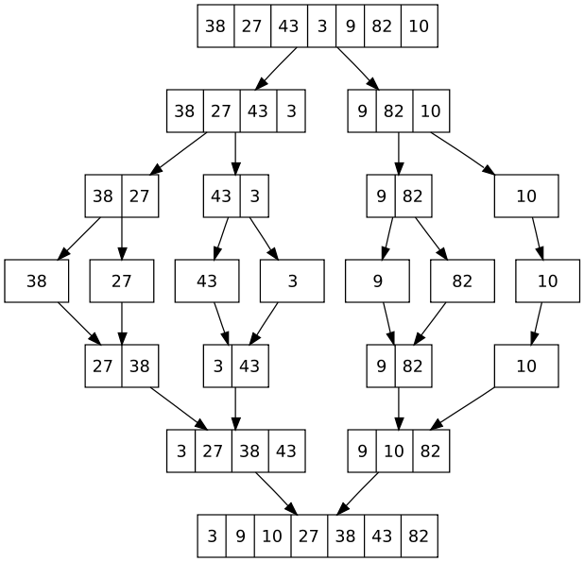
Mergesort is Classic Divide & Conquer
Mergesort Strategy:

Slide 18
Algorithm: Mergesort
Specification:
Input: Array E and indexes first and last, such that the elements E[i] are defined for first <= i <= last.
Output: E[first], …, E[last] is sorted rearrangement of the same elements
Algorithm:
def mergesort(list, first, last):
if first < last:
mid = (first+last)/2
mergesort(list, first, mid)
mergesort(list, mid+1, last)
merge(list, first, mid, last) # merge 2 halves
return

Slide 19
Exercise: Find Max and Min
Given a list of elements, find both the maximum element and the minimum element
Obvious solution:
Consider first element to be max
Consider first element to be min
Scan linearly from 2nd to last, and update if something larger then max or if something smaller than min
Another way:
Write a recursive function that solves this using divide and conquer.
Prototype: void maxmin (list, first, last, max, min);
Base case(s)? Subproblems? How to combine results?

Slide 20
Recurrence Relations

Slide 21
Solving Recurrence Relations
Several (four) methods for solving:
Directly Solve
Substitution method
In short, guess the runtime and solve by induction
Recurrence trees
We won’t see this in great detail, but a graphical view of the recurrence
Sometimes a picture is worth 2¹⁰ words!
“Master” theorem
Easy to find Order-Class for a number of common cases
Different variations are called different things, depending on the source

Slide 22
Directly Solve
For Mergesort:
T(n) = 2*T(n/2) + n
Do it on board →

Slide 23
Iteration or Substitution Method
Strategy
1. Consider Mergesort Recurrence
T(n) = 2*T(n/2) + n
2. Guess the solution
Let’s go with n*log(n) **Remember logs are all base 2 (usually)
3. Inductively Prove that recurrence is in proper order class
For n*log(n), we need to prove that T(n) <= c*n*log(n)
For some ‘c’ constant and for all n >= n0
Remember, we get to choose the ‘c’ and ‘n0’ values
Do it on board →

Slide 24
Substitution Method: Subtleties
Consider:
T(n) = 2*T(n/2) + 1
Let’s make our guess:
We are thinking O(n)
Try to prove:
T(n) <= c*n
What happens? How do we fix this issue?
On board →

Slide 25
Substitution Method: Another Pitfall
Consider Mergesort recurrence again:
T(n) = 2*T(n/2) + n
Let’s make our guess:
We are thinking O(n) ← Note that this is INCORRECT!
Try to prove:
T(n) <= c*n
What happens?
On board →

Slide 26
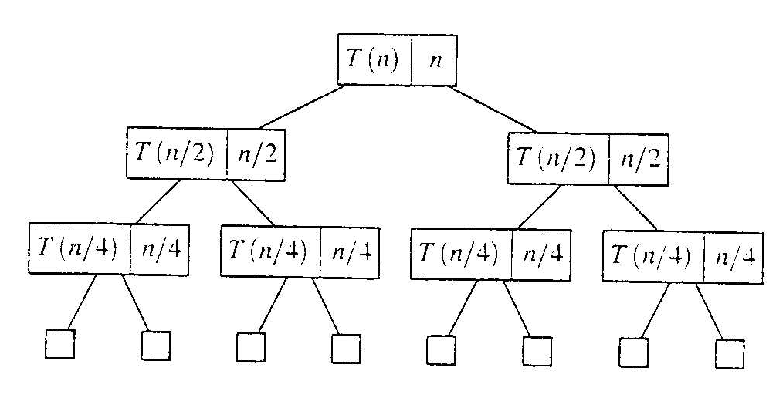
Recursion Tree Method
Evaluate: T(n) = 2*T(n/2) + n
Work copy: T(k) = T(k/2) + T(k/2) + k
For k=n/2, T(n/2) = T(n/4) + T(n/4) + (n/2)
[size| non-recursive cost]

Slide 27
Recursion Tree: Total Cost
To evaluate the total cost of the recursion tree
sum all the non-recursive costs of all nodes
= Sum (rowSum(cost of all nodes at the same depth))
Determine the maximum depth of the recursion tree:
For our example, at tree depth d the size parameter is n/(2^{d})
the size parameter converging to base case, i.e. case 1
such that, n/(2^{d}) = 1,
d = lg(n)
The rowSum for each row is n
Therefore, the total cost, T(n) = n lg(n)

Slide 28
The Master Theorem
Given: a divide and conquer algorithm
An algorithm that divides the problem of size n into a subproblems, each of size n/b
Let the cost of each stage (i.e., the work to divide the problem + combine solved subproblems) be described by the function f(n)
Then, the Master Theorem gives us a cookbook for the algorithm’s running time
Some textbooks has a simpler version they call the “Main Recurrence Theorem”
We’ll splits it into individual parts

Slide 29
The Master Theorem (from Cormen)
If T(n) = a T(n/b) + f(n)
then let k = lg a / lg b = log_{b}(a) (critical exponent)
Then three common cases based on how quickly T(n) grows
If f(n) ∈ O(n^{k-ε}) for some positive ε, then T(n) ∈ Θ(n^{k})
If f(n) ∈ Θ(n^{k}) then T(n) ∈ Θ( f(n) log(n) ) = Θ(n^{k} log(n))
If f(n) ∈ Ω(n^{k+ε}) for some positive ε, and
a f(n/b) ≤ c f(n) for some c < 1 and sufficiently large n, then T(n) ∈ Θ(f(n))
Note: none of these cases may apply

Slide 30
The Main Recurrence Theorem
A somewhat simpler version of the master theorem
If T(n) = aT(n/b) + f(n) and f(n) = Θ(n^{c})
Cases for exact bound:
T(n) ∈ Θ(n^{k}) where k=log_{b}(a) if a > b^{c}
T(n) ∈ Θ( n^{c} log(n) ) if a = b^{c}
T(n) ∈ Θ(n^{c}) if a < b^{c}
Note f(n) is polynomial
This is less general than earlier Master Theorem

Slide 31
Using these two methods
T(n) = 9T(n/3) + n
A = 9, b = 3, f(n) = n
Main Recurrence Theorem
f(n) = n = n¹, thus k=1
a ? b^{k} 9 > 3¹, so Θ(n^{E}) where E=log₃(9) = 2, Θ(n²)
Master Theorem
k = lg 9 / lg 3 = log3 9 = 2
Since f(n) = O(n^{log3 9 - ε}), where ε=1, case 1 applies: T(n) ∈ Θ(n^{k})
Thus the solution is T(n) = Θ(n²) since k=2

Slide 32
Problems to Try
Can you use a theorem on these?
Assume T(1) = 1
T(n) = T(n/2) + lg n
T(n) = T(n/2) + n
T(n) = 2T(n/2) + n (like Mergesort)
T(n) = 2T(n/2) + n lg n

Slide 33
Back to Towers of Hanoi
Recurrence: W(1) = 1; W(n) = 2 W(n-1) +1
Closed form solution: W(n) = 2^{n} – 1
Original “legend” says the monks moves 64 golden disks
And then the world ends! (Uh oh.)
That’s 18,446,744,073,709,551,615 moves!
If one move per second, day and night, then 580 billion years
Whew, that’s a relief!

Slide 34
Closest Pairs

Slide 35
Problem: Find Closest Pair of Points
Given a set of points in 2-space, find a pair that has the minimum distance between them
Distance is Euclidean distance
A computational geometry problem…
And other applications where distance is some similarity measure
Pattern recognition problems
Items identified by a vector of scores
Graphics
VLSI
Etc.

Slide 36
Obvious Solution: Closest Pair of Points
For the complete set of n(n-1)/2 pairings, calculate the distances and keep the smallest
Θ(n²)
Not good enough! Let’s try to do better!

Slide 37
A first attempt:
1. Base Case
If n<3, try all pairs in O(1)
2. Divide P into two halves with a vertical line
3. Recursively Find:
δ_{L}: min distance of points left of division
δ_{R}: min distance of points right of division
4. We may have divided the closest pair, so:
Test every pair across the dividing line to find δ_{M}
Yes, this is too slow as stated. Why?
5. Return min(δ_{L}, δ_{R}, δ_{M})

Slide 38
Our Recurrence:
T(n) = 2 * T(n/2) + n²
2 sub-problems
Each has size n/2 (approximately)
Test all pair across dividing line is O(n²)
Main Recurrence Theorem:
a ? b^{k} 2 < 4
a < b^{k} yields Θ(n^{k})
Thus, our runtime is Θ(n²) ← NOT GOOD ENOUGH ☹

Slide 39
Fixing our algorithm:
We can make this more efficient by noticing that:
Any two points across that are the closest MUST be closer to each other than δ = min(δ_{L}, δ_{R})
So, let’s change how we do step 4
4.i. Let P_{M} be the points within δ of the divide line
4.ii. For each p in P_{M}, calculate distance to points in δxδ size rectangle (on the other side of the divide)
How long does this take? Our goal is O(n)

Slide 40
Fixing our algorithm:
4.i. Let P_{M} be the points within δ of the divide line
4.ii. For each p in P_{M}, calculate distance to points in δxδ size rectangle
How long does this take? Our goal is O(n)
We have to be able to quickly:
A) divide the points in half (in the divide step)
B) quickly find the set P_{M}
C) quickly find the special points in the rectangle when combining (maximum of four possible on other side of divide)

Slide 41
Fixing our algorithm:
A) divide the points in half (in the divide step)
Sort the points by x-value. We can then find P_{L}, P_{R}, and P_{M} in linear time
B) quickly find the special points in the rectangle when combining (maximum of four possible)
Sort the points in P_{M} by y-value. Then for p in P_{M}, we compare it to the next seven points in the list
Why seven?

Slide 42
NOTE!
In order to get our n*log(n) runtime, we NEED to have linear time f(n) in our recurrence.
Thus, you should sort the points by x-value and by y-value ONCE at the beginning of the algorithm. Maintain these lists and pass them around (or parts of them) recursively as needed.

Slide 43
Summary of algorithm:
1. Base Case
If n<3, try all pairs in O(1)
2. Divide P into two halves with a vertical line
Sort P first by x-value (don’t do this over and over recursively) to do this in constant time
3. Recursively Find:
δ_{L}: min distance of points left of division
δ_{R}: min distance of points right of division
4.i. Let P_{M} be the points within δ of the divide line
Points already sorted by y-value, loop through once to find P_{M}
4.ii. For each p in P_{M}, calculate distance to points in δxδ size rectangle
P_{M} sorted by y-value, so just test next 7 values in P_{M} with p
5. Return min(δ_{L}, δ_{R}, δ_{M})

Slide 44
Analysis: Closest Pairs
What are we counting exactly?
Several parts of this algorithm. No single basic-operation for the whole thing
(1) Sort all points twice: Θ(n log n)
(2) Recurrence: T(3) = 1 T(n) = 2*T(n/2) + c*n
Checking the strip is clearly O(n)
This is Case 2 of the Main Theorem, so the recursive part is also Θ(n log n)
So the whole algorithm is Θ(n log n)

Slide 45
Mergesort

Slide 46
New Problem: Sorting a Sequence
The problem:
Given a sequence a₀ … a_{n} reorder them into a permutation a’₀ … a’_{n} such that a’_{i} <= a’_{i+1} for all pairs
Specifically, this is sorting in non-descending order…
Basic operation
Comparison of keys. Why?
Controls execution, so total operations often proportional
Important for definition of a solution
Often an expensive operation (say, large strings are keys)
However, swapping items is often expensive
We can apply same techniques to count swapping in a separate analysis

Slide 47
Why Do We Study Sorting?
An important problem, often needed
Often users want items in some order
Required to make many other algorithms work well. Example: For searching on sorted data by comparing keys, optimal solutions require θ(log n) comparisons using binary search
And, for the study of algorithms…
A history of solutions
Illustrates various design strategies and data structures
Illustrates analysis methods
Can prove something about optimality

Slide 48
Mergesort is Classic Divide & Conquer
Strategy

Slide 49
Algorithm: Mergesort
Specification:
Input: Array list and indexes first, and Last, such that the elements list[i] are defined for first <= i <= last.
Output: list[first], …, list[last] is sorted rearrangement of the same elements
Algorithm:
def mergesort(list, first, last):
if first < last:
mid = (first+last)/2
mergesort(list, first, mid)
mergesort(list, mid+1, last)
merge(list, first, mid, last)
return

Slide 50
Exercise: Trace Mergesort Execution
Can you trace MergeSort() on this list? A = {8, 3, 2, 9, 7, 1, 5, 4};

Slide 51
Efficiency of Mergesort
Cost to divide in half? No comparisons
Two subproblems: each size n/2
Combining results? What is the cost of merging two lists of size n/2
Soon we’ll see it’s n-1 in the worst-case
Recurrence relation: W(1) = 0 W(n) = 2 W(n/2)+ merge(n) = 2 W(n/2) + n-1 You can now show that this W(n) ∈ θ(n log n)

Slide 52
Merging Sorted Sequences
Problem:
Given two sequences A and B sorted in non-decreasing order, merge them to create one sorted sequence C
Input size: C has n items, and A and B each have n/2
Strategy:
determine the first item in C: It is the minimum between the first items of A and B. Suppose it is the first items of A. Then, rest of C consisting of merging rest of A with B.

Slide 53
Algorithm: Merge
Merge(A, B, C) // where A, B, and C are sequences
if (A is empty)
rest of C = rest of B
else if (B is empty)
rest of C = rest of A
else if (first of A <= first of B)
first of C = first of A
merge (rest of A, B, rest of C)
else
first of C = first of B
merge (A, rest of B, rest of C)
return
W(n) = n – 1

Slide 54
More on Merge, Sorting,…
See textbook for a more detailed code for merge
Python example available soon on the course website
In-place merge is possible
What’s “in-place” mean?
Space usage is constant, or Θ(1)
When is a sort stable?
If duplicate keys, their relative order is the same after sorting as it was before
Sometimes this is important for an application
Why is mergesort stable?

Slide 55
Trominoes

Slide 56
Next Example: Trominos
Tiling problems
For us, a game: Trominos
In “real” life: serious tiling problems regarding component layout on VLSI chips
Definitions
Tromino
A deficient board
n x n where n = 2^{k}
exactly one square missing
Problem statement:
Given a deficient board, tile it with trominos
Exact covering, no overlap

Slide 57
Trominos: Playing the Game, Strategy
Java app for Trominos: http://www3.amherst.edu/~nstarr/puzzle.html
How can we approach this problem using Divide and Conquer?
Small solutions: Can we solve them directly?
Yes: 2 x 2 board
Next larger problem: 4 x 4 board
Hmm, need to divide it
Four 2 x 2 boards
Only one of these four has the missing square
Solve it directly!
What about the other three?

Slide 58
Trominos: Key to the Solution
Place one tromino where three 2 x 2 boards connect
You now have three 2 x 2 deficient boards
Solve directly!
General solution for deficient board of size n
Divide into four boards
Identify the smaller board that has the removed tile
Place one tromino that covers the corner of the other three
Now recursively process all four deficient boards
Don’t forget! First, check for n==2

Slide 59
Input Parameters: n, a power of 2 (the board size);
the location L of the missing square
Output Parameters: None
tile(n,L) {
if (n == 2) {
// the board is a right tromino T
tile with T
return
}
divide the board into four n/2 × n/2 subboards
place one tromino as in Figure 5.1.4(b)
// each of the 1 × 1 squares in this tromino
// is considered as missing
let m₁,m₂,m₃,m₄ be the locations of the missing squares
tile(n/2,m₁)
tile(n/2,m₂)
tile(n/2,m₃)
tile(n/2,m₄)
}

Slide 60
Trominos: Analysis
What do we count? What’s the basic operation?
Note we place a tromino and it stays put
No loops or conditionals other than placing a tile
Assume placing or drawing a tromino is constant
Assume that finding which subproblem has the missing tile is constant
Conclusion: we can just count how many trominos are placed
How many fit on a n x n board?
(n² – 1) / 3
Do you think this optimal?

Slide 61
Matrix Multiplication

Slide 62
Matrix Multiplication
We’ve known how to multiply matrices for a long time!
If we count how many arithmetic operations, then it takes n³ multiplications and n³ additions
So Θ(n³) is “normal”, but could we do better.
Hard to see how….
But matrices and can be broken up into sub-matrices and operated on
Leads to recursive way to multiply matrices
One approach: T(n) = 8T(n/2) + n²
That’s still Θ(n^{log28}) = Θ(n³)

Slide 63
Matrix Multiplication
In 1969, Strassen found a faster approach
Mathematicians were surprised
Consider two matrices:
Their product is:

Slide 64
Original running time
Splitting two n-size matrices along two dimensions each leads to 8 sub-problems
And it takes 4(n/2)² = n² additions to combine them
Recurrence: T(n) = 8T(n/2) + n²
Running time is Θ(n^{log28}) = Θ(n³)

Slide 65
Strassen’s Algorithm
Compute:
Then the product is:

Slide 66
Strassen’s Matrix Multiplication
Important fact (for us)
Just needs 7 multiplications of n/2 size matrices, not 8
Also requires Θ(n²) arithmetical operations
T(n) = 7T(n/2) + n² = n^{lg7} = n^{2.807}
Running time is Θ(n^{log27}) = Θ(n^{2.807})
Why? Go back and look at our theorems!
Not just a theoretical result: useful for n>50
And not really time efficient for n<50
Better result later: Θ(n^{2.376}) by Coppersmith & Winograd
But the big-Theta constant is so large that to see a speedup, you need matrices that are too large for modern day computers to handle

Slide 67
Conclusion

Slide 68
Divide and Conquer: Bottom-line
Powerful technique for a wide array of problems
Don’t let a lot of “extra” work fool you:
Sometimes recursive pays off
But you need to know when
Algorithm analysis!

