Slide 1
Dynamic Programming
CS 4102
Fall 2016
Mark Floryan

Slide 2
Introduction

Slide 3
Dynamic programming
Old “bad” name (see Wikipedia or textbook)
It is used, when the solution can be recursively described in terms of solutions to sub-problems (optimal substructure)
Algorithm finds solutions to sub-problems and stores them in memory for later use
More efficient than “brute-force methods”, which solve the same sub-problems over and over again

Slide 4
Optimal Substructure Property
Definition
If S is an optimal solution to a problem, then the components of S are optimal solutions to subproblems
Examples:
True for knapsack
True for coin-changing
True for single-source shortest path
Not true for longest-simple-path

Slide 5
Dynamic Programming
Works “bottom-up”
Finds solutions to small sub-problems first
Stores them
Combines them somehow to find a solution to a slightly larger sub-problem
Compare to greedy approach
Also requires optimal substructure
But greedy makes choice first, then solves
Greedy looks only at the current situation, not at a past ‘history’

Slide 6
Problems Solved with Dyn. Prog.
Coin changing with non-easy coin selection
Longest common subsequence
All-pairs shortest paths (Floyd’s algorithm)
Knapsack problem (we’ll do 0/1)
And ones we might not get to:
Constructing optimal binary search trees
Multiplying a sequence of matrices
Can do in various orders: (AB)C vs. A(BC)
Pick order that does fewest number of scalar multiplications

Slide 7
Memoization
Before talking about dynamic programming, another general technique: Memoization
AKA using a memory function
Simple idea:
Calculate and store solutions to sub-problems
Before solving it (again), look to see if you’ve remembered it

Slide 8
Memoization
Use a Table abstract data type
Lookup key: whatever identifies a sub-problem
Value stored: the solution
Could be an array/vector
E.g. for Fibonacci, store fib(n) using index n
Need to initialize the array
Could use a map / hash-table

Slide 9
Simple Example: Fibonacci

Slide 10
Remember Fibonacci numbers?
Recursive code: long fib(int n) { assert( >= 0); if ( n == 0 ) return 0; if ( n == 1 ) return 1; return fib(n-1) + fib(n-2); }
What’s the problem?
Repeatedly solves the same sub-problems
“Obscenely” exponential

Slide 11
Memoization and Fibonacci
Before recursive code below called, must initialize results[] so all values are -1
long fib_mem(int n, long results[]) { if ( results[n] != -1 ) return results[n]; // return stored value longval; if ( n == 0 || n ==1 ) val = n; // odd but right else val = fib_mem(n-1, results) + fib_mem(n-2, results); results[n] = val; // store calculated value return val; }

Slide 12
Observations on fib_mem()
Same elegant top-down, recursive approach based on definition
Without repeated subproblems
Memory function: a function that remembers
Save time by using extra space
Can show this runs in Θ(n)

Slide 13
Dyn. Prog. vs. Divide and Conquer
Remember divide and conquer?
Divide into sub-problems. Solve each. Combine.
Good when sub-problems do not overlap, when they’re independent
No need to repeat them
Divide and conquer: top-down
Dynamic programming: bottom-up

Slide 14
Process for Dynamic Programming!
1. Define the sub-problems
2. Recursively define the solution to a generic sub-problem as a function of smaller sub-problems
3. Formulate a data structure (usually an array) that can lookup solution to any sub-problem in constant time.
4. Develop algorithm that loops through data structure solving each sub-problem one at a time.

Slide 15
Process for Dynamic Programming!
1. Define the sub-problems
Fib[n] is the nth Fibonacci number
2. Recursively define the solution to a generic sub-problem as a function of smaller sub-problems
Fib(n) = Fib(n-1) + Fib(n-2) Fib(0)=0, Fib(1)=1
3. Formulate a data structure (usually an array) that can lookup solution to any sub-problem in constant time.
Array Fib[n] pulls the nth Fibonacci number in O(1) time
4. Develop algorithm that loops through data structure solving each sub-problem one at a time.
Loop through the table; Fib[n] = Fib[n-1] + Fib[n-2]

Slide 16
0/1 Knapsack

Slide 17
Knapsack Problem
Recall the Knapsack problem
You are given a number of items, each with a weight and a value
And a container (knapsack) that has a maximum capacity
How can you best pick the items to put in the knapsack?
There are two variations:
Continuous knapsack: you can pick parts of each item
0/1 knapsack: you must choose all or none of each item

Slide 18
Continuous knapsack
Greedy solution:
Starting at the item with the highest ratio of value to weight, pick as much of that item as you can
Continue until the knapsack is filled
Consider a knapsack with capacity 4 and the items in the table shown
Greedy solution: pick all of item 1 (ratio 3), then all of item 2 (ratio 2.5), then as much of item 3 as will fit (1/3)
Total value is 10
Item | Value | Weight | Ratio
1 | 3 | 1 | 3
2 | 5 | 2 | 2.5
3 | 6 | 3 | 2

Slide 19
0/1 knapsack
Using the greedy solution with the 0/1 version
Capacity is still 4
Greedy solution: pick all of item 1 (ratio 3), then all of item 2 (ratio 2.5), and then no (complete) more items will fit
Total value is 8
But picking items 1 and 3 will fit, and will give a total value of 9
Thus, the greedy solution does not produce an optimal solution to the 0/1 knapsack algorithm
Item | Value | Weight | Ratio
1 | 3 | 1 | 3
2 | 5 | 2 | 2.5
3 | 6 | 3 | 2

Slide 20
Dynamic programming solution to 0/1
A dynamic programming solution can be designed that produces the optimal answer. To do this, we must:
Identify a recursive definition of how a larger solution is built from optimal results for smaller sub-problems.
Create a table that we can build bottom-up to calculate results for sub-problems and eventually solve the entire problem.
How can we break an entire problem down into sub-problems in a way that uses optimal results of sub-problems?
First we need to make sure we have a clear idea of what a sub-problem solution might look like.

Slide 21
Some assumptions and observations
Given a set S of the objects and a capacity W
We assume the optimal solution is O, a subset of S
For example, the items in O could be the bolded ones: S = { s₁, s₂, s₃, …, s_{k-1}, s_{k}, …, s_{n} }
Note that O – { s_{k} } is an optimal solution for S_{k-1} = { s₁, …, s_{k-1} } and knapsack capacity W-w_{k}
Or the value calculated for S_{k-1} plus v_{k}
Why? Left as an exercise
We assume W and all w_{i} are integer values

Slide 22
Step 1!
Define the sub-problems
What are the variables that can grow?
Probably W (capacity) and k (number of items to steal)
Think of the base case
No knapsack (W=0) and nothing to steal (k=0) is easy to solve
So…sub-problems are:
Knap(k,w)
Where k is the number of the items I’m allowed to steal
And w is the capacity of my knapsack

Slide 23
Step 2!
Recursively define solutions to sub-problems
Base Case
Knap(k,0) = 0
Knap(0,w) = 0
Recursive Case
Knap(k,w) = ?

Slide 24
Three cases to calculate Knap[k,w]
Three cases for calculating Knap[k,w]:
There is sufficient capacity to add item s_{k} to the knapsack, and that creates an optimal solution for k items
There is sufficient capacity to add item s_{k} to the knapsack, and that does NOT creates an optimal solution for k items
There is insufficient capacity to add item s_{k} to the knapsack
Case 3 is easy to determine; we’ll have to compute whether 1 or 2 is optimal

Slide 25
Case 1: sufficient capacity, optimal
There is sufficient capacity to add item s_{k} to the knapsack, and that creates an optimal solution for k items
Thus, our solution for the first k items is when we add item s_{k} to the solution for the first k-1 items
But by adding item s_{k} to the knapsack, we have less weight
In particular, w-w_{k}
So the value for Knap[k,w] = v_{k} + Knap[k-1, w-w_{k}]

Slide 26
Case 2: sufficient capacity, non-optimal
There is sufficient capacity to add item s_{k} to the knapsack, and that does NOT creates an optimal solution for k items
Thus, our solution for the first k items is when we do NOT add item s_{k} to the solution for the first k-1 items
Since we are not adding item s_{k} to the knapsack, the solution is the same as the first k-1 items with the same weight
So Knap[k,w] = Knap[k-1,w]

Slide 27
Case 3: insufficient capacity
There is insufficient capacity to add item s_{k} to the knapsack
This is because w-w_{k} < 0 (i.e. w < w_{k})
Then Knap[k,w] = Knap[k-1,w]
Since we can’t add item s_{k} to the knapsack, the solution is the same as the first k-1 items with the same weight
Note that this is the same as case 2

Slide 28
Back to Step 2!
Recursively define solutions to sub-problems
Base Case
Knap(k,0) = 0
Knap(0,w) = 0
Recursive Case
Knap(k,w) = Max( Knap(k-1,w), Knap(k-1, w-w_{k}) + v_{k} )
s_{k} doesn’t fit or isn’t an optimal choice ^^ ^^ s_{k} is an optimal choice

Slide 29
Step 3!
Define a data-structure that allows us to lookup a sub-problem value in O(1) time
Knap(k,w) has two parameters, so two-dimensional array needed.
Make an array called V[k,w]
Store solution to Knap(k,w) at position V[k,w]

Slide 30
The dynamic programming
Our table will contain the optimal solutions of the sub-problems of the first k items with capacity w
In other words, we are computing Knap[k,w]
k ranges from 0 to n (total # of items to steal)
w ranges from 0 to W
V[k,w] | w = 0 | w = 1 | w = 2 | … | w = W
k = 0
k = 1
k = 2
…
k = n

Slide 31
Initial values
If k = 0 (i.e. there are no items to place in the backpack), then the value of the (zero) items in the knapsack is 0
If w = 0 (i.e. there is zero backpack capacity), then we can’t place any items inside, and the value of the items in the knapsack is 0
V[k,w] | w = 0 | w = 1 | w = 2 | … | w = W
k = 0 | 0 | 0 | 0 | 0 | 0
k = 1 | 0
k = 2 | 0
… | 0
k = n | 0

Slide 32
Determining the cases
To determine between cases 1 and 2
Simply compute both values, and take the higher
if (w-w_{k}< 0) // not room for item k
V[k,w] = V[k-1,w] // best result for k-1 items
else {
val_with_kth = v_{k} + V[k-1, w-w_{k}] // Case 1 above
val_for_k-1 = V[k-1,w] // Case 2 above
V[k,w] = max( val_with_kth, val_for_k-1 )
}

Slide 33
Step 4
Write a loop that fills in the table one cell at a time
The table fills in one row at a time, moving rightwards and downwards
V[k,w] | w = 0 | w = 1 | w = 2 | … | w = W
k = 0 | 0 | 0 | 0 | 0 | 0
k = 1 | 0
k = 2 | 0
… | 0
k = n | 0

Slide 34
Pseudo-code
Knapsack(v, w, W) {
for (w = 0 to W) V[0,w] = 0
for (k = 0 to n) V[k,0] = 0
for (k = 1to n) {
for (w = 1 to W) {
if (w-wk< 0) // not room for item k
V[k,w] = V[k-1,w] // best result for k-1 items
else {
val_with_kth = vk + V[k-1, w-wk] // Case 1 above
val_for_k-1 = V[k-1,w] //best result for k-1 items
V[k,w] = max( val_with_kth, val_for_k-1 )
}
}
}
return V[n,W]
}

Slide 35
But our solution is only the value!
We don’t know the items in the knapsack
To figure this out, we have to trace backward through the table
If V[k,w] = V[k-1,w], then s_{k} is not an item in the knapsack (this was from cases 2 and 3)
Otherwise, s_{k} is an item in the knapsack, and we look at V[k-1,w-w_{k}] next (this was from case 1)

Slide 36
Longest Common Subsequence

Slide 37

Application: DNA testing
A DNA sequence is a series of nucleotides (ACGT)
One compares DNA for:
Maternity/paternity testing
Finding how similar a newly found gene is to existing known genes
Find what breeds are in your dog through DNA testing
One way to do this is by finding the longest common set of nucleotides
And that algorithm better be efficient, since there are a lot of DNA nucleotides…

Slide 38
Longest Common Subsequence (LCS)
Application: comparison of two DNA strings
Ex: X= {A B C B D A B }, Y= {B D C A B A}
Longest Common Subsequence:
X = A B C B D A B
Y = B D C A B A
Brute force algorithm would compare each subsequence of X with the symbols in Y

Slide 39
LCS Algorithm
if |X| = m, |Y| = n, then there are 2^{m} subsequences of X; we must compare each with Y (n comparisons)
So the running time of the brute-force algorithm is O(n 2^{m})
Notice that the LCS problem has optimal substructure: solutions of sub-problems are parts of the final solution.
Sub-problems: “find LCS of pairs of prefixes of X and Y”
Notes:
Illustration:
From previous slide:
X = A B C B D A B
Y = B D C A B A
X_3, a prefix of X: ABC
Y_4, a prefix of Y: BDCA
Optimal solution for these is: BC

Slide 40
Step 1
Define the sub-problems!
Tricky this time. How should we do this?
Try thinking of a base case:
If one (or both) of strings are “”, then solution is clearly 0
Perhaps a sub-problem is simply when we truncate the strings
Let LCS (X_{i}, Y_{j}) be the LCS of two strings where:
X_{i} is the first i characters of string X
Y_{j} is the first j character of string Y

Slide 41
Step 2!
Define solution to problem as a function of sub-problems
Key observation: if last two characters match, then we can use LCS of sub-problem and simply add the last two matching characters to it.
If X[i] == Y[j]
LCS(X_{i}, Y_{j}) = LCS(X_{i-1}, Y_{j-1}) + 1
But what if last characters don’t match?
LCS(X_{i}, Y_{j}) = Max( LCS(X_{i-1}, Y_{j}), LCS(X_{i}, Y_{j-1}) )

Slide 42
Step 3!
Create a data structure for constant sub-problem lookups.
Two variables (i and j)
Let c[i, j] be a two-dimensional array.
c[i, j] stores the solution to LCS(X_{i}, Y_{j})

Slide 43
Step 3!
Combining steps two and three, we have a recursive definition of our solution in terms of our data structure.

Slide 44
Step 4: Write the loop
We start with i = j = 0 (empty substrings of x and y)
Since X₀ and Y₀ are empty strings, their LCS is always empty (i.e. c[0,0] = 0)
LCS of empty string and any other string is empty, so for every i and j: c[0, j] = c[i,0] = 0

Slide 45
LCS recursive solution
When we calculate c[i,j], we consider two cases:
First case: X[i]=Y[j]: one more symbol in strings X and Y matches, so the length of LCS X_{i} and Y_{j} equals to the length of LCS of smaller strings X_{i-1} and Y_{j-1} , plus 1

Slide 46
LCS recursive solution
Second case: X[i] != Y[j]
As symbols don’t match, our solution is not improved, and the length of LCS(X_{i} , Y_{j}) is the same as before (i.e. maximum of LCS(X_{i}, Y_{j-1}) and LCS(X_{i-1},Y_{j})
Why not just take the length of LCS(X_{i-1}, Y_{j-1}) ?

Slide 47
LCS Length Algorithm
LCS-Length(X, Y)
m = length(X) // get the # of symbols in X
n = length(Y) // get the # of symbols in Y
for i = 1 to m c[i,0] = 0 // special case: Y₀
for j = 1 to n c[0,j] = 0 // special case: X₀
for i = 1 to m // for all X_{i}
for j = 1 to n // for all Y_{J}
if ( X[i] == Y[j] )
c[i,j] = c[i-1,j-1] + 1
else
c[i,j] = max( c[i-1,j], c[i,j-1] )
return c[m,n] // return LCS length for X and Y

Slide 48
LCS Example
We’ll see how LCS algorithm works on the following example:
X = ABCB
Y = BDCAB
What is the Longest Common Subsequence of X and Y?
LCS(X, Y) = BCB
X = A B C B
Y = B D C A B

Slide 49
LCS Example (0)
ABCB
BDCAB
j 0 1 2 3 4 5
i
Yj
B
D
C
A
B
0
Xi
A
1
2
B
3
C
4
B
X = ABCB; m = |X| = 4
Y = BDCAB; n = |Y| = 5
Allocate array c[5,4]

Slide 50
LCS Example (1)
ABCB
BDCAB
j 0 1 2 3 4 5
i
Yj
B
D
C
A
B
0
Xi
0
0
0
0
0
0
A
1
0
2
B
0
3
C
0
4
B
0
for i = 1 to m c[i,0] = 0
for j = 1 to n c[0,j] = 0

Slide 51
LCS Example (2)
ABCB
BDCAB
j 0 1 2 3 4 5
i
Yj
B
D
C
A
B
0
Xi
0
0
0
0
0
0
A
1
0
0
2
B
0
3
C
0
4
B
0
if ( X[i] == Y[j])
c[i,j] = c[i-1,j-1] + 1
else c[i,j] = max( c[i-1,j], c[i,j-1] )

Slide 52
LCS Example (3)
ABCB
BDCAB
j 0 1 2 3 4 5
i
Yj
B
D
C
A
B
0
Xi
0
0
0
0
0
0
A
1
0
0
0
0
2
B
0
3
C
0
4
B
0
if ( X[i] == Y[j])
c[i,j] = c[i-1,j-1] + 1
else c[i,j] = max( c[i-1,j], c[i,j-1] )

Slide 53
LCS Example (4)
ABCB
BDCAB
j 0 1 2 3 4 5
i
Yj
B
D
C
A
B
0
Xi
0
0
0
0
0
0
A
1
0
0
0
0
1
2
B
0
3
C
0
4
B
0
if ( X[i] == Y[j])
c[i,j] = c[i-1,j-1] + 1
else c[i,j] = max( c[i-1,j], c[i,j-1] )

Slide 54
LCS Example (5)
ABCB
BDCAB
j 0 1 2 3 4 5
i
Yj
B
D
C
A
B
0
Xi
0
0
0
0
0
0
A
1
0
0
0
0
1
1
2
B
0
3
C
0
4
B
0
if ( X[i] == Y[j])
c[i,j] = c[i-1,j-1] + 1
else c[i,j] = max( c[i-1,j], c[i,j-1] )

Slide 55
LCS Example (6)
ABCB
BDCAB
j 0 1 2 3 4 5
i
Yj
B
D
C
A
B
0
Xi
0
0
0
0
0
0
A
1
0
0
0
0
1
1
2
B
0
1
3
C
0
4
B
0
if ( X[i] == Y[j])
c[i,j] = c[i-1,j-1] + 1
else c[i,j] = max( c[i-1,j], c[i,j-1] )

Slide 56
LCS Example (7)
ABCB
BDCAB
j 0 1 2 3 4 5
i
Yj
B
D
C
A
B
0
Xi
0
0
0
0
0
0
A
1
0
0
0
0
1
1
2
B
0
1
1
1
1
3
C
0
4
B
0
if ( X[i] == Y[j])
c[i,j] = c[i-1,j-1] + 1
else c[i,j] = max( c[i-1,j], c[i,j-1] )

Slide 57
LCS Example (8)
ABCB
BDCAB
j 0 1 2 3 4 5
i
Yj
B
D
C
A
B
0
Xi
0
0
0
0
0
0
A
1
0
0
0
0
1
1
2
B
0
1
1
1
1
2
3
C
0
4
B
0
if ( X[i] == Y[j])
c[i,j] = c[i-1,j-1] + 1
else c[i,j] = max( c[i-1,j], c[i,j-1] )

Slide 58
LCS Example (10)
ABCB
BDCAB
j 0 1 2 3 4 5
i
Yj
B
D
C
A
B
0
Xi
0
0
0
0
0
0
A
1
0
0
0
0
1
1
2
B
0
1
1
1
1
2
3
C
0
1
1
4
B
0
if ( X[i] == Y[j])
c[i,j] = c[i-1,j-1] + 1
else c[i,j] = max( c[i-1,j], c[i,j-1] )

Slide 59
LCS Example (11)
ABCB
BDCAB
j 0 1 2 3 4 5
i
Yj
B
D
C
A
B
0
Xi
0
0
0
0
0
0
A
1
0
0
0
0
1
1
2
B
0
1
1
1
1
2
3
C
0
1
1
2
4
B
0
if ( X[i] == Y[j])
c[i,j] = c[i-1,j-1] + 1
else c[i,j] = max( c[i-1,j], c[i,j-1] )

Slide 60
LCS Example (12)
ABCB
BDCAB
j 0 1 2 3 4 5
i
Yj
B
D
C
A
B
0
Xi
0
0
0
0
0
0
A
1
0
0
0
0
1
1
2
B
0
1
1
1
1
2
3
C
0
1
1
2
2
2
4
B
0
if ( X[i] == Y[j])
c[i,j] = c[i-1,j-1] + 1
else c[i,j] = max( c[i-1,j], c[i,j-1] )

Slide 61
LCS Example (13)
ABCB
BDCAB
j 0 1 2 3 4 5
i
Yj
B
D
C
A
B
0
Xi
0
0
0
0
0
0
A
1
0
0
0
0
1
1
2
B
0
1
1
1
1
2
3
C
0
1
1
2
2
2
4
B
0
1
if ( X[i] == Y[j])
c[i,j] = c[i-1,j-1] + 1
else c[i,j] = max( c[i-1,j], c[i,j-1] )

Slide 62
LCS Example (14)
ABCB
BDCAB
j 0 1 2 3 4 5
i
Yj
B
D
C
A
B
0
Xi
0
0
0
0
0
0
A
1
0
0
0
0
1
1
2
B
0
1
1
1
1
2
3
C
0
1
1
2
2
2
4
B
0
1
1
2
2
if ( X[i] == Y[j])
c[i,j] = c[i-1,j-1] + 1
else c[i,j] = max( c[i-1,j], c[i,j-1] )

Slide 63
LCS Example (15)
ABCB
BDCAB
j 0 1 2 3 4 5
i
Yj
B
D
C
A
B
0
Xi
0
0
0
0
0
0
A
1
0
0
0
0
1
1
2
B
0
1
1
1
1
2
3
C
0
1
1
2
2
2
4
B
3
0
1
1
2
2
if ( X[i] == Y[j])
c[i,j] = c[i-1,j-1] + 1
else c[i,j] = max( c[i-1,j], c[i,j-1] )

Slide 64
LCS Algorithm Running Time
LCS algorithm calculates the values of each entry of the array c[m,n]
So what is the running time?
O(m*n)
since each c[i,j] is calculated in constant time, and there are m*n elements in the array

Slide 65
How to find actual LCS
So far, we have just found the length of LCS, but not LCS itself.
We want to modify this algorithm to make it output Longest Common Subsequence of X and Y
Each c[i,j] depends on c[i-1,j] and c[i,j-1]
or c[i-1, j-1]
For each c[i,j] we can say how it was acquired:
For example, here c[i,j] = c[i-1,j-1] +1 = 2+1=3
2
2
2
3

Slide 66
How to find actual LCS - continued
Remember that
So we can start from c[m,n] and go backwards
Look first to see if second case above was true
If not, then c[i,j] = c[i-1, j-1]+1, so remember X[i] (because X[i] is a part of LCS)
When i=0 or j=0 (i.e. we reached the beginning), output remembered letters in reverse order

Slide 67
Algorithm to find actual LCS
Here’s a recursive algorithm to do this: LCS_print(x, m, n, c) { if ( m==0 || n==0) return; // base case if (c[m][n] == c[m-1][n]) // go up? LCS_print(x, m-1, n, c); else if (c[m][n] == c[m][n-1] // go left? LCS_print(x, m, n-1, c); else { // it was a match! LCS_print(x, m-1, n-1, c); print(x[m]); // print after recursive call } }

Slide 68
Finding LCS
j 0 1 2 3 4 5
i
Yj
B
D
C
A
B
0
Xi
0
0
0
0
0
0
A
1
0
0
0
0
1
1
2
B
0
1
1
1
1
2
3
C
0
1
1
2
2
2
4
B
3
0
1
1
2
2

Slide 69
Finding LCS (2)
j 0 1 2 3 4 5
i
Yj
B
D
C
A
B
0
Xi
0
0
0
0
0
0
A
1
0
0
0
0
1
1
2
B
0
1
1
1
1
2
3
C
0
1
1
2
2
2
4
B
3
0
1
1
2
2
LCS (reversed order):
B
C
B
B C B
(this string turned out to be a palindrome)
LCS (straight order):

Slide 70
Want to practice?
X = <G, D, V, E, G, T, A> and Y = <G, V, C, E, K, S, T>
Find the LCS, show the c table

Slide 71
Weighted Interval Scheduling

Slide 72
Weighted Interval Scheduling
Recall Interval Scheduling:
Given a list of intervals pick a schedule of non-overlapping intervals that maximizes the number chosen
i.e. each one has the same value
Weighted interval scheduling is similar, but…
Each interval has a different value

Slide 73
Greedy solution to interval scheduling
The algorithm:
Sort the activities by finish time
Schedule the first activity
Then schedule the next activity in sorted list which starts after previous activity finishes
Repeat until no more activities
Intuition is even more simple:
Always pick next activity that finishes earliest

Slide 74
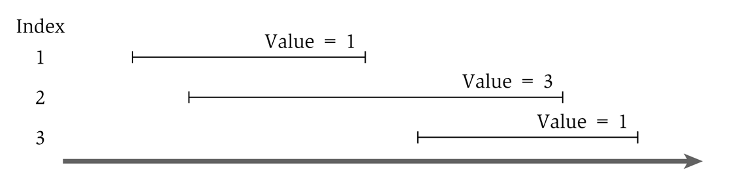
Greedy solution to the weighted version
What would the greedy algorithm pick for this example?
And is that answer optimal?
We can see that the greedy algorithm does not work for the weighted version

Slide 75
Step 1
Define the sub-problem
This problem has optimal substructure (we proved this in Greedy section), so let’s only consider intervals up to a certain point.
Let Opt(j) be the solution to this problem when only considering intervals 1 through j
How should we order the intervals? Does it matter? We will see soon that it does.
Note that Opt(0) = 0

Slide 76
Step 2
Define solution to problem in terms of sub-problems
Base Case:
Opt(0) = 0
Opt(j) = ?

Slide 77
Step 2
Opt(j) = ?
Two cases:
Interval j is not in the optimal solution
Opt(j) = Opt(j-1) //same solution, because j interval doesn’t matter
Interval j is in the optimal solution
Opt(j) = Vj + Opt(intervals compatible with j)
Intervals compatible with j? Yikes? How do we calculate that?

Slide 78
Calculating Opt(j)
Sort all intervals by their finish time
And number them sequentially
We define interval i is less than interval j if i finishes before j (i.e. is before it in the sort)
Define p(j) to be the highest numbered interval i<j such that i and j are disjoint
Define OPT(j) to be the value of an optimal solution for intervals 1 through j only

Slide 79
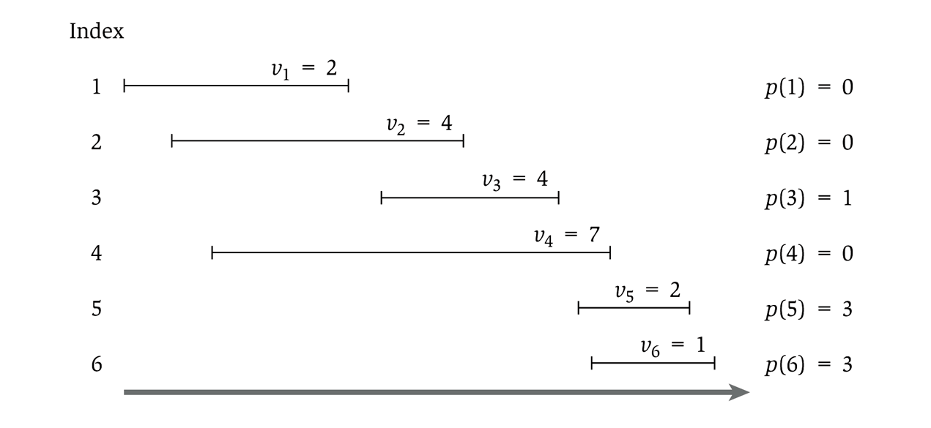
Showing p(j)

Slide 80
Step 2
Opt(j) = ?
Two cases:
Interval j is not in the optimal solution
Opt(j) = Opt(j-1) //same solution, because j interval doesn’t matter
Interval j is in the optimal solution
Opt(j) = Vj + Opt(p(j))
So…we have
Opt(j) = Max( Opt(j-1), Vj + Opt(p(j)) )

Slide 81
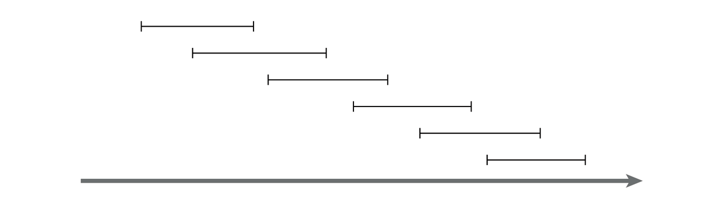
Recursive solution
OPT(j) = max(v_{j} + OPT(p(j)), OPT(j-1))
And OPT(0) = 0
This is similar in running time to the Fibonacci sequence
And similarly exponential
Consider a simple example:
Notes:
For any j, will generate recursive calls on inputs of size j-1 and j-2.
Just like Fibonacci!

Slide 82
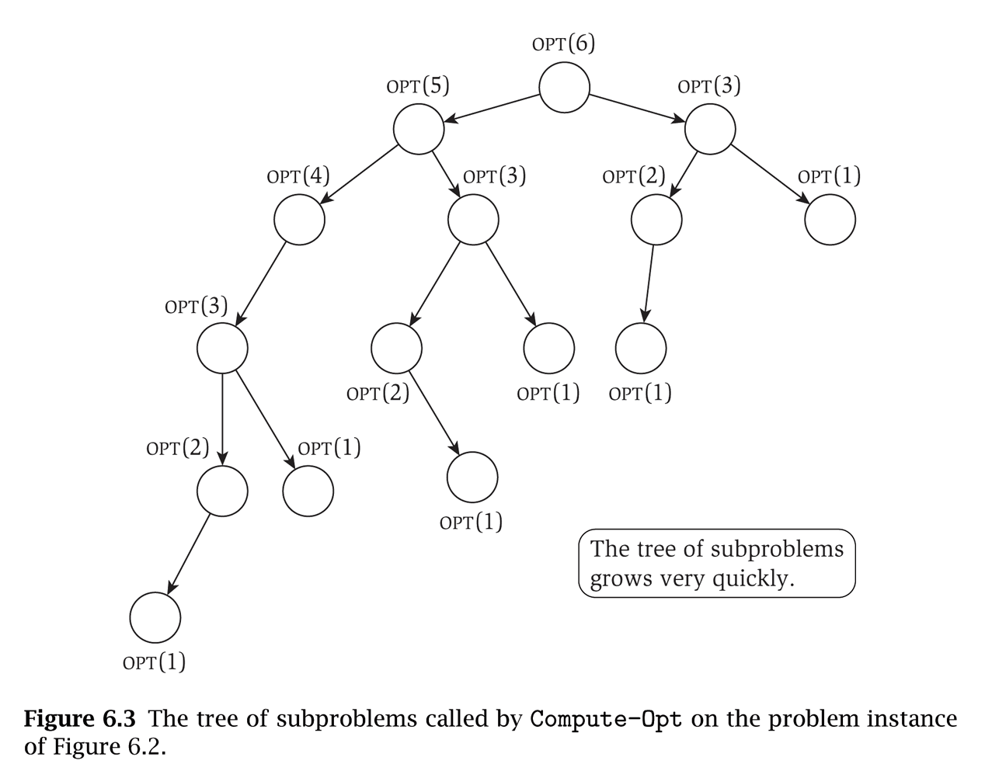
That example will take exponential time
Notice that the sub-problems are being re-computed each time

Slide 83
Step 3!
Formulate the data structure to look up subproblems.
Pretty simple, define M[n]
M[j] stores the solution to Opt(j)

Slide 84
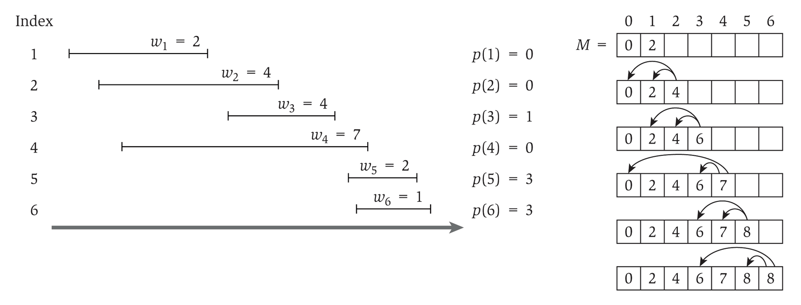
So we add memoization…
This runs in linear time

Slide 85
Computing the intervals
The solution only gives us the final value
Computing a sub-array each step would make it quadratic running time
To determine the intervals:
If v_{j} + M[p(j)] ≥ M[j-1]
Then j is part of the solution, and consider p(j)
Else
Then j is NOT part of the solution, and consider j-1

Slide 86
Coin Change

Slide 87
Recall coin change
Given an amount A, pick the minimum amount of coins that yield A
Recall the greedy algorithm:
Use the biggest coin possible, and use as many of those as possible
Repeat with successively smaller denominations
This algorithm won’t work with non-standard denominations

Slide 88
Greedy algorithm
Given coin cent amounts of 10, 6, 5, and 1
Compute the coins needed for 12 cents
The greedy algorithm picks 10, 1, 1
But 6, 6 is more optimal (fewer coins)

Slide 89
Definitions
We define an array denom which holds the denominations of the coins such that:
denom[1] > denom[2] > … > denom[n] = 1
In other words, we sort the coin denominations in decreasing order, ending with a penny
We are obtaining change for an amount A
Consider the i,j problem:
The available denominations are denom[i] through denom[n], where i ≥ 1 (i.e. the smaller n-i+1 coins)
Note: when i is large, you’re working with fewer types of coins, and when i=1 you’re working with your complete set
The amount we are looking for is j, where j ≤ A (i.e. the remaining amount of money)

Slide 90
The i,j problem
Consider the i,j problem:
The available denominations are denom[i] through denom[n], where i ≥ 1 (i.e. the smaller n-i+1 coins)
The amount we are looking for is j, where j ≤ A (i.e. the remaining amount of money)
Given coins of denominations 10, 6, and 1, here’s the table showing how to create change up to 12 cents:
j
 | 0 | 1 | 2 | 3 | 4 | 5 | 6 | 7 | 8 | 9 | 10 | 11 | 12
1 | 0 | 1 | 2 | 3 | 4 | 5 | 1 | 2 | 3 | 4 | 1 | 2 | 2
2 | 0 | 1 | 2 | 3 | 4 | 5 | 1 | 2 | 3 | 4 | 5 | 6 | 2
3 | 0 | 1 | 2 | 3 | 4 | 5 | 6 | 7 | 8 | 9 | 10 | 11 | 12
i

Slide 91
Solving the problem
How to solve the i,j problem
If denom[i] > j, then we don’t use this coin
Then the solution is the same as the (i+1),j problem
Is this making the problem simpler?
We could use a coin of denomination i
Then the solution is 1 more than the i,(j-denom[i]) problem
i doesn’t change because there could be multiple coins of denomination i used in the solution
We could NOT use a coin of denomination i
Then the solution is the same as the (i+1),j problem

Slide 92
The formulaic solution
The solution becomes:
Where C[i][0] = 0 for all values of i
If we have a penny, then C[n][j] = j
This is required to get all amounts, so we assume a penny is the smallest denomination

Slide 93
Recursive solution
The solution:
Note that a given problem (C[i][j]) is expressed in terms of sub-problems
We can write a solution now using recursion

Slide 94
The (non-recursive) algorithm
dynamic_coin_change1 (denom, A, C) {
n = denom.last
for j = 0 to A
C[n][j] = j
for i = n-1 downto 1
for j = 0 to A
if ( denom[j] > j ||
C[i+1][j] < 1+C[i][j-denom[i]] )
C[i][j] = C[i+1][j]
else
C[i][j] = 1 + C[i][j-denom[i]]
}

Slide 95
But how to record the answers?
We’ll keep a used Boolean array
If used[i][j] is true, then the solution for i,j does use a coin of denom[i] for amount j
If false, it does not
j
 | 0 | 1 | 2 | 3 | 4 | 5 | 6 | 7 | 8 | 9 | 10 | 11 | 12
1 | F | F | F | F | F | F | F | F | F | F | T | T | F
2 | F | F | F | F | F | F | T | T | T | T | T | T | T
3 | F | T | T | T | T | T | T | T | T | T | T | T | T
10 cents
6 cents
1 cent
i

Slide 96
Recording the answers
dynamic_coin_change2 (denom, A, C, used) {
n = denom.last
for j = 0 to A
C[n][j] = j
used[n][j] = true
for i = n-1 downto 1
for j = 0 to A
if ( denom[j] > j ||
C[i+1][j] < 1+C[i][j-denom[i]] )
C[i][j] = C[i+1][j]
used[i][j] = false
else
C[i][j] = 1 + C[i][j-denom[i]]
used[i][j] = true
}

Slide 97
Obtaining the coin set
optimal_coins_set (i, j, denom, used) {
if ( j == 0 )
return
if ( used[i][j] )
println (“Use coin of denomination “ + denom[i])
optimal_coins_set (i, j-denom[i], denom, used)
else
optimal_coins_set (i+1, j, denom, used)
}

Slide 98
Conclusion

Slide 99
Review: Dynamic programming
DP is a method for solving certain kind of problems
DP can be applied when the solution of a problem includes solutions to subproblems
We need to find a recursive formula for the solution
We can recursively solve subproblems, starting from the trivial case, and save their solutions in memory
In the end we’ll get the solution of the whole problem

Slide 100
Properties of a problem that can be solved with dynamic programming
Simple Subproblems
We should be able to break the original problem to smaller subproblems that have the same structure
Optimal Substructure of the problems
The solution to the problem must be a composition of subproblem solutions
Subproblem Overlap
Optimal subproblems to unrelated problems can contain subproblems in common

Slide 101
Conclusion
Dynamic programming is a useful technique of solving certain kind of problems
When the solution can be recursively described in terms of partial solutions, we can store these partial solutions and re-use them as necessary
Running time (Dynamic Programming algorithm vs. naïve algorithm):
LCS: O(m*n) vs. O(n * 2^{m})
0-1 Knapsack problem: O(W*n) vs. O(2^{n})

