Slide 1
NP
CS 4102: Algorithms
Fall 2016
Mark Floryan

Slide 2
Background: Reductions

Slide 3
Reductions
If you reduce problem A to problem B in polynomial time…
Written as A ≤_{p} B
…then you are using a solution to B to create a solution to A
With polynomial increase in time
Thus, B is as hard as, or harder than, A

Slide 4
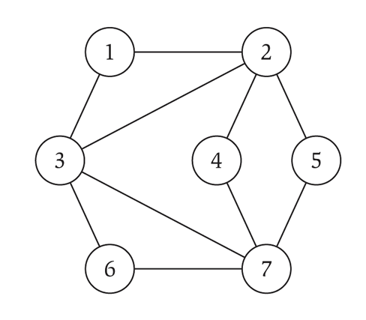
Independent Set
An independent set (IS) is on a graph G = (V,E) is a subset of vertices S ⊆ V such that no two vertices in S have an edge between them
We typically look for the largest independent set
The largest independent set in the graph to the right is of size 4
1, 4, 5, 6

Slide 5
Vertex Cover
A vertex cover (VC) on a graph G = (V,E) is a subset of vertices S ⊆ V such that every edge in the graph is connected to at least one vertex in S
We typically look for the smallest vertex cover
The smallest vertex cover in the graph to the right is of size 3
2, 3, 7

Slide 6
Problem equivalence
VC is just the inverse of IS
These problems can be reduced to each other:
IS ≤_{p} VC
VC ≤_{p} IS

Slide 7
Non-bi-directional reductions
Not all problems can be reduced in both directions
Consider Independent Set and the problem of finding two vertices that are not connected to each other
We’ll call this other problem FOO
FOO ≤_{p} IS
Just pick two vertices in the IS set
But not the other way around
IS is “at least as hard as” FOO
But FOO is not as hard as IS

Slide 8
Background: Finite State Machines

Slide 9
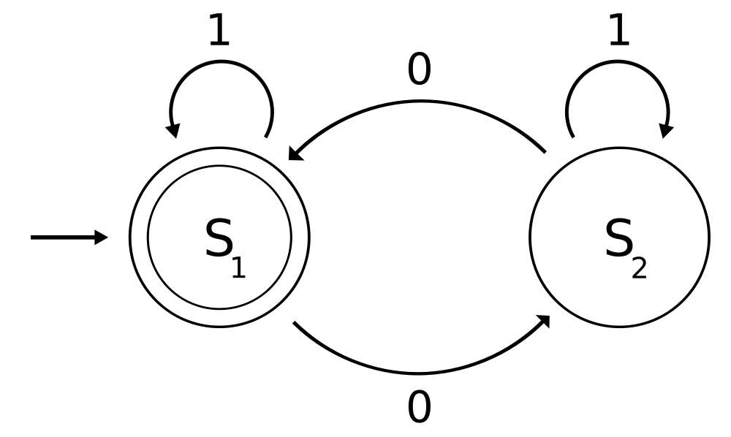
Finite state machines
Also called Finite State Automata, FSMs, etc.

Slide 10
FSMs
A FSM is a quintuple: (Σ, S, s₀, δ, F):
Σ is the alphabet (the transition labels)
S is the set of states
s₀ is the (single) start state
δ is the set of transitions: given a state and an input symbol, determine the (one) destination state
δ: S ×Σ → S
F is the set of final state(s)

Slide 11
Final (accepting) states
Starting in the start state, you continue until input is completely read in
There are three possibilities:
Before you finish input, you are unable to make a move (the current state does not allow the current input symbol)
You end up in a non-final state
You end up in the final state
The last one means the input was accepted by the FSM; the first two means the input was not accepted

Slide 12
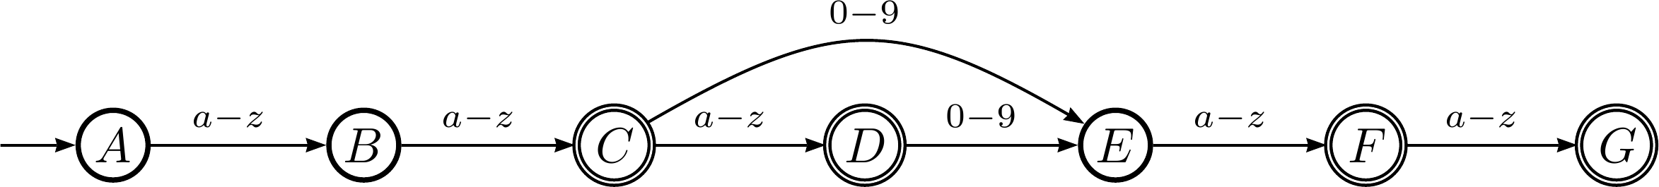
FSM to accept UVa userids
There are many different allowed formats:
ab, ab1d, ab1de, abc, abc1d, abc1de
And note the multiple final (accepting states)

Slide 13
Deterministic & Non-deterministic FSMs
A deterministic FSM (aka DFA) has ONLY ONE destination state for each starting state / transition pair
A non-deterministic FSM (aka NFA) has POSSIBLY MANY destination state(s) for each starting state / transition pair
Meaning, given a current state and a input symbol, there are multiple states that could be transitioned to
And it has an empty transition (the current state can change without an input symbol)

Slide 14
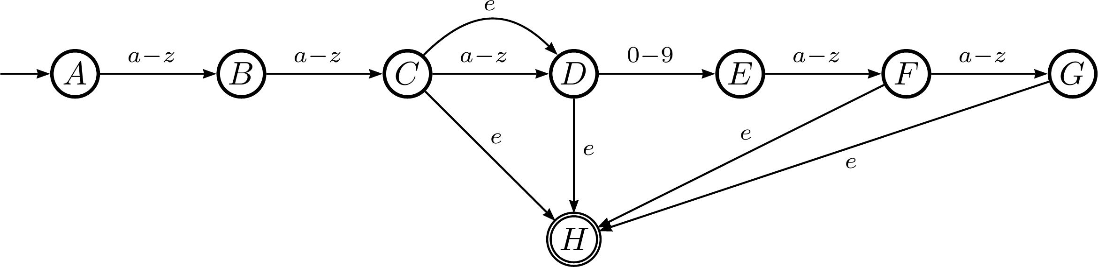
NFA to accept UVa userids
Note the empty transitions (labeled ‘e’ or ‘ε’)
This accepts the exact same input as the previous DFA

Slide 15
Converting NFAs to DFAs
Each DFA state is a set of NFA states
Given a current NFA state and an input, consider which multiple NFA states you could be in after that transition
That is your new DFA state
This could result in an exponential increase of the states
The DFA states are each element of the power set of NFA states
Do we remember what the power set is?

Slide 16
Background: Turing Machines

Slide 17

Turing machine
A Turing machine is a formal model of computation
It’s is basically a head (CPU) that manipulates symbols on a tape
The head (CPU) is a (deterministic) finite state machine
It reads in a symbol from the tape, and then:
Writes a new symbol
Moves the head (left or right)
It’s meant for thought experiments, not as a actual device

Slide 18
Turing machine
Formally, a Turing machine consists of:
Q, a set of states that the CPU is in
Γ, a set of symbols that can be written on the tape
b ∈ Γ, the blank symbol
Σ ⊆ Γ \ {b}, the set of input symbols
q₀ ∈Q, the initial state
F ⊆ Q, the set of final states
δ : Q \ F × Γ → Q × Γ × {L,R}, the transition function

Slide 19
The transition function
The transition function: δ : Q \ F × Γ → Q × Γ × {L,R}
This means that:
Given a state that is not final (Q \ F)
And an input symbol (Γ) (where the head currently is)
It will then:
Transition to a new state (Q)
Write a new symbol in the current spot (Γ)
Move the head left or right ({L,R})

Slide 20
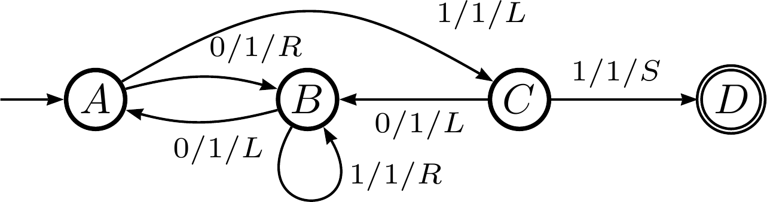
Turing machine example
A “no-shift”
operator;
equivalent
to a {L,R} TM
Q = { A, B, C, D }
Γ = { 0, 1 }
Σ = Γ = { 0, 1 }
F = { D }
δ: see next slide
Each transition lists: input symbol, output symbol, head move direction

Slide 21
Turing machine example
The transition function:
δ : Q \ F × Γ → Q × Γ × {L,R,S}
Q \ F | Γ | Q | Γ | {L,R,S}
A | 0 | B | 1 | R
A | 1 | C | 1 | L
B | 0 | A | 1 | L
B | 1 | B | 1 | R
C | 0 | B | 1 | L
C | 1 | D | 1 | S

Slide 22
Non-deterministic TMs
A non-deterministic Turing Machine can generally compute the result to an exponential problem in polynomial time
But in order to run it on a computer, we have to convert the NFA to a DFA
This results in exponential blow-up of the FSM states
Resulting in an exponential computation time on a computer
Quantum computers may change all this…

Slide 23
Abbreviations
TM = Turing Machine
NTM = Non-deterministic Turing Machine
DTM = Deterministic Turing Machine

Slide 24
Problem Types

Slide 25
Problem types
Given a problem (such as traveling salesperson, etc.), there are three variants of the problem:
Decision problem: does a solution of type X exist?
Given graph G, is there a round-trip cost cheaper than y?
The answer is either yes or no for a decision problem
Verification problem: given a potential solution, can you verify that it is a solution?
Given a graph G and a path P, does P both (a) visit each node, and (b) cost less than c?
Function problem: what is the actual solution?
Given graph G, what is the minimum round-trip cost?
Or, alternatively, what is the minimum round-trip path?

Slide 26
Problems we’ve seen
Of all the problems we have seen (in 2150 & 4102):
Very few have been decision or verification problems; most have been function problems
All have been either logarithmic, polynomial, or exponential time for the functional version
And the decision version – typically, these two problem types have the same complexity class
All have polynomial-time verification problems

Slide 27
Complexity classes and problem types
The running time of the various problem types is partially what determines it’s complexity class
Polynomial problems have polynomial time for decision (and thus function) and verification
NP/NP-hard/NP-complete problems have exponential time for decision (and thus function) but polynomial time for verification
PSPACE problems have exponential time for all three types (well, sort of)

Slide 28
Equivalent terms
Note that these two terms are equivalent:
Verifiable in polynomial time by a DTM
Solvable in polynomial time by a NTM
Psuedo-proof:
1 → 2
If a single solution can be verified in polynomial time by a DTM
Then, an NTM can “verify” ALL possible solutions in parallel (polynomial time each) using same process.
2 → 1
If an NTM can solve the problem. Though non-deterministic, one computation path is the accepting path.
This particular path can be used to verify an input (as a DTM) in polynomial time.

Slide 29
Equivalent terms
Note that these two terms are equivalent:
Verifiable in polynomial time by a DTM
Solvable in polynomial time by a NTM
This is critical to remember!

Slide 30
Complexity Classes

Slide 31
Polynomial algorithms
Most of the algorithms we have studied have run in polynomial time: O(n^{c}), where c can be anything
We’ve seen some exponential algorithms: traveling salesperson
Is it accurate to say that all polynomial problems are Θ(n^{c})? Can you think of a counter-example?
We call this complexity class P (for ‘polynomial’)
Regardless of the value of c, a problem in P has an algorithm that will run in less time than an exponential algorithm.
Polynomial problems are tractable: given enough computing power, we can solve them in a reasonable amount of time

Slide 32
Exponential algorithms
Exponential problems are intractable: given enough computing power, we still can’t solve it in a reasonable amount of time
Say, in less time than the estimated life of the universe
The range of exponential problems is vast
And thus split into various classes: NP/NP-hard/NP-complete, Co-NP, PSPACE, etc.

Slide 33
NP
This does NOT mean not-polynomial!
It means that it can be solved by a non-deterministic Turing machine in polynomial time
NP = “non-deterministic polynomial time”
The decision and function problems run in “non-deterministic polynomial time”
We have only found exponential solutions with a DFA
The verification problem is still polynomial

Slide 34
P ⊆ NP
Any problem in P will run in “deterministic polynomial time”
And thus will run in “non-deterministic polynomial time”
NP
P

Slide 35
Is P ⊂ NP or is P = NP?
If P = NP, then we can find efficient (i.e. polynomial) time solutions to all the problems in NP
If P ⊂ NP (that’s a proper subset symbol), then there are problems in NP that we can never solve in efficient (i.e. polynomial) time
We don’t know the answer yet, but everybody believes that P ⊂ NP

Slide 36
The problems in NP
Some of the problems in NP do not have any known efficient solutions
They might, but nobody’s found them yet (and not due to lack of trying!)
We can claim that these problems are the “hardest” problems in NP
How we define “hardest” we’ll see in a bit

Slide 37
NP-hard
A problem, H, that is NP-hard is at least as hard as the hardest problems in NP
It could be harder (i.e. PSPACE), but it’s not any easier
We show this by a reduction:
Consider a known “hard” problem in NP, call it L
We reduce L to H in polynomial time: L ≤_{p} H
Because we can use H to solve L, H must be as hard as, or harder than, L

Slide 38
NP-completeness
Imagine that we could do the following:
Create a group of functions of which there are no known efficient (i.e. polynomial) time solutions to
They are all as hard as each other (i.e. they can all be reduced to each other)
They are all in NP
These problems would form a set of equivalently difficult problems for which there are no known efficient solutions
We call that set NP-complete
Only decision problems are NP-complete

Slide 39
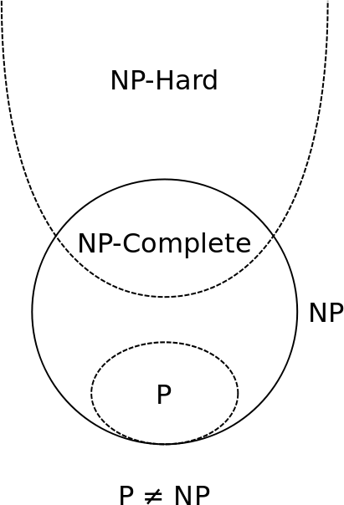
Diagram
To show a problem in NP-complete, we need to show:
That it is in NP
(this can include P algorithms as well)
That it is in NP-hard
(this can include PSPACE algorithms as well)
If both are true, then the problem is NP-complete

Slide 40
Proving NP-completeness
To show a problem ‘A’ is NP-complete, we need to show:
That it is in NP
Show that a non-deterministic Turing machine can solve this in polynomial time
OR that the algorithm can be verified (deterministically) in polynomial time ← Typically we do this one because it is easier.
That it is in NP-hard
By a reduction with a known NP-complete problem
Take any known NP-Complete problem L
Show L ≤_{p} A

Slide 41
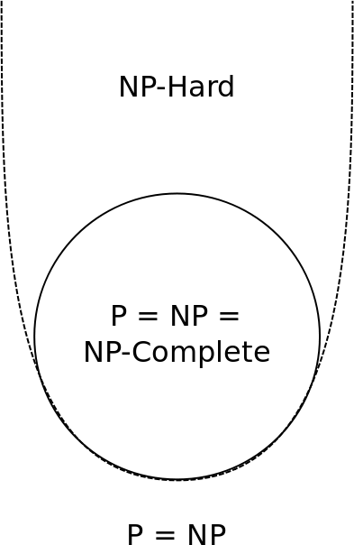
Does P = NP?
If we could find an efficient (i.e. polynomial) time solution to any NP-complete problem
Then we could, through a polynomial-time reduction, find an efficient (i.e. polynomial) solution to all NP-complete problems
That’s what the “-complete” part means

Slide 42
Proving something is NP-complete
This is done by a reduction with only one of the thousands of existing NP-complete problems
But how did we figure out the first NP-complete problem?
And what was that problem?

Slide 43
Satisfiability

Slide 44
Satisfiability
Consider a Boolean expression that uses only and, or, & not
Label the variables x₁ … x_{n}
Can we find truth assignments to x₁ … x_{n} such that the overall result is true?

Slide 45
Satisfiability variants
Originally, the formula had to be in conjunctive normal form
A long and-ing of clauses
Each clause was an or-ing of literals (or negated literals)
In other words, a conjunction of disjunctions
This was called circuit satisfiability
Now, any Boolean expression is valid
And it is usually just called satisfiability

Slide 46
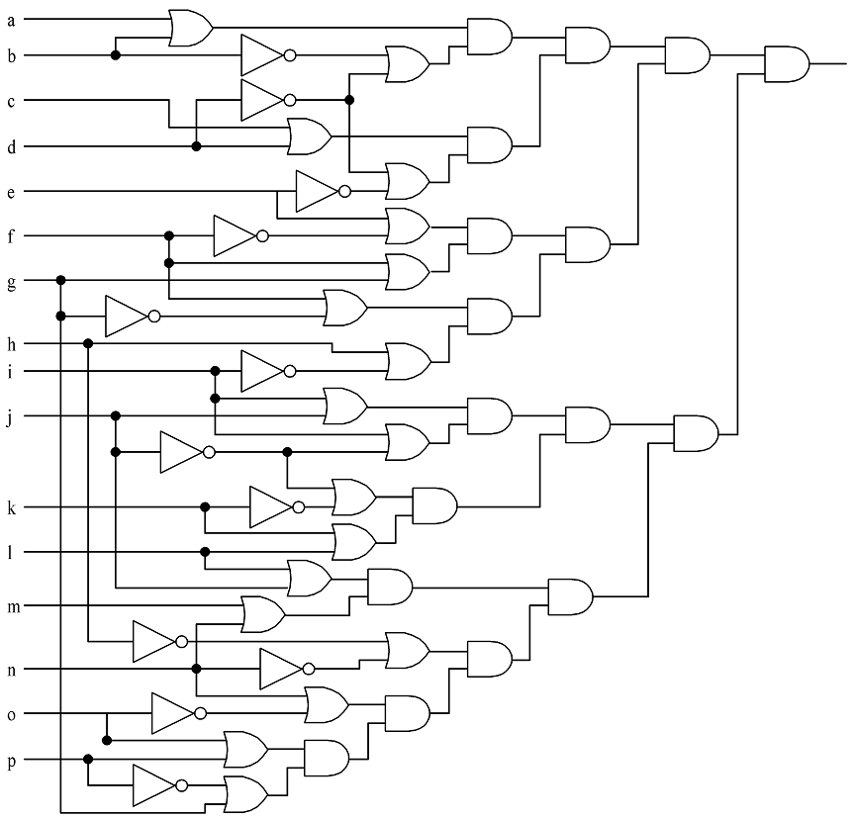
Circuit satisfiability example
1
1
0
1
Not satisfied
1
1
1
1
1
1
1
1
1
1
1
1
1

Slide 47
Circuit satisfiability example
That formula:
(v[0] || v[1]) && (!v[1] || !v[3]) && (v[2] || v[3]) && (!v[3] || !v[4]) && (v[4] || !v[5]) && (v[5] || !v[6]) && (v[5] || v[6]) && (v[6] || !v[15]) && (v[7] || !v[8]) && (!v[7] || !v[13]) && (v[8] || v[9]) && (v[8] || !v[9]) && (!v[9] || !v[10]) && (v[9] || v[11]) && (v[10] || v[11]) && (v[12] || v[13]) && (v[13] || !v[14]) && (v[14] || v[15])

Slide 48
Solutions
Solutions:
1110111110011001
1010111111011001
0110111110111001
0110111110011001
1110111111011001
1010111110011001
1010111110111001
0110111111011001
1110111110111001

Slide 49
Satisfiability
The only known solutions take exponential time
The decision problem: given an equation E (or a circuit E), is it satisfiable?
Only known solutions are non-deterministic polynomial time
Or deterministic exponential time
The function problem: given an equation E, what is/are the satisfiable solution(s)?
Same running time as the decision problem
The verification problem: given an equation E, and a solution S, does S satisfy E?
Polynomial time to verify

Slide 50
The Cook-Levin Theorem

Slide 51
The Cook-Levin Theorem
Sometimes just called the Cook Theorem
Developed independently by Stephen Cook (US) and Leonid Levin (USSR) in 1971 & 1973
It states, simply, that Circuit Satisfiability (SAT) is NP-complete (NPC)

Slide 52
Cook-Levin Theorem Proof
To show that SAT is NPC, we must show:
SAT ∈NP
That every other NP problem can be reduced to SAT in polynomial time
This proof generally follows the Wikipedia article for the Cook-Levin theorem
As I thought it explained it fairly well

Slide 53
SAT ∈ NP
This is easy:
Any solution to a NP problem can be verified in polynomial time by a DTM
Equivalent statement: solvable in polynomial time by a NTM
Given a solution to SAT, we can easily check this in polynomial time on a DTM
How?
Plug in the values for the solution, run through the terms of the equation and compute their truth value.

Slide 54
∀_{X∈NP} X≤_{p}SAT
Every problem in NP can be reduced to SAT
Consider an NTM that accepts a generic problem X in NP
M = (Q, Σ, s, F, δ)
We will see how to reduce this general problem X to an instance of SAT

Slide 55
Variables
Variables used in our conversion:
n is the input size
p(n) is the (polynomial) time the NTM takes
q ∈ Q
-p(n) ≤ i ≤ p(n)
j ∈Σ
0 ≤ k ≤ p(n)
Variable | Meaning | How many
T_{ijk} | True if tape cell i contains symbol j at step k of the computation | O(p(n)²)
H_{ik} | True if the M’s read/write head is at tape cell i at step k of the computation | O(p(n)²)
Q_{qk} | True if M is in state q at step k of the computation | O(p(n))

Slide 56
Create a conjunction ‘B’ of…
Expression | Conditions | Interpretation | How many
T_{ij0} | Tape cell i initially contains symbol j | Initial tape state; blank symbols below 0 and above n | O(p(n))
Q_{s0} |  | Initial state of the NTM | 1
H₀₀ |  | Initial position of the read/write head | 1
T_{ijk} → ¬T_{ij’k} | j != j’ | One symbol per tape cell | O(p(n)²)
T_{ijk} = T_{ij(k+1)} ∨ H_{ik} |  | Tape remains unchanged unless written | O(p(n)²)
Q_{qk} → ¬Q_{q’k} | q ≠ q’ | Only one state at a time | O(p(n))
H_{ik} → ¬H_{i’k} | i ≠ i’ | Only one head position at a time | O(p(n)²)
(H_{ik} ∧ Q_{qk} ∧ T_{iσk}) → (H_{(i+d)(k+1)} ∧ Q_{q’(k+1)} ∧ T_{iσ(k+1)}) | (q, σ, q’, σ’, d) ∈ δ | Possible transitions at computation step k when head position is at position I | O(p(n)²)
∨_{f∈F} Qfp(n) |  | Must finish in an accepting state | 1

Slide 57
Final part of the proof
If there is an accepting computation for the NTM on input I, then B is satisfiable by assigning T_{ijk}, H_{jk}, and Q_{jk} their intended interpretations
The number of sub-expressions is 2p(n) + 4p(n)² + 3 = O(p(n)²)
Which means the reduction is polynomial
B is called the tableau of the NTM

Slide 58
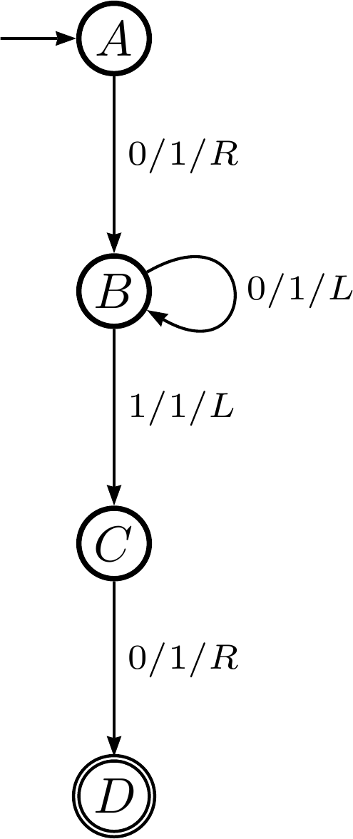
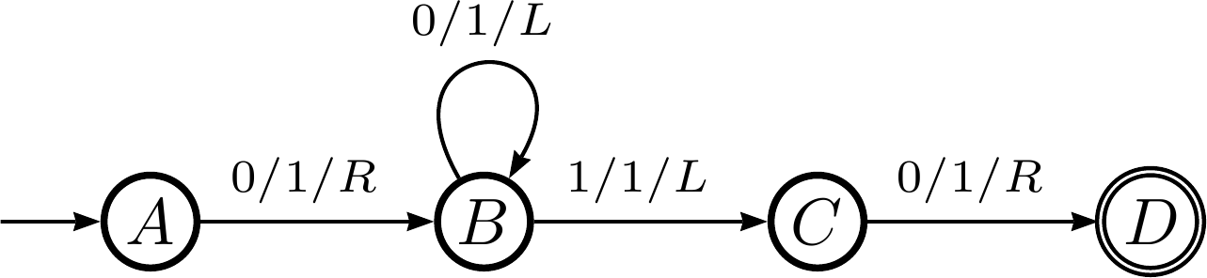
Cook-Levin proof example
Consider the following DTM:

Slide 59
Cook-Levin proof example
Step 0: in state A
Step 1: in state B
Step 2: in state B
Step 3: in state C
Step 4: in state D
…
0
0
0
0
0
0
0
…
…
0
0
0
1
0
0
0
…
…
0
0
0
1
1
0
0
…
…
0
0
0
1
1
0
0
…
…
0
0
1
1
1
0
0
…

Slide 60
The state of the TM, part 1
The tape is all zeros for the 7 cells we care about (cells 0-6)
T_{ijk} is true if the tape cell i contains symbol j at step k
T₀₀₀ ∧ T₁₀₀ ∧ T₂₀₀ ∧ T₃₀₀ ∧ T₄₀₀ ∧ T₅₀₀ ∧ T₆₀₀
The initial state of the TM is state A
Q_{qk} is true if the TM is in state q at step k
Q_{A0}
The head is in the center (cell 3)
H_{ik} is true if the TM is in cell i at step k
H₃₀

Slide 61
The state of the TM, part 2
The tape is all zeros for the 7 cells we care about (cells 0-6)
We’ll only focus on cells 2-4 for brevity
T_{ijk} is true if the tape cell i contains symbol j at step k
T_{ijk} → T_{ij’k} where j!=j’
(T₂₀₀ → ¬T₂₁₀) ∧ (T₃₀₀ → ¬T₃₁₀) ∧ (T₄₀₀ → ¬T₄₁₀)
Likewise for all the other steps (0 ≤ k ≤ 4)
Convert that to an or clause: p→q ≡ ¬p∨q
(¬T₂₀₀ ∨ ¬T₂₁₀) ∧ (¬T₃₀₀ ∨ ¬T₃₁₀) ∧ (¬T₄₀₀ ∨ ¬T₄₁₀)

Slide 62
Create a conjunction ‘B’ of…
Expression | Conditions | Interpretation | How many
T_{ij0} | Tape cell i initially contains symbol j | Initial tape state; blank symbols below 0 and above n | O(p(n))
Q_{s0} |  | Initial state of the NTM | 1
H₀₀ |  | Initial position of the read/write head | 1
T_{ijk} → ¬T_{ij’k} | j != j’ | One symbol per tape cell | O(p(n)²)
T_{ijk} = T_{ij(k+1)} ∨ H_{jk} |  | Tape remains unchanged unless written | O(p(n)²)
Q_{qk} → ¬Q_{q’k} | q ≠ q’ | Only one state at a time | O(p(n))
H_{jk} → ¬H_{j’k} | i ≠ i’ | Only one head position at a time | O(p(n)²)
(H_{ij} ∧ Q_{qk} ∧ T_{iσk}) → (H_{(i+d)(k+1)} ∧ Q_{q’(k+1)} ∧ T_{iσ(k+1)}) | (q, σ, q’, σ’, d) ∈ δ | Possible transitions at computation step k when head position is at position I | O(p(n)²)
∨_{f∈F} Qfp(n) |  | Must finish in an accepting state | 1

Slide 63
End conjunction
B = T₀₀₀ ∧ T₁₀₀ ∧ T₂₀₀ ∧ T₃₀₀ ∧ T₄₀₀ ∧ T₅₀₀ ∧ T₆₀₀ ∧ Q_{A0} ∧ H₃₀ ∧ (¬T₂₀₀ ∨ ¬T₂₁₀) ∧ (¬T₃₀₀ ∨ ¬T₃₁₀) ∧ (¬T₄₀₀ ∨ ¬T₄₁₀) ∧ …
If the TM successfully completes the computation, then B will be true

Slide 64
How to prove problem X is NP-complete
Show it is in NP
Any solution to a NP problem can be verified in polynomial time by a DTM
Equivalent statement: solvable in polynomial time by a NTM
Show it is in NP-hard
You can convert any NP problem into L in polynomial time
Done via a reduction: SAT ≤_{p} X

Slide 65
P = NP?

Slide 66
Does P = NP?
We have not found any efficient solution to any of the NP-complete problems
But that doesn’t mean one does not exist
It’s possible that one does, and we just haven’t found it yet
But nobody really believes that
However, nobody has been able to prove that P ≠ NP

Slide 67
What if P does equal NP?
That would be bad
There are many things that we want to be hard
Cracking any sort of encryption, for example
This would then be computable in polynomial time

Slide 68

Funny:

Slide 69
Why we believe that P ≠ NP
After decades of study, nobody has been able to find an efficient solution to any one of over 3,000 known NP-complete problems
Many of these problems were analyzed long before NP-completeness was defined

Slide 70
Earn a million dollars!
The Clay Mathematics Institute defined 7 “Millennium Problems”
And offered $1 million to anybody who can offer a solution (one way or the other) to one of them
One of the is if P = NP or not
http://www.claymath.org/millennium/P_vs_NP/
Only one has been solved: the Poincare conjecture

Slide 71
3-SAT

Slide 72
Circuit-SAT versus SAT
Circuit-SAT is a translation of a Boolean circuit
Only and, or, and not
Each operator only operates on 2 literals (or their negations)
SAT can be any Boolean expression
Including conditionals and bi-conditionals
Sometimes called Formula SAT to differentiate it
They were known to be equivalent in expressive power long before NP-completeness came around
And are thus used rather interchangeably

Slide 73
3-SAT
Satisfiability (SAT) takes pretty much any Boolean expression
And, or, conditional, bi-conditional, etc.
In 3-SAT, we claim that the Boolean expression must be a conjunction of disjunctions
Each clause is a disjunction (OR’ing) of literals (or their negations)
The overall expression is a conjunction (AND’ing) of the clauses
Each clause can have exactly 3 literals
It’s called 3-CNF-SAT because it must be in conjunctive normal form (a conjunction of disjunctions)

Slide 74
Showing 3-SAT is NP-complete
First, we must show it’s in NP
A NTM can decide it in polynomial time
Rephrased: it can be verified by a DTM in polynomial time
The equivalence of those two statements is on slide 30
This second one is easy to show
A formal proof would require showing how, which I’ll do verbally
Next we must show that 3-SAT is NP-hard: that we can reduce an NP-complete problem to 3-SAT
Not surprisingly, we choose SAT
We’ll consider the following formula:
φ = ((x₁ → x₂) ∨ ¬((¬x₁ ↔ x₃) ∨ x₄)) ∧ ¬x₂

Slide 75
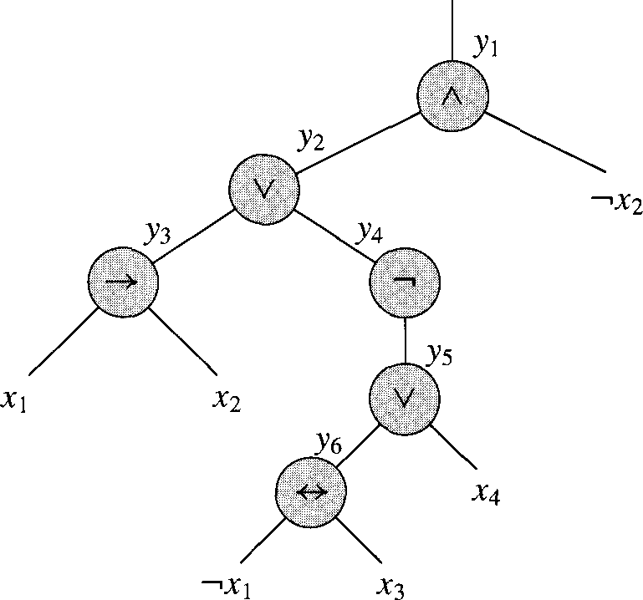
Converting SAT to 3-SAT, step 1
φ = ((x₁ → x₂) ∨ ¬((¬x₁ ↔ x₃) ∨ x₄)) ∧ ¬x₂
We parse the expression into an expression tree
You did this in 2150 lab 5 with arithmetic operators; same principle applies
Since each operator (other than ¬) is binary, it will be a binary tree

Slide 76
Converting SAT to 3-SAT, step 2
We introduce a variable y_{i} for each internal node
We can then re-write our expression:
φ’ = y₁ ∧ (y₁ ↔ (y₂ ∧ ¬x₂)
∧ (y₂ ↔ (y₃ ∨ y₄))
∧ (y₃ ↔ (x₁ → x₂))
∧ (y₄ ↔ ¬y₅)
∧ (y₅ ↔ (y₆ ∨ x₄))
∧ (y₆ ↔ (¬x₁ ↔ x₃))

Slide 77
Converting SAT to 3-SAT, step 3
So we build a truth table for each clause φ’_{i}:
φ’ = y₁ ∧ (y₁ ↔ (y₂ ∧ ¬x₂)
∧ (y₂ ↔ (y₃ ∨ y₄))
∧ (y₃ ↔ (x₁ → x₂))
∧ (y₄ ↔ ¬y₅)
∧ (y₅ ↔ (y₆ ∨ x₄))
∧ (y₆ ↔ (¬x₁ ↔ x₃))
We have an equation with at most 3 literals each
But it’s not in CNF!
y₁ | y₂ | _{X2} | (y₁ ↔ (y₂ ∧ ¬x₂))
1 | 1 | 1 | 0
1 | 1 | 0 | 1
1 | 0 | 1 | 0
1 | 0 | 0 | 0
0 | 1 | 1 | 1
0 | 1 | 0 | 0
0 | 0 | 1 | 1
0 | 0 | 0 | 1

Slide 78
Converting SAT to 3-SAT, step 4
So we build a truth table for each clause φ’_{i}:
For each clause φ’_{i}, we create new DNF (disjunctive normal form) clauses for when it’s false:
¬φ’_{i} = (y₁∧y₂∧x₂) ∨ (y₁∧¬y₂∧x₂) ∨ (y₁∧¬y₂∧¬x₂) ∨ (¬y₁∧y₂∧¬x₂)
We then negate that to get when it’s true
y₁ | y₂ | x₂ | (y₁ ↔ (y₂ ∧ ¬x₂))
1 | 1 | 1 | 0
1 | 1 | 0 | 1
1 | 0 | 1 | 0
1 | 0 | 0 | 0
0 | 1 | 1 | 1
0 | 1 | 0 | 0
0 | 0 | 1 | 1
0 | 0 | 0 | 1

Slide 79
Converting SAT to 3-SAT, step 5
So we build a truth table for each clause φ’_{i}:
¬φ’_{i} = (y₁∧y₂∧x₂) ∨ (y₁∧¬y₂∧x₂) ∨ (y₁∧¬y₂∧¬x₂) ∨ (¬y₁∧y₂∧¬x₂)
Then the negation (DeMorgan’s law!) is:
φ’_{i} = (¬y₁∨¬y₂∨¬x₂) ∧ (¬y₁∨y₂∨¬x₂) ∧ (¬y₁∨y₂∨x₂) ∧ (y₁∨¬y₂∨x₂)
y₁ | y₂ | x₂ | (y₁ ↔ (y₂ ∧ ¬x₂))
1 | 1 | 1 | 0
1 | 1 | 0 | 1
1 | 0 | 1 | 0
1 | 0 | 0 | 0
0 | 1 | 1 | 1
0 | 1 | 0 | 0
0 | 0 | 1 | 1
0 | 0 | 0 | 1

Slide 80
Converting SAT to 3-SAT, step 6
Three cases can occur for all the CNF clauses C_{i}:
C_{i} has 3 literals: then we include it in the final formula
C_{i} has 2 literals (l₁ and l₂): we include (l₁ ∨ l₂ ∨ p) ∧ (l₁ ∨ l₂ ∨ ¬p)
It doesn’t matter whether p is true or false; one clause will evaluate to true, the other to l₁ ∨ l₂
C_{i} has just one literal (l): we include the following:
(l ∨ p ∨ q) ∧ (l ∨ ¬p ∨ q) ∧ (l ∨ p ∨ ¬q) ∧ (l ∨ ¬p ∨ ¬q)
Regardless of what p and q are, 3 clauses will evaluate to true, and the other one to l

Slide 81
We’re done!
Whew!
Note that each step of converting SAT to 3-SAT was in polynomial time
And thus the entire thing in polynomial time

Slide 82
Cliques

Slide 83
Clique
A Clique in a graph G is a set of nodes such that each one is connected to each other in the set
In other words, it’s a maximal sub-graph of G
The problem is to find the maximal clique in a graph

Slide 84
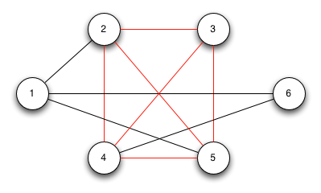
Clique
A Clique in a graph G is a set of nodes such that each one is connected to each other in the set
In other words, it’s a maximal sub-graph of G
The problem is to find the maximal clique in a graph

Slide 85
Proving Clique is NP-complete
First show it’s in NP
Can we verify it with a DTM in polynomial time?
Given a set of nodes, we can quickly determine if they are all connected to each other
A formal proof will require explaining how, which I’ll do verbally
Done!
Next, show it’s NP-hard
We reduce another NP-complete problem to Clique
Our choices so far are SAT and 3-SAT
We’ll use 3-SAT
In other words, that we can use a Clique solution to solve a 3-SAT problem
3-SAT ≤_{p} Clique

Slide 86
The reduction
Consider a 3-SAT problem with k clauses, C₁ to C_{k}; each clause C_{r} (where 1 ≤ r ≤ k) has literals l^{r}₁, l^{r}₂, l^{r}₃
We create a graph G as follows:
For each literal, create a vertex
Draw an edge between each vertex and every other vertex that:
Is not in the same clause
Is consistent: i.e., is not the negation of that literal
Claim: if the there is a clique of size k in G, then the equation is satisfiable

Slide 87
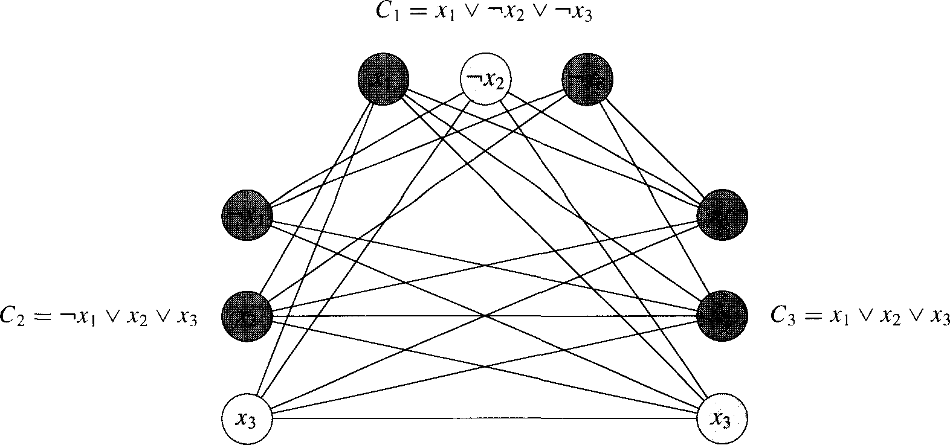
Reduction example
φ = (x₁∨¬x₂∨¬x₃)∧(¬x₁∨x₂∨x₃)∧(x₁∨x₂∨x₃)
x₁
¬x₃
¬x₁
x₁
x₂
x₂

Slide 88
Satisfiable(φ) → Clique(G, k)
If the equation is satisfiable:
Then there is at least one true literal in each clause
We pick one such true literal from each clause
They are all connected to each other, since inconsistent nodes are not connected to each other
They form a click of size k
You cannot have a clique of size k+1
Since nodes within a clause are not connected to each other
Thus, if the equation of k clauses is satisfiable, there is a clique of size k in graph G

Slide 89
Clique(G, k) → Satisfiable(φ)
If G has a clique of size k:
Let the nodes be n1, n2, n3 (each node MUST be in a different ‘clause’
Find the corresponding literals in φ for these nodes
Set them all to true
This assignment satisfies φ
Why? Because they were connected in the graph G meaning they are consistent (they can all be set to true with no conflicts).
Thus, if the equation of k clauses is not satisfiable, there is not a clique of size k in graph G

Slide 90
Notes about this proof
It is notable because it shows a reduction from a formulaic problem to a graph problem
And the Cook-Levin theorem translates the graph problem (Clique) back to a formulaic problem (SAT)

Slide 91
Vertex Cover

Slide 92
Vertex Cover
A vertex cover (VC) on a graph G = (V,E) is a subset of vertices S ⊆ V such that every edge in the graph is connected to at least one vertex in S
We typically look for the smallest vertex cover
The smallest vertex cover in the graph to the right is of size 3
2, 3, 7

Slide 93
Vertex Cover
We will reduce Clique to VC
Decision problem we will prove: given a graph G, is there a vertex cover of size k?
VC ∈NP: given a set of vertices, we can tell in polynomial time on a DTM if they form a proper VC
A formal proof will require explaining how, which I’ll do verbally
VC is NP-hard: done by a reduction
Clique ≤_{p} VC

Slide 94
Reduction
Given a graph G, we want to find a clique
To do so, we take the complement graph G’
G’ has edges between every pair of nodes that do not have edges between them in G
… and we find the vertex cover on G’
Claim: if there is a VC in G’ of size k, then there is a clique in G of size |V|-k
Or if a VC in G’ is of size |V|-k, then there is a clique of size k in G

Slide 95
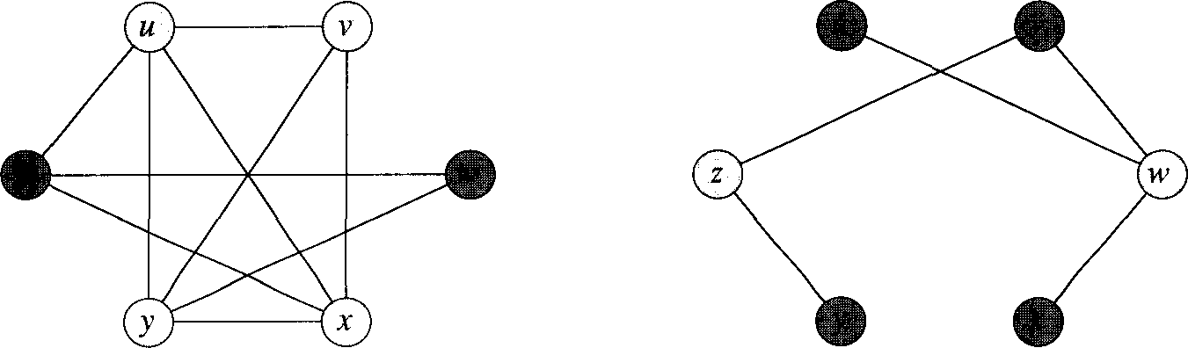
Reduction example
G is on the left, and the white nodes form a Clique
G’ is on the right, and the white nodes form a VC
u
v
z
w
y
z

Slide 96
Clique(G, k) → VC(G’, |V|-k)
Suppose G has a clique C ⊆ V with |C| = k
The claim is that V-C is a VC in G’
Let (u,v) be any edge in E’
Thus, (u,v) ∉E, since E’ is the complement of E
Then at least one of u or v does not belong to C (since C is a clique)
And thus at least one of u or v is in V-C (the VC)
So the edge (u,v) is covered by the VC
This is true for all edges in E’
Thus, V-C has size |V|-k, and forms a VC of G’

Slide 97
VC(G’, k) → Clique(G, |V|-k)
Conversely, suppose that G’ has a VC Cover ⊆ V with |Cover| = k
Then G has a clique of V-Cover, of size |V|-k
Same basic argument.
Examine the complement of Cover (call it Cover’)
No hypothetical edge e between two nodes in Cover’ exists in G’ because then the original Cover wouldn’t be a valid VC
Thus, the complement of E’ (which is just E) contains ALL of the edges between all pairs of nodes in Cover’
Thus Cover’ is a clique
|Cover’| = |V| - |Cover| = |V| - k

Slide 98
More Reductions

Slide 99
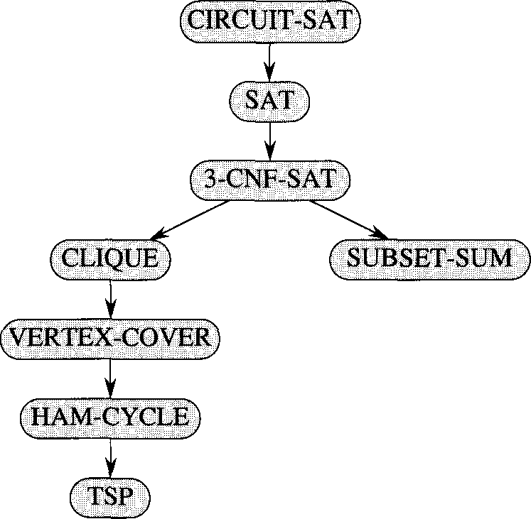
More reductions!
In 1972, Richard Karp showed a number of problems were NP-complete
The problems were known to be “hard”, but how “hard” was not really quantified until then

Slide 100
Trying to prove X ∈P is NP-complete
We know that X is in NP
Since P ⊆ NP, then the same reasoning that applies for NP problems applies for P problems
In other words, X ≤_{p} SAT
Next, we show a known NP-complete problem Y reduces to X
In other words, Y ≤_{p} X
This would imply that we could use a polynomial-time solution to X to solve the NP-complete problem Y
This is where the proof would most likely fail

Slide 101
NP-complete proofs we won’t see
Hamiltonian cycle (reduces from 3-SAT)
3-D matching (reduces from 3-SAT)
Subset Sum (reduces from 3-D matching)
These are all in the textbook or online

Slide 102
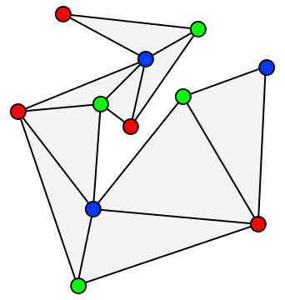
3-Coloring
Given graph G, and three colors c1,c2,c3 (not really given as input)
Can we color the graph with these colors such that no adjacent nodes have the same color.
Turns out that 3-Coloring is NP-Complete

Slide 103
3-Coloring
First show:
3-Coloring ∈ NP
How?
Given a coloring of the graph, is it valid?
Must do this in polynomial time!

Slide 104
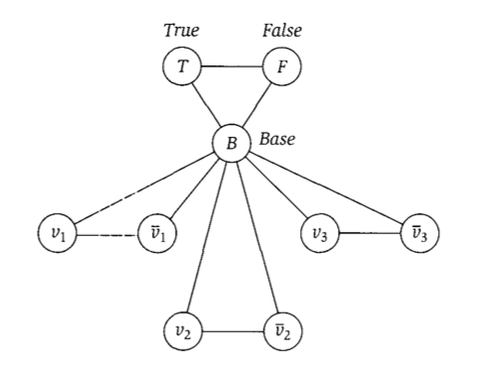
Reducing 3-SAT to 3-coloring

Slide 105
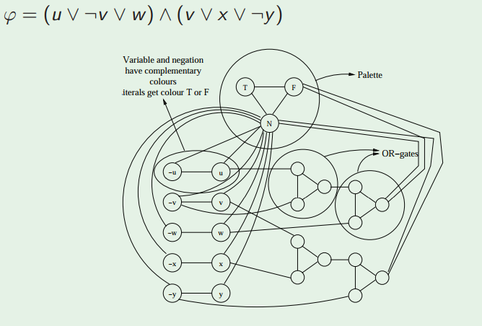
Reducing 3-SAT to 3-coloring

Slide 106
(VERY informal) proof of reduction
Sat(Φ) → G is 3-Colorable
Assume Φ is satisfiable
3 colors (true, false, base)
Color B,T,F with these colors
Color variable nodes with T and F depending on their satisfying values for Φ
Or gates always colorable so that they represent correct OR (output is true iff one or more inputs true)
Thus G is 3-Colorable
G is 3-Colorable → Sat(Φ)
Assume G is 3-Colorable
Color the graph
Let the colors of the B,T,F nodes represent base, true, and false respectively.
Re-arrange OR gate colors slightly if necessary so output is always T or F
Let variable assignments be the color they were given
These assignments satisfy Φ

Slide 107
CS 2150 lecture planning
There are n total guest lectures that can be given
There are l guest lectures to be given (one per week) during the first “half” of the course
For each week, a different set of lectures are available
There may be more guest lectures than l
During the second “half” of the course, there are p projects to be completed, one each week
Each project requires one of a set of guest lectures
Can you schedule l guest lecturers (one per week) such that all p the projects can be completed?

Slide 108
Lecture planning example
l (the number of weeks of lectures) = 2
p (the number of projects) = 3
n (the number of possible guest lecturers) = 4
Availability for the two weeks:
L₁ = {A, B, C}, L₂ = {A, D}
Which lectures/lecturers are needed for each of the 3 projects:
P₁ = {B, C}, P₂ = {A, B, D}, P₃ = {C, D}
Of the 4 lecturers, can we schedule 2 of them such that all 3 of the projects can be completed?
Yes, we can schedule B in the first week and D in the second week

Slide 109
Prove that Lecture Planning is NP-complete
Can reduce from 3-SAT
Can you do it?
Will you see this later on something?
Maybe ;)
Actually…no you won’t
Is he lying?
I’m confused!
Seriously though…this is really good practice. Please try this on your own when studying for final exam.
Notes:
Pages 502-505

Slide 110
Co-NP

Slide 111
Algorithmic Complement
Given a problem X, we can define the complement, X’
Take the decision version of the problem X
Change all the ‘yes’ answers to ‘no’ and visa-versa
Consider the problem of if a number is prime
The complement problem is if a number is composite

Slide 112
co-NP
NP contains the set of problems for which proof of a ‘yes’ solution is easily verifiable
To show a ‘yes’ instance, I just have to show one: exists quantifier
To show no instances, I have to show it’s ‘no’ for all: for all quantifier
To show that there is no satisfiable set of truth values for a SAT problem, you have to show each possible one
co-NP contains the set of problems for which proof of no solutions is easily verifiable
Consider the isPrime() problem. To show a number is NOT prime, simply find the factor that disproves it.

Slide 113
co-NP examples
SAT: given a expression, is there a satisfiable set of truth assignments?
To prove a ‘yes’ instance, you just (quickly) check a given (correct) answer (polynomial time)
To prove there are no instances, you must show for all (exponential time)
co-SAT: given an expression, are there no satisfiable set of truth assignments?
To prove a ‘no’ instance (which means there is a satisfiable truth assignment), we just (quickly) check a given (correct) answer (polynomial time)
To prove ‘yes’, you must show for all (exponential time)

Slide 114
co-NP
Consider subset-sum: given a finite set of integers, is there a non-empty subset which sums to zero?
To prove a ‘yes’, specify the non-empty subset
The complement asks, “given a finite set of integers, does every non-empty subset have non-zero sum?”
To prove a ‘no’, specify a non-empty subset

Slide 115
P is closed under complement
Meaning P = P’
For problems in P: finding a ‘yes’ instance or finding there are no instances are both polynomial time
For problems in P’: finding a ‘no’ instance or finding there are yes instances are both polynomial time
For NP/co-NP, one way was exponential

Slide 116
Does NP = co-NP?
We don’t know for sure
We know that P ⊆ NP
Likewise, P ⊆ co-NP
Given a problem in P, it’s complement P’ is also in P
P’ is in co-NP
Thus P ⊆ co-NP

Slide 117
Are there problems in both NP and Co-CP?
For this to be true, yes instances would need quick proofs and so would no instances.
Consider Max-Flow (is max-flow of G at least f?)
To prove a yes, simply provide a flow and see if it is greater than f.
To prove no, we don’t have to enumerate all flows, we just find one cut whose capacity is less than f
Thus, the problem of finding max-flow is in NP and Co-NP!

Slide 118
NP and co-NP
We’ll show that if P = NP then NP = co-NP
We don’t think that P = NP, but we can still show the conditional is true
Assume P = NP…
Let X ∈NP
Then, X ∈ P because P=NP
X’ ∈ P because P closed under complement
X’ ∈ NP because P=NP
X ∈ co-NP because definition of co-NP
Same Exact argument backwards for the other way
Thus, if P = NP then NP = co-NP
Also means that if NP != co-NP then P != NP

Slide 119
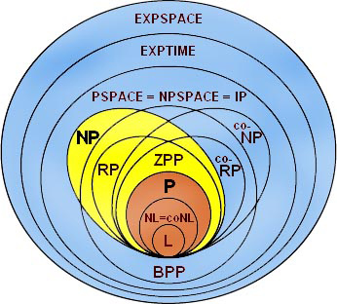
Complexity class diagram

Slide 120
A couple complexity classes we won’t see:
EXPTIME
Deterministic exponential time
NEXPTIME
Non-Deterministic exponential time
PSPACE
Deterministic Polynomial Space
NPSPACE
Non-Deterministic Polynomial Space
EXPSPACE
Deterministic Exponential Space
NEXPSPACE
Non-Deterministic Exponential Space

Slide 121
A couple complexity classes we won’t see:
PSPACE
Deterministic Polynomial Space
NPSPACE
Non-Deterministic Polynomial Space
EXPSPACE
Deterministic Exponential Space
NEXPSPACE
Non-Deterministic Exponential Space
PSPACE = NPSPACE and EXPSPACE = NEXPSPACE
WOAH! That’s pretty cool!

Slide 122
Last two (I swear):
BPP
Bounded Error Probabilistic Polynomial Time
Solved by a probabilistic TM in polynomial time
Returns the incorrect answer at MOST 1/3 of the time
ZPP
Zero Error Probabilistic Polynomial Time
Has a couple equivalent definitions, we’ll go with this one:
Always returns the correct answer YES or NO
Average running time polynomial (though sometimes is much longer)

