Slide 1
Artificial Intelligence Algorithms
CS 4102: Algorithms
Spring 2014
Mark Floryan

Slide 2
A* Pathfinding

Slide 3

Introduction
Almost every game requires pathfinding
Agents must be able to find their way around the game world
Pathfinding is not a trivial problem
The fastest and most efficient pathfinding techniques tend to consume a great deal of resources

Slide 4
Topics we’ll cover
Map types
Grids
Waypoint graphs
Navigation meshes
Algorithms
Random-trace
Breadth-first
Best-fit
Dijkstra
A*

Slide 5

Representing the Search Space
Agents need to know where they can move
Search space should represent either
Clear routes that can be traversed
Or the entire walkable surface
Search space typically doesn’t represent:
Small obstacles or moving objects
Use ray-tracing to deal with these, but we won’t discuss that
Most common search space representations:
Grids
Waypoint graphs
Navigation meshes

Slide 6
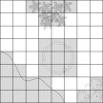
Grids | Characteristics of Grids
2D grids – intuitive world representation
Works well for many games including some 3D games such as Warcraft III
Each cell is flagged
Passable or impassable
Each object in the world can occupy one or more cells
Fast look-up
Easy access to neighboring cells
Complete representation of the level

Slide 7
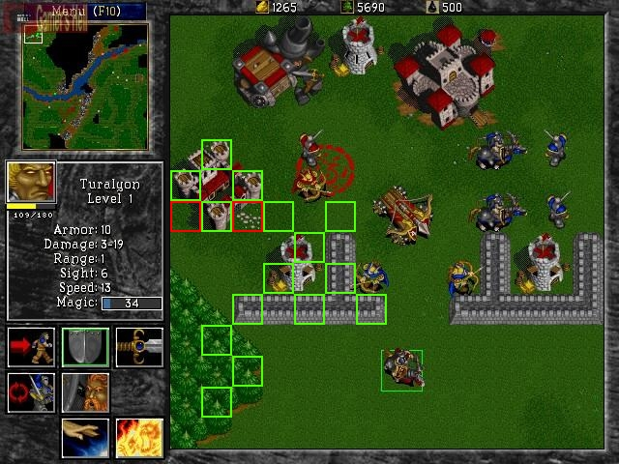
Example of 2D Grid

Slide 8
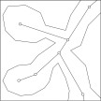
Waypoint Graph | Characteristics of
A waypoint graph specifies lines/routes that are “safe” for traversing
Each line (or link) connects exactly two waypoints
Waypoint node can be connected to any number of other waypoint nodes
Waypoint graph can easily represent arbitrary 3D levels
Can incorporate auxiliary information
Such as ladders and jump pads
Incomplete representation of the level

Slide 9
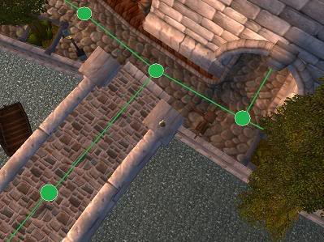
Waypoint Graph | Example

Slide 10
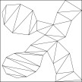
Navigation Meshes | Characteristics of
Combination of grids and waypoint graphs
Every node of a navigation mesh represents a convex polygon (or area)
As opposed to a single position in a waypoint node
Advantage of convex polygon
Any two points inside can be connected without crossing an edge of the polygon
Navigation mesh can be thought of as a walkable surface
Complete representation of the level
Ties pathfinding and collision detection together
Can easily be used for 2D and 3D games

Slide 11
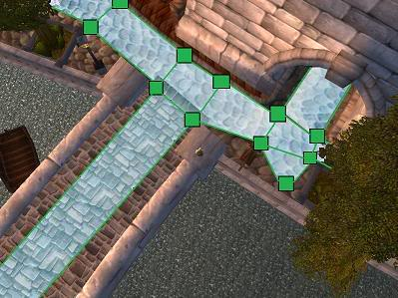
Navigation Meshes | Characteristics of

Slide 12
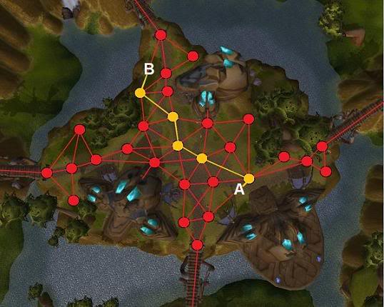
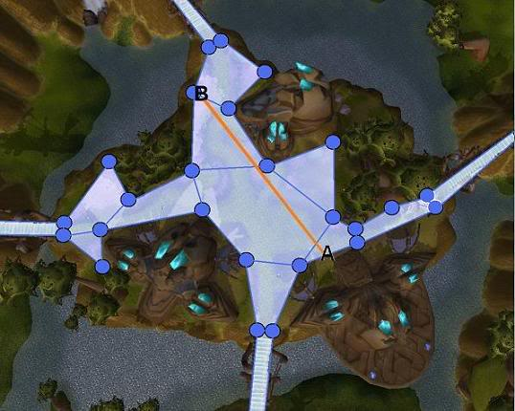
Another Comparison

Slide 13
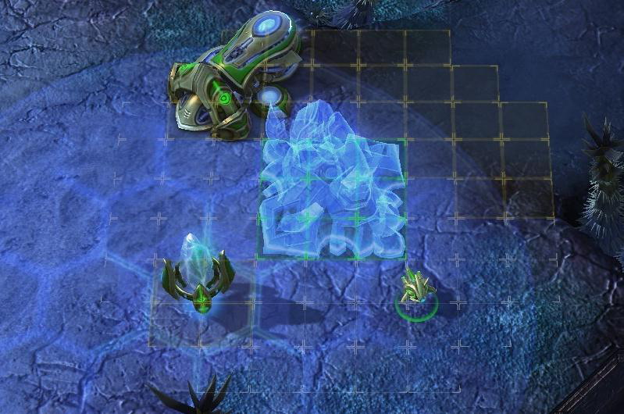
Another Example

Slide 14
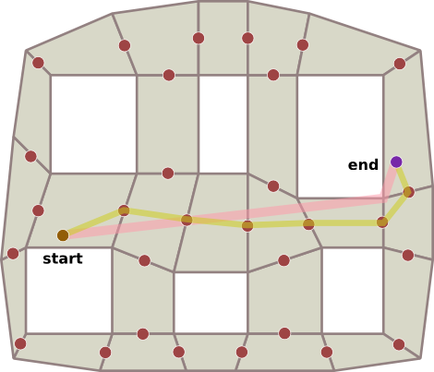
Path Smoothing
Use more points within each mesh
Smooth the path out
For each point on path, see if you can travel straight to point i+2, if so remove i+1 point.
Continue until you cannot optimize further.

Slide 15

Searching for a Path | Criteria for Evaluating Pathfinding Algorithms
Quality of final path
Resource consumption during search
CPU and memory
Whether it is a complete algorithm
A complete algorithm guarantees to find a path if one exists
A path is a list of cells, points, or nodes that an agent must traverse
A pathfinding algorithm finds a path
From a start position to a goal position
The following pathfinding algorithms can be used on
Grids
Waypoint graphs
Navigation meshes

Slide 16

Random Trace
How will Random Trace do on the following maps?
Not a complete algorithm
Found paths are unlikely to be optimal
Consumes very little memory
Simple algorithm
Agent moves towards goal
If goal reached, then done
If obstacle
Trace around the obstacle clockwise or counter-clockwise (pick randomly) until free path towards goal
Repeat procedure until goal reached

Slide 17

Understanding A*
All of the following algorithms use two lists
The open list
The closed list
Open list keeps track of promising nodes
When a node is examined from open list
Taken off open list and checked to see whether it has reached the goal
If it has not reached the goal
Used to create additional nodes
Then placed on the closed list

Slide 18

Overall Structure of the Algorithms
1. Create start point node – push onto open list
2. While open list is not empty
A. Pop node from open list (call it currentNode)
B. If currentNode corresponds to goal, break from step 2
C. Create new nodes (successors nodes) for cells around currentNode and push them onto open list
D. Put currentNode onto closed list

Slide 19

Breadth-First | Characteristics of
Finds a path from the start to the goal by examining the search space ply-by-ply
Exhaustive search
Systematic, but not clever
Consumes substantial amount of CPU and memory
Guarantees to find paths that have fewest number of nodes in them
Not necessarily the shortest distance!
Complete algorithm

Slide 20

Best-First
Uses problem specific knowledge to speed up the search process
Head straight for the goal
Computes the distance of every node to the goal
Uses the distance (or heuristic cost) as a priority value to determine the next node that should be brought out of the open list

Slide 21

Best-First | Characteristics of
Situation where Best-First finds a suboptimal path
Heuristic search
Uses fewer resources than Breadth-First
Tends to find good paths
No guarantee to find most optimal path
Complete algorithm

Slide 22

Dijkstra | Characteristics of
Disregards distance to goal
Keeps track of the cost of every path
No guessing
Computes accumulated cost paid to reach a node from the start
Uses the cost (called the given cost) as a priority value to determine the next node that should be brought out of the open list
Exhaustive search
At least as resource intensive as Breadth-First
Always finds the most optimal path
Complete algorithm

Slide 23

A* | Characteristics of
Uses both heuristic cost and given cost to order the open list
Final Cost = Given Cost + (Heuristic Cost * Heuristic Weight)
Avoids Best-First trap!
Heuristic search
On average, uses fewer resources than Dijkstra and Breadth-First
Admissible heuristic
Can never overestimate the cost
guarantees it will find the most optimal path
Complete algorithm

Slide 24
Thinking about these algorithms
Each algorithm uses the following function to determing the “priority” of each node:
P(x) = w1*f(x) + w2*g(x)
w1 & w2 are int weights
f(x) is distance traveled so far to node x
g(x) is heuristic guess as to distance from this node to goal.
Breadth-first search
f(x) is num hops to node x
w2 = 0
Dijkstra’s Algo:
w1 = 1, w2 = 1
f(x) is distance to node x
g(x) is smallest outgoing edge to non-visited node
Best-first search:
w1 = 0, w2 = 1
g(x) is heuristic guess of distance to goal
A*
w1 > 0, w2 > 0
f(x) distance to node x
g(x) heuristic guess of distance to goal
g(x) <= actual distance to goal

Slide 25

Summary
Two key aspects of pathfinding:
Representing the search space
Searching for a path

Slide 26
Genetic Algorithms

Slide 27
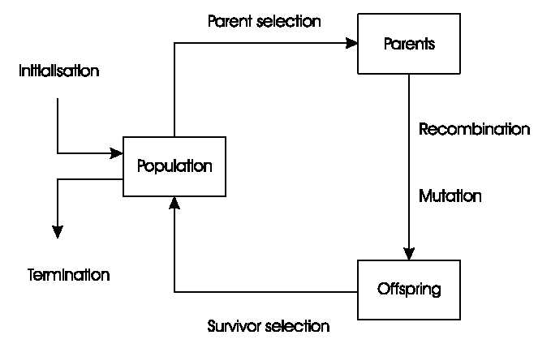
General Scheme of GAs

Slide 28
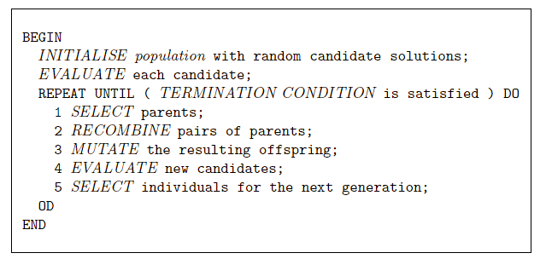
Pseudo-code for typical GA

Slide 29
Representations
Candidate solutions (individuals) exist in phenotype space
They are encoded in chromosomes, which exist in genotype space
Encoding : phenotype=> genotype
Decoding : genotype=> phenotype
Chromosomes contain genes, which are in (usually fixed) positions called loci (sing. locus) and have a value (allele)
In order to find the global optimum, every feasible solution must be represented in genotype space
Short version: You must be able to represent ALL solutions to the problem simply (say…as a string)

Slide 30
Evaluation (Fitness) Function
Represents the requirements that the population should adapt to
a.k.a. quality function or objective function
Assigns a single real-valued fitness to each phenotype which forms the basis for selection
So the more discrimination (different values) the better
Typically we talk about fitness being maximised
Some problems may be best posed as minimisation problems, but conversion is trivial
Short version: fitness function evaluates HOW GOOD a solution you’ve seen solves the given problem. Higher values mean the solution is closer to optimal.

Slide 31
Population
Holds (representations of) possible solutions
Usually has a fixed size and is a multi-set of genotypes
Selection operators usually take whole population into account i.e., reproductive probabilities are relative to current generation
Diversity of a population refers to the number of different fitnesses / phenotypes / genotypes present (note not the same thing)

Slide 32
Parent Selection Mechanism
Assigns variable probabilities of individuals acting as parents depending on their fitnesses
Usually probabilistic
high quality solutions more likely to become parents than low quality
but not guaranteed
even worst in current population usually has non-zero probability of becoming a parent
This stochastic nature can aid escape from local optima
What does this mean?? You should understand this idea. Only matters when search space is VERY large, otherwise we could just exhaustively search all possible offspring and return max fitness

Slide 33
Variation Operators
Role is to generate new candidate solutions
Usually divided into two types according to their arity (number of inputs):
Arity 1 : mutation operators
Arity >1 : Recombination operators
Arity = 2 typically called crossover

Slide 34
Mutation
Acts on one genotype and delivers another
Element of randomness is essential and differentiates it from other unary heuristic operators
Importance ascribed depends on representation and dialect:
Binary GAs – background operator responsible for preserving and introducing diversity
EP for FSM’s/ continuous variables – only search operator
GP – hardly used
May guarantee connectedness of search space and hence convergence proofs

Slide 35
Recombination
Merges information from parents into offspring
Choice of what information to merge is stochastic
Most offspring may be worse, or the same as the parents
Hope is that some are better by combining elements of genotypes that lead to good traits
Principle has been used for millennia by breeders of plants and livestock

Slide 36
Survivor Selection
a.k.a. replacement
Most EAs use fixed population size so need a way of going from (parents + offspring) to next generation
Often deterministic
Fitness based : e.g., rank parents+offspring and take best
Age based: make as many offspring as parents and delete all parents
Sometimes do combination (elitism)

Slide 37
Initialization / Termination
Initialization usually done at random,
Need to ensure even spread and mixture of possible allele values
Can include existing solutions, or use problem-specific heuristics, to “seed” the population
Termination condition checked every generation
Reaching some (known/hoped for) fitness
Reaching some maximum allowed number of generations
Reaching some minimum level of diversity
Reaching some specified number of generations without fitness improvement

Slide 38
Example: the 8 queens problem
Place 8 queens on an 8x8 chessboard in
such a way that they cannot check each other

Slide 39
The 8 queens problem: representation
Phenotype:
a board configuration
Genotype:
a permutation of
the numbers 1 - 8
Obvious mapping
1
3
5
2
6
4
7
8

Slide 40
8 Queens Problem: Fitness evaluation
Penalty of one queen:
the number of queens she can check.
Penalty of a configuration:
the sum of the penalties of all queens.
Note: penalty is to be minimized
Fitness of a configuration:
inverse penalty to be maximized

Slide 41
The 8 queens problem: Mutation
Small variation in one permutation, e.g.:
swapping values of two randomly chosen positions,
1
3
5
2
6
4
7
8
1
3
7
2
6
4
5
8

Slide 42
The 8 queens problem: Recombination
Combining two permutations into two new permutations:
choose random crossover point
copy first parts into children
create second part by inserting values from other parent:
in the order they appear there
beginning after crossover point
skipping values already in child
1
3
5
2
6
4
7
8
1
3
5
4
2
8
7
6
8
7
6
5
4
3
2
1
8
7
6
2
4
1
3
5

Slide 43
The 8 queens problem: Selection
Parent selection:
Pick 5 parents and take best two to undergo crossover
Survivor selection (replacement)
insert the two new children into the population
sort the whole population by decreasing fitness
delete the worst two

Slide 44
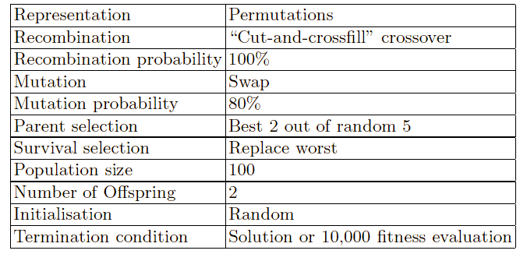
8 Queens Problem: summary
Note that this is only one possible
set of choices of operators and parameters

