Slide 1
Course Reflection
Aaron Bloomfield
CS 4102
Spring 2011

Slide 2
Course Objectives
Comprehend fundamental ideas in algorithm analysis, including: time and space complexity; identifying and counting basic operations; order classes and asymptotic growth; lower bounds; optimal algorithms.
Apply these fundamental ideas to analyze and evaluate important problems and algorithms in computing, including search, sorting, graph problems, and optimization problems.
Apply appropriate mathematical techniques in evaluation and analysis, including limits, logarithms, exponents, summations, recurrence relations, lower-bounds proofs and other proofs.
Comprehend, apply and evaluate the use of algorithm design techniques such as divide and conquer, the greedy approach, dynamic programming, and exhaustive or brute-force solutions.
Comprehend the fundamental ideas related to the problem classes NP and NP-complete, including their definitions, their theoretical implications, Cook's theorem, etc. Be exposed to the design of polynomial reductions used to prove membership in NP-complete.

Slide 3
What was new this spring
The Collab gradebook applet
My second time teaching this course, so the lectures ran much smoother
The advanced data structures talks
Almost all new homeworks (except W1, P1, and MaxFlow)

Slide 4
HW comments
W1: LaTeX
W2: Greedy
W3: Divide & Conquer
W4: Dynamic Programming
W5: Graphs
W6: NPC, part 1
W7: DP & NPC
P1: Change (intro)
P2: Moving (greedy)
P3: Trading (D&C)
P4: Drainage (DP)
P5: Classes (MaxFlow)
P6: Paths (pathfinding)

Slide 5
What didn’t work well
The textbook was not as useful as I would have liked, but better than last semester
And the challenge of using textbook material in lecture
How the programming homeworks were judged caused some consternation
The exams were a bit more difficult than intended
Keeping the material interesting is an ongoing challenge, especially at 9 a.m. M/W/F

Slide 6
What did work well
The gradebook applet
Submission script! This saved a HUGE amount of TA time, and streamlined submission and grading
Grading was kept up with very well!
The late day policy was much more sane this semester…
Behind-the-scenes stuff: TA management, organization, etc.

Slide 7
Did I push too hard?
I got as many “things are going great” comments as “things are going terrible”
Part of the issues were how the programming homeworks were graded
I think this class is harder than 4102 when taught by Horton or Cohoon, but easier than when taught by Shelat
So I think I got a good balance…

Slide 8
Changes for next spring
I’m teaching game design in the fall and algorithms again in the spring
All new assignments!
More improvements to the gradebook
Might just ditch the textbook – am considering using only online resources

Slide 9
Let me know your comments!
Please send me your feedback!
Either by e-mail or anonymously or on the course surveys
Please fill out the course surveys!

Slide 10
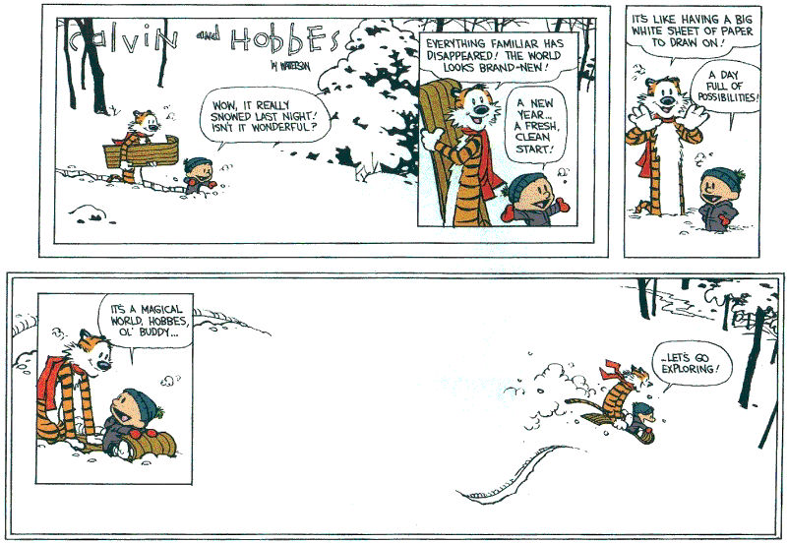
Have a great summer break!

