Slide 1
Genetic Algorithms
Chapter 3

Slide 2
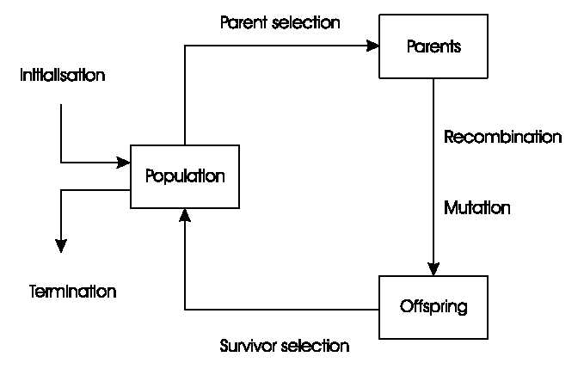
General Scheme of GAs

Slide 3
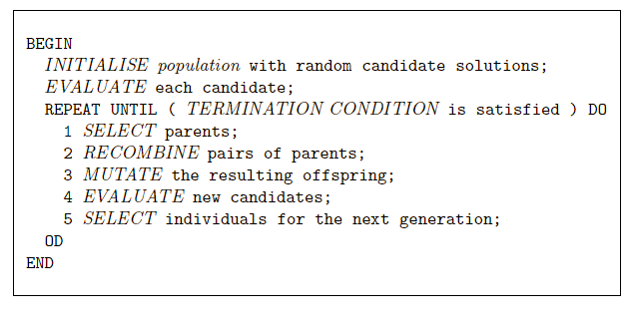
Pseudo-code for typical GA

Slide 4
Representations
Candidate solutions (individuals) exist in phenotype space
They are encoded in chromosomes, which exist in genotype space
Encoding : phenotype=> genotype
Decoding : genotype=> phenotype
Chromosomes contain genes, which are in (usually fixed) positions called loci (sing. locus) and have a value (allele)
In order to find the global optimum, every feasible solution must be represented in genotype space

Slide 5
Evaluation (Fitness) Function
Represents the requirements that the population should adapt to
a.k.a. quality function or objective function
Assigns a single real-valued fitness to each phenotype which forms the basis for selection
So the more discrimination (different values) the better
Typically we talk about fitness being maximised
Some problems may be best posed as minimisation problems, but conversion is trivial

Slide 6
Population
Holds (representations of) possible solutions
Usually has a fixed size and is a multi-set of genotypes
Selection operators usually take whole population into account i.e., reproductive probabilities are relative to current generation
Diversity of a population refers to the number of different fitnesses / phenotypes / genotypes present (note not the same thing)

Slide 7
Parent Selection Mechanism
Assigns variable probabilities of individuals acting as parents depending on their fitnesses
Usually probabilistic
high quality solutions more likely to become parents than low quality
but not guaranteed
even worst in current population usually has non-zero probability of becoming a parent
This stochastic nature can aid escape from local optima

Slide 8
Variation Operators
Role is to generate new candidate solutions
Usually divided into two types according to their arity (number of inputs):
Arity 1 : mutation operators
Arity >1 : Recombination operators
Arity = 2 typically called crossover

Slide 9
Mutation
Acts on one genotype and delivers another
Element of randomness is essential and differentiates it from other unary heuristic operators
Importance ascribed depends on representation and dialect:
Binary GAs – background operator responsible for preserving and introducing diversity
EP for FSM’s/ continuous variables – only search operator
GP – hardly used
May guarantee connectedness of search space and hence convergence proofs

Slide 10
Recombination
Merges information from parents into offspring
Choice of what information to merge is stochastic
Most offspring may be worse, or the same as the parents
Hope is that some are better by combining elements of genotypes that lead to good traits
Principle has been used for millennia by breeders of plants and livestock

Slide 11
Survivor Selection
a.k.a. replacement
Most EAs use fixed population size so need a way of going from (parents + offspring) to next generation
Often deterministic
Fitness based : e.g., rank parents+offspring and take best
Age based: make as many offspring as parents and delete all parents
Sometimes do combination (elitism)

Slide 12
Initialization / Termination
Initialization usually done at random,
Need to ensure even spread and mixture of possible allele values
Can include existing solutions, or use problem-specific heuristics, to “seed” the population
Termination condition checked every generation
Reaching some (known/hoped for) fitness
Reaching some maximum allowed number of generations
Reaching some minimum level of diversity
Reaching some specified number of generations without fitness improvement

Slide 13
Example: the 8 queens problem
Place 8 queens on an 8x8 chessboard in
such a way that they cannot check each other

Slide 14
The 8 queens problem: representation
Phenotype:
a board configuration
Genotype:
a permutation of
the numbers 1 - 8
Obvious mapping
1
3
5
2
6
4
7
8

Slide 15
8 Queens Problem: Fitness evaluation
Penalty of one queen:
the number of queens she can check.
Penalty of a configuration:
the sum of the penalties of all queens.
Note: penalty is to be minimized
Fitness of a configuration:
inverse penalty to be maximized

Slide 16
The 8 queens problem: Mutation
Small variation in one permutation, e.g.:
swapping values of two randomly chosen positions,
1
3
5
2
6
4
7
8
1
3
7
2
6
4
5
8

Slide 17
The 8 queens problem: Recombination
Combining two permutations into two new permutations:
choose random crossover point
copy first parts into children
create second part by inserting values from other parent:
in the order they appear there
beginning after crossover point
skipping values already in child
1
3
5
2
6
4
7
8
1
3
5
4
2
8
7
6
8
7
6
5
4
3
2
1
8
7
6
2
4
1
3
5

Slide 18
The 8 queens problem: Selection
Parent selection:
Pick 5 parents and take best two to undergo crossover
Survivor selection (replacement)
insert the two new children into the population
sort the whole population by decreasing fitness
delete the worst two

Slide 19
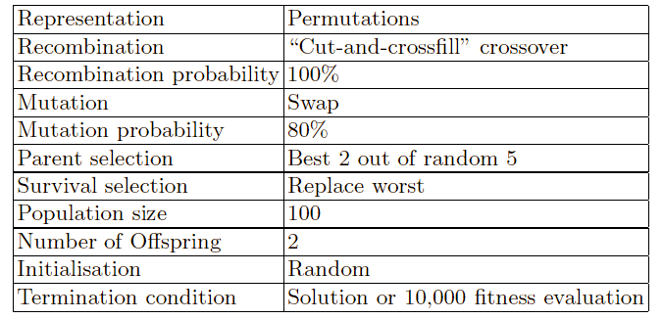
8 Queens Problem: summary
Note that this is only one possible
set of choices of operators and parameters

Slide 20
GA Quick Overview
Developed: USA in the 1970’s
Early names: J. Holland, K. DeJong, D. Goldberg
Typically applied to:
discrete optimization (recently continuous also)
Attributed features:
not too fast
good heuristic for combinatorial problems
Special Features:
Traditionally emphasizes combining information from good parents (crossover)
many variants, e.g., reproduction models, operators

Slide 21
Genetic algorithms
Holland’s original GA is now known as the simple genetic algorithm (SGA)
Other GAs use different:
Representations
Mutations
Crossovers
Selection mechanisms

Slide 22
SGA technical summary tableau
Representation | Binary strings
Recombination | N-point or uniform
Mutation | Bitwise bit-flipping with fixed probability
Parent selection | Fitness-Proportionate
Survivor selection | All children replace parents
Speciality | Emphasis on crossover

Slide 23
Representation
Phenotype space
Genotype space = {0,1}^{L}
Encoding
(representation)
10010001
10010010
010001001
011101001
Decoding
(inverse representation)

Slide 24
SGA reproduction cycle
Select parents for the mating pool
(size of mating pool = population size)
Shuffle the mating pool
For each consecutive pair apply crossover with probability p_{c} , otherwise copy parents
For each offspring apply mutation (bit-flip with probability p_{m} independently for each bit)
Replace the whole population with the resulting offspring

Slide 25
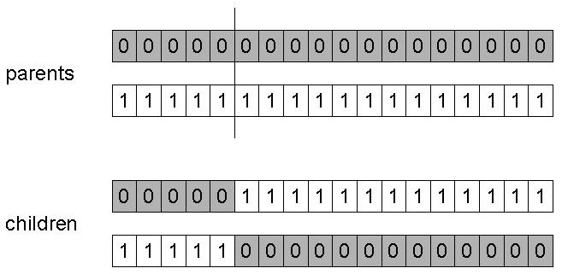
SGA operators: 1-point crossover
Choose a random point on the two parents
Split parents at this crossover point
Create children by exchanging tails
P_{c} typically in range (0.6, 0.9)

Slide 26
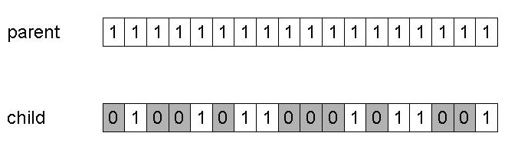
SGA operators: mutation
Alter each gene independently with a probability p_{m}
p_{m} is called the mutation rate
Typically between 1/pop_size and 1/ chromosome_length

Slide 27
SGA operators: Selection
Main idea: better individuals get higher chance
Chances proportional to fitness
Implementation: roulette wheel technique
Assign to each individual a part of the roulette wheel
Spin the wheel n times to select n individuals
1/6 = 17%
B
fitness(A) = 3
A
C
fitness(B) = 1
3/6 = 50%
2/6 = 33%
fitness(C) = 2

Slide 28
An example after Goldberg ‘89 (1)
Simple problem: max x² over {0,1,…,31}
GA approach:
Representation: binary code, e.g. 01101 ↔ 13
Population size: 4
1-point xover, bitwise mutation
Roulette wheel selection
Random initialization
We show one generational cycle done by hand

Slide 29
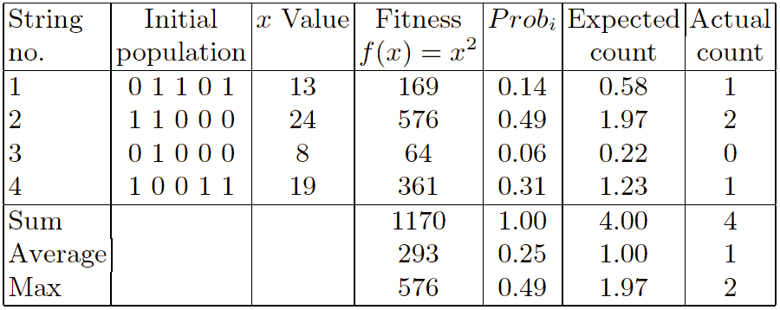
x² example: selection

Slide 30
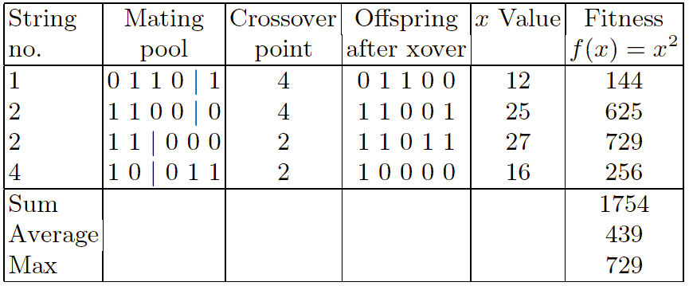
X² example: crossover

Slide 31
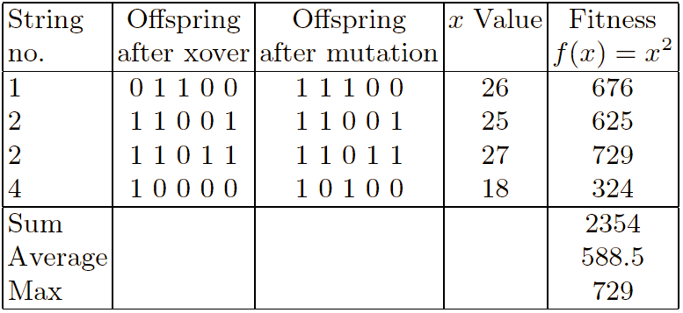
X² example: mutation

Slide 32
The simple GA
Has been subject of many (early) studies
still often used as benchmark for novel GAs!
Shows many shortcomings, e.g.
Representation is too restrictive
Mutation & crossovers only applicable for bit-string & integer representations
Selection mechanism sensitive for converging populations with close fitness values
Generational population model (step 5 in SGA repr. cycle) can be improved with explicit survivor selection

Slide 33
Alternative Crossover Operators
Performance with 1 Point Crossover depends on the order that variables occur in the representation
more likely to keep together genes that are near each other
Can never keep together genes from opposite ends of string
This is known as Positional Bias
Can be exploited if we know about the structure of our problem, but this is not usually the case

Slide 34
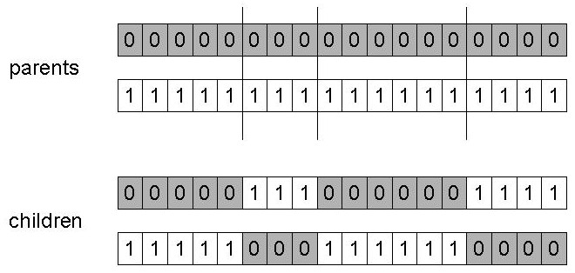
n-point crossover
Choose n random crossover points
Split along those points
Glue parts, alternating between parents
Generalisation of 1 point (still some positional bias)

Slide 35
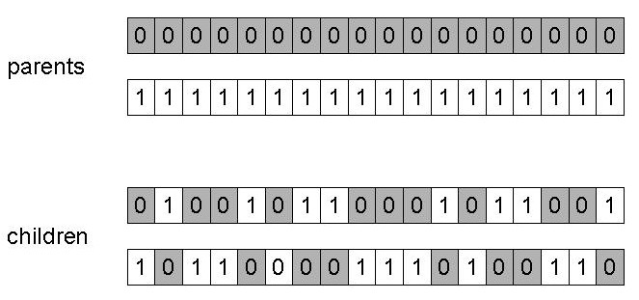
Uniform crossover
Assign 'heads' to one parent, 'tails' to the other
Flip a coin for each gene of the first child
Make an inverse copy of the gene for the second child
Inheritance is independent of position

Slide 36
Other representations
Gray coding of integers (still binary chromosomes)
Gray coding is a mapping that “attempts” to improve causality (small changes in the genotype cause small changes in the phenotype) unlike binary coding. “Smoother” genotype-phenotype mapping makes life easier for the GA
Nowadays it is generally accepted that it is better to encode numerical variables directly as
Integers
Floating point variables

Slide 37
Integer representations
Some problems naturally have integer variables, e.g. image processing parameters
Others take categorical values from a fixed set e.g. {blue, green, yellow, pink}
N-point / uniform crossover operators work
Extend bit-flipping mutation to make
“creep” i.e. more likely to move to similar value
Random choice (esp. categorical variables)
For ordinal problems, it is hard to know correct range for creep, so often use two mutation operators in tandem

Slide 38
Permutation Representations
Ordering/sequencing problems form a special type
Task is (or can be solved by) arranging some objects in a certain order
Example: scheduling algorithm: important thing is which tasks occur before others (order)
Example: Travelling Salesman Problem (TSP) : important thing is which elements occur next to each other (adjacency)
These problems are generally expressed as a permutation:
if there are n variables then the representation is as a list of n integers, each of which occurs exactly once

Slide 39
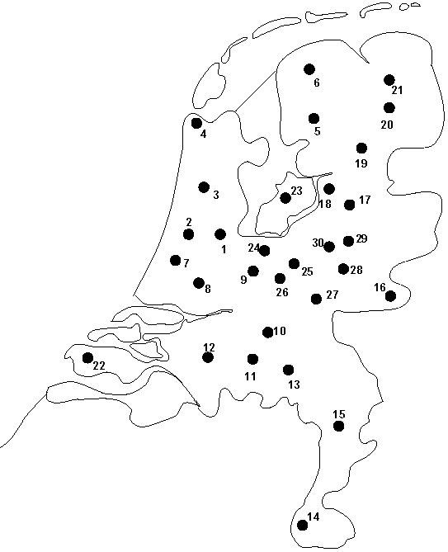
Permutation representation: TSP example
Problem:
Given n cities
Find a complete tour with minimal length
Encoding:
Label the cities 1, 2, … , n
One complete tour is one permutation (e.g. for n =4 [1,2,3,4], [3,4,2,1] are OK)
Search space is BIG:
for 30 cities there are 30! ≈ 10³² possible tours

Slide 40
Mutation operators for permutations
Normal mutation operators lead to inadmissible solutions
e.g. bit-wise mutation : let gene i have value j
changing to some other value k would mean that k occurred twice and j no longer occurred
Therefore must change at least two values
Mutation parameter now reflects the probability that some operator is applied once to the whole string, rather than individually in each position

Slide 41
Insert Mutation for permutations
Pick two allele values at random
Move the second to follow the first, shifting the rest along to accommodate
Note that this preserves most of the order and the adjacency information

Slide 42
Swap mutation for permutations
Pick two alleles at random and swap their positions
Preserves most of adjacency information (4 links broken), disrupts order more

Slide 43
Inversion mutation for permutations
Pick two alleles at random and then invert the sub-string between them.
Preserves most adjacency information (only breaks two links) but disruptive of order information

Slide 44
Scramble mutation for permutations
Pick a subset of genes at random
Randomly rearrange the alleles in those positions
(note subset does not have to be contiguous)

Slide 45
Crossover operators for permutations
“Normal” crossover operators will often lead to inadmissible solutions
Many specialised operators have been devised which focus on combining order or adjacency information from the two parents
1 2 3 4 5
1 2 3 2 1
5 4 3 2 1
5 4 3 4 5

Slide 46
Order crossover
Idea is to preserve relative order of elements
Informal procedure:
1. Choose an arbitrary part from the first parent
2. Copy this part to the first child
3. Copy the numbers that are not in the first part, to the first child:
starting right from cut point of the copied part,
using the order of the second parent
and wrapping around at the end
4. Analogous for the second child, with parent roles reversed

Slide 47
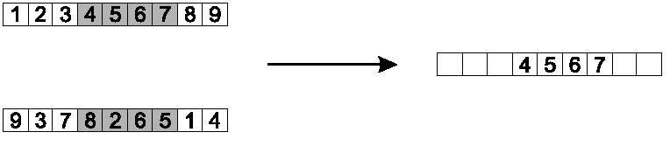
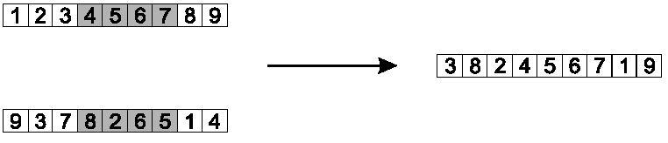
Order crossover example
Copy randomly selected set from first parent
Copy rest from second parent in order 1,9,3,8,2

Slide 48
Partially Mapped Crossover (PMX)
Informal procedure for parents P1 and P2:
Choose random segment and copy it from P1
Starting from the first crossover point look for elements in that segment of P2 that have not been copied
For each of these i look in the offspring to see what element j has been copied in its place from P1
Place i into the position occupied by j in P2, since we know that we will not be putting j there (as is already in offspring)
If the place occupied by j in P2 has already been filled in the offspring k, put i in the position occupied by k in P2
Having dealt with the elements from the crossover segment, the rest of the offspring can be filled from P2.
Second child is created analogously

Slide 49
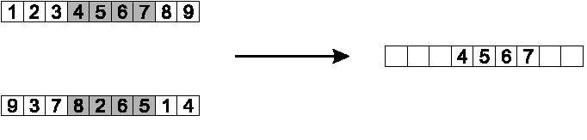
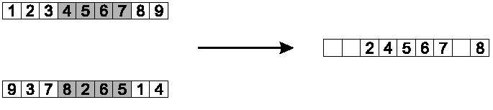
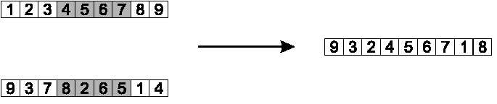
PMX example
Step 1
Step 2
Step 3

Slide 50
Cycle crossover
Basic idea:
Each allele comes from one parent together with its position.
Informal procedure:
1. Make a cycle of alleles from P1 in the following way.
(a) Start with the first allele of P1.
(b) Look at the allele at the same position in P2.
(c) Go to the position with the same allele in P1.
(d) Add this allele to the cycle.
(e) Repeat step b through d until you arrive at the first allele of P1.
2. Put the alleles of the cycle in the first child on the positions they have in the first parent.
3. Take next cycle from second parent

Slide 51
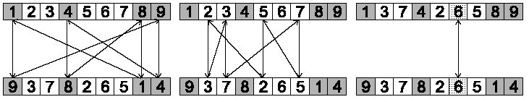
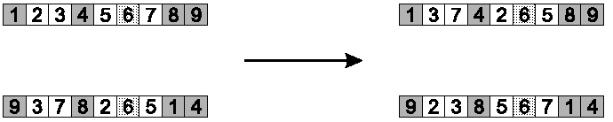
Cycle crossover example
Step 1: identify cycles
Step 2: copy alternate cycles into offspring

Slide 52
Population Models
SGA uses a Generational model:
each individual survives for exactly one generation
the entire set of parents is replaced by the offspring
At the other end of the scale are Steady-State models:
one offspring is generated per generation,
one member of population replaced,
Generation Gap
the proportion of the population replaced
1.0 for GGA, 1/pop_size for SSGA

Slide 53
Fitness Based Competition
Selection can occur in two places:
Selection from current generation to take part in mating (parent selection)
Selection from parents + offspring to go into next generation (survivor selection)
Selection operators work on whole individual
i.e. they are representation-independent
Distinction between selection
operators: define selection probabilities
algorithms: define how probabilities are implemented

Slide 54
Implementation example: SGA
Expected number of copies of an individual i
E( n_{i} ) = μ • f(i)/ ⟨∑ f⟩
(μ = pop.size, f(i) = fitness of i, ⟨∑ f⟩ total fitness in pop.)
Roulette wheel algorithm:
Given a probability distribution, spin a 1-armed wheel n times to make n selections
No guarantees on actual value of n_{i}
Baker’s SUS algorithm:
n evenly spaced arms on wheel and spin once
Guarantees floor(E( n_{i} ) ) ≤ n_{i} ≤ ceil(E( n_{i} ) )

Slide 55
Fitness-Proportionate Selection
Problems include
One highly fit member can rapidly take over if rest of population is much less fit: Premature Convergence
At end of runs when fitnesses are similar, lose selection pressure
Highly susceptible to function transposition
Scaling can fix last two problems
Windowing: f’(i) = f(i) - β ^{t}
where β is worst fitness in this (last n) generations
Sigma Scaling: f’(i) = max( f(i) – (⟨ f ⟩ - c • σ_{f} ), 0.0)
where c is a constant, usually 2.0

Slide 56
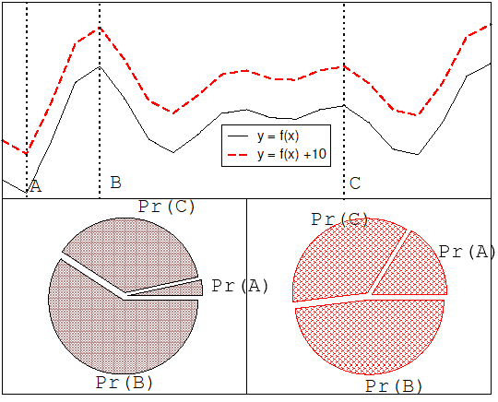
Function transposition for FPS

Slide 57
Rank – Based Selection
Attempt to remove problems of FPS by basing selection probabilities on relative rather than absolute fitness
Rank population according to fitness and then base selection probabilities on rank where fittest has rank μ and worst rank 1
This imposes a sorting overhead on the algorithm, but this is usually negligible compared to the fitness evaluation time

Slide 58
Linear Ranking
Parameterised by factor s: 1.0 < s ≤ 2.0
measures advantage of best individual
in GGA this is the number of children allotted to it

Slide 59
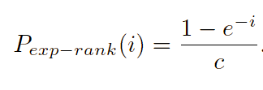
Exponential Ranking
Linear Ranking is limited to selection pressure
Exponential Ranking can allocate more than 2 copies to fittest individual
Normalize constant factor c according to population size

Slide 60
Tournament Selection
All methods above rely on global population statistics
Could be a bottleneck esp. on parallel machines
Relies on presence of external fitness function which might not exist: e.g. evolving game players
Informal Procedure:
Pick k members at random then select the best of these
Repeat to select more individuals

Slide 61
Tournament Selection 2
Probability of selecting i will depend on:
Rank of i
Size of sample k
higher k increases selection pressure
Whether contestants are picked with replacement
Picking without replacement increases selection pressure
Whether fittest contestant always wins (deterministic) or this happens with probability p
For k = 2, time for fittest individual to take over population is the same as linear ranking with s = 2 • p

Slide 62
Survivor Selection
Most of methods above used for parent selection
Survivor selection can be divided into two approaches:
Age-Based Selection
e.g. SGA
In SSGA can implement as “delete-random” (not recommended) or as first-in-first-out (a.k.a. delete-oldest)
Fitness-Based Selection
Using one of the methods above or

Slide 63
Two Special Cases
Elitism
Widely used in both population models (GGA, SSGA)
Always keep at least one copy of the fittest solution so far
GENITOR: a.k.a. “delete-worst”
From Whitley’s original Steady-State algorithm (he also used linear ranking for parent selection)
Rapid takeover : use with large populations or “no duplicates” policy

