Slide 1
Graphs – Basic Review and BFS
Tom Horton, Mark Floryan
CLRS Chapter 22.1 and 22.2

Slide 2
Reminder: Lemmas

Slide 3
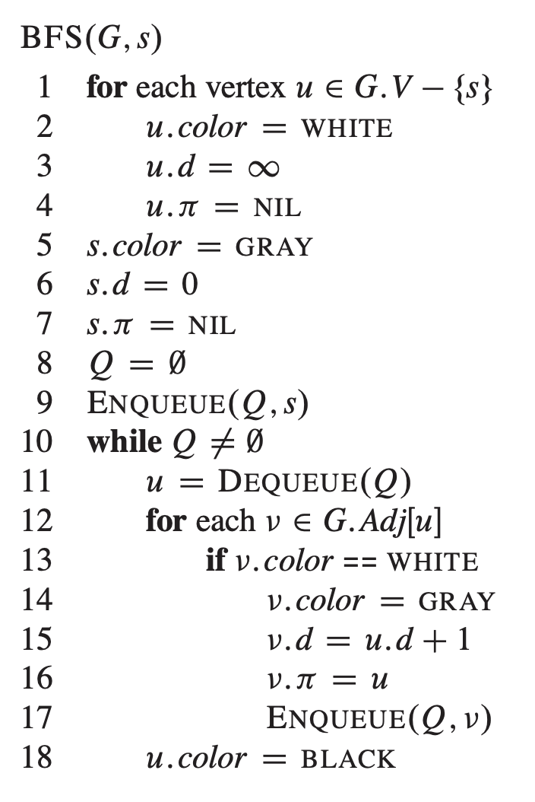
Breadth-first search implementation
Vertices here have some properties:
color = white/gray/black
d = distance from start node
pi = node through which d is achieved

Slide 4

Reminder: Lemma 1
Let G = (V,E) be a directed or undirected graph, and suppose BFS is run on G from a given source vertex $s∈V$, Then upon termination, for each vertex $v∈V$, the value v.d computed by BFS satisfies:
$v.d≥δ(s,v)$

Slide 5
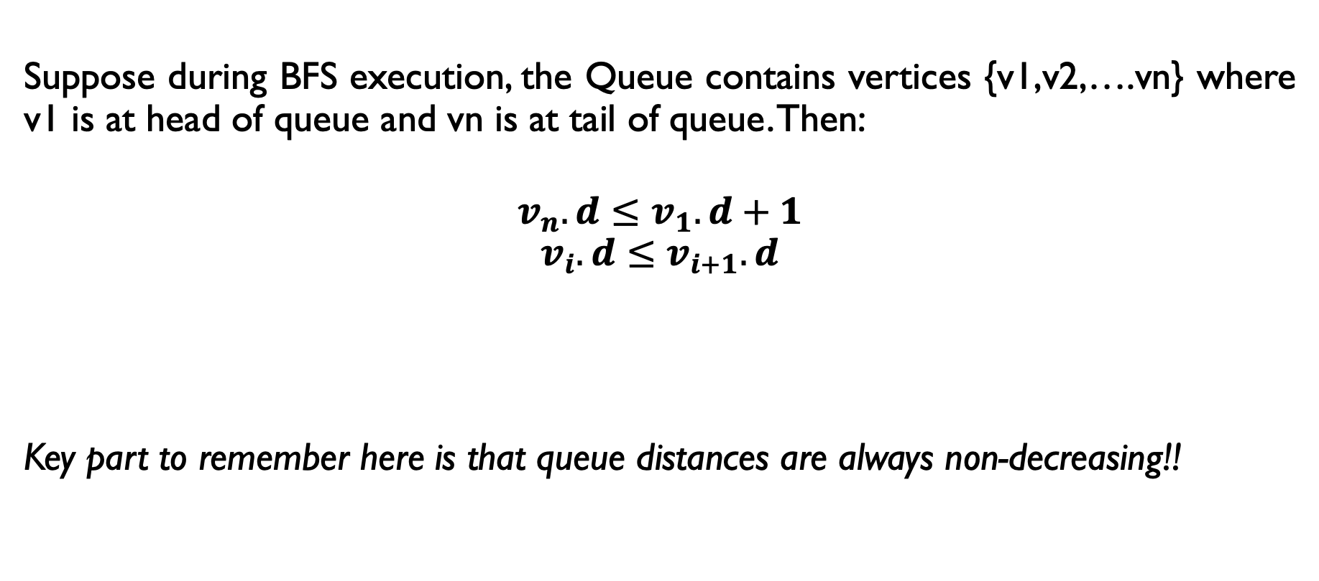
Reminder: Lemma 2
Suppose during BFS execution, the Queue contains vertices {v1,v2,….vn} where v1 is at head of queue and vn is at tail of queue. Then:
$$v_{n}.d≤v_{1}.d+1$$
$$v_{i}.d≤v_{i+1}.d$$
Key part to remember here is that queue distances are always non-decreasing!!

Slide 6
Correctness of BFS

Slide 7

Proof of Correctness
Claim:
Let G=(V,E) be a directed or undirected graph, and suppose that BFS is run on G from a given source vertex $s∈V$. Then, during its execution, BFS discovers every vertex $v∈V$ that is reachable from s, and upon termination $v.d=δ(s,v)$ for all $v∈V$.

Slide 8
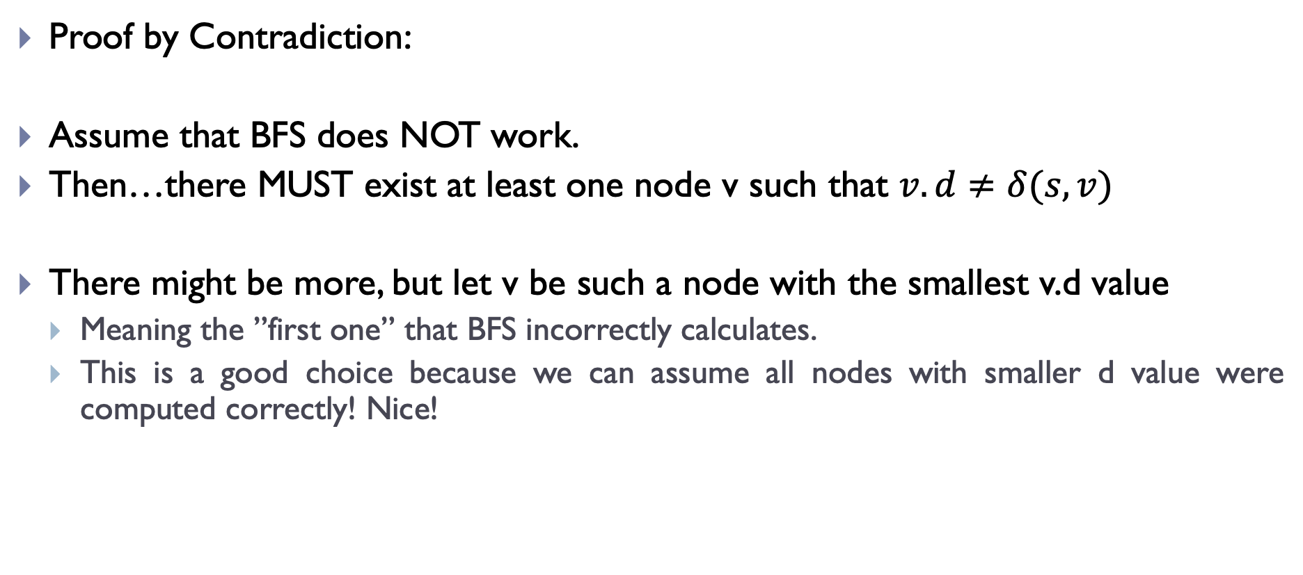
Proof of Correctness
Proof by Contradiction:
Assume that BFS does NOT work.
Then…there MUST exist at least one node v such that $v.d≠δ(s,v)$
There might be more, but let v be such a node with the smallest v.d value
Meaning the ”first one” that BFS incorrectly calculates.
This is a good choice because we can assume all nodes with smaller d value were computed correctly! Nice!

Slide 9

Proof of Correctness
So, this incorrectly calculated node v has the following property:
$$v.d>δ\left(s,v\right)=δ\left(s,u\right)+1=u.d+1$$
By definition of
optimal path
By how we chose
v
Because of Lemma 1!

Slide 10
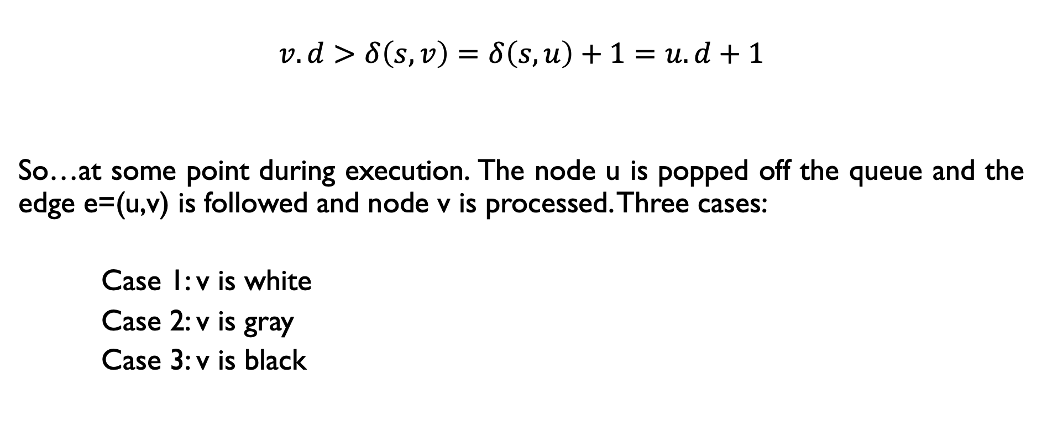
Proof of Correctness
$$v.d>δ\left(s,v\right)=δ\left(s,u\right)+1=u.d+1$$
So…at some point during execution. The node u is popped off the queue and the edge e=(u,v) is followed and node v is processed. Three cases:
Case 1: v is white
Case 2: v is gray
Case 3: v is black

Slide 11

Proof of Correctness
$$v.d>δ\left(s,v\right)=δ\left(s,u\right)+1=u.d+1$$
Case 1: v is white
If v is white, algorithm sets $v.d=u.d+1$ (line 15).
Contradiction! above formula shows $v.d>u.d+1$

Slide 12
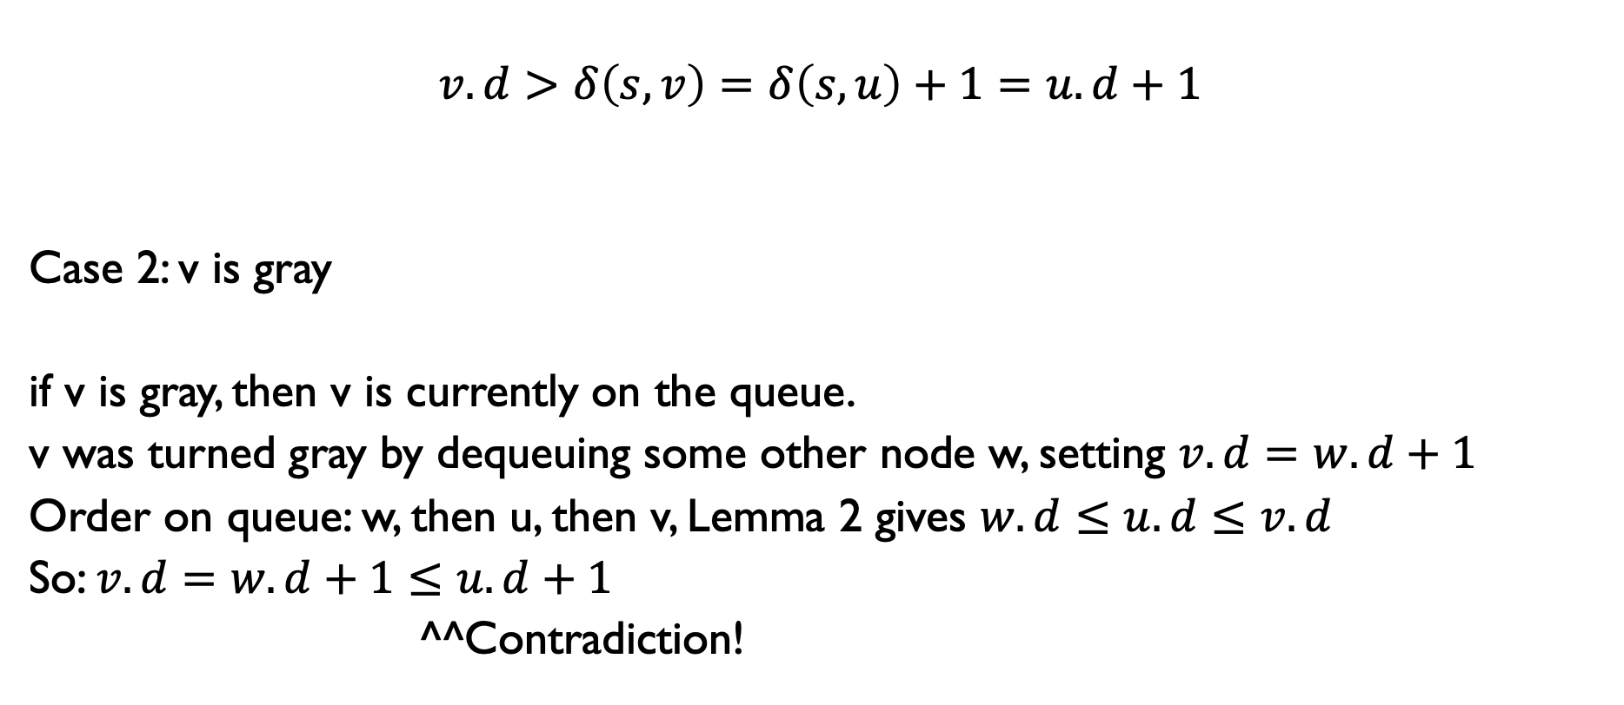
Proof of Correctness
$$v.d>δ\left(s,v\right)=δ\left(s,u\right)+1=u.d+1$$
Case 2: v is gray
if v is gray, then v is currently on the queue.
v was turned gray by dequeuing some other node w, setting $v.d=w.d+1$
Order on queue: w, then u, then v, Lemma 2 gives $w.d≤u.d≤v.d$
So: $v.d=w.d+1≤u.d+1$
^^Contradiction!

Slide 13
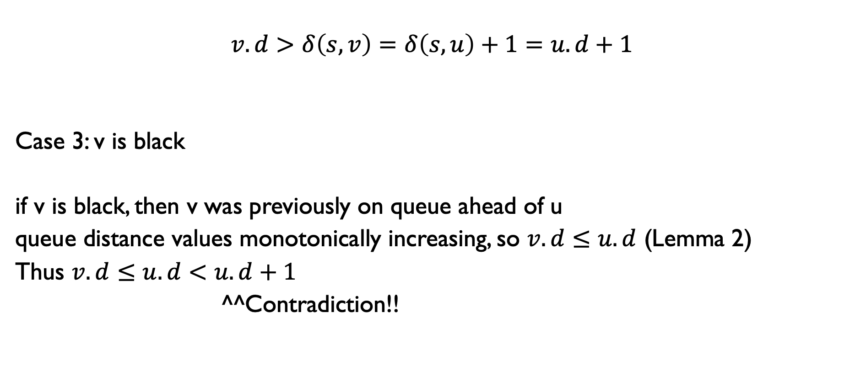
Proof of Correctness
$$v.d>δ\left(s,v\right)=δ\left(s,u\right)+1=u.d+1$$
Case 3: v is black
if v is black, then v was previously on queue ahead of u
queue distance values monotonically increasing, so $v.d≤u.d$ (Lemma 2)
Thus $v.d≤u.d<u.d+1$
^^Contradiction!!

Slide 14

Proof of Correctness
Finishing out the proof!
If BFS is wrong then either:
$$v.d<δ\left(s,v\right)$$
No! By Lemma 1
$$v.d>δ(s,v)$$
No! By proof by contradiction
Thus, $v.d=δ(s,v)$

