Slide 1
Live Session, Feb. 15 Quicksort and Closest Pair of Points
CS 4102: Algorithms
Spring 2021
Mark Floryan and Tom Horton

Slide 2
Monday, Feb. 15
Gradescope is live (link via Collab to sign up)
Made some cosmetic changes to programming hws
Recommended schedule up on schedule page of website.
Recommended that “distancing” be done this week
Sample HW assignment is up on webpage and GS
For your benefit if you want it, not required.
Office hours going ok?
Don’t forget Wednesday is a break day so no class!
Correction: Closest pair of points readings: CLRS 33.4
Horton out: 9pm Monday through Weds.
Today we will do quicksort and closest pair of points!
Self-assessment “quiz”: https://forms.gle/UY83NtmQT2PBdkXT8

Slide 3
Quicksort and Partition
Readings: CLRS Chapter 7 (not 7.4.2)

Slide 4
Quicksort’s Strategy
Called on subsection of array from first to last
Like mergesort
First, choose some element in the array to be the pivot element
Any element! Doesn't matter for correctness.
Often the first item. For us, the last. Or, we often move some element into the last position (to get better efficiency)
Second, call partition, which does two things:
Puts the pivot in its proper place, i.e. where it will be in the correctly sorted sequence
All elements below the pivot are less-than the pivot, and all elements above the pivot are greater-than
Third, use quicksort recursively on both sub-lists

Slide 5
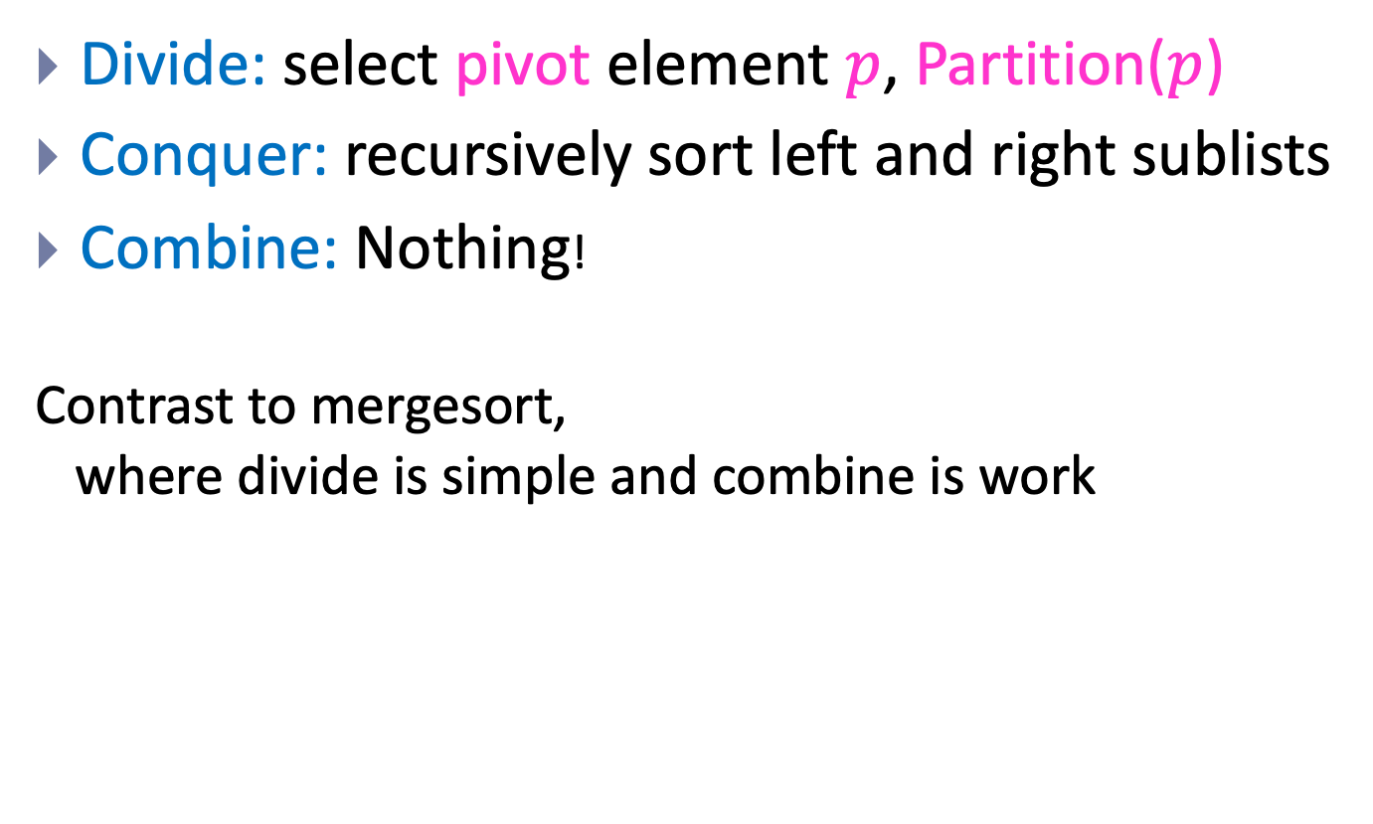
Quicksort is Divide and Conquer
Divide: select pivot element $p$, Partition($p$)
Conquer: recursively sort left and right sublists
Combine: Nothing!
Contrast to mergesort, where divide is simple and combine is work

Slide 6
Quicksort’s Strategy (a picture)
Use last element as pivot (or pick one and move it there)
After call to partition…
Now sort two parts recursively and we’re done!
Note that splitPoint may be anywhere in first..last
Note our assumption that all keys are distinct
pivot
first
last
<= pivot (unsorted)
pivot
> pivot (unsorted)
first
split point
last
<= pivot (sorted)
pivot
> pivot (sorted)
first
split point
last

Slide 7
Quicksort Code
Input Parameters: list, first, last
Output Parameters: list
def quicksort(list, first, last):
if first < last:
q = partition(list, first, last)
quicksort(list, first, q-1)
quicksort(list, q+1, last)
return

Slide 8

Strategy for Lomuto’s Partition
Invariant: At any point:
i indexes the right-most element <= pivot
j-1 indexes the right-most element > pivot
Strategy:
Look at next item a[j]
If that item > pivot, all is well!
If that item < pivot, increment i and then swap items at positions i and j
When done, swap pivot with item at position i+1
Number of comparisons: n-1

Slide 9
Lomuto’s Partition: Code
Input Parameters: list, first, last
Output Parameters: list.
Return value: the split point
def partition(list, first, last):
pval = list[last]
i = first-1
for j in range(first, last): # first up to before last
if list[j] <= pval:
i = i+1
(list[i], list[j]) = (list[j], list[i]) # swap!
(list[last], list[i+1]) = (list[i+1], list[last]) # swap!
return i+1

Slide 10
Partition this: [c t o a m b f]

Slide 11
Partition this: [c t o a m b f]
Strategy:
Look at next item a[j]
If that item > pivot, all is well!
If that item < pivot, increment i and then swap items at positions i and j
When done, swap pivot with item at position i+1

Slide 12
Partition this: [c t o a m b f]
Was that a “good” result? Correct? Desirable for some other reason?
Let’s do a randomized partition now!

Slide 13
Efficiency of Quicksort
Partition divides into two sub-lists, perhaps unequal size
Depends on value of pivot element
Recurrence for Quicksort T(n) = partition-cost + T(size of 1st section) + T(size of 2nd section)
If divides equally, T(n) = 2 T(n/2) + n-1
Just like mergesort
Solve by substitution or master theorem T(n) ∈ Θ(n lg n )
This is the best-case. But…

Slide 14
Worst Case of Quicksort
What if divides in most unequal fashion possible?
One subsection has size 0, other has size n-1
T(n) = T(0) + T(n-1) + n-1
What if this happens every time we call partition recursively?
Uh oh. Same as insertion sort.
“Sorry Prof. Hoare – we have to take back that Turing Award now!”

Slide 15
Quicksort’s Average Case
Good if it divides equally, bad if most unequal.
Remember: when subproblems size 0 and n-1
Can worst-case happen? Sure! Many cases. One is when elements already sorted. Last element is max, pivot around that. Next pivot is 2nd max…
What’s the average?
Much closer to the best case
A bad-split then a good-split is closer to best-case (pp. 176-178)
To prove A(n), fun with recurrences!
The result: If all permutations are equal, then A(n) ≅ 1.386 n lg n (for large n)
So very fast on average.
And, we can take simple steps to avoid the worst case!

Slide 16
Avoiding Quicksort’s Worst Case
Make sure we don’t pivot around max or min
Find a better choice and swap it with last element
Then partition as before
Recall we get best case if divides equally
Could find median. But this costs Θ(n). Instead…
Choose a random element between first and last and swap it with the last element
Or, estimate the median by using the “median-of-three” method
Pick 3 elements (say, first, middle and last)
Choose median of these and swap with last. (Cost?)
If sorted, then this chooses real median. Best case!

Slide 17
Tuning Quicksort’s Performance
In practice quicksort runs fast
A(n) is log-linear, and the “constants” are smaller than mergesort and heapsort
Often used in software libraries
So worth tuning it to squeeze the most out of it
Always do something to avoid worst-case
Sort small sub-lists with (say) insertion sort
For small inputs, insertion sort is fine
No recursion, function calls
Variation: don’t sort small sections at all. After quicksort is done, sort entire array with insertion sort
It’s efficient on almost-sorted arrays!

Slide 18
Quicksort’s Space Complexity
Looks like it’s in-place, but there’s a recursion stack
Depends on your definition: some people define in-place to not include stack space used by recursion
E.g. our CLRS algorithms textbook
Other books and people do “count” this
How much goes on the stack?
If most uneven splits, then Θ(n).
If splits evenly every time, then Θ(lg n).
Ways to reduce stack-space used due to recursion
Various books cover the details (not ours, though)
First, remove 2nd recursive call (tail-recursion)
Second, always do recursive call on smaller section

Slide 19
Summary: Quicksort
Divide and conquer where divide does the heavy-lifting
In worst-case, efficiency is Θ(n²)
But it’s practical to avoid the worst-case
On average, efficiency is Θ(n lg n)
Better space-complexity than mergesort.
In practice, runs fast and widely used
Many ways to tune its performance
Various strategies for Partition
Some work better if duplicate keys
More details? See Sedgewick’s algorithms textbook
He’s the expert! PhD on this under Donald Knuth

Slide 20
Closest Pair of Points
Readings: CLRS 33.4

Slide 21
Closest Pair of Points in 2D Space
Given:
A list of points
Return:
Distance of the pair of points that are closest together (or possibly the pair too)
2
1
5
4
6
7
3
8

Slide 22


Closest Pair of Points: Naïve
Given:
A list of points
Return:
Distance of the closest pair of points
2
1
5
4
6
Naive Algorithm:
Test every pair of points, return the closest.
$$O(n^{2})$$
7
3
We can do better!
8
$$Θ(n\log{n)}$$

Slide 23
Closest Pair of Points: D&C
Divide:
How?
2
At median x coordinate
1
Conquer:
5
4
6
Combine:
7
3
8
23

Slide 24
Closest Pair of Points: D&C
Divide:
2
At median x coordinate
1
Conquer:
5
4
Recursively find closest pairs from Left and Right
6
Combine:
7
3
8
LeftPoints
RightPoints
24

Slide 25
Closest Pair of Points: D&C
Divide:
2
At median x coordinate
1
Conquer:
5
4
Recursively find closest pairs from Left and Right
6
Combine:
7
Return min of Left and Right pairs
?
Problem?
3
8
LeftPoints
RightPoints
25

Slide 26
Closest Pair of Points: D&C
Combine:
2 Cases:
1
2
1. Closest Pair is completely in Left or Right
5
4
6
2. Closest Pair Spans our “Cut”
7
Need to test points across the cut
?
3
8
LeftPoints
RightPoints
26

Slide 27



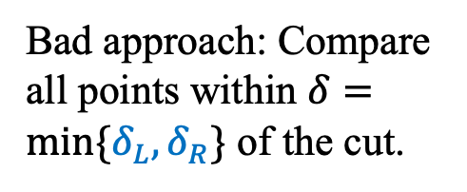
Spanning the Cut
Define “runway” or “strip” along the cut.
Combine:
2. Closest Pair Spanned our “Cut”
1
2
$$δ_{L}$$
Need to test points across the cut.
5
$$δ_{R}$$
4
6
Bad approach: Compare all points within $δ=min⁡\{δ_{L}, δ_{R}\}$ of the cut.
7
How many are there?
3
$$2δ$$
8
LeftPoints
RightPoints
27

Slide 28



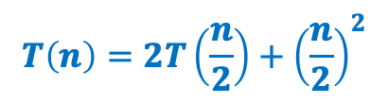
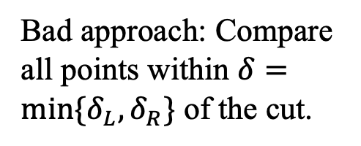
Spanning the Cut
Define “runway” or “strip” along the cut.
Combine:
2. Closest Pair Spanned our “Cut”
1
2
$$δ_{L}$$
Need to test points across the cut
4
5
$$δ_{R}$$
Bad approach: Compare all points within $δ=min⁡\{δ_{L}, δ_{R}\}$ of the cut.
6
7
How many are there?
$$T\left(n\right)=2T\left(\frac{n}{2}\right)+{\left(\frac{n}{2}\right)}^{2}$$
3
$$2δ$$
8
$$=Θ\left(n^{2}\right)$$
LeftPoints
RightPoints
28

Slide 29
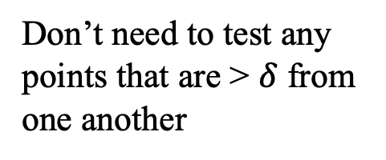
Spanning the Cut
Combine:
2. Closest Pair Spanned our “Cut”
1
2
$$δ_{L}$$
Need to test points across the cut
4
5
$$δ_{R}$$
We don’t need to test all pairs!
6
7
Don’t need to test any points that are > $δ$ from one another
3
$$2δ$$
8
LeftPoints
RightPoints
29

Slide 30



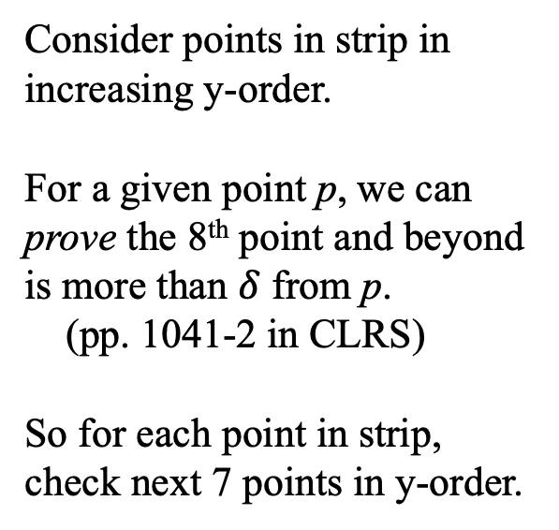

Spanning the Cut
Combine:
1
2
2. Closest Pair Spanned our “Cut”
$$δ_{L}$$
Consider points in strip in increasing y-order.
For a given point p, we can prove the 8th point and beyond is more than $δ$ from p.
(pp. 1041-2 in CLRS)
So for each point in strip, check next 7 points in y-order.
4
5
$$δ_{R}$$
Only check next 7
6
7
3
$$2δ$$
8
LeftPoints
RightPoints
$$Θ\left(n\right) Better!$$
30

Slide 31

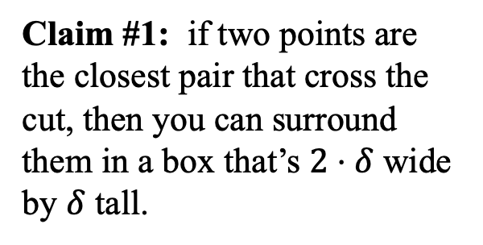

Reducing Search Space
Combine:
Need to test points across the cut
$$2⋅δ$$
Claim #1: if two points are the closest pair that cross the cut, then you can surround them in a box that’s $2⋅δ$ wide by $δ$ tall.
$$δ$$
Let’s draw some examples.
31

Slide 32

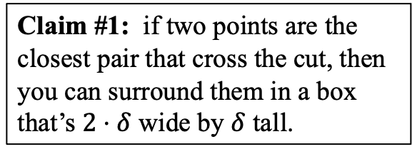

Reducing Search Space
Claim #1: if two points are the closest pair that cross the cut, then you can surround them in a box that’s $2⋅δ$ wide by $δ$ tall.
Assume you’re checking in increasing y-order, and you’ve reached the first point of the closest pair.
Do you have to look at all points above it to be guaranteed to find the other point and the minimum distance?
$$2⋅δ$$
$$δ$$
No!
Imagine you drew a box with its bottom at point’s y-coordinate.
See Claim #1.
Claim #2: only 8 points can be in the box.
32

Slide 33
Reducing Search Space
Claim #1: if two points are the closest pair that cross the cut, then you can surround them in a box that’s $2⋅δ$ wide by $δ$ tall.
Assume you’re checking in increasing y-order, and you’ve reached the first point of the closest pair.
Do you have to look at all points above it to be guaranteed to find the other point and the minimum distance?
$$2⋅δ$$
$$δ$$
No!
Imagine you drew a box with its bottom at point’s y-coordinate.
See Claim #1.
Claim #2: only 8 points can be in the box.
33

Slide 34
Spanning the Cut
Combine:
1
2
2. Closest Pair Spanned our “Cut”
$$δ_{L}$$
Consider points in strip in increasing y-order.
For a given point p, we can prove the 8th point and beyond is more than $δ$ from p.
(pp. 1041-2 in CLRS)
So for each point in strip, check next 7 points in y-order.
4
5
$$δ_{R}$$
Only check next 7
6
7
3
$$2δ$$
8
LeftPoints
RightPoints
$$Θ\left(n\right) Better!$$
34

Slide 38
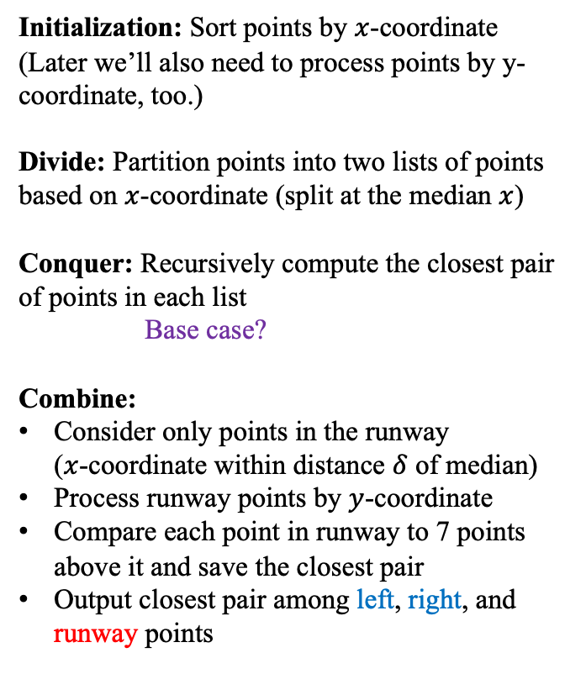
Closest Pair of Points: Divide and Conquer
Initialization: Sort points by $x$-coordinate
(Later we’ll also need to process points by y-coordinate, too.)
Divide: Partition points into two lists of points based on $x$-coordinate (split at the median $x$)
Conquer: Recursively compute the closest pair of points in each list
Base case?
Combine:
Consider only points in the runway ($x$-coordinate within distance $δ$ of median)
Process runway points by $y$-coordinate
Compare each point in runway to 7 points above it and save the closest pair
Output closest pair among left, right, and runway points
1
2
5
4
6
7
?
3
8
LeftPoints
RightPoints

Slide 39



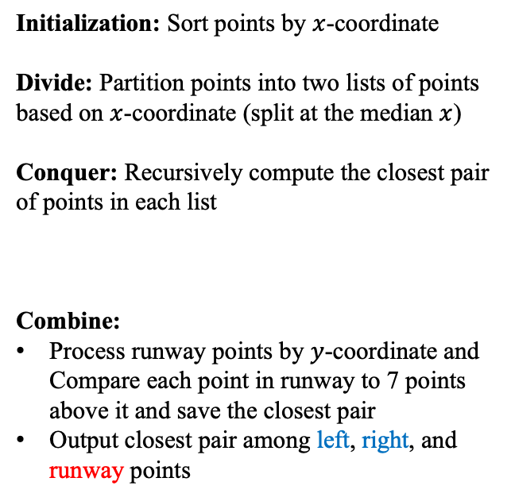

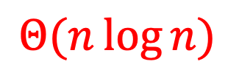

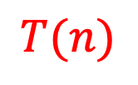

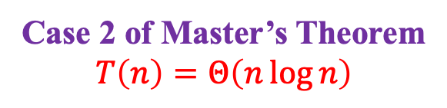
Closest Pair of Points: Divide and Conquer
What is the running time?
$$Θ\left(n\log{n}\right)$$
Initialization: Sort points by $x$-coordinate
Divide: Partition points into two lists of points based on $x$-coordinate (split at the median $x$)
Conquer: Recursively compute the closest pair of points in each list
Combine:
Process runway points by $y$-coordinate and Compare each point in runway to 7 points above it and save the closest pair
Output closest pair among left, right, and runway points
$$Θ(n\log{n})$$
$$Θ\left(1\right)$$
$$2T(n/2)$$
$$T(n)$$
$$T(n)=2T(n/2)+Θ(n)$$
$$Θ\left(n\right)$$
Case 2 of Master’s Theorem
$$T\left(n\right)=Θ\left(n\log{n}\right)$$
$$Θ\left(1\right)$$

Slide 40
Summary for Closest Pair of Points
Comparing all pairs is a brute-force fail
Except for small inputs
Divide and conquer a big improvement
Needed to find an efficient way for part of the combine step
Geometry came through for us here!
Only needed to look at constant number of points for each point in the strip
Implementation subtleties
Don’t want to sort the strip by y-coordinate in each recursive call
In initialization, create an “index” that lets you process all points in order by y-coordinate
(There are other ways to address this.)

