Slide 1
CS4102 Algorithms Spring 2021 – Floryan and Horton
Module 3: Dynamic Programming
Greedy Algorithms

Slide 2

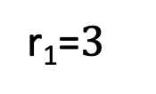


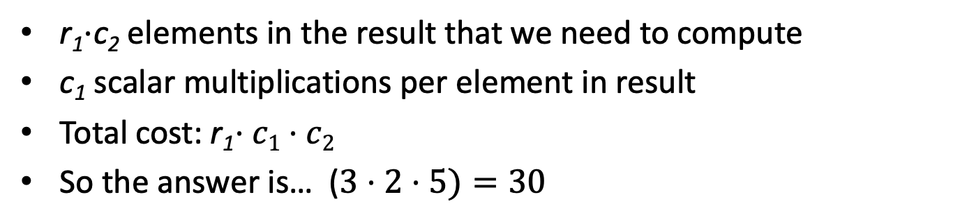
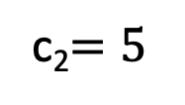



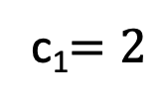

Motivating Example
How many scalar multiplications are required to multiply matrices A and B in this example?
c₁$=2$
c₂$=5$
$$5$$
r₁=$3$
$$×$$
$$2$$
$$=$$
$$3$$
$$A$$
$$B$$
r₁$⋅$c₂ elements in the result that we need to compute
c₁ scalar multiplications per element in result
Total cost: r₁$⋅c1⋅c2$
So the answer is… ($3⋅2⋅5)=30$

Slide 3

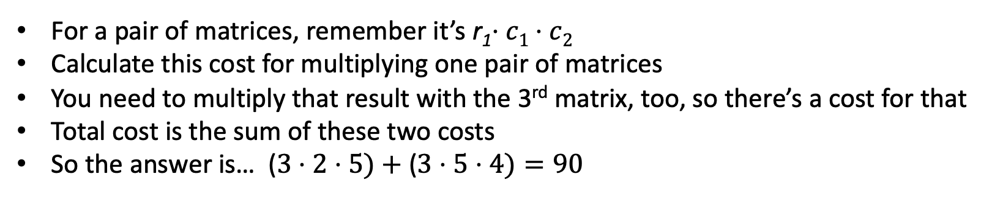












Trickier Question
What’s the smallest number of scalar multiplications required to calculate the matrix product ABC in this example?
$$4$$
$$2$$
$$5$$
$$4$$
$$3$$
$$×$$
$$2$$
$$×$$
$$5$$
$$=$$
$$3$$
$$A$$
$$B$$
$$C$$
For a pair of matrices, remember it’s r₁$⋅c1⋅c2$
Calculate this cost for multiplying one pair of matrices
You need to multiply that result with the 3rd matrix, too, so there’s a cost for that
Total cost is the sum of these two costs
So the answer is… ($3⋅2⋅5)+$($3⋅5⋅4)=90$
Nope! The answer is 64. Think about how this might be!
Notes:
A(BC) vs. (AB)C

Slide 4
CLRS Readings
Chapter 15, Dynamic Programming
Section 15.1, Log/Rod cutting, optimal substructure property
Note: r_{i} in book is called Cut() or C[] in our slides. We do use their example.
Section 15.3, More on elements of DP, including optimal substructure property
Chapter 16, Greedy Algorithms
Intro, page 414
Section 16.2, Elements of the Greedy Strategy, Knapsack problem
Later Section 16.1, Activity Selection problem

Slide 5
Dynamic Programming and Greedy Approach
Module 3 is on Dynamic Programming and the Greedy Approach
This term we’re doing something unusual: We’ll introduce these together, not in sequence
They have a lot in common
Goal: teach you enough about both early enough so you can work on HWs on both topics

Slide 6
Optimization Problems
Both DP and Greedy solve optimization problems:
Find the best solution among all feasible solutions
An example you know: Find the shortest path in a weighted graph G from s to v
Form of the solution: a path (and sum of its edge-weights)
Feasible solutions must meet problem constraints
Example: All edges in solution are in graph G and form a simple path from s to v
We can get a score for each feasible solution on some criteria:
We call this the objective function
Example: the sum of the edge weights in path
One (or more) feasible solutions that scores highest (by the objective function) is the optimal solution(s)

Slide 7


Example #1: Knapsack Problems
Pages 425-427 in textbook
Description: Thief robbing a store finds n items, each with a profit amount p_{i} and a weight w_{i}
Wants to steal as valuable a load as possible
But can only carry total weight C in their knapsack
Which items should they take to maximize profit?
Form of the solution: an x_{i} value for each item, showing if (or how much) of that item is taken
Inputs are: C, n, the p_{i} and w_{i} values
7

Slide 8
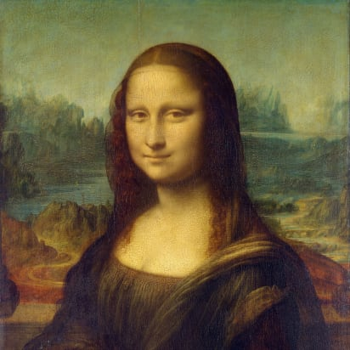

Two Types of Knapsack Problem
0/1 knapsack problem
Each item is discrete: must choose all of it or none of it. So each x_{i} is 0 or 1
Greedy approach does not produce optimal solutions
But dynamic programming does
Fractional knapsack problem (AKA continuous knapsack)
Can pick up fractions of each item. So each x_{i} is a value between 0 or 1
A greedy algorithm finds the optimal solution
8

Slide 9
Formal Statement of Fractional Knapsack Problem
Given n objects and a knapsack of capacity C, where object i has weight w_{i} and earns profit p_{i}, find values x_{i} that maximize the total profit subject to the constraints

Slide 10
Greedy Approach
Let’s use a greedy strategy to solve the fractional knapsack
Build solution by stages, adding one item to partial solution found so far
At each stage, make locally optimal choice based on the greedy choice (sometimes called the greedy rule or the selection function)
Locally optimal, i.e. best choice given what info available now
Irrevocable: a choice can’t be un-done
Sequence of locally optimal choices leads to globally optimal solution (hopefully)
Must prove this for a given problem!
Approximation algorithms, heuristic algorithms

Slide 11
A Bit More Terminology
Problems solvable by both Dynamic Programming and the Greedy approach have the optimal substructure property:
An optimal solution to a problem contains within it optimal solutions to subproblems
This allows us to build a solution one step at a time, because we can solve increasingly smaller problems with confidence
Dynamic Programming not a good solution for problems that have the greedy-choice property:
We can assemble a globally-optimal solution for the current by making a locally-optimal choice, without considering results from subproblems

Slide 12
Greedy Approach for Fractional Knapsack?
Build up a partial solutions:
Determine which of the remaining items to add
How much can you add (its x_{i})
Repeat until knapsack is full (or no more items)
Which item to choose next? What’s a good greedy choice (AKA greedy selection)?
Let’s try several obvious options on this example:
n = 3, C = 20
Item | Value | Weight
1 | 25 | 18
2 | 24 | 15
3 | 15 | 10

Slide 13
Possible Greedy Choices for Knapsack
Greedy choice #1: by highest profit value
n = 3, C = 20
Item 1 first. Can take all of it, so x₁ is 1. Capacity used is 18 of 20. Profit so far is 25.
Item 2 next. Room for only 2 units, so x₂ is 2/15 = 0.133. Capacity used is 20 of 20. Profit so far is 25 + (24 x 0.133) = 28.2.
Item 3 would be next, but knapsack full! x₃ is 0. Total profit is 28.2. x_{i} = (1, .133, 0)
Item | Value | Weight
1 | 25 | 18
2 | 24 | 15
3 | 15 | 10
Select item 1 first, then item 2, then item 3. Take as much of each as fits!

Slide 14
Possible Greedy Choices for Knapsack
Greedy choice #2: by lowest weight
n = 3, C = 20
Item 3 first. Can take all of it, so x₃ is 1. Capacity used is 10 of 20. Profit so far is 15.
Item 2 next. Room for only 10 units, so x₂ is 10/15 = 0.667. Capacity used is 20 of 20. Profit so far is 15 + (24 x 0.667) = 31.
Item 1 would be next, but knapsack full! x₁ is 0. Total profit is 31.0. x_{i} = (0, .667, 1)
Note it’s better than previous greedy choice.
Best possible?
Item | Value | Weight
1 | 25 | 18
2 | 24 | 15
3 | 15 | 10
Select item 3 first, then item 2, then item 1. Take as much of each as fits!

Slide 15
Possible Greedy Choices for Knapsack
Greedy choice #3: highest value-to-weight ratio
n = 3, C = 20
Item 2 first. Can take all of it, so x₂ is 1. Capacity used is 15 of 20. Profit so far is 24.
Item 3 next. Room for only 5 units, so x₁ is 5/10 = 0.5. Capacity used is 20 of 20. Profit so far is 24 + (15 x 0.5) = 31.5.
Item 1 would be next, but knapsack full! x₁ is 0. Total profit is 31.5. x_{i} = (0, 1, 0.5)
This greedy choice produces optimal solution!
Must prove this (but we won’t today).
Item | Value | Weight | Ratio
1 | 25 | 18 | 1.4
2 | 24 | 15 | 1.6
3 | 15 | 10 | 1.5
Select item 2 first, then item 3, then item 1. Take as much of each as fits!

Slide 16
Fractional Knapsack Algorithm
FRACTIONAL_KNAPSACK(a, C)
1 n = a.last
2 for i = 1 to n
3 ratio[i] = a[i].p / a[i].w
4 sort(a, ratio)
5 weight = 0
6 i = 1
7 while (i ≤ n and weight < C)
8 if (weight + a[i].w ≤ C)
9 println “select all of object “ + a[i].id
10 weight = weight + a[i].w
11 else
12 r = (C – weight) / a[i].w
13 println “select “ + r + “ of object “ + a[i].id
14 weight = C
15 i = i+1
Worst-case runtime: for loop and while loop take θ(n) time,
sorting takes θ(nlgn) time, so algorithm takes θ(nlgn) time

Slide 17
Another Knapsack Example to Try
Assume for this problem that:
Ratios of profit to weight:
What order do we examine items?
What are the x_{i} values that result?
What’s the total profit?
p₁/w₁ = 5/120 = .0417
p₂/w₂ = 5/150 = .0333
p₃/w₃ = 4/200 = .0200
p₄/w₄ = 8/150 = .0533
p₅/w₅ = 3/140 = .0214

Slide 18
Proving a Greedy Algorithm Correct
For fractional knapsack, we can prove greedy choice of p_{i}/w_{i} leads to optimal solution
In general, given a greedy algorithm, how do approach such a proof?
Recall we’ve done this for Dijkstra’s SP and Prim’s MST
We can compare the solution our algorithm finds with an optimal solution
Show they’re the same
Or, assume they’re not and show a contradiction
Remember exchange argument for Dijkstra’s or for Prim’s?

Slide 19
0/1 knapsack
n = 3, C = 4
Let’s try this same greedy solution with the 0/1 version
New example inputs →
Item 1 first. So x₁ is 1. Capacity used is 1 of 4. Profit so far is 3.
Item 2 next. There’s room for it! So x₂ is 1. Capacity used is 3 of 4. Profit so far is 3 + 5 = 8.
Item 3 would be next, but its weight is 3 and knapsack only has 1 unit left! So x₃ is 0. Total profit is 8. x_{i} = (1, 1, 0)
But picking items 1 and 3 will fit in knapsack, with total value of 9
Thus, the greedy solution does not produce an optimal solution to the 0/1 knapsack algorithm
Greedy choice left unused room, but we can’t take a fraction of an item
The 0/1 knapsack problem doesn’t have the greedy choice property
Item | Value | Weight | Ratio
1 | 3 | 1 | 3
2 | 5 | 2 | 2.5
3 | 6 | 3 | 2

Slide 20
Dynamic Programming

Slide 21
Dynamic programming
Old “bad” name (see Wikipedia or textbook)
Useful when the solution can be recursively described in terms of solutions to sub-problems (optimal substructure)
But greedy choice property doesn’t hold for the problem
Algorithm finds solutions to sub-problems and stores them in memory for later use
More efficient than brute-force methods or recursive approaches that solve the same sub-problems over and over again

Slide 22
Optimal Substructure Property
Definition
If S is an optimal solution to a problem, then the components of S are optimal solutions to sub-problems
Examples:
True for coin-changing
True for single-source shortest path
Not true for longest-simple-path
True for knapsack

Slide 23
Dynamic Programming
Works “bottom-up”
Finds solutions to small sub-problems first
Stores them
Combines them somehow to find a solution to a slightly larger sub-problem
Comparison to greedy approach
Also requires optimal substructure
But greedy makes choice first, then solves
Greedy looks only at the current situation, not at a past ‘history’
DP is good when sub-problems overlap, when they’re not independent
No need to repeat the calculation to solve them
Dynamic programming has stored them, so doesn’t repeat the calculation

Slide 24
Process for Dynamic Programming
Recognize what the sub-problems are
Identify the recursive structure of the problem in terms of its sub-problems
At the top level, what is the “last thing” done?
This helps you see a recursive solution for any generic sub-problem in terms of smaller sub-problems
Formulate a data structure (array, table) that can look-up solution to any sub-problem in constant time
Develop an algorithm that loops through data structure solving each sub-problem one at a time
Bottom-up: from smallest sub-problems, to next largest, …, to complete problem

Slide 25
Problems Solved with Dyn. Prog.
Log cutting (first example, uses list data structure)
0/1 knapsack problem
Coin changing with “non-standard” coin selection
Longest common subsequence
Multiplying a sequence of matrices
Can do in various orders: (AB)C vs. A(BC)
Pick order that does fewest number of scalar multiplications
And ones we might not get to:
All-pairs shortest paths (Floyd’s algorithm)
Constructing optimal binary search trees

Slide 26
Start for Live Session 3/22
Review for first few slides

Slide 27
Live Session CS4102, Monday March 22

Slide 28
Announcements for Monday, March 22
Note ”goof” on slide 15 in recording for today (fixed in slides)
Wrote/said “value to profit ratio” when meant “value to weight ratio”
Update to grading policy
No distinction between Basic and Adv. HWs. (So future Adv HWs can make up for bad results in Module 1)
To get D- or higher, must pass at least 1 HW in 3 modules
To get C- or higher, must pass at least 1 HW in all 4 modules
Quiz time! Module 2 and re-take for Module 1 this week
Noon Friday until 6 pm Saturday. (Was that OK?)
Topic list for Module 2 by Weds class time

Slide 29
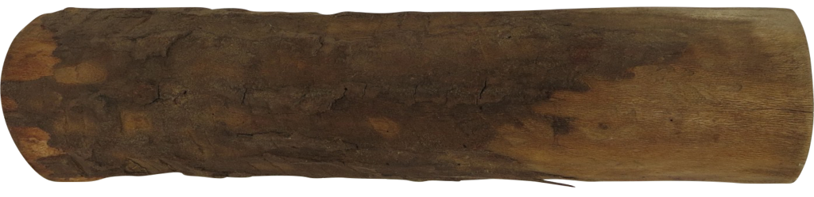
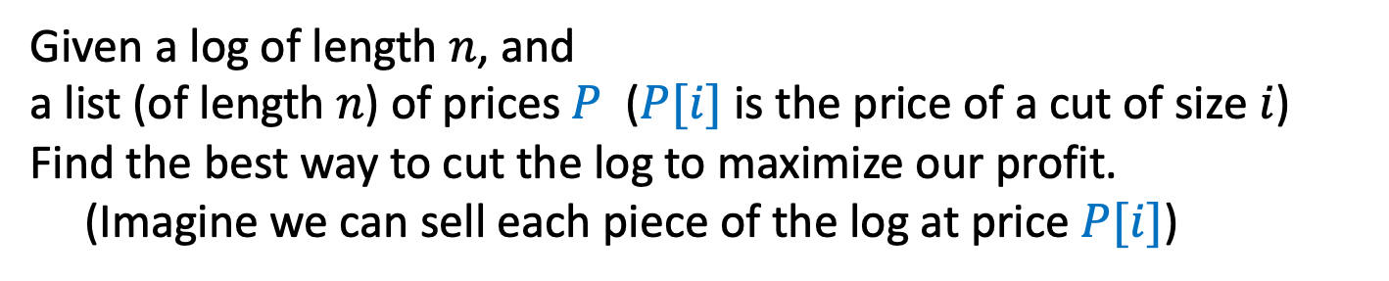
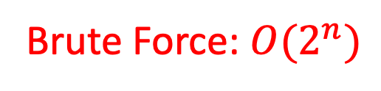
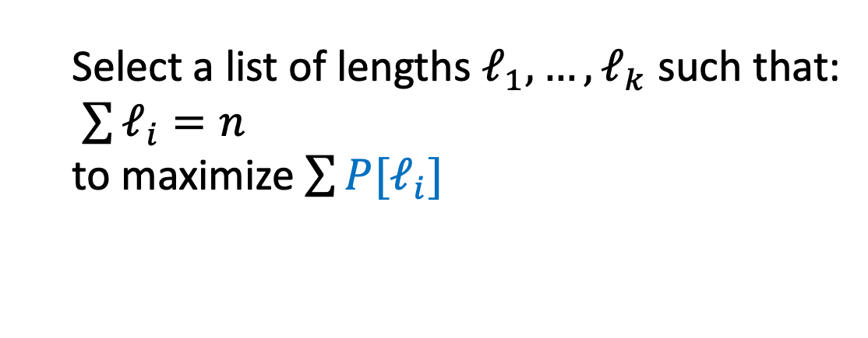
Log Cutting
Given a log of length $n$, and
a list (of length $n$) of prices $P$ ($P[i]$ is the price of a cut of size $i$)
Find the best way to cut the log to maximize our profit.
(Imagine we can sell each piece of the log at price $P[i]$)
Price:
1
5
8
9
10
17
17
20
24
30
Length:
1
2
3
4
5
6
7
8
9
10
Select a list of lengths $ℓ_{1}, …, ℓ_{k}$ such that:
$\sum{ℓ_{i}=n}$
to maximize $\sum{{P[ℓ}_{i}]}$
Brute Force: $O(2^{n})$

Slide 30
Dynamic Programming
Requires Optimal Substructure
Solution to larger problem contains the solutions to smaller ones
Idea:
Identify the recursive structure of the problem
What is the “last thing” done?
Formulate a data structure (array, table) that can look-up solution to any sub-problem in constant time
Select a good order for solving subproblems
“Top Down”: Solve each recursively. (Using memorization – we’ll do later!)
“Bottom Up”: Iteratively solve smallest to largest

Slide 31
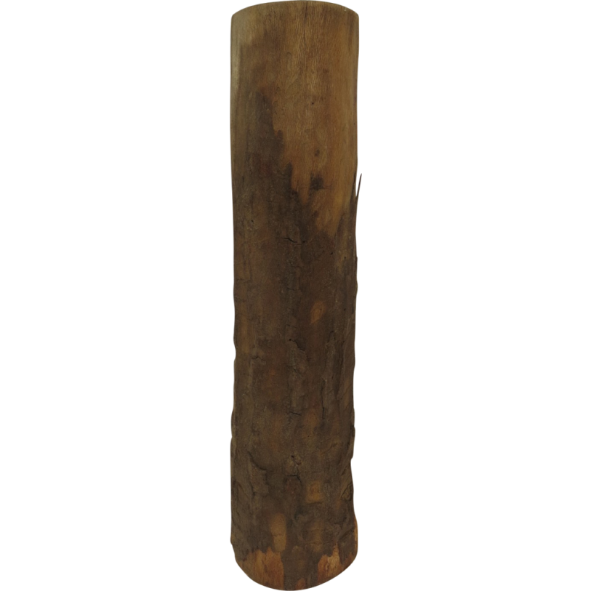

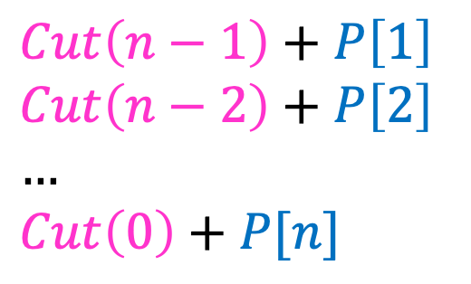



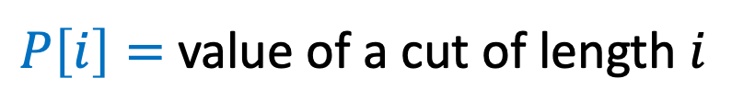
1. Identify Recursive Structure
$P\left[i\right]=$ value of a cut of length $i$
$Cut(n)=$ value of best way to cut a log of length $n$
$Cut\left(n−1\right)+P\left[1\right]$
$Cut\left(n−2\right)+P\left[2\right]$
$…$
$Cut\left(0\right)+P[n]$
So for a given value of n, to find Cut(n), we need sub-problem solutions for Cut(n-1) down to Cut(0).
$Cut\left(n\right)=max⁡$
$$Cut(n−ℓ_{k})$$
What’s the problem with a top-down recursive approach?
$$ℓ_{k}$$
best way to cut a log of length $n−ℓ_{k}$
Last Cut

Slide 32
Dynamic Programming
Requires Optimal Substructure
Solution to larger problem contains the solutions to smaller ones
Idea:
Identify the recursive structure of the problem
What is the “last thing” done?
Save the solution to each subproblem in memory
Select a good order for solving subproblems
“Top Down”: Solve each recursively
“Bottom Up”: Iteratively solve smallest to largest

Slide 33

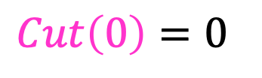
3. Select a Good Order for Solving Subproblems
Solve smallest sub-problem first
$Cut\left(0\right)=0⁡$
$Cut(i)$:
0
Length:
0
1
2
3
4
5
6
7
8
9
10
0

Slide 34
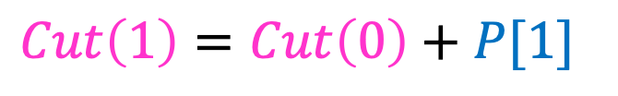
3. Select a Good Order for Solving Subproblems
Solve smallest sub-problem first
$Cut\left(1\right)=Cut\left(0\right)+P[1]⁡$
$Cut(i)$:
0
Length:
0
1
2
3
4
5
6
7
8
9
10
1
Price:
1
5
8
9
10
17
17
20
24
30
Length:
1
2
3
4
5
6
7
8
9
10

Slide 35
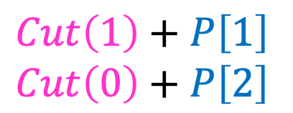
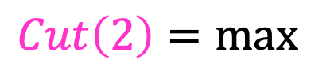
3. Select a Good Order for Solving Subproblems
Solve smallest sub-problem first
$Cut\left(1\right)+P\left[1\right]$
$Cut\left(0\right)+P\left[2\right]$
$Cut\left(2\right)=max⁡$
$Cut(i)$:
0
Length:
0
1
2
3
4
5
6
7
8
9
10
2
Price:
1
5
8
9
10
17
17
20
24
30
Length:
1
2
3
4
5
6
7
8
9
10

Slide 36
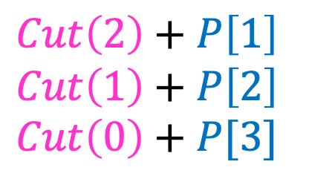
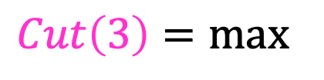
3. Select a Good Order for Solving Subproblems
Solve smallest sub-problem first
$Cut\left(2\right)+P\left[1\right]$
$Cut\left(1\right)+P\left[2\right]$
$Cut\left(0\right)+P[3]$
$Cut\left(3\right)=max⁡$
$Cut(i)$:
0
Length:
0
1
2
3
4
5
6
7
8
9
10
3
Price:
1
5
8
9
10
17
17
20
24
30
Length:
1
2
3
4
5
6
7
8
9
10

Slide 37
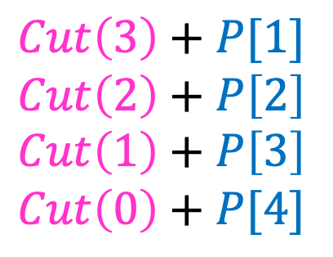
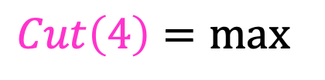
3. Select a Good Order for Solving Subproblems
Solve smallest sub-problem first
$Cut\left(3\right)+P[1]$
$Cut\left(2\right)+P\left[2\right]$
$Cut\left(1\right)+P\left[3\right]$
$Cut\left(0\right)+P[4]$
$Cut\left(4\right)=max⁡$
$Cut(i)$:
0
Length:
0
1
2
3
4
5
6
7
8
9
10
4
Price:
1
5
8
9
10
17
17
20
24
30
Length:
1
2
3
4
5
6
7
8
9
10

Slide 38
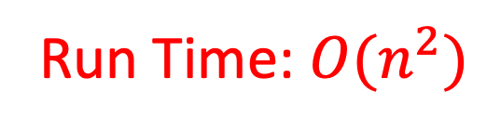
Log Cutting Pseudocode
Initialize Memory C
Cut(n):
C[0] = 0
for i=1 to n: // log size
best = 0
for j = 1 to i: // last cut
best = max(best, C[i-j] + P[j])
C[i] = best
return C[n]
Run Time: $O(n^{2})$

Slide 39
How to find the cuts?
This procedure told us the profit, but not the cuts themselves
Idea: remember the choice that you made, then backtrack

Slide 40
Remember the choice made
Initialize Memory C, Choices
Cut(n):
C[0] = 0
for i=1 to n:
best = 0
for j = 1 to i:
if best < C[i-j] + P[j]:
best = C[i-j] + P[j]
Choices[i]=j
C[i] = best
return C[n]
Gives the size of the last cut

Slide 41
Reconstruct the Cuts
Backtrack through the choices
Choices:
0
1
1
2
4
3
4
1
2
4
3
Length:
0
1
2
3
4
5
6
7
8
9
10
1
2
6
7
Example to demo Choices[] only. Profit of 20 is not optimal!

Slide 42
Backtracking Pseudocode
i = n
while i > 0:
print Choices[i]
i = i – Choices[i]

Slide 43
Our Example: Getting Optimal Solution
i | 0 | 1 | 2 | 3 | 4 | 5 | 6 | 7 | 8 | 9 | 10
C[i] | 0 | 1 | 5 | 8 | 10 | 13 | 17 | 18 | 22 | 25 | 30
Choices[i] | 0 | 1 | 2 | 3 | 2 | 2 | 6 | 1 | 2 | 3 | 10
If n were 5
Best score is 13
Cut at Choices[n]=2, then cut at Choices[n-Choices[n]]= Choices[5-2]= Choices[3]=3
If n were 7
Best score is 18
Cut at 1, then cut at 6
Price:
1
5
8
9
10
17
17
20
24
30
Length:
1
2
3
4
5
6
7
8
9
10

Slide 44
Memoization

Slide 45
Remember Fibonacci numbers?
Formula: F(n) = F(n-1) + F(n-2)
Recursive code: long fib(int n) { assert(n >= 0); if ( n == 0 ) return 0; if ( n == 1 ) return 1; return fib(n-1) + fib(n-2); }
What's the problem?
Repeatedly solves the same subproblems
“Obscenely” exponential

Slide 46
Top-down using Memoization
Before talking about bottom-up dynamic programming using tables, top-down approach uses general technique of Memoization
AKA using a memory function
Simple idea:
Calculate and store solutions to subproblems
Before solving it (again), look to see if you've remembered it

Slide 47
Memoization
Use a Table abstract data type
Lookup key: whatever identifies a subproblem
Value stored: the solution
Could be an array/vector or 2D table(s)
E.g. for Fibonacci, store fib(n) using index n
Need to initialize the array
Could use a map / hash-table

Slide 48
Memoization and Fibonacci
Before recursive code below called, must initialize results[] so all values are -1 long fib_mem(int n, long results[]) { if ( results[n] != -1 ) return results[n]; // return stored value long val; if ( n == 0 || n ==1 ) val = n; // odd but right else val = fib_mem(n-1, results) + fib_mem(n-2, results); results[n] = val; // store calculated value return val; }

Slide 49
Observations on fib_mem()
Same elegant top-down, recursive approach based on definition
Without repeated subproblems
Memory function: a function that remembers
Save time by using extra space
Can show this runs in Θ(n)

Slide 50
CLRS’s Top-Down CUT-ROD using Memoization
MEMOIZED-CUT(p, n)
1 let C[0..n] be a new array // for revenue values
2 for i = 0 to n
3 C[i] = -∞
4 return MEMOIZED-CUT-AUX(p, n, C)
MEMOIZED-CUT-AUX(p, n, C)
1 if C[n] ≥ 0 // subproblem already solved
2 return C[n]
3 if n == 0 // log of length 0
4 best = 0
5 else best = -∞
6 for i = 1 to n
7 best = max(best, p[i] + MEMOIZED-CUT-AUX(p, n-i, C)
8 C[n] = best // store solution for this length n
9 return C[n]

Slide 51
Memoization and Functional Languages
Languages like Lisp and Scheme are functional languages
How could memoization help?
What could go wrong? Would this always work?
Side effects
Haskell does this (call-by-need)
Notes:
From:
http://en.wikipedia.org/wiki/Dynamic_programming
Some functional programming languages, most notably Haskell, can automatically memoize the result of a function call with a particular set of arguments, in order to speed up call-by-name evaluation (this mechanism is referred to as call-by-need). This is only possible for a function which has no side-effects, which is always true in Haskell but seldom true in imperative languages.

