Slide 1
Recurrence Relations
CS 4102: Algorithms
Spring 2021
Mark Floryan and Tom Horton

Slide 2
Recurrence Relations

Slide 3
Solving Recurrence Relations
Several (four) methods for solving:
Directly Solve
Substitution method
In short, guess the runtime and solve by induction
Recurrence trees
We won’t see this in great detail, but a graphical view of the recurrence
Sometimes a picture is worth 2¹⁰ words!
“Master” theorem
Easy to find Order-Class for a number of common cases
Different variations are called different things, depending on the source

Slide 4
Directly Solve (unrolling the recurrence)
For Mergesort:
T(n) = 2*T(n/2) + n
Do it on board →

Slide 5
Iteration or Substitution Method
Strategy
1. Consider Mergesort Recurrence
T(n) = 2*T(n/2) + n
2. Guess the solution
Let’s go with n*log(n) **Remember logs are all base 2 (usually)
3. Inductively Prove that recurrence is in proper order class
For n*log(n), we need to prove that T(n) <= c*n*log(n)
For some ‘c’ constant and for all n >= n0
Remember, we get to choose the ‘c’ and ‘n0’ values
Do it on board →

Slide 6
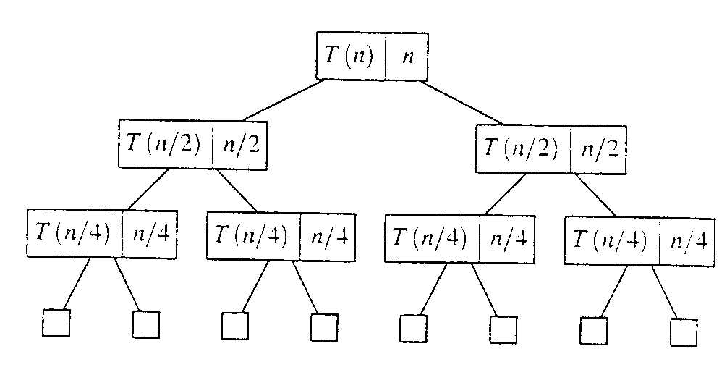
Recursion Tree Method
Evaluate: T(n) = 2*T(n/2) + n
Work copy: T(k) = T(k/2) + T(k/2) + k
For k=n/2, T(n/2) = T(n/4) + T(n/4) + (n/2)
[size| non-recursive cost]

Slide 7
Recursion Tree: Total Cost
To evaluate the total cost of the recursion tree
sum all the non-recursive costs of all nodes
= Sum (rowSum(cost of all nodes at the same depth))
Determine the maximum depth of the recursion tree:
For our example, at tree depth d the size parameter is n/(2^{d})
the size parameter converging to base case, i.e. case 1
such that, n/(2^{d}) = 1,
d = lg(n)
The rowSum for each row is n
Therefore, the total cost, T(n) = n lg(n)

Slide 8
The Master Theorem
Given: a divide and conquer algorithm
An algorithm that divides the problem of size n into a subproblems, each of size n/b
Let the cost of each stage (i.e., the work to divide the problem + combine solved subproblems) be described by the function f(n)
Then, the Master Theorem gives us a cookbook for the algorithm’s running time
Some textbooks has a simpler version they call the “Main Recurrence Theorem”
We’ll splits it into individual parts

Slide 9
The Master Theorem (from Cormen)
If T(n) = a T(n/b) + f(n)
then let k = lg a / lg b = log_{b}(a) (critical exponent)
Then three common cases:
If f(n) ∈ O(n^{k-ε}) for some positive ε, then T(n) ∈ Θ(n^{k})
If f(n) ∈ Θ(n^{k}) then T(n) ∈ Θ( f(n) log(n) ) = Θ(n^{k} log(n))
If f(n) ∈ Ω(n^{k+ε}) for some positive ε, and
a f(n/b) ≤ c f(n) for some c < 1 and sufficiently large n, then T(n) ∈ Θ(f(n))
Note: none of these cases may apply

Slide 10
Using these two methods
T(n) = 9T(n/3) + n
A = 9, b = 3, f(n) = n
Master Theorem
k = lg 9 / lg 3 = log3 9 = 2
Since f(n) = O(n^{log3 9 - ε}), where ε=1, case 1 applies: T(n) ∈ Θ(n^{k})
Thus the solution is T(n) = Θ(n²) since k=2

Slide 11
Problems to Try
Can you use a theorem on these?
Assume T(1) = 1
T(n) = T(n/2) + lg n
T(n) = T(n/2) + n
T(n) = 2T(n/2) + n (like Mergesort)
T(n) = 2T(n/2) + n lg n

