Slide 1
PATHPLANNING WITH NAV2
Kartik Krishnan

Slide 2

Project Overview
launch
maps
models
params
rviz

Slide 3

Project Overview
launch
maps
models
params
rviz
navigation2.launch.py
simulation.launch.py
robot_state_publisher.launch.py
ros_ign_bridge.launch.py

Slide 4

Project Overview
launch
maps
models
params
rviz
empty_world.yaml
empty_world.pgm
turtlebot3_world.yaml
turtlebot3_world.pgm

Slide 5

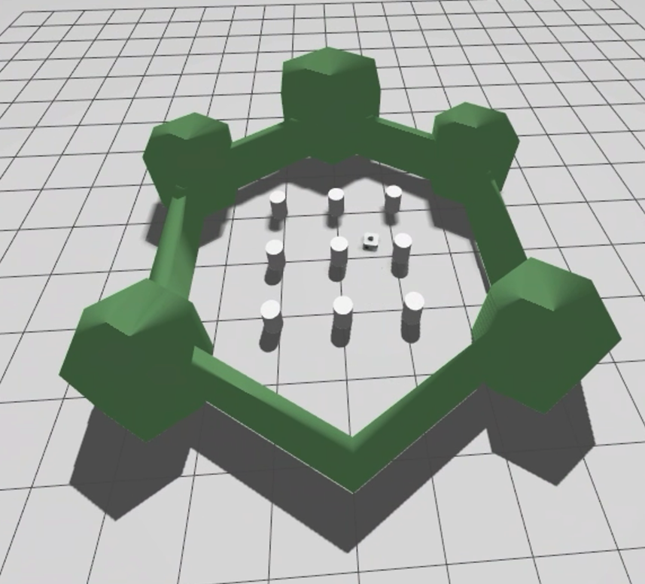
Project Overview
launch
maps
models
params
rviz
turtlebot3
model.sdf
model.sdf
worlds
world_only.sdf
„empty plane“

Slide 6
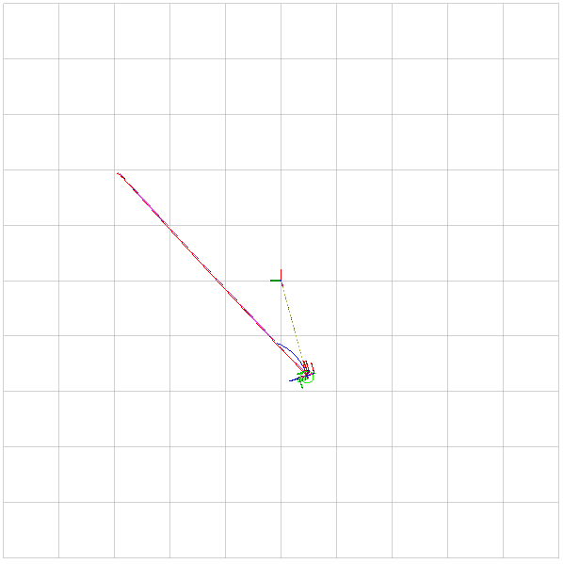
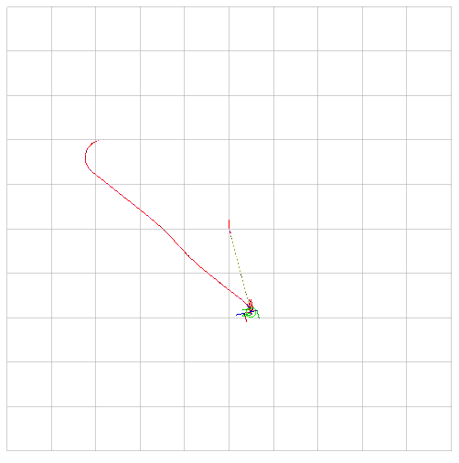


Project Overview
launch
maps
models
params
rviz
diffdrive.yaml
accerPlanner.yaml

Slide 7
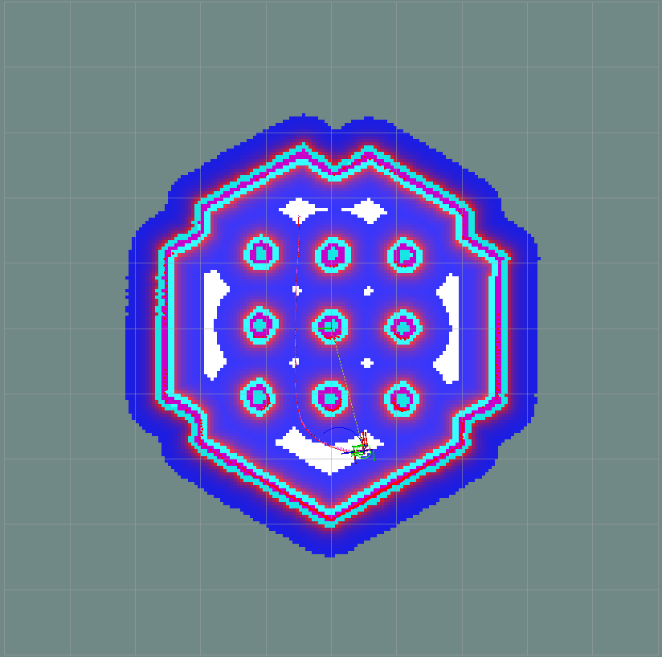
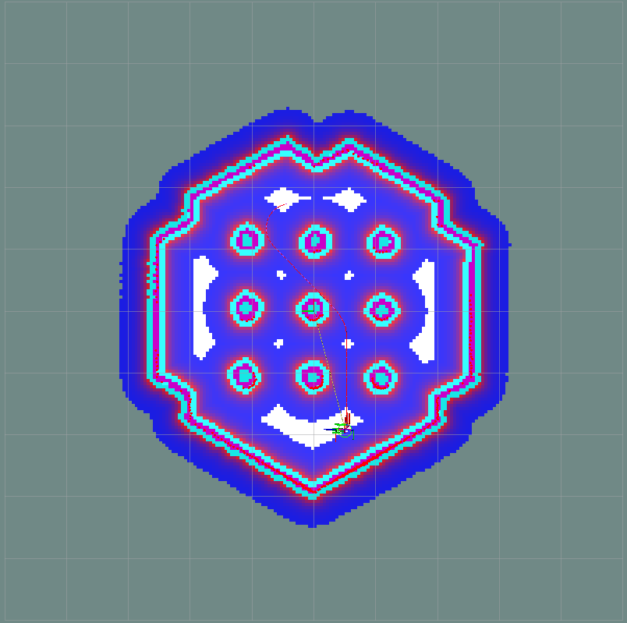
Project Overview
launch
maps
models
params
rviz
diffdrive.yaml
accerPlanner.yaml

Slide 8

Project Overview
launch
maps
models
params
rviz
my_rviz_config.rviz
nav2_default_view.rviz
old_rviz_configuration.rviz

Slide 9






NAV2
Simulation & Real-Time
Multiple
Uses Cases
Modular Design
Highly Extensible
Parallel Workflow

Slide 10
COMPONENTS
Core Navigation Modules
  BT Navigator
  AMCL
  Planner Server
  Controller Server
  Velocity Smoother
Support / Utility Modules
  Map Server
Extended Behavior Modules
  Behavior Server
  Waypoint Follower

Slide 11
BEHAVIOR-TREE NAVIGATOR
bt_navigator:
  ros__parameters:
    use_sim_time: True
    global_frame: map
    robot_base_frame: base_link
    odom_topic: /odom
    bt_loop_duration: 10
    default_server_timeout: 20
    plugin_lib_names:
    - nav2_compute_path_to_pose_action_bt_node
    - nav2_compute_path_through_poses_action_bt_node
…
Uses predefined default Bahvor Tree structure:
nav2_bt_navigator/navigate_to_pose_w_replanning_and_recovery.xml

Slide 12
BEHAVIOR-TREE NAVIGATOR
Selects
Controller
& Planner
Plans
Path
Follows
Path
Publish
succes
Navigate
Recovery
MainTree
Recovery
Check
Update
Goal
Recovery
Actions
6 trys

Slide 13
Adaptive Monte Carlo Localization
Localizes on a known 2D map
Estimates with combining
  Odomentry
  Laser scan data
  Static Map
/map
/scan
/amcl
pose
/tf
/amcl
/tf
/odom
/particle
cloud
/initial
pose

Slide 14
Adaptive Monte Carlo Localization
Sensor Update:
Receive Map
Simulate Laser
Compare to Real Scan
Scores each Particle
Motion Update:
Extract Movement
Add Random Noise
Update Particles
Output:
Cloud of possible Poses
Refine with motion + sensor data
Publish Pose and particle cloud

Slide 15
Adaptive Monte Carlo Localization
laser_model_type: "likelihood_field"
alpha1: 0.2
alpha2: 0.2
alpha3: 0.2
alpha4: 0.2
alpha5: 0.2
beam_skip_distance: 0.5
beam_skip_error_threshold: 0.9
beam_skip_threshold: 0.3
do_beamskip: false
max_beams: 60
max_particles: 2000
min_particles: 500
z_hit: 0.5
z_rand: 0.5
sigma_hit: 0.2

Slide 16
Planner Server
planner_server:
  ros__parameters:
    expected_planner_frequency: 20.0
    use_sim_time: True
    planner_plugins: ["GridBased"]
  GridBased:
    plugin: "nav2_smac_planner/SmacPlannerHybrid"
    smooth_path: true
    motion_model_for_search: "REEDS_SHEPP”
    angle_quantization_bins: 72
    ...

Slide 17
Planner Server
SmacPlannerHybrid
Accounts for motion constraints / a kinematics-aware planner
A grid-based A* but with (x, y, θ) -> Position and Orientation
Get costmap
Sets up start and goal nodes
Runs Hybrid-A*
Collision_checker to avoid obstacles
Applies smoother
Returns as nav_msgs::msg::Path

Slide 18

Planner Server
A* Planner

Slide 19
Planner Server
A* Planner
14
28
10
38
14
48
42
48
62
10
38
10
52
48
62
14
48
10
52
14
56
62
62
70

Slide 20
Planner Server
A* Planner
28
14
24
24
28
34
42
48
62
24
24
14
28
10
38
14
48
48
42
48
62
28
34
10
38
10
52
62
48
62
14
48
10
52
14
56
62
62
70

Slide 21
Planner Server
A* Planner
42
0
38
10
42
20
42
48
62
38
10
28
14
24
24
28
34
48
42
48
62
42
20
24
24
14
28
10
38
14
48
62
48
42
48
62
28
34
10
38
10
52
62
48
62
14
48
10
52
14
56
62
62
70

Slide 22
Planner Server
A* Planner
42
0
38
10
42
20
42
48
62
38
10
28
14
24
24
28
34
48
42
48
62
42
20
24
24
14
28
10
38
14
48
62
48
42
48
62
28
34
10
38
10
52
62
48
62
14
48
10
52
14
56
62
62
70

Slide 23
Planner Server
A* Hybrid Planner
Bigger Turning Radius

Slide 24
Planner Server
Bigger Turning Radius
(0,1)
90°
Distance to Start and Endpoint is Calculated in the same way as A*
(0,1)
120°
(0,1)
60°

Slide 25
Planner Server
Smaller Turning Radius

Slide 26
Planner Server
Smaller Turning Radius
(0,1)
90°
Man muss von allen drei Versionen einen neuen Pfad ausprobieren
(0,1)
105°
(0,1)
75°

Slide 27
Controller Server
FollowPath:
plugin: "dwb_core::DWBLocalPlanner"
general_goal_checker:
plugin: "nav2_controller::SimpleGoalChecker"
progress_checker:
plugin: "nav2_controller::SimpleProgressChecker"
/amcl
pose
Controller server
/cmd
vel
/map

Slide 28

Controller Server
"dwb_core::DWBLocalPlanner"
Uses Dynamic Window Approach algorithm
Finds all possible paths
Each Path is a prediction of a $\left(v, ω\right)$ set

Slide 29


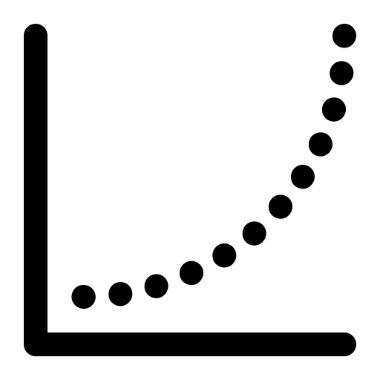

Controller Server
FollowPath:
plugin: "dwb_core::DWBLocalPlanner"
Keep best possible path
GoalDist
BaseObstacle
PathDist
Oscillation
GoalAlign
PathAlign

Slide 30
Velocity Smoother
Reduces abrupt changes in robot velocity
Smoothes controller output before reaching the robot
scale_velocities: False
allows motion until limit and then cuts extra velocity
feedback: ”CLOSED_LOOP"
Smoother does check actuall movement in contrast to “OPEN_LOOP“
Adapts to different behavior from previous commands

Slide 31

How does the Robot actually move?
Plugin: libignition-gazebo-diff-drive-system.so
Needed info:
<left_joint>wheel_left_joint</left_joint>
<right_joint>wheel_right_joint</right_joint>
<wheel_separation>0.287</wheel_separation>
<wheel_radius>0.033</wheel_radius>
<topic>cmd_vel</topic>
taken out of sdf file

Slide 32



How does the Robot actually move?
Example cmd_vel:
{x = 0.3 $\frac{m}{s}$, z = 0.5 $\frac{rad}{s}$}
Predefined Values:
Wheel seperation: $L=0.287 m$
Wheel radius: $r=0.033m$

Slide 33


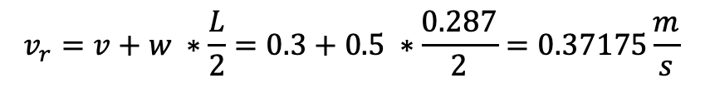
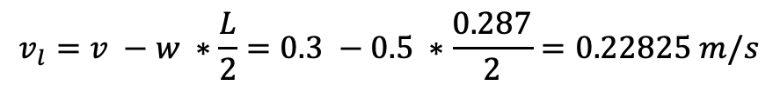
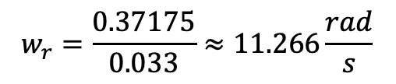
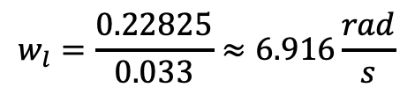
How does the Robot actually move?
$$v_{l}=v −w ∗\frac{L}{2}=0.3 −0.5 ∗\frac{0.287}{2}=0.22825 m/s$$
Example cmd_vel:
{x = 0.3 $\frac{m}{s}$, z = 0.5 $\frac{rad}{s}$}
$$v_{r}=v+w ∗\frac{L}{2}=0.3+0.5 ∗\frac{0.287}{2}=0.37175\frac{m}{s}$$
Predefined Values:
Wheel seperation: $L=0.287 m$
$$w_{l}=\frac{0.22825}{0.033}≈6.916\frac{rad}{s}$$
Wheel radius: $r=0.033m$
$$w_{r}=\frac{0.37175}{0.033}≈11.266\frac{rad}{s}$$

Slide 34
How does the Robot actually move?
$$v_{l}=v −w ∗\frac{L}{2}=0.3 −0.5 ∗\frac{0.287}{2}=0.22825 m/s$$
Example cmd_vel:
{x = 0.3 $\frac{m}{s}$, z = 0.5 $\frac{rad}{s}$}
$$v_{r}=v+w ∗\frac{L}{2}=0.3+0.5 ∗\frac{0.287}{2}=0.37175\frac{m}{s}$$
Predefined Values:
Wheel seperation: $L=0.287 m$
$$w_{l}=\frac{0.22825}{0.033}≈6.916\frac{rad}{s}$$
Wheel radius: $r=0.033m$
$$w_{r}=\frac{0.37175}{0.033}≈11.266\frac{rad}{s}$$
This finally causes the movement:
<plugin
filename="ignition-gazebo-physics-system"
name="ignition::gazebo::systems::Physics">
</plugin>

Slide 35
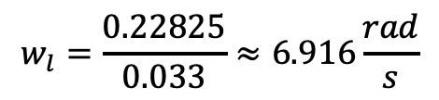

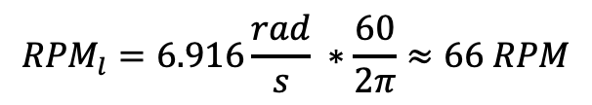
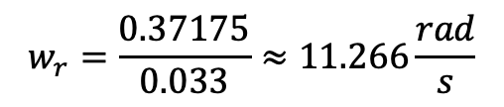
In Real World Scenario
Needed:
Motor driver
PWM-capable GPIOs on the microcontroller
Keep in Mind: Wheels are limited to RPM (Revolutions Per Minute)
- e.g max RPM = 100
$$w_{l}=\frac{0.22825}{0.033}≈6.916\frac{rad}{s}$$
$${RPM}_{l}=6.916\frac{rad}{s} ∗\frac{60}{2π}≈66 RPM$$
$$w_{r}=\frac{0.37175}{0.033}≈11.266\frac{rad}{s}$$
${RPM}_{r}=11.266\frac{rad}{s}$ $∗\frac{60}{2π}≈108 RPM$

Slide 36
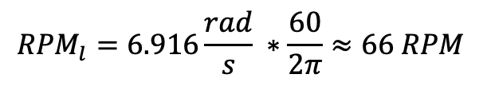
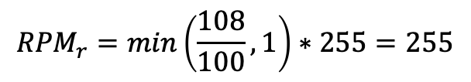
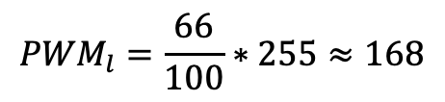

In Real World Scenario
$${RPM}_{l}=6.916\frac{rad}{s} ∗\frac{60}{2π}≈66 RPM$$
${RPM}_{r}=11.266\frac{rad}{s}$ $∗\frac{60}{2π}≈108 RPM$
Signals have to be PWM (Pulse Width Modulation)
Minimum: 0 RPM → PWM = 0
Maximum: 100 RPM → PWM = 255
PWM is a technique for controlling the power sent to a device (like a motor) by rapidly switching the signal on and off, where the ratio of on-time to off-time (duty cycle) determines the effective output level. — that means 255 would stand for max speed and 0 for no movement at all.
$${PWM}_{l}=\frac{66}{100}∗255≈168$$
$${RPM}_{r}=min\left(\frac{108}{100}, 1\right)∗255=255$$

Slide 37

Behavior Server
Failure Case
Behavior Plugin
Executes short-term reactive robot behavior (e.g. spinning in place, waiting, etc. )
Different Actions if the normal path-following fails or isn‘t suitable
Stuck near obstacle
backup
Can‘t turn to goal
spin
No valid Path
Drive on heading
Needs retry delay
wait
Needs retry delay
wait

Slide 38
Behavior Server
Load all plugins:
spin:
plugin: "nav2_behaviors/Spin"
backup:
plugin: "nav2_behaviors/BackUp"
drive_on_heading:
plugin: "nav2_behaviors/DriveOnHeading"
wait:
plugin: "nav2_behaviors/Wait"
assisted_teleop:
plugin: "nav2_behaviors/AssistedTeleop"
Required Inputs:
costmap_topic: local_costmap/costmap_raw
footprint_topic: local_costmap/published_footprint
global_frame: odom
robot_base_frame: base_link

Slide 39
Behavior Server
Update and Monitor Frequency:
cycle_frequency: 10.0
Allowed Transform Delay:
transform_tolerance: 0.1
Simulated Time Horizon:
simulate_ahead_time: 2.0
Spin Motion Limits:
max_rotational_vel: 1.0
min_rotational_vel: 0.4
rotational_acc_lim: 3.2

Slide 40
Waypoint Follower
Navigates through a list of predefined waypoints
Sends sequential navigations goals to bt_navigator
Can Include Behavior Plugins
Wait or Pause
Take a Picture
Play a Sound
Custom ROS action …
Failure Handling
Can stop on failed waypoints or skip to next
wait_at_waypoint:
  plugin: "nav2_waypoint_follower::WaitAtWaypoint"
  enabled: True
  waypoint_pause_duration: 200
Enabled in Behavior Server
stop_on_failure: false

Slide 41


Map Modules in Nav2
Map Server:
Map file is passed through navigation2.launch.py
  Params for Map Server are empty
0 = black (occupied)
255 = white (free)
1 – 254 = shades of grey (unkown)
Map with obstacles
Map without obstacles

