Slide 1
Device Selection for Federated Learning
CS491: Project - I
Supervisor:
Dr. Satendra Kumar
Name: Kartik Mouli
Roll No.: 2001CS35

Slide 2
Index
Introduction
Problem Statement
Solution
Result and Comparisons
Conclusion
Future Work

Slide 3
Introduction
Importance of Device Selection
The success of Federated Learning hinges on the effective selection of devices participating in the training process.
Optimal device selection impacts the efficiency, convergence speed, and overall performance of federated learning algorithms.

Slide 4
Problem Statement
Diverse Device Characteristics
Devices exhibit variations in Computational Power, Memory Capacity, Cost Efficiency, and Network Latency.
Harmonizing these diverse characteristics for effective collaboration poses a challenge in device selection.
Random selection may overlook the efficient use of device resources, emphasizing the need for strategic, property-aware selection methods.

Slide 5
Solution: A Naive Way
Combinatorial Complexity
The naive approach of considering all possible combinations of devices for collaboration leads to a combinatorial explosion.
Improvement
The improved strategy involves choosing a single device in each epoch, mitigating the combinatorial complexity associated with exhaustive combinations.

Slide 6
Solution: Optimal Approach
Optimization aims to leverage device properties—Computational Power, Memory Capacity, Cost Efficiency, and Network Latency—for strategic and efficient model collaboration.
Establishing a threshold to filter devices, ensuring selection is based on a strategic balance of computational power, memory capacity, cost efficiency, and network latency.
Utilizing a heuristic function to evaluate device properties and assign relevance scores.

Slide 7
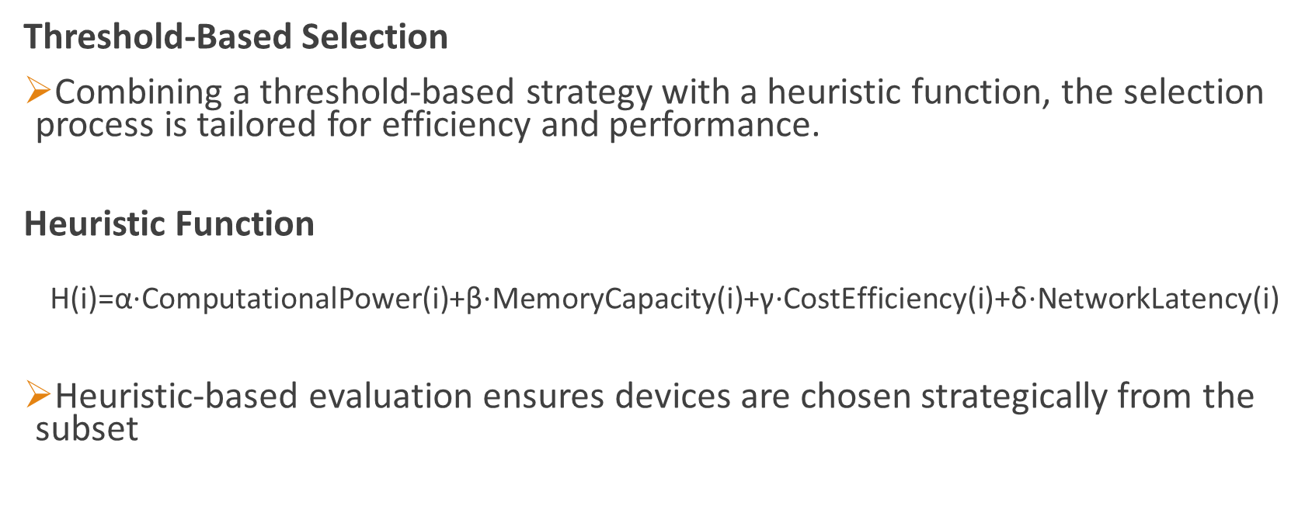
Solution: Optimal Approach
Threshold-Based Selection
Combining a threshold-based strategy with a heuristic function, the selection process is tailored for efficiency and performance.
Heuristic Function
$$\text{H}\text{(}\text{i}\text{)=}\text{α}\text{⋅}\text{ComputationalPower}\text{(}\text{i}\text{)+}\text{β}\text{⋅}\text{MemoryCapacity}\text{(}\text{i}\text{)+}\text{γ}\text{⋅}\text{CostEfficiency}\text{(}\text{i}\text{)+}\text{δ}\text{⋅}\text{NetworkLatency}\text{(}\text{i}\text{)}$$
Heuristic-based evaluation ensures devices are chosen strategically from the subset

Slide 8
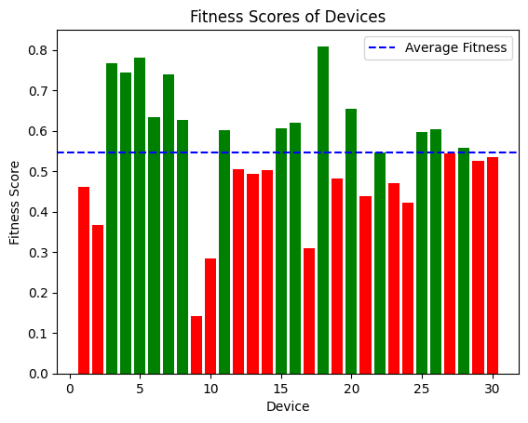
Result And Comparisons
Fitness Score: Average fitness score of each device, considering properties Computational Power, Memory Capacity, Cost Efficiency, and Network Latency.

Slide 9
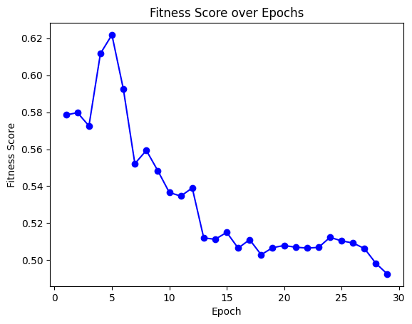
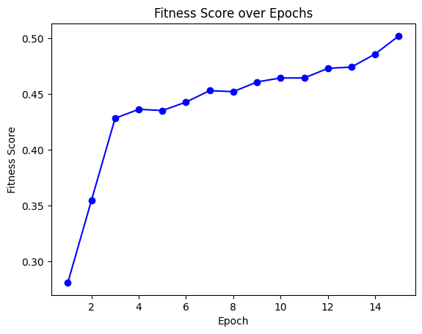
Result And Comparisons
Old Approach
Optimal Approach

Slide 10
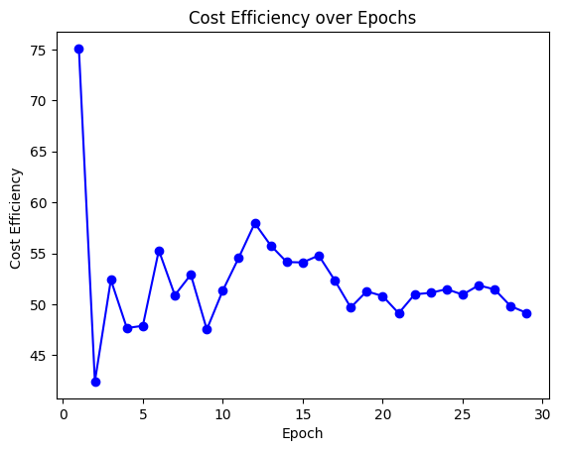
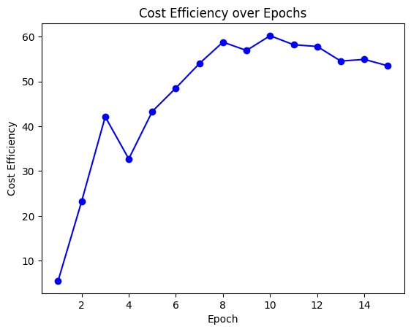
Result And Comparisons
Old Approach
Optimal Approach

Slide 11
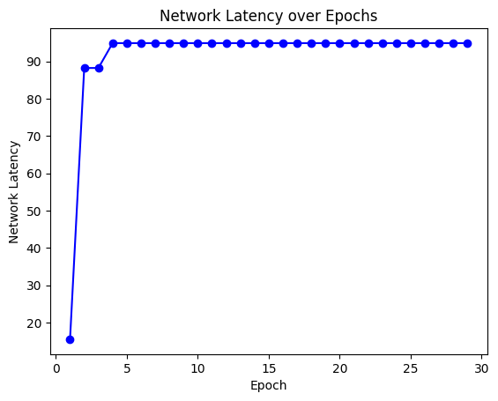
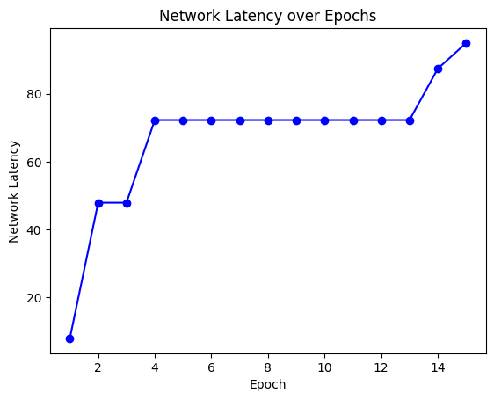
Result And Comparisons
Old Approach
Optimal Approach

Slide 12
Conclusion
Crucial Role of Device Selection
It Shows pivotal role of device selection strategies in shaping the efficiency and effectiveness in federated learning algorithms.
Balancing Randomness and Optimization
Striking a balance between randomness and optimization is key, as random approaches introduce diversity, while optimization ensures purposeful and strategic device selection based on properties.

Slide 13
Future Work
Explore additional factors for device selection and continuous refinement of heuristic functions and thresholds to enhance adaptability to diverse use cases.
Explore the implementation of a ranking-based system for device selection.

Slide 14

Thank You

