Slide 1
Chapter 3: Introduction to SQL

Slide 2
SQL Parts
DML -- provides the ability to query information from the database and to insert tuples into, delete tuples from, and modify tuples in the database.
integrity – the DDL includes commands for specifying integrity constraints.
View definition -- The DDL includes commands for defining views.
Transaction control –includes commands for specifying the beginning and ending of transactions.
Embedded SQL and dynamic SQL -- define how SQL statements can be embedded within general-purpose programming languages.
Authorization – includes commands for specifying access rights to relations and views.

Slide 3
Data Definition Language
The SQL data-definition language (DDL) allows the specification of information about relations, including:
The schema for each relation.
The type of values associated with each attribute.
The Integrity constraints
The set of indices to be maintained for each relation.
Security and authorization information for each relation.
The physical storage structure of each relation on disk.

Slide 4
Domain Types in SQL
char(n). Fixed length character string, with user-specified length n.
varchar(n). Variable length character strings, with user-specified maximum length n.
int. Integer (a finite subset of the integers that is machine-dependent).
smallint. Small integer (a machine-dependent subset of the integer domain type).
numeric(p,d). Fixed point number, with user-specified precision of p digits, with d digits to the right of decimal point. (ex., numeric(3,1), allows 44.5 to be stores exactly, but not 444.5 or 0.32)
real, double precision. Floating point and double-precision floating point numbers, with machine-dependent precision.
float(n). Floating point number, with user-specified precision of at least n digits.
More are covered in Chapter 4.

Slide 5
Create Table Construct
An SQL relation is defined using the create table command:
create table r
(A₁ D₁, A₂ D₂, ..., A_{n} D_{n}, (integrity-constraint₁), ..., (integrity-constraint_{k}))
r is the name of the relation
each A_{i} is an attribute name in the schema of relation r
D_{i} is the data type of values in the domain of attribute A_{i}
Example:
create table instructor ( ID char(5), name varchar(20), dept_name varchar(20), salary numeric(8,2))

Slide 6
Integrity Constraints in Create Table
Types of integrity constraints
primary key (A₁, ..., A_{n} )
foreign key (A_{m}, ..., A_{n} ) references r
not null
SQL prevents any update to the database that violates an integrity constraint.
Example:
create table instructor ( ID char(5), name varchar(20) not null, dept_name varchar(20), salary numeric(8,2), primary key (ID), foreign key (dept_name) references department);

Slide 7
And a Few More Relation Definitions
create table student ( ID varchar(5), name varchar(20) not null, dept_name varchar(20), tot_cred numeric(3,0), primary key (ID),
foreign key (dept_name) references department);
create table takes ( ID varchar(5), course_id varchar(8), sec_id varchar(8), semester varchar(6), year numeric(4,0), grade varchar(2),
primary key (ID, course_id, sec_id, semester, year) ,
foreign key (ID) references student, foreign key (course_id, sec_id, semester, year) references section);

Slide 8
And more still
create table course ( course_id varchar(8), title varchar(50), dept_name varchar(20), credits numeric(2,0),
primary key (course_id),
foreign key (dept_name) references department);

Slide 9
Updates to tables
Insert
insert into instructor values ('10211', 'Smith', 'Biology', 66000);
Delete
Remove all tuples from the student relation
delete from student
Drop Table
drop table r
Alter
alter table r add A D
where A is the name of the attribute to be added to relation r and D is the domain of A.
All exiting tuples in the relation are assigned null as the value for the new attribute.
alter table r drop A
where A is the name of an attribute of relation r
Dropping of attributes not supported by many databases.

Slide 10
Basic Query Structure
A typical SQL query has the form: select A₁, A₂, ..., A_{n} from r₁, r₂, ..., r_{m} where P
A_{i} represents an attribute
R_{i} represents a relation
P is a predicate.
The result of an SQL query is a relation.
Notes:
2

Slide 11
The select Clause
The select clause lists the attributes desired in the result of a query
corresponds to the projection operation of the relational algebra
Example: find the names of all instructors: select name from instructor
NOTE: SQL names are case insensitive (i.e., you may use upper- or lower-case letters.)
E.g., Name ≡ NAME ≡ name
Some people use upper case wherever we use bold font.
Notes:
3

Slide 12
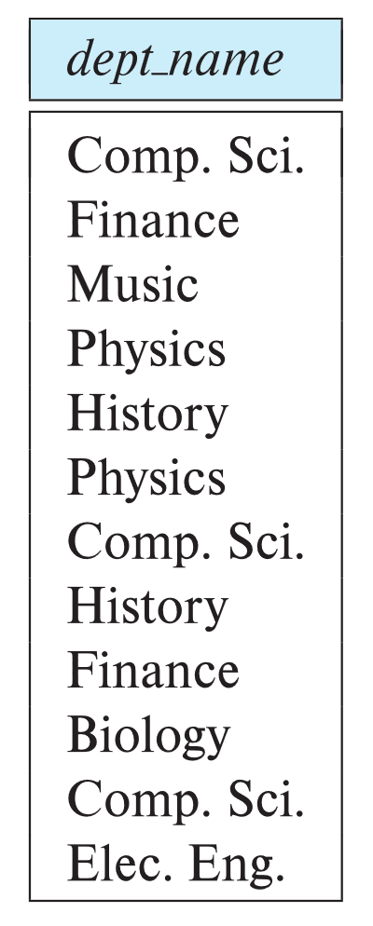
The select Clause (Cont.)
SQL allows duplicates in relations as well as in query results.
To force the elimination of duplicates, insert the keyword distinct after select.
Find the department names of all instructors, and remove duplicates
select distinct dept_name from instructor
The keyword all specifies that duplicates should not be removed.
select all dept_name from instructor
Notes:
4

Slide 13
The select Clause (Cont.)
An asterisk in the select clause denotes “all attributes”
select * from instructor
An attribute can be a literal with no from clause
select '437'
Results is a table with one column and a single row with value “437”
Can give the column a name using:
select '437' as FOO
An attribute can be a literal with from clause
select 'A' from instructor
Result is a table with one column and N rows (number of tuples in the instructors table), each row with value “A”
Notes:
5

Slide 14
The select Clause (Cont.)
The select clause can contain arithmetic expressions involving the operation, +, –, ∗, and /, and operating on constants or attributes of tuples.
The query:
select ID, name, salary/12 from instructor
would return a relation that is the same as the instructor relation, except that the value of the attribute salary is divided by 12.
Can rename “salary/12” using the as clause:
select ID, name, salary/12 as monthly_salary
Notes:
5

Slide 15
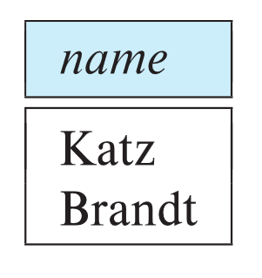
The where Clause
The where clause specifies conditions that the result must satisfy
Corresponds to the selection predicate of the relational algebra.
To find all instructors in Comp. Sci. dept
select name from instructor where dept_name = 'Comp. Sci.'
SQL allows the use of the logical connectives and, or, and not
The operands of the logical connectives can be expressions involving the comparison operators <, <=, >, >=, =, and <>.
Comparisons can be applied to results of arithmetic expressions
To find all instructors in Comp. Sci. dept with salary > 70000
select name from instructor where dept_name = 'Comp. Sci.' and salary > 70000
Notes:
6

Slide 16
The from Clause
The from clause lists the relations involved in the query
Corresponds to the Cartesian product operation of the relational algebra.
Find the Cartesian product instructor X teaches
select ∗ from instructor, teaches
generates every possible instructor – teaches pair, with all attributes from both relations.
For common attributes (e.g., ID), the attributes in the resulting table are renamed using the relation name (e.g., instructor.ID)
Cartesian product not very useful directly, but useful combined with where-clause condition (selection operation in relational algebra).
Notes:
8

Slide 17
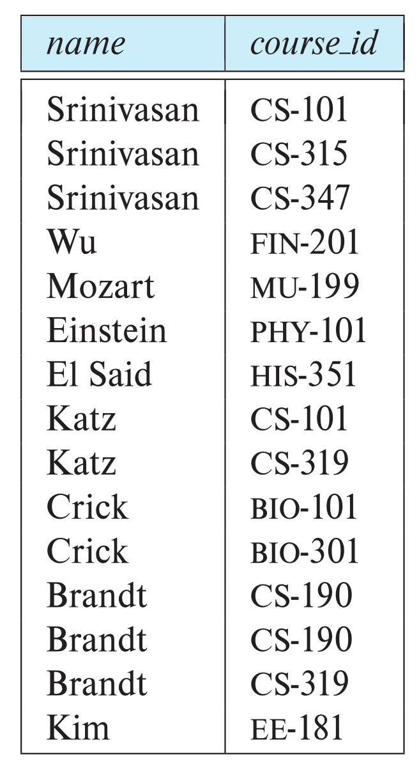
Examples
Find the names of all instructors who have taught some course and the course_id
select name, course_id from instructor , teaches where instructor.ID = teaches.ID
Find the names of all instructors in the Art department who have taught some course and the course_id
select name, course_id from instructor , teaches where instructor.ID = teaches.ID and instructor. dept_name = 'Art'
Notes:
9

