Slide 1
Turing Machines
Recursively Enumerable and Recursive Languages

Slide 2
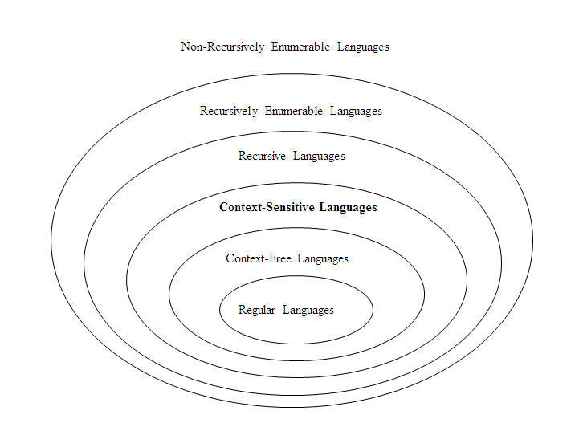
The Hierarchy of Languages:
Non-Recursively Enumerable Languages
Recursively Enumerable Languages
Recursive Languages
Context-Sensitive Languages
Context-Free Languages - ε
Regular Languages - ε

Slide 3
Recursively enumerable languages are also known as type 0 languages.
Context-sensitive languages are also known as type 1 languages.
Context-free languages are also known as type 2 languages.
Regular languages are also known as type 3 languages.

Slide 4
TMs model the computing capability of a general purpose computer, which informally can be described as:
Effective procedure
Finitely describable
Well defined, discrete, “mechanical” steps
Always terminates
Computable function
A function computable by an effective procedure

Slide 5
TMs model the computing capability of a general purpose computer, which informally can be described as:
Effective procedure
Finitely describable
Well defined, discrete, “mechanical” steps
Always terminates
Computable function
A function computable by an effective procedure
TMs formalize the above notion.
Church-Turing Thesis: There is an effective procedure for solving a problem if and only if there is a TM that halts for all inputs and solves the problem.
There are many other computing models, but all are equivalent to or subsumed by TMs. There is no more powerful machine (Technically cannot be proved).
DFAs and PDAs do not model all effective procedures or computable functions, but only a subset.

Slide 6
Deterministic Turing Machine (DTM)
…….. ……..
Two-way, infinite tape, broken into cells, each containing one symbol.
Two-way, read/write tape head.
An input string is placed on the tape, padded to the left and right infinitely with blanks, read/write head is positioned at the left most input character.
Finite control (read/write head is part of this control), knows current symbol being scanned, and its current state.
B | B | 0 | 1 | 1 | 0 | 0 | B | B
Finite
Control

Slide 7
Deterministic Turing Machine (DTM)
…….. ……..
In one move, depending on the current state and the current symbol being scanned, the TM does: (1) changes state, (2) prints a symbol over the cell being scanned, and (3) moves its’ tape head one cell left or right.
Many modifications possible, but Church-Turing declares equivalence of all.
B | B | 0 | 1 | 1 | 0 | 0 | B | B
Finite
Control

Slide 8
Formal Definition of a DTM
A DTM is a seven-tuple:
M = (Q, Σ, Γ, δ, q₀, B, F)
Q A finite set of states
Σ A finite input alphabet, which is a subset of Γ– {B}
Γ A finite tape alphabet, which is a strict superset of Σ
B A distinguished blank symbol, which is in Γ
q₀ The initial/starting state, q₀ is in Q
F A set of final/accepting states, which is a subset of Q
δ A next-move function, which is a mapping (i.e., may be undefined) δ : Q x Γ –> Q x Γ x {L,R}
Intuitively, δ(q,s) specifies the next state, symbol to be written, and the direction of tape head movement by M after reading symbol s while in state q.

Slide 9
Example #1: {w | w is in {0,1}* and w ends with a 0}
= {0, 00, 10, 10110, …}
Note: ε is not in the language

Slide 10
Example #1: {w | w is in {0,1}* and w ends with a 0}
= {0, 00, 10, 10110, …}
Note: ε is not in the language
Q = {q₀, q₁, q₂}
Γ = {0, 1, B}
Σ = {0, 1}
F = {q₂}
δ:
0 1 B
->q₀ (q₀, 0, R) (q₀, 1, R) (q₁, B, L)
q₁ (q₂, 0, R) - -
q₂* - - -
q₀ is the start state and the “scan right” state, until hits B
q₁ state is to begin the verification – last character is 0 or not
q₂ is the final state

Slide 11
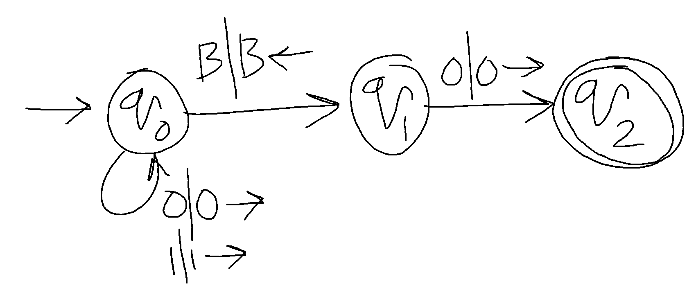
Example #1: {w | w is in {0,1}* and w ends with a 0}
Q = {q₀, q₁, q₂}
Γ = {0, 1, B}
Σ = {0, 1}
F = {q₂}
δ:
0 1 B
->q₀ (q₀, 0, R) (q₀, 1, R) (q₁, B, L)
q₁ (q₂, 0, R) - -
q₂* - - -
q₀ is the start state and the “scan right” state, until hits B
q₁ state is to begin the verification – last character is 0 or not
q₂ is the final state

Slide 12
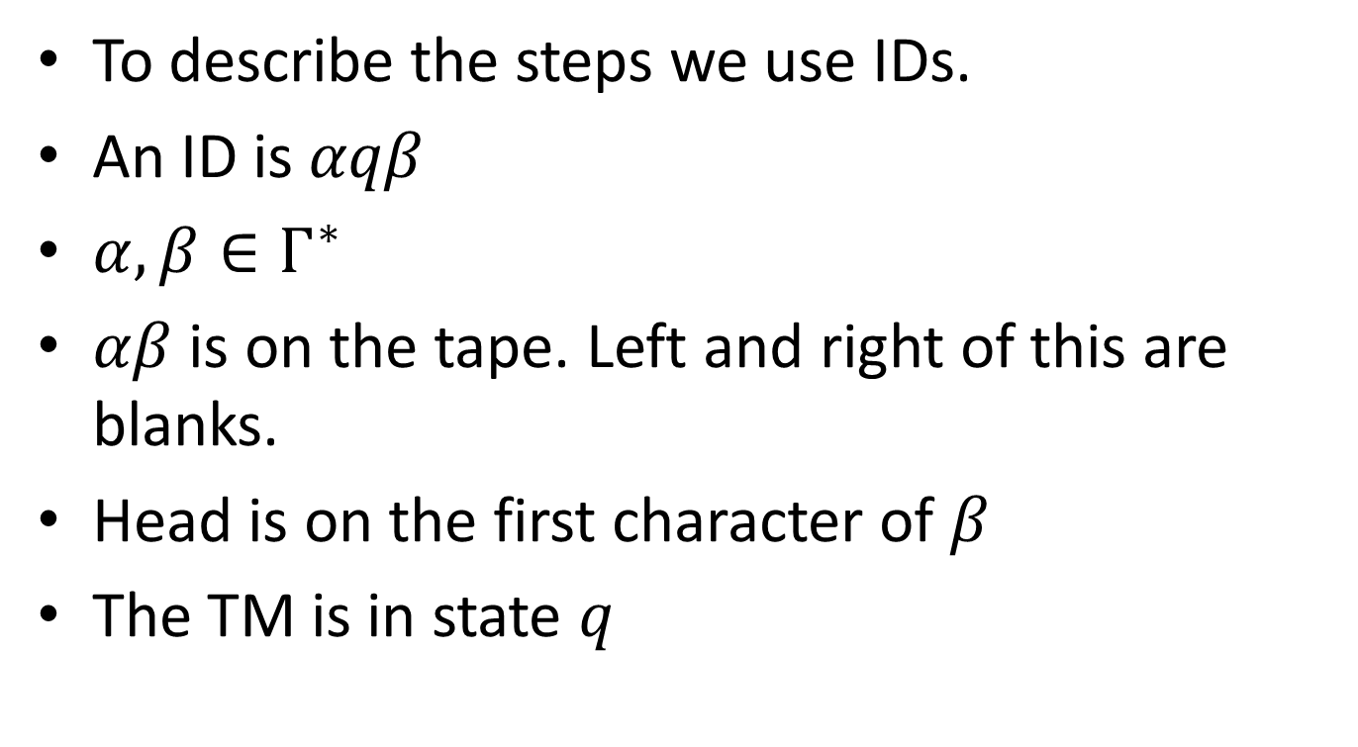
ID

Slide 13
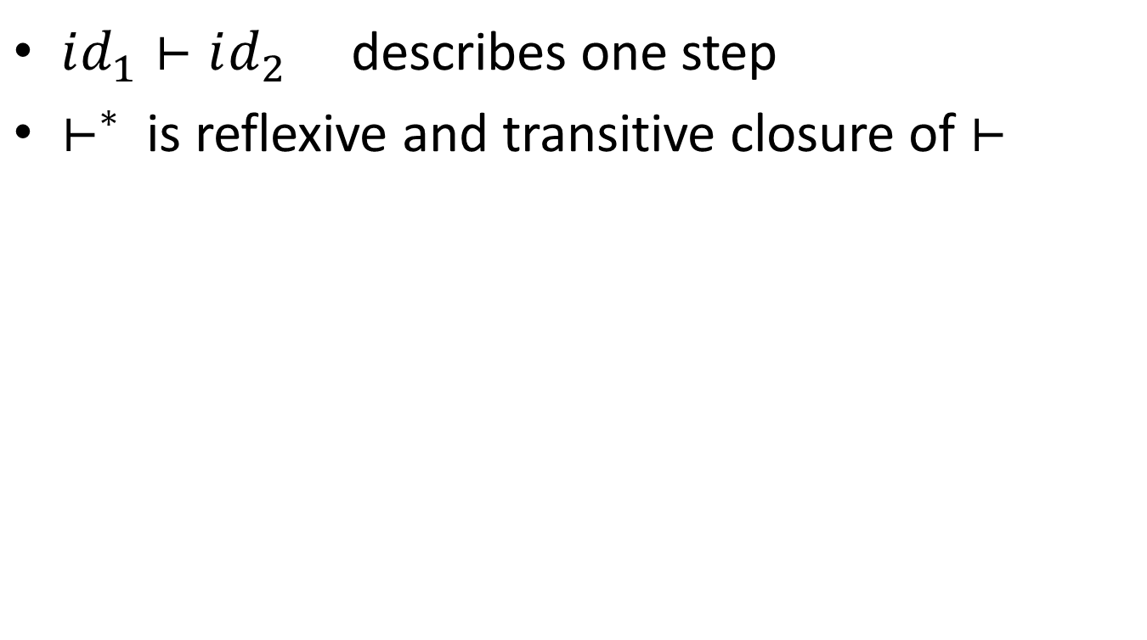
Step

Slide 14
For input 1010, computation steps…

Slide 15
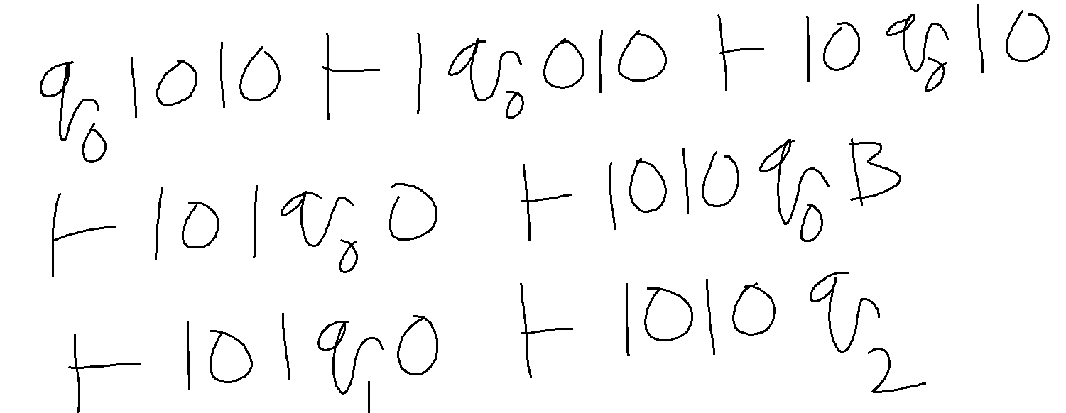
For input 1010, computation steps…

Slide 16
Have you noticed
Recognition is immediate.
TM, once hits one of the final states, it accepts and halts.
No need for the input to be exhausted !!
How TM rejects?
It gets stuck.
It goes on infinitely without ever hitting a final state.

Slide 17
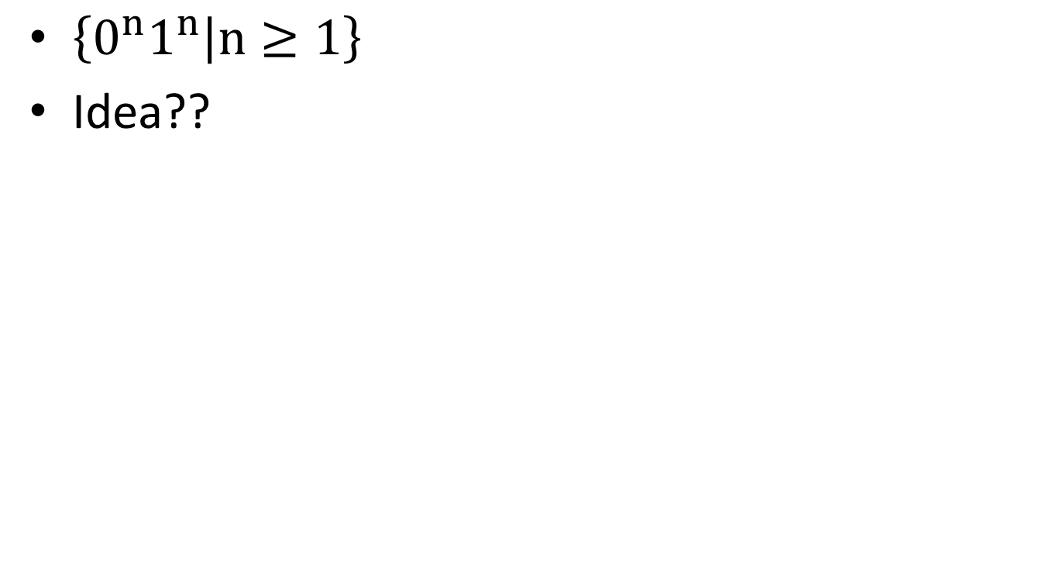

Slide 19

B | B | 0 | 0 | 0 | 1 | 1 | 1 | B
 |  | ↑

Slide 20
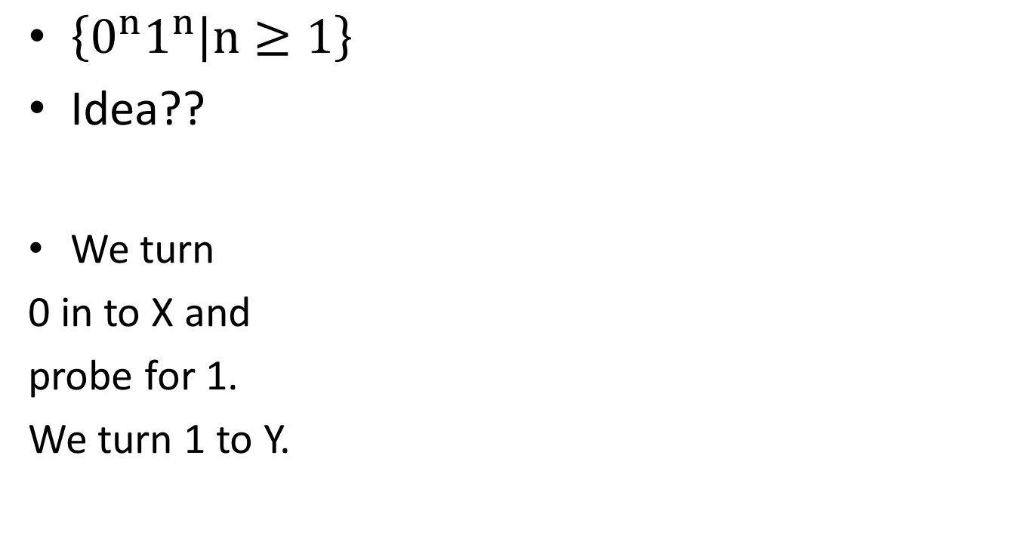


B | B | 0 | 0 | 0 | 1 | 1 | 1 | B
 |  | ↑
B | B | X | 0 | 0 | 1 | 1 | 1 | B
 |  |  | ↑

Slide 21
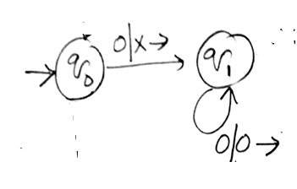



B | B | 0 | 0 | 0 | 1 | 1 | 1 | B
 |  | ↑
B | B | X | 0 | 0 | 1 | 1 | 1 | B
 |  |  | ↑
B | B | X | 0 | 0 | 1 | 1 | 1 | B
 |  |  |  |  | ↑

Slide 22


B | B | 0 | 0 | 0 | 1 | 1 | 1 | B
 |  | ↑
B | B | X | 0 | 0 | 1 | 1 | 1 | B
 |  |  | ↑
B | B | X | 0 | 0 | 1 | 1 | 1 | B
 |  |  |  |  | ↑
B | B | X | 0 | 0 | Y | 1 | 1 | B
 |  |  |  | ↑

Slide 23
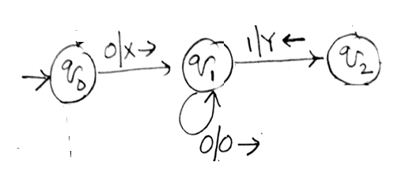
B | B | 0 | 0 | 0 | 1 | 1 | 1 | B
 |  | ↑
B | B | X | 0 | 0 | 1 | 1 | 1 | B
 |  |  | ↑
B | B | X | 0 | 0 | 1 | 1 | 1 | B
 |  |  |  |  | ↑
B | B | X | 0 | 0 | Y | 1 | 1 | B
 |  |  |  | ↑

Slide 24
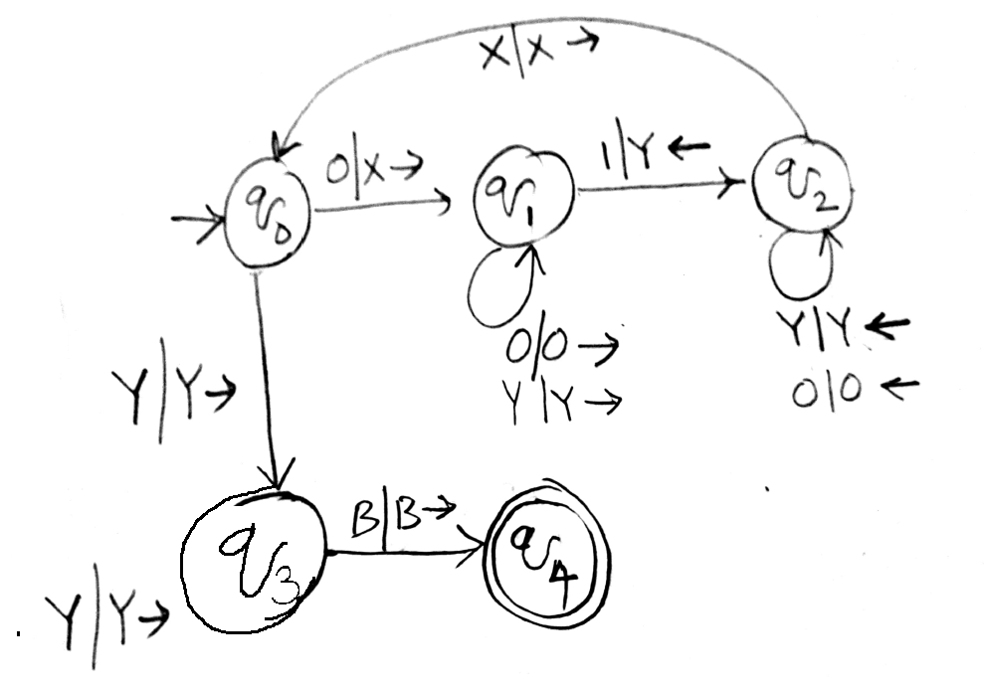

Slide 25
Example #2: {0^{n}1^{n} | n ≥ 1}
0 1 X Y B
->q₀ (q₁, X, R) - - (q₃, Y, R)0’s finished -
q₁ (q₁, 0, R)ignore1 (q₂, Y, L) - (q₁, Y, R) ignore2 - [more 0’s]
q₂ (q₂, 0, L) ignore2 - (q₀, X, R) (q₂, Y, L) ignore1 -
q₃ - - [more 1’s] - (q₃, Y, R) ignore (q₄, B, R)
q₄* - - - - -
Sample Computation: (on input: 0011),
q₀0011BB.. |— Xq₁011
|— X0q₁11
|— Xq₂0Y1
|— q₂X0Y1
|— Xq₀0Y1
|— XXq₁Y1
|— XXYq₁1
|— XXq₂YY
|— Xq₂XYY
|— XXq₀YY
|— XXYq₃Y B…
|— XXYYq₃ BB…
|— XXYYBq₄

Slide 26
TM
TM can be seen as a recognizer.
TM can be seen as a input-output mapper.
TM can also be seen as an enumerator.
Generates the language one string after the other.

Slide 27
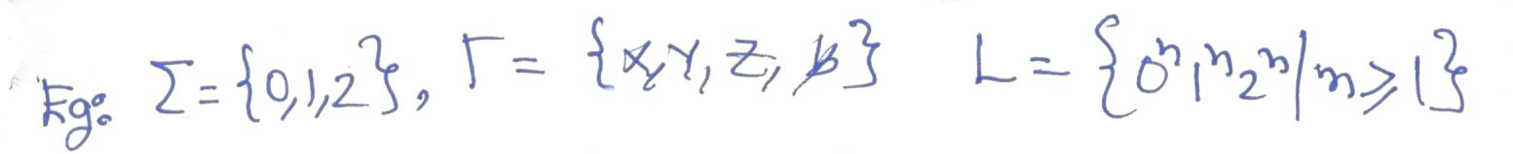
But, there is a mistake in this.

Slide 28
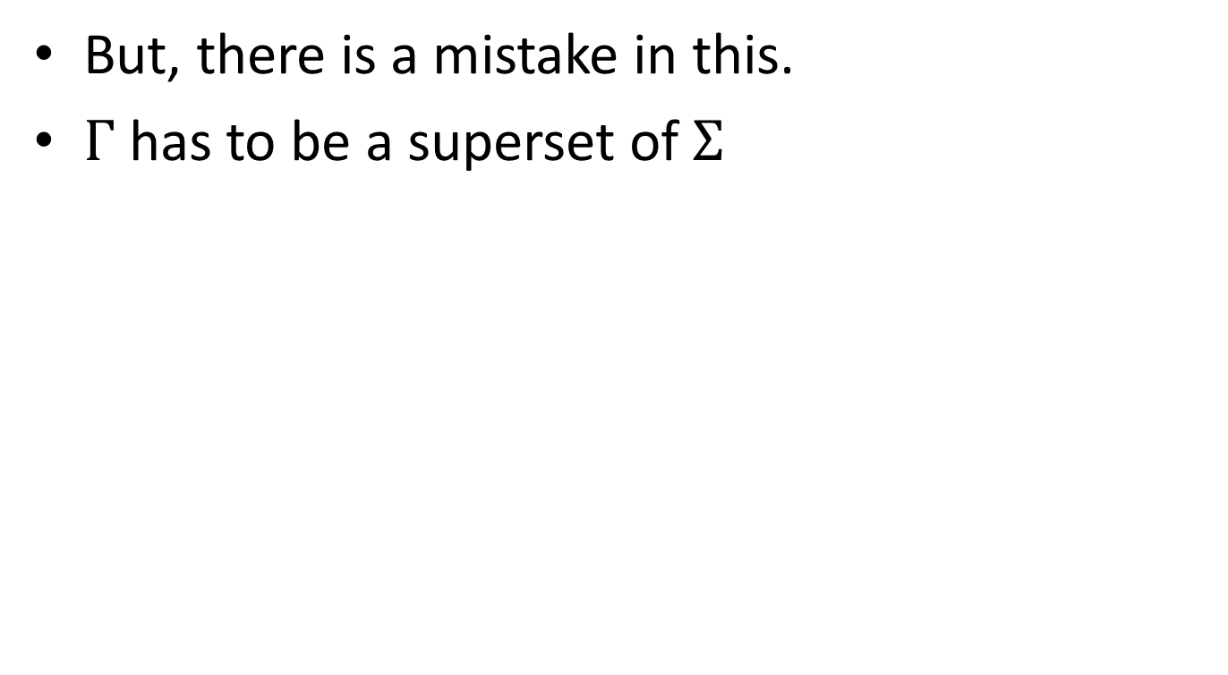

Slide 29
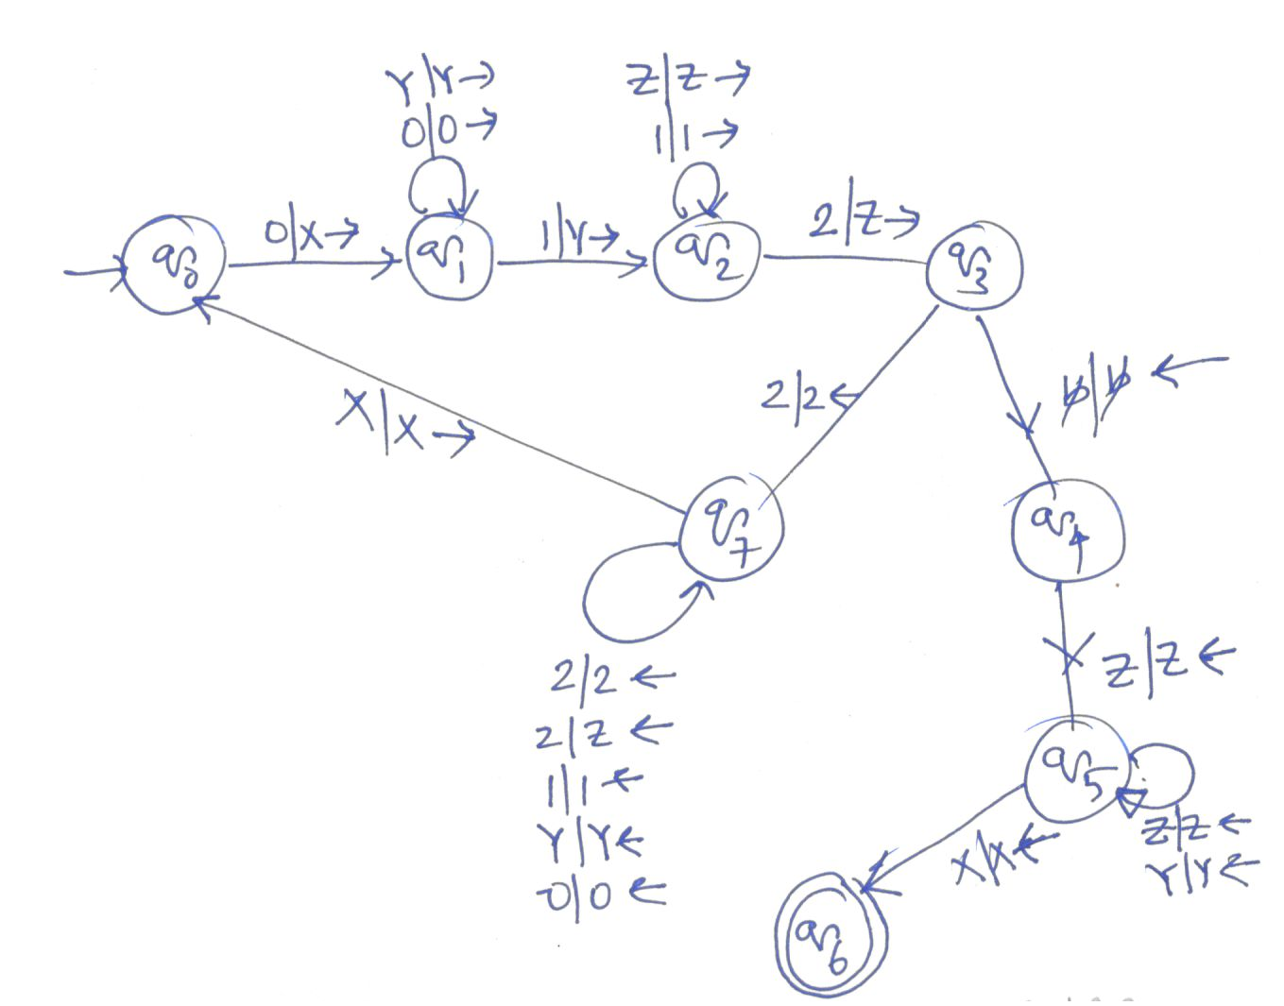

Slide 30

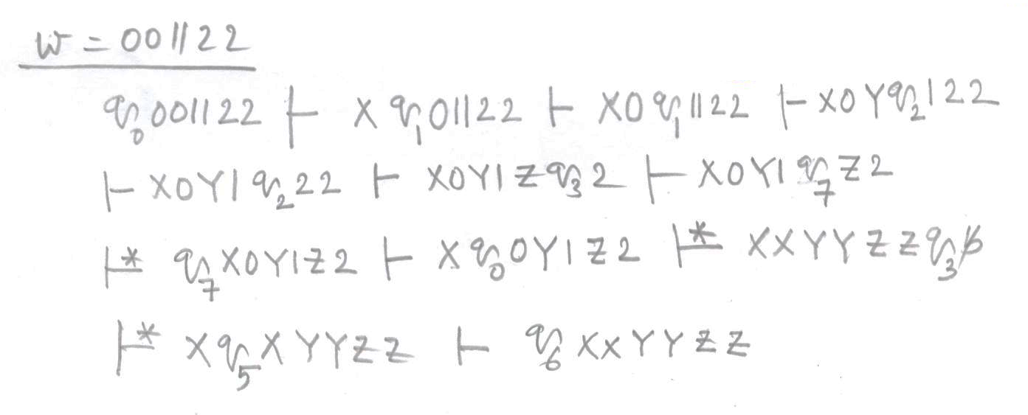

Slide 31
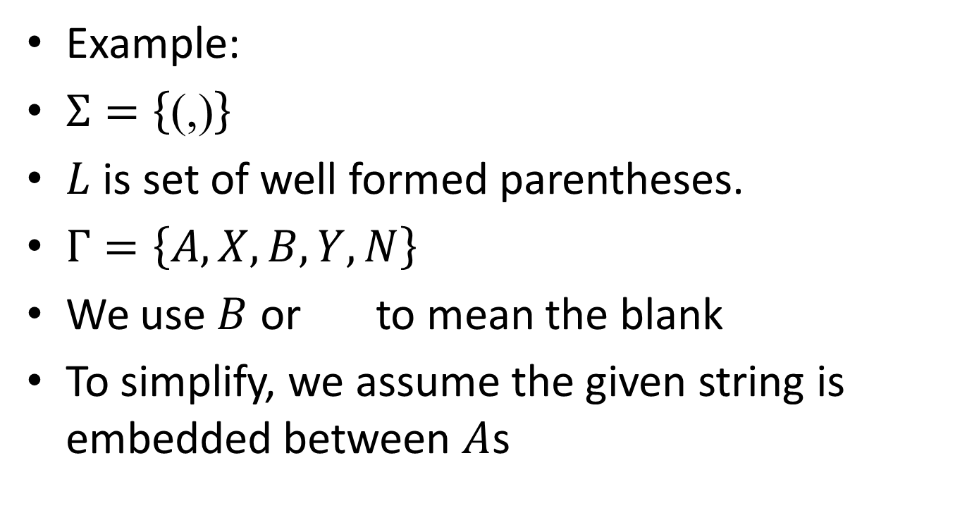

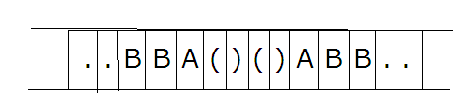
TM that gives output

Slide 32
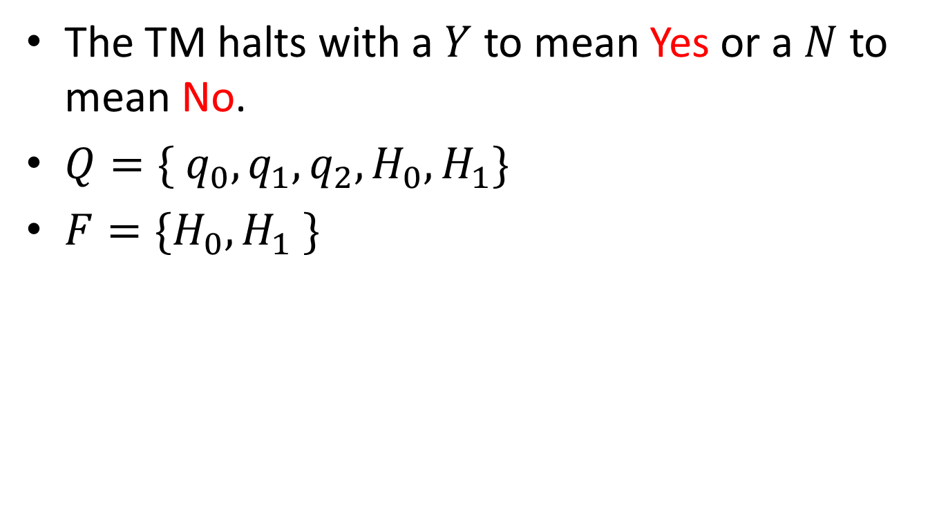

Slide 33
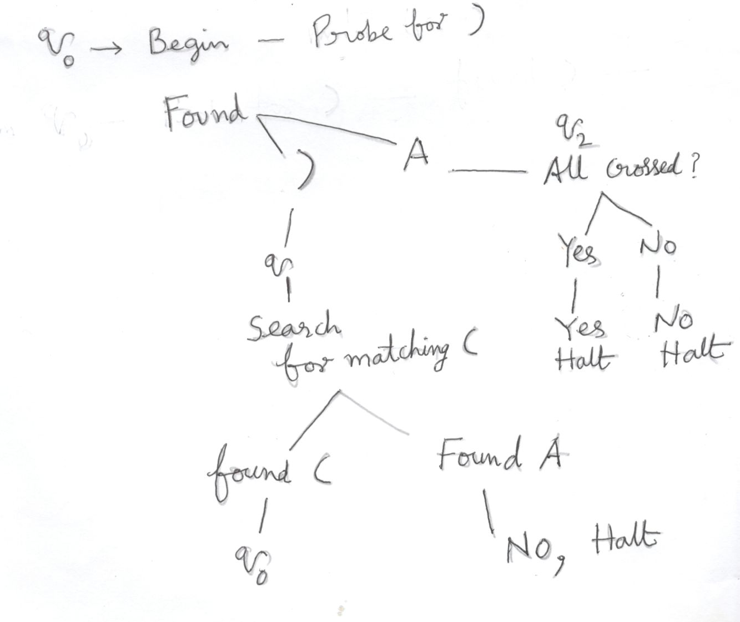
Idea

Slide 34
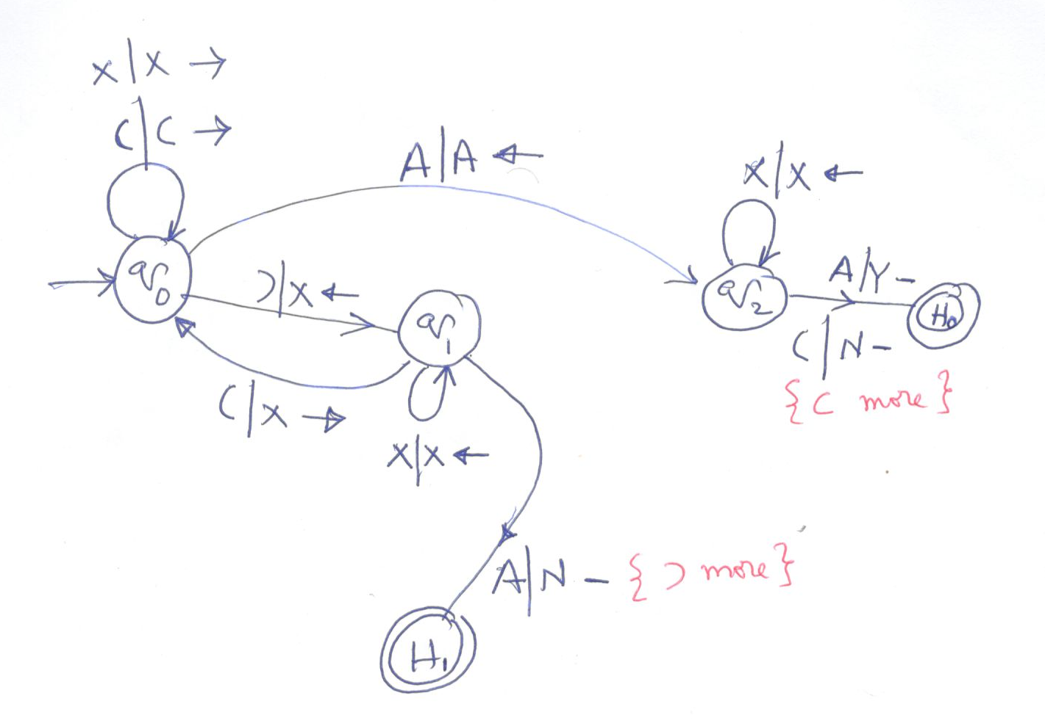
The transition diagram

Slide 35

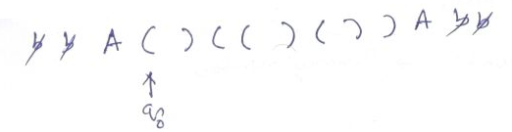
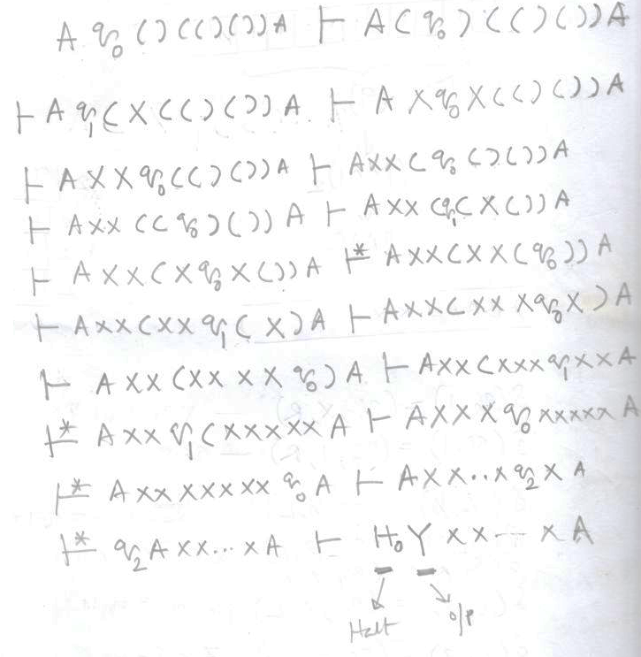

Slide 36
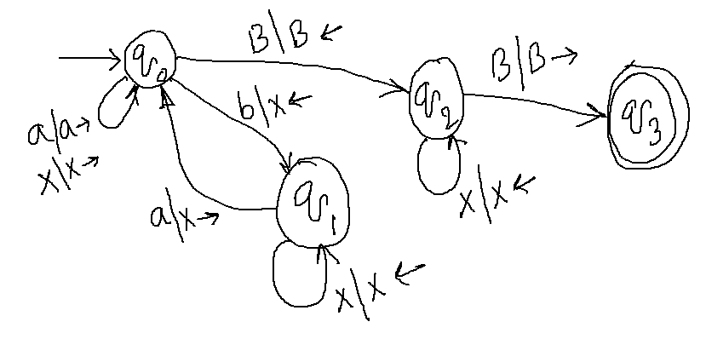
For the same problem (well balanced paranthesis) as a recognition problem
Let ( and ) are represented as a and b, respectively. (B is the blank symbol)
 | B | X | a | b
→ q0 | (q2,B,L) | (q0,X,R) | (q0,a,R) | (q1,X,L)
q1 |  | (q1,X,L) | (q0,X,R)
q2 | (q3,B,R) | (q2,X,L)
*q3

Slide 37

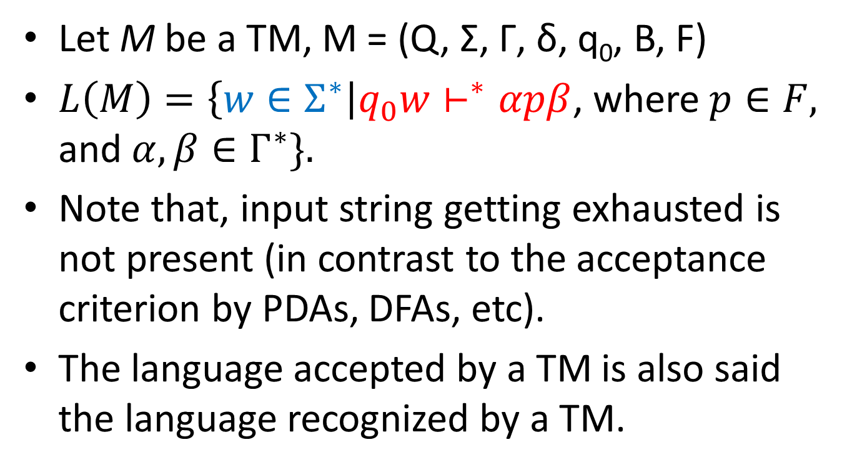

Slide 38
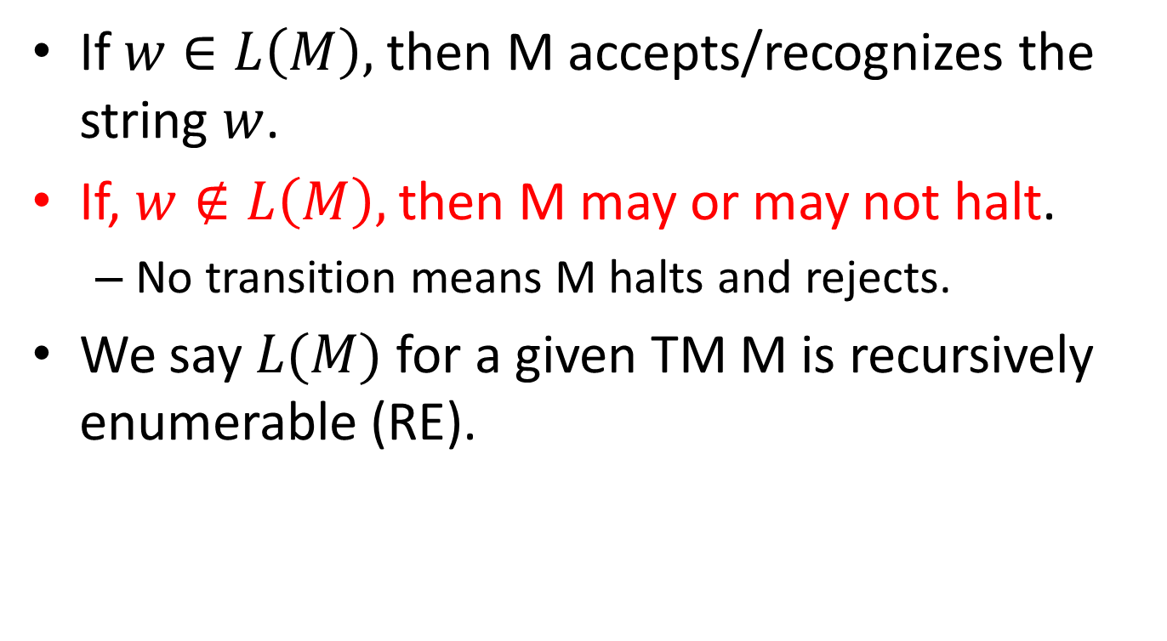
Recursively enumerable

Slide 39
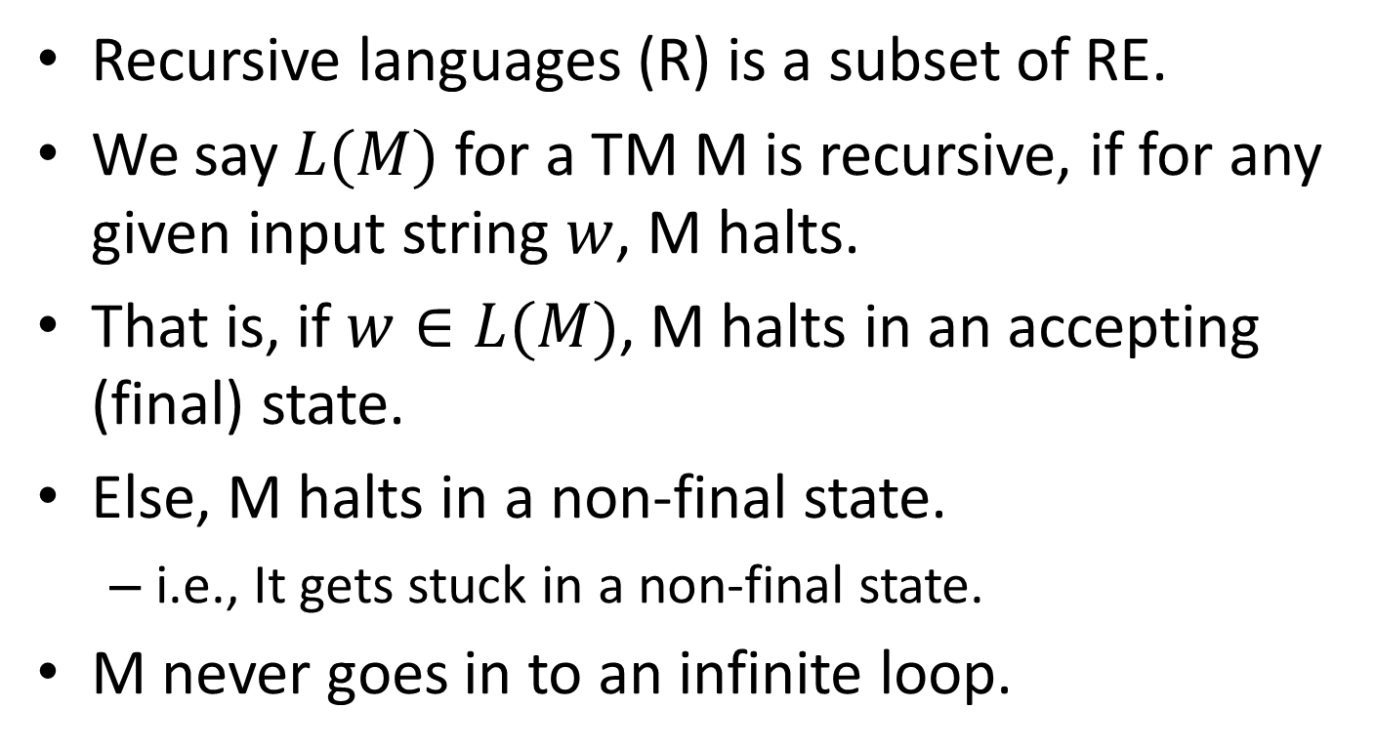
Recursive languages

Slide 40
RE Vs. R
RE
R
A TM M recognizes.
A TM M decides.

Slide 41
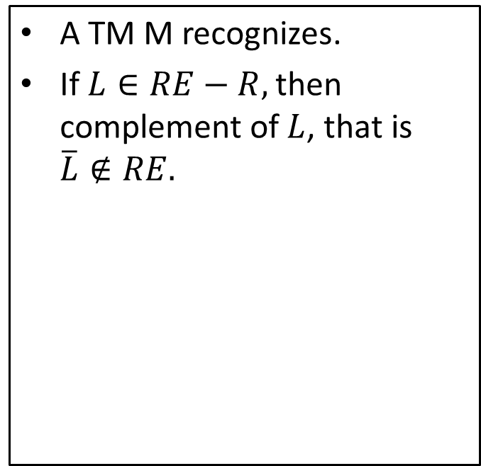
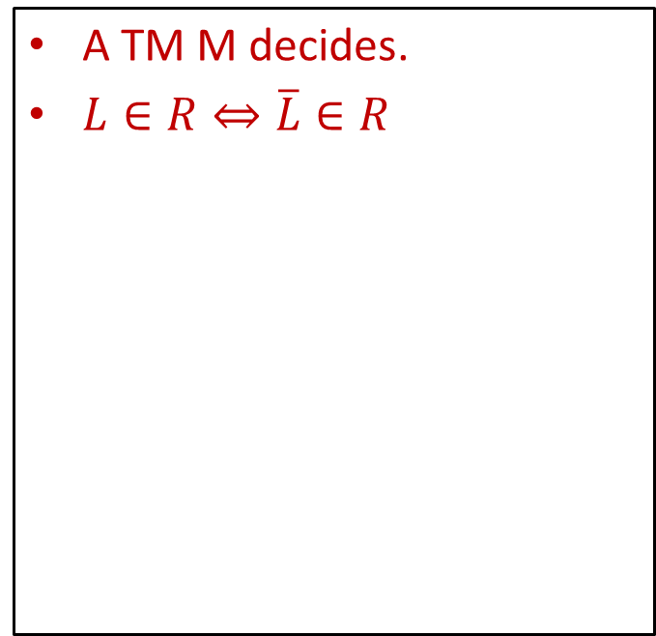
RE Vs. R
RE
R

Slide 42
RE Vs. R
RE
R

Slide 43
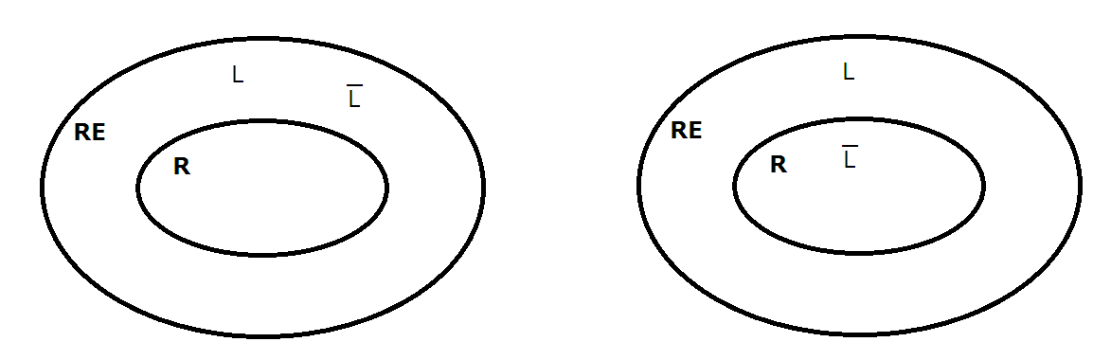
Not Possible

Slide 44
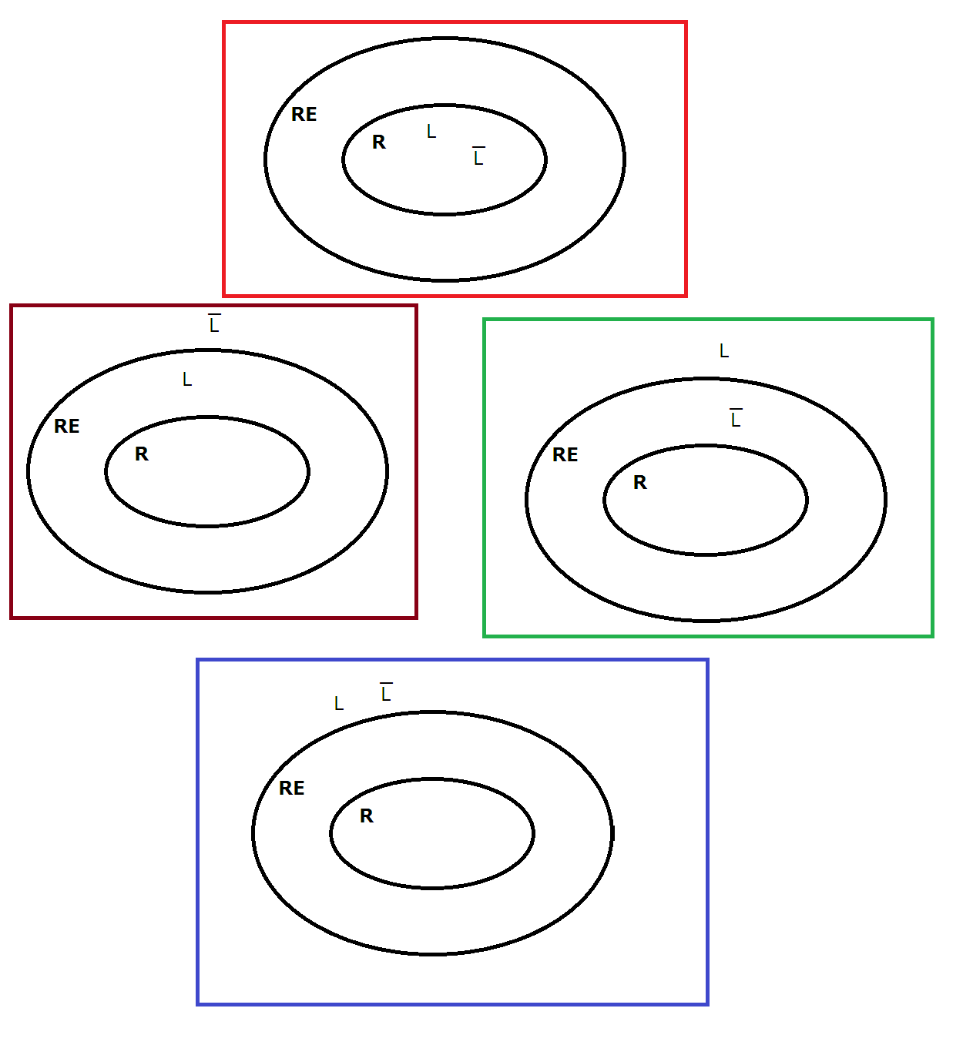
Possible

