Slide 1
Variants of TM
Multi-track, multi-tape, NTM
https://www.andrew.cmu.edu/user/ko/pdfs/lecture-14.pdf

Slide 2
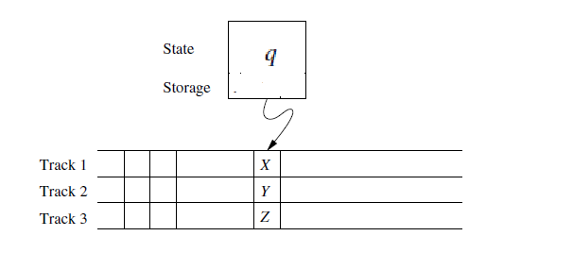
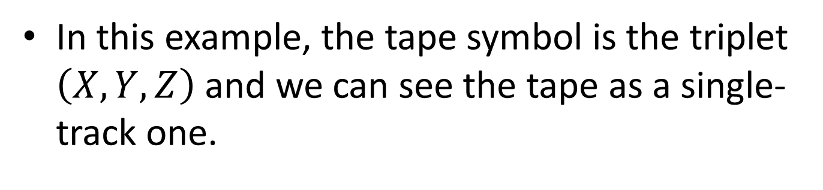
Multi-track

Slide 3
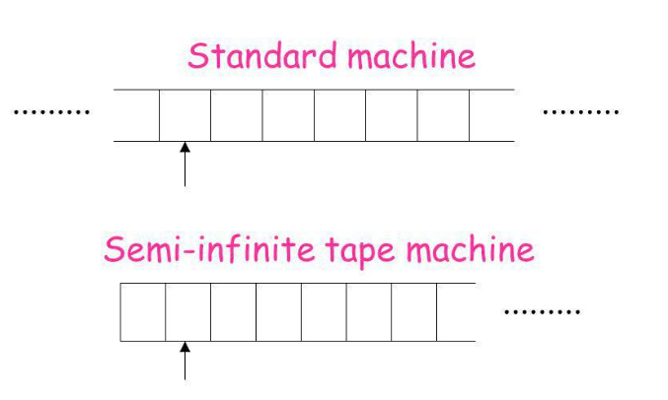
Semi-infinite tape

Slide 4
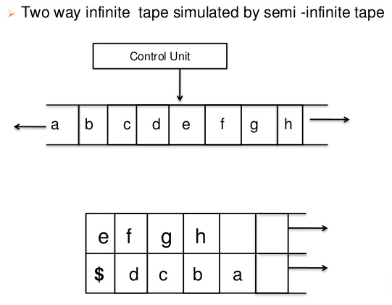
Simulation of two way infinite by semi-infinite tape

Slide 5
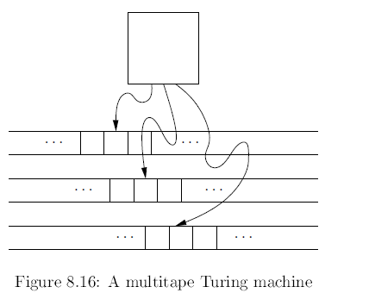
Multi-tape

Slide 6
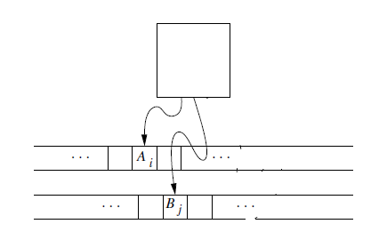
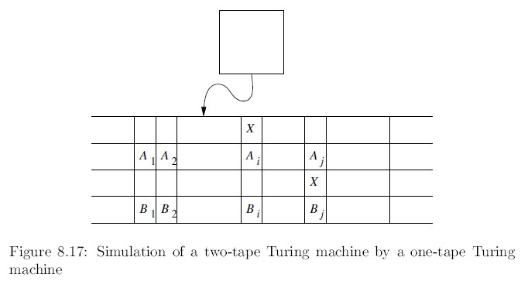
Simulation of multi-tape by one-tape

Slide 7
NONDETERMINISTIC TM
NTM

Slide 8
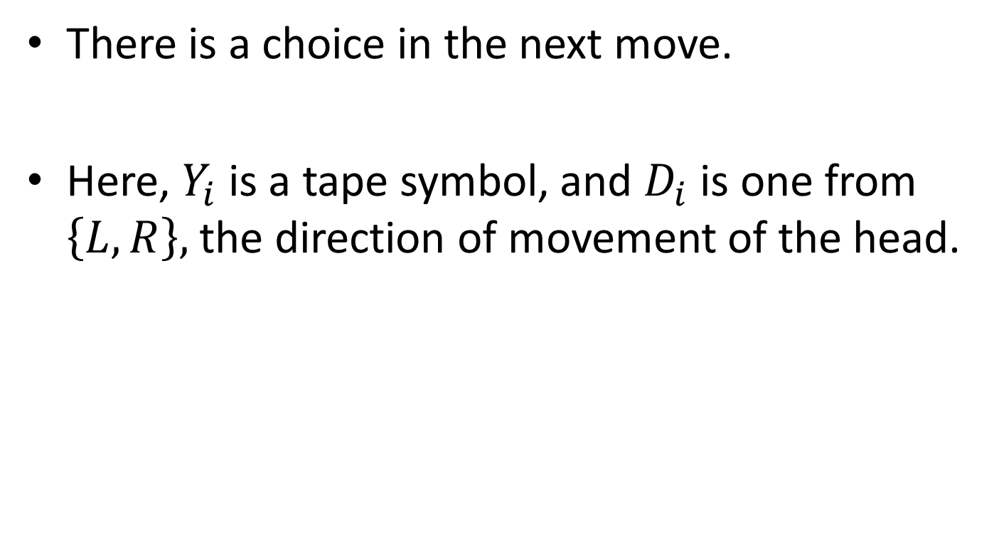


Slide 9
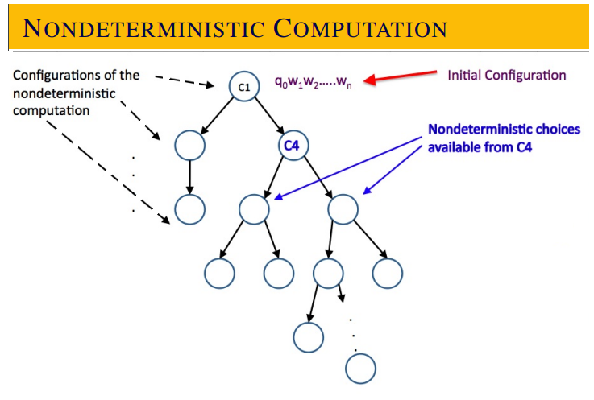

Slide 10
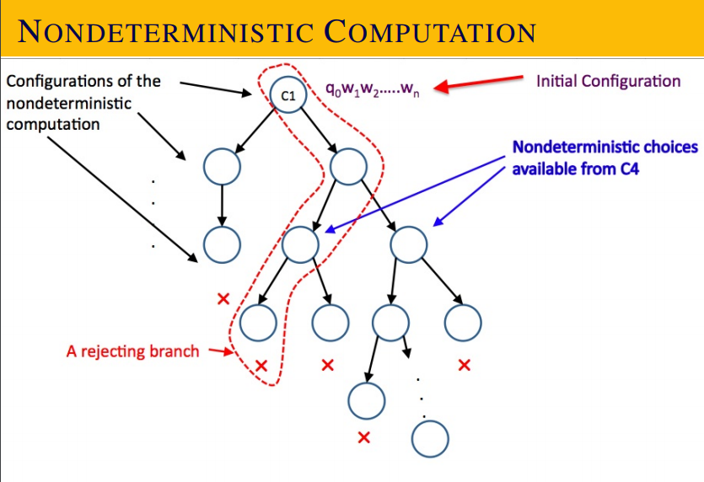

Slide 11
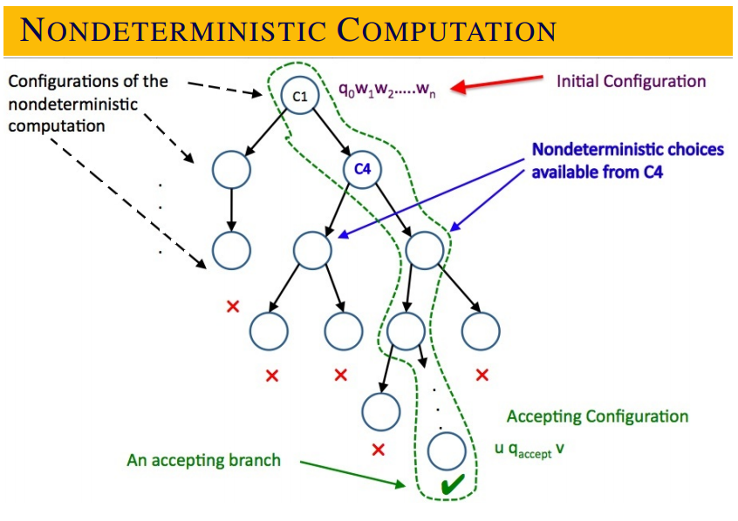

Slide 12
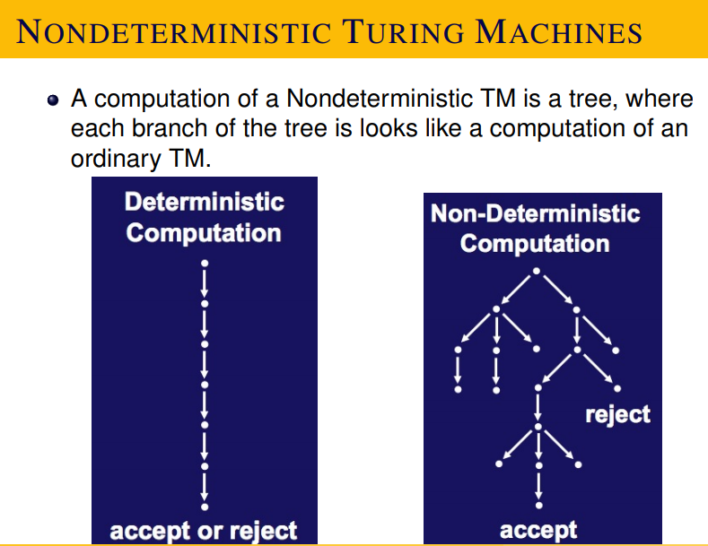

Slide 13
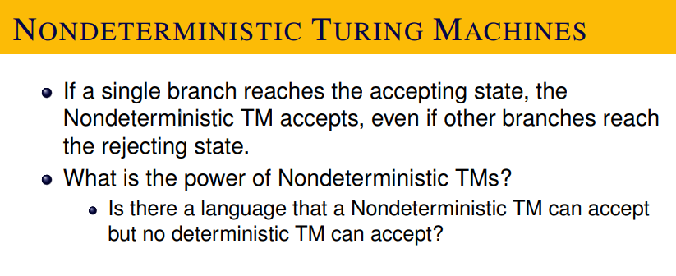
Note, NTM rejects means
Each of the branch either explicitly rejects (by getting stuck in a non-final state), or goes in to an infinite loop.

Slide 14
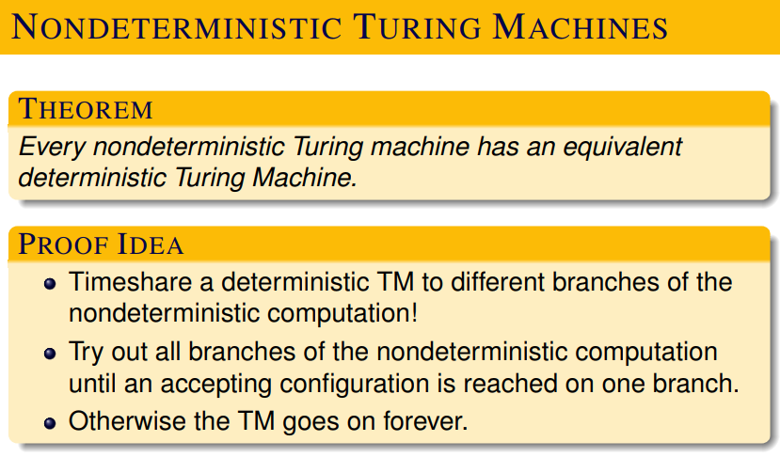

Slide 15
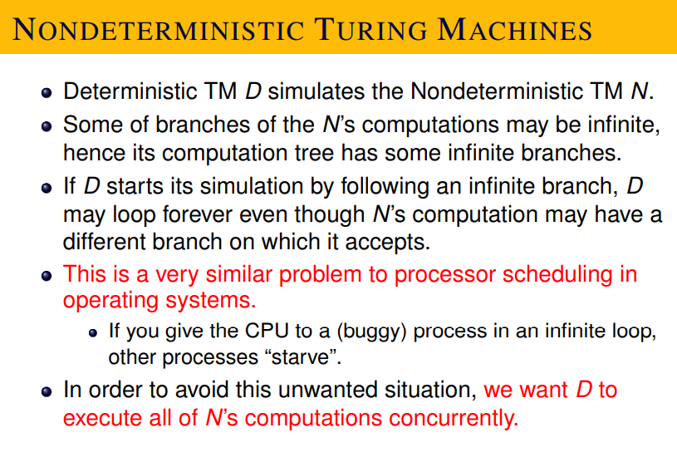

Slide 16
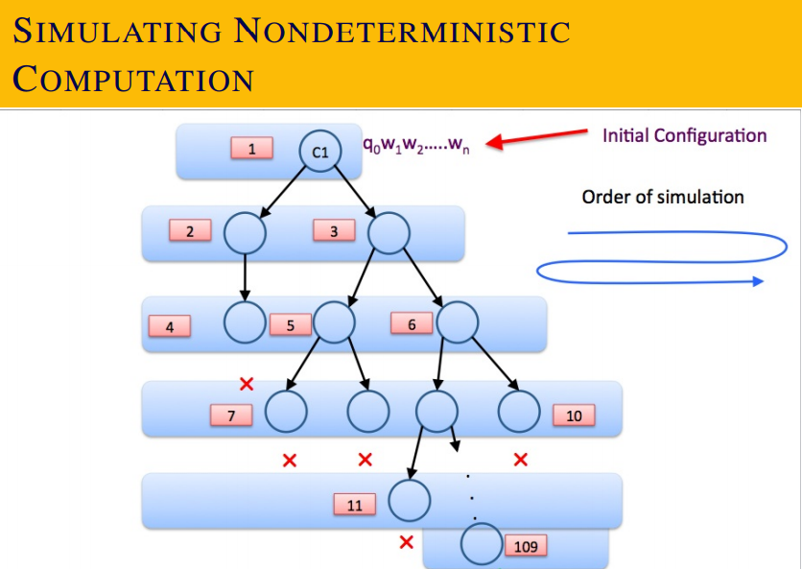

Slide 17
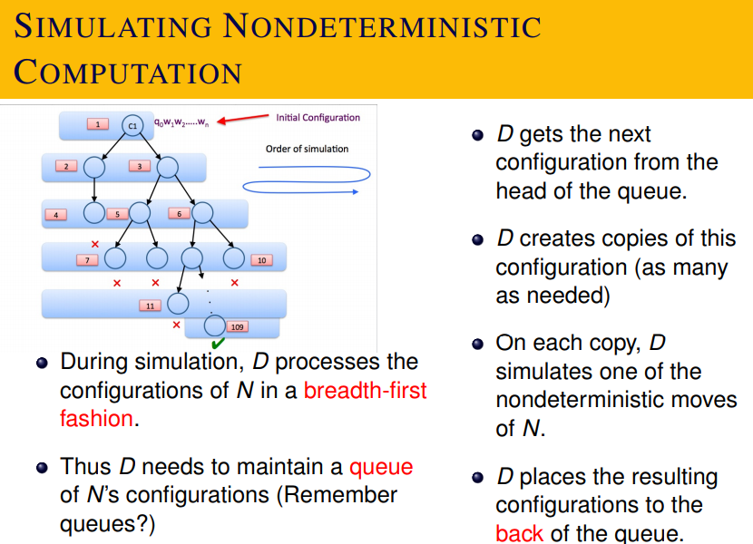

Slide 18
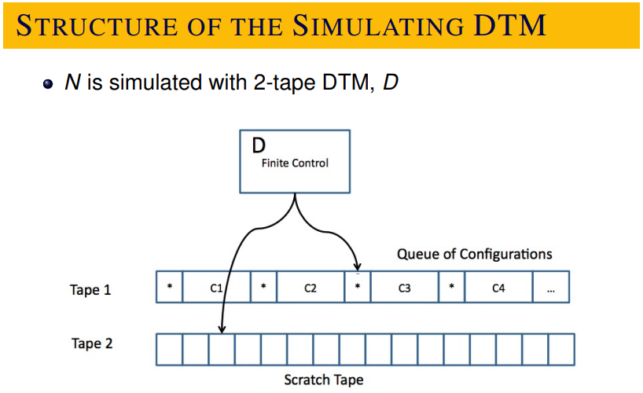

Slide 19


Slide 20
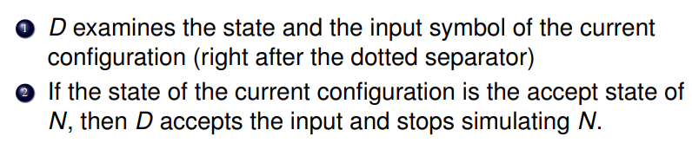

Slide 21
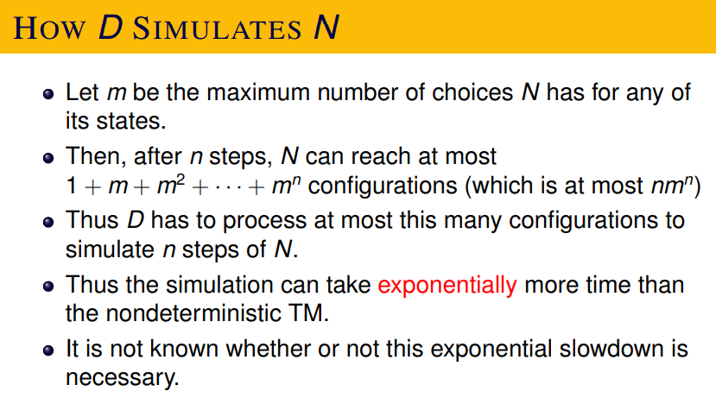

Slide 22
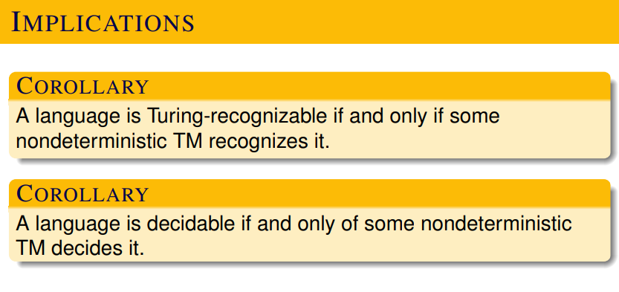

Slide 23
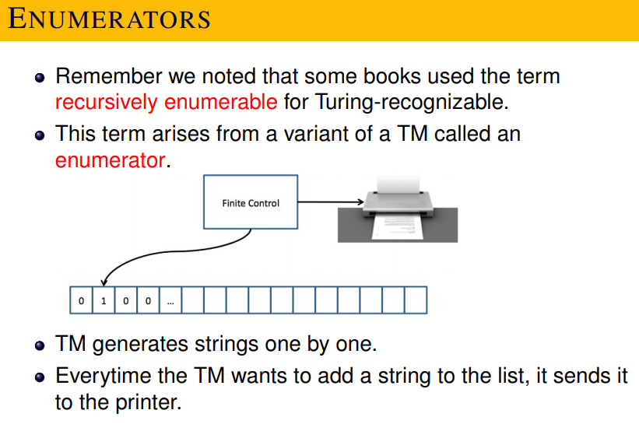

Slide 24
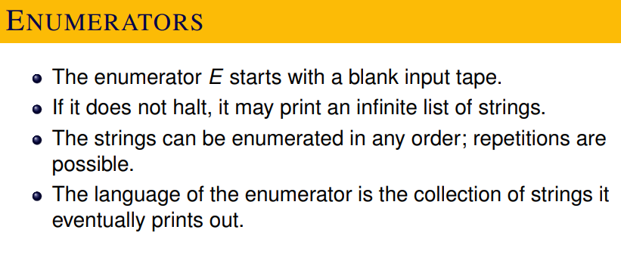

Slide 25
We can assume that the enumerator E writes one string at a time over a tape (it can use a tape symbol # to separate strings).

Slide 26
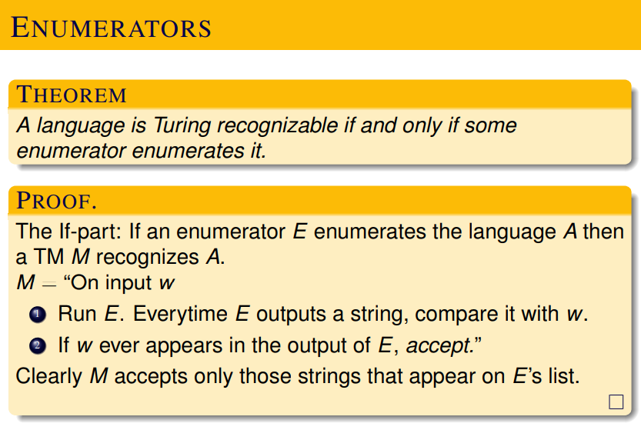

Slide 27
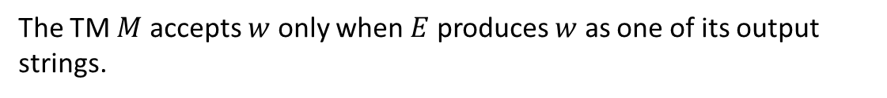

Slide 28
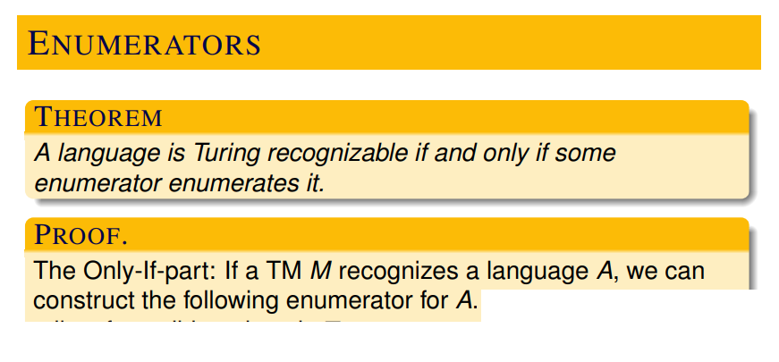
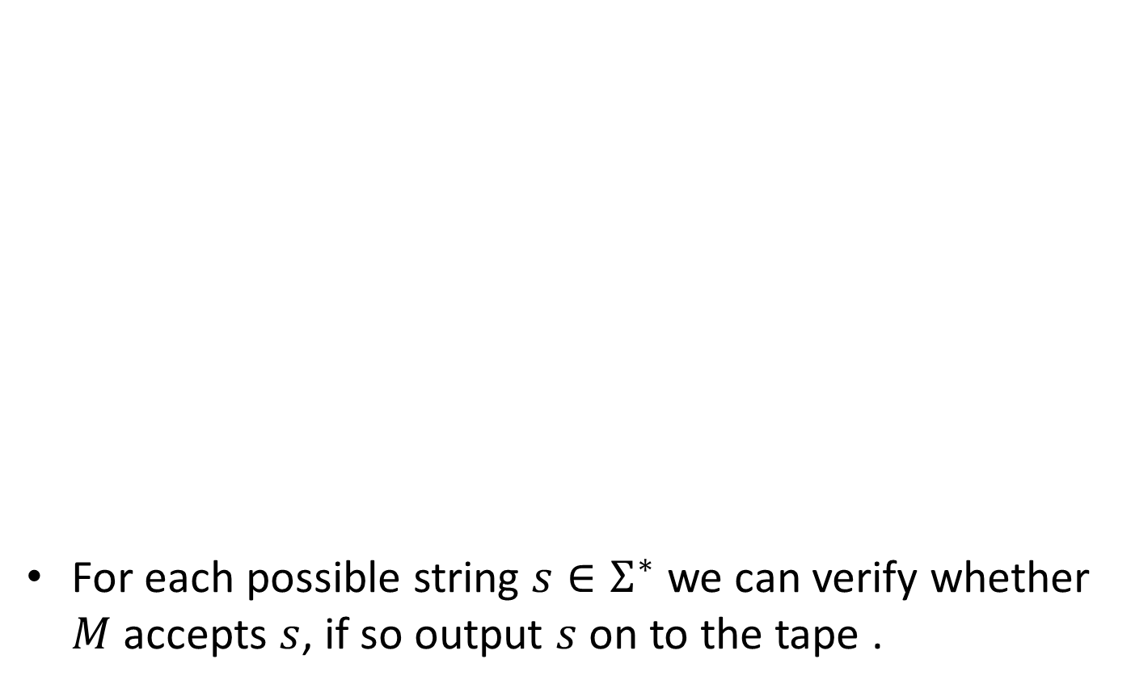

Slide 29
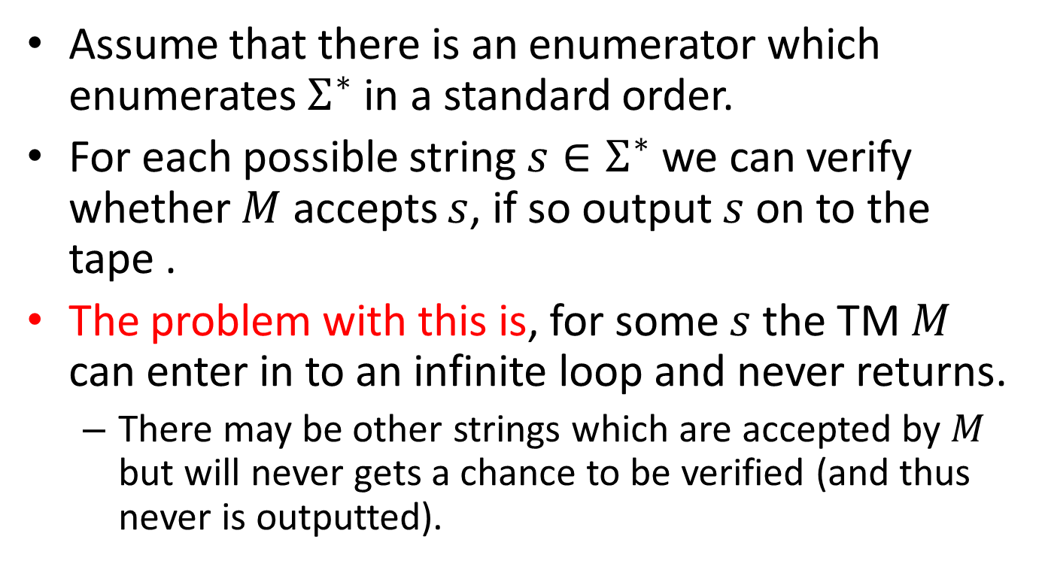
Following attempt, does not work.

Slide 30
A feasible way of doing this (without falling in to an infinite loop) is given in the next slide.
Basic idea:
For example if there are two strings w1 and w2 and one of them makes the TM to loop infinitely. Do the following.
k = 1
Run TM for k steps on w1 and if accept occurs then output “accept” and stop.
Run TM for k steps on w2 and if accept occurs then output “accept” and stop.
k++; goto step 2.

Slide 31
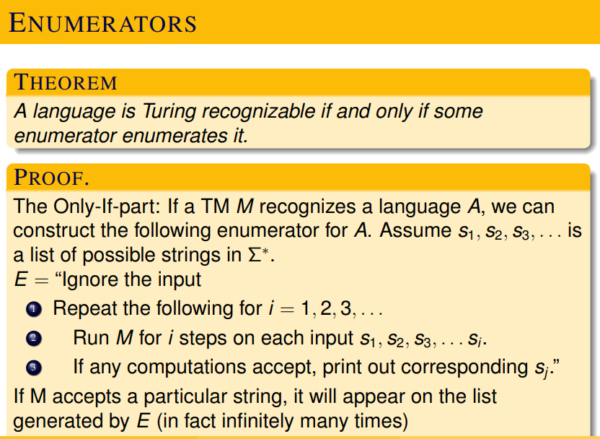

Slide 32
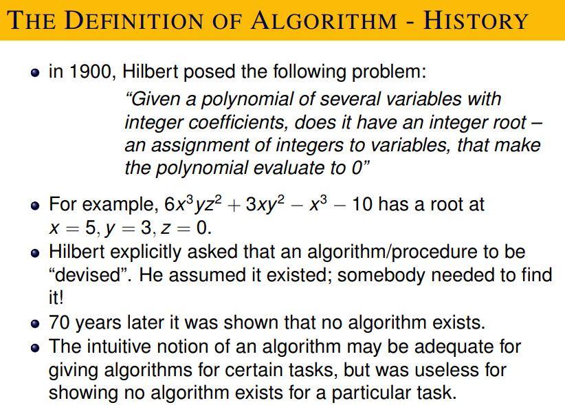
This is known as Hilbert’s Tenth Problem.

Slide 33
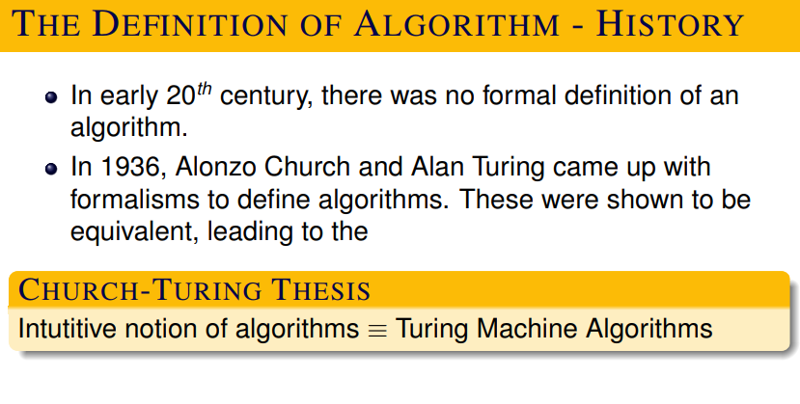

Slide 34
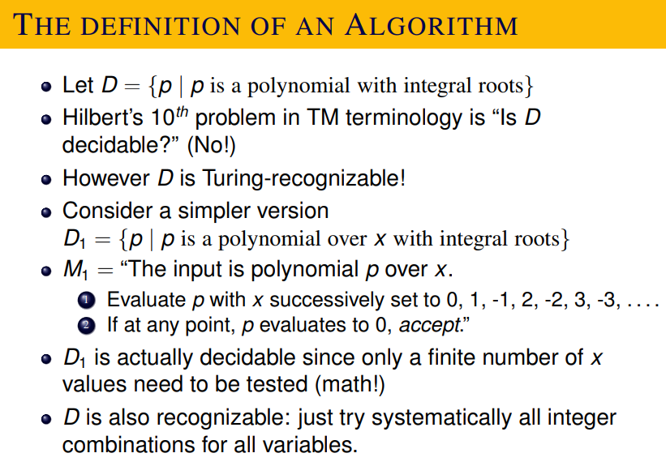

Slide 35
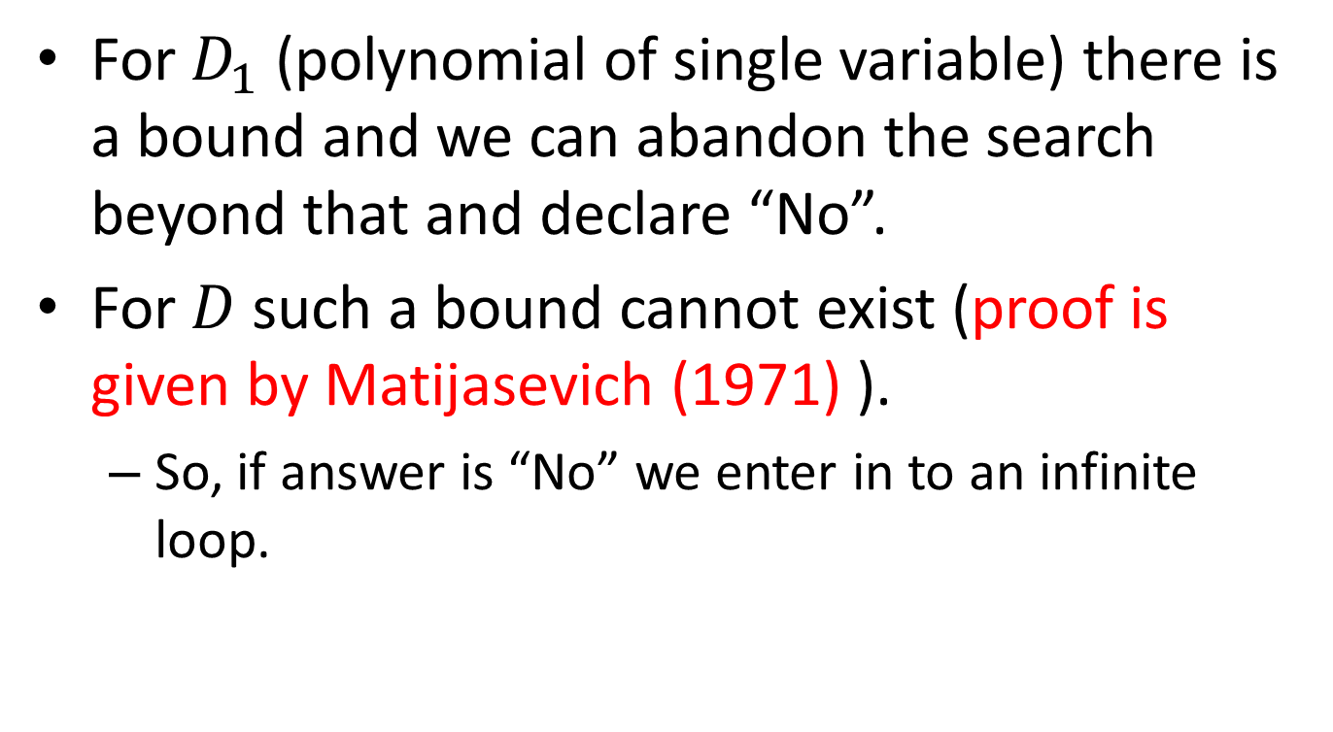
In 1971, Yuri Matijasevich gave a resounding negative answer to Hilbert’s tenth problem.

Slide 36
This is called undecidability.
Hilbert’s tenth problem is undecidable.
We will see the theory behind this in the next …

