Slide 1
Decidability
Theory behind existence of undecidable problems – Halting Problem --
Ref: https://www.andrew.cmu.edu/user/ko/pdfs/lecture-15.pdf

Slide 2
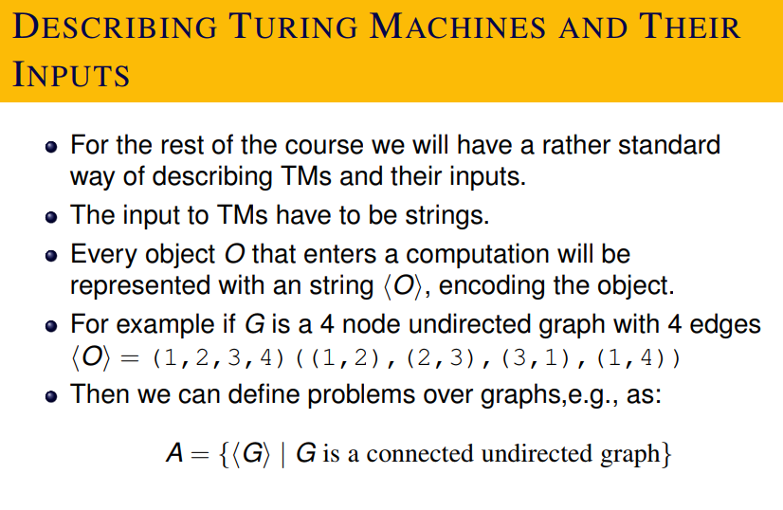
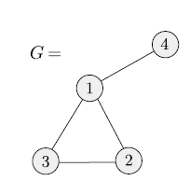

Slide 3
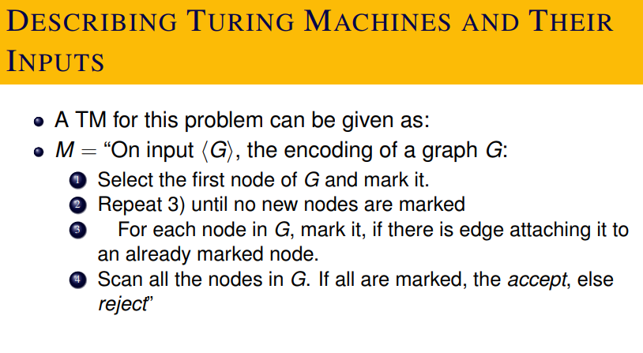

Slide 4
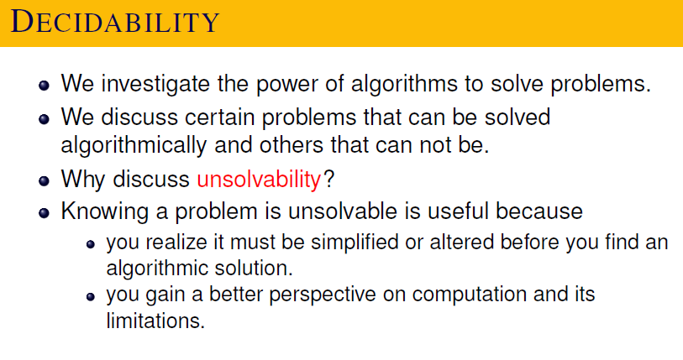

Slide 5
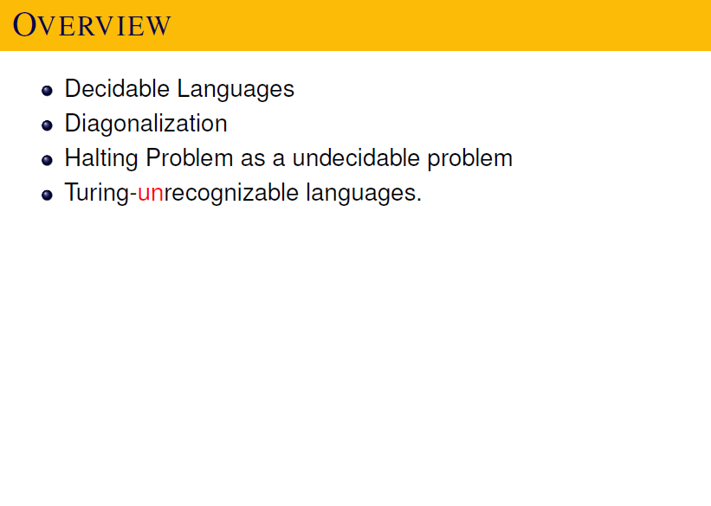

Slide 6
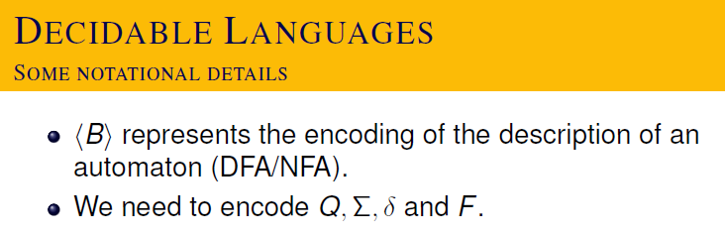

Slide 7
Important thing to understand is that a machine (computing machine) can be represented as a string in some language.
It will be a string over some alphabet.
This is, in some sense, equivalent to say that program is also data.

Slide 8
Representation Vs. Real Thing
DNA represents a living thing (like a human-being).
Some people believe (!) that this is a complete description of a human being.
You can know his personality, you can even know what he will do in future?
Some Hollywood movies captured this idea.

Slide 9
A representation in itself is lifeless.
A program in itself cannot process the data.
It has to be realized through a processing unit or DNA has to be realized through a laboratory test tube or so.
But the processing unit, now can be entirely independent of the program.
It can execute any program.

Slide 10
We can give <program, data> to a general purpose computer which runs the program over the data and gives the output.

Slide 11
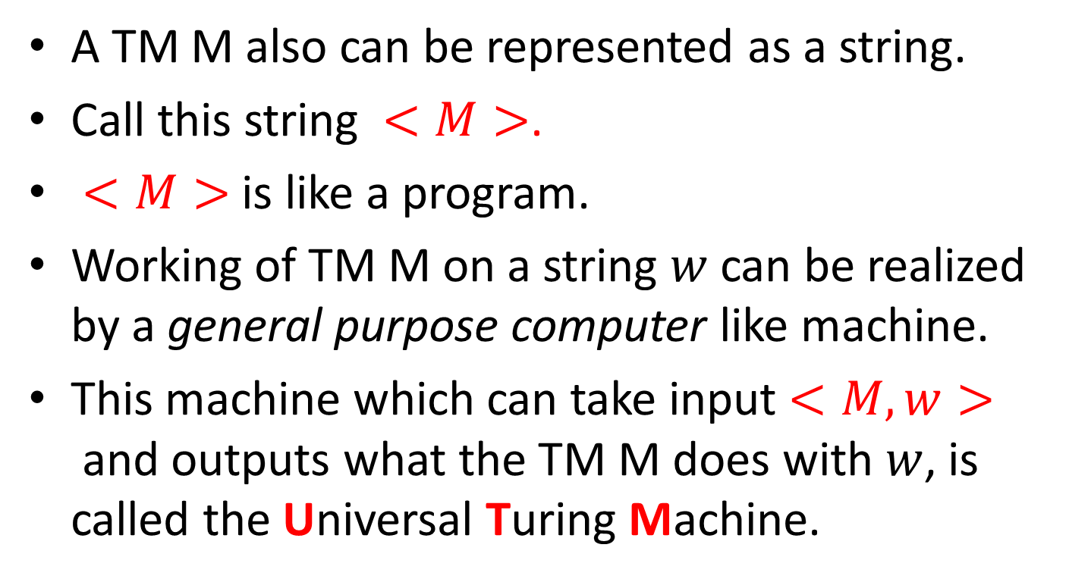

Slide 12
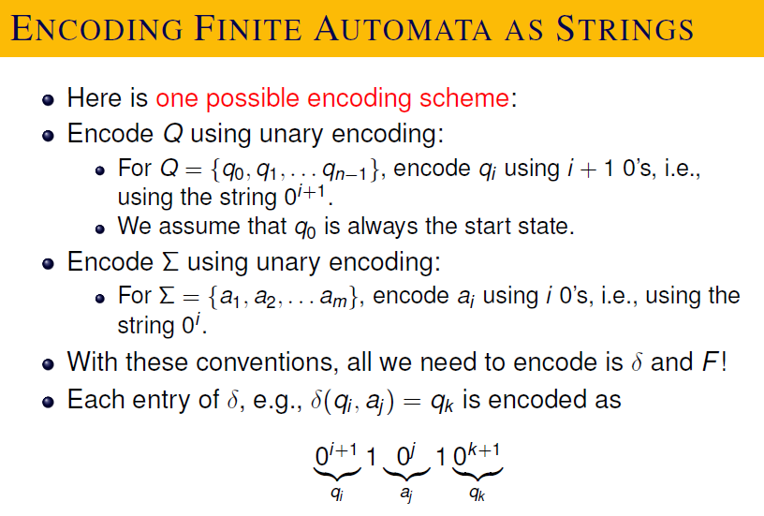

Slide 13
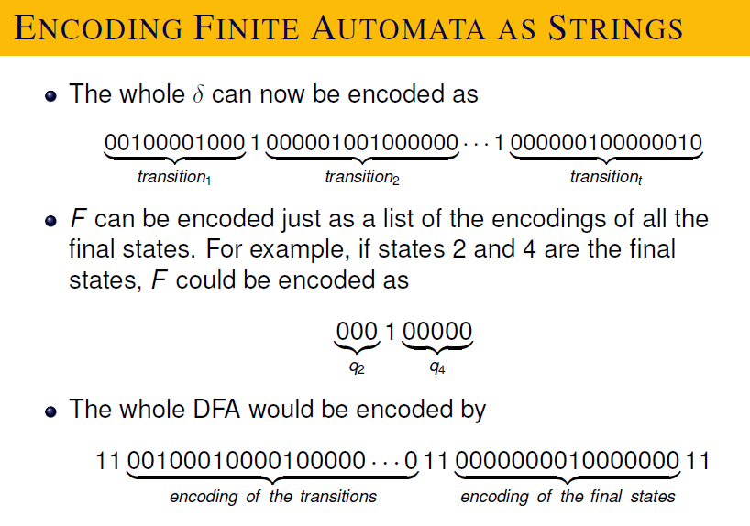

Slide 14
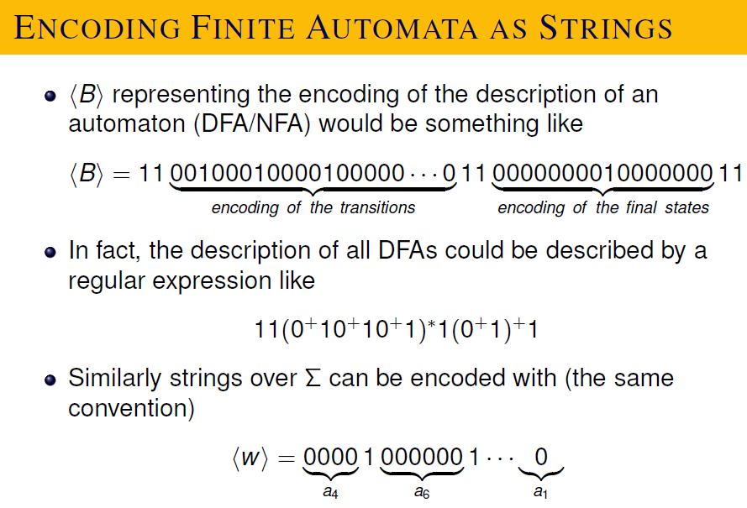

Slide 15
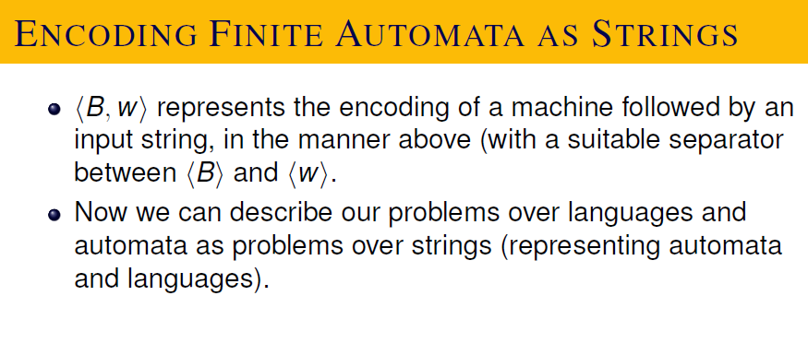

Slide 16
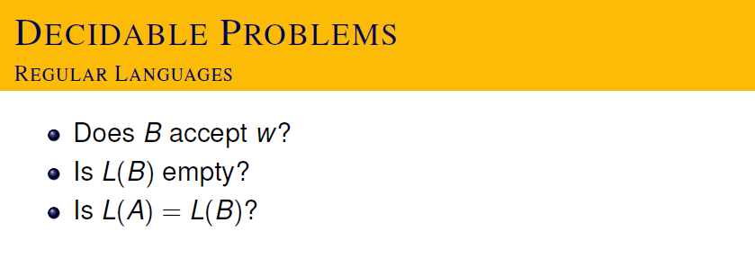

Slide 17
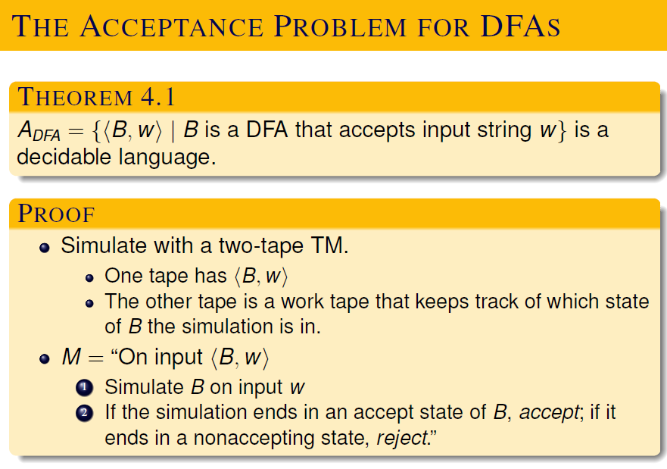

Slide 18
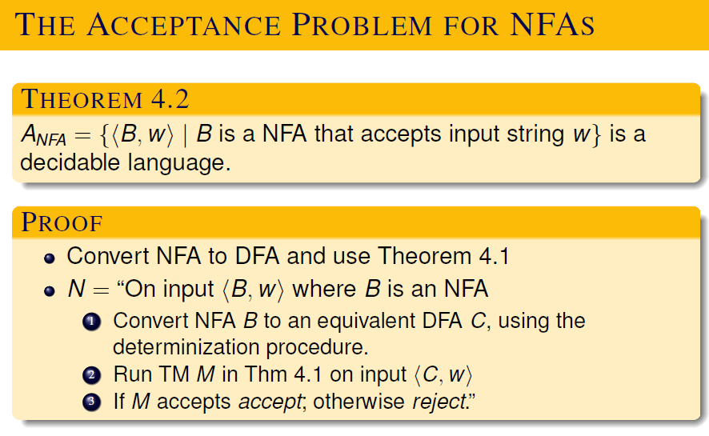

Slide 19
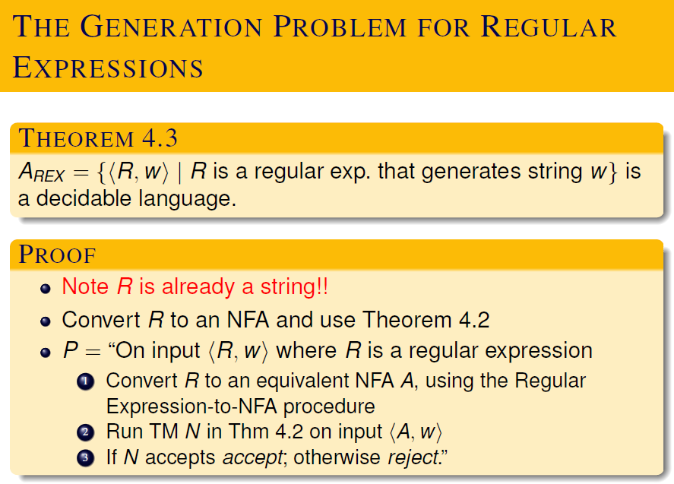

Slide 20
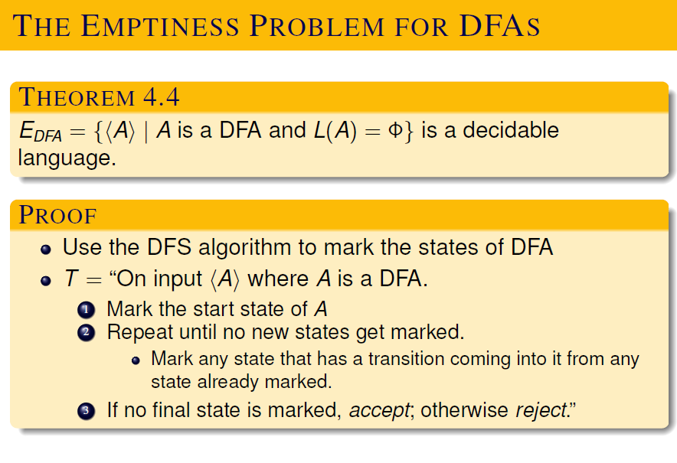

Slide 21
Is the following a decidable language?

Slide 22
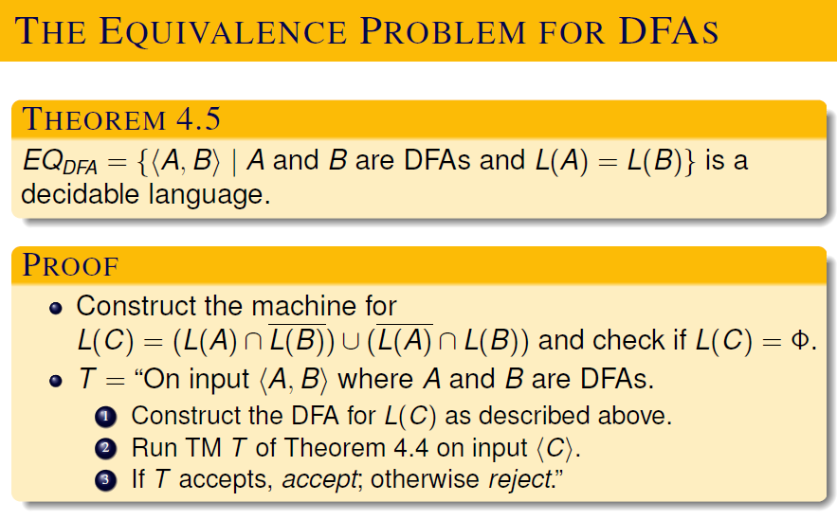

Slide 23
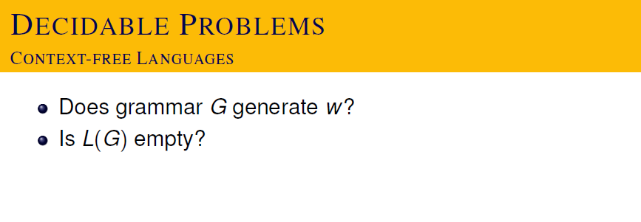

Slide 24
Is the following language decidable?

Slide 25
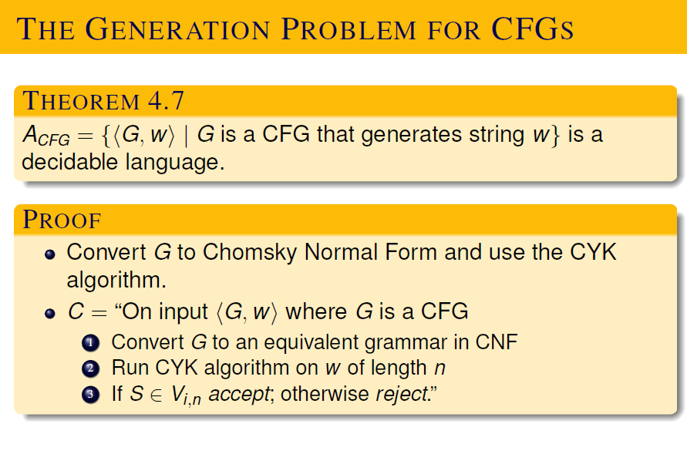

Slide 26
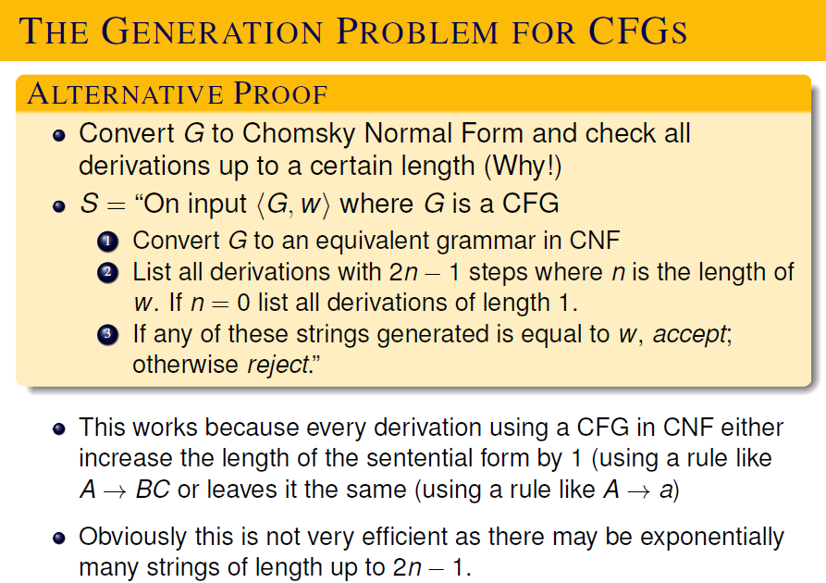

Slide 27
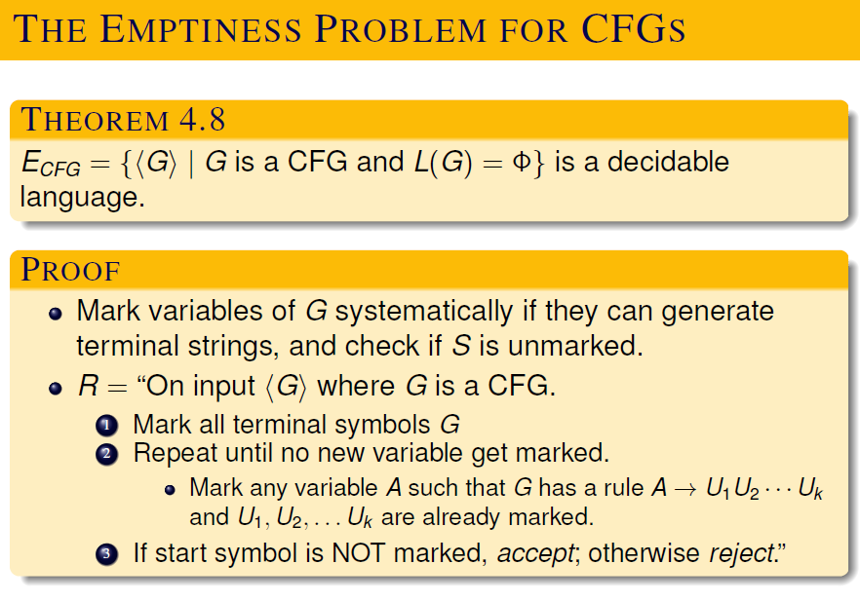

Slide 28
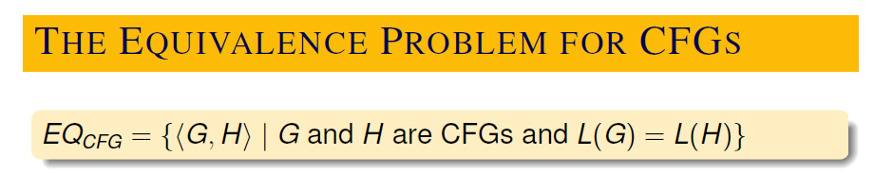
Is this decidable?

Slide 29
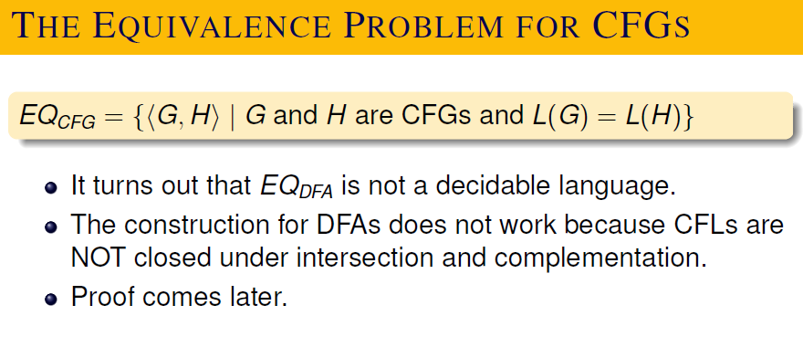

Slide 30
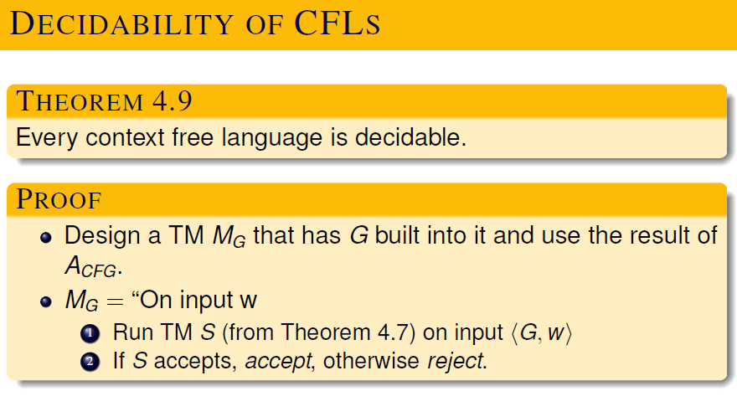

Slide 31
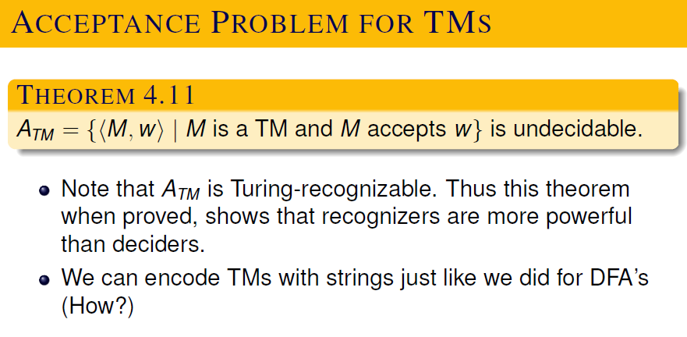

Slide 32
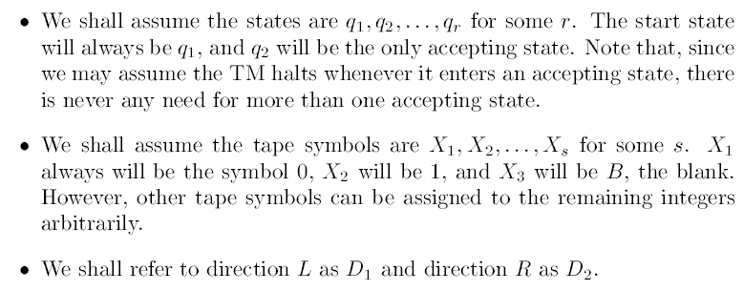

Slide 33
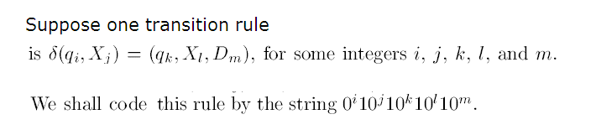

Slide 34
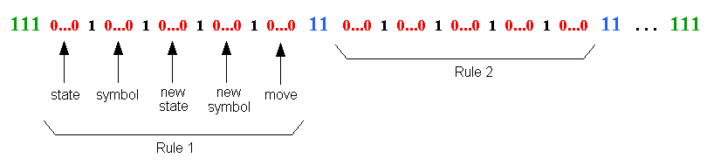
Encoding of a TM

Slide 35
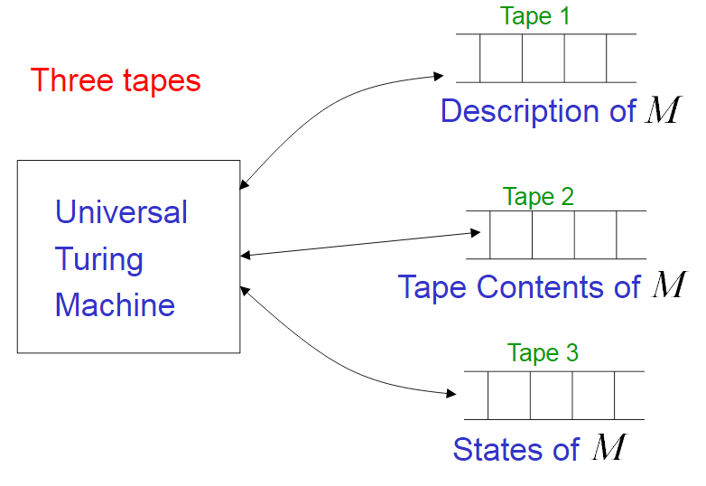

Slide 36
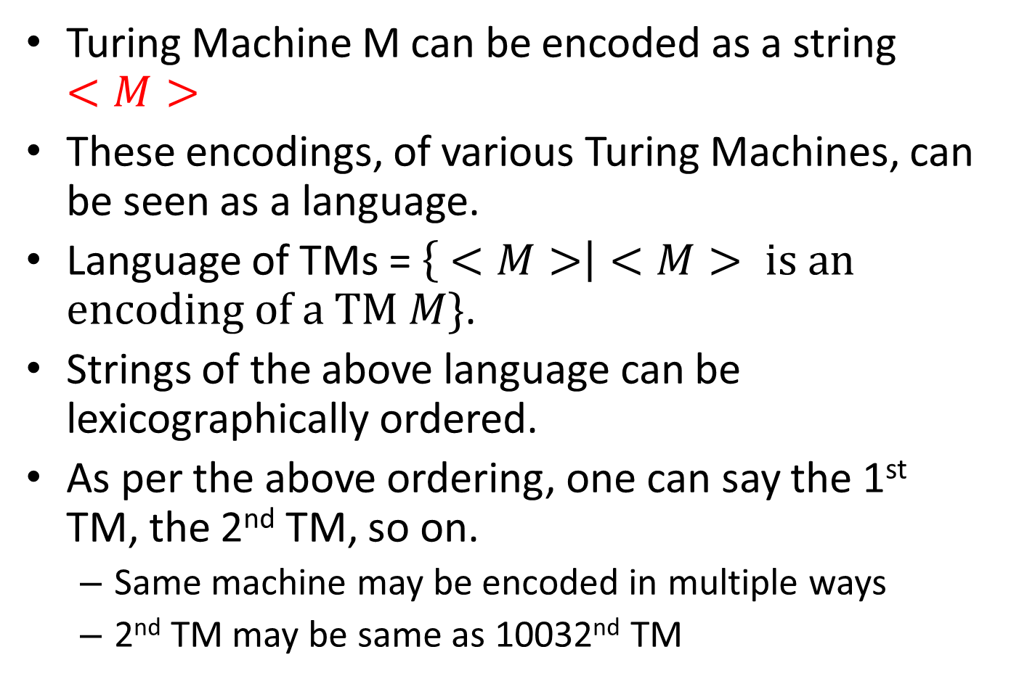

Slide 37
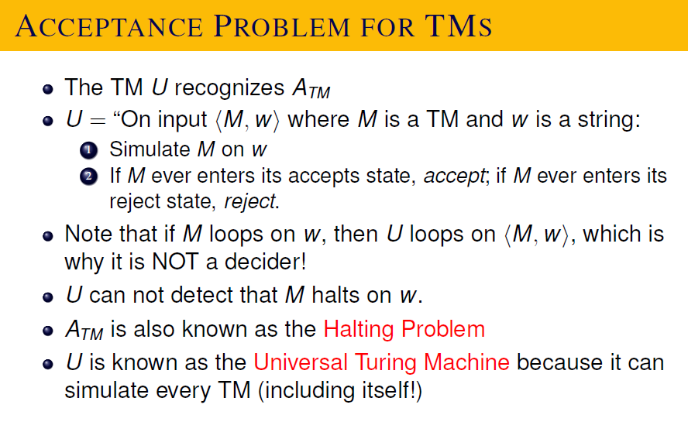

Slide 38
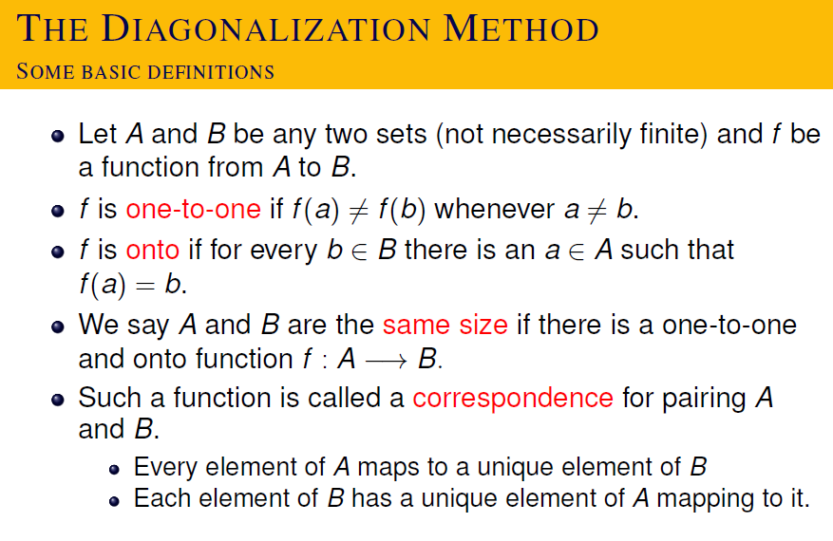

Slide 39
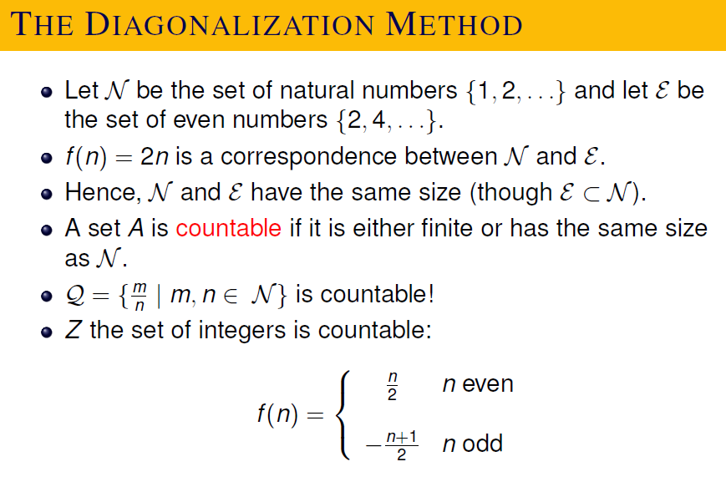

Slide 40
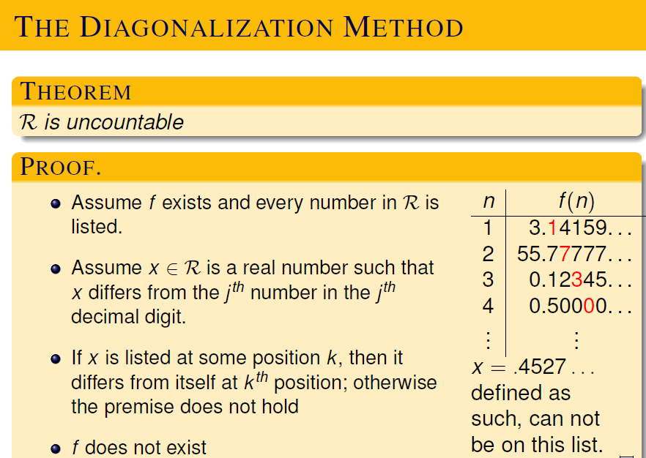

Slide 41
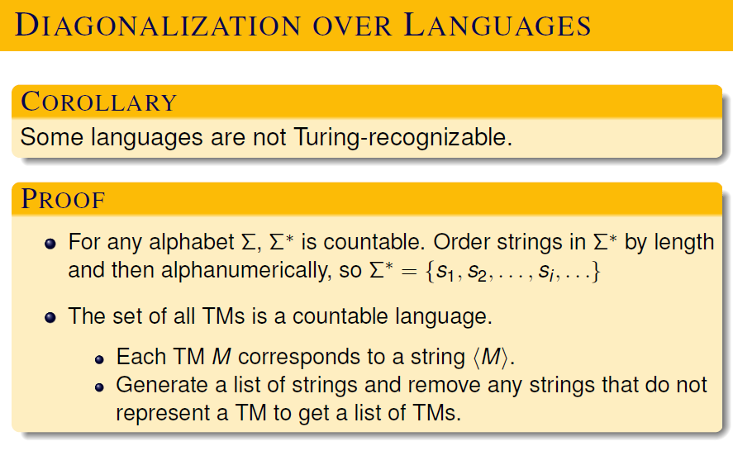

Slide 42
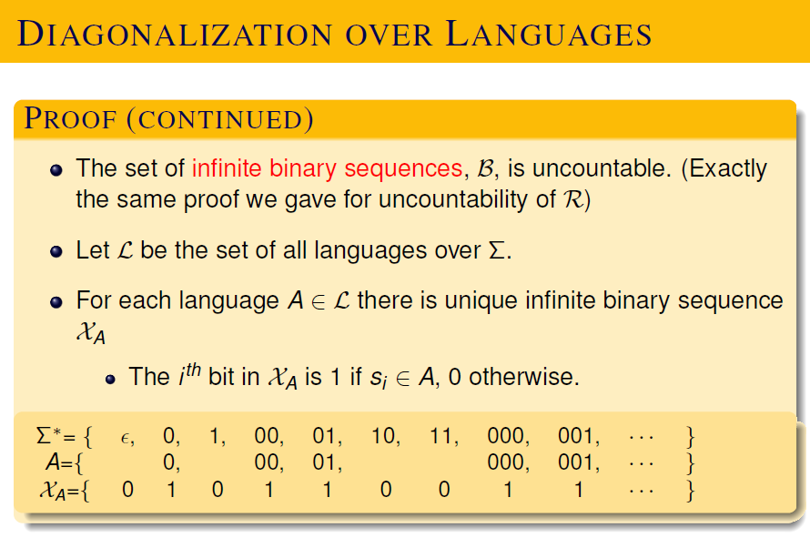

Slide 43
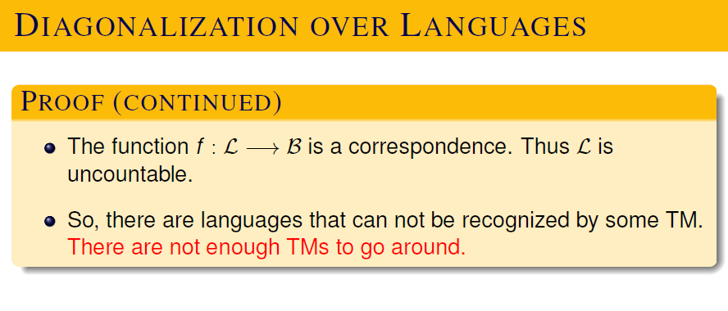

Slide 44
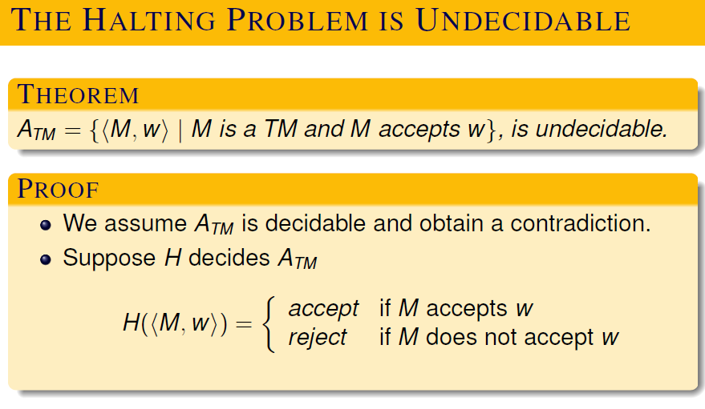

Slide 45
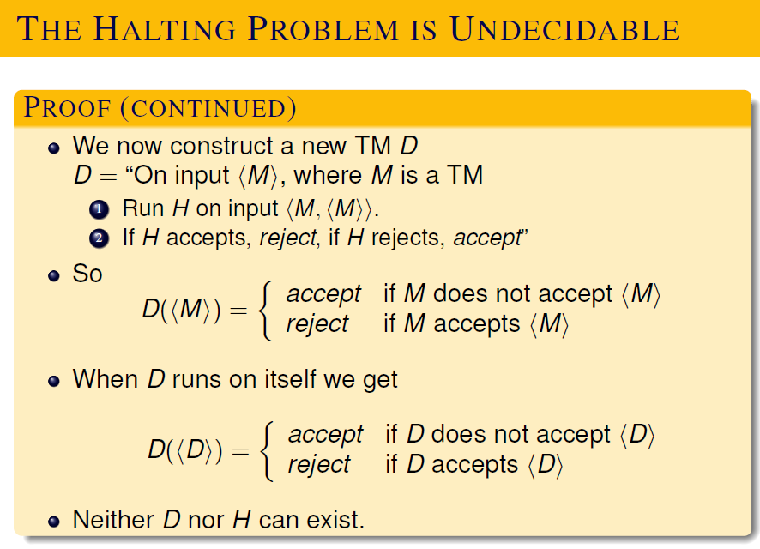

Slide 46
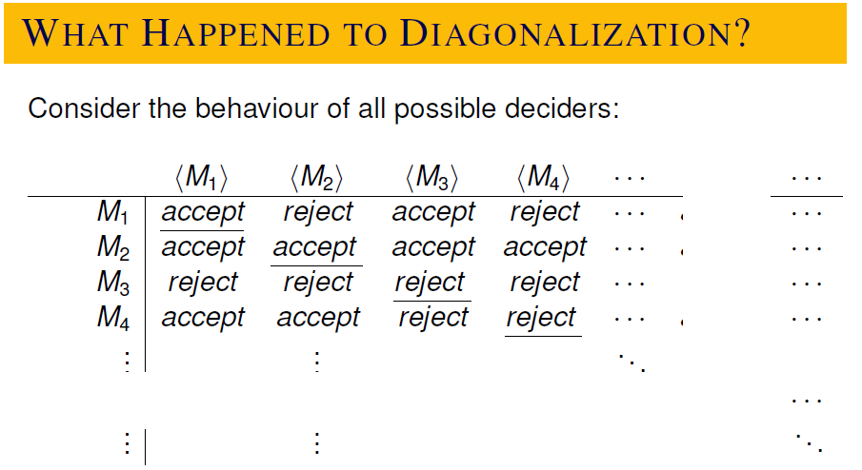

Slide 48
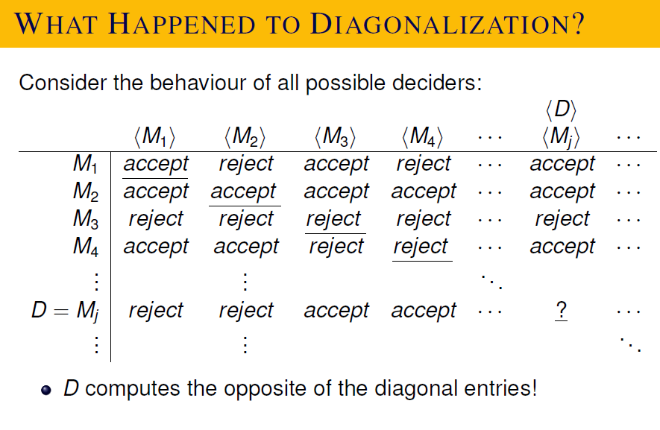

Slide 49
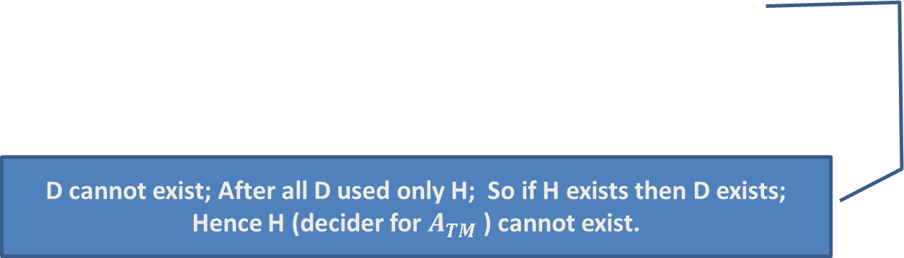

Slide 50
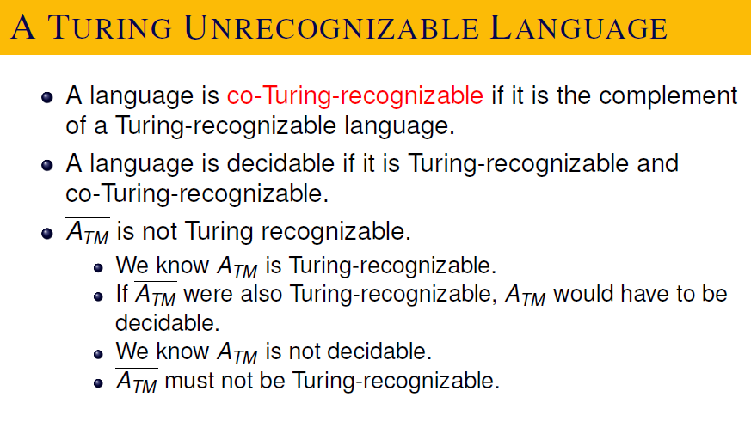

Slide 51
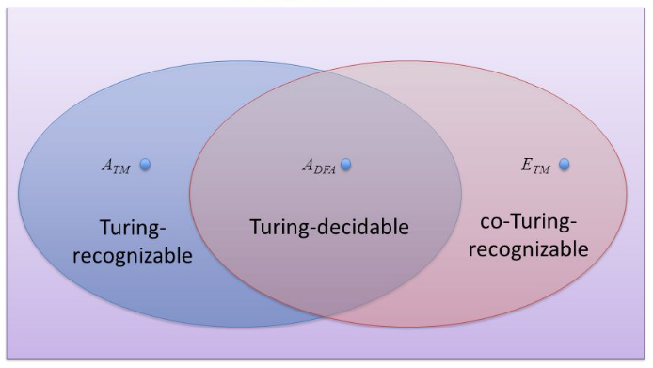
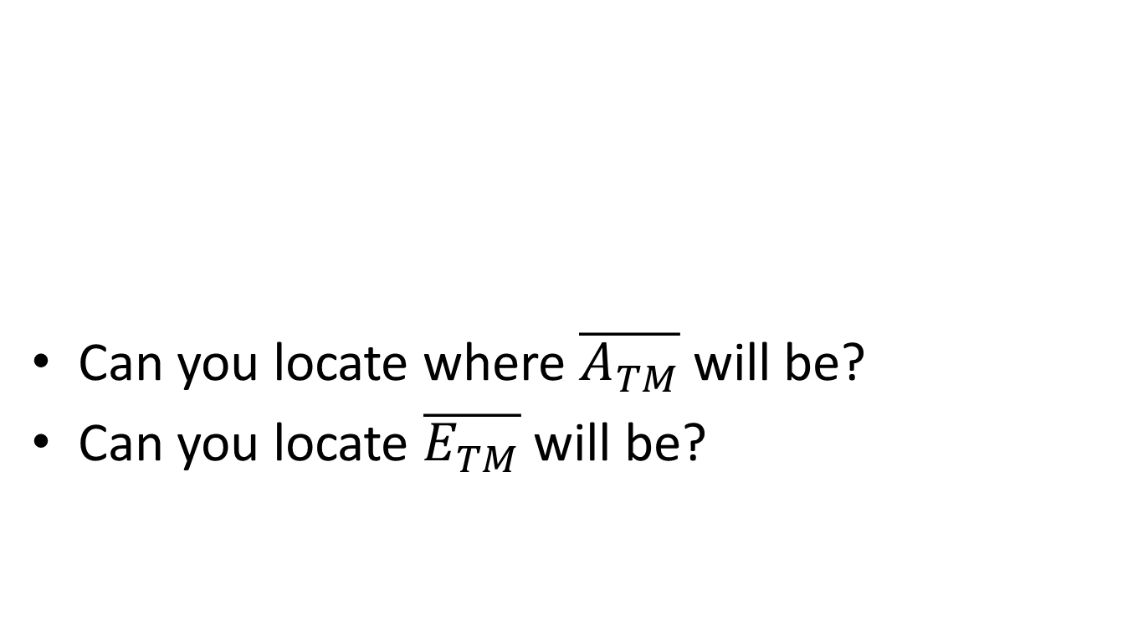

Slide 52
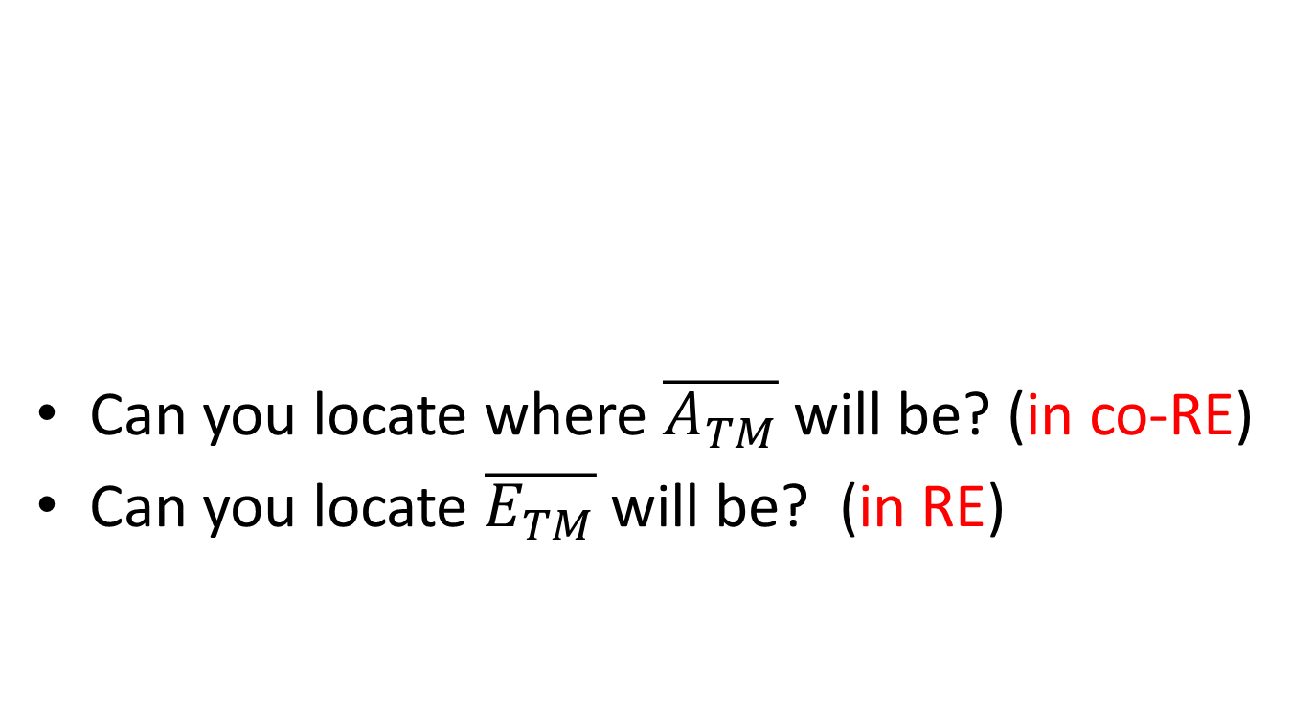

Slide 53
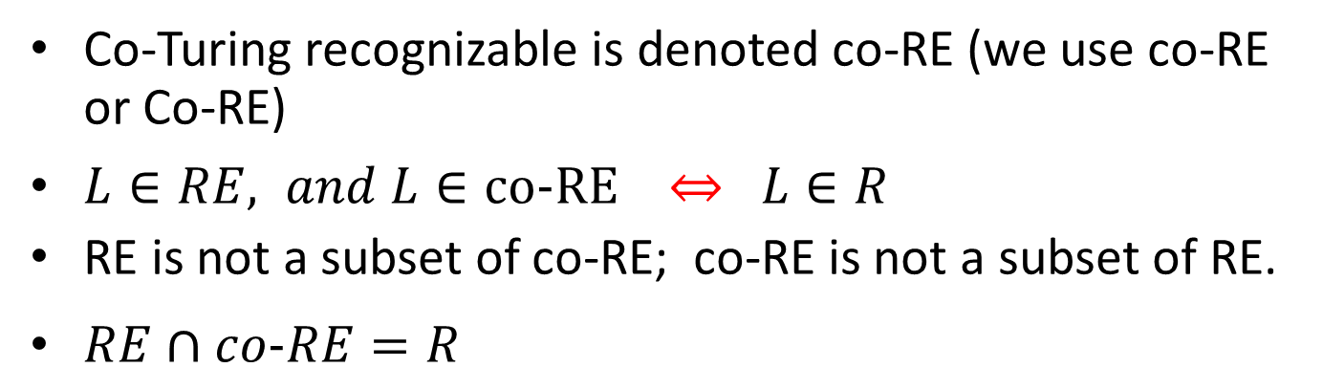

Slide 54
Preview …
Are there languages which are neither RE nor co-RE ?? (i.e. both the language and its complement are not in RE).

Slide 55
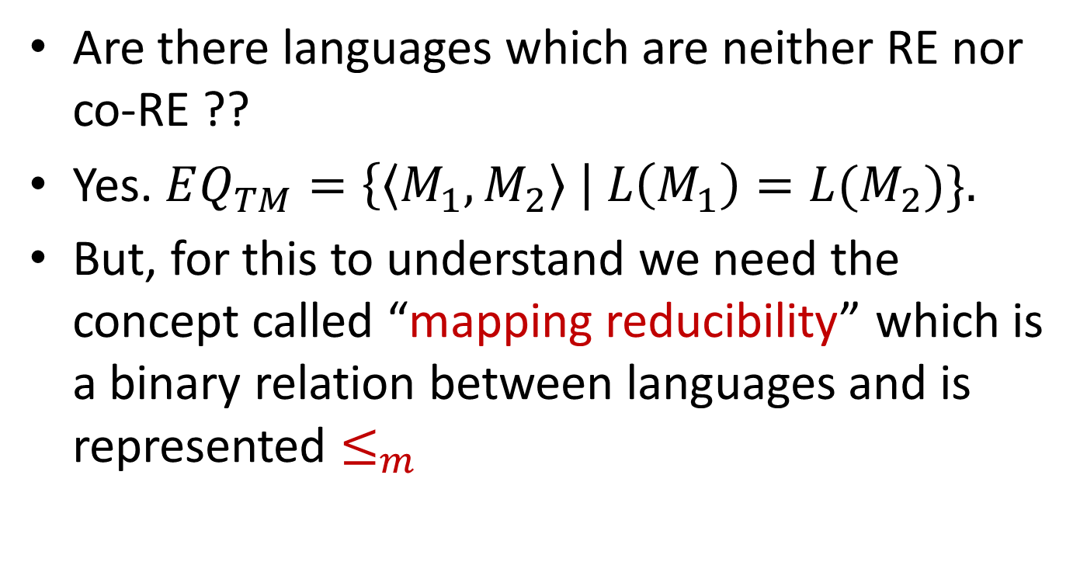
Preview …

Slide 56
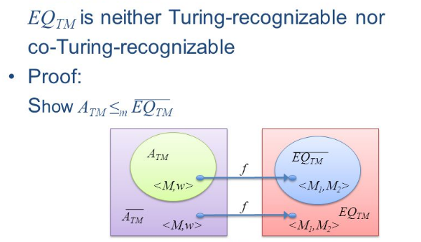
Preview …
Are there languages which are neither RE nor co-RE ??

