Slide 1
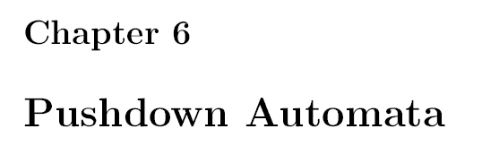

Slide 2
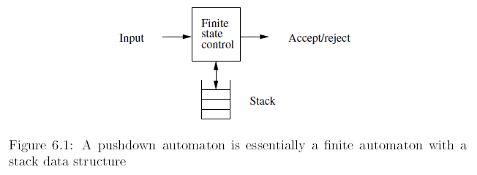
PDA is an extension of nondeterministic finite automaton with a stack (of infinite size).
DPDA -- deterministic version of PDA (but is not enough to recognize all CFLs).
(the languages recognized by DPDAs are called “deterministic CFLs”).

Slide 3
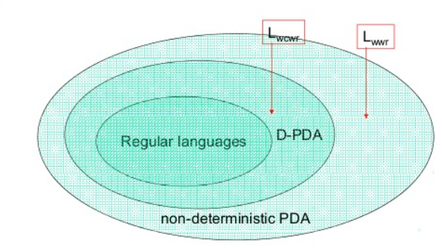
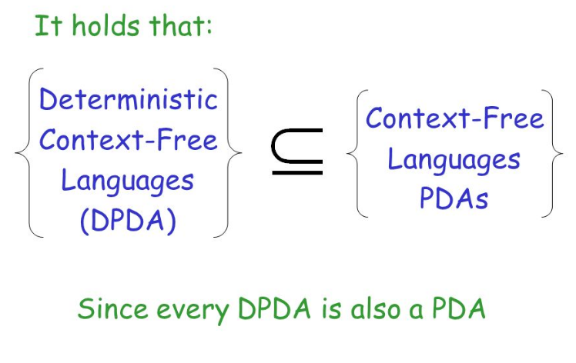

Slide 4
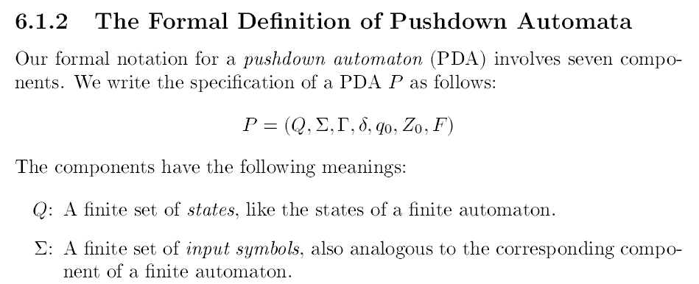

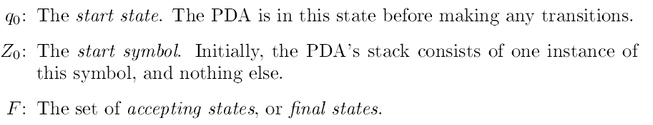

Slide 5
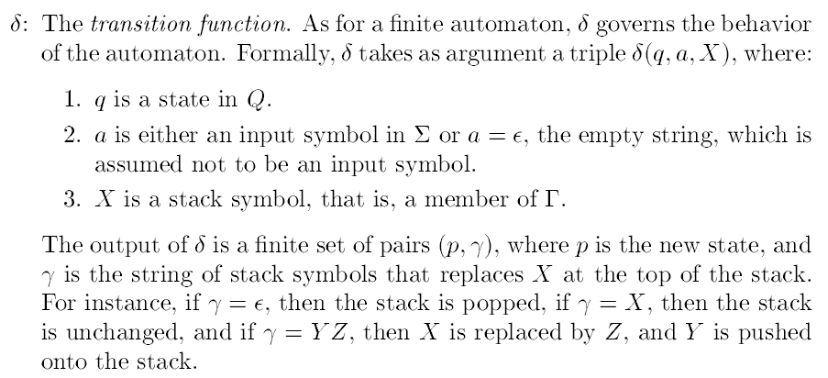

Slide 6

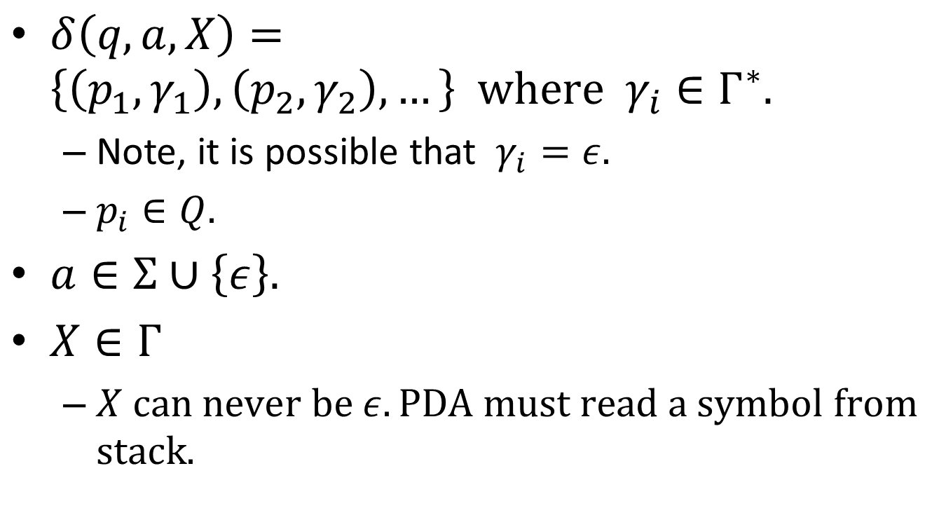
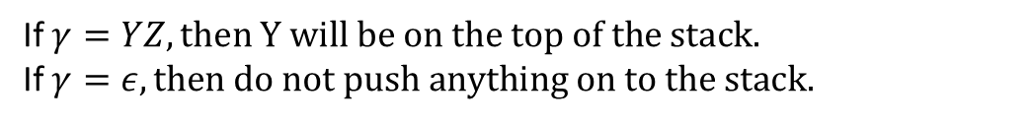
$δ\left(q,a,X\right)=\left\{\left(p_{1},γ_{1}\right),\left(p_{2}, γ_{2}\right),…\right\} \text{where} γ_{i}∈Γ^{∗}.$
Note, it is possible that $γ_{i}=ε.$
$p_{i}∈Q.$
$a∈Σ∪\left\{ε\right\}.$
$X∈Γ$
$X \text{can} \text{never} \text{be} ε. \text{PDA} \text{must} \text{read} \text{a} \text{symbol} \text{from} \text{stack}\text{.}$
If $γ=YZ, \text{then} \text{Y} \text{will} \text{be} \text{on} \text{the} \text{top} \text{of} \text{the} \text{stack}.$
If $γ=ε, \text{then} \text{do} \text{not} \text{push} \text{anything} \text{on} \text{to} \text{the} \text{stack}.$

Slide 7
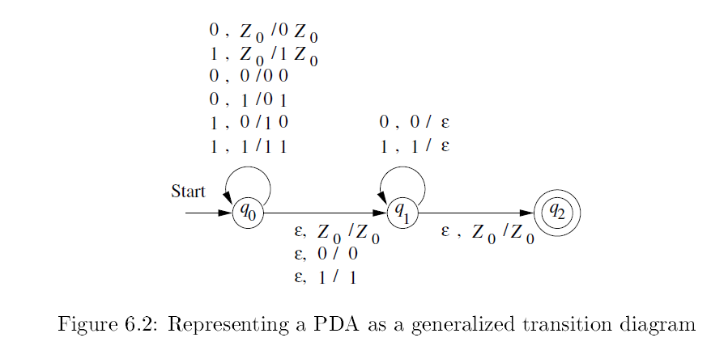

$$L_{wwr}$$

Slide 8
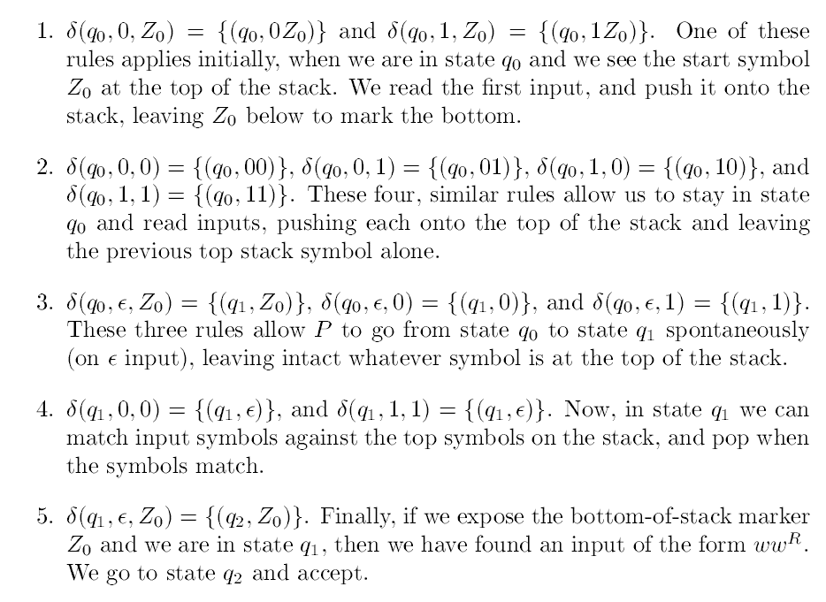

Slide 9
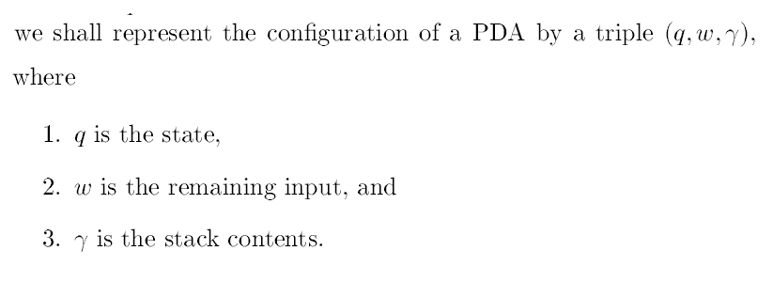

Slide 10
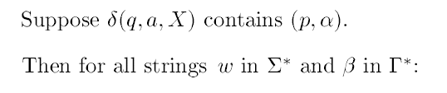


One step, and several steps

Slide 11
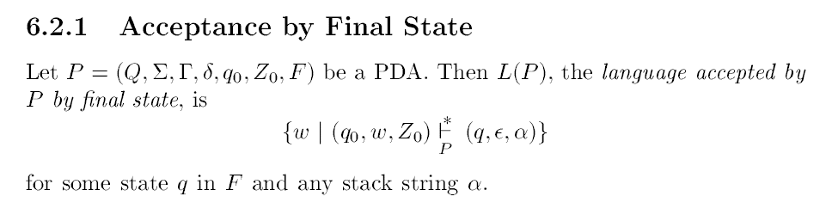

Slide 12
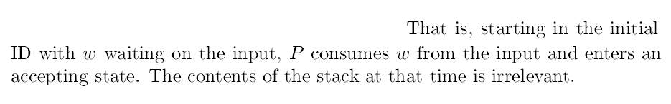

Slide 13
Do we have some other acceptance criterion?!

Slide 14
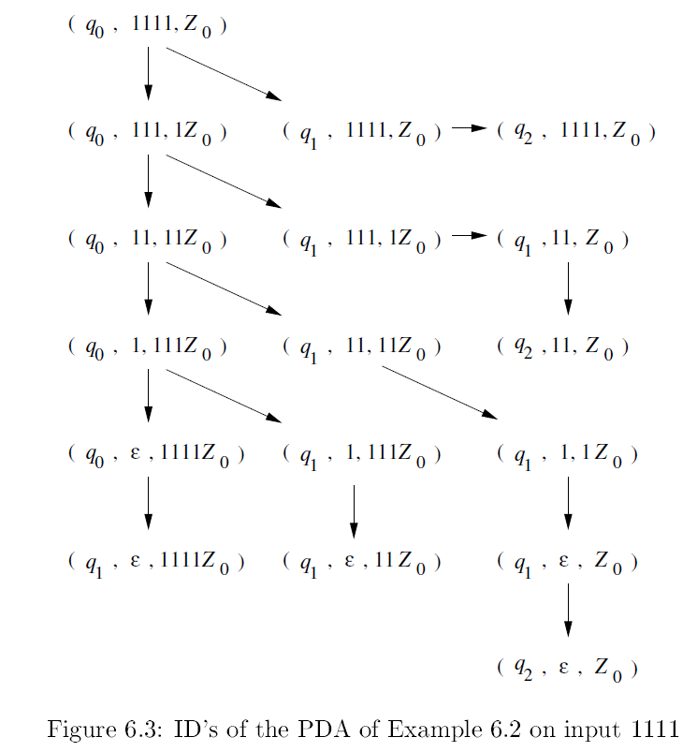
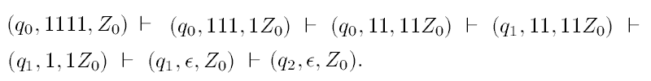

Slide 15


This is same as
So, $1111$ is in the language.

Slide 16
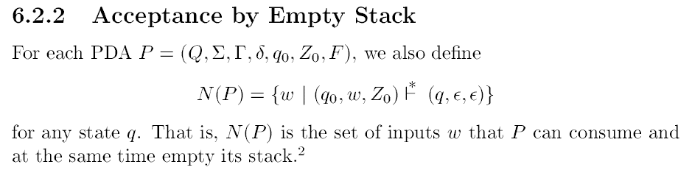

Slide 17

$L(P)$ Vs. $N(P)$
For the same PDA P there are now two languages !!

Slide 18

$L\left(P\right)=\left\{ww^{R} | w∈{\left(0+1\right)}^{∗}\right\}=L_{wwr }$
$N\left(P\right)= ?$

Slide 19
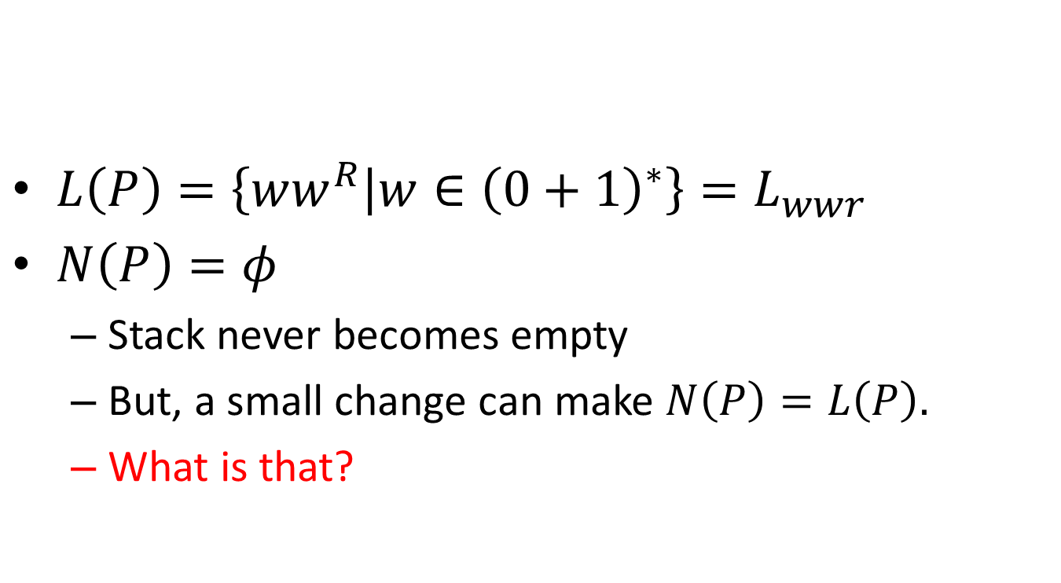
$L\left(P\right)=\left\{ww^{R} | w∈{\left(0+1\right)}^{∗}\right\}=L_{wwr }$
$N\left(P\right)=φ$
Stack never becomes empty
But, a small change can make $N\left(P\right)=L\left(P\right).$
What is that?

Slide 20
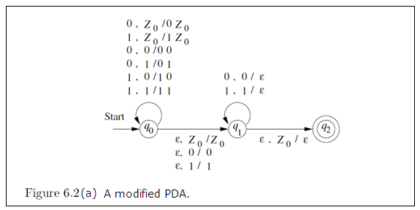

Slide 21
Acceptance by empty stack

Slide 22
Acceptance by empty stack

Slide 23
Do we have two types of PDAs?
One with final states, other with empty stack …

Slide 24
Do we have two types of PDAs?
One with final states, other with empty stack …
NO.

Slide 25
Do we have two types of PDAs?
One with final states, other with empty stack …
NO.
But, for any PDA there are two languages (both are CFLs) associated with that PDA.
These two (languages) may or may not be same.

Slide 26
Crucial thing is…
Set of languages accepted by final state is equal to the set of languages accepted by empty stack.
Proof of this one is by construction.

Slide 27
Crucial thing is…
Set of languages accepted by final state is equal to the set of languages accepted by empty stack.
Proof of this one is by construction.
So, power of PDA is same whether recognition happens either by final state or by empty stack.

Slide 28



Slide 29
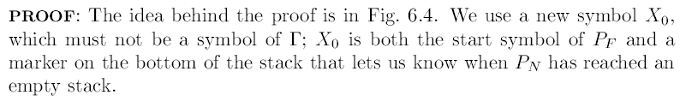

Slide 30
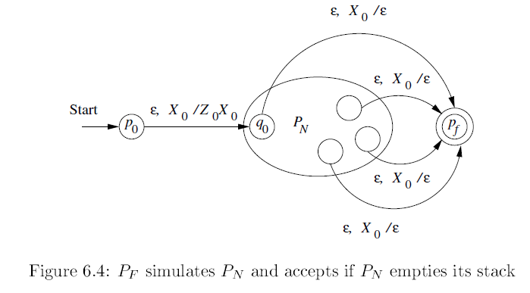

Slide 31


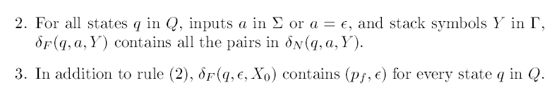

Slide 33
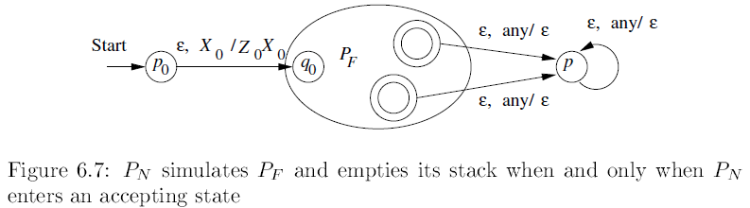

Slide 34


Slide 36
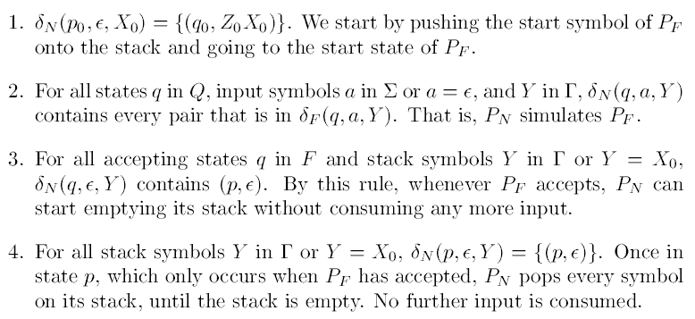

Slide 37

One point ..
In $P_{F}$ if stack becomes empty (in between) then $P_{F}$ gets stuck. (That PDA gets killed).

Slide 38

One point ..
In $P_{F}$ if stack becomes empty (in between) then $P_{F}$ gets stuck. (That PDA gets killed).
Now, in this situation $P_{N}$ has $X_{0}$ in the stack, so will this be a problem?

Slide 39
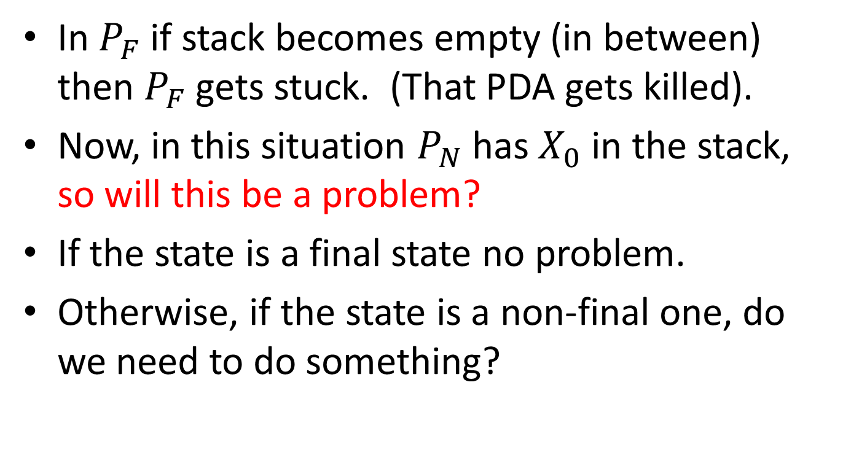
One point ..
In $P_{F}$ if stack becomes empty (in between) then $P_{F}$ gets stuck. (That PDA gets killed).
Now, in this situation $P_{N}$ has $X_{0}$ in the stack, so will this be a problem?
If the state is a final state no problem.
Otherwise, if the state is a non-final one, do we need to do something?

Slide 40
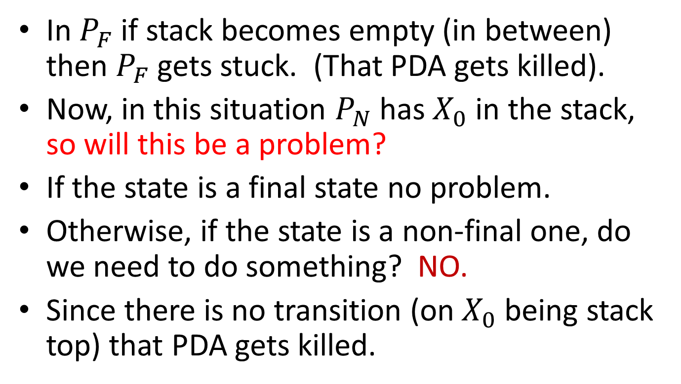
One point ..
In $P_{F}$ if stack becomes empty (in between) then $P_{F}$ gets stuck. (That PDA gets killed).
Now, in this situation $P_{N}$ has $X_{0}$ in the stack, so will this be a problem?
If the state is a final state no problem.
Otherwise, if the state is a non-final one, do we need to do something? NO.
Since there is no transition (on $X_{0}$ being stack top) that PDA gets killed.

Slide 41
Next …
Equivalence of PDA’s and CFG’s

Slide 42
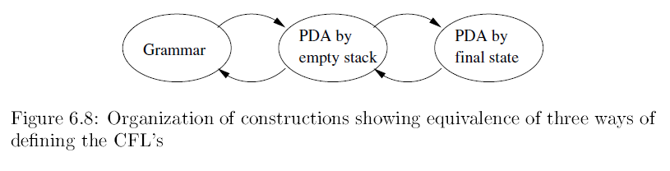
Next …
Equivalence of PDA’s and CFG’s

Slide 43

CFG to PDA

Slide 44
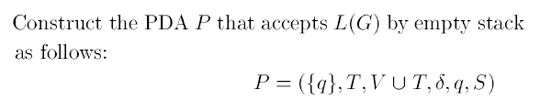
CFG to PDA

Slide 45
CFG to PDA
Single state !

Slide 46
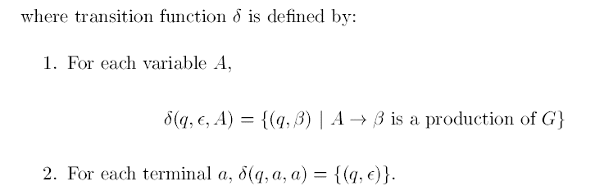
CFG to PDA

Slide 47
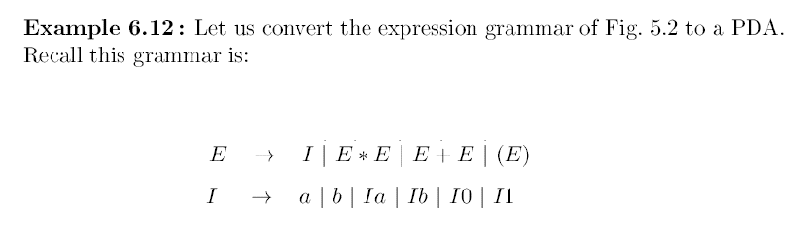
Can you identify (V,T,Q,S) of this CFG?

Slide 48

Can you identify (V,T,Q,S) of this CFG?
$V=\left\{E,I\right\}$
$T=\{ a,b,0,1,+,∗,\left(,\right) \}$
$S=E$

Slide 49
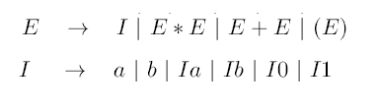

For the PDA stack alphabet is $Γ=\{E,I, a,b,0,1,+,∗,\left(,\right)\}$
Start symbol of the stack is $E.$
We will have only one state, call it $q.$

Slide 50
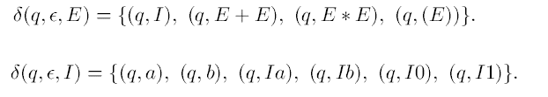
For the PDA stack alphabet is $Γ=\{E,I, a,b,0,1,+,∗,\left(,\right)\}$
Start symbol of the stack is $E.$
We will have only one state, call it $q.$

Slide 51

For the PDA stack alphabet is $Γ=\{E,I, a,b,0,1,+,∗,\left(,\right)\}$
Start symbol of the stack is $E.$
We will have only one state, call it $q.$

Slide 52
Have you noted?
The PDA we constructed simulates, which derivation?

Slide 53
Have you noted?
The PDA we constructed simulates, which derivation?
It is “left-most derivation”

Slide 54
Have you noted?
The PDA we constructed simulates, which derivation?
It is “left-most derivation”
In compilers, these are top-down parsers
LL parsers;
but non-determinism is a problem.
Backtracking (to try the other choice)
Parse table (to find feasible choices; at that time)

Slide 55
Compilers
We have parsers which are bottom-up
Which will simulate right-most derivation
These are called LR parsers.
One notable drawback in all these parsers:

Slide 56
Compilers
We have parsers which are bottom-up
Which will simulate right-most derivation
These are called LR parsers.
One notable drawback in all these parsers: each have their own limitations, and works only for subclasses of CFLs;
Some superior, some inferior …

Slide 57
PDA to CFG
We skip this in this basic course.

Slide 58
Deterministic PDA
DPDA
Can recognize a proper subset of CFLs
Parsers (used in compilers), mostly are DPDAs.
Most of our programming languages are in the subclass which can be recognized by DPDAs.

Slide 60
DPDA
Only one choice atmost.

Slide 61

DPDA
Atmost one choice. But $ε$ moves (should we remove them? ).

Slide 62
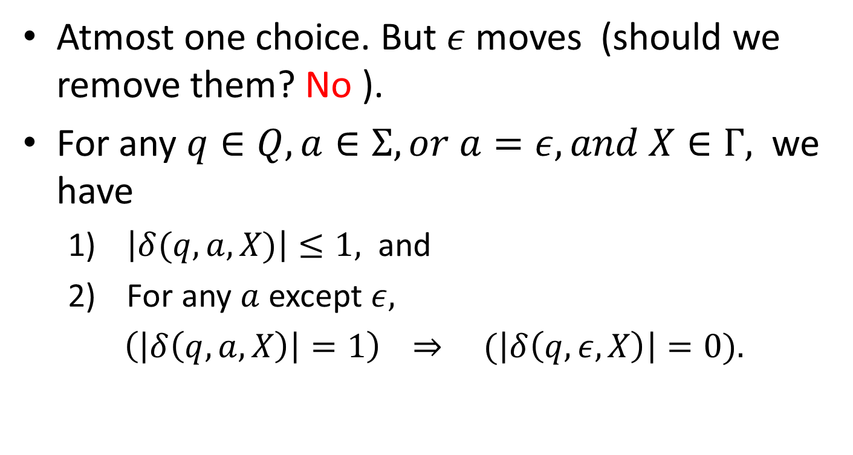
DPDA
Atmost one choice. But $ε$ moves (should we remove them? No ).
For any $q∈Q, a∈Σ, or a=ε, and X∈Γ,$ we have
$\left|δ(q,a,X)\right|≤1,$ and
For any $a$ except $ε,$
$\left(\left|δ\left(q,a,X\right)\right|=1\right)$ $⇒ (\left|δ\left(q,ε,X\right)\right|=0).$

Slide 63
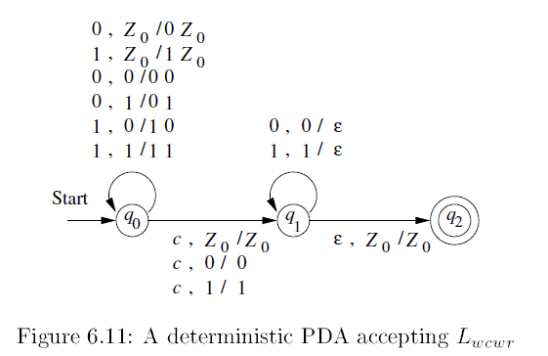

Slide 64
Regular Languages and DPDAs

Slide 65
Regular Languages and DPDAs
Proof is simple.
DFA is there for the regular language.
What about stack??

Slide 66
Regular Languages and DPDAs
Proof is simple.
DFA is there for the regular language.
What about stack??
Ignore the stack.

Slide 67
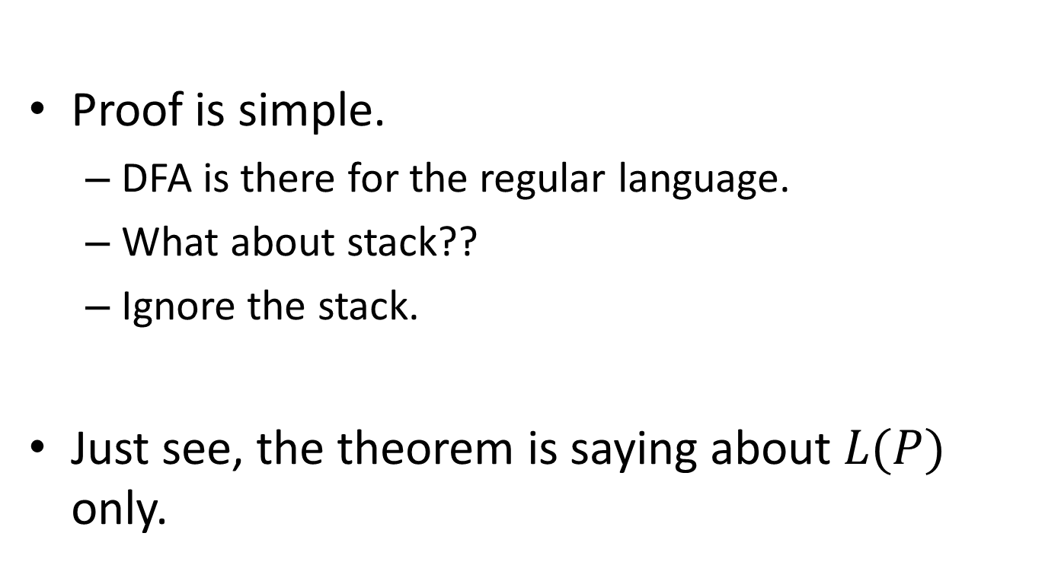
Regular Languages and DPDAs
Proof is simple.
DFA is there for the regular language.
What about stack??
Ignore the stack.
Just see, the theorem is saying about $L(P)$ only.

Slide 68
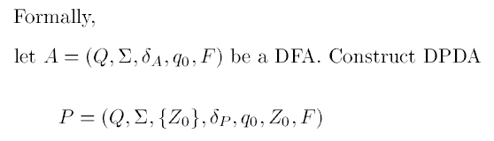

Slide 71
Exercise
Create DFA for 0*10*
Convert the DFA into PDA by final state.
Is this a DPDA?
Convert the PDA into PDA by empty stack.

Slide 72
DPDA and N(P) ??
For some regular languages, there can no DPDA by empty stack that recognizes the language.

Slide 73
DPDA and N(P) ??
For some regular languages, there can no DPDA by empty stack that recognizes the language.
But, for a proper subset of regular languages, it is possible to build a DPDA by empty stack.
These are characterized by “prefix property”.
DPDA by empty stack can recognize some non-regular languages also, provided they obey the property.

Slide 74

Prefix property
A language $L$ has the prefix property, if there are no two distinct strings $x$ and $y$ in $L$ such that $x$ is a prefix of $y$.

Slide 75

Prefix property
A language $L$ has the prefix property, if there are no two distinct strings $x$ and $y$ in $L$ such that $x$ is a prefix of $y$.
$L_{wcwr}$ has this property.

Slide 76
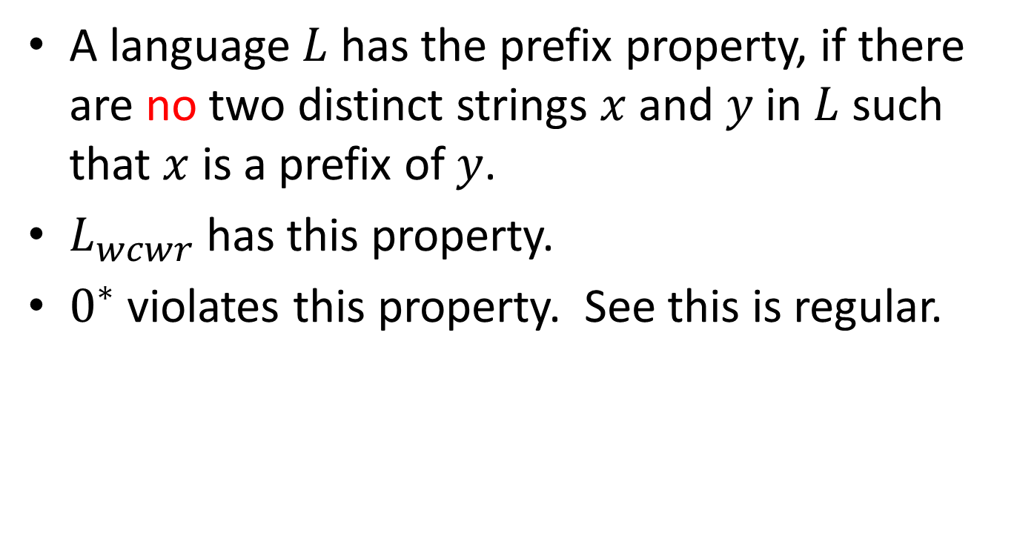
Prefix property
A language $L$ has the prefix property, if there are no two distinct strings $x$ and $y$ in $L$ such that $x$ is a prefix of $y$.
$L_{wcwr}$ has this property.
$0^{∗}$ violates this property. See this is regular.

Slide 77

Exercise– which of the following has the prefix property
0*1
(0+1)*
Set of palindromes
$\left\{0^{n}1^{n}\right|n≥1\}$
$\left\{0^{n}1^{n}\right|n≥0\}$
$\left\{ε\right\}$
$\{ε, 0\}$

Slide 78
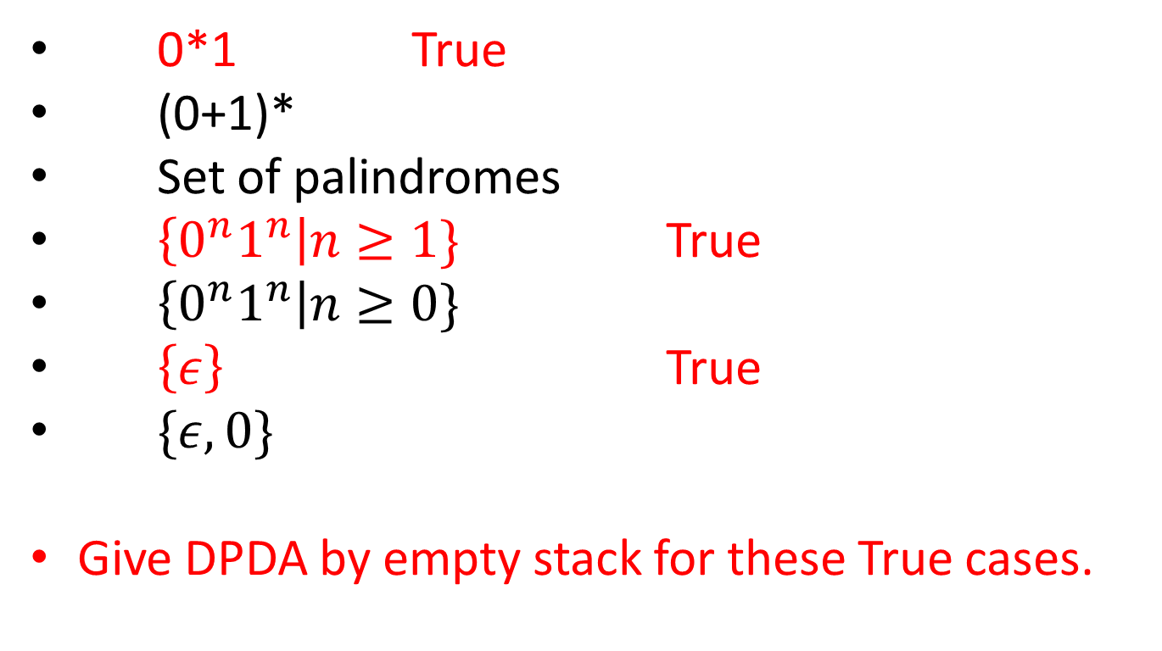
Exercise– which of the following has the prefix property
0*1 True
(0+1)*
Set of palindromes
$\left\{0^{n}1^{n}\right|n≥1\}$ True
$\left\{0^{n}1^{n}\right|n≥0\}$
$\left\{ε\right\}$ True
$\{ε, 0\}$
Give DPDA by empty stack for these True cases.

Slide 80
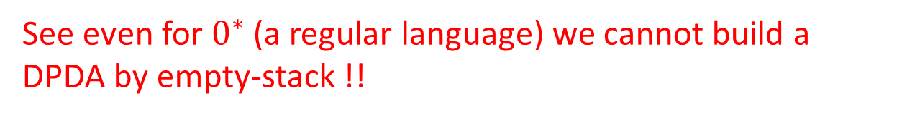
See even for $0^{∗}$ (a regular language) we cannot build a DPDA by empty-stack !!

Slide 81
But, we can build a DPDA by final state !
Then, why not convert this to DPDA by empty stack by our construction principle?
See even for $0^{∗}$ (a regular language) we cannot build a DPDA by empty-stack !!

Slide 82
But, we can build a DPDA by final state !
Then, why not convert this to DPDA by empty stack by our construction principle?
See even for $0^{∗}$ (a regular language) we cannot build a DPDA by empty-stack !!
This conversion gives us PDA, not DPDA !!

Slide 83


DPDA s.t. $N(P) = L_{wcwr}$

Slide 84
DPDA s.t. $N(P) = L_{wcwr}$
This is not a regular language.

Slide 85

There is no DPDA to recognize the CFL $L_{wwr}$
Proof is complex. But we can see the idea behind..

Slide 86


Slide 87
Some points to note,
We cannot make converse of these statements.

