Slide 1
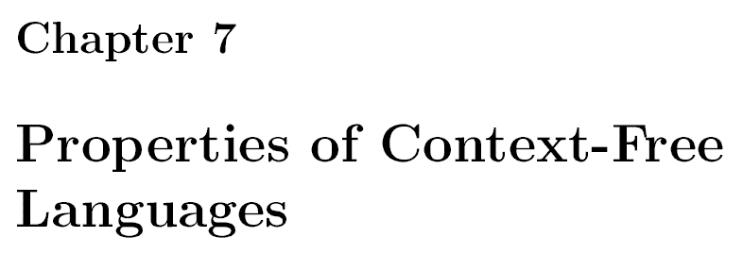

Slide 2
We first simplify CFGs
Then we prove “pumping lemma” for CFLs
Then closure properties and decision properties are considered.

Slide 3

Chomsky Normal Form (CNF)
Every CFL (without $ε$) is generated by a CFG in which all productions are of the form $A→BC \text{or} A→a$

Slide 4

But, this requires preprocessing of the CFG …
We must eliminate useless symbols,
We must eliminate $ε\text{−}\text{productions}$, and
We must eliminate unit productions.

Slide 5
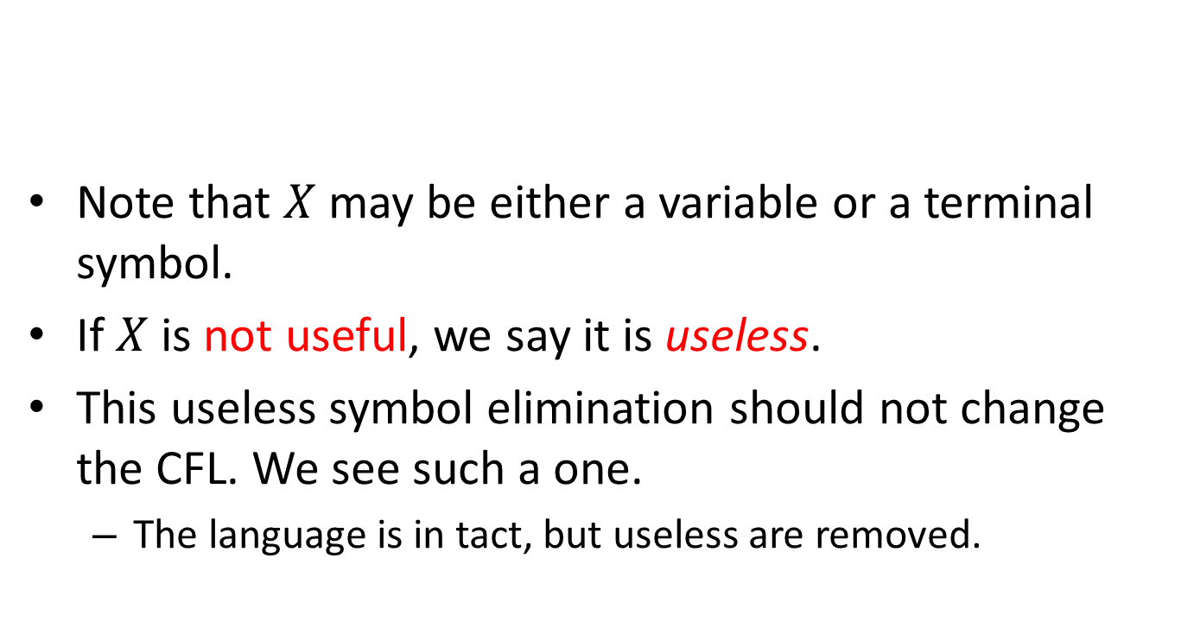
Eliminating useless symbols
Note that $X$ may be either a variable or a terminal symbol.
If $X$ is not useful, we say it is useless.
This useless symbol elimination should not change the CFL. We see such a one.
The language is in tact, but useless are removed.

Slide 7
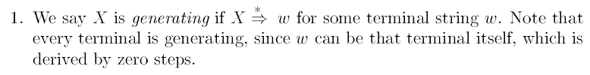

Slide 8


Slide 9
Order is important
Eliminate nongenerating symbols first,
then, from the remaining eliminate unreachable symbols.

Slide 10
Order is important
Eliminate nongenerating symbols first,
then, from the remaining eliminate unreachable symbols.
Whatever left are only useful ones.

Slide 11
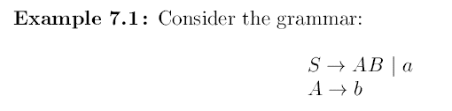

Slide 12
Find non-generating symbols.
How to find this?

Slide 13
Find non-generating symbols.
How to find this?
We can find generating symbols, inductively.

Slide 14
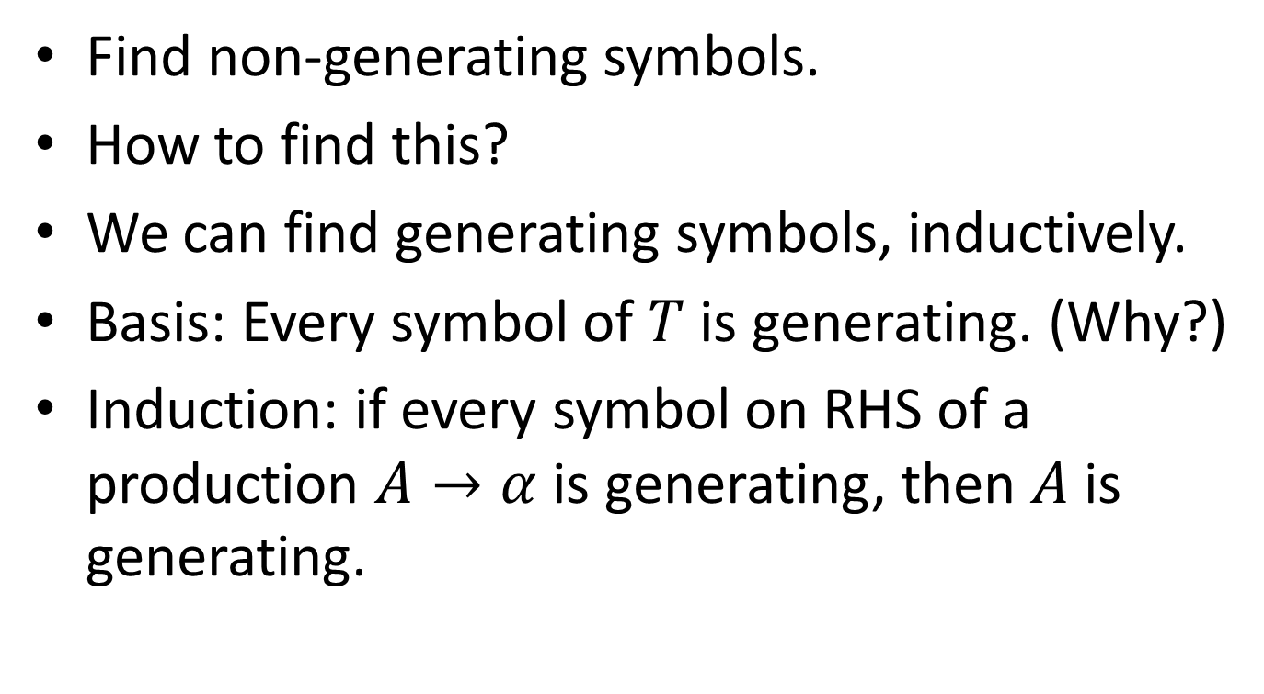
Find non-generating symbols.
How to find this?
We can find generating symbols, inductively.
Basis: Every symbol of $T$ is generating. (Why?)
Induction: if every symbol on RHS of a production $A→α$ is generating, then $A$ is generating.

Slide 15
What are the generating symbols?

Slide 16
What are the generating symbols?
{a,b,A,S}

Slide 17
What are the generating symbols?
{a,b,A,S}
So the non-generating symbol is B.

Slide 18
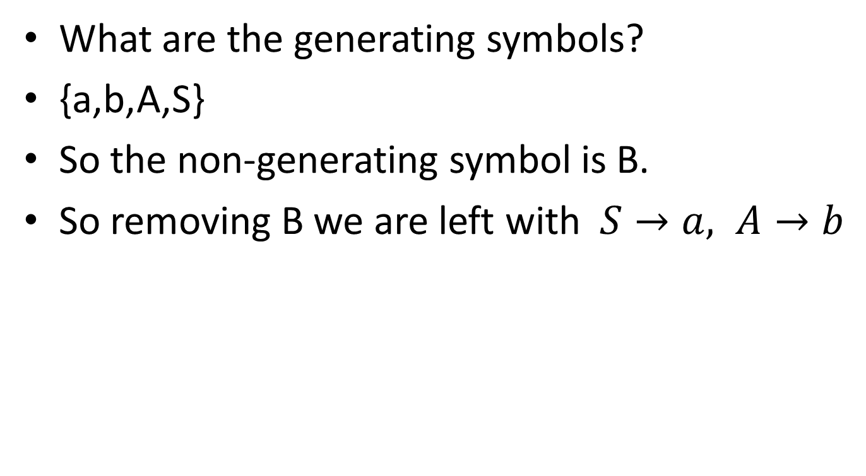
What are the generating symbols?
{a,b,A,S}
So the non-generating symbol is B.
So removing B we are left with $S→a, A→b$

Slide 19
Proof is skipped.

Slide 20

Finding reachable symbols
By induction, again.
Basis. $S$ is reachable.
Induction. $A$ is reachable, and $A→α$, then all symbols in $α$ are reachable.

Slide 21
Find reachable.

Slide 22
Find reachable.
{S,A,B,a,b}

Slide 23
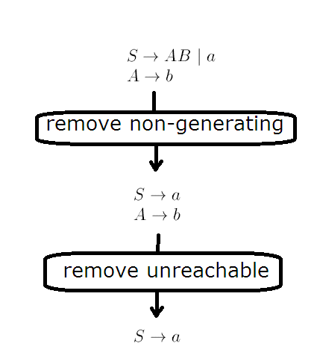
As per order, to remove useless

Slide 24
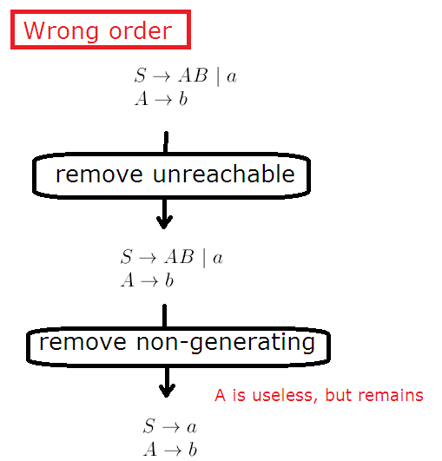
As per order, to remove useless

Slide 25


Eliminating $ε$-productions
$A→ε$ is an $ε$-production
Let $L$ be a CFL.
For $L−\{ε\}$there is a CFG which is without $ε$-productions

Slide 26

Eliminating $ε$-productions
Discover nullable variables.
A variable A is nullable if $A\underset{⇒}{∗}ε$
In this case, replace $B→CAD$ by $B→CAD|CD$

Slide 27
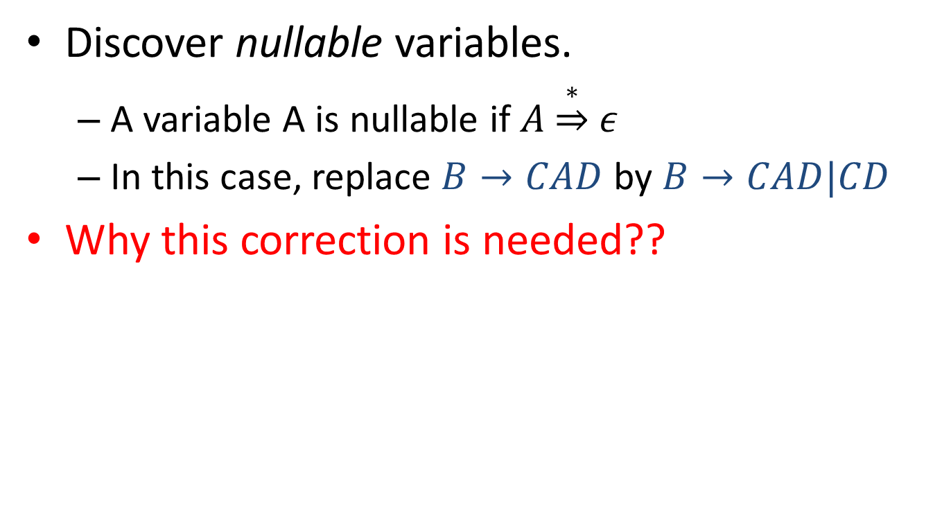
Eliminating $ε$-productions
Discover nullable variables.
A variable A is nullable if $A\underset{⇒}{∗}ε$
In this case, replace $B→CAD$ by $B→CAD|CD$
Why this correction is needed??

Slide 28
Finding the nullable

Slide 29
Finding the nullable

Slide 30

Finding the nullable

Slide 31
Finding the nullable

Slide 32
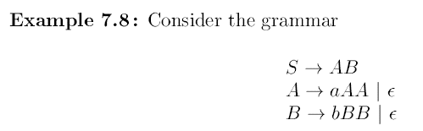
Find the nullable symbols.

Slide 33
Find the nullable symbols.
{A,B,S}

Slide 34
Find the nullable symbols.
{A,B,S}
Apply the method.

Slide 35
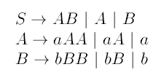
Find the nullable symbols.
{A,B,S}
Apply the method.

Slide 36
Find the nullable symbols.
{A,B,S}
Apply the method.
Any thing missing??

Slide 37
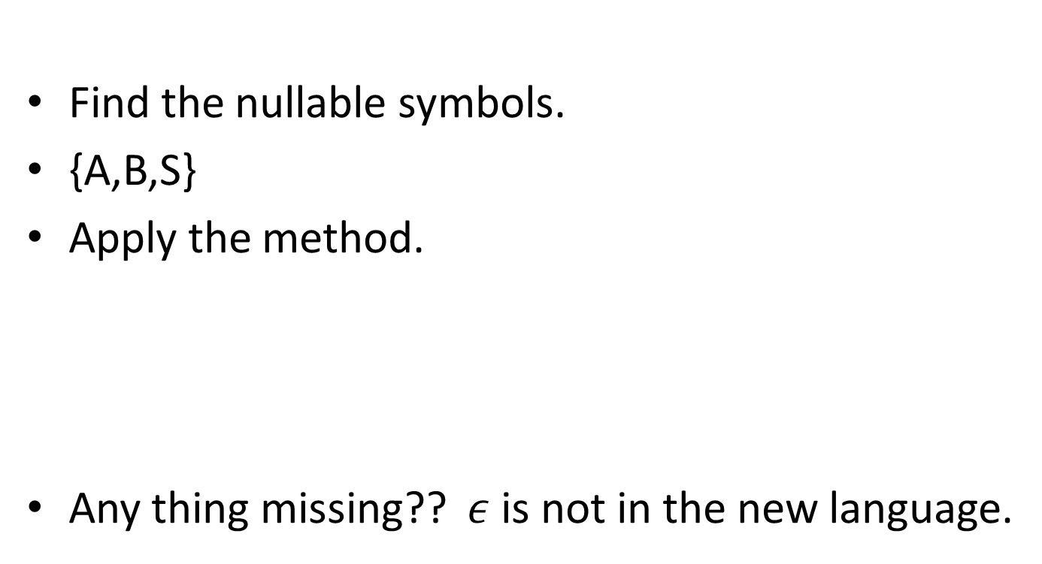
Find the nullable symbols.
{A,B,S}
Apply the method.
Any thing missing?? $ε$ is not in the new language.

Slide 39

Eliminating Unit Productions
A unit production is of the form $A→B$, where $A$ and $B$ are variables.

Slide 40
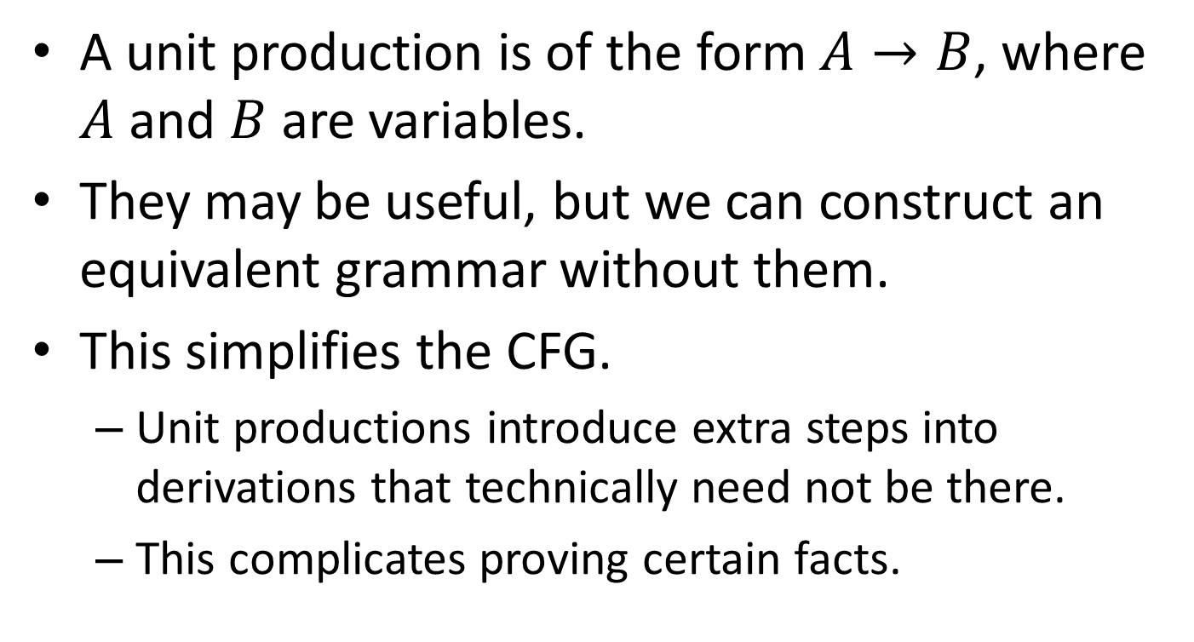
Eliminating Unit Productions
A unit production is of the form $A→B$, where $A$ and $B$ are variables.
They may be useful, but we can construct an equivalent grammar without them.
This simplifies the CFG.
Unit productions introduce extra steps into derivations that technically need not be there.
This complicates proving certain facts.

Slide 41
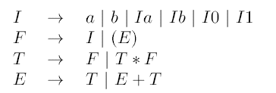
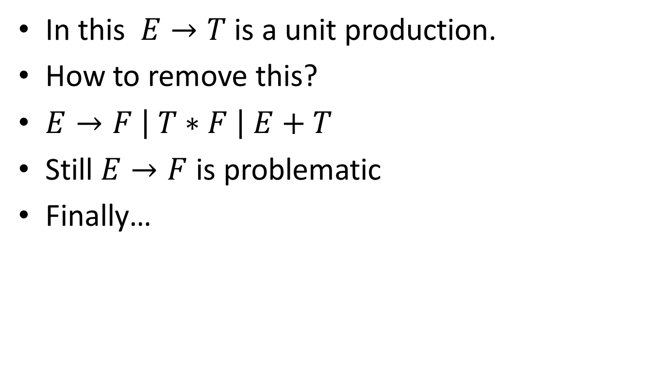
In this $E→T$ is a unit production.
How to remove this?
$E→F \left| T∗F \right| E+T$
Still $E→F$ is problematic
Finally…

Slide 42
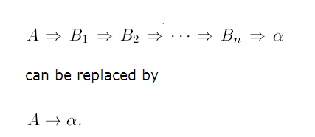

Slide 43
How to do this systematically?
Unit pairs are identified.
Along with this, the CFG is used to produce a new CFG which is without any unit production.

Slide 44


Unit pair
$\left(A,B\right)$ is a unit pair if $A\underset{⇒}{∗}B$
Note, if the CFG have
then, $\left(A,B\right)$ is a unit pair

Slide 45
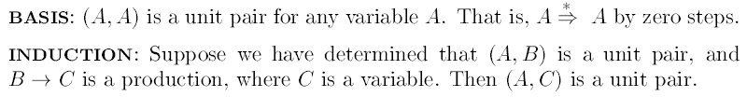

Slide 46
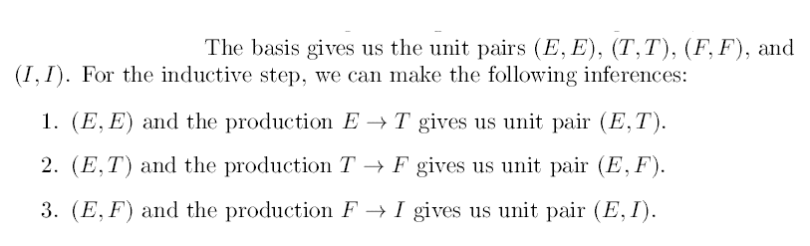
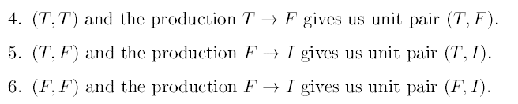

Slide 47
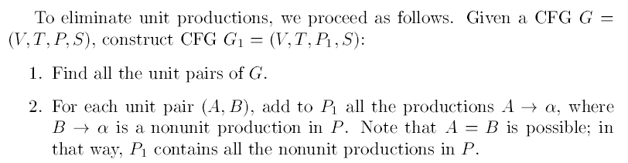

Slide 48
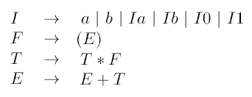
Given CFG:
Non-unit productions are

Slide 49

Given CFG:
Non-unit productions are
Unit Pairs

Slide 50
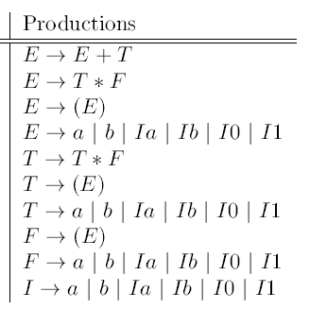
Given CFG:
Non-unit productions are
Unit Pairs

Slide 51
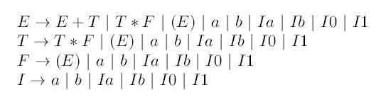
Given CFG:
Non-unit productions are
Unit Pairs
CFG without unit productions

Slide 52
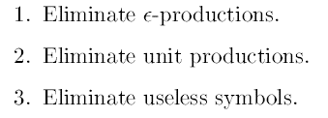
The order in which these preprocessing steps can occur

Slide 53
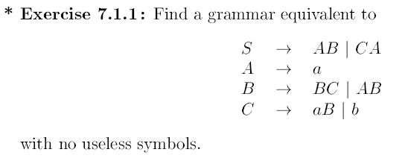

Slide 54
Eliminate non-generating, first.

Slide 55
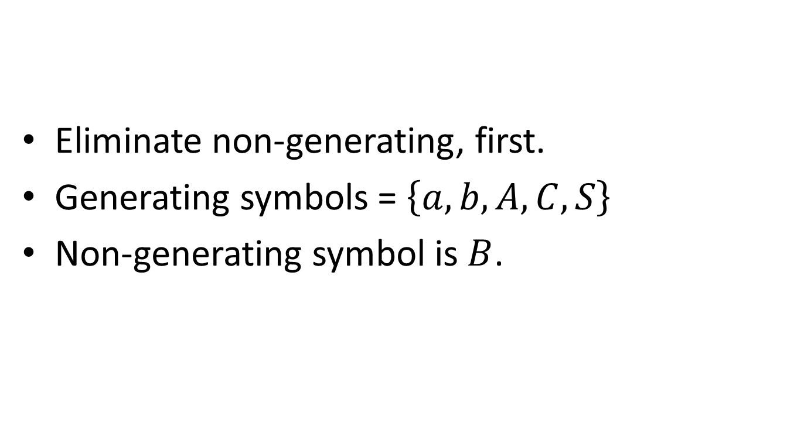
Eliminate non-generating, first.
Generating symbols = $\left\{a,b,A,C,S\right\}$
Non-generating symbol is $B$.

Slide 56
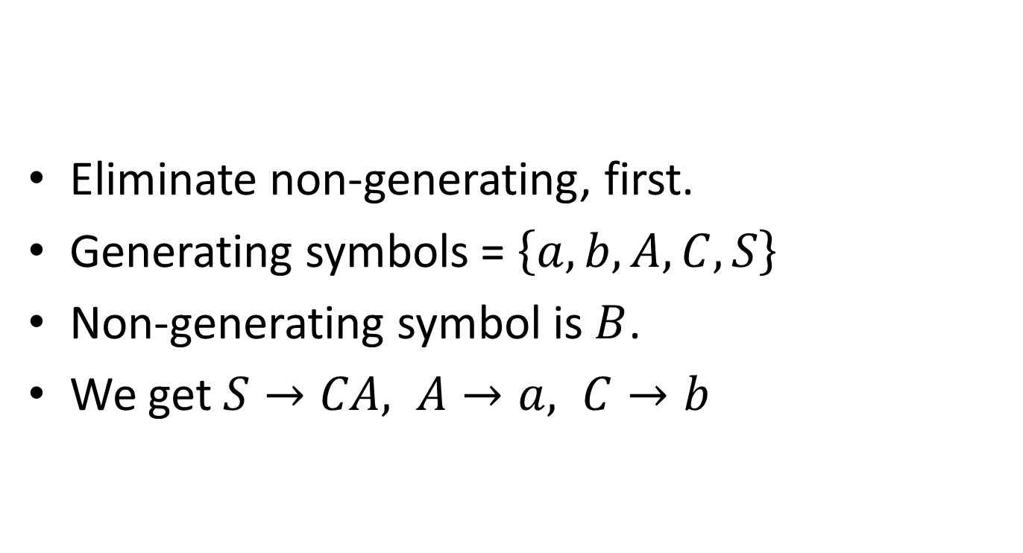
Eliminate non-generating, first.
Generating symbols = $\left\{a,b,A,C,S\right\}$
Non-generating symbol is $B$.
We get $S→CA, A→a, C→b$

Slide 57
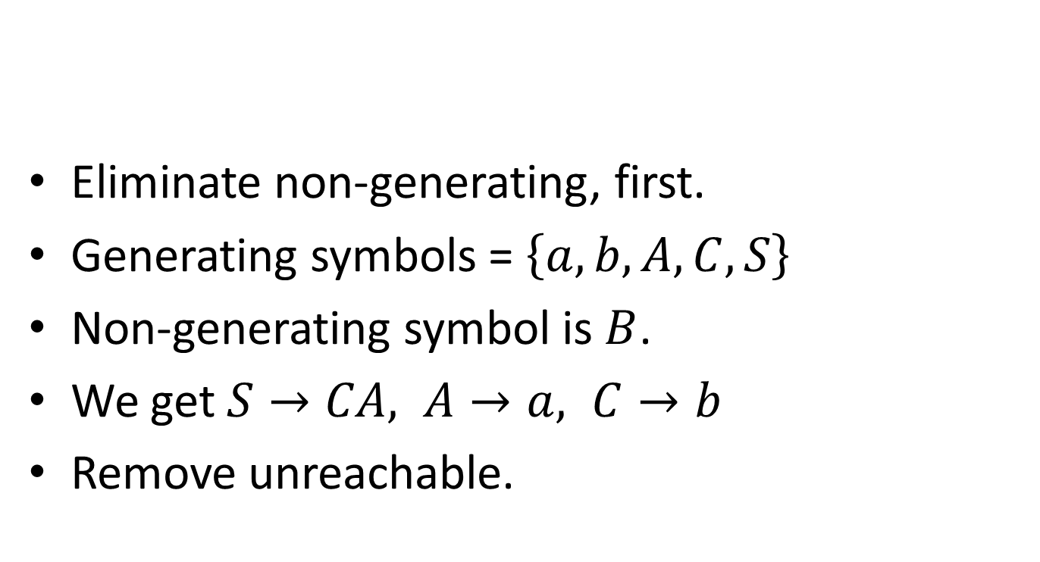
Eliminate non-generating, first.
Generating symbols = $\left\{a,b,A,C,S\right\}$
Non-generating symbol is $B$.
We get $S→CA, A→a, C→b$
Remove unreachable.

Slide 58
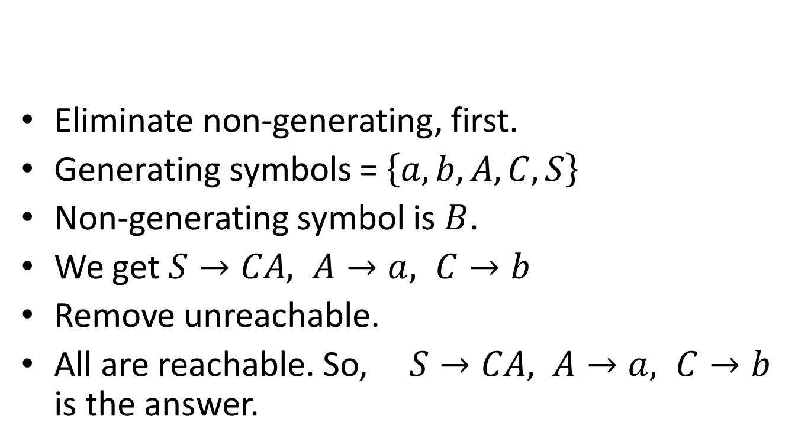
Eliminate non-generating, first.
Generating symbols = $\left\{a,b,A,C,S\right\}$
Non-generating symbol is $B$.
We get $S→CA, A→a, C→b$
Remove unreachable.
All are reachable. So, $S→CA, A→a, C→b$ is the answer.

Slide 59

Chomsky Normal Form
For a CFL without $ε,$where all productions are of the form $A→BC, A→a.$
After preprocessing steps, it is quite easy to get in to CNF.

Slide 60

$A→BCDE$ can be replaced by $A→BF, F→CDE.$

Slide 61

$A→BCDE$ can be replaced by $A→BF, F→CDE.$
Then $F→CDE$ can be replaced by $F→CG$ and $G→DE$

Slide 62
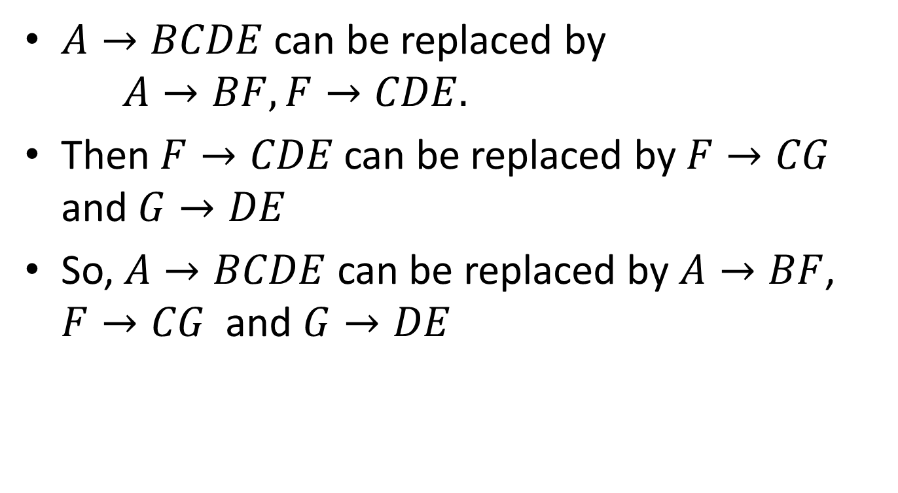
$A→BCDE$ can be replaced by $A→BF, F→CDE.$
Then $F→CDE$ can be replaced by $F→CG$ and $G→DE$
So, $A→BCDE$ can be replaced by $A→BF$, $F→CG$ and $G→DE$

Slide 63

Similarly, $A→BabC$ can be replaced by $A→BDEC, D→a, E→b.$
Then $A→BDEC$ can be replaced by …

Slide 64
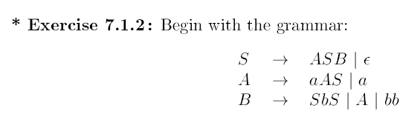
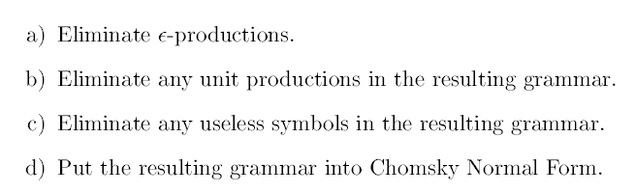

Slide 65

Theorem: Let $G$ be a CFG in CNF form, then for any $w∈ L(G), w$ can be derived in exactly $(2|w| −1)$steps.

Slide 66
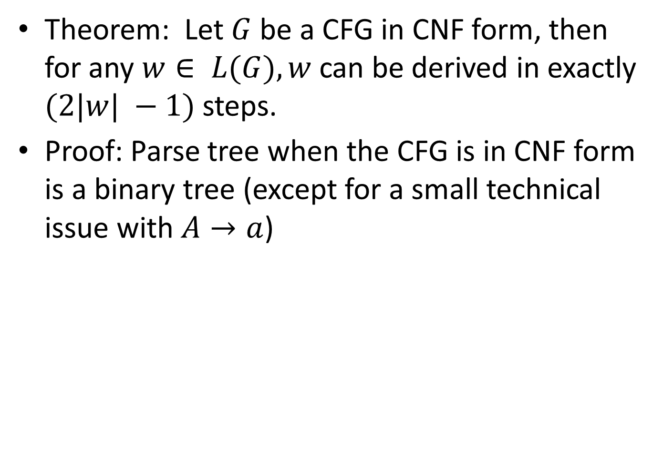
Theorem: Let $G$ be a CFG in CNF form, then for any $w∈ L(G), w$ can be derived in exactly $(2|w| −1)$steps.
Proof: Parse tree when the CFG is in CNF form is a binary tree (except for a small technical issue with $A→a$)

Slide 67
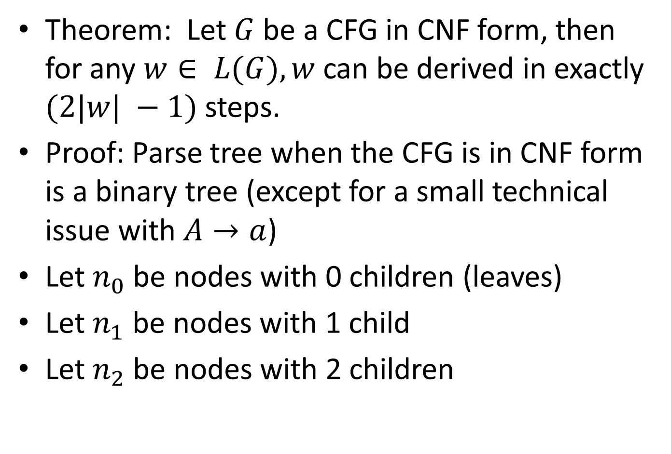
Theorem: Let $G$ be a CFG in CNF form, then for any $w∈ L(G), w$ can be derived in exactly $(2|w| −1)$steps.
Proof: Parse tree when the CFG is in CNF form is a binary tree (except for a small technical issue with $A→a$)
Let $n_{0}$ be nodes with 0 children (leaves)
Let $n_{1}$ be nodes with 1 child
Let $n_{2}$ be nodes with 2 children

Slide 68
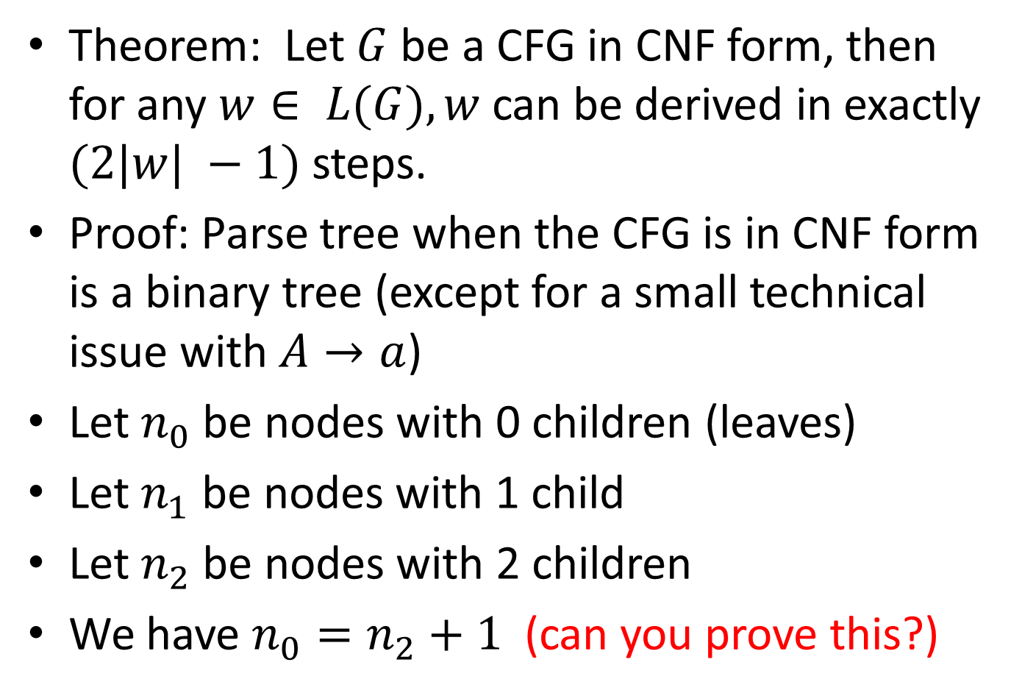
Theorem: Let $G$ be a CFG in CNF form, then for any $w∈ L(G), w$ can be derived in exactly $(2|w| −1)$steps.
Proof: Parse tree when the CFG is in CNF form is a binary tree (except for a small technical issue with $A→a$)
Let $n_{0}$ be nodes with 0 children (leaves)
Let $n_{1}$ be nodes with 1 child
Let $n_{2}$ be nodes with 2 children
We have $n_{0}=n_{2}+1$ (can you prove this?)

Slide 69

We have, $n_{0}=\left|w\right|$
$n_{0}=n_{1}$ (why?)
Number of steps $=n_{2}+n_{1}$
$$=n_{0}+n_{0}−1$$
$$=2n_{0}−1$$
$$=2\left|w\right|−1$$

